Slide 2
Portraits of Love: Scriptural Stories of Hospitality
Rich Mendola
International Friendships, Inc.
July 14, 2016
© International Friendships, Inc.
No part of this presentation may be used without permission.

Slide 3
I. The link between hospitality and love
a. Hospitality is one of the primary ways that outsiders (strangers) experience love.

Slide 4
I. The link between hospitality and love
“Keep on loving one another as brothers and sisters. Do not forget to show hospitality to strangers, for by so doing some people have shown hospitality to angels without knowing it.”
Hebrews 13:1-2

Slide 5
I. The link between hospitality and love
“Love must be sincere. Hate what is evil; cling to what is good.”
Romans 12:9
“Share with the Lord’s people who are in need. Practice hospitality.
Romans 12:13

Slide 6
I. The link between hospitality and love
“Above all, love each other deeply, because love covers over a multitude of sins. Offer hospitality to one another without grumbling.”
1 Peter 4:8-9

Slide 7
I. The link between hospitality and love
b. Love through hospitality is the pattern of teaching in the Word of God.

Slide 8
II. Hospitality is commanded, but also illustrated.
We need not only to be told to practice hospitality, but we need to know what that practice looks like.

Slide 9
III. Basic components of hospitality illustrated in the story of Abraham & the 3 visitors (Genesis 18:1-20)
“The Lord appeared to Abraham near the great trees of Mamre while he was sitting at the entrance to his tent in the heat of the day. Abraham looked up and saw three men standing nearby. When he saw them, he hurried from the entrance of his tent to meet them and bowed low to the ground.
He said, ‘If I have found favor in your eyes, my lord, do not pass your servant by. Let a little water be brought, and then you may all wash your feet and rest under this tree. Let me get you something to eat, so you can be refreshed and then go on your way—now that you have come to your servant.’
‘Very well,’ they answered, ‘do as you say.’

Slide 10
III. Basic components of hospitality illustrated in the story of Abraham & the 3 visitors (Genesis 18:1-20)
“So Abraham hurried into the tent to Sarah. ‘Quick,’ he said, ‘get three seahs of the finest flour and knead it and bake some bread.’
Then he ran to the herd and selected a choice, tender calf and gave it to a servant, who hurried to prepare it. He then brought some curds and milk and the calf that had been prepared, and set these before them. While they ate, he stood near them under a tree.
‘Where is your wife Sarah?’ they asked him.
‘There, in the tent,’ he said.
Then one of them said, ‘I will surely return to you about this time next year, and Sarah your wife will have a son.’

Slide 11
III. Basic components of hospitality illustrated in the story of Abraham & the 3 visitors (Genesis 18:1-20)
“Now Sarah was listening at the entrance to the tent, which was behind him. Abraham and Sarah were already very old, and Sarah was past the age of childbearing. So Sarah laughed to herself as she thought, ‘After I am worn out and my lord is old, will I now have this pleasure?’
Then the Lord said to Abraham, ‘Why did Sarah laugh and say, “Will I really have a child, now that I am old?” Is anything too hard for the Lord? I will return to you at the appointed time next year, and Sarah will have a son.’
Sarah was afraid, so she lied and said, ‘I did not laugh.’
But he said, ‘Yes, you did laugh.’

Slide 12
III. Basic components of hospitality illustrated in the story of Abraham & the 3 visitors (Genesis 18:1-20)
“When the men got up to leave, they looked down toward Sodom, and Abraham walked along with them to see them on their way. Then the Lord said, ‘Shall I hide from Abraham what I am about to do? Abraham will surely become a great and powerful nation, and all nations on earth will be blessed through him. For I have chosen him, so that he will direct his children and his household after him to keep the way of the Lord by doing what is right and just, so that the Lord will bring about for Abraham what he has promised him.’
Then the Lord said, ‘The outcry against Sodom and Gomorrah is so great and their sin so grievous.’”
Genesis 18:1-20

Slide 13
III. Basic components of hospitality illustrated in the story of Abraham & the 3 visitors (Genesis 18:1-20)
a. This story is the foundational story of hospitality.
“Keep on loving one another as brothers and sisters. Do not forget to show hospitality to strangers, for by so doing some people have shown hospitality to angels without knowing it.”
Hebrews 13:1-2

Slide 14
III. Basic components of hospitality illustrated in the story of Abraham & the 3 visitors (Genesis 18:1-20)
b. Hospitality includes a warm welcome.

Slide 15
III. Basic components of hospitality illustrated in the story of Abraham & the 3 visitors (Genesis 18:1-20)
“The Lord appeared to Abraham near the great trees of Mamre while he was sitting at the entrance to his tent in the heat of the day. Abraham looked up and saw three men standing nearby. When he saw them, he hurried from the entrance of his tent to meet them and bowed low to the ground.
He said, ‘If I have found favor in your eyes, my lord, do not pass your servant by. Let a little water be brought, and then you may all wash your feet and rest under this tree. Let me get you something to eat, so you can be refreshed and then go on your way—now that you have come to your servant.’
‘Very well,’ they answered, ‘do as you say.’
Genesis 18:1-5

Slide 16
III. Basic components of hospitality illustrated in the story of Abraham & the 3 visitors (Genesis 18:1-20)
c. Hospitality involves sharing food and drink.

Slide 17
III. Basic components of hospitality illustrated in the story of Abraham & the 3 visitors (Genesis 18:1-20)
“So Abraham hurried into the tent to Sarah. ‘Quick,’ he said, ‘get three seahs of the finest flour and knead it and bake some bread.’
Then he ran to the herd and selected a choice, tender calf and gave it to a servant, who hurried to prepare it. He then brought some curdsand milk and the calf that had been prepared, and set these before them. While they ate, he stood near them under a tree.”
Genesis 18:6-8

Slide 18
III. Basic components of hospitality illustrated in the story of Abraham & the 3 visitors (Genesis 18:1-20)
d. Hospitality involves sharing from the heart.

Slide 19
III. Basic components of hospitality illustrated in the story of Abraham & the 3 visitors (Genesis 18:1-20)
“Then one of them said, ‘I will surely return to you about this time next year, and Sarah your wife will have a son.’
Now Sarah was listening at the entrance to the tent, which was behind him. Abraham and Sarah were already very old, and Sarah was past the age of childbearing. So Sarah laughed to herself as she thought, ‘After I am worn out and my lord is old, will I now have this pleasure?’
Then the Lord said to Abraham, ‘Why did Sarah laugh and say, “Will I really have a child, now that I am old?” Is anything too hard for the Lord? I will return to you at the appointed time next year, and Sarah will have a son.’
Sarah was afraid, so she lied and said, ‘I did not laugh.’
But he said, ‘Yes, you did laugh.’

Slide 20
III. Basic components of hospitality illustrated in the story of Abraham & the 3 visitors (Genesis 18:1-20)
“When the men got up to leave, they looked down toward Sodom, and Abraham walked along with them to see them on their way. Then the Lord said, ‘Shall I hide from Abraham what I am about to do? Abraham will surely become a great and powerful nation, and all nations on earth will be blessed through him. For I have chosen him, so that he will direct his children and his household after him to keep the way of the Lord by doing what is right and just, so that the Lord will bring about for Abraham what he has promised him.’
Then the Lord said, ‘The outcry against Sodom and Gomorrah is so great and their sin so grievous.’”
Genesis 18:10-20

Slide 21
III. Basic components of hospitality illustrated in the story of Abraham & the 3 visitors (Genesis 18:1-20)
e. Outcomes:
hearing the Word of God
a son
a resurrection

Slide 22
III. Basic components of hospitality illustrated in the story of Abraham & the 3 visitors (Genesis 18:1-20)
f. Application:
Which aspect of hospitality is easiest for you?
Which is most difficult?
What lifestyle changes would you need to make to practice hospitality?

Slide 23
IV. Planned hospitality – story of the Shunammite woman (2 Kings 4:8-17)
“One day Elisha went to Shunem. And a well-to-do woman was there, who urged him to stay for a meal. So whenever he came by, he stopped there to eat. She said to her husband, ‘I know that this man who often comes our way is a holy man of God. Let’s make a small room on the roof and put in it a bed and a table, a chair and a lamp for him. Then he can stay there whenever he comes to us.’
One day when Elisha came, he went up to his room and lay down there. He said to his servant Gehazi, ‘Call the Shunammite.’ So he called her, and she stood before him. Elisha said to him, ‘Tell her, “You have gone to all this trouble for us. Now what can be done for you? Can we speak on your behalf to the king or the commander of the army?”’
She replied, ‘I have a home among my own people.’

Slide 24
IV. Planned hospitality – story of the Shunammite woman (2 Kings 4:8-17)
“‘What can be done for her?’ Elisha asked.
Gehazi said, ‘She has no son, and her husband is old.’
Then Elisha said, ‘Call her.’ So he called her, and she stood in the doorway. ‘About this time next year,’ Elisha said, ‘you will hold a son in your arms.’
‘No, my lord!’ she objected. ‘Please, man of God, don’t mislead your servant!’
But the woman became pregnant, and the next year about that same time she gave birth to a son, just as Elisha had told her.”
2 Kings 4:8-17

Slide 25
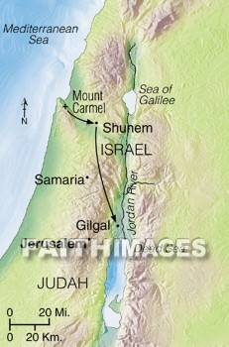
Map of Shunem

Slide 26
IV. Planned hospitality – story of the Shunammite woman (2 Kings 4:8-17)
a. There are two kinds of hospitality: spontaneous and planned. We need to practice both.

Slide 27
IV. Planned hospitality – story of the Shunammite woman (2 Kings 4:8-17)
b. Spontaneous hospitality.
“One day Elisha went to Shunem. And a well-to-do woman was there, who urged him to stay for a meal. So whenever he came by, he stopped there to eat.”
2 Kings 4:8

Slide 28
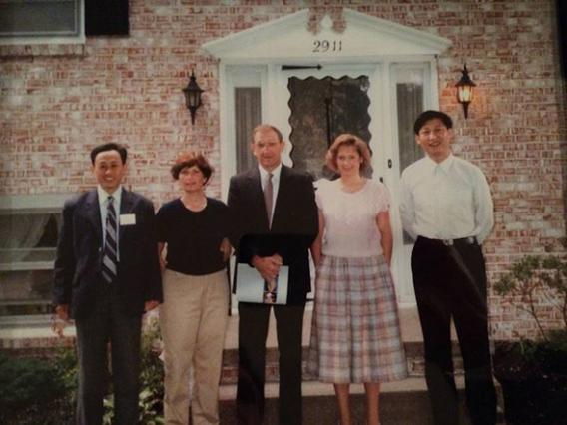

Slide 29
IV. Planned hospitality – story of the Shunammite woman (2 Kings 4:8-17)
c. Enthusiastic hospitality (a warm welcome)
“One day Elisha went to Shunem. And a well-to-do woman was there, who urged him to stay for a meal. So whenever he came by, he stopped there to eat.”
2 Kings 4:8

Slide 30
IV. Planned hospitality – story of the Shunammite woman (2 Kings 4:8-17)
d. Consistent hospitality
“One day Elisha went to Shunem. And a well-to-do woman was there, who urged him to stay for a meal. So whenever he came by, he stopped there to eat.”
2 Kings 4:8

Slide 31
IV. Planned hospitality – story of the Shunammite woman (2 Kings 4:8-17)
e. Planned hospitality
“Let’s make a small room on the roof and put in it a bed and a table, a chair and a lamp for him. Then he can stay there whenever he comes to us.”
2 Kings 4:10

Slide 32
IV. Planned hospitality – story of the Shunammite woman (2 Kings 4:8-17)
f. Generous hospitality – the use of our resources to practice hospitality.
“Let’s make a small room on the roof and put in it a bed and a table, a chair and a lamp for him. Then he can stay there whenever he comes to us.”
2 Kings 4:10

Slide 33
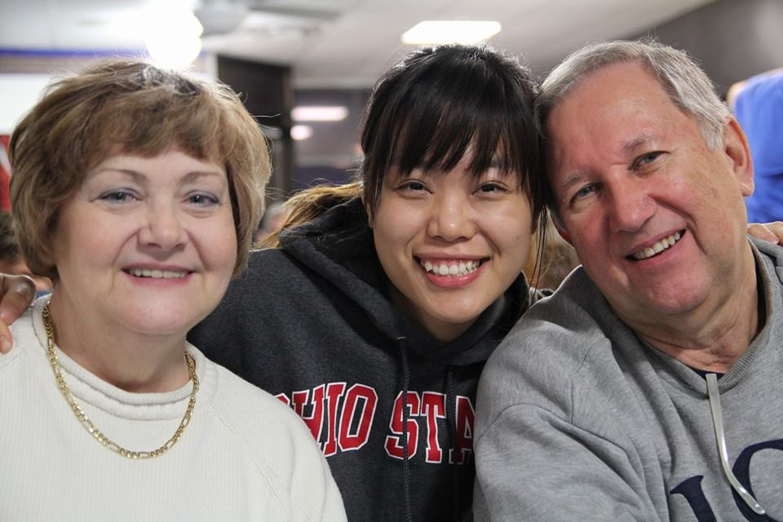

Slide 34
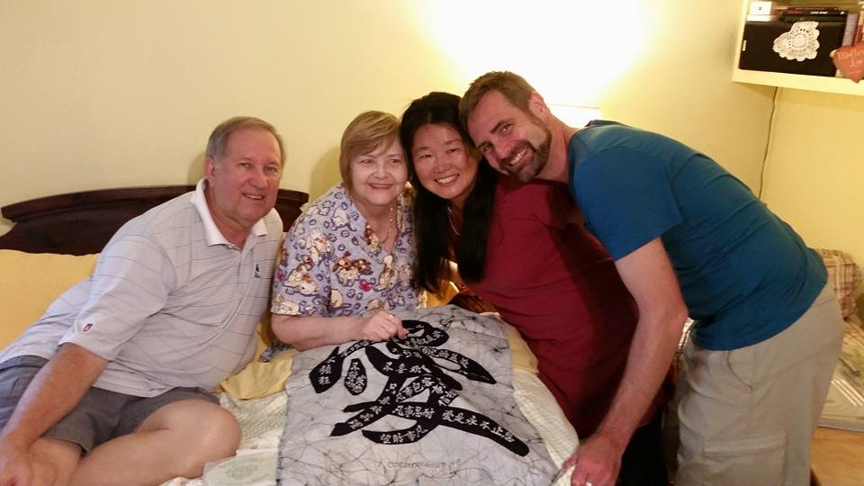

Slide 35
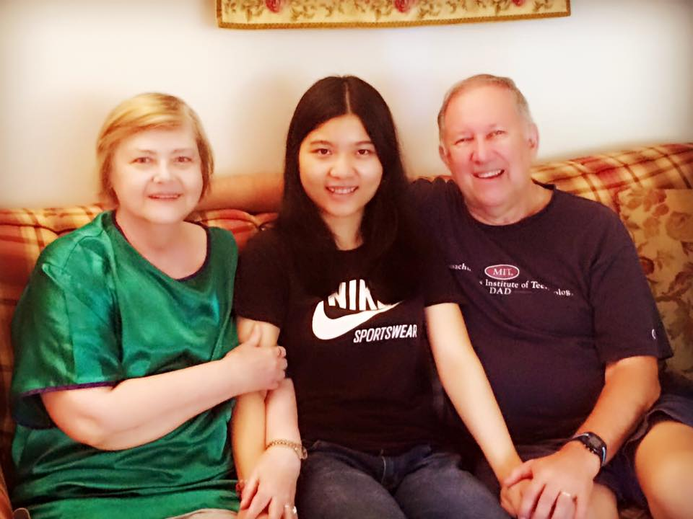

Slide 36
IV. Planned hospitality – story of the Shunammite woman (2 Kings 4:8-17)
g. Unconditional hospitality
“One day when Elisha came, he went up to his room and lay down there. He said to his servant Gehazi, ‘Call the Shunammite.’ So he called her, and she stood before him. Elisha said to him, ‘Tell her, “You have gone to all this trouble for us. Now what can be done for you? Can we speak on your behalf to the king or the commander of the army?”’ She replied, ‘I have a home among my own people.’”
2 Kings 4:11-13

Slide 37
IV. Planned hospitality – story of the Shunammite woman (2 Kings 4:8-17)
h. Outcomes:
hearing the Word of God
a son
a resurrection

Slide 38
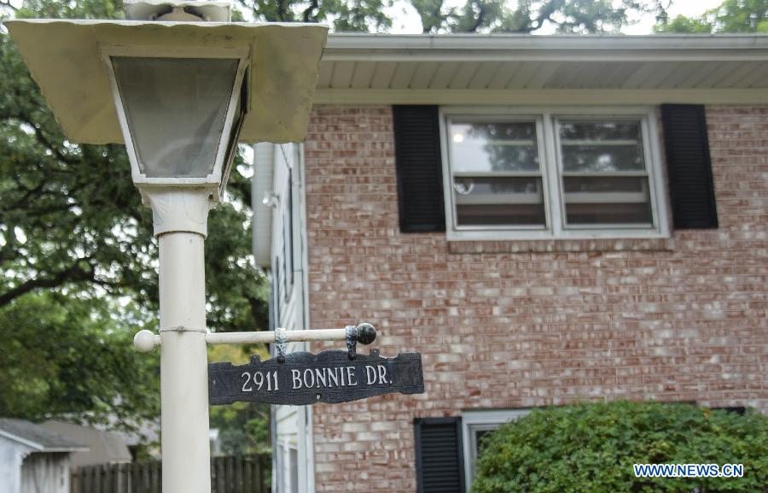

Slide 39
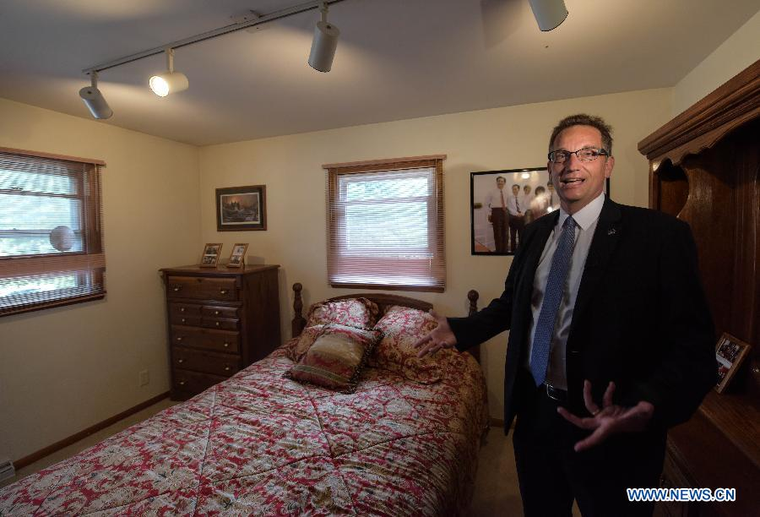

Slide 41
IV. Planned hospitality – story of the Shunammite woman (2 Kings 4:8-17)
i. Application:
What step(s) can you take to practice hospitality regularly?
Will you ask the Lord for His plan for you in this area?
What resources has God given you that you can use to practice hospitality? Will you offer them to God?

Slide 42
V. Sacrificial hospitality – the widow at Zarephath (1 Kings 17:7-24)
“Some time later the brook dried up because there had been no rain in the land. ⁸ Then the word of the Lord came to him: ’Go at once to Zarephath in the region of Sidon and stay there. I have directed a widow there to supply you with food.’ So he went to Zarephath. When he came to the town gate, a widow was there gathering sticks. He called to her and asked, ‘Would you bring me a little water in a jar so I may have a drink?’ As she was going to get it, he called, ‘And bring me, please, a piece of bread.’
‘As surely as the Lord your God lives,’ she replied, ‘I don’t have any bread—only a handful of flour in a jar and a little olive oil in a jug. I am gathering a few sticks to take home and make a meal for myself and my son, that we may eat it—and die.’

Slide 43
V. Sacrificial hospitality – the widow at Zarephath (1 Kings 17:7-24)
Elijah said to her, ‘Don’t be afraid. Go home and do as you have said. But first make a small loaf of bread for me from what you have and bring it to me, and then make something for yourself and your son. For this is what the Lord, the God of Israel, says: “The jar of flour will not be used up and the jug of oil will not run dry until the day the Lord sends rain on the land.”’
She went away and did as Elijah had told her. So there was food every day for Elijah and for the woman and her family. For the jar of flour was not used up and the jug of oil did not run dry, in keeping with the word of the Lord spoken by Elijah.
Some time later the son of the woman who owned the house became ill. He grew worse and worse, and finally stopped breathing. She said to Elijah, ‘What do you have against me, man of God? Did you come to remind me of my sin and kill my son?’

Slide 44
V. Sacrificial hospitality – the widow at Zarephath (1 Kings 17:7-24)
‘Give me your son,’ Elijah replied. He took him from her arms, carried him to the upper room where he was staying, and laid him on his bed. Then he cried out to the Lord, ‘Lord my God, have you brought tragedy even on this widow I am staying with, by causing her son to die?’ Then he stretched himself out on the boy three times and cried out to the Lord, ‘Lord my God, let this boy’s life return to him!’
The Lord heard Elijah’s cry, and the boy’s life returned to him, and he lived. Elijah picked up the child and carried him down from the room into the house. He gave him to his mother and said, ‘Look, your son is alive!’
Then the woman said to Elijah, ‘Now I know that you are a man of God and that the word of the Lord from your mouth is the truth.’”
1 Kings 17:7-24

Slide 45
V. Sacrificial hospitality – the widow at Zarephath (1 Kings 17:7-24)
a. The widow was a person with little to give and seemed an unlikely person to practice hospitality.
“Go at once to Zarephath in the region of Sidon and stay there. I have directed a widow there to supply you with food.”
1 Kings 17:9

Slide 46
V. Sacrificial hospitality – the widow at Zarephath (1 Kings 17:7-24)
b. God wants to use hospitality as the means to supply the needs of strangers.
“Go at once to Zarephath in the region of Sidon and stay there. I have directed a widow there to supply you with food.”
1 Kings 17:9

Slide 47
V. Sacrificial hospitality – the widow at Zarephath (1 Kings 17:7-24)
c. When God calls us to practice hospitality and meet the needs of others, we either react with fear or faith.

Slide 48
V. Sacrificial hospitality – the widow at Zarephath (1 Kings 17:7-24)
“‘As surely as the Lord your God lives,’ she replied, ‘I don’t have any bread—only a handful of flour in a jar and a little olive oil in a jug. I am gathering a few sticks to take home and make a meal for myself and my son, that we may eat it—and die.’
Elijah said to her, ‘Don’t be afraid. Go home and do as you have said. But first make a small loaf of bread for me from what you have and bring it to me, and then make something for yourself and your son. For this is what the Lord, the God of Israel, says: “The jar of flour will not be used up and the jug of oil will not run dry until the day the Lord sends rain on the land.”’”
1 Kings 17:12-14

Slide 49
V. Sacrificial hospitality – the widow at Zarephath (1 Kings 17:7-24)
d. Outcomes:
hearing the Word of God
a son
a resurrection

Slide 50
V. Sacrificial hospitality – the widow at Zarephath (1 Kings 17:7-24)
e. Application:
Will you be obedient to ask those to whom God sends you for provision?
Will you share what you have (resources, time, experiences) believing that God will meet all your needs out of His glorious riches?
Will you overcome your fears to obey and give?
Will you be hospitable to the stranger God sends you?

Slide 51
VI. Burdensome hospitality: how not to practice hospitality – the story of Martha & Mary (Luke 10:38-42)
“As Jesus and his disciples were on their way, he came to a village where a woman named Martha opened her home to him. She had a sister called Mary, who sat at the Lord’s feet listening to what he said. But Martha was distracted by all the preparations that had to be made. She came to him and asked, ‘Lord, don’t you care that my sister has left me to do the work by myself? Tell her to help me!’
‘Martha, Martha,’ the Lord answered, ‘you are worried and upset about many things, but few things are needed—or indeed only one. Mary has chosen what is better, and it will not be taken away from her.’”
Luke 10:38-42

Slide 52
VI. Burdensome hospitality: how not to practice hospitality – the story of Martha & Mary (Luke 10:38-42)
a. Martha has the desire to be hospitable.
“As Jesus and his disciples were on their way, he came to a village where a woman named Martha opened her home to him.”
Luke 10:38

Slide 53
VI. Burdensome hospitality: how not to practice hospitality – the story of Martha & Mary (Luke 10:38-42)
b. Mary understands the heart of hospitality: relationships.
“She had a sister called Mary, who sat at the Lord’s feet listening to what he said.”
Luke 10:39

Slide 54
VI. Burdensome hospitality: how not to practice hospitality – the story of Martha & Mary (Luke 10:38-42)
b. Mary understands the heart of hospitality: relationships.
Honoring through attention
Honoring through receiving, not just giving
Honoring through treasuring

Slide 55
VI. Burdensome hospitality: how not to practice hospitality – the story of Martha & Mary (Luke 10:38-42)
c. Martha experienced hospitality as a burden.
“But Martha was distracted by all the preparations that had to be made. She came to him and asked, ‘Lord, don’t you care that my sister has left me to do the work by myself? Tell her to help me!’”
Luke 10:40

Slide 56
VI. Burdensome hospitality: how not to practice hospitality – the story of Martha & Mary (Luke 10:38-42)
c. Martha experienced hospitality as a burden.
Too much to do, not enough help
Results: anger, frustration, self-pity, and resentment

Slide 57
VI. Burdensome hospitality: how not to practice hospitality – the story of Martha & Mary (Luke 10:38-42)
d. Jesus rebukes her and calls her to true hospitality.
“‘Martha, Martha,’ the Lord answered, ‘you are worried and upset about many things, but few things are needed—or indeed only one. Mary has chosen what is better, and it will not be taken away from her.’”
Luke 10:41-42

Slide 58
VI. Burdensome hospitality: how not to practice hospitality – the story of Martha & Mary (Luke 10:38-42)
e. Outcomes:
hearing the Word of God
the resurrection of Lazarus from the dead

Slide 59
VI. Burdensome hospitality: how not to practice hospitality – the story of Martha & Mary (Luke 10:38-42)
f. Application:
Do we practice hospitality out of communion with Jesus or obligation to Jesus?
Do we need the rebuke of Jesus regarding how we practice or don’t practice hospitality?
How can you overcome busyness to practice hospitality?

Slide 60
VII. The blessings of hospitality
Relationships
The Word of God
Supernatural provision
Supernatural power (resurrection)

Slide 61
VII. The blessings of hospitality
e. Why do you think that hospitality is linked to resurrection power?

Slide 62
VII. The blessings of hospitality
f. With such clear commandments to practice hospitality, stories that illustrate hospitality, and such powerful blessings associated with hospitality, why do we hesitate to practice Biblical hospitality?

Slide 63
VII. The blessings of hospitality
g. Applications:
What steps can you take to develop a lifestyle of hospitality?
When will you get started?

Slide 64
For more information about hospitality with international students:
Rich Mendola
International Friendships, Inc.
www.richmendola.org
www.ifipartners.org

Slide 65
Portraits of Love: Scriptural Stories of Hospitality
Rich Mendola
International Friendships, Inc.
July 14, 2016
© International Friendships, Inc.
No part of this presentation may be used without permission.

