Slide 1
1:1-11
3 Ways to Grow
(when you can’t leave the house…)

Slide 2
What would it be like to be happy with yourself and your life?
Paul mentions “joy” or “rejoicing” (16 times!!)
What was his secret?

Slide 3
(Phil. 1:1) Paul and Timothy,
servants of Christ Jesus.
To all God’s holy people in Christ Jesus at Philippi, together with the overseers and deacons.
² Grace and peace to you from God our Father and the Lord Jesus Christ.

Slide 4
(Phil. 1:1) Paul and Timothy, servants of Christ Jesus.
To all God’s holy people in Christ Jesus at Philippi, together with the overseers and deacons.
² Grace and peace to you from God our Father and the Lord Jesus Christ.
Not “holy” in ourselves—only “in Christ Jesus.”

Slide 5
(Phil. 1:1) Paul and Timothy, servants of Christ Jesus.
To all God’s holy people in Christ Jesus at Philippi, together with the overseers and deacons.
² Grace and peace to you from God our Father and the Lord Jesus Christ.
“I already looked into Christianity…
…when I was 10 years old.”
Not primarily addressed to the “clergy,” but to everyone!

Slide 6
(Phil. 1:1) Paul and Timothy, servants of Christ Jesus.
To all God’s holy people in Christ Jesus at Philippi, together with the overseers and deacons.
² Grace and peace to you from God our Father and the Lord Jesus Christ.

Slide 7
God blocks Bithynia (Acts 16:6).
Paul chooses Timothy (Acts 16:1-3).
Paul calls him an example (Phil. 2:19-21).

Slide 8
Philippi
Roman colony in Macedonia.
Situated along an east-west highway that passed through Greece.

Slide 9
Later (~AD 58), the authorities arrested Paul in Jerusalem on a false charge…
???

Slide 10
AD 60-61

Slide 11
(Phil. 1:1) Paul and Timothy, servants of Christ Jesus.
To all God’s holy people in Christ Jesus at Philippi, together with the overseers and deacons.
² Grace and peace to you from God our Father and the Lord Jesus Christ.
What was going through Paul’s mind…?
“I am by far the most gifted, ambitious, and educated Christian on Planet Earth.”
Judaism: Acts 22:3; Galatians 1:13-14
Classics: Acts 17:28; 1 Cor. 15:33; Titus 1:12-13
“I’ve started more Christian groups than anyone alive.”
1 Corinthians 15:10
“Jesus speaks directly to me.”
Acts 9:4; 18:9-10; 23:11; 2 Cor. 12:2-4, 9

Slide 12
(Phil. 1:1) Paul and Timothy, servants of Christ Jesus.
To all God’s holy people in Christ Jesus at Philippi, together with the overseers and deacons.
² Grace and peace to you from God our Father and the Lord Jesus Christ.
What was going through Paul’s mind…?
“God, I’ve seen you do miracles… Why aren’t you getting me out of here?”
“I’ve been serving you faithfully for nearly three decades… Is this what I get?”
“I am capable of doing so many good things for you.”

Slide 13
(Phil. 1:1) Paul and Timothy, servants of Christ Jesus.
To all God’s holy people in Christ Jesus at Philippi, together with the overseers and deacons.
² Grace and peace to you from God our Father and the Lord Jesus Christ.
Instead of growing bitter, angry, or depressed…
(1) Paul grew in his APPRECIATION for people.
(2) Paul grew in his ATTITUDE toward God.
(3) Paul grew in his ABILITY TO PRAY.

Slide 14
(Phil. 1:3) I thank my God every time I remember you.
⁴ In all my prayers for all of you,
I always pray with joy
⁵ because of your partnership in the good news from the first day until now.

Slide 15
(Phil. 1:6) I am confident of this,
that he who began a good work in you will carry it on to completion until the day of Christ Jesus.

Slide 16
(Phil. 1:7) It is right for me to feel this way about all of you, since I have you in my heart.
Whether I am in chains or defending and confirming the gospel, all of you share in God’s grace with me.

Slide 17
(Phil. 1:8) God can testify how I long for all of you with the affection of Christ Jesus.

Slide 18
(Phil. 1:9) I pray that your love will overflow more and more, and that you will keep on growing in knowledge and understanding.

Slide 19
(Phil. 1:10) For I want you to understand what really matters,
so that you may live pure and blameless lives until the day of Christ’s return.

Slide 20
(Phil. 1:11) May you always be filled with the fruit of your salvation—the righteous character produced in your life by Jesus Christ—for this will bring much glory and praise to God.

Slide 21
(1) Paul grew in his APPRECIATION for people.
(v.3) “I thank God every time I remember you.”
(v.4) “I always pray with joy.”
(v.7) “I have you in my heart.”
(v.8) “I long for all of you with the affection of Christ Jesus.”
Was this a particularly spectacular church?
Honestly, not really.
The problem with this group
was it was filled with people!
Disunity (Phil. 2:1-2).
Selfishness (Phil. 2:3-4, 21).
Complaining (Phil. 2:14).
Personal conflict (Phil. 4:2-3).
What did Paul choose to focus on?
(v.5) “You have been my partners in spreading the Good News about Christ from the time you first heard it until now.”
This probably refers to financial giving (Phil. 4:15; 2 Cor. 8:1-5; 11:9).

Slide 22
(1) Paul grew in his APPRECIATION for people.
(v.3) “I thank God every time I remember you.”
(v.4) “I always pray with joy.”
(v.7) “I have you in my heart.”
(v.8) “I long for all of you with the affection of Christ Jesus.”
Was this a particularly spectacular church?
Honestly, not really.
The problem with this group was it was filled with people!
Disunity (Phil. 2:1-2).
Selfishness (Phil. 2:3-4, 21).
Complaining (Phil. 2:14).
Personal conflict (Phil. 4:2-3).
If you focus on people’s faults…
It becomes a self-reinforcing belief.
They begin to behave that way.
Not nearly as effective as vision.
Ignored? 40% disengaged.
Criticized? 22% disengaged.
Strengths? 1% disengaged.
Tom Rath, Strengths Finder 2.0 (New York: Gallup, 2007), p.4.

Slide 23
(2) Paul grew in his ATTITUDE toward God.
(v.6) “I am confident of this,
that he who began a good work in you
will carry it on to completion
until the day of Christ Jesus.”
Importance for us today?
We don’t serve in a vacuum.
None other than Jesus Christ himself is influencing others!
Where was Paul’s confidence?
The faithfulness of the Philippians? (v.5)
Who began the “good work”?
Paul is looking backward and forward.

Slide 24
(3) Paul grew in his ABILITY TO PRAY.
(v.9) “I pray that your love will overflow more and more,
and that you will keep on growing in knowledge and understanding.”
“Understanding” (aisthēsis)
“Discernment” (NASB).
“Practical application of knowledge to the myriad circumstances of life.”
Homer Kent, Philippians (Grand Rapids, MI: Zondervan, 1981), p.108.
Translated as “wisdom.”
Proverbs 1:4, 7, 22; 3:20; 5:2 (LXX).

Slide 25
(3) Paul grew in his ABILITY TO PRAY.
(v.10) “For I want you to understand what really matters, so that you may live pure and blameless lives until the day of Christ’s return.”
NIV: “Discern what is best.”
Importance for us today?
Knowing how to effectively motivate different types of people.
Approaching someone in a sensitive situation or conversation.
Sensing the needs of others.

Slide 26
(3) Paul grew in his ABILITY TO PRAY.
(v.10) “For I want you to understand what really matters, so that you may live pure and blameless lives until the day of Christ’s return.”
NIV: “Discern what is best.”
Not to be confused with “paralysis by analysis.”
(Know a good call when you hear it!)

Slide 27
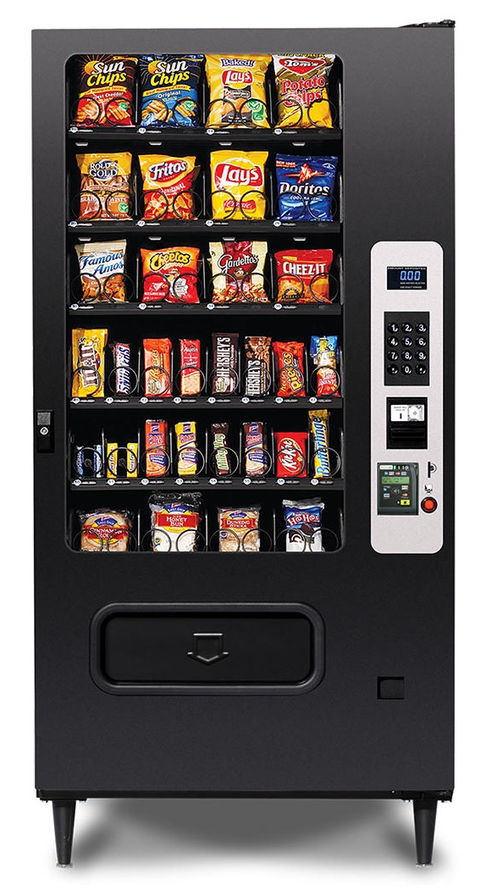
(3) Paul grew in his ABILITY TO PRAY.
(v.11) May you always be filled with the fruit of your salvation—the righteous character produced in your life by Jesus Christ—for this will bring much glory and praise to God.
Pray that the Holy Spirit would make the truth about us a reality (Eph. 1:17-20).

Slide 28
(3) Paul grew in his ABILITY TO PRAY.
(v.11) May you always be filled with the fruit of your salvation—the righteous character produced in your life by Jesus Christ—for this will bring much glory and praise to God.
Do you pray for others like this??

Slide 29
(3) Paul grew in his ABILITY TO PRAY.
(v.11) May you always be filled with the fruit of your salvation—the righteous character produced in your life by Jesus Christ—for this will bring much glory and praise to God.

Slide 30
(3) Paul grew in his ABILITY TO PRAY.
(v.11) May you always be filled with the fruit of your salvation—the righteous character produced in your life by Jesus Christ—for this will bring much glory and praise to God.
The same man who changed the world…
…can change your life!

Slide 31
(3) Paul grew in his ABILITY TO PRAY.
(v.11) May you always be filled with the fruit of your salvation—the righteous character produced in your life by Jesus Christ—for this will bring much glory and praise to God.
(1) Paul grew in APPRECIATION for people.
(2) Paul grew in his ATTITUDE toward God.
(3) Paul grew in his ABILITY TO PRAY.

Slide 34
3 Ways to Grow
(when you can’t leave the house…)
(1) Paul grew in his APPRECIATION for people.
(2) Paul grew in his ATTITUDE toward God.
(3) Paul grew in his ABILITY TO PRAY.

