Slide 2
Responding to Our Fears
God says: “Do not be afraid” 366 times in the Bible . . .

Slide 3
Responding to Our Fears
God says: “Do not be afraid” 366 times in the Bible . . .
“Do not be afraid” means: “Don’t let your fears paralyze you” or “Don’t take the counsel of your fears.”

Slide 4
Responding to Our Fears
. . . The reason God usually gives for “Do not be afraid” is: “For I am with you”

Slide 5
Responding to Our Fears
. . . The reason God usually gives for “Do not be afraid” is: “For I am with you”
How can we appropriate God’s help to live in substantial freedom from our fears?

Slide 6
Responding to Our Fears 2 Chronicles 20
^{20:1} Now it came about after this that the sons of Moab and the sons of Ammon, together with some of the Meunites, came to make war against Jehoshaphat. ² Then some came and reported to Jehoshaphat, saying, “A great multitude is coming against you from beyond the sea, out of Aram and behold, they are in Hazazon-tamar (that is Engedi).”

Slide 7
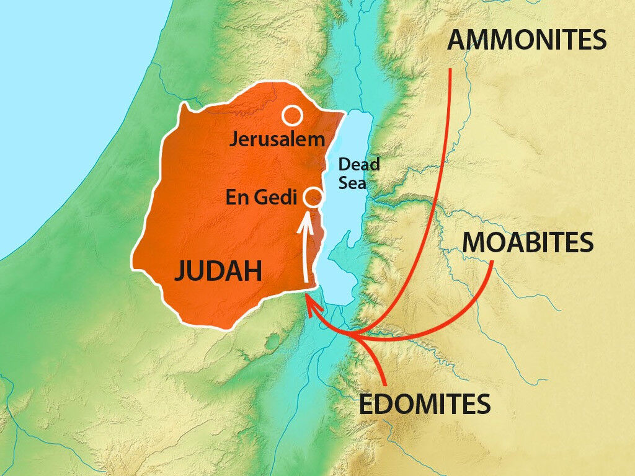
Responding to Our Fears 2 Chronicles 20
^{20:3} Jehoshaphat was afraid . . .

Slide 8
Responding to Our Fears 2 Chronicles 20
JEHOSHAPHAT’S RESPONSE: PRAYER
^{20:3} Jehoshaphat was afraid and turned his attention to seek the Lord, and proclaimed a fast throughout all Judah. ⁴ So Judah gathered together to seek help from the Lord; they even came from all the cities of Judah to seek the Lord.

Slide 9
Responding to Our Fears 2 Chronicles 20
JEHOSHAPHAT’S RESPONSE: PRAYER
This requires a deliberate choice, despite our runaway thoughts & feelings
^{20:3} Jehoshaphat was afraid and turned his attention to seek the Lord, and proclaimed a fast throughout all Judah. ⁴ So Judah gathered together to seek help from the Lord; they even came from all the cities of Judah to seek the Lord.

Slide 10
Responding to Our Fears 2 Chronicles 20
JEHOSHAPHAT’S RESPONSE: PRAYER FOCUSING ON GOD’S SOVEREIGNTY & FAITHFULNESS
^{20:5} Then Jehoshaphat stood in the assembly of Judah and Jerusalem, in the house of the Lord before the new court, ⁶ and he said, “O Lord, the God of our fathers, are You not God in the heavens? And are You not ruler over all the kingdoms of the nations? Power and might are in Your hand so that no one can stand against You.

Slide 11
Responding to Our Fears 2 Chronicles 20
JEHOSHAPHAT’S RESPONSE: PRAYER FOCUSING ON GOD’S SOVEREIGNTY & FAITHFULNESS
Our God is all-powerful & committed to us (1 Cor. 10:13; Rom. 8:28; 1 Pet. 5:10,11)
^{20:5} Then Jehoshaphat stood in the assembly of Judah and Jerusalem, in the house of the Lord before the new court, ⁶ and he said, “O Lord, the God of our fathers, are You not God in the heavens? And are You not ruler over all the kingdoms of the nations? Power and might are in Your hand so that no one can stand against You.

Slide 12
Responding to Our Fears 2 Chronicles 20
JEHOSHAPHAT’S RESPONSE: PRAYER FOCUSING ON GOD’S SOVEREIGNTY & FAITHFULNESS
⁷ “Did You not, O our God, drive out the inhabitants of this land before Your people Israel and give it to the descendants of Abraham Your friend forever?

Slide 13
Responding to Our Fears 2 Chronicles 20
JEHOSHAPHAT’S RESPONSE: PRAYER FOCUSING ON GOD’S SOVEREIGNTY & FAITHFULNESS
Our God has a history of delivering us (& His people)
⁷ “Did You not, O our God, drive out the inhabitants of this land before Your people Israel and give it to the descendants of Abraham Your friend forever?

Slide 14
Responding to Our Fears 2 Chronicles 20
JEHOSHAPHAT’S RESPONSE: PRAYER FOCUSING ON GOD’S SOVEREIGNTY & FAITHFULNESS
⁸ “They have lived in it, and have built You a sanctuary there for Your name, saying, ⁹ ‘Should evil come upon us, the sword, or judgment, or pestilence, or famine, we will stand before this house and before You (for Your name is in this house) and cry to You in our distress, and You will hear and deliver us.’

Slide 15
Responding to Our Fears 2 Chronicles 20
JEHOSHAPHAT’S RESPONSE: PRAYER FOCUSING ON GOD’S SOVEREIGNTY & FAITHFULNESS
Our God invites us to draw near to receive His help in time of need (Heb. 4:15)
⁸ “They have lived in it, and have built You a sanctuary there for Your name, saying, ⁹ ‘Should evil come upon us, the sword, or judgment, or pestilence, or famine, we will stand before this house and before You (for Your name is in this house) and cry to You in our distress, and You will hear and deliver us.’

Slide 16
Responding to Our Fears 2 Chronicles 20
JEHOSHAPHAT’S RESPONSE: PRAYER FOCUSING ON GOD’S SOVEREIGNTY & FAITHFULNESS
. . . ¹² “O our God, will You not judge them? For we are powerless before this great multitude who are coming against us; nor do we know what to do, but our eyes are on You.”

Slide 17
Responding to Our Fears 2 Chronicles 20
JEHOSHAPHAT’S RESPONSE: PRAYER FOCUSING ON GOD’S SOVEREIGNTY & FAITHFULNESS
Acknowledge your utter helplessness
. . . ¹² “O our God, will You not judge them? For we are powerless before this great multitude who are coming against us; nor do we know what to do, but our eyes are on You.”

Slide 18
Responding to Our Fears 2 Chronicles 20
JEHOSHAPHAT’S RESPONSE: PRAYER FOCUSING ON GOD’S SOVEREIGNTY & FAITHFULNESS
Depend on God’s deliverance & await His direction
. . . ¹² “O our God, will You not judge them? For we are powerless before this great multitude who are coming against us; nor do we know what to do, but our eyes are on You.”

Slide 19
Responding to Our Fears 2 Chronicles 20
GOD’S RESPONSE: FORTIFICATION & DIRECTION
¹⁴ Then in the midst of the assembly the Spirit of the Lord came upon Jahaziel the son of Zechariah, the son of Benaiah, the son of Jeiel, the son of Mattaniah, the Levite of the sons of Asaph; ¹⁵ and he said, “Listen, all Judah and the inhabitants of Jerusalem and King Jehoshaphat: thus says the Lord to you, ‘Do not fear or be dismayed because of this great multitude, for the battle is not yours but God’s.

Slide 20
Responding to Our Fears 2 Chronicles 20
GOD’S RESPONSE: FORTIFICATION & DIRECTION
¹⁶ ‘Tomorrow go down against them. Behold, they will come up by the ascent of Ziz, and you will find them at the end of the valley in front of the wilderness of Jeruel. ¹⁷ ‘You need not fight in this battle; station yourselves, stand and see the salvation of the Lord on your behalf, O Judah and Jerusalem.’ Do not fear or be dismayed; tomorrow go out to face them, for the Lord is with you.”

Slide 21
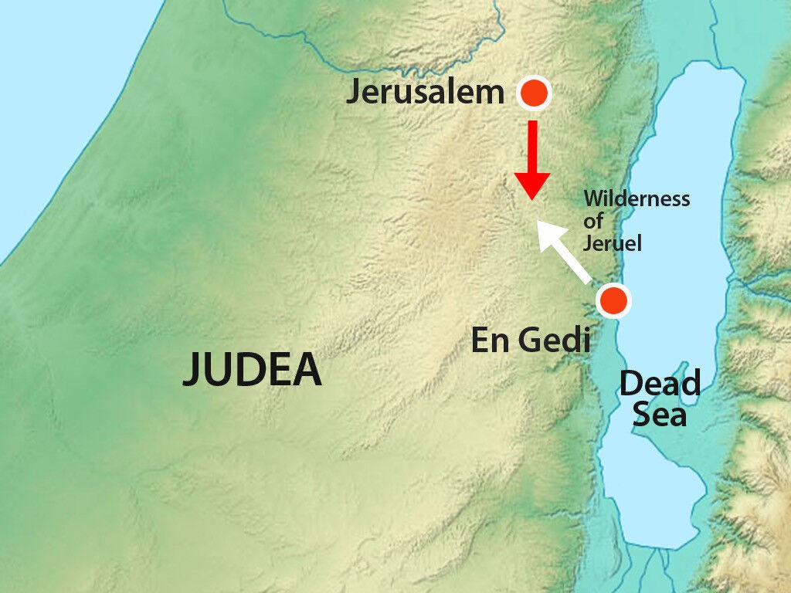
Responding to Our Fears 2 Chronicles 20
GOD’S RESPONSE: FORTIFICATION & DIRECTION
¹⁶ ‘Tomorrow go down against them. Behold, they will come up by the ascent of Ziz, and you will find them at the end of the valley in front of the wilderness of Jeruel. ¹⁷ ‘You need not fight in this battle; station yourselves, stand and see the salvation of the Lord on your behalf, O Judah and Jerusalem.’ Do not fear or be dismayed; tomorrow go out to face them, for the Lord is with you.”

Slide 22
Responding to Our Fears 2 Chronicles 20
GOD’S RESPONSE: FORTIFICATION & DIRECTION
What one step of faith does God want you to take? Commit to obey this ASAP.
¹⁶ ‘Tomorrow go down against them. Behold, they will come up by the ascent of Ziz, and you will find them at the end of the valley in front of the wilderness of Jeruel. ¹⁷ ‘You need not fight in this battle; station yourselves, stand and see the salvation of the Lord on your behalf, O Judah and Jerusalem.’ Do not fear or be dismayed; tomorrow go out to face them, for the Lord is with you.”

Slide 23
Responding to Our Fears 2 Chronicles 20
JEHOSHAPHAT’S RESPONSE: OBEDIENCE TO GOD’S DIRECTION
²⁰ They rose early in the morning and went out to the wilderness of Tekoa; and when they went out, Jehoshaphat stood and said, “Listen to me, O Judah and inhabitants of Jerusalem, put your trust in the Lord your God and you will be established. Put your trust in His prophets and succeed.” ²¹ When he had consulted with the people, he appointed those who sang to the Lord and those who praised Him in holy attire, as they went out before the army and said, “Give thanks to the Lord, for His lovingkindness is everlasting.”

Slide 24
Responding to Our Fears 2 Chronicles 20
GOD’S RESPONSE: DELIVERANCE FROM THEIR FEARS
²² When they began singing and praising, the Lord set ambushes against the sons of Ammon, Moab and Mount Seir, who had come against Judah; so they were routed ²³ For the sons of Ammon and Moab rose up against the inhabitants of Mount Seir destroying them completely; and when they had finished with the inhabitants of Seir, they helped to destroy one another.

Slide 25
Responding to Our Fears 2 Chronicles 20
GOD’S RESPONSE: DELIVERANCE FROM THEIR FEARS
God will meet you at your step of faith, to protect, sustain, empower & guide you
²² When they began singing and praising, the Lord set ambushes against the sons of Ammon, Moab and Mount Seir, who had come against Judah; so they were routed ²³ For the sons of Ammon and Moab rose up against the inhabitants of Mount Seir destroying them completely; and when they had finished with the inhabitants of Seir, they helped to destroy one another.

Slide 26
Responding to Our Fears 2 Chronicles 20
GOD’S RESPONSE: DELIVERANCE FROM THEIR FEARS
²⁵ When Jehoshaphat and his people came to take their spoil, they found much among them, including goods, garments and valuable things which they took for themselves, more than they could carry . . . ²⁷ Every man of Judah and Jerusalem returned with Jehoshaphat at their head, returning to Jerusalem with joy, for the Lord had made them to rejoice over their enemies.

Slide 27
Responding to Our Fears 2 Chronicles 20
PRAY, FOCUSING ON GOD’S SOVEREIGNTY & FAITHFULNESS
GOD FORTIFIES & GIVES DIRECTION
OBEY GOD’S DIRECTION
GOD DELIVERS FROM OUR FEARS

