Slide 2
Jesus One on One
Mark 10

Slide 3
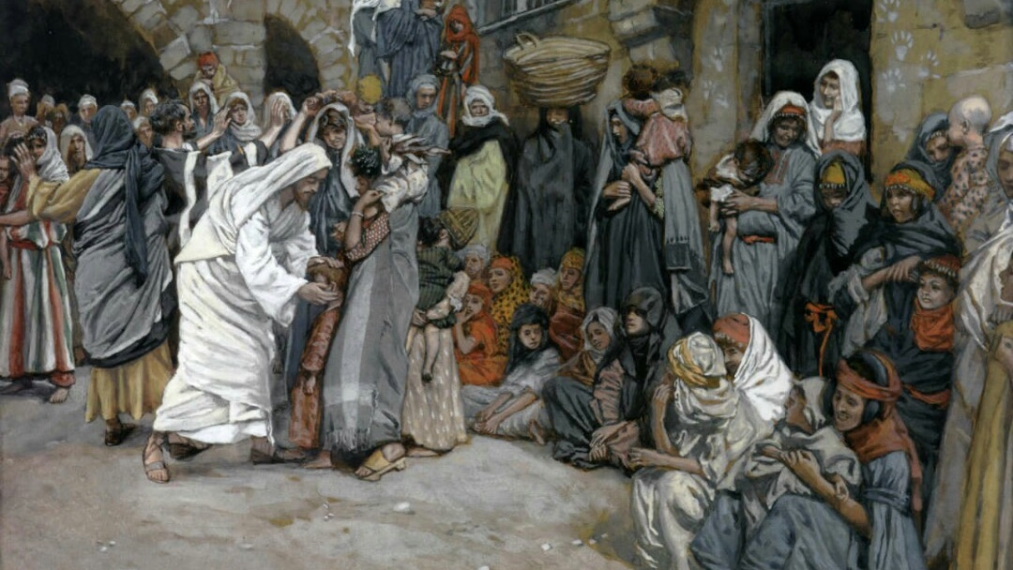
^{Mark 10:13} And they were bringing children to Him so that He might touch them; but the disciples rebuked them.

Slide 4
^{Mark 10:14} But when Jesus saw this, He was indignant and said to them, “Permit the children to come to Me; do not hinder them; for the kingdom of God belongs to such as these.

Slide 5
^{Mark 10:15} Truly I say to you, whoever does not receive the kingdom of God like a child will not enter it at all.” ¹⁶ And He took them in His arms and began blessing them, laying His hands on them.

Slide 6
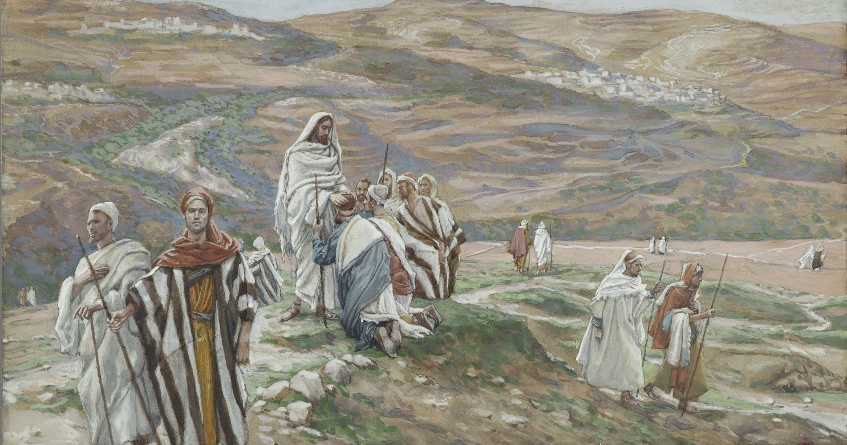
^{Mark 10:17} As He was setting out on a journey, a man ran up to Him and knelt before Him, and asked Him, “Good Teacher, what shall I do to inherit eternal life?”

Slide 7
Jesus One on One: Jesus and the Rich Young Ruler
Wealthy (Mark 10:22)
Young (Matt 19:20 )
Ruler (Luke 18:18)
^{Mark 10:17} As He was setting out on a journey, a man ran up to Him and knelt before Him, and asked Him, “Good Teacher, what shall I do to inherit eternal life?”

Slide 8
Jesus One on One: Jesus and the Rich Young Ruler
^{10:17 “}What shall I do to inherit eternal life?”
^{Mark 10:17} As He was setting out on a journey, a man ran up to Him and knelt before Him, and asked Him, “Good Teacher, what shall I do to inherit eternal life?”

Slide 9
Jesus One on One: Jesus and the Rich Young Ruler
He’s gonna tell him he needs to be born again
He’s gonna offer him “living water”
^{10:17 “}What shall I do to inherit eternal life?”
He’s probably already good to go
He’s gonna say “everyone who believes in Me will not perish but have eternal life.” (john 3:16)
^{Mark 10:17} As He was setting out on a journey, a man ran up to Him and knelt before Him, and asked Him, “Good Teacher, what shall I do to inherit eternal life?”

Slide 10
Jesus One on One: Jesus and the Rich Young Ruler
^{10:18} “Why do you call Me good? No one is good except God alone. ”
^{10:17 “}What shall I do to inherit eternal life?”
. . .
^{10:19} “You know the commandments, ‘Do not murder, Do not commit adultery, Do not steal, Do not bear false witness, Do not defraud, Honor your father and mother.’”
^{Mark 10:18} And Jesus said to him,

Slide 11
Jesus One on One: Jesus and the Rich Young Ruler
^{10:20} “Teacher, I have kept all these things from my youth up.”
^{10:19} “You know the commandments, ‘Do not murder, Do not commit adultery, Do not steal, Do not bear false witness, Do not defraud, Honor your father and mother.’”
^{Mark 10:20} And he said to Him,

Slide 12
Jesus One on One: Jesus and the Rich Young Ruler
^{10:20} “Teacher, I have kept all these things from my youth up.”
^{10:19} “You know the commandments, ‘Do not murder, Do not commit adultery, Do not steal, Do not bear false witness, Do not defraud, Honor your father and mother.’”
^{Mark 10:21} Looking at him, Jesus felt a love for him and said to him,

Slide 13
Jesus One on One: Jesus and the Rich Young Ruler
^{10:20} “Teacher, I have kept all these things from my youth up.”
^{10:21} “One thing you lack:”
^{10:21 “}go and sell all you possess and give to the poor, and you will have treasure in heaven; and come, follow Me.”
^{Mark 10:21} Looking at him, Jesus felt a love for him and said to him,

Slide 14
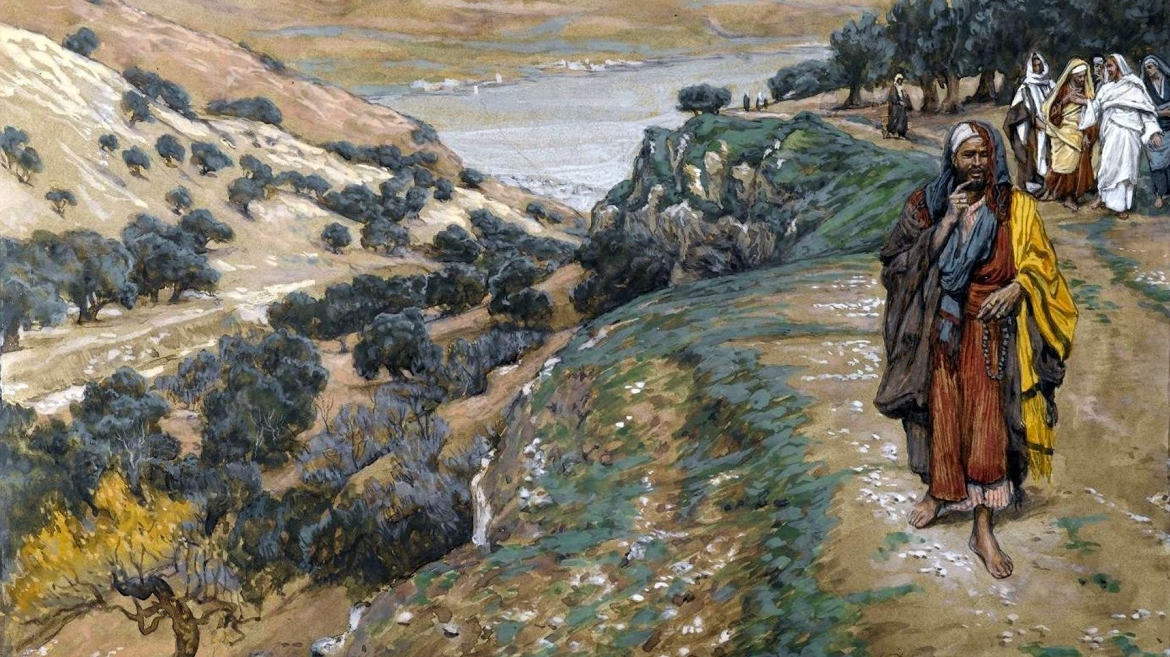
Jesus One on One: Jesus and the Rich Young Ruler
^{John 2:24} But Jesus … knew all about people. ²⁵ No one needed to tell him about human nature, for he knew what was in each person’s heart.
^{Mark 10:22} But at these words he was saddened, and he went away grieving, for he was one who owned much property.

Slide 15
How don’t we receive eternal life?
How do we receive eternal life?

Slide 16
How don’t we receive eternal life?
How do we receive eternal life?

Slide 17
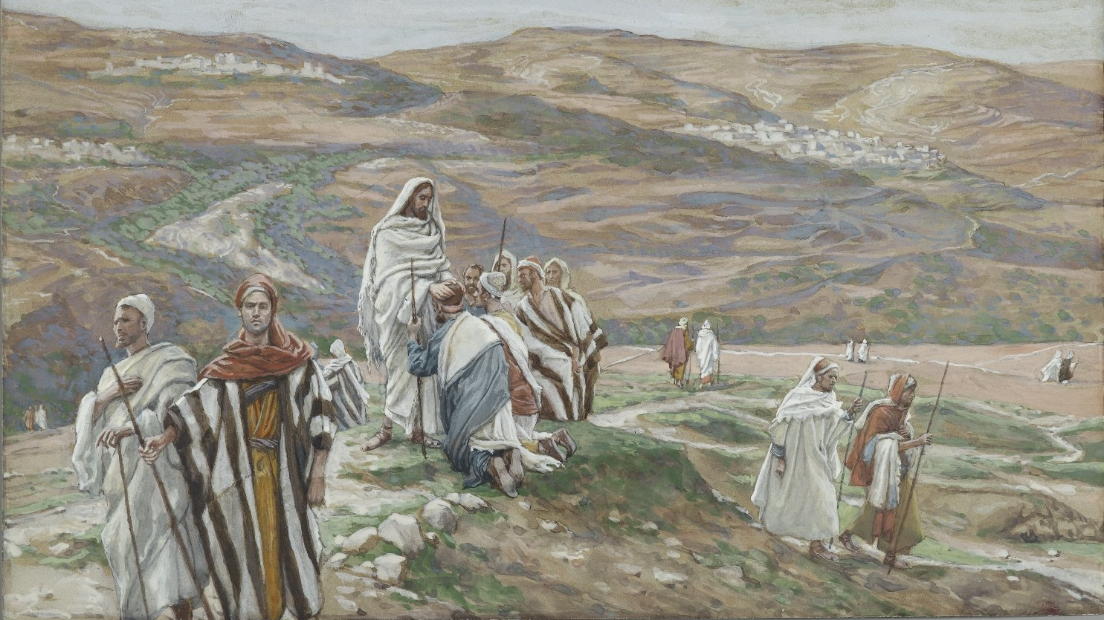
How don’t we receive eternal life?
^{10:18} “Why do you call Me good? No one is good except God alone.”
When Jesus asks questions . . .

Slide 18
How don’t we receive eternal life?
^{10:17 “}What shall I do to inherit eternal life?”
^{10:19} “You know the commandments, ‘Do not murder, Do not commit adultery, Do not steal, Do not bear false witness, Do not defraud, Honor your father and mother.’”
Why does Jesus point him to the law?
He’s answering the man’s question

Slide 19
How don’t we receive eternal life?
^{10:17 “}What shall I do to inherit eternal life?”
^{10:19} “You know the commandments, ‘Do not murder, Do not commit adultery, Do not steal, Do not bear false witness, Do not defraud, Honor your father and mother.’”
Why does Jesus point him to the law?
He’s answering the man’s question

Slide 20
How don’t we receive eternal life?
^{10:17 “}What shall I do to inherit eternal life?”
^{10:19} “You know the commandments, ‘Do not murder, Do not commit adultery, Do not steal, Do not bear false witness, Do not defraud, Honor your father and mother.’”
Why does Jesus point him to the law?
He’s answering the man’s question

Slide 21
How don’t we receive eternal life?
^{10:17 “}What shall I do to inherit eternal life?”
^{10:19} “You know the commandments, ‘Do not murder, Do not commit adultery, Do not steal, Do not bear false witness, Do not defraud, Honor your father and mother.’”
Why does Jesus point him to the law?
He’s answering the man’s question

Slide 22
How don’t we receive eternal life?
Being “good.”
^{10:21} “One thing you lack:”
^{10:20} “Teacher, I have kept all these things from my youth up.”
If you want to earn eternal life, keep the commandments
Plan A

Slide 23
How don’t we receive eternal life?
Being “good.”
^{10:21} “One thing you lack:”
^{10:20} “Teacher, I have kept all these things from my youth up.”
He’s pointing him to the law to expose how he *thinks* he’s going to earn eternal life, and then showing him the problem with it
Plan A

Slide 24
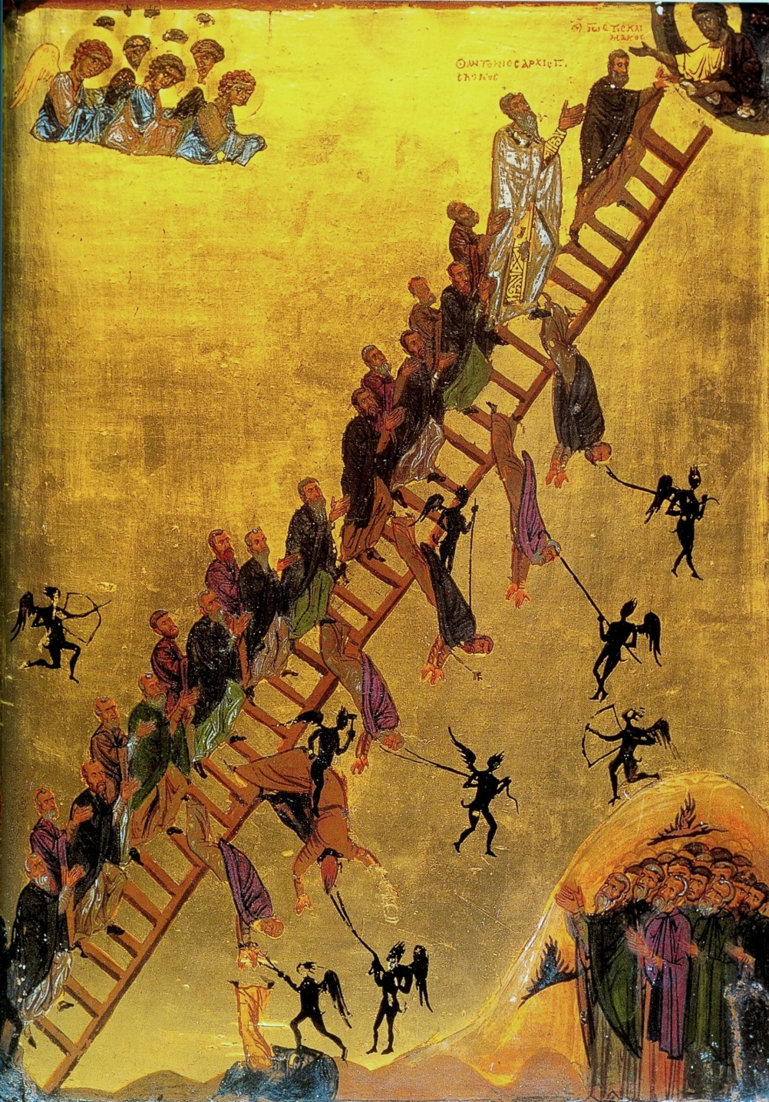
How don’t we receive eternal life?
Being “good.”
“All that matters is: Be Kind.”

Slide 25
How don’t we receive eternal life?
Being “good.”
Problems with “plan A”
- Measures progress by comparison against other people
- We’re good at keeping up appearances
- We have a biased view of how good we actually are
- We’re experts at watering down standards

Slide 26
Oh REALLY??
How don’t we receive eternal life?
Being “good.”
^{10:20} “Teacher, I have kept all these things from my youth up.”

Slide 27
Oh REALLY??
How don’t we receive eternal life?
Being “good.”
^{10:20} “Teacher, I have kept all these things from my youth up.”
^{Matt 5:21} You have heard that the law of Moses says, “Do not murder. If you commit murder, you are subject to judgment.”

Slide 28
Oh REALLY??
How don’t we receive eternal life?
Being “good.”
^{10:20} “Teacher, I have kept all these things from my youth up.”
^{Matt 5:22} But I say, if you are angry with someone, you are subject to judgment! If you call someone an idiot, you are in danger of being brought before the high council. And if you curse someone, you are in danger of the fires of hell.

Slide 29
Earn Eternal Life REPORT CARD
Your Score:
Pharisee’s version: Do Not Murder
^{Matt 5:22} But I say, if you are angry with someone, you are subject to judgment! If you call someone an idiot, you are in danger of being brought before the high council. And if you curse someone, you are in danger of the fires of hell.

Slide 30
Earn Eternal Life REPORT CARD
Your Score:
Pharisee’s version: Do Not Murder
Jesus’s version:
Never be angry with anyone
Never Insult anyone
^{Matt 5:22} But I say, if you are angry with someone, you are subject to judgment! If you call someone an idiot, you are in danger of being brought before the high council. And if you curse someone, you are in danger of the fires of hell.

Slide 31
Earn Eternal Life REPORT CARD
Your Score:
Pharisee’s version:
Do not cheat on your spouse
^{Matt 5:27} You have heard that the law of Moses says, “Do not commit adultery.”

Slide 32
Earn Eternal Life REPORT CARD
Your Score:
Pharisee’s version:
Do not cheat on your spouse
Jesus’s version:
Do not ever look with lust at a person you are not married to
^{Matt 5:28} But I say, anyone who even looks at a woman with lust in his eyes has already committed adultery with her in his heart.

Slide 33
Earn Eternal Life REPORT CARD
Your Score:
Pharisee’s version:
Do not cheat on your spouse
Jesus’s version:
Do not ever look with lust at a person you are not married to
^{Matt 5:29} So if your eye causes you to lust, gouge it out and throw it away. It is better for you to lose one part of your body than for your whole body to be thrown into hell.

Slide 34
Earn Eternal Life REPORT CARD
Your Score:
Pharisee’s version: You must love others, unless they’re different from you, then you may hate them.
^{Leviticus 19:18} Never seek revenge or bear a grudge against anyone, but love your neighbor as yourself.
^{Matt 5:43} You have heard that the law of Moses says, “Love your neighbor and hate your enemy.”

Slide 35
Earn Eternal Life REPORT CARD
Your Score:
Pharisee’s version: You must love others, unless they’re different from you, then you may hate them.
Jesus’s version: Love everyone, especially those who hate you.
^{Matt 5:44} But I say love your enemies! Pray for those who persecute you! In that way, you will be acting as true children of your Father in heaven. .. ⁴⁶ If you love only those who love you, what good is that? Even the corrupt tax collectors do that much.

Slide 36
Earn Eternal Life REPORT CARD
Your Score:
Pharisee’s version:
Do Not Worship Baal
Jesus’s version:
Money counts as a god
^{Deut 5:7} You shall have no other gods before me.

Slide 37
Earn Eternal Life REPORT CARD
FINAL GRADE:
Pharisee’s version: You must do better than others to pass this test
Jesus’s version:
YOU. MUST. BE.
PERFECT.
^{Matt 5:48} But you are to be perfect, even as your Father in heaven is perfect.

Slide 38
How don’t we receive eternal life?
Being “good.”
Problems with “plan A”
- The real standard is perfection
- Therefore WILL NOT EVER WORK!
^{James 2:10} And the person who keeps all of the laws except one is as guilty as the person who has broken all of God’s laws.

Slide 39
How do we receive eternal life?
That’s how we don’t inherit eternal life

Slide 40
How do we receive eternal life?
That’s how we don’t inherit eternal life
^{Mark 10:14} “Permit the children to come to Me; do not hinder them; for the kingdom of God belongs to such as these. ¹⁵ Truly I say to you, whoever does not receive the kingdom of God like a child will not enter it at all.”

Slide 41
How do we receive eternal life?
That’s how we don’t inherit eternal life
^{Mark 10:14} “Permit the children to come to Me; do not hinder them; for the kingdom of God belongs to such as these. ¹⁵ Truly I say to you, whoever does not receive the kingdom of God like a child will not enter it at all.”

Slide 42
How do we receive eternal life?
That’s how we don’t inherit eternal life
^{Mark 10:14} “Permit the children to come to Me; do not hinder them; for the kingdom of God belongs to such as these. ¹⁵ Truly I say to you, whoever does not receive the kingdom of God like a child will not enter it at all.”

Slide 43
How do we receive eternal life?
Like a child
What about children is He pointing to?
The way they “came to him;”
the way they “received” from him.
^{Mark 10:14} “Permit the children to come to Me; do not hinder them; for the kingdom of God belongs to such as these. ¹⁵ Truly I say to you, whoever does not receive the kingdom of God like a child will not enter it at all.”

Slide 44
How do we receive eternal life?
Like a child
What about children is He pointing to?
It’s the humility
^{Mark 10:14} “Permit the children to come to Me; do not hinder them; for the kingdom of God belongs to such as these. ¹⁵ Truly I say to you, whoever does not receive the kingdom of God like a child will not enter it at all.”

Slide 45
How do we receive eternal life?
Like a child
What would it mean to “receive the kingdom of God like a child?”
Plan B
It’s the humility
^{Mark 10:14} “Permit the children to come to Me; do not hinder them; for the kingdom of God belongs to such as these. ¹⁵ Truly I say to you, whoever does not receive the kingdom of God like a child will not enter it at all.”

Slide 46
How do we receive eternal life?
Like a child
What would it mean to “receive the kingdom of God like a child?”
^{Matt 5:17} Don’t misunderstand why I have come. I did not come to abolish the law of Moses or the writings of the Prophets. No, I came to fulfill them
Plan B
It’s the humility
^{Mark 10:14} “Permit the children to come to Me; do not hinder them; for the kingdom of God belongs to such as these. ¹⁵ Truly I say to you, whoever does not receive the kingdom of God like a child will not enter it at all.”

Slide 47
How do we receive eternal life?
Like a child
Never grow out of this part!
Plan B
^{Mark 10:14} “Permit the children to come to Me; do not hinder them; for the kingdom of God belongs to such as these. ¹⁵ Truly I say to you, whoever does not receive the kingdom of God like a child will not enter it at all.”

Slide 48
How do we receive eternal life?
Like a child
“receive the kingdom like a child”
Vs
“What shall I do to inherit eternal life”
Plan B
^{Mark 10:14} “Permit the children to come to Me; do not hinder them; for the kingdom of God belongs to such as these. ¹⁵ Truly I say to you, whoever does not receive the kingdom of God like a child will not enter it at all.”

Slide 49
How do we receive eternal life?
Like a child
Why does Jesus point him to this one thing?
Because you really have to sell everything to be saved?
^{10:21 “}go and sell all you possess and give to the poor, and you will have treasure in heaven; and come, follow Me.”

Slide 50
How do we receive eternal life?
Like a child
Why does Jesus point him to this one thing?
Because this was really the only thing he lacked?
^{10:21 “}go and sell all you possess and give to the poor, and you will have treasure in heaven; and come, follow Me.”

Slide 51
How do we receive eternal life?
Like a child
Why does Jesus point him to this one thing?
Because it was the one thing he would never do
^{10:21 “}go and sell all you possess and give to the poor, and you will have treasure in heaven; and come, follow Me.”

Slide 52
How do we receive eternal life?
Like a child
Why does Jesus point him to this one thing?
He points him to that one thing in love
Jesus held him to the law to point him to the gospel
^{10:21 “}go and sell all you possess and give to the poor, and you will have treasure in heaven; and come, follow Me.”
^{Mark 10:21} Looking at him, Jesus felt a love for him and said to him,

Slide 53
How do we receive eternal life?
Like a child
Why does Jesus point him to this one thing?
He points him to that one thing in love
Jesus is helping him toward eternal life
^{10:21 “}go and sell all you possess and give to the poor, and you will have treasure in heaven; and come, follow Me.”
^{Mark 10:21} Looking at him, Jesus felt a love for him and said to him,

Slide 54
^{Mark 10:22} But at these words he was saddened, and he went away grieving, for he was one who owned much property.

Slide 55
^{Mark 10:23} And Jesus, looking around, said to His disciples, “How hard it will be for those who are wealthy to enter the kingdom of God!”

Slide 56
^{Mark 10:24} The disciples were amazed at His words.

Slide 57
Wealth isn’t a sign that you’re close to righteousness
And it doesn’t make it easier to receive from God
In fact, it’s makes it harder
Why?
But Jesus answered again and said to them, “Children, how hard it is to enter the kingdom of God! ²⁵ It is easier for a camel to go through the eye of a needle than for a rich man to enter the kingdom of God.”

Slide 58
The more plausible it seems that I can do it myself, the harder it is for me to come to him like a child for help.
But Jesus answered again and said to them, “Children, how hard it is to enter the kingdom of God! ²⁵ It is easier for a camel to go through the eye of a needle than for a rich man to enter the kingdom of God.”

Slide 59
^{Mark 10:26} They were even more astonished and said to Him, “Then who can be saved?”
²⁷ Looking at them, Jesus said, “With people it is impossible, but not with God; for all things are possible with God.”

Slide 60
^{Mark 10:26} They were even more astonished and said to Him, “Then who can be saved?”
²⁷ Looking at them, Jesus said, “With people it is impossible, but not with God; for all things are possible with God.”

Slide 61
This is so hopeful!
Plan B
^{Mark 10:26} They were even more astonished and said to Him, “Then who can be saved?”
²⁷ Looking at them, Jesus said, “With people it is impossible, but not with God; for all things are possible with God.”

