Slide 1
Acts
The Church in Jerusalem
Acts 5: Suffering for Christ

Slide 2
Acts
The Church in Jerusalem
Chronicling the history of the first church

Slide 3
Acts
The Church in Jerusalem
The church faces a series of obstacles …

Slide 4
Acts
The Church in Jerusalem
Challenge: Intimidation
The church faces a series of obstacles …

Slide 5
Acts
The Church in Jerusalem
Challenge: Intimidation
^{4:7} “By what power, or in what name, have you done this?”
The church faces a series of obstacles …

Slide 6
Acts
The Church in Jerusalem
Challenge: Intimidation
^{4:7} “By what power, or in what name, have you done this?”
^{Acts 4:18} And when they had summoned them, they commanded them not to speak or teach at all in the name of Jesus.
The church faces a series of obstacles …

Slide 7
Acts
The Church in Jerusalem
Challenge: Intimidation
^{4:7} “By what power, or in what name, have you done this?”
¹⁹ “Whether it is right in the sight of God to give heed to you rather than to God, you be the judge; ²⁰ for we cannot stop speaking about what we have seen and heard.”
^{Acts 4:18} And when they had summoned them, they commanded them not to speak or teach at all in the name of Jesus.
The church faces a series of obstacles …

Slide 8
Acts
The Church in Jerusalem
Challenge: Intimidation
^{4:7} “By what power, or in what name, have you done this?”
¹⁹ “Whether it is right in the sight of God to give heed to you rather than to God, you be the judge; ²⁰ for we cannot stop speaking about what we have seen and heard.”
^{Acts 4:18} And when they had summoned them, they commanded them not to speak or teach at all in the name of Jesus.
^{Acts 4:31} and they were all filled with the Holy Spirit and began to speak the word of God with boldness.
The church faces a series of obstacles …

Slide 9
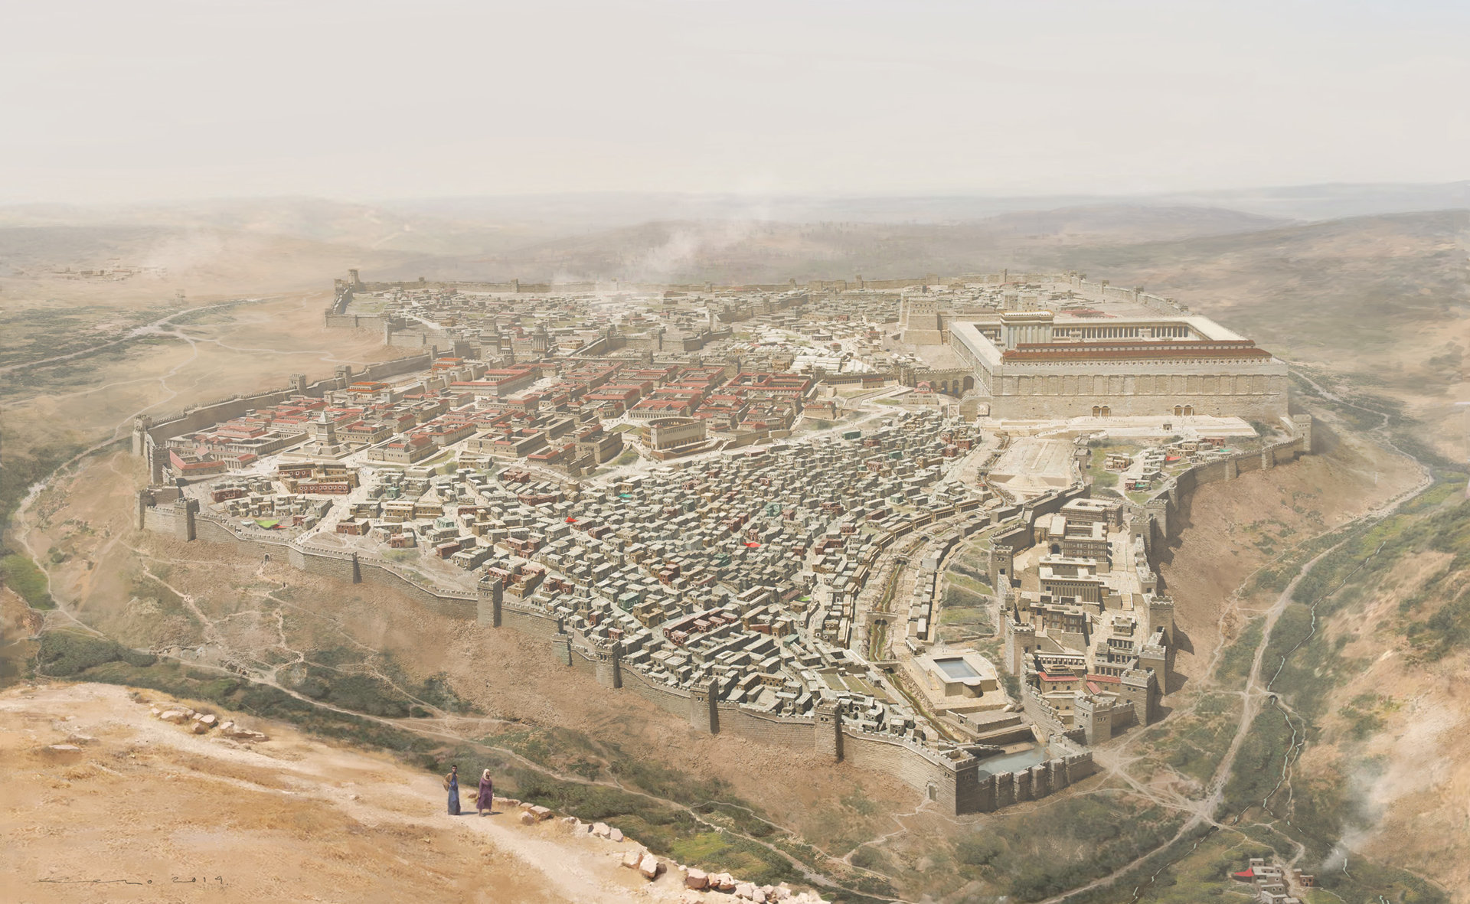
Acts
The Church in Jerusalem
Challenge: Intimidation
Result: confidence in Christ
^{Acts 4:18} And when they had summoned them, they commanded them not to speak or teach at all in the name of Jesus.
^{Acts 4:31} and they were all filled with the Holy Spirit and began to speak the word of God with boldness.
The church faces a series of obstacles …

Slide 10
Acts
The Church in Jerusalem
Challenge: Intimidation
Result: confidence in Christ
Result: the gospel advances!
^{Acts 4:18} And when they had summoned them, they commanded them not to speak or teach at all in the name of Jesus.
^{Acts 4:31} and they were all filled with the Holy Spirit and began to speak the word of God with boldness.
The church faces a series of obstacles …

Slide 11
Acts
The Church in Jerusalem
Challenge: Intimidation
Result: confidence in Christ
Result: the gospel advances!
Theme: “You’re only making it stronger!”
^{Acts 4:18} And when they had summoned them, they commanded them not to speak or teach at all in the name of Jesus.
^{Acts 4:31} and they were all filled with the Holy Spirit and began to speak the word of God with boldness.
The church faces a series of obstacles …

Slide 12
Acts
The Church in Jerusalem
Theme: “You’re only making it stronger!”
Pattern:
Crisis → Provision & Perseverance → Growth

Slide 13
Acts
The Church in Jerusalem
Theme: “You’re only making it stronger!”
^{Acts 5:1} But a man named Ananias…
Pattern:
Crisis → Provision & Perseverance → Growth

Slide 14
Acts
The Church in Jerusalem
Challenge: Hypocrisy
Theme: “You’re only making it stronger!”
^{Acts 5:1} But a man named Ananias…
Pattern:
Crisis → Provision & Perseverance → Growth

Slide 15
Acts
The Church in Jerusalem
Challenge: Hypocrisy
Result: unity, integrity, credibility
Theme: “You’re only making it stronger!”
^{Acts 5:1} But a man named Ananias…
Pattern:
Crisis → Provision & Perseverance → Growth

Slide 16
Acts
The Church in Jerusalem
Challenge: Hypocrisy
Result: unity, integrity, credibility
Theme: “You’re only making it stronger!”
^{Acts 5:12} …and they were all with one accord in Solomon’s portico. ¹³ But none of the rest dared to associate with them; however, the people held them in high esteem. ¹⁴ And all the more believers in the Lord, multitudes of
men and women, were constantly added to their number
^{Acts 5:1} But a man named Ananias…
Pattern:
Crisis → Provision & Perseverance → Growth

Slide 17
Acts
The Church in Jerusalem
Challenge: Hypocrisy
Result: unity, integrity, credibility
Result: the gospel advances!
Theme: “You’re only making it stronger!”
^{Acts 5:12} …and they were all with one accord in Solomon’s portico. ¹³ But none of the rest dared to associate with them; however, the people held them in high esteem. ¹⁴ And all the more believers in the Lord, multitudes of
men and women, were constantly added to their number
^{Acts 5:1} But a man named Ananias…
Pattern:
Crisis → Provision & Perseverance → Growth

Slide 18
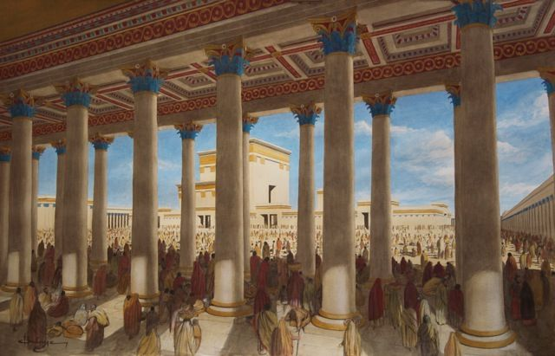
Acts
The Church in Jerusalem
^{Acts 5:12} …and they were all with one accord in Solomon’s portico. ¹³ But none of the rest dared to associate with them; however, the people held them in high esteem. ¹⁴ And all the more believers in the Lord, multitudes of
men and women, were constantly added to their number
^{Acts 5:1} But a man named Ananias…
Pattern:
Crisis → Provision & Perseverance → Growth

Slide 19
Acts
… BUT …
The Church in Jerusalem
^{Acts 5:12} …and they were all with one accord in Solomon’s portico. ¹³ But none of the rest dared to associate with them; however, the people held them in high esteem. ¹⁴ And all the more believers in the Lord, multitudes of
men and women, were constantly added to their number
^{Acts 5:1} But a man named Ananias…
Pattern:
Crisis → Provision & Perseverance → Growth

Slide 20
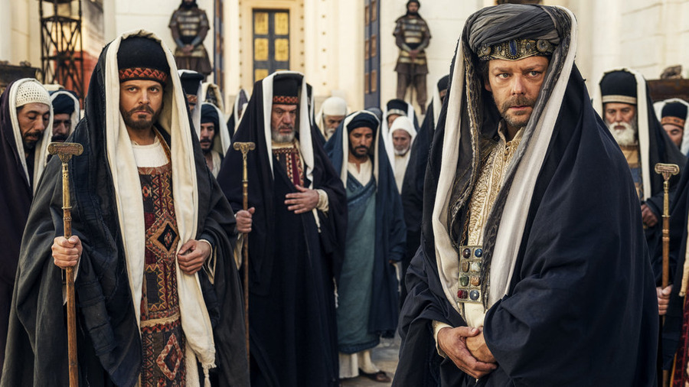
… BUT …
^{Acts 5:17} But the high priest rose up, along with all his associates (that is the sect of the Sadducees), and they were filled with jealousy.
^{Acts 5:17} But the high priest rose up, along with all his associates (that is the sect of the Sadducees), and they were filled with jealousy.
^{Acts 5:17} But the high priest rose up, along with all his associates (that is the sect of the Sadducees), and they were filled with jealousy.
^{Acts 5:17} But the high priest rose up, along with all his associates (that is the sect of the Sadducees), and they were filled with jealousy.

Slide 21
… BUT …
^{Acts 5:18} They laid hands on the apostles and put them in a public jail.

Slide 22
… BUT …
^{Acts 5:18} They laid hands on the apostles and put them in a public jail.
Crisis

Slide 23
… BUT …
^{Acts 5:19} But during the night an angel of the Lord opened the gates of the prison, and taking them out he said, ²⁰ “Go, stand and speak to the people in the temple the whole message of this Life.”
^{Acts 5:18} They laid hands on the apostles and put them in a public jail.
Crisis

Slide 24
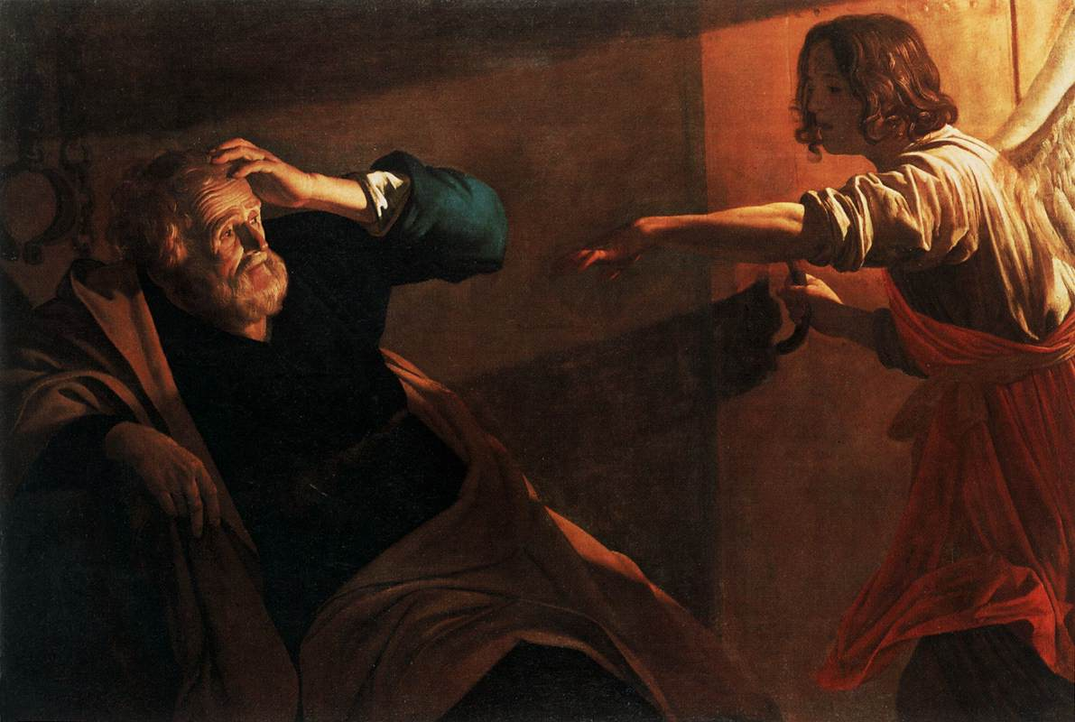
… BUT …
Provision
^{Acts 5:19} But during the night an angel of the Lord opened the gates of the prison, and taking them out he said, ²⁰ “Go, stand and speak to the people in the temple the whole message of this Life.”
^{Acts 5:19} But during the night an angel of the Lord opened the gates of the prison, and taking them out he said, ²⁰ “Go, stand and speak to the people in the temple the whole message of this Life.”
^{Acts 5:19} But during the night an angel of the Lord opened the gates of the prison, and taking them out he said, ²⁰ “Go, stand and speak to the people in the temple the whole message of this Life.”

Slide 25
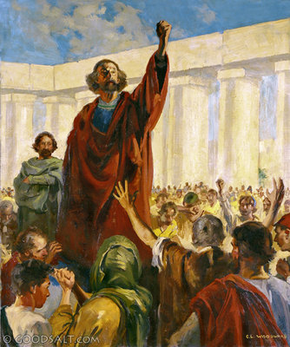
^{Acts 5:21} Upon hearing this, they entered into the temple about daybreak and began to teach.
You’re only making it stronger . . .

Slide 26
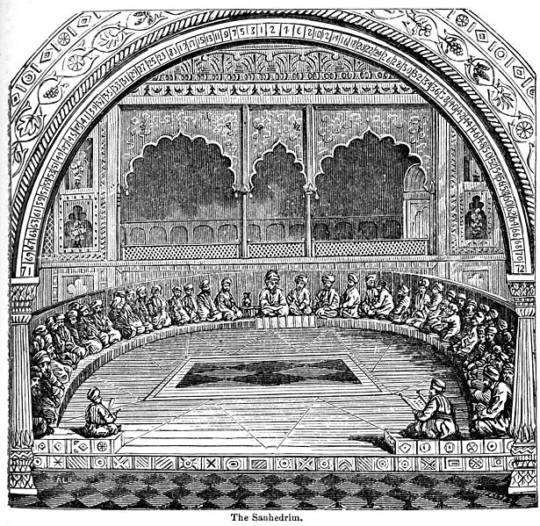
^{Acts 5:21}Now when the high priest and his associates came, they called the Council together, even all the Senate of the sons of Israel, and sent orders to the prison house for them to be brought.
^{Acts 5:21}Now when the high priest and his associates came, they called the Council together, even all the Senate of the sons of Israel, and sent orders to the prison house for them to be brought.

Slide 27
^{Acts 5:22} But the officers who came did not find them in the prison; and they returned and reported back, ²³ saying, “We found the prison house locked quite securely and the guards standing at the doors; but when we had opened up, we found no one inside.”

Slide 28
^{Acts 5:24} Now when the captain of the temple guard
and the chief priests heard these words, they were greatly perplexed about them as to what would come of this.
^{Acts 5:24} Now when the captain of the temple guard
and the chief priests heard these words, they were greatly perplexed about them as to what would come of this.

Slide 29
^{Acts 5:24} Now when the captain of the temple guard
and the chief priests heard these words, they were greatly perplexed about them as to what would come of this.
^{Acts 5:24} Now when the captain of the temple guard
and the chief priests heard these words, they were greatly perplexed about them as to what would come of this.

Slide 30
^{Acts 5:25} But someone came and reported to them, “The men whom you put in prison are standing in the temple and teaching the people!”

Slide 31
^{Acts 5:26} Then the captain went along with the officers and proceeded to bring them back without violence (for they were afraid of the people, that they might be stoned).
^{Acts 5:26} Then the captain went along with the officers and proceeded to bring them back without violence (for they were afraid of the people, that they might be stoned).

Slide 32
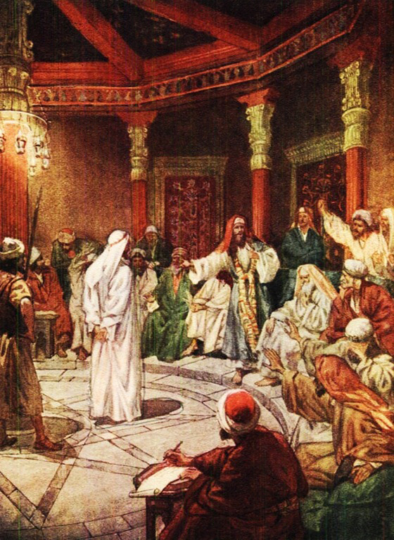
^{Acts 5:27} When they had brought them, they stood them before the Council.
^{Acts 5:26} Then the captain went along with the officers and proceeded to bring them back without violence (for they were afraid of the people, that they might be stoned).

Slide 33
^{Acts 5:27} The high priest questioned them, ²⁸ saying, “We gave you strict orders not to continue teaching in this name, and yet, you have filled Jerusalem with your teaching and intend to bring this man’s blood upon us.”
^{Acts 5:27} The high priest questioned them, ²⁸ saying, “We gave you strict orders not to continue teaching in this name, and yet, you have filled Jerusalem with your teaching and intend to bring this man’s blood upon us.”
^{Acts 5:27} The high priest questioned them, ²⁸ saying, “We gave you strict orders not to continue teaching in this name, and yet, you have filled Jerusalem with your teaching and intend to bring this man’s blood upon us.”
^{Acts 5:27} The high priest questioned them, ²⁸ saying, “We gave you strict orders not to continue teaching in this name, and yet, you have filled Jerusalem with your teaching and intend to bring this man’s blood upon us.”

Slide 34
^{Acts 5:29} But Peter and the apostles answered, “We must obey God rather than men.” ³⁰ The God of our fathers raised up Jesus, whom you had put to death by hanging Him on a cross.
^{Acts 5:29} But Peter and the apostles answered, “We must obey God rather than men.” ³⁰ The God of our fathers raised up Jesus, whom you had put to death by hanging Him on a cross.
^{Acts 5:29} But Peter and the apostles answered, “We must obey God rather than men.” ³⁰ The God of our fathers raised up Jesus, whom you had put to death by hanging Him on a cross.

Slide 35
^{Acts 5:31} He is the one whom God exalted to His right hand as a Prince and a Savior, to grant repentance to Israel, and forgiveness of sins. ³² And we are witnesses of these things; and so is the Holy Spirit, whom God has given to those who obey Him.”
^{Acts 5:31} He is the one whom God exalted to His right hand as a Prince and a Savior, to grant repentance to Israel, and forgiveness of sins. ³² And we are witnesses of these things; and so is the Holy Spirit, whom God has given to those who obey Him.”
^{Acts 5:31} He is the one whom God exalted to His right hand as a Prince and a Savior, to grant repentance to Israel, and forgiveness of sins. ³² And we are witnesses of these things; and so is the Holy Spirit, whom God has given to those who obey Him.”
^{Acts 5:31} He is the one whom God exalted to His right hand as a Prince and a Savior, to grant repentance to Israel, and forgiveness of sins. ³² And we are witnesses of these things; and so is the Holy Spirit, whom God has given to those who obey Him.”

Slide 36
BTW, this is a sincere invitation
^{Acts 5:31} He is the one whom God exalted to His right hand as a Prince and a Savior, to grant repentance to Israel, and forgiveness of sins. ³² And we are witnesses of these things; and so is the Holy Spirit, whom God has given to those who obey Him.”
^{Acts 5:31} He is the one whom God exalted to His right hand as a Prince and a Savior, to grant repentance to Israel, and forgiveness of sins. ³² And we are witnesses of these things; and so is the Holy Spirit, whom God has given to those who obey Him.”
^{Acts 5:31} He is the one whom God exalted to His right hand as a Prince and a Savior, to grant repentance to Israel, and forgiveness of sins. ³² And we are witnesses of these things; and so is the Holy Spirit, whom God has given to those who obey Him.”
^{Acts 5:31} He is the one whom God exalted to His right hand as a Prince and a Savior, to grant repentance to Israel, and forgiveness of sins. ³² And we are witnesses of these things; and so is the Holy Spirit, whom God has given to those who obey Him.”

Slide 37
^{Acts 6:7} … a great many of the priests were becoming obedient to the faith.
BTW, this is a sincere invitation
^{Acts 5:31} He is the one whom God exalted to His right hand as a Prince and a Savior, to grant repentance to Israel, and forgiveness of sins. ³² And we are witnesses of these things; and so is the Holy Spirit, whom God has given to those who obey Him.”
^{Acts 5:31} He is the one whom God exalted to His right hand as a Prince and a Savior, to grant repentance to Israel, and forgiveness of sins. ³² And we are witnesses of these things; and so is the Holy Spirit, whom God has given to those who obey Him.”
^{Acts 5:31} He is the one whom God exalted to His right hand as a Prince and a Savior, to grant repentance to Israel, and forgiveness of sins. ³² And we are witnesses of these things; and so is the Holy Spirit, whom God has given to those who obey Him.”
^{Acts 5:31} He is the one whom God exalted to His right hand as a Prince and a Savior, to grant repentance to Israel, and forgiveness of sins. ³² And we are witnesses of these things; and so is the Holy Spirit, whom God has given to those who obey Him.”

Slide 38
^{Acts 5:33} But when they heard this, they were cut to the quick and intended to kill them.
^{Acts 5:33} But when they heard this, they were cut to the quick and intended to kill them.

Slide 39
^{Acts 5:33} But when they heard this, they were cut to the quick and intended to kill them.
^{Acts 5:33} But when they heard this, they were cut to the quick and intended to kill them.
Crisis

Slide 40
^{Acts 5:34} But a Pharisee named Gamaliel, a teacher of the Law, respected by all the people, stood up in the Council and gave orders to put the men outside for a short time.

Slide 41
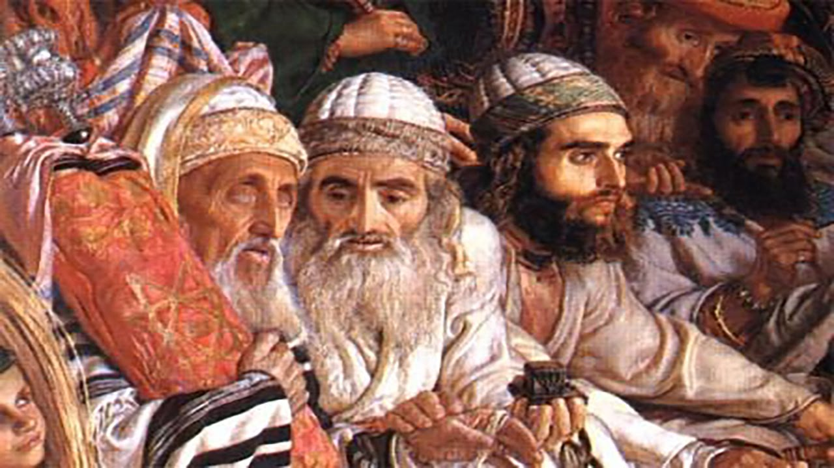
^{Acts 5:34} But a Pharisee named Gamaliel, a teacher of the Law, respected by all the people, stood up in the Council and gave orders to put the men outside for a short time.

Slide 42
^{Acts 5:35} And he said to them, “Men of Israel, take care what you propose to do with these men.

Slide 43
^{Acts 5:36} For some time ago Theudas rose up, claiming to be somebody, and a group of about four hundred men joined up with him. But he was killed, and all who followed him were dispersed and came to nothing.

Slide 44
^{Acts 5:37} After this man, Judas of Galilee rose up in the days of the census and drew away some people after him; he too perished, and all those who followed him were scattered.

Slide 45
^{Acts 5:38} So in the present case, I say to you, stay away from these men and let them alone, for if this plan or action is of men, it will be overthrown; ³⁹ but if it is of God, you will not be able to overthrow them; or else you may even be found fighting against God.”
^{Acts 5:38} So in the present case, I say to you, stay away from these men and let them alone, for if this plan or action is of men, it will be overthrown; ³⁹ but if it is of God, you will not be able to overthrow them; or else you may even be found fighting against God.”
^{Acts 5:38} So in the present case, I say to you, stay away from these men and let them alone, for if this plan or action is of men, it will be overthrown; ³⁹ but if it is of God, you will not be able to overthrow them; or else you may even be found fighting against God.”

Slide 46
^{Acts 5:40} They took his advice; and after calling the apostles in, they flogged them and ordered them not to speak in the name of Jesus, and then released them.

Slide 47
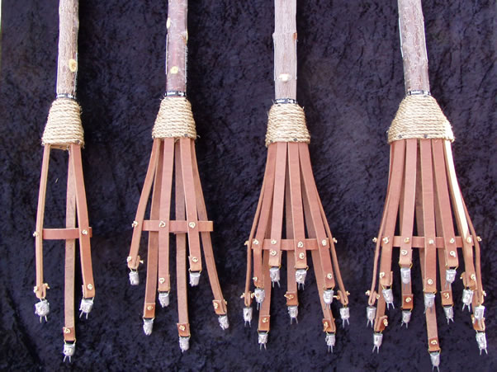
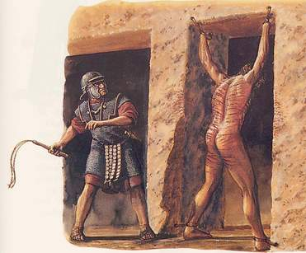
^{Acts 5:40} They took his advice; and after calling the apostles in, they flogged them and ordered them not to speak in the name of Jesus, and then released them.
^{Acts 5:40} They took his advice; and after calling the apostles in, they flogged them and ordered them not to speak in the name of Jesus, and then released them.

Slide 48
^{Acts 5:40} They took his advice; and after calling the apostles in, they flogged them and ordered them not to speak in the name of Jesus, and then released them.
^{Acts 5:40} They took his advice; and after calling the apostles in, they flogged them and ordered them not to speak in the name of Jesus, and then released them.
^{Acts 5:40} They took his advice; and after calling the apostles in, they flogged them and ordered them not to speak in the name of Jesus, and then released them.

Slide 49
This is BAD!
^{Acts 5:40} They took his advice; and after calling the apostles in, they flogged them and ordered them not to speak in the name of Jesus, and then released them.
^{Acts 5:40} They took his advice; and after calling the apostles in, they flogged them and ordered them not to speak in the name of Jesus, and then released them.
^{Acts 5:40} They took his advice; and after calling the apostles in, they flogged them and ordered them not to speak in the name of Jesus, and then released them.

Slide 50
This is BAD!
Disastrous for the movement!
^{Acts 5:40} They took his advice; and after calling the apostles in, they flogged them and ordered them not to speak in the name of Jesus, and then released them.
^{Acts 5:40} They took his advice; and after calling the apostles in, they flogged them and ordered them not to speak in the name of Jesus, and then released them.
^{Acts 5:40} They took his advice; and after calling the apostles in, they flogged them and ordered them not to speak in the name of Jesus, and then released them.

Slide 51
This is BAD!
Disastrous for the movement!
Challenge to the church:
Persecution
^{Acts 5:40} They took his advice; and after calling the apostles in, they flogged them and ordered them not to speak in the name of Jesus, and then released them.
^{Acts 5:40} They took his advice; and after calling the apostles in, they flogged them and ordered them not to speak in the name of Jesus, and then released them.
^{Acts 5:40} They took his advice; and after calling the apostles in, they flogged them and ordered them not to speak in the name of Jesus, and then released them.

Slide 52
^{Acts 5:40} They took his advice; and after calling the apostles in, they flogged them and ordered them not to speak in the name of Jesus, and then released them.
^{Acts 5:40} They took his advice; and after calling the apostles in, they flogged them and ordered them not to speak in the name of Jesus, and then released them.
^{Acts 5:41} So they went on their way from the presence of the Council, rejoicing that they had been considered worthy to suffer shame for His name.

Slide 53
?
^{Acts 5:40} They took his advice; and after calling the apostles in, they flogged them and ordered them not to speak in the name of Jesus, and then released them.
^{Acts 5:40} They took his advice; and after calling the apostles in, they flogged them and ordered them not to speak in the name of Jesus, and then released them.
^{Acts 5:41} So they went on their way from the presence of the Council, rejoicing that they had been considered worthy to suffer shame for His name.

Slide 54
They were just arrested, tried, nearly killed, physically beaten, publicly shamed, and their movement has been banned under threat of death…
?
^{Acts 5:40} They took his advice; and after calling the apostles in, they flogged them and ordered them not to speak in the name of Jesus, and then released them.
^{Acts 5:40} They took his advice; and after calling the apostles in, they flogged them and ordered them not to speak in the name of Jesus, and then released them.
^{Acts 5:41} So they went on their way from the presence of the Council, rejoicing that they had been considered worthy to suffer shame for His name.

Slide 55
They were just arrested, tried, nearly killed, physically beaten, publicly shamed, and their movement has been banned under threat of death…
What should we make of this counterintuitive response?
?
^{Acts 5:40} They took his advice; and after calling the apostles in, they flogged them and ordered them not to speak in the name of Jesus, and then released them.
^{Acts 5:40} They took his advice; and after calling the apostles in, they flogged them and ordered them not to speak in the name of Jesus, and then released them.
^{Acts 5:41} So they went on their way from the presence of the Council, rejoicing that they had been considered worthy to suffer shame for His name.

Slide 56
Where did they get this tenacious attitude?
This courage? This willingness (joy!) to suffer?
What should we make of this counterintuitive response?
?
^{Acts 5:40} They took his advice; and after calling the apostles in, they flogged them and ordered them not to speak in the name of Jesus, and then released them.
^{Acts 5:40} They took his advice; and after calling the apostles in, they flogged them and ordered them not to speak in the name of Jesus, and then released them.
^{Acts 5:41} So they went on their way from the presence of the Council, rejoicing that they had been considered worthy to suffer shame for His name.

Slide 57
Where did they get this tenacious attitude?
This courage? This willingness (joy!) to suffer?
Not from their “inner strength!”
What should we make of this counterintuitive response?
?
^{Acts 5:40} They took his advice; and after calling the apostles in, they flogged them and ordered them not to speak in the name of Jesus, and then released them.
^{Acts 5:40} They took his advice; and after calling the apostles in, they flogged them and ordered them not to speak in the name of Jesus, and then released them.
^{Acts 5:41} So they went on their way from the presence of the Council, rejoicing that they had been considered worthy to suffer shame for His name.

Slide 58
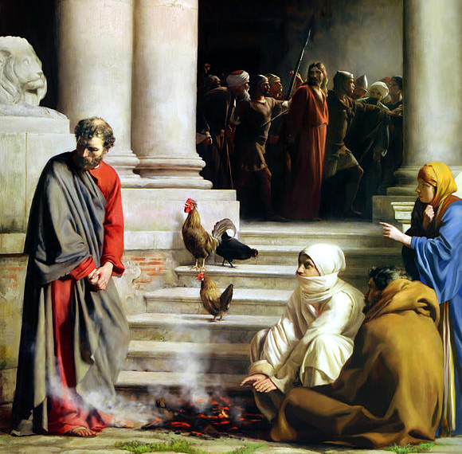
Luke 22
Woman I do not know Him.
This man was with Him too.
Man, I am not!
You are one of them too!

Slide 59
Luke 22
Certainly this man also was with Him
Man, I do not know what you are talking about.

Slide 60
Luke 22
^{Luke 22:60} Immediately, while he was still speaking, a rooster crowed. ⁶¹ The Lord turned and looked at Peter. And Peter remembered the word of the Lord, how He had told him, “Before a rooster crows today, you will deny Me three times.” ⁶² And he went out and wept bitterly.
Certainly this man also was with Him

Slide 61
Luke 22
Quite a transformation!
^{Luke 22:60} Immediately, while he was still speaking, a rooster crowed. ⁶¹ The Lord turned and looked at Peter. And Peter remembered the word of the Lord, how He had told him, “Before a rooster crows today, you will deny Me three times.” ⁶² And he went out and wept bitterly.
Certainly this man also was with Him

Slide 62
Luke 22
Quite a transformation!
These are men who had been changed by the cross
^{Luke 22:60} Immediately, while he was still speaking, a rooster crowed. ⁶¹ The Lord turned and looked at Peter. And Peter remembered the word of the Lord, how He had told him, “Before a rooster crows today, you will deny Me three times.” ⁶² And he went out and wept bitterly.
Certainly this man also was with Him

Slide 63
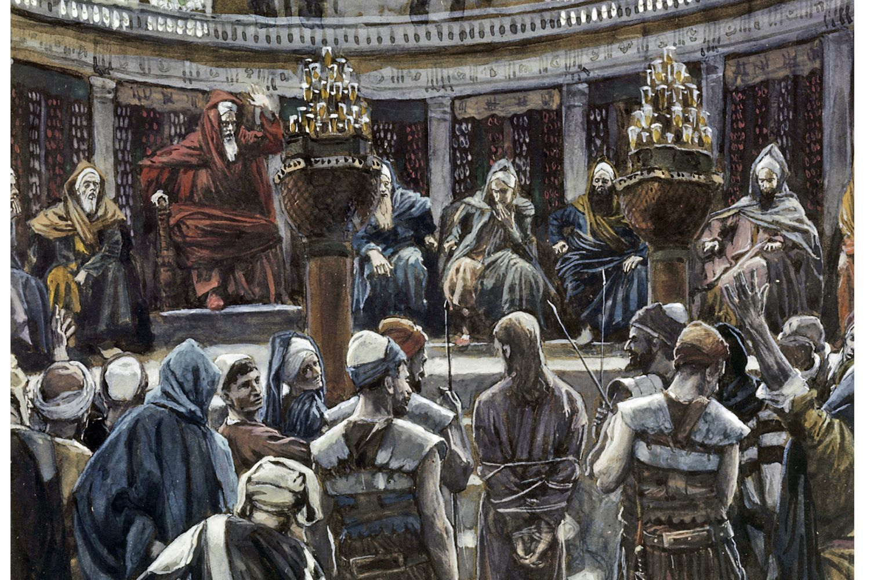
Quite a transformation!
These are men who had been changed by the cross
^{Acts 5:40} They took his advice; and after calling the apostles in, they flogged them and ordered them not to speak in the name of Jesus, and then released them.
^{Acts 5:40} They took his advice; and after calling the apostles in, they flogged them and ordered them not to speak in the name of Jesus, and then released them.
^{Acts 5:41} So they went on their way from the presence of the Council, rejoicing that they had been considered worthy to suffer shame for His name.

Slide 64
The apostles considered it an honor to
suffer for the name of Jesus
^{Acts 5:40} They took his advice; and after calling the apostles in, they flogged them and ordered them not to speak in the name of Jesus, and then released them.
^{Acts 5:40} They took his advice; and after calling the apostles in, they flogged them and ordered them not to speak in the name of Jesus, and then released them.
^{Acts 5:41} So they went on their way from the presence of the Council, rejoicing that they had been considered worthy to suffer shame for His name.
^{Acts 5:41} So they went on their way from the presence of the Council, rejoicing that they had been considered worthy to suffer shame for His name.

Slide 65
The apostles considered it an honor to
suffer for the name of Jesus
^{1 Pet 3:21} For you have been called for this purpose, since Christ also suffered for you, leaving you an example for you to follow in His Steps.
^{Acts 5:40} They took his advice; and after calling the apostles in, they flogged them and ordered them not to speak in the name of Jesus, and then released them.
^{Acts 5:40} They took his advice; and after calling the apostles in, they flogged them and ordered them not to speak in the name of Jesus, and then released them.
^{Acts 5:41} So they went on their way from the presence of the Council, rejoicing that they had been considered worthy to suffer shame for His name.
^{Acts 5:41} So they went on their way from the presence of the Council, rejoicing that they had been considered worthy to suffer shame for His name.

Slide 66
The apostles considered it an honor to
suffer for the name of Jesus
^{1 Pet 3:21} For you have been called for this purpose, since Christ also suffered for you, leaving you an example for you to follow in His Steps.
They understood something about the path of the person they were following
^{Acts 5:40} They took his advice; and after calling the apostles in, they flogged them and ordered them not to speak in the name of Jesus, and then released them.
^{Acts 5:40} They took his advice; and after calling the apostles in, they flogged them and ordered them not to speak in the name of Jesus, and then released them.
^{Acts 5:41} So they went on their way from the presence of the Council, rejoicing that they had been considered worthy to suffer shame for His name.
^{Acts 5:41} So they went on their way from the presence of the Council, rejoicing that they had been considered worthy to suffer shame for His name.

Slide 67
The apostles considered it an honor to
suffer for the name of Jesus
^{1 Pet 3:21} For you have been called for this purpose, since Christ also suffered for you, leaving you an example for you to follow in His Steps.
They understood something about the path of the person they were following
That it was a path of suffering…
^{Acts 5:40} They took his advice; and after calling the apostles in, they flogged them and ordered them not to speak in the name of Jesus, and then released them.
^{Acts 5:40} They took his advice; and after calling the apostles in, they flogged them and ordered them not to speak in the name of Jesus, and then released them.
^{Acts 5:41} So they went on their way from the presence of the Council, rejoicing that they had been considered worthy to suffer shame for His name.
^{Acts 5:41} So they went on their way from the presence of the Council, rejoicing that they had been considered worthy to suffer shame for His name.

Slide 68
The apostles considered it an honor to
suffer for the name of Jesus
^{1 Pet 3:21} For you have been called for this purpose, since Christ also suffered for you, leaving you an example for you to follow in His Steps.
They understood something about the path of the person they were following
That it was a path of suffering…
…that brings life to others!
^{Acts 5:40} They took his advice; and after calling the apostles in, they flogged them and ordered them not to speak in the name of Jesus, and then released them.
^{Acts 5:40} They took his advice; and after calling the apostles in, they flogged them and ordered them not to speak in the name of Jesus, and then released them.
^{Acts 5:41} So they went on their way from the presence of the Council, rejoicing that they had been considered worthy to suffer shame for His name.
^{Acts 5:41} So they went on their way from the presence of the Council, rejoicing that they had been considered worthy to suffer shame for His name.

Slide 69
The apostles considered it an honor to
suffer for the name of Jesus
^{Luke 6:22} Blessed are you when men hate you, and ostracize you, and insult you, and scorn your name as evil, for the sake of the Son of Man. ²³ Be glad in that day and leap for joy, for behold, your reward is great in heaven. For in the same way their fathers used to treat the prophets.
^{Luke 6:22} Blessed are you when men hate you, and ostracize you, and insult you, and scorn your name as evil, for the sake of the Son of Man. ²³ Be glad in that day and leap for joy, for behold, your reward is great in heaven. For in the same way their fathers used to treat the prophets.
^{Acts 5:40} They took his advice; and after calling the apostles in, they flogged them and ordered them not to speak in the name of Jesus, and then released them.
^{Acts 5:40} They took his advice; and after calling the apostles in, they flogged them and ordered them not to speak in the name of Jesus, and then released them.
^{Acts 5:41} So they went on their way from the presence of the Council, rejoicing that they had been considered worthy to suffer shame for His name.
^{Acts 5:41} So they went on their way from the presence of the Council, rejoicing that they had been considered worthy to suffer shame for His name.

Slide 70
The apostles considered it an honor to
suffer for the name of Jesus
^{Luke 6:22} Blessed are you when men hate you, and ostracize you, and insult you, and scorn your name as evil, for the sake of the Son of Man. ²³ Be glad in that day and leap for joy, for behold, your reward is great in heaven. For in the same way their fathers used to treat the prophets.
^{Luke 6:22} Blessed are you when men hate you, and ostracize you, and insult you, and scorn your name as evil, for the sake of the Son of Man. ²³ Be glad in that day and leap for joy, for behold, your reward is great in heaven. For in the same way their fathers used to treat the prophets.
^{Luke 6:22} Blessed are you when men hate you, and ostracize you, and insult you, and scorn your name as evil, for the sake of the Son of Man. ²³ Be glad in that day and leap for joy, for behold, your reward is great in heaven. For in the same way their fathers used to treat the prophets.
^{Acts 5:40} They took his advice; and after calling the apostles in, they flogged them and ordered them not to speak in the name of Jesus, and then released them.
^{Acts 5:40} They took his advice; and after calling the apostles in, they flogged them and ordered them not to speak in the name of Jesus, and then released them.
^{Acts 5:41} So they went on their way from the presence of the Council, rejoicing that they had been considered worthy to suffer shame for His name.
^{Acts 5:41} So they went on their way from the presence of the Council, rejoicing that they had been considered worthy to suffer shame for His name.

Slide 71
The apostles considered it an honor to
suffer for the name of Jesus
^{Luke 6:22} Blessed are you when men hate you, and ostracize you, and insult you, and scorn your name as evil, for the sake of the Son of Man. ²³ Be glad in that day and leap for joy, for behold, your reward is great in heaven. For in the same way their fathers used to treat the prophets.
^{Luke 6:22} Blessed are you when men hate you, and ostracize you, and insult you, and scorn your name as evil, for the sake of the Son of Man. ²³ Be glad in that day and leap for joy, for behold, your reward is great in heaven. For in the same way their fathers used to treat the prophets.
^{Luke 6:22} Blessed are you when men hate you, and ostracize you, and insult you, and scorn your name as evil, for the sake of the Son of Man. ²³ Be glad in that day and leap for joy, for behold, your reward is great in heaven. For in the same way their fathers used to treat the prophets.
^{Luke 6:22} Blessed are you when men hate you, and ostracize you, and insult you, and scorn your name as evil, for the sake of the Son of Man. ²³ Be glad in that day and leap for joy, for behold, your reward is great in heaven. For in the same way their fathers used to treat the prophets.
^{Acts 5:40} They took his advice; and after calling the apostles in, they flogged them and ordered them not to speak in the name of Jesus, and then released them.
^{Acts 5:40} They took his advice; and after calling the apostles in, they flogged them and ordered them not to speak in the name of Jesus, and then released them.
^{Acts 5:41} So they went on their way from the presence of the Council, rejoicing that they had been considered worthy to suffer shame for His name.
^{Acts 5:41} So they went on their way from the presence of the Council, rejoicing that they had been considered worthy to suffer shame for His name.

Slide 72
The apostles considered it an honor to
suffer for the name of Jesus
^{Luke 6:22} Blessed are you when men hate you, and ostracize you, and insult you, and scorn your name as evil, for the sake of the Son of Man. ²³ Be glad in that day and leap for joy, for behold, your reward is great in heaven. For in the same way their fathers used to treat the prophets.
^{Luke 6:22} Blessed are you when men hate you, and ostracize you, and insult you, and scorn your name as evil, for the sake of the Son of Man. ²³ Be glad in that day and leap for joy, for behold, your reward is great in heaven. For in the same way their fathers used to treat the prophets.
^{Luke 6:22} Blessed are you when men hate you, and ostracize you, and insult you, and scorn your name as evil, for the sake of the Son of Man. ²³ Be glad in that day and leap for joy, for behold, your reward is great in heaven. For in the same way their fathers used to treat the prophets.
^{Luke 6:22} Blessed are you when men hate you, and ostracize you, and insult you, and scorn your name as evil, for the sake of the Son of Man. ²³ Be glad in that day and leap for joy, for behold, your reward is great in heaven. For in the same way their fathers used to treat the prophets.
^{Luke 6:22} Blessed are you when men hate you, and ostracize you, and insult you, and scorn your name as evil, for the sake of the Son of Man. ²³ Be glad in that day and leap for joy, for behold, your reward is great in heaven. For in the same way their fathers used to treat the prophets.
^{Acts 5:40} They took his advice; and after calling the apostles in, they flogged them and ordered them not to speak in the name of Jesus, and then released them.
^{Acts 5:40} They took his advice; and after calling the apostles in, they flogged them and ordered them not to speak in the name of Jesus, and then released them.
^{Acts 5:41} So they went on their way from the presence of the Council, rejoicing that they had been considered worthy to suffer shame for His name.
^{Acts 5:41} So they went on their way from the presence of the Council, rejoicing that they had been considered worthy to suffer shame for His name.

Slide 73
The apostles considered it an honor to
suffer for the name of Jesus
^{Luke 6:22} Blessed are you when men hate you, and ostracize you, and insult you, and scorn your name as evil, for the sake of the Son of Man. ²³ Be glad in that day and leap for joy, for behold, your reward is great in heaven. For in the same way their fathers used to treat the prophets.
^{Luke 6:22} Blessed are you when men hate you, and ostracize you, and insult you, and scorn your name as evil, for the sake of the Son of Man. ²³ Be glad in that day and leap for joy, for behold, your reward is great in heaven. For in the same way their fathers used to treat the prophets.
^{Luke 6:22} Blessed are you when men hate you, and ostracize you, and insult you, and scorn your name as evil, for the sake of the Son of Man. ²³ Be glad in that day and leap for joy, for behold, your reward is great in heaven. For in the same way their fathers used to treat the prophets.
^{Luke 6:22} Blessed are you when men hate you, and ostracize you, and insult you, and scorn your name as evil, for the sake of the Son of Man. ²³ Be glad in that day and leap for joy, for behold, your reward is great in heaven. For in the same way their fathers used to treat the prophets.
^{Luke 6:22} Blessed are you when men hate you, and ostracize you, and insult you, and scorn your name as evil, for the sake of the Son of Man. ²³ Be glad in that day and leap for joy, for behold, your reward is great in heaven. For in the same way their fathers used to treat the prophets.
You’re suffering in good company!
^{Acts 5:40} They took his advice; and after calling the apostles in, they flogged them and ordered them not to speak in the name of Jesus, and then released them.
^{Acts 5:40} They took his advice; and after calling the apostles in, they flogged them and ordered them not to speak in the name of Jesus, and then released them.
^{Acts 5:41} So they went on their way from the presence of the Council, rejoicing that they had been considered worthy to suffer shame for His name.
^{Acts 5:41} So they went on their way from the presence of the Council, rejoicing that they had been considered worthy to suffer shame for His name.

Slide 74
The apostles considered it an honor to
suffer for the name of Jesus
^{1Pet 4:13} but to the degree that you share the sufferings of Christ, keep on rejoicing,
koinoneo:
^{Acts 5:40} They took his advice; and after calling the apostles in, they flogged them and ordered them not to speak in the name of Jesus, and then released them.
^{Acts 5:40} They took his advice; and after calling the apostles in, they flogged them and ordered them not to speak in the name of Jesus, and then released them.
^{Acts 5:41} So they went on their way from the presence of the Council, rejoicing that they had been considered worthy to suffer shame for His name.
^{Acts 5:41} So they went on their way from the presence of the Council, rejoicing that they had been considered worthy to suffer shame for His name.

Slide 75
The apostles considered it an honor to
suffer for the name of Jesus
They were honored to have solidarity with Christ!
^{1Pet 4:13} but to the degree that you share the sufferings of Christ, keep on rejoicing,
koinoneo:
^{Acts 5:40} They took his advice; and after calling the apostles in, they flogged them and ordered them not to speak in the name of Jesus, and then released them.
^{Acts 5:40} They took his advice; and after calling the apostles in, they flogged them and ordered them not to speak in the name of Jesus, and then released them.
^{Acts 5:41} So they went on their way from the presence of the Council, rejoicing that they had been considered worthy to suffer shame for His name.
^{Acts 5:41} So they went on their way from the presence of the Council, rejoicing that they had been considered worthy to suffer shame for His name.

Slide 76
The apostles considered it an honor to
suffer for the name of Jesus
They knew that they were suffering for a purpose that really mattered
^{1Pet 4:13} but to the degree that you share the sufferings of Christ, keep on rejoicing,
koinoneo:
^{Acts 5:40} They took his advice; and after calling the apostles in, they flogged them and ordered them not to speak in the name of Jesus, and then released them.
^{Acts 5:40} They took his advice; and after calling the apostles in, they flogged them and ordered them not to speak in the name of Jesus, and then released them.
^{Acts 5:41} So they went on their way from the presence of the Council, rejoicing that they had been considered worthy to suffer shame for His name.
^{Acts 5:41} So they went on their way from the presence of the Council, rejoicing that they had been considered worthy to suffer shame for His name.

Slide 77
Resulted in a mindset that was
ready to suffer with joy!
^{Acts 5:40} They took his advice; and after calling the apostles in, they flogged them and ordered them not to speak in the name of Jesus, and then released them.
^{Acts 5:40} They took his advice; and after calling the apostles in, they flogged them and ordered them not to speak in the name of Jesus, and then released them.
^{Acts 5:41} So they went on their way from the presence of the Council, rejoicing that they had been considered worthy to suffer shame for His name.
^{Acts 5:41} So they went on their way from the presence of the Council, rejoicing that they had been considered worthy to suffer shame for His name.

Slide 78
Resulted in a mindset that was
ready to suffer with joy!
Relevance for us?
^{Acts 5:41} So they went on their way from the presence of the Council, rejoicing that they had been considered worthy to suffer shame for His name.

Slide 79
Resulted in a mindset that was
ready to suffer with joy!
Relevance for us?
Persecution remains a major challenge or the church today
^{Acts 5:41} So they went on their way from the presence of the Council, rejoicing that they had been considered worthy to suffer shame for His name.

Slide 80
Resulted in a mindset that was
ready to suffer with joy!
Relevance for us?
Even if you’re never persecuted, if you’re going to follow His footsteps, then you will be acquainted with suffering

Slide 81
Resulted in a mindset that was
ready to suffer with joy!
Relevance for us?
Even if you’re never persecuted, if you’re going to follow His footsteps, then you will be acquainted with suffering
Any time you step out in His name, and it costs you something, you are sharing in the sufferings of Christ!

Slide 82
Resulted in a mindset that was
ready to suffer with joy!
Relevance for us?
Even if you’re never persecuted, if you’re going to follow His footsteps, then you will be acquainted with suffering
Any time you step out in His name, and it costs you something, you are sharing in the sufferings of Christ!
Therefore: this attitude is essential equipment for our mission and ministry today!

Slide 83
Resulted in a mindset that was
ready to suffer with joy!
Relevance for us?
This attitude doesn’t come naturally to us, but that makes it all the more important to strive for …
Therefore: this attitude is essential equipment for our mission and ministry today!

Slide 84
Resulted in a mindset that was
ready to suffer with joy!
Relevance for us?
This attitude doesn’t come naturally to us, but that makes it all the more important to strive for …
What would happen if we adopted their mentality toward suffering in our ministry?
Therefore: this attitude is essential equipment for our mission and ministry today!

Slide 85
Resulted in a mindset that was
ready to suffer with joy!
^{1 Pet 4:1} Therefore, since Christ has suffered in the flesh, arm yourselves also with the same purpose, because he who has suffered in the flesh has ceased from sin, ² so as to live the rest of the time in the flesh no longer for the lusts of men, but for the will of God.
Therefore: this attitude is essential equipment for our mission and ministry today!

Slide 86
Resulted in a mindset that was
ready to suffer with joy!
hoplizo: “to make ready, to equip”
^{1 Pet 4:1} Therefore, since Christ has suffered in the flesh, arm yourselves also with the same purpose, because he who has suffered in the flesh has ceased from sin, ² so as to live the rest of the time in the flesh no longer for the lusts of men, but for the will of God.
Therefore: this attitude is essential equipment for our mission and ministry today!

Slide 87
Resulted in a mindset that was
ready to suffer with joy!
hoplizo: “to make ready, to equip”
“Take up this attitude like you take up a weapon in hand!”
^{1 Pet 4:1} Therefore, since Christ has suffered in the flesh, arm yourselves also with the same purpose, because he who has suffered in the flesh has ceased from sin, ² so as to live the rest of the time in the flesh no longer for the lusts of men, but for the will of God.
Therefore: this attitude is essential equipment for our mission and ministry today!

Slide 88
Resulted in a mindset that was
ready to suffer with joy!
hoplizo: “to make ready, to equip”
“Take up this attitude like you take up a weapon in hand!”
Implication: this attitude is a CHOICE
^{1 Pet 4:1} Therefore, since Christ has suffered in the flesh, arm yourselves also with the same purpose, because he who has suffered in the flesh has ceased from sin, ² so as to live the rest of the time in the flesh no longer for the lusts of men, but for the will of God.
Therefore: this attitude is essential equipment for our mission and ministry today!

Slide 89
Resulted in a mindset that was
ready to suffer with joy!
“Take up this attitude like you take up a weapon in hand!”
Implication: this attitude is a CHOICE
^{1 Pet 4:1} Therefore, since Christ has suffered in the flesh, arm yourselves also with the same purpose, because he who has suffered in the flesh has ceased from sin, ² so as to live the rest of the time in the flesh no longer for the lusts of men, but for the will of God.
^{1 Pet 4:1} Therefore, since Christ has suffered in the flesh, arm yourselves also with the same purpose, because he who has suffered in the flesh has ceased from sin, ² so as to live the rest of the time in the flesh no longer for the lusts of men, but for the will of God.
Therefore: this attitude is essential equipment for our mission and ministry today!

Slide 90
Resulted in a mindset that was
ready to suffer with joy!
You can live your life for your appetites and desires, or you can live for something much greater!
“Take up this attitude like you take up a weapon in hand!”
Implication: this attitude is a CHOICE
^{1 Pet 4:1} Therefore, since Christ has suffered in the flesh, arm yourselves also with the same purpose, because he who has suffered in the flesh has ceased from sin, ² so as to live the rest of the time in the flesh no longer for the lusts of men, but for the will of God.
^{1 Pet 4:1} Therefore, since Christ has suffered in the flesh, arm yourselves also with the same purpose, because he who has suffered in the flesh has ceased from sin, ² so as to live the rest of the time in the flesh no longer for the lusts of men, but for the will of God.
Therefore: this attitude is essential equipment for our mission and ministry today!

Slide 91
“the purpose of my life is to be as comfortable as possible for as long as possible.”

Slide 92
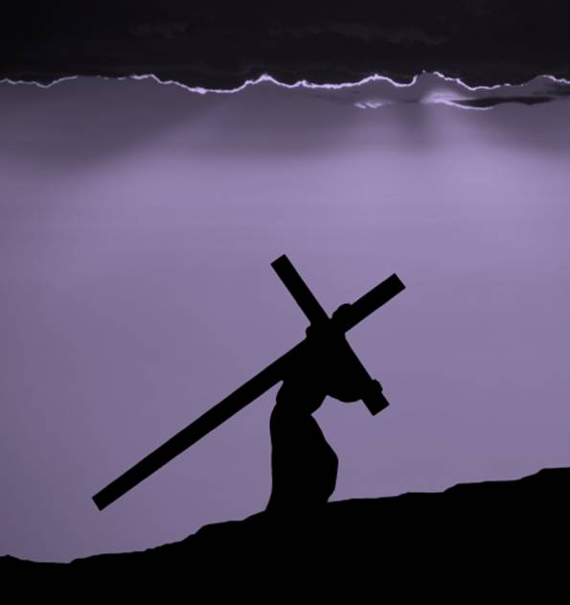
Suffering
“the purpose of my life is to be as comfortable as possible for as long as possible.”
How does knowing I share in Christ’s suffering help?
Suffering
Suffering
Suffering
Suffering
Suffering
Suffering
Suffering

Slide 93
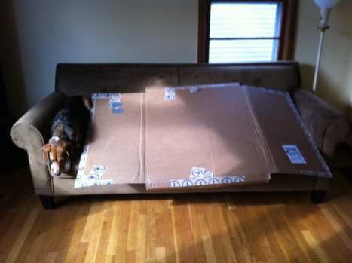
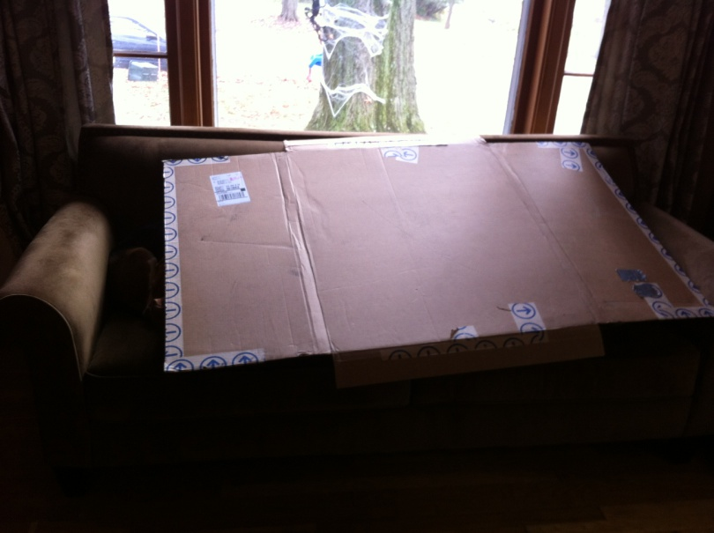
“the purpose of my life is to be as comfortable as possible for as long as possible.”

Slide 94
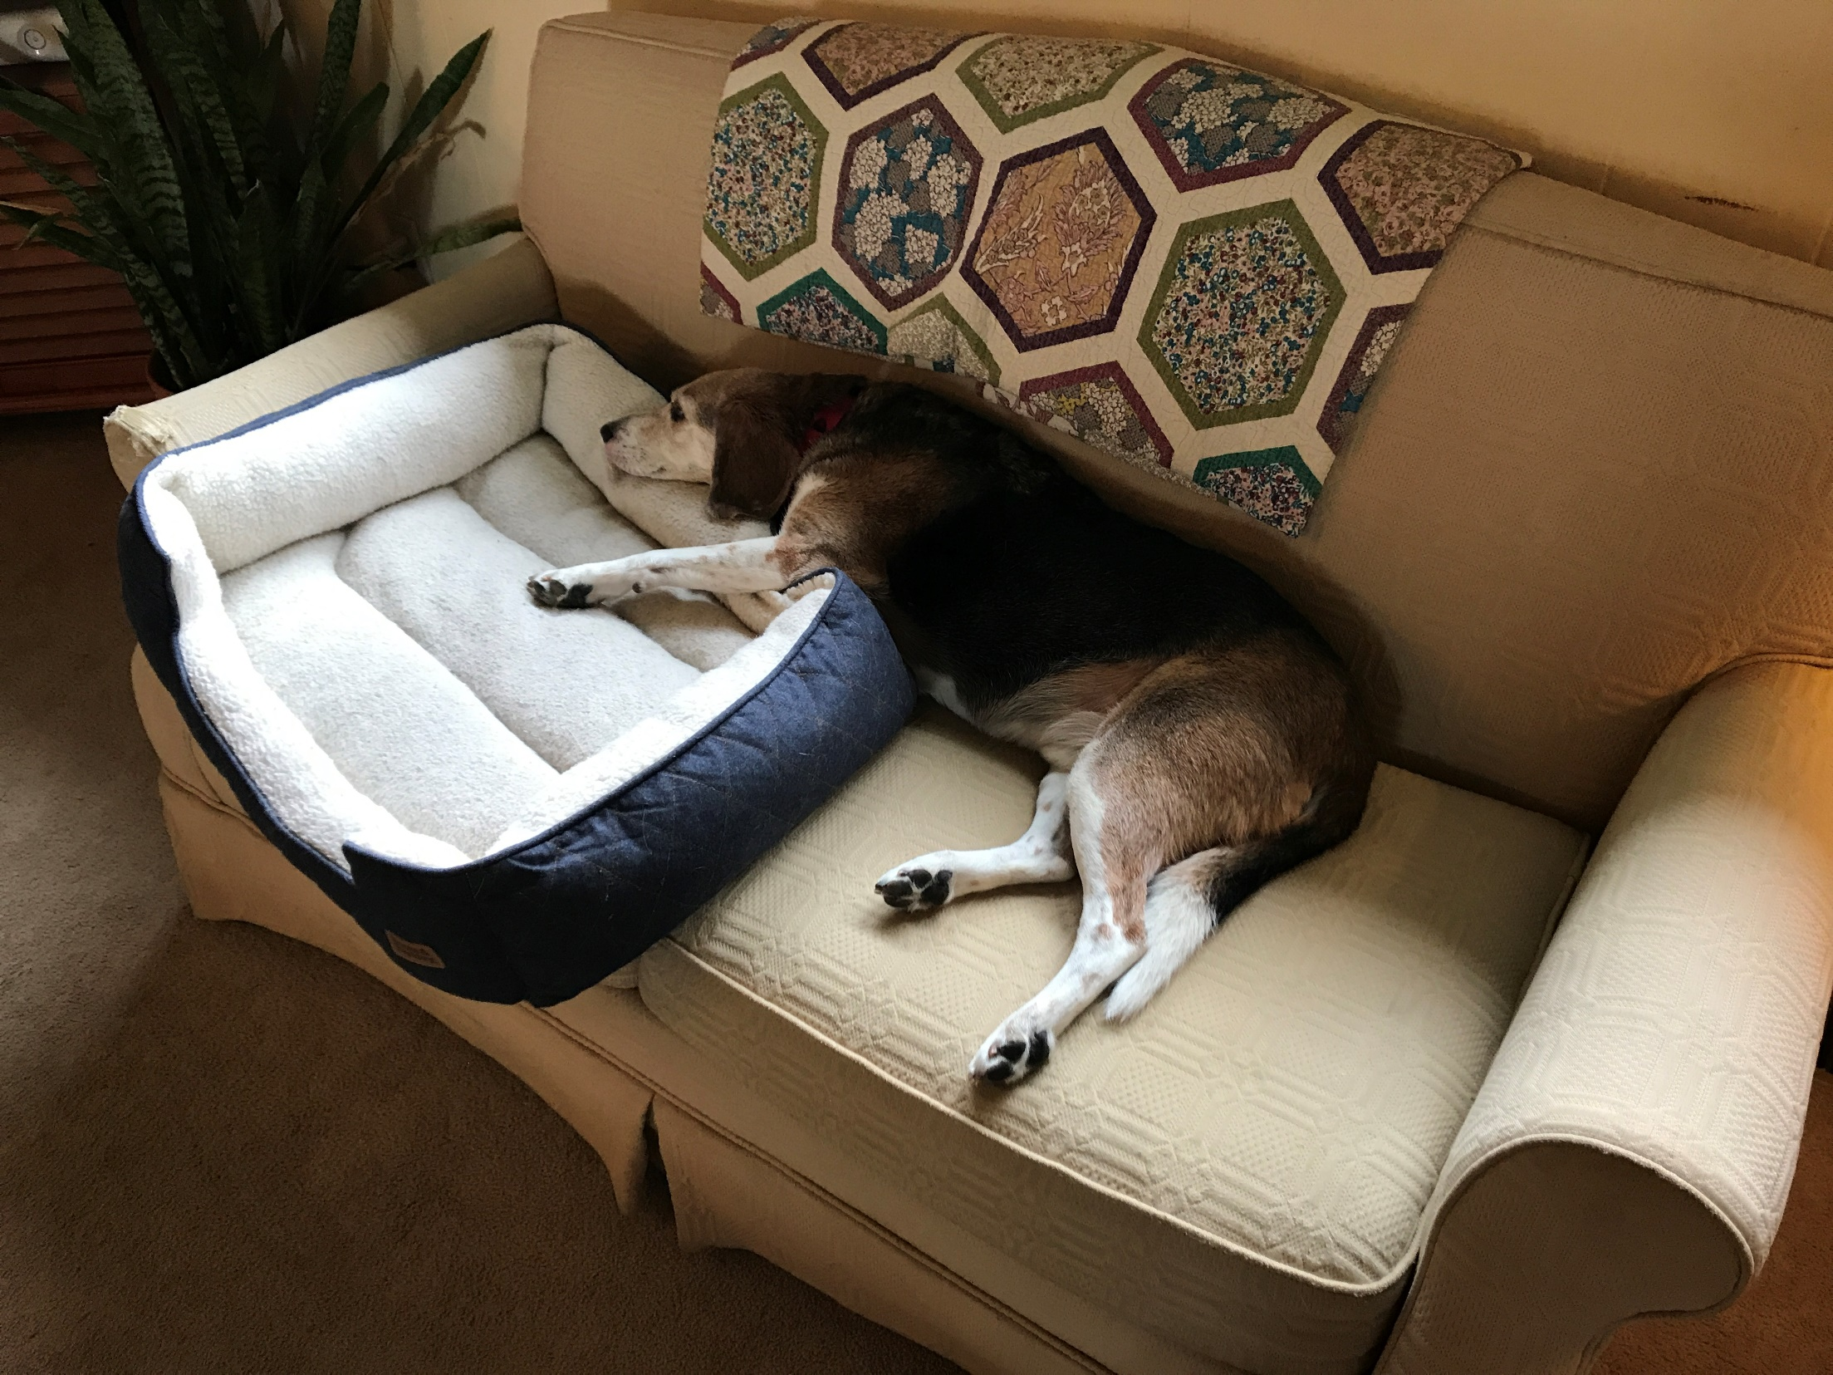
“the purpose of my life is to be as comfortable as possible for as long as possible.”

Slide 95
“the purpose of my life is to be as comfortable as possible for as long as possible.”
Willing to go to any length in the name of comfort… ALL of his resources are devoted to the cause

Slide 96
“the purpose of my life is to be as comfortable as possible for as long as possible.”
“A trouble-free life is the norm that I deserve and expect, and if I get it I will be happy”

Slide 97
“the purpose of my life is to be as comfortable as possible for as long as possible.”
“A trouble-free life is the norm that I deserve and expect, and if I get it I will be happy”
And how’s that working out?

Slide 98
So you can live your life for comfort, and you will be empty when you get it, and miserable when you don’t…

Slide 99
So you can live your life for comfort, and you will be empty when you get it, and miserable when you don’t…
^{1 Pet 4:1} Therefore, since Christ has suffered in the flesh, arm yourselves also with the same purpose, because he who has suffered in the flesh has ceased from sin, ² so as to live the rest of the time in the flesh no longer for the lusts of men, but for the will of God.
^{1 Pet 4:1} Therefore, since Christ has suffered in the flesh, arm yourselves also with the same purpose, because he who has suffered in the flesh has ceased from sin, ² so as to live the rest of the time in the flesh no longer for the lusts of men, but for the will of God.
^{1 Pet 4:1} Therefore, since Christ has suffered in the flesh, arm yourselves also with the same purpose, because he who has suffered in the flesh has ceased from sin, ² so as to live the rest of the time in the flesh no longer for the lusts of men, but for the will of God.

Slide 100
So you can live your life for comfort, and you will be empty when you get it, and miserable when you don’t…
Or you can live for something that matters
^{1 Pet 4:1} Therefore, since Christ has suffered in the flesh, arm yourselves also with the same purpose, because he who has suffered in the flesh has ceased from sin, ² so as to live the rest of the time in the flesh no longer for the lusts of men, but for the will of God.
^{1 Pet 4:1} Therefore, since Christ has suffered in the flesh, arm yourselves also with the same purpose, because he who has suffered in the flesh has ceased from sin, ² so as to live the rest of the time in the flesh no longer for the lusts of men, but for the will of God.
^{1 Pet 4:1} Therefore, since Christ has suffered in the flesh, arm yourselves also with the same purpose, because he who has suffered in the flesh has ceased from sin, ² so as to live the rest of the time in the flesh no longer for the lusts of men, but for the will of God.

Slide 101
So you can live your life for comfort, and you will be empty when you get it, and miserable when you don’t…
Or you can live for something that matters
^{1 Pet 4:1} Therefore, since Christ has suffered in the flesh, arm yourselves also with the same purpose, because he who has suffered in the flesh has ceased from sin, ² so as to live the rest of the time in the flesh no longer for the lusts of men, but for the will of God.
^{1 Pet 4:1} Therefore, since Christ has suffered in the flesh, arm yourselves also with the same purpose, because he who has suffered in the flesh has ceased from sin, ² so as to live the rest of the time in the flesh no longer for the lusts of men, but for the will of God.
^{1 Pet 4:1} Therefore, since Christ has suffered in the flesh, arm yourselves also with the same purpose, because he who has suffered in the flesh has ceased from sin, ² so as to live the rest of the time in the flesh no longer for the lusts of men, but for the will of God.
Which will cost you some comfort

Slide 102
Suffering
PURPOSE
How does knowing I share in Christ’s suffering help?
Suffering
Suffering
Suffering
Suffering
Suffering
Suffering
Suffering
Some things are worth suffering for!

Slide 103
When we choose an attitude of readiness to suffer in Christ’s name, we equip a powerful weapon!

Slide 104
Watchman Nee – Have a Mind to Suffer
Having the mind to suffer speaks of my readiness before God to suffer. I am willing to go through trial, and I choose the path of hardship. It is up to the Lord whether or not to put suffering in my path, but on my part I am always prepared to suffer … The problem we face is that many brothers and sisters shrink back at the slightest provocation.
When we choose an attitude of readiness to suffer in Christ’s name, we equip a powerful weapon!

Slide 105
They do not possess the mind to suffer. When the Lord arranges to let us have a favorable environment, without any lack in material things, and with a relatively healthy body, we can serve Him daily and well. But once we encounter a little trial and meet up with the slightest trivial problem, our whole being collapses. This betrays the fact that we do not have the heart to suffer. How can we possibly stand any test if we do not have such a heart?
When we choose an attitude of readiness to suffer in Christ’s name, we equip a powerful weapon!

Slide 106
A person who lacks this character attitude shall find his labor in the Lord limited. For when the outside demand exceeds his ability, he will immediately withdraw. He is unable to sacrifice at all. He can only be engaged in the smoothest service during the most convenient days. He needs the Lord to remove all the obstacles for him so that he may work peacefully. Yet how surprising that a person who serves the Lord should make such a demand.
When we choose an attitude of readiness to suffer in Christ’s name, we equip a powerful weapon!

Slide 107
A person who lacks this character attitude shall find his labor in the Lord limited. For when the outside demand exceeds his ability, he will immediately withdraw. He is unable to sacrifice at all. He can only be engaged in the smoothest service during the most convenient days. He needs the Lord to remove all the obstacles for him so that he may work peacefully. Yet how surprising that a person who serves the Lord should make such a demand.
Think of the limited range of things he can actually ask you to do!
When we choose an attitude of readiness to suffer in Christ’s name, we equip a powerful weapon!

Slide 108
This effectively neutralizes us!
An opportunity to do something good

Slide 109
This effectively neutralizes us!
Possibility of failure
Not in my routine
inconvenient
Don’t have time
God didn’t put it on my heart
It sounds hard
An opportunity to do something good
Potentially exposes a weakness
Might be uncomfortable
Not my “gifting”

Slide 110
The result is we don’t do it at all!
This effectively neutralizes us!
Possibility of failure
Not in my routine
inconvenient
Don’t have time
God didn’t put it on my heart
It sounds hard
An opportunity to do something good
Potentially exposes a weakness
Might be uncomfortable
Not my “gifting”

Slide 111
Is there a decision that you have been holding back on because it probably will include some discomfort?

Slide 112
If we head into our ministry with zero-tolerance for suffering, then we will be stymied and accomplish little.

Slide 113
If we head into our ministry with zero-tolerance for suffering, then we will be stymied and accomplish little.
But when we adopt a “mind to suffer,” even in minor ways, we free God’s hands to use us readily, and to realize the full potential He has in mind for each of us!

Slide 114
If we head into our ministry with zero-tolerance for suffering, then we will be stymied and accomplish little.
But when we adopt a “mind to suffer,” even in minor ways, we free God’s hands to use us readily, and to realize the full potential He has in mind for each of us!
“Yet this is an awesome weapon, before which Satan is unquestionably bound.”

Slide 115
If we head into our ministry with zero-tolerance for suffering, then we will be stymied and accomplish little.
But when we adopt a “mind to suffer,” even in minor ways, we free God’s hands to use us readily, and to realize the full potential He has in mind for each of us!
“Yet this is an awesome weapon, before which Satan is unquestionably bound.”
Let’s take up this awesome weapon!

Slide 116
^{Acts 5:40} They took his advice; and after calling the apostles in, they flogged them and ordered them not to speak in the name of Jesus, and then released them.
^{Acts 5:40} They took his advice; and after calling the apostles in, they flogged them and ordered them not to speak in the name of Jesus, and then released them.
^{Acts 5:41} So they went on their way from the presence of the Council, rejoicing that they had been considered worthy to suffer shame for His name.
^{Acts 5:41} So they went on their way from the presence of the Council, rejoicing that they had been considered worthy to suffer shame for His name.
^{Acts 5:42} And every day, in the temple and from house to house, they kept right on teaching and preaching Jesus as the Christ.

Slide 117
Acts
The Church in Jerusalem
Next week:
Another challenge to the church

