Slide 2
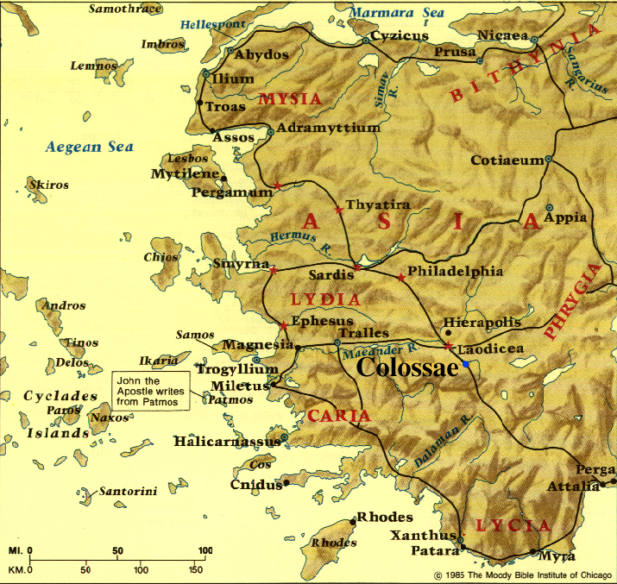

Slide 3
FALSE TEACHERS: “Jesus was only a junior spirit”

Slide 4
FALSE TEACHERS: “Jesus was only a junior spirit”
PAUL: “Jesus is God-incarnate – fully divine & fully human” (2:9)

Slide 5
FALSE TEACHERS: “Jesus’ death on the cross was spiritually insignificant”

Slide 6
FALSE TEACHERS: “Jesus’ death on the cross was spiritually insignificant”
PAUL: “Jesus’ death on the cross accomplished our full salvation” (2:10-15)

Slide 7
FALSE TEACHERS: “Spiritual development requires adherence to several religious practices”

Slide 8
FALSE TEACHERS: “Spiritual development requires adherence to several religious practices”
PAUL: “These religious practices are unnecessary & counter-productive to spiritual development” (2:16-23)

Slide 9
Colossians 2:16-23 3 Deadly Detours
RITUALISM
MYSTICISM
LEGALISM

Slide 10
Colossians 2:16-23 3 Deadly Detours
RITUALISM: relating to God primarily through prescribed rituals
^{2:16} Therefore no one is to act as your judge in regard to food or drink or in respect to a festival or a new moon or a Sabbath day—¹⁷ things which are a mere shadow of what is to come; but the substance belongs to Christ.

Slide 11
Colossians 2:16-23 3 Deadly Detours
RITUALISM: relating to God primarily through prescribed rituals
^{2:16} Therefore no one is to act as your judge in regard to food or drink or in respect to a festival or a new moon or a Sabbath day—¹⁷ things which are a mere shadow of what is to come; but the substance belongs to Christ.

Slide 12
Colossians 2:16-23 3 Deadly Detours
RITUALISM: relating to God primarily through prescribed rituals
^{2:16} Therefore no one is to act as your judge in regard to food or drink or in respect to a festival or a new moon or a Sabbath day—¹⁷ things which are a mere shadow of what is to come; but the substance belongs to Christ.
Tabernacle & Temple
Clean/unclean laws
Human priesthood
Animal sacrifices
Liturgy & religious calendar

Slide 13
Colossians 2:16-23 3 Deadly Detours
RITUALISM: relating to God primarily through prescribed rituals
^{2:16} Therefore no one is to act as your judge in regard to food or drink or in respect to a festival or a new moon or a Sabbath day—¹⁷ things which are a mere shadow of what is to come; but the substance belongs to Christ.
Jesus is God’s unique Temple & true Priest
Jesus’ death purchases our full forgiveness
Jesus’ Spirit now indwells all believers to enable us to relate personally to God

Slide 14
Colossians 2:16-23 3 Deadly Detours
RITUALISM: relating to God primarily through prescribed rituals
^{Galatians 4:4} But when the fullness of the time came, God sent forth His Son . . . ⁵ so that He might redeem those who were under the Law, that we might receive the adoption as sons. ⁶ Because you are sons, God has sent forth the Spirit of His Son into our hearts, crying, “Abba! Father!”

Slide 15
Colossians 2:16-23 3 Deadly Detours
RITUALISM: relating to God primarily through prescribed rituals
Hundreds of rituals vs. 2 rituals
^{Galatians 4:4} But when the fullness of the time came, God sent forth His Son . . . ⁵ so that He might redeem those who were under the Law, that we might receive the adoption as sons. ⁶ Because you are sons, God has sent forth the Spirit of His Son into our hearts, crying, “Abba! Father!”

Slide 16
Colossians 2:16-23 3 Deadly Detours
RITUALISM: relating to God primarily through prescribed rituals
Hundreds of rituals vs. 2 rituals
Detailed ritual instruction vs. little instruction
^{Galatians 4:4} But when the fullness of the time came, God sent forth His Son . . . ⁵ so that He might redeem those who were under the Law, that we might receive the adoption as sons. ⁶ Because you are sons, God has sent forth the Spirit of His Son into our hearts, crying, “Abba! Father!”

Slide 17
Colossians 2:16-23 3 Deadly Detours
RITUALISM: relating to God primarily through prescribed rituals
^{Galatians 4:9} But now that you have come to know God, or rather to be known by God, how is it that you turn back again to the weak and worthless elemental things, to which you desire to be enslaved all over again? ¹⁰ You observe days and months and seasons and years. ¹¹ I fear for you, that perhaps I have labored over you in vain.

Slide 18
Colossians 2:16-23 3 Deadly Detours
MYSTICISM: seeking dramatic spiritual experiences as a key/proof of spiritual maturity
^{2:18} Let no one keep defrauding you of your prize by delighting in self-abasement and the worship of the angels, taking his stand on visions he has seen, inflated without cause by his fleshly mind . . .

Slide 19
Colossians 2:16-23 3 Deadly Detours
MYSTICISM: seeking dramatic spiritual experiences as a key/proof of spiritual maturity
Vulnerability to spiritual deception!!
^{2:18} Let no one keep defrauding you of your prize by delighting in self-abasement and the worship of the angels, taking his stand on visions he has seen, inflated without cause by his fleshly mind . . .

Slide 20
Colossians 2:16-23 3 Deadly Detours
MYSTICISM: seeking dramatic spiritual experiences as a key/proof of spiritual maturity
Vulnerability to spiritual deception!!
Not proof of spiritual maturity!!
^{2:18} Let no one keep defrauding you of your prize by delighting in self-abasement and the worship of the angels, taking his stand on visions he has seen, inflated without cause by his fleshly mind . . .

Slide 21
Colossians 2:16-23 3 Deadly Detours
MYSTICISM: seeking dramatic spiritual experiences as a key/proof of spiritual maturity
^{2:19} . . . and not holding fast to the Head, from whom the entire body, being supplied and held together by the joints and ligaments, grows with a growth which is from God.

Slide 22
Colossians 2:16-23 3 Deadly Detours
MYSTICISM: seeking dramatic spiritual experiences as a key/proof of spiritual maturity
Relate to Jesus by abiding in His Word (Jn. 15:5,7)
^{2:19} . . . and not holding fast to the Head, from whom the entire body, being supplied and held together by the joints and ligaments, grows with a growth which is from God.

Slide 23
Colossians 2:16-23 3 Deadly Detours
MYSTICISM: seeking dramatic spiritual experiences as a key/proof of spiritual maturity
Relate to Jesus by abiding in His Word (Jn. 15:5,7)
Allow other Christians to communicate God’s truth & love (Eph. 4:15,16)
^{2:19} . . . and not holding fast to the Head, from whom the entire body, being supplied and held together by the joints and ligaments, grows with a growth which is from God.

Slide 24
Colossians 2:16-23 3 Deadly Detours
LEGALISM: emphasizing extra-biblical rules & prohibitions as requirements for spirituality
^{2:20} If you have died with Christ to the elementary principles of the world, why, as if you were living in the world, do you submit yourself to decrees, such as, ²¹ “Do not handle, do not taste, do not touch!” ²² (which all refer to things destined to perish with use)—in accordance with human commandments and teachings?

Slide 25
Colossians 2:16-23 3 Deadly Detours
LEGALISM: emphasizing extra-biblical rules & prohibitions as requirements for spirituality
The “logic” of legalism: “If X is sinful, then make rules against activities that might tempt you/others to do X”
^{2:20} If you have died with Christ to the elementary principles of the world, why, as if you were living in the world, do you submit yourself to decrees, such as, ²¹ “Do not handle, do not taste, do not touch!” ²² (which all refer to things destined to perish with use)—in accordance with human commandments and teachings?

Slide 26
Colossians 2:16-23 3 Deadly Detours
LEGALISM: emphasizing extra-biblical rules & prohibitions as requirements for spirituality
Unnecessary because we have God’s Word & the Holy Spirit to protect us
^{2:20} If you have died with Christ to the elementary principles of the world, why, as if you were living in the world, do you submit yourself to decrees, such as, ²¹ “Do not handle, do not taste, do not touch!” ²² (which all refer to things destined to perish with use)—in accordance with human commandments and teachings?

Slide 27
Colossians 2:16-23 3 Deadly Detours
LEGALISM: emphasizing extra-biblical rules & prohibitions as requirements for spirituality
Needlessly alienates non-Christians
^{2:20} If you have died with Christ to the elementary principles of the world, why, as if you were living in the world, do you submit yourself to decrees, such as, ²¹ “Do not handle, do not taste, do not touch!” ²² (which all refer to things destined to perish with use)—in accordance with human commandments and teachings?

Slide 28
Colossians 2:16-23 3 Deadly Detours
LEGALISM: emphasizing extra-biblical rules & prohibitions as requirements for spirituality
Defines spirituality negatively vs. positively (Gal. 5:22,23; Rom. 14:17)
^{2:20} If you have died with Christ to the elementary principles of the world, why, as if you were living in the world, do you submit yourself to decrees, such as, ²¹ “Do not handle, do not taste, do not touch!” ²² (which all refer to things destined to perish with use)—in accordance with human commandments and teachings?

Slide 29
Colossians 2:16-23 3 Deadly Detours
RITUALISM
MYSTICISM
LEGALISM
^{2:23} These are matters which have, to be sure, the appearance of wisdom in self-made religion and self-abasement and severe treatment of the body, but are of no value against fleshly indulgence (i.e., a self-centered lifestyle).

Slide 30
NEXT WEEK:
Colossians 3:1–4 Keys to Authentic Spirituality – Part 1

