Slide 1
Knowing God, Bearing Fruit
Colossians 1:1-12

Slide 2
Colossians 1
¹ This letter is from Paul, chosen by the will of God to be an apostle of Christ Jesus, and from our brother Timothy.
² We are writing to God’s holy people in the city of Colossae, who are faithful brothers and sisters in Christ.
May God our Father give you grace and peace.

Slide 3
Colossians 1
¹ This letter is from Paul, chosen by the will of God to be an apostle of Christ Jesus, and from our brother Timothy.
² We are writing to God’s holy people in the city of Colossae, who are faithful brothers and sisters in Christ.
May God our Father give you grace and peace.
Paul and Timothy, from a Roman prison (60-62 AD)
Carried by Tychicus (Colossians 4:7-8)

Slide 4
Colossians 1
¹ This letter is from Paul, chosen by the will of God to be an apostle of Christ Jesus, and from our brother Timothy.
² We are writing to God’s holy people in the city of Colossae, who are faithful brothers and sisters in Christ.
May God our Father give you grace and peace.
Not mentioned in Acts or started by Paul (Colossians 2:1)
Planted by Epaphras (Colossians 1:7)

Slide 5
[Paul] held daily discussions at the lecture hall of Tyrannus.
This went on for the next two years,

Slide 6
so that people throughout the province of Asia—both Jews and Greeks—heard the word of the Lord. (Acts 19:9-10; cf. Rev 2-3)

Slide 7
Epaphras (and Philemon?) go to Colossae (Col. 4:12; Phm. 19)
Tychicus and Onesimus return with at least 3 letters (Colossians 4:16; Philemon 1)

Slide 8
The False Teaching at Colosse
Jewish – Circumcision, dietary laws, and holy days (2:11, 14, 16, 17)
A “philosophy” (2:8), related to Gnosticism? (1:27; 2:2-3; 1:19; 2:9)
Visions and angels (2:18)
Asceticism (2:20-23)
The Solution: Jesus Christ

Slide 9
Colossians 1
³ We give thanks to God, (1:4-8) the Father of our Lord Jesus Christ, praying always for you (1:9-12)
1. We Thank God For You

Slide 10
Colossians 1
⁴ since we heard of your faith in Christ Jesus and the love which you have for all the saints;
⁵ because of the hope laid up for you in heaven
1. We Thank God For You

Slide 11
Colossians 1
⁴ since we heard of your faith in Christ Jesus and the love which you have for all the saints;
⁵ because of the hope laid up for you in heaven
Giving of myself
Trust in Christ
Confident expectation
A common trio
Evidence of God’s work in their lives
1. We Thank God For You

Slide 12
Colossians 1
⁴ since we heard of your faith in Christ Jesus and the love which you have for all the saints;
⁵ because of the hope laid up for you in heaven
Giving of myself
Trust in Christ
Confident expectation
Faith looks back
Hope looks ahead
Love looks around
1. We Thank God For You

Slide 13
Colossians 1
⁴ since we heard of your faith in Christ Jesus and the love which you have for all the saints;
⁵ because of the hope laid up for you in heaven
of which you previously heard in the word of truth, the good news [“gospel”]
1. We Thank God For You

Slide 14
Colossians 1
⁴ since we heard of your faith in Christ Jesus and the love which you have for all the saints;
⁵ because of the hope laid up for you in heaven
of which you previously heard in the word of truth, the good news [“gospel”]
Jesus: “I am the way, the truth and the life” (John 14:6)
God is knowable
Focus on his revealed word, esp. the good news
1. We Thank God For You

Slide 15
Colossians 1
6 The good news has come to you, just as in all the world also it is constantly bearing fruit and increasing,
even as it has been doing in you also since the day you heard of it and understood the grace of God in truth;
1. We Thank God For You

Slide 16
Colossians 1
6 The good news has come to you, just as in all the world also it is constantly bearing fruit and increasing,
even as it has been doing in you also since the day you heard of it and understood the grace of God in truth;
The seed that fell on good soil represents those who truly hear and understand God’s word and produce a harvest (Matthew 13:23)
Other seeds fell on fertile soil, and they sprouted, grew, and produced a crop… (Mark 4:8)
1. We Thank God For You

Slide 17
Colossians 1
6 The good news has come to you, just as in all the world also it is constantly bearing fruit and increasing,
even as it has been doing in you also since the day you heard of it and understood the grace of God in truth;
How does the good news bear fruit?
Numerical and qualitative growth (Acts 6:7; 1 Peter 2:2)
My story and others
By the power of God
1. We Thank God For You

Slide 18
Colossians 1
6 The good news has come to you, just as in all the world also it is constantly bearing fruit and increasing,
even as it has been doing in you also since the day you heard of it and understood the grace of God in truth;
What role do we play?
Expect God to work, thank him, cooperate
Don’t “move on.” Go deeper into grace.
1. We Thank God For You

Slide 19
Colossians 1
⁷ just as you learned it from Epaphras, our beloved fellow bond-servant, who is a faithful servant of Christ on our behalf,
⁸ and he also informed us of your love in the Spirit.
1. We Thank God For You

Slide 20
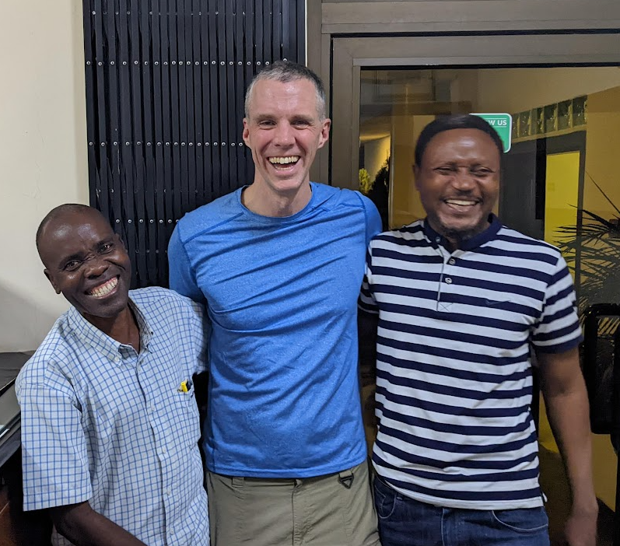
Colossians 1
⁷ just as you learned it from Epaphras, our beloved fellow bond-servant, who is a faithful servant of Christ on our behalf,
⁸ and he also informed us of your love in the Spirit.
Epaphras taught them, prayed for them (4:12), went to Rome for help
Application: You don’t need a “pastor” and a church building to spread the good news
1. We Thank God For You

Slide 21
Colossians 1
⁹ For this reason also, since the day we heard of it, we have not ceased to pray for you
and to ask that you may be filled with the knowledge of His will in all spiritual wisdom and understanding,
2. We Pray to God for Continued Fruit

Slide 22
Colossians 1
⁹ For this reason also, since the day we heard of it, we have not ceased to pray for you
and to ask that you may be filled with the knowledge of His will in all spiritual wisdom and understanding,
knowledge
spiritual wisdom
understanding
“true knowledge” =
Intellectual content, esp. about God and his will
2. We Pray to God for Continued Fruit

Slide 23
Colossians 1
⁹ For this reason also, since the day we heard of it, we have not ceased to pray for you
and to ask that you may be filled with the knowledge of His will in all spiritual wisdom and understanding,
knowledge
spiritual wisdom
understanding
“spiritual wisdom” =
Applied knowledge, people skills, street smarts
2. We Pray to God for Continued Fruit

Slide 24
Colossians 1
⁹ For this reason also, since the day we heard of it, we have not ceased to pray for you
and to ask that you may be filled with the knowledge of His will in all spiritual wisdom and understanding,
knowledge
spiritual wisdom
understanding
“understanding” =
Knowing how the facts fit together, discernment
2. We Pray to God for Continued Fruit

Slide 25
Colossians 1
¹⁰ so that you will walk in a manner worthy of the Lord, to please Him in all respects,
bearing fruit in every good work and
increasing in the true knowledge of God;
2. We Pray to God for Continued Fruit

Slide 26
Colossians 1
¹⁰ so that you will walk in a manner worthy of the Lord, to please Him in all respects,
bearing fruit in every good work and
increasing in the true knowledge of God;
1. True knowledge → increasing true knowledge
Are you pursuing this true knowledge?
Some aren’t pursuing any knowledge
Some are pursuing other kinds of knowledge
Both personal and intellectual knowledge
2. We Pray to God for Continued Fruit

Slide 27
Colossians 1
¹⁰ so that you will walk in a manner worthy of the Lord, to please Him in all respects,
bearing fruit in every good work and
increasing in the true knowledge of God;
How to pursue this?
Classes, challenging reading, learning together
Acting on your learning
Spending time with God
Counting on God’s commitment to do this
2. We Pray to God for Continued Fruit

Slide 28
Colossians 1
¹⁰ so that you will walk in a manner worthy of the Lord, to please Him in all respects,
bearing fruit in every good work and
increasing in the true knowledge of God;
2. Pleasing God in all respects
Fearing people is a dangerous trap… (Proverbs 29:25)
Ask: “God, how can I please you today?”
Are you seeking to please him in all respects?
2. We Pray to God for Continued Fruit

Slide 29
Colossians 1
¹⁰ so that you will walk in a manner worthy of the Lord, to please Him in all respects,
bearing fruit in every good work and
increasing in the true knowledge of God;
3. Good works
Saved for good works, not saved by works
Need balance – both knowledge and works
2. We Pray to God for Continued Fruit

Slide 30
Colossians 1
¹¹⁻¹² strengthened with all power, according to His glorious might,
for the attaining of all
steadfastness and patience;
joyously giving thanks to the Father
2. We Pray to God for Continued Fruit

Slide 31
Colossians 1
¹¹⁻¹² strengthened with all power, according to His glorious might,
for the attaining of all
steadfastness and patience;
joyously giving thanks to the Father
4. Transformed character
Steadfastness = dealing with difficult circumstances
Patience = dealing with difficult people
If you pray for spiritual growth…
2. We Pray to God for Continued Fruit

Slide 32
Colossians 1
¹¹⁻¹² strengthened with all power, according to His glorious might,
for the attaining of all
steadfastness and patience;
joyously giving thanks to the Father
Not stoicism or angry patience
Try writing down 5 things you’re thankful for
A selfish person takes God’s blessings for granted
2. We Pray to God for Continued Fruit

Slide 33
Conclusions
“We have not ceased to pray for you…”
We must find a way to pray
Why not pray Colossians 1 for one person?
You can also pray this for yourself
Then watch God begin to bear fruit

Slide 34
Knowing God and Bearing Fruit (Colossians 1)
Questions?
Comments?
Experiences?
risleys@dwellcc.org
See the Dwell App OR teachings.dwellcc.org
Possible discussion questions
What has helped you grow in joyful patience or increase in true knowledge?
What did you notice about Paul’s prayers for the Colossians?
How do you see the connection between “faith, hope and love” in your life?
Next time: The Exalted Christ (Colossians 1)

