Slide 1
FIRST PETER
THE BOOK OF

Slide 2
1 Peter 5
⁸ Be of sober spirit, be on the alert. Your adversary, the devil, prowls around like a roaring lion, seeking someone to devour.

Slide 3
1 Peter 5
⁸ Be of sober spirit, be on the alert. Your adversary, the devil, prowls around like a roaring lion, seeking someone to devour.
Is Satan real?
» 67% of self-described Christians believe that “Satan is a symbol of evil.”
» Another 8% were unsure what they believed about the existence of a personal Satan.

Slide 4
1 Peter 5
⁸ Be of sober spirit, be on the alert. Your adversary, the devil, prowls around like a roaring lion, seeking someone to devour.
Is Satan real?
» 67% of self-described Christians believe that “Satan is a symbol of evil.”
» Another 8% were unsure what they believed about the existence of a personal Satan.
» Why do so many people have a hard time believing in Satan?

Slide 5
1 Peter 5
⁸ Be of sober spirit, be on the alert. Your adversary, the devil, prowls around like a roaring lion, seeking someone to devour.
Reasons to think he is real.
» Philosophical
» Biblical
» Experiential

Slide 6
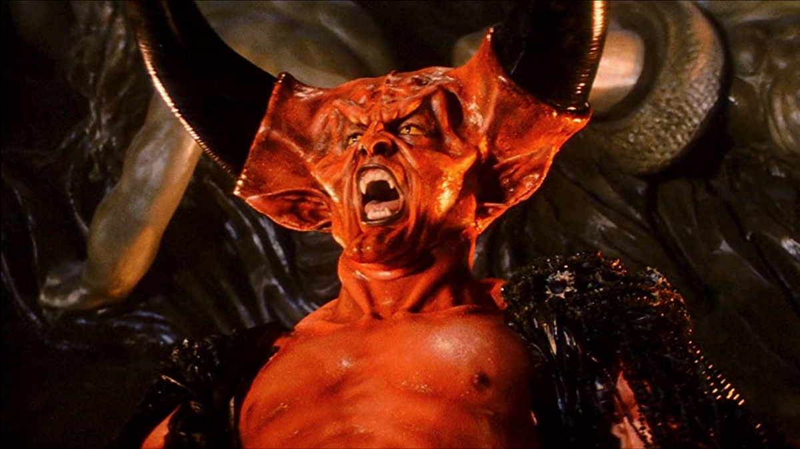
1 Peter 5
⁸ Be of sober spirit, be on the alert. Your adversary, the devil, prowls around like a roaring lion, seeking someone to devour.
Know your enemy.

Slide 7
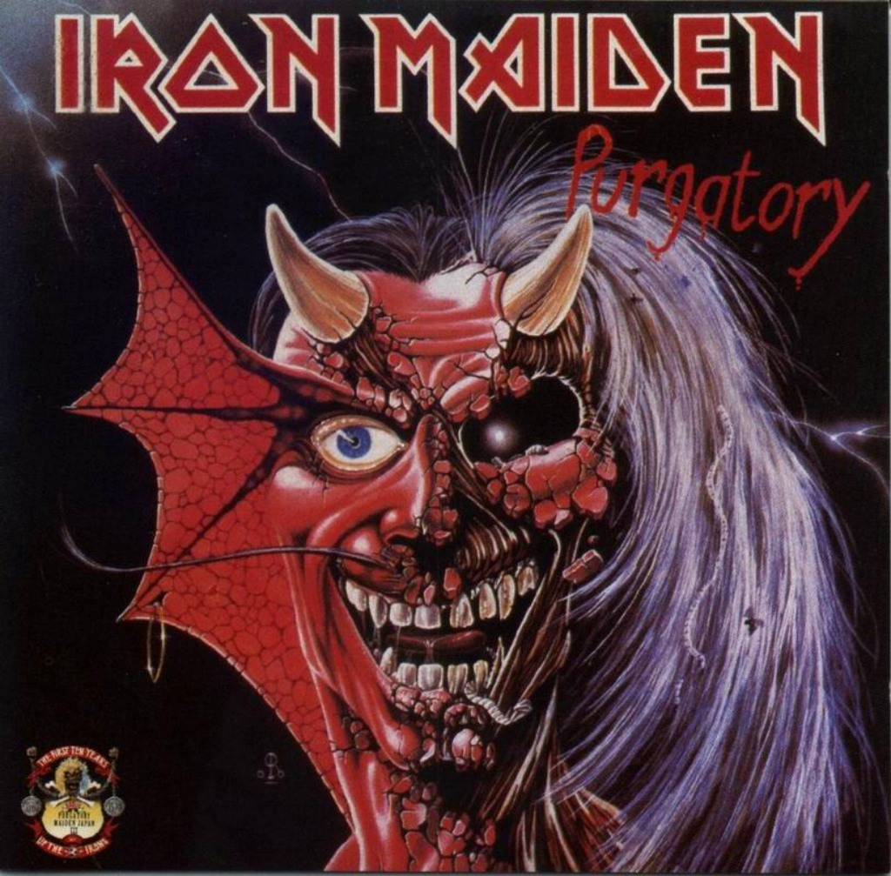
1 Peter 5
⁸ Be of sober spirit, be on the alert. Your adversary, the devil, prowls around like a roaring lion, seeking someone to devour.
Know your enemy.

Slide 8
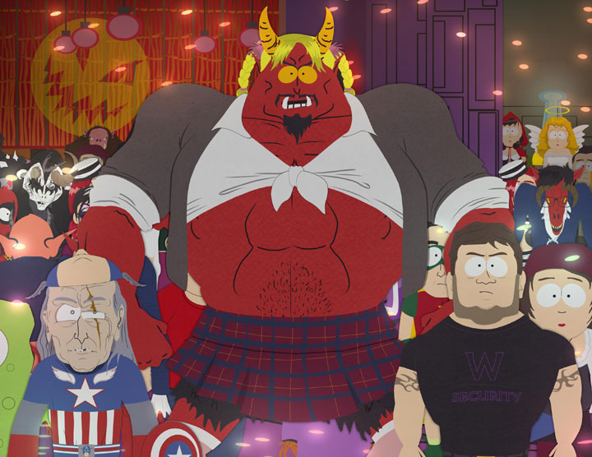
1 Peter 5
⁸ Be of sober spirit, be on the alert. Your adversary, the devil, prowls around like a roaring lion, seeking someone to devour.
Know your enemy.

Slide 9
1 Peter 5
⁸ Be of sober spirit, be on the alert. Your adversary, the devil, prowls around like a roaring lion, seeking someone to devour.
Know your enemy.
» He is one of God’s greatest created beings.
» Satan convinced a third of the angels to follow him.

Slide 10
1 Peter 5
⁸ Be of sober spirit, be on the alert. Your adversary, the devil, prowls around like a roaring lion, seeking someone to devour.
Why is he after humans?
» Humans are often pawns in this cosmic battle.
“Greater is he who is in you that he who is in the world” (1 John 4:4).

Slide 11
1 Peter 5
⁸ Be of sober spirit, be on the alert. Your adversary, the devil, prowls around like a roaring lion, seeking someone to devour.
Why is he after humans?
» Humans are often pawns in this cosmic battle.
» God neutralized Satan’s greatest accusation toward him at the cross.

Slide 12
1 Peter 5
⁸ Be of sober spirit, be on the alert. Your adversary, the devil, prowls around like a roaring lion, seeking someone to devour.
Why is he after humans?
» Satan has redoubled his efforts to make sure that people never hear about or place their trust in Christ.
Revelations 12:12: “Woe to the earth and the sea, because the devil has come down to you, having great wrath, knowing that he has only a short time.”

Slide 13
1 Peter 5
⁸ Be of sober spirit, be on the alert. Your adversary, the devil, prowls around like a roaring lion, seeking someone to devour.
» Satan’s moves are predictable (2 Corinthians 2:11).
» What’s his strategy?
The entire human race is being held captive by the Evil One.
“Satan, who is the god of this world, has blinded the minds of those who don’t believe. [So that] they are unable to see the glorious light of the Good News” (2 Corinthians 4:4).

Slide 14
1 Peter 5
⁸ Be of sober spirit, be on the alert. Your adversary, the devil, prowls around like a roaring lion, seeking someone to devour.
» Satan’s moves are predictable (2 Corinthians 2:11).
» What’s his strategy?
The entire human race is being held captive by the Evil One.
Therefore, he seeks to prevent people from ever hearing the message of Christ (Colossians 1:13).

Slide 15
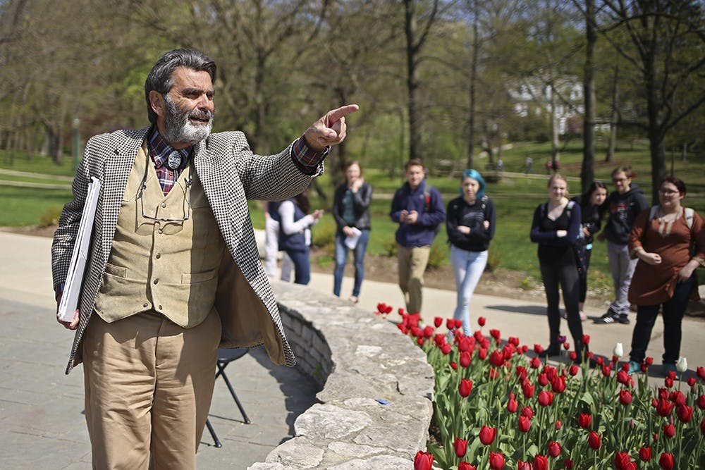
1 Peter 5
⁸ Be of sober spirit, be on the alert. Your adversary, the devil, prowls around like a roaring lion, seeking someone to devour.
His tactics against non-Christians
» Call God’s goodness into question.
» He incites Christians to do things that odious and offensive to non-Christians.

Slide 16
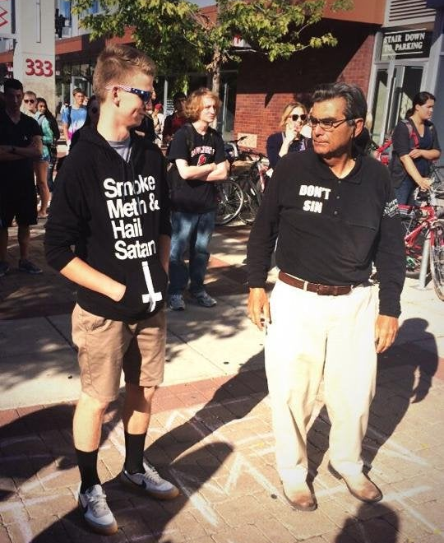
1 Peter 5
⁸ Be of sober spirit, be on the alert. Your adversary, the devil, prowls around like a roaring lion, seeking someone to devour.
His tactics against non-Christians
» Call God’s goodness into question.
» He incites Christians to do things that odious and offensive to non-Christians.

Slide 17
1 Peter 5
⁸ Be of sober spirit, be on the alert. Your adversary, the devil, prowls around like a roaring lion, seeking someone to devour.
His tactics against non-Christians
» Call God’s goodness into question.
» He incites Christians to do things that odious and offensive to non-Christians.
» Distraction

Slide 18
1 Peter 5
⁸ Be of sober spirit, be on the alert. Your adversary, the devil, prowls around like a roaring lion, seeking someone to devour.
His tactics against Christians
» Destroy Christian’s spiritual lives
Temptation
Accusation

Slide 19
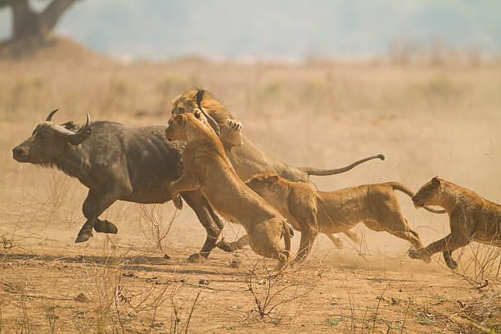
1 Peter 5
⁸ Be of sober spirit, be on the alert. Your adversary, the devil, prowls around like a roaring lion, seeking someone to devour.
His tactics against Christians
» Destroy Christian’s spiritual lives
Isolation
“Everyone is judging me.”
“No one gets you.”

Slide 20
1 Peter 5
⁸ Be of sober spirit, be on the alert. Your adversary, the devil, prowls around like a roaring lion, seeking someone to devour.
His tactics against Christians
» Destroy Christian’s spiritual lives
Isolation
“Look how others let you down…
“Maybe they’re the real enemy?”

Slide 21
1 Peter 5
⁸ Be of sober spirit, be on the alert. Your adversary, the devil, prowls around like a roaring lion, seeking someone to devour.
His tactics against Christians
» Destroy Christian’s spiritual lives
Isolation
If you look around and you feel all alone, that means you are being hunted.

Slide 22
1 Peter 5
⁸ Be of sober spirit, be on the alert. Your adversary, the devil, prowls around like a roaring lion, seeking someone to devour.
His tactics against Christians
» Destroy Christian’s spiritual lives
» Neutralize our effectiveness for God.
Discouragement
Deception

Slide 23
1 Peter 5
⁸ Be of sober spirit, be on the alert. Your adversary, the devil, prowls around like a roaring lion, seeking someone to devour.
His tactics against Christians
» Destroy Christian’s spiritual lives
» Neutralize our effectiveness for God.
Opposition
“We planned to come to you, but Satan hindered us” (1 Thessalonians 2:18).

Slide 24
1 Peter 5
⁹ But resist him, firm in your faith, knowing that the same experiences of suffering are being accomplished by your [brothers and sisters] who are in the world.

Slide 25
1 Peter 5
⁹ But resist him, firm in your faith, knowing that the same experiences of suffering are being accomplished by your [brothers and sisters] who are in the world.
» Learn how to protect yourself with God’s truth.
Ephesians 6:13-17: Put on every piece of God’s armor so you will be able to resist the enemy in the time of evil…Stand your ground, putting on the belt of truth and the body armor of God’s righteousness…In addition to all of these, hold up the shield of faith to stop the fiery arrows of the devil. Put on salvation as your helmet, and take the sword of the Spirit, which is the word of God.

Slide 26
1 Peter 5
⁹ But resist him, firm in your faith, knowing that the same experiences of suffering are being accomplished by your [brothers and sisters] who are in the world.
» Learn how to protect yourself with God’s truth.
“So you think you can just waltz into God’s presence like nothing happened?”
“Who dares accuse us whom God has chosen for his own? No one – for God himself has given us right standing with himself” (Romans 8:33).

Slide 27
1 Peter 5
⁹ But resist him, firm in your faith, knowing that the same experiences of suffering are being accomplished by your [brothers and sisters] who are in the world.
» Learn how to protect yourself with God’s truth.
“You are not qualified to serve God. You don’t know enough.”
“Such confidence we have through Christ toward God. Not that we are adequate in ourselves to consider anything as coming from ourselves, but our adequacy is from God” (2 Corinthians 3:4-5).

Slide 28
1 Peter 5
⁹ But resist him, firm in your faith, knowing that the same experiences of suffering are being accomplished by your [brothers and sisters] who are in the world.
» Learn how to protect yourself with God’s truth.
» Resist God’s enemy by unleashing the power of God through prayer.
“Be of sound judgment and sober spirit for the purpose of prayer” (1 Peter 4:7)

Slide 29
1 Peter 5
⁹ But resist him, firm in your faith, knowing that the same experiences of suffering are being accomplished by your [brothers and sisters] who are in the world.
» The most dangerous place to find yourself is on a battlefield…

Slide 30
1 Peter 5
⁹ But resist him, firm in your faith, knowing that the same experiences of suffering are being accomplished by your [brothers and sisters] who are in the world.
» The most dangerous place to find yourself is on a battlefield…and not know it.
“Don’t be afraid!” Elisha told him. “For there are more on our side than on theirs!” Then Elisha prayed, “O LORD, open his eyes and let him see!” The LORD opened the young man’s eyes, and when he looked up, he saw that the hillside around Elisha was filled with horses and chariots of fire (2 Kings 6:16-17).

Slide 31
FIRST PETER
THE BOOK OF

