Slide 2
Mountaintop Experience
Mark 9:2-7

Slide 3
Mark 9
² After six days Jesus took Peter, James and John with him and led them up a high mountain, where they were all alone. There he was transfigured before them.
³ His clothes became dazzling white, whiter than anyone in the world could bleach them.

Slide 4
Mark 9
² After six days Jesus took Peter, James and John with him and led them up a high mountain, where they were all alone. There he was transfigured before them.
³ His clothes became dazzling white, whiter than anyone in the world could bleach them.
The Bible records similar events in the Old Testament.

Slide 5
Mark 9
² After six days Jesus took Peter, James and John with him and led them up a high mountain, where they were all alone. There he was transfigured before them.
³ His clothes became dazzling white, whiter than anyone in the world could bleach them.
In this case, the Lord was showing his glory through a person.
Matthew 17:2: “His face shone like the sun.”

Slide 6
Mark 9
² After six days Jesus took Peter, James and John with him and led them up a high mountain, where they were all alone. There he was transfigured before them.
³ His clothes became dazzling white, whiter than anyone in the world could bleach them.
In this case, the Lord was showing his glory through a person.
Hebrews 1:3: “[Jesus] is the radiance of [God’s] glory and the exact representation of His nature.”

Slide 7
Mark 9
² After six days Jesus took Peter, James and John with him and led them up a high mountain, where they were all alone. There he was transfigured before them.
³ His clothes became dazzling white, whiter than anyone in the world could bleach them.
The transfiguration revealed Jesus’ transcendence.
Up to this point, Jesus revealed God’s immanence to his disciples.

Slide 8
Mark 9
² After six days Jesus took Peter, James and John with him and led them up a high mountain, where they were all alone. There he was transfigured before them.
³ His clothes became dazzling white, whiter than anyone in the world could bleach them.
The transfiguration revealed Jesus’ transcendence.
We need a balanced perspective of both these characteristics.

Slide 9
Mark 9
² After six days Jesus took Peter, James and John with him and led them up a high mountain, where they were all alone. There he was transfigured before them.
³ His clothes became dazzling white, whiter than anyone in the world could bleach them.

Slide 10
Mark 9
⁴ And there appeared before them Elijah and Moses, who were talking with Jesus.

Slide 11
Mark 9
⁷ Then a cloud appeared and covered them, and a voice came from the cloud: “This is my Son, whom I love. Listen to him!”

Slide 12
Mark 9
⁷ Then a cloud appeared and covered them, and a voice came from the cloud: “This is my Son, whom I love. Listen to him!”
This cloud was a visible sign of God’s presence.
Exodus 29:45: “I will dwell among the sons of Israel and will be their God.”

Slide 13
Mark 9
⁷ Then a cloud appeared and covered them, and a voice came from the cloud: “This is my Son, whom I love. Listen to him!”
John pick up this imagery to describe Jesus’ appearance on earth.
John 1:1,14: “In the beginning was the Word, and the Word was with God, and the Word was God… The Word became flesh and made his dwelling among us. We have seen his glory, the glory of the one and only Son, who came from the Father, full of grace and truth”

Slide 14
Mark 9
⁷ Then a cloud appeared and covered them, and a voice came from the cloud: “This is my Son, whom I love. Listen to him!”
Peter, James and John would have made this connection.
Acts 3:20-22: “‘Then times of refreshment will come from the presence of the Lord, and he will again send you Jesus, your appointed Messiah…

Slide 15
Mark 9
⁷ Then a cloud appeared and covered them, and a voice came from the cloud: “This is my Son, whom I love. Listen to him!”
Peter, James and John would have made this connection.
Acts 3:20-22: “Moses said, “The LORD your God will raise up for you a Prophet like me from among your own people…

Slide 16
Mark 9
⁷ Then a cloud appeared and covered them, and a voice came from the cloud: “This is my Son, whom I love. Listen to him!”
Peter, James and John would have made this connection.
Acts 3:20-22: “Moses said, “Listen carefully to everything he tells you.”

Slide 17
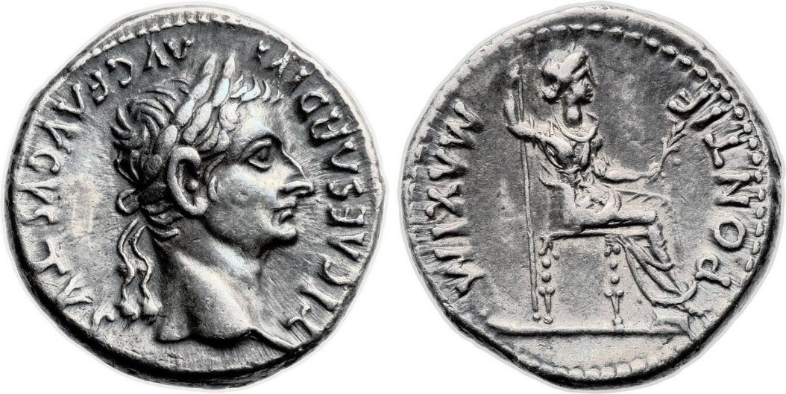
What does it mean?
Listen to Jesus.
Hebrews 1:1-3: “God, after He spoke long ago to the fathers in the prophets in many portions and in many ways, in these last days has spoken to us in His Son, whom He appointed heir of all things, through whom also He made the world. And He is the radiance of His glory and the exact representation of His nature, and upholds all things by the word of His power. When He had made purification of sins, He sat down at the right hand of the Majesty on high.

Slide 18
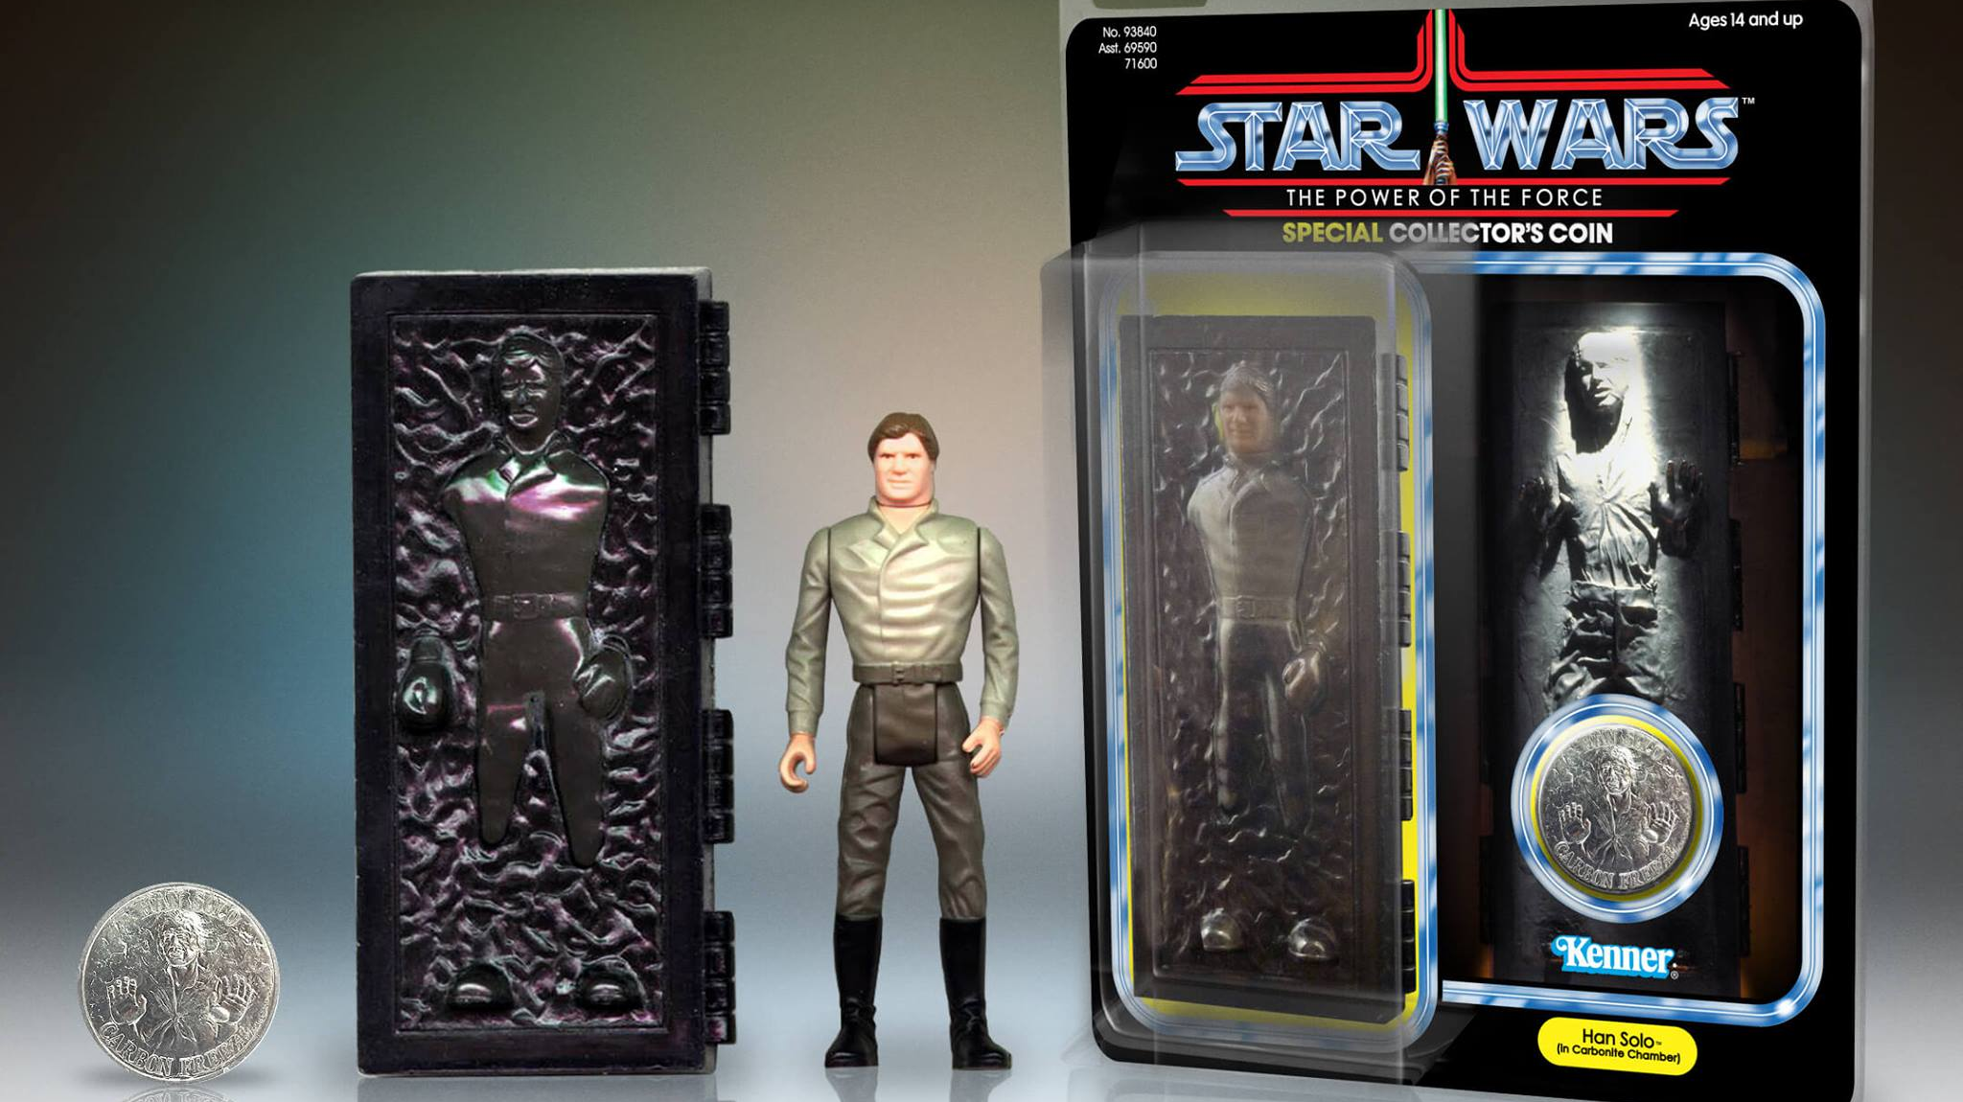

Slide 19
What does it mean?
Listen to Jesus.
Jesus occupies a higher status than Moses
Since Jesus superseded Moses, his New Covenant supersedes the Old Covenant.
Galatians 3:10: “But those who depend on the law to make them right with God are under his curse…

Slide 20
What does it mean?
Listen to Jesus.
Jesus occupies a higher status than Moses
The law acts as a mirror to show us our moral imperfections.
Romans 3:20: “For no one can ever be made right with God by doing what the law commands. The law simply shows us how sinful we are.”

Slide 21
What does it mean?
Listen to Jesus.
Jesus occupies a higher status than Moses
But God provided a way for us to be right with him, without keeping the law.
Romans 3:21-22: “God has shown us a way to be made right with him without keeping the requirements of the law, as was promised in the writings of Moses and the prophets long ago…

Slide 22
What does it mean?
Listen to Jesus.
Jesus occupies a higher status than Moses
But God provided a way for us to be right with him, without keeping the law.
Romans 3:21-22: “We are made right with God by placing our faith in Jesus Christ. And this is true for everyone who believes, no matter who we are.”

Slide 23
What does it mean?
Jesus fulfilled the law and the prophets.
But he was pierced for our transgressions, he was crushed for our iniquities; the punishment that brought us peace was upon him, and by his wounds we are healed…He was oppressed and afflicted, yet he did not open his mouth; he was led like a lamb to the slaughter, and as a sheep before her shearers is silent, so he did not open his mouth.

Slide 24
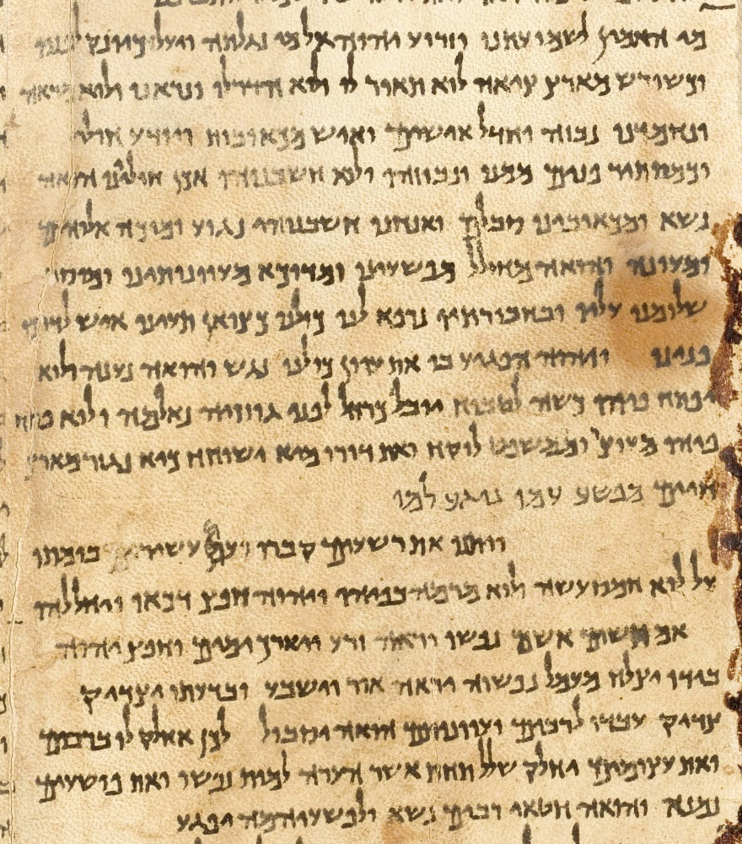
Great Isaiah Scroll (DSS)
335-107 BC
He was pierced for our transgressions, he was crushed for our iniquities; the punishment that brought us peace was on him, and by his wounds we are healed (v5).

Slide 25
Mark 9
Luke 9:32: Peter and his companions were very sleepy, but when they became fully awake, they saw his glory and the two men standing with him.

Slide 26
Mark 9
⁵ Peter said to Jesus, “Rabbi, it is good for us to be here. Let us put up three shelters—one for you, one for Moses and one for Elijah.”

Slide 27
Mark 9
⁵ Peter said to Jesus, “Rabbi, it is good for us to be here. Let us put up three shelters—one for you, one for Moses and one for Elijah.”
⁶ (He did not know what to say, they were so frightened.)
Powerful experiences are a part of following God.
But these feelings inevitably fade.
Mature believers eventually learn to rely on God’s truth rather than their feelings.
Some Christians center their walk on finding ways to get back that spiritual high.

Slide 28
Mark 9
⁵ Peter said to Jesus, “Rabbi, it is good for us to be here. Let us put up three shelters—one for you, one for Moses and one for Elijah.”
⁶ (He did not know what to say, they were so frightened.)
Role of Powerful Experiences
To encourage us
Strengthens us for future trials

Slide 29
Mark 9
⁵ Peter said to Jesus, “Rabbi, it is good for us to be here. Let us put up three shelters—one for you, one for Moses and one for Elijah.”
⁶ (He did not know what to say, they were so frightened.)
Role of Powerful Experiences
2 Peter 1:16–18: “For we did not follow cleverly devised tales when we made known to you the power and coming of our Lord Jesus Christ, but we were eyewitnesses of His majesty…

Slide 30
Mark 9
⁵ Peter said to Jesus, “Rabbi, it is good for us to be here. Let us put up three shelters—one for you, one for Moses and one for Elijah.”
⁶ (He did not know what to say, they were so frightened.)
Role of Powerful Experiences
2 Peter 1:16–18: ‘For when He received honor and glory from God the Father, such an utterance as this was made to Him by the Majestic Glory, “This is My beloved Son with whom I am well-pleased”— and we ourselves heard this utterance made from heaven when we were with Him on the holy mountain.’

Slide 31
Summary
God is immanent AND transcendent.
Jesus fulfills AND supersedes the Old Testament.
Enjoy these mountaintop experiences; but don’t depend on them.

