Slide 1
XSI: SUMMER 2015
JEWISH ESCHATOLOGY/JEWISH MESSIANISM
ERIC CHABOT
chabotec@gmail.com
Thinkapologetics.com
1

Slide 2
Salvation?
Most people only think in terms of “getting saved” from hell and going to heaven.
This is overly simplistic and doesn’t allow for Christians to understand the entire storyline of the Bible.
2

Slide 3
Our Focus
God’s Redemptive Plan
God’s Relationship with Israel and the Nations
What does this mean for us today?
3

Slide 4
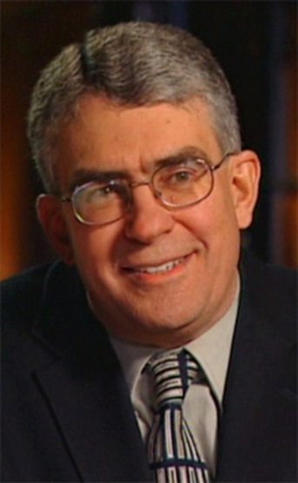
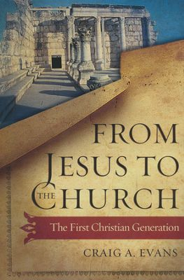
“Did Jesus intend to found the Christian church? This interesting question can be answered in the affirmative and in the negative. It depends on what precisely is being asked. If by church one means an organization and a people that stand outside of Israel, the answer is no. If by a community of disciples committed to the restoration of Israel and the conversion and instruction of the Gentiles, then the answer is yes.” ---Craig A Evans, From Jesus to the Church: The First Christian Generation, pg 18
4
Notes:
4

Slide 5
“Jesus did not wish to lead his disciples out of Israel, but to train followers who will lead Israel, who will bring renewal to Israel , and who will instruct Gentiles in the way of the Lord. Jesus longed for the fulfillment of the promises and the prophecies, a fulfillment that would bless Israel and the nations alike.” -Craig A Evans, From Jesus to the Church: The First Christian Generation
5

Slide 6
Reading the Bible Left to Right
OLD
TESTAMENT
JESUS
COMES
O
L
D
T
E
S
T
A
M
E
N
T
Progressive Revelation
Notes:
6

Slide 7
Israel’s Election
“Election is the choice by one person of another person out of a range of possible candidates. This choice then establishes a mutual relationship between the elector and the elected, in biblical terms a “covenant” (berit). The elector chooses another person with whom she will both act and elicit responses, and then establishes the community in which these acts are done, and then promises that for which the election has occurred.”--Scott Bader-Saye, Church and Israel After Christendom), pg 31
7

Slide 8
Israel’s Election:
They are called to a holy people (Deut. 7:6 [3x]); (Isa. 62:12; 63:18; Dan. 12:7).
They are called to be a redeemed people (Joshua 4:23-24).
They are called to be a kingdom of priests (Exod. 19:6).
Bring the Scriptures to the world: “To them were entrusted the oracles of God” (Rom 3:2).
8

Slide 9
Israel Is Elected to Be a Light to the Nations
“Arise, shine, for your light has come, and the glory of the Lord has risen upon you. For behold, darkness shall cover the earth, and thick darkness the peoples; but the Lord will arise upon you, and his glory will be seen upon you. And nations shall come to your light, and kings to the brightness of your rising.”- Isa. 60:2-3
9

Slide 10
Israel’s Election: The Messiah
Genesis 12: 1-3
“And I will make of you a great nation, and I will bless you and make your name great, so that you will be a blessing I will bless those who bless you, and him who dishonors you I will curse, and in you all the families of the earth shall be blessed.”
Paul says “And the scripture, foreseeing that God would justify the Gentiles by faith, declared the gospel beforehand to Abraham, saying ‘All the Gentiles shall be blessed in you.” (Gal 3:8)
10
Notes:
10

Slide 11
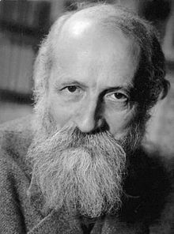
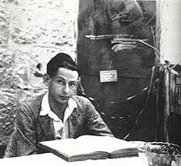
“Messianism is Judaism’s most profoundly original idea”- Martin Buber, Der Jude und sein Judentum, Cologne, 1963, 41.
“Messianism is the idea which Israel gave to the world.” –Gershom Scholem, Zum Verstandnis der messianischen Idee’ Judaica I Frankfurt 1963, 73.

Slide 12
Israel’s Election
God’s plans are national (Israel), but the nation is an instrument to bring international blessings.
Israel’s Head, Jesus the Messiah, is able to restore the nation and use the nation to bring blessings to the other nations of the earth—blessings that are spiritual and physical.
12

Slide 13
“Did Jesus intend to found the Christian church? This interesting question can be answered in the affirmative and in the negative. It depends on what precisely is being asked. If by church one means an organization and a people that stand outside of Israel, the answer is no. If by a community of disciples committed to the restoration of Israel and the conversion and instruction of the Gentiles, then the answer is yes.” -Craig A Evans, From Jesus to the Church: The First Christian Generation, pg 18
13
Notes:
13

Slide 14
Jesus the Nationalist
“Do not go among the Gentiles or enter any town of the Samaritans. Go rather to the lost sheep of the house of Israel.” (Matt 10: 5-6)
“ I was sent only to the lost sheep of Israel.”
(Matt 15: 24)
Jesus teaches his disciples that they will bear witness to “governors and kings” (Matt. 10: 18 = Luke 21: 12), which probably implies bearing witness to Gentiles (as is made explicit in Matt. 10: 18).
14

Slide 15
Judaism’s
1st century
Rabbinic
Judaism
Modern
Judaism
Orthodox
Conservative
Reform
Christianity
(Separate from
Judaism)
Protestantism
Roman Catholicism
Eastern Orthodoxy
Nazarenes
Essenes
Pharisees
Sadducees
Zealots
Messianic
Judaism

Slide 16
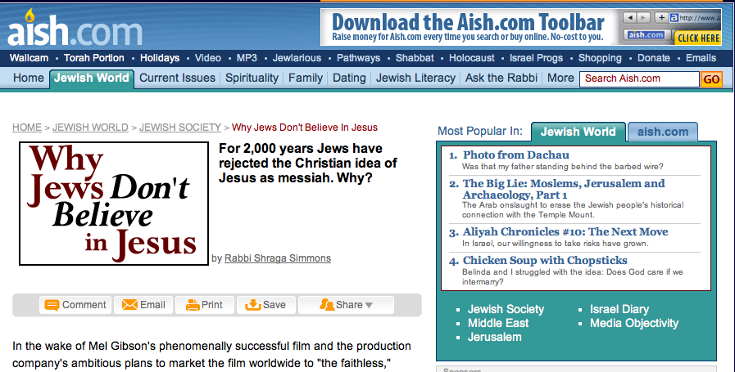

Slide 17
Jewish Expectation
“When God comes to bring his kingdom, it is to this world that he comes and in this world that he establishes his reign. The hope of Israel is not for a home in heaven but for the revelation of the glory of God in this world. As God’s claim on man encompasses the totality of his life, so God’s salvation for man encompasses the totality of human existence, including our historical existence.” -G. R. Beasley-Murray, Jesus and the Kingdom of God, 25).
17

Slide 18
Acts 1: 6-8
“So when they had come together, they asked him, “Lord, will you at this time restore the kingdom to Israel?” He said to them, “It is not for you to know times or seasons that the Father has fixed by his own authority. But you will receive power when the Holy Spirit has come upon you, and you will be my witnesses in Jerusalem and in all Judea and Samaria, and to the end of the earth.”
18

Slide 19
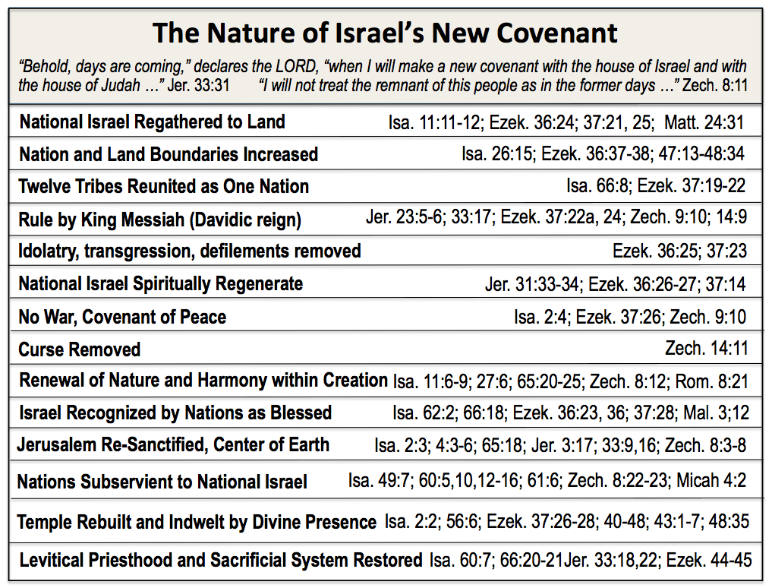
The Earthly, National, Kingdom of God: A Restored Israel?
Eternal (five-fold repetition of “forever”)
Isa. 24:5; 61:8; Jer. 31:36, 40; 32:40; 50:5

Slide 20
“What, then, does the Bible say about the Messianic age? The recovery of independence and power, an era of peace and prosperity, of fidelity to God and his law and justice and fair- dealing and brotherly love among men and of personal rectitude and piety. If we think about this sentence for just a moment in the light of the history of the last two thousand years, we will begin to see what enormous obstacles must be overcome if we are to believe in the messianic mission of Jesus.” --David Berger and Michael Wyschogrod, “Jews and Jewish Christianity” A Jewish Response to the Missionary Challenge (Toronto: Jews for Judaism, 2002), 20
20

Slide 21
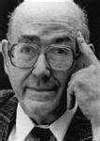
“The role of the messianic kings in the Bible was political; all of the messianic prophecies in the last days were politically colored; the plight of Israel out of which the Messiah was to save God’s people was primarily political. A nonpolitical Messiah would have been a self- contradiction during the rule of Rome. The spiritualizing of the salvation for which everyone longed—for instance, in the sense of having an immaterial soul—would have been perceived as biblical escapism, indeed, as a denial of historical political responsibility for this God-created world.” ----Pinchas Lapide, Orthodox Jewish Scholar

Slide 22
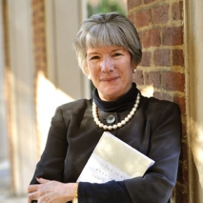
“Did Jews reject Jesus because he wasn’t the Messiah they were expecting? That claim that Jews rejected Jesus because he counseled peace and all Jews were looking for some warrior Messiah whose job it would be to get the Romans out of the country misses the variety of messianic ideas that were floating around in the first century. The majority of Jews did not accept Jesus as a Messiah because most Jews thought that the Messiah and the messianic age came together. The messianic age meant peace on earth and the end of war, death, disease, and poverty, the ingathering of the exiles, a general resurrection of the dead. When that didn’t happen, I suspect quite a number of Jews who were highly attracted to Jesus’ message of the kingdom of heaven thought: That’s a good message, but we have to keep waiting.”
Amy-Jill Levine
22

Slide 23
Warrior Messiah?
“Lord, you chose David to be king over Israel, and swore to him about his descendants forever, that his kingdom should not fail before you. Undergird him with the strength to destroy the unrighteous rulers, to purge Jerusalem from the gentiles…..to destroy the unlawful nations with the word of his mouth. He will gather a holy people who he will lead in righteousness; and he will judge the tribes of his people. He will not tolerate unrighteousness (even) to pause among them, and any person who knows wickedness shall not live with them… And he will purge Jerusalem (and make it) holy as it was from the beginning.” (Psalms of Solomon 18:4,22,26,27,30).
23

Slide 24
Why Jesus Didn’t Do it?
He couldn't do it(He isn't the Messiah).
2. He did do it but he did it spiritually.
3. He will do it (bring a future earthly kingdom and restore Israel) in the future. (Futurism)
24

Slide 25
“Did Jews reject Jesus because he wasn’t the Messiah they were expecting? That claim that Jews rejected Jesus because he counseled peace and all Jews were looking for some warrior Messiah whose job it would be to get the Romans out of the country misses the variety of messianic ideas that were floating around in the first century.”
Amy-Jill Levine
25

Slide 26
Defining “Messiah”
Other names were used to describe the messianic person other than the “Messiah.” Some of the names include Son of David, Son of God, Son of Man, Prophet, Elect One, Servant, Prince, Branch, Root, Scepter, Star, Chosen One, and Coming One.
26

Slide 27
Messianic Expectations at Time of Jesus
Son of God/Davidic King: (2 Samuel 7:14; Psalm 2:7; Psalm 89:26-27).
Miracle Working Messiah: Paul says Jews demand signs and Greeks seek wisdom, but we preach Christ crucified, a stumbling block to Jews and folly to Gentiles…(see 1 Corinthians 1:22-24).
27

Slide 28
Messianic Expectations at Time of Jesus
Transcendent/Divine Messiah: The concept of the Messiah as a “son of man” after the figure in Daniel 7:13 is expressed in a section of the apocryphal book of 1 Enoch, which has been argued to have a date as early as 40 B.C.
Prophetic Messiah like Moses (John 6:14; John 7:40).
The Qumran community which predated the time of Jesus thought there were possibly two Messiahs, one priestly and one royal (1QS 9.11; CD 12.22-23; 13. 20-22; 14. 18-19; 19.34-20.1; CD-B 1.10-11; 2.1; 1Q Sa 2. 17-22).
28

Slide 29
Corporate Solidarity
One person can represent a whole group.
While Israel is seen as a son and God is their Father, Jesus is the ideal “Son of God/The Davidic King.”

Slide 30
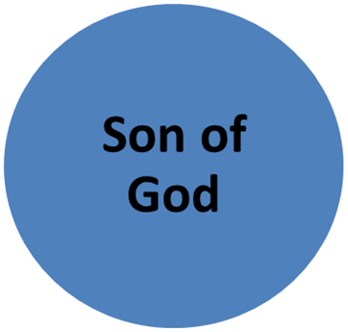
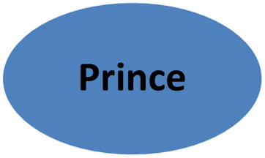
Scepter/Star
Son of Man
Branch
Jesus Embodies Israel as their Head
Prophet
Son of David
Servant of the Lord

Slide 31
The Earthly, National, Kingdom of God: A Restored Israel?
Eternal (five-fold repetition of “forever”)
Isa. 24:5; 61:8; Jer. 31:36, 40; 32:40; 50:5

Slide 32
Jewish Expectations
The Jewish expectations of the reign/kingdom of God what would come would be:
(1) Visible
(2) All at once
(3) In complete fullness
(4) When God’s enemies would be defeated
(5) The saints are separated from the ungodly, the former receiving reward and the latter punishment
32

Slide 33
Jesus did do it but he did it spiritually?
Read Matthew 12 and the Pharisees rejection of the miracles of Jesus.
Jesus spoke of a mystery form of the kingdom (Matt. 13:11) that is taking place between His first and second coming.
Jesus now offers an invisible, spiritual reign through a new birth to both Jew and Gentile that will last throughout eternity (John 3:3-7; 18:36; Luke 17:20-21.
33

Slide 34
Matthew 13: Mystery Kingdom which is:
(1) For the most part invisibly, so that one must have eyes to perceive it.
(2) In two stages (already- and- not full)
(3) Growing over an extended time from one stage to the last stage.
(4) God’s opponents are not defeated immediately all together, but the invisible satanic powers are first subjugated and then at the end of time, all foes will be vanquished and judged.
(5) Saints are not being separated from the ungodly in the beginning stage of the kingdom, but such a separation will occur on the last day.
34

Slide 35
Paul and the Mystery of the Relationship Between Jews and Gentiles
35

Slide 36
Mystery
“The revelation of God’s partially hidden wisdom, particularly, as it concerns events in the “latter days.”
“Divine wisdom that was previously “hidden” but has now been “revealed.”
We see the use of mystery in Daniel, Matthew, Ephesians, Romans,1 Corinthians, Colossians, 1 Timothy, 2 Thessalonians, Revelation, etc.
36

Slide 37
Paul’s use of mystery:
“For this reason I, Paul, the prisoner of Christ Jesus for the sake of you Gentiles— if indeed you have heard of the stewardship of God’s grace which was given to me for you; that by revelation there was made known to me the mystery, as I wrote before in brief. By referring to this, when you read you can understand my insight into the mystery of Christ, which in other generations was not made known to the sons of men, as it has now been revealed to His holy apostles and prophets in the Spirit; to be specific, that the Gentiles are fellow heirs and fellow members of the body, and fellow partakers of the promise in Christ Jesus through the gospel.”- Ephesians 3:1-6
37

Slide 38
The Earthly, National, Kingdom of God: A Restored Israel?
Eternal (five-fold repetition of “forever”)
Isa. 24:5; 61:8; Jer. 31:36, 40; 32:40; 50:5

Slide 39
What is the Mystery?:
The O.T also prophesied when Gentiles would become Israelites in the latter days- they would adhere to the same nationalistic tags that identified a Jewish person (e.g., Is.56:3-8;66:18-21; Zech. 14:16-19).
39

Slide 40
What is the mystery?:
Therefore remember that formerly you, the Gentiles in the flesh, who are called “Uncircumcision” by the so-called “Circumcision,” which is performed in the flesh by human hands— remember that you were at that time separate from Christ, excluded from the commonwealth of Israel, and strangers to the covenants of promise, having no hope and without God in the world. But now in Christ Jesus you who formerly were far off have been brought near by the blood of Christ. For He Himself is our peace, who made both groups into one and broke down the barrier of the dividing wall, by abolishing in His flesh the enmity, which is the Law of commandments contained in ordinances, so that in Himself He might make the two into one new man, thus establishing peace, and might reconcile them both in one body to God through the cross, by it having put to death the enmity.” Eph 2: 11-16
40

Slide 41
Mystery:
Eph. 3: 1-6: But in the “latter days,” Jews and Gentiles who trust in Jesus become one n Christ (Messiah).
Gentiles don’t have to take on Israel’s national markers to be accepted before God.
41

Slide 42
Role Reversal?
“So I ask, did they stumble in order that they might fall? By no means! Rather through their trespass salvation has come to the Gentiles, so as to make Israel jealous. Now if their trespass means riches for the world, and if their failure means riches for the Gentiles, how much more will their fulfillment mean!”- Romans 11: 11-12
“Lest you be wise in your own sight, I do not want you to be unaware of this mystery, brothers: a partial hardening has come upon Israel, until the fullness of the Gentiles has come in.”-Romans 11: 25
42

Slide 43
Relationship of Israel and the Gentiles in the Ekklesia
Ekklesia
ELECT JEWISH
REMNANT
NATIONAL
ISRAEL/
GENTILE
REMNANT
GENTILE
NATIONS
Rom. 11:17,
20-21
Rom. 3:1-2;
10:1; 11:14
Rom. 11:5
Gal. 6:16
Matt. 21:43
Rom. 2:28-29
Rom. 11:11,
24a; Acts 10:35;
15:3, 6-11,14
Gen. 10:32
Eph. 2:11-12
Acts 17:26
Eph. 2:13-
22; 3:1-12
Rom. 16:25
“The Messiah has become a servant to the circumcision on behalf of the truth of God to confirm the promises given to the fathers, and for the Gentiles to glorify God for His mercy” Romans 15:8-9

Slide 44
Romans 11: “All Israel Will Be Saved”:The Future Salvation of Israel?
The 148 instances of “all Israel” in the OT all
refer to the historic, ethnic Israel.
Speaks of Israel as large number of ethnic Jewish people coming to faith at a specific time in history- the end of history.
“All” means “a large number” but not every ethnic Jewish person.
Notes:
44

Slide 45
Israel’s Future Salvation?
Paul doesn’t say how this will happen.
Israel may have a direct encounter with the Lord, not by apostolic preaching.
See Zech. 12-14: The Return of the Lord is preceded by repentance of Israel.
Notes:
45

Slide 46
“Did Jesus intend to found the Christian church? This interesting question can be answered in the affirmative and in the negative. It depends on what precisely is being asked. If by church one means an organization and a people that stand outside of Israel, the answer is no. If by a community of disciples committed to the restoration of Israel and the conversion and instruction of the Gentiles, then the answer is yes.” -Craig A Evans, From Jesus to the Church: The First Christian Generation, pg 18
46
Notes:
46

Slide 47
What Was Jesus’s Vision for the Judaism of His Day?
Was He Trying to Bring Renewal into Israel?
Was He bringing an end to ‘Judaism’ and forming a entirely new religion called ‘Christianity’?
Jesus demanded repentance, but this was a repentance from within Judaism, not repentance from Judaism.
47

Slide 48
Jesus is God’s agent to inaugurate the reign of God:
The time is fulfilled, and the kingdom of God is at hand; repent, and believe in the gospel" (Mark 1:15).
Jesus linked his miracles and exorcisms to the proclamation of the Kingdom of God: "But if it is by the finger of God that I cast out demons, then the kingdom of God has come upon you" (Luke 11:20).
48

Slide 49
“And he came to Nazareth, where he had been brought up. And as was his custom, he went to the synagogue on the Sabbath day, and he stood up to read. And the scroll of the prophet Isaiah was given to him. He unrolled the scroll and found the place where it was written, “The Spirit of the Lord is upon me, because he has anointed me to proclaim good news to the poor. He has sent me to proclaim liberty to the captives and recovering of sight to the blind, to set at liberty those who are oppressed, to proclaim the year of the Lord's favor.”- Luke 4: 18-19

Slide 50
Luke Jesus appeals to Isaiah 61:1-2
A published scroll from Qumran has helped confirm this: According to 4Q521,
"Heaven and earth will obey his Messiah and all that is in them will not turn away from the commandments of the holy ones ... for (the Lord) will honor the pious upon the throne of the eternal Kingdom, setting prisoners free, opening the eyes of the blind, raising up those who are bowed down…. For he will heal the wounded, revive the dead, proclaim good news to the poor."
50

Slide 51
Kingship of God Theme
The kingship of God is already, but not full.
In the Jewish perspective of Scripture, there are only two ages: “this age” (olam ha-zeh) and “the age to come” (olam ha-ba). There is a tension between the present and the future.
51

Slide 52
Jesus and the Restoration of Israel
“Truly I say to you, that you who have followed Me, in the regeneration when the Son of Man will sit on His glorious throne, you also shall sit upon twelve thrones, judging the twelve tribes of Israel” (Matt 19:28).
Jesus sits on the Davidic throne and the restored twelve tribes of Israel will be ruled by the twelve apostles.
The Twelve are to rule over Israel, judging the nation as the judges of old judged the twelve tribes.
52
Notes:
52

Slide 53
Matt 23: 37-39:Israel’s Repentance and Messiah’s Return?
"Jerusalem, Jerusalem, you who kill the prophets and stone those sent to you, how often I have longed to gather your children together, as a hen gathers her chicks under her wings, and you were not willing. Look, your house is left to you desolate. For I tell you, you will not see me again until you say, ‘Blessed is he who comes in the name of the Lord.’”
Notice the emphasis on the article “until.” Here, it could not be clearer that Jesus says the Jewish people will not see him again and cry out to Him until there is genuine belief on their part.
53

Slide 54
Acts 3: 17-21
“And now, brethren, I know that you acted in ignorance, just as your rulers did also. But the things which God announced beforehand by the mouth of all the prophets, that His Christ would suffer, He has thus fulfilled. Therefore repent and return, so that your sins may be wiped away, in order that times of refreshing may come from the presence of the Lord; and that He may send Jesus, the Christ appointed for you, whom heaven must receive until the period of restoration of all things about which God spoke by the mouth of His holy prophets from ancient time.”
54

Slide 55
Acts 3: 19-21
Peter calls upon the Jewish people to repent and turn to the Lord.
If they did, Peter expected that the Lord would return in his own day.
55

Slide 56
“What is most interesting in the Talmud of the land of Israel’s picture is that the hope for the Messiah’s coming is further joined to the moral condition of each individual Israelite. Hence, messianic fulfillment was made to depend on the repentance of Israel. The coming of the Messiah depended not on historical action but on moral regeneration”- Bruce Chilton and Jacob Neusner, Jewish Christian Debates: God, Kingdom, Messiah, pg 172.
56

Slide 57
What is Salvation?
“Luke uses the language of salvation more than any other New Testament writer, but employs that language in co-texts whose effect is to give salvation broad meaning. Salvation is, preeminently, status reversal, and this includes not only the raising up of ‘lowly’ persons whom Jesus encounters in the Gospel, but also the people of Israel as a people, promised liberation from the oppressive hand of Rome. Salvation is also the coming of the kingdom of God, then, the coming of God’s reign of justice, to deconstruct the worldly systems and values at odds with the purpose of God. Salvation also entails membership in the new community God is drawing together around Jesus, a community into which all – especially the previously excluded for reasons of sin, and its corollary, despised status – are invited to participate in the blessings of the kingdom as well as to share in its service.”--- Joel B. Green, The Theology of the Gospel of Luke, pg. 94

Slide 58
Christians Can Demonstrate the Reign of God is Here by:
Our relationships with others- be shalom makers
Forgiveness
Fruit of the Spirit (Gal 5: 22-25)
Love
Speaking both truth and love
Doing acts of justice
Explaining the Gospel: the Gospel isn’t just fire insurance
58

Slide 59
Sources
Slide 25, 33, 34, 36, 39: Courtesy of G. K. Beale, Benjamin L. Gladd, Hidden But Now Revealed: A Biblical Theology of Mystery, pgs, 20, 73, 164, 166.
Slide 31, 38, 41, 43: courtesy of Randall Price, Answering New Covenant Perspective's Charge on the Absence of Restoration to the Land Texts in the New Testament, used with permission, LCGE Conference, Chicago, 2014.
3. Slide 22: Amy Jill Levine, A Jewish take on Jesus: Amy-Jill Levine talks the gospels, Available at: http://www.uscatholic.org/church/2012/09/jewish-take-jesus-amy-jill-levine-talks-gospels#sthash.a7HVTI1q.dpuf

