Slide 2
(1 Pet. 5:1) Therefore, I exhort the elders among you,
as your fellow elder and witness of the sufferings of Christ, and a partaker also of the glory that is to be revealed.

Slide 3
(1 Pet. 5:1) Therefore, I exhort the elders among you, as your fellow elder and witness of the sufferings of Christ, and a partaker also of the glory that is to be revealed.
Why should I care?
(1) Leadership refers to influencing others, and all of us will play this role.
(e.g. careers, friends, families, kids, etc.)
(2) What if God called you to lead?
God delegates leadership to people.
Groups flourish under good leadership.
(3) Learn from a veteran leader!
He saw great success and brutal failure.

Slide 4
(1 Pet. 5:1) Therefore, I exhort the elders among you, as your fellow elder and witness of the sufferings of Christ, and a partaker also of the glory that is to be revealed.
Peter seemed like the kind of guy you’d want to hang around.
(He didn’t seem to take himself too seriously…)

Slide 5
(1 Pet. 5:2) Shepherd the flock of God among you,
Leadership is a way to love God
“Shepherd the flock” (poimainō)
(Jn. 21:16) Jesus asked, “Peter, do you love me?”
“Yes, Lord,” Peter said, “you know I love you.”
“Then take care of my sheep.” (poimainō)

Slide 6
(1 Pet. 5:2) Shepherd the flock of God among you,
The people we lead belong to God, and he loves them far more than we ever could! (Acts 20:28)

Slide 7
(1 Pet. 5:2) Shepherd the flock of God among you,
Singular
Plural
Leaders lead together—not alone
This comes from biblical teaching, principle, and example.
(Acts 14:23; Titus 1:5; biblical anthropology)
Growth occurs best in this context.
Teams “sharpen” weak areas (Prov. 27:17).
If you’re too immature to work on a team,
then you’re too immature to lead.

Slide 8
(1 Pet. 5:2) Shepherd the flock of God among you,
exercising oversight not under compulsion, but voluntarily, according to the will of God.
Leadership is a gift of God
It is called a “mercy” and a “gift of God’s grace” (2 Cor. 4:1; 1 Tim. 1:16; Eph. 3:7).
Why is leadership considered a gift?
It’s the highest possible mission.
Given to the least deserving people.
God uses this role in a variety of ways.

Slide 9
“I need to change my character in order to lead.”
“I need to build relationships with people that I don’t naturally like.”
“If it wasn’t for leadership, my character would be far, far worse!”
“Most of my best friendships have come from people I’ve led alongside.”

Slide 10
“I keep facing one bad circumstance after another.”
“Nobody is responding to my efforts.”
“I realize how little I appreciated or deserved the good seasons.”
“Many continue to grow despite my numerous faults.”

Slide 11
“Leading others has taken time away from my marriage.”
“Leading together has drawn us closer together, keeping us from living parallel lives.”
“God has used leading others to teach us sacrificial love.”

Slide 12
“It’s a been a real difficulty balancing leadership and parenting.”
“It’s a real labor to drag my kids around.”
“My kids will grow up seeing me serve—even when it’s tough.”
“My kids enjoy seeing fellow Christians.”
“I don’t hear my kids complaining.”

Slide 13
(1 Pet. 5:2) Shepherd the flock of God among you, exercising oversight not under compulsion, but voluntarily, according to the will of God.
Leadership is a gift of God
It is called a “mercy” and a “gift of God’s grace” (2 Cor. 4:1; 1 Tim. 1:16; Eph. 3:7).
Why is leadership considered a gift?
It’s the highest possible mission.
Given to the least deserving people.
God uses this role in a variety of ways.

Slide 14
(1 Pet. 5:2) Shepherd the flock of God among you, exercising oversight not under compulsion, but voluntarily, according to the will of God.
This is the source of our impact on others.

Slide 15
(1 Pet. 5:2) Shepherd the flock of God among you, exercising oversight not under compulsion, but voluntarily, according to the will of God.
Not for sordid gain, but with eagerness.

Slide 16
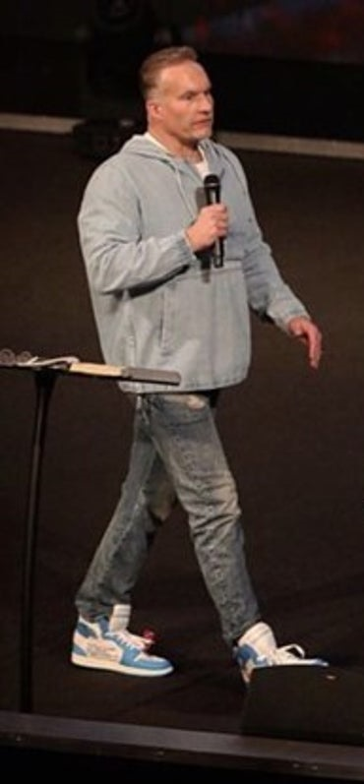
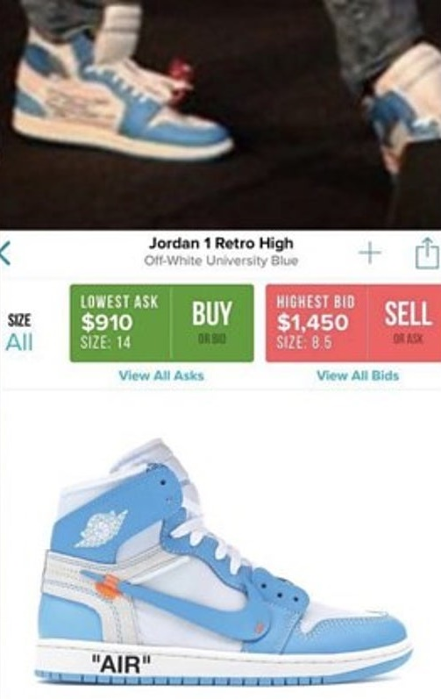
(1 Pet. 5:2) Shepherd the flock of God among you, exercising oversight not under compulsion, but voluntarily, according to the will of God.
Not for sordid gain, but with eagerness.

Slide 17
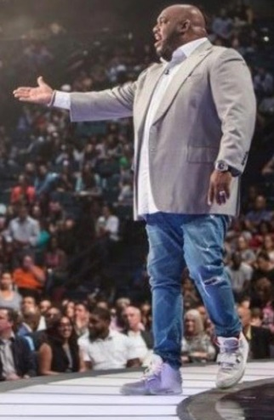
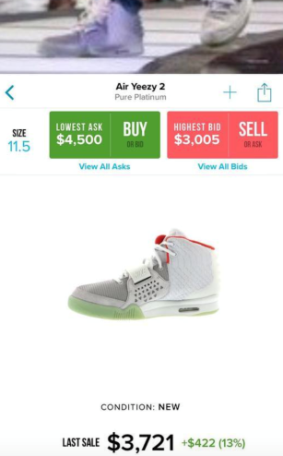
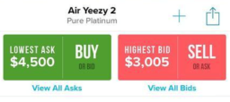
(1 Pet. 5:2) Shepherd the flock of God among you, exercising oversight not under compulsion, but voluntarily, according to the will of God.
Not for sordid gain, but with eagerness.

Slide 18
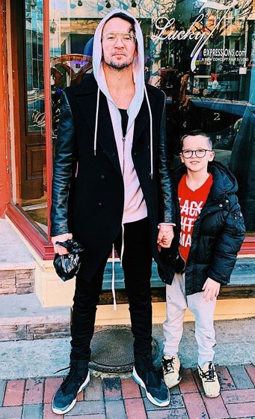
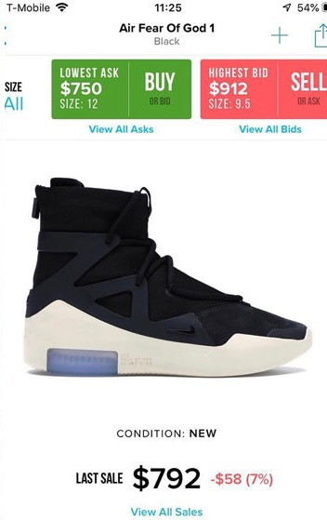
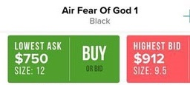
(1 Pet. 5:2) Shepherd the flock of God among you, exercising oversight not under compulsion, but voluntarily, according to the will of God.
Not for sordid gain, but with eagerness.

Slide 19
(1 Pet. 5:2) Shepherd the flock of God among you, exercising oversight not under compulsion, but voluntarily, according to the will of God.
Not for sordid gain, but with eagerness.
Why do you want to be influential?
To gain popularity, power, press, etc.?
Or to eagerly give away the life and love that you’ve experienced?

Slide 20
(1 Pet. 5:3) Not lording it over those allotted to your charge,
(Mk. 10:42) Jesus said, “You know that the rulers in this world lord it over their people, and officials flaunt their authority over those under them.
⁴³ But among you it will be different.
Whoever wants to be a leader among you must be your servant.”

Slide 21
(1 Pet. 5:3) Not lording it over those allotted to your charge,
(Mk. 10:44) “Whoever wants to be first among you must be the slave of everyone else.
⁴⁵ For even the Son of Man came not to be served
but to serve others
and to give his life as a ransom for many.”

Slide 22
(1 Pet. 5:3) Not lording it over those allotted to your charge,
but proving to be examples to the flock.
Paul
(1 Cor. 4:16; 11:1; Phil. 3:17; 4:9; 2 Thess. 3:7-9)
Timothy
(1 Tim. 4:12)
Titus
(Titus 2:7-8)
Christian leaders
(Heb. 13:7)

Slide 23
(1 Pet. 5:3) Not lording it over those allotted to your charge,
but proving to be examples to the flock.
Can I see people changing?
Can people see me changing?

Slide 24
(1 Pet. 5:4) And when the Chief Shepherd appears, you will receive the unfading crown of glory.

Slide 25
(1 Pet. 5:5) You younger men, likewise, be subject to your elders.
We aren’t ready to lead
until we’ve learned how to follow.

Slide 26
(1 Pet. 5:5) All of you,
clothe yourselves with humility toward one another,
for God is opposed to the proud,
but gives grace to the humble.

Slide 27
(1 Pet. 5:6) Therefore humble yourselves under the mighty hand of God, that He may exalt you at the proper time,
Peter learned these leadership lessons directly from Jesus.
(Mt. 23:12; Lk. 14:11; 18:14)

Slide 28
(1 Pet. 5:6) Therefore humble yourselves under the mighty hand of God, that He may exalt you at the proper time,
⁷ casting all your anxiety on Him,
because He cares for you.
How is anxiety a form of pride?
“I care for my loved ones more than God, and I can’t trust him with my fears.”
(“casting your all your anxiety on him… He cares for you”)
“God doesn’t have the power to fix this.”
(“mighty hand”)
“God won’t God give me what I want… I need to figured this out myself.”
(“He may exalt you at the proper time.”)

Slide 29
(1 Pet. 5:6) Therefore humble yourselves under the mighty hand of God, that He may exalt you at the proper time,
⁷ casting all your anxiety on Him, because He cares for you.

Slide 30
Do you believe…
That God uses broken people?
That God’s timing to bless your efforts is always good?
That God could be holding back on the scope of your impact for your own good?
What is the one area that God brought to your mind tonight?
Are you going to respond to God’s prompting? Or will you self-justify and deflect?

Slide 31
Lessons in Leadership
Do you believe God uses broken people?
Do you believe that God’s timing is best?
Have you ever thought that God could be holding back the size of your impact
for your own good?

