Slide 1
Acts
The Church in Jerusalem
Acts 2: Community
teachings available at www.centralteachings.com

Slide 2
Context…
^{Acts 2:41} So then, those who had received his word were baptized; and that day there were added about three thousand souls.

Slide 3
Now what?
^{Acts 2:41} So then, those who had received his word were baptized; and that day there were added about three thousand souls.

Slide 4
Now what?
This is the genesis of the Christian “Church”
^{Acts 2:41} So then, those who had received his word were baptized; and that day there were added about three thousand souls.

Slide 5
Now what?
This is the genesis of the Christian “Church”
Today: Luke describes the first church
^{Acts 2:41} So then, those who had received his word were baptized; and that day there were added about three thousand souls.

Slide 6
What comes to mind when you hear the word “church?”
Steeple
Sunday best
Pew
Tradition
Rules
Duty/obligation
Old-fashioned
Hypocrites?
A little judgey…

Slide 7
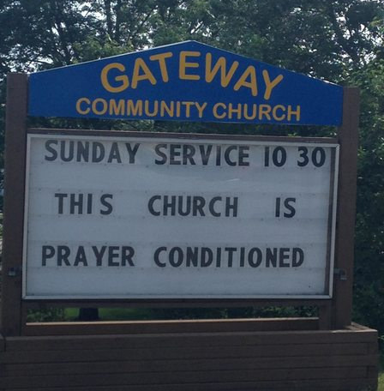
What comes to mind when you hear the word “church?”
Steeple
Sunday best
Pew
Tradition
Rules
Duty/obligation
Old-fashioned
Hypocrites?
A little judgey…

Slide 8
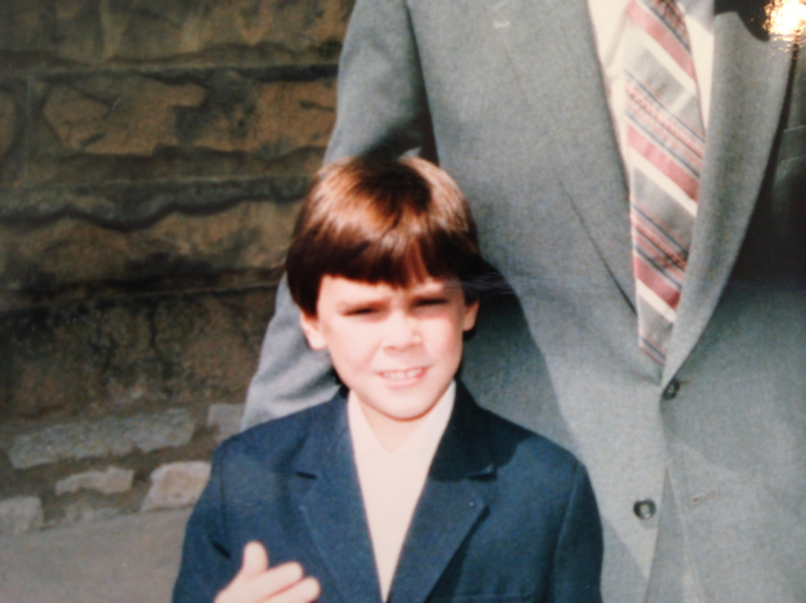
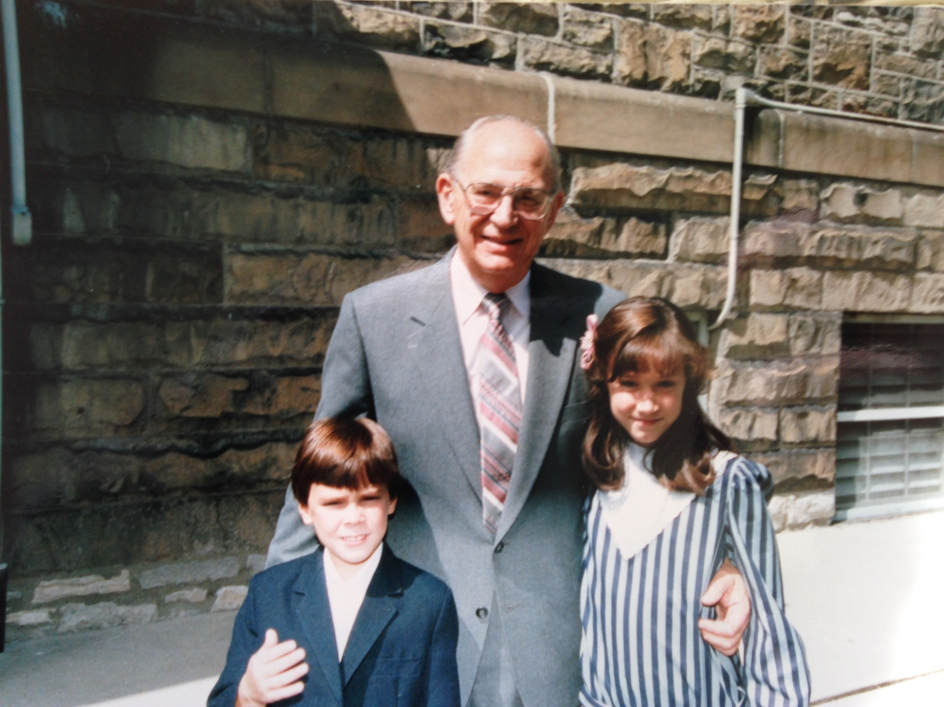

Slide 9
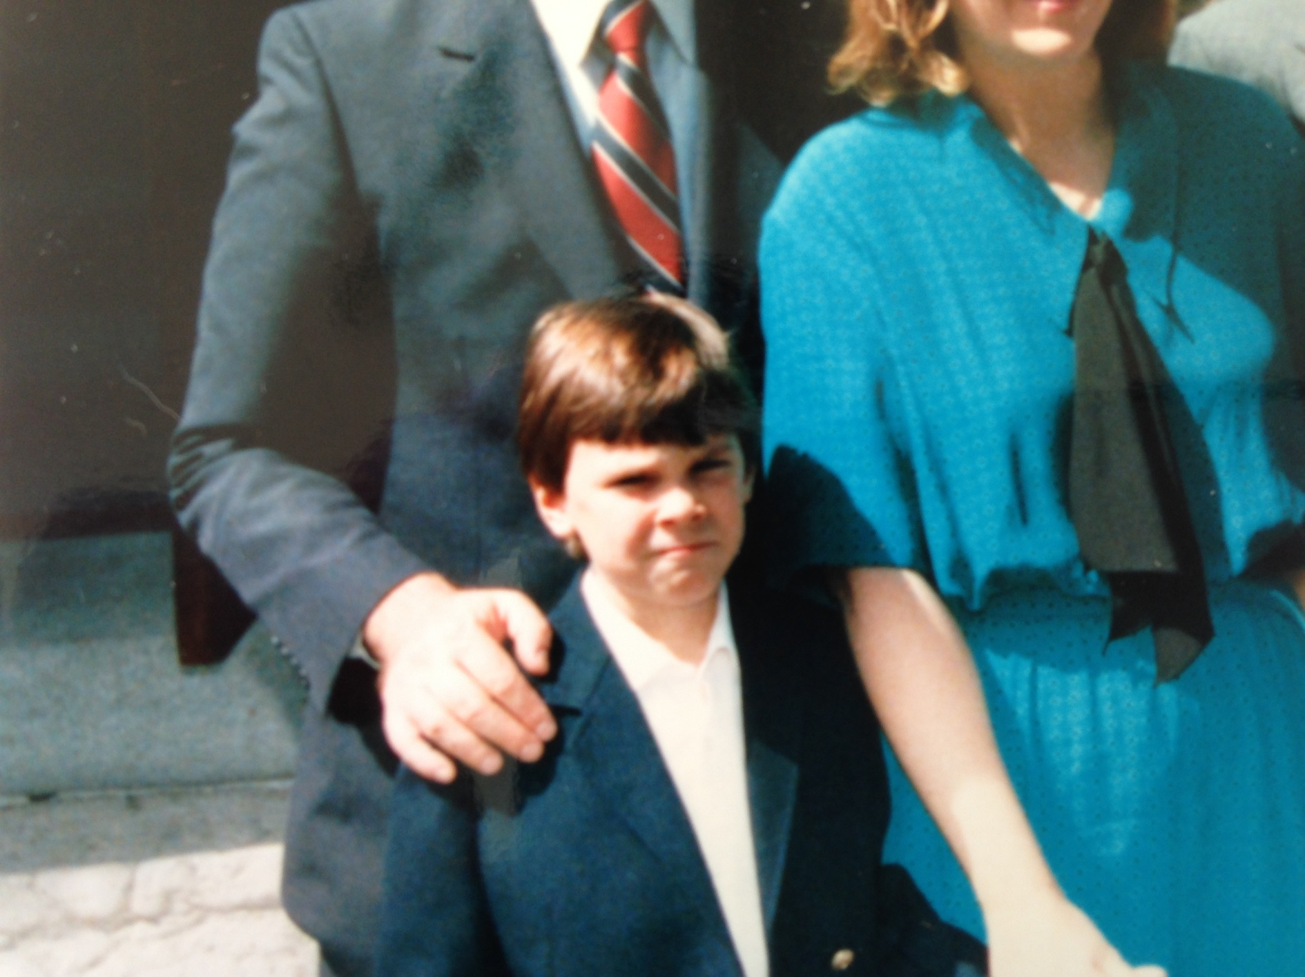

Slide 10
What comes to mind when you hear the word “church?”
^{Acts 2:42} from that day forward, they set about perfunctory attendance, being careful to keep up appearances, and begrudgingly shaking hands with their weird neighbors that they never talked to except on Sundays.
Is THAT what Luke is going to give us?

Slide 11
^{Acts2:42} They were continually devoting themselves to the apostles’ teaching and to fellowship, to the breaking of bread and to prayer. ⁴³ Everyone kept feeling a sense of awe; and many wonders and signs were taking place through the apostles. ⁴⁴ And all those who had believed were together and had all things in common; ⁴⁵ and they began selling their property and possessions and were sharing them with all, as anyone might have need. ⁴⁶ Day by day continuing with one mind in the temple, and breaking bread from house to house, they were taking their meals together with gladness and sincerity of heart, ⁴⁷ praising God and having favor with all the people. And the Lord was adding to their number day by day those who were being saved.

Slide 12
^{Acts2:42} They were continually devoting themselves to the apostles’ teaching and to fellowship, to the breaking of bread and to prayer. ⁴³ Everyone kept feeling a sense of awe; and many wonders and signs were taking place through the apostles. ⁴⁴ And all those who had believed were together and had all things in common; ⁴⁵ and they began selling their property and possessions and were sharing them with all, as anyone might have need. ⁴⁶ Day by day continuing with one mind in the temple, and breaking bread from house to house, they were taking their meals together with gladness and sincerity of heart, ⁴⁷ praising God and having favor with all the people. And the Lord was adding to their number day by day those who were being saved.

Slide 13
^{Acts2:42} They were continually devoting themselves to the apostles’ teaching and to fellowship, to the breaking of bread and to prayer. ⁴³ Everyone kept feeling a sense of awe; and many wonders and signs were taking place through the apostles. ⁴⁴ And all those who had believed were together and had all things in common; ⁴⁵ and they began selling their property and possessions and were sharing them with all, as anyone might have need. ⁴⁶ Day by day continuing with one mind in the temple, and breaking bread from house to house, they were taking their meals together with gladness and sincerity of heart, ⁴⁷ praising God and having favor with all the people. And the Lord was adding to their number day by day those who were being saved.
Like a montage

Slide 14
^{Acts2:42} They were continually devoting themselves to the apostles’ teaching and to fellowship, to the breaking of bread and to prayer. ⁴³ Everyone kept feeling a sense of awe; and many wonders and signs were taking place through the apostles. ⁴⁴ And all those who had believed were together and had all things in common; ⁴⁵ and they began selling their property and possessions and were sharing them with all, as anyone might have need. ⁴⁶ Day by day continuing with one mind in the temple, and breaking bread from house to house, they were taking their meals together with gladness and sincerity of heart, ⁴⁷ praising God and having favor with all the people. And the Lord was adding to their number day by day those who were being saved.
Like a montage

Slide 15
^{Acts2:42} They were continually devoting themselves to the apostles’ teaching and to fellowship, to the breaking of bread and to prayer. ⁴³ Everyone kept feeling a sense of awe; and many wonders and signs were taking place through the apostles. ⁴⁴ And all those who had believed were together and had all things in common; ⁴⁵ and they began selling their property and possessions and were sharing them with all, as anyone might have need. ⁴⁶ Day by day continuing with one mind in the temple, and breaking bread from house to house, they were taking their meals together with gladness and sincerity of heart, ⁴⁷ praising God and having favor with all the people. And the Lord was adding to their number day by day those who were being saved.
Like a montage

Slide 16
So what does this tell us about the first “Church?”

Slide 17
So what does this tell us about the first “Church?”
This was not a stuffy institution…
it was a spontaneous movement!

Slide 18
So what does this tell us about the first “Church?”
This was not a place…
It was a vibrant community!
Connected, exciting, dynamic, different, relevant, growing and making a real impact on their city

Slide 19
So what does this tell us about the first “Church?”
This was not a place…
It was a vibrant community!
Connected, exciting, dynamic, different, relevant, growing and making a real impact on their city
“Church” in Acts = Ekklesia: “assembly”
Lit. “called out ones”

Slide 20
So, should we try to do exactly what they did?

Slide 21
So, should we try to do exactly what they did?
The passage is descriptive, not prescriptive

Slide 22
So, should we try to do exactly what they did?
The passage is descriptive, not prescriptive
It’s an example of what “church” might look like

Slide 23
So, should we try to do exactly what they did?
The passage is descriptive, not prescriptive
It’s an example of what “church” might look like
But it’s a good example

Slide 24
So, should we try to do exactly what they did?
The passage is descriptive, not prescriptive
It’s an example of what “church” might look like
But it’s a good example
It’s the first example
The immediate result of the coming of the HS
We have a lot in common with them
God was pleased

Slide 25
So, should we try to do exactly what they did?
The passage is descriptive, not prescriptive
It’s an example of what “church” might look like
But it’s a good example
It’s the first example
The immediate result of the coming of the HS
We have a lot in common with them
God was pleased
^{Acts2:47}And the Lord was adding to their number day by day those who were being saved.

Slide 26
So, should we try to do exactly what they did?
We have a lot of freedom… there isn’t only one right way to do church…

Slide 27
So, should we try to do exactly what they did?
We have a lot of freedom… there isn’t only one right way to do church…
But Acts 2 gives us a ideal example that we should seek to emulate in essence

Slide 28
So, should we try to do exactly what they did?
We have a lot of freedom… there isn’t only one right way to do church…
But Acts 2 gives us a ideal example that we should seek to emulate in essence
“what are enduring principles that underlie this description and fit with biblical commands?”

Slide 29
So, should we try to do exactly what they did?
We have a lot of freedom… there isn’t only one right way to do church…
But Acts 2 gives us a ideal example that we should seek to emulate in essence
“what are enduring principles that underlie this description and fit with biblical commands?”
“And what would those principles look like expressed in our modern setting?”

Slide 30
So, should we try to do exactly what they did?
We have a lot of freedom… there isn’t only one right way to do church…
But Acts 2 gives us a ideal example that we should seek to emulate in essence
“what are enduring principles that underlie this description and fit with biblical commands?”
“And what would those principles look like expressed in our modern setting?”
That’s what we’re trying to do here at XCF

Slide 31
^{Acts 2:42} They were continually devoting themselves to the apostles’ teaching and to fellowship, to the breaking of bread and to prayer.
^{Acts 2:42} They were continually devoting themselves to the apostles’ teaching and to fellowship, to the breaking of bread and to prayer.

Slide 32
= proskartereo: “to attend constantly,” to “stick close by,” “be close at hand,” to “attach oneself to” “to wait on”
^{Acts 2:42} They were continually devoting themselves to the apostles’ teaching and to fellowship, to the breaking of bread and to prayer.
^{Acts 2:42} They were continually devoting themselves to the apostles’ teaching and to fellowship, to the breaking of bread and to prayer.

Slide 33
They were committed
= proskartereo: “to attend constantly,” to “stick close by,” “be close at hand,” to “attach oneself to” “to wait on”
^{Acts 2:42} They were continually devoting themselves to the apostles’ teaching and to fellowship, to the breaking of bread and to prayer.
^{Acts 2:42} They were continually devoting themselves to the apostles’ teaching and to fellowship, to the breaking of bread and to prayer.

Slide 34
They were committed
What were they committed to?
= proskartereo: “to attend constantly,” to “stick close by,” “be close at hand,” to “attach oneself to” “to wait on”
^{Acts 2:42} They were continually devoting themselves to the apostles’ teaching and to fellowship, to the breaking of bread and to prayer.
^{Acts 2:42} They were continually devoting themselves to the apostles’ teaching and to fellowship, to the breaking of bread and to prayer.

Slide 35
They were committed
What were they committed to?
^{Acts 2:42} They were continually devoting themselves to the apostles’ teaching and to fellowship, to the breaking of bread and to prayer.

Slide 36
They were committed
What were they committed to?
^{Acts 5:12} and they were all with one accord in Solomon’s portico.
^{Acts 2:42} They were continually devoting themselves to the apostles’ teaching and to fellowship, to the breaking of bread and to prayer.

Slide 37
They were committed
What were they committed to?
^{Acts 5:12} and they were all with one accord in Solomon’s portico.
^{Acts 2:42} They were continually devoting themselves to the apostles’ teaching and to fellowship, to the breaking of bread and to prayer.

Slide 38
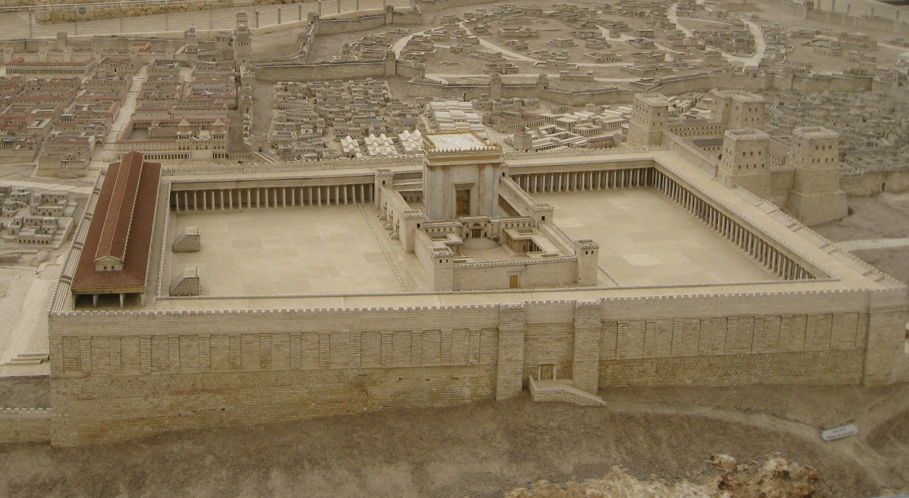
They were committed
What were they committed to?
^{Acts 5:12} and they were all with one accord in Solomon’s portico.
^{Acts 2:42} They were continually devoting themselves to the apostles’ teaching and to fellowship, to the breaking of bread and to prayer.

Slide 39
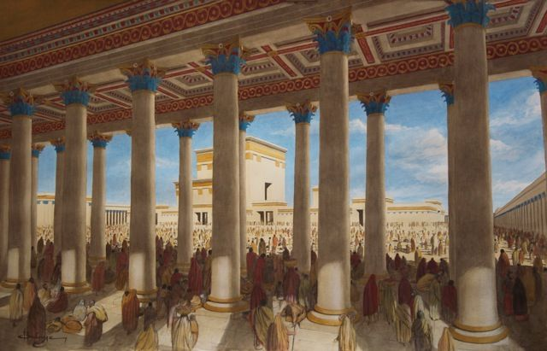
They were committed
What were they teaching?
What were they committed to?
^{Acts 5:12} and they were all with one accord in Solomon’s portico.
^{Acts 2:42} They were continually devoting themselves to the apostles’ teaching and to fellowship, to the breaking of bread and to prayer.

Slide 40
They were committed
What were they teaching?
What were they committed to?
^{John 14:26} But the Helper, the Holy Spirit, whom the Father will send in My name, He will teach you all things, and bring to your remembrance all that I said to you.
^{Acts 5:12} and they were all with one accord in Solomon’s portico.
^{Acts 2:42} They were continually devoting themselves to the apostles’ teaching and to fellowship, to the breaking of bread and to prayer.

Slide 41
They were committed
What were they teaching?
This was Jesus’s command
What were they committed to?
^{Acts 5:12} and they were all with one accord in Solomon’s portico.
^{Acts 2:42} They were continually devoting themselves to the apostles’ teaching and to fellowship, to the breaking of bread and to prayer.

Slide 42
They were committed
What were they teaching?
This was Jesus’s command
What were they committed to?
^{Matt: 28:19} Go therefore and make disciples of all the nations, baptizing them in the name of the Father and the Son and the Holy Spirit, ²⁰ teaching them to observe all that I commanded you; and lo, I am with you always, even to the end of the age.”
^{Acts 5:12} and they were all with one accord in Solomon’s portico.
^{Acts 2:42} They were continually devoting themselves to the apostles’ teaching and to fellowship, to the breaking of bread and to prayer.

Slide 43
They were committed
What were they teaching?
This was Jesus’s command
What were they committed to?
The foundation of the church
^{Matt: 28:19} Go therefore and make disciples of all the nations, baptizing them in the name of the Father and the Son and the Holy Spirit, ²⁰ teaching them to observe all that I commanded you; and lo, I am with you always, even to the end of the age.”
^{Acts 5:12} and they were all with one accord in Solomon’s portico.
^{Acts 2:42} They were continually devoting themselves to the apostles’ teaching and to fellowship, to the breaking of bread and to prayer.

Slide 44
They were committed
What were they committed to?
^{Acts 5:12} and they were all with one accord in Solomon’s portico.
^{Acts 2:42} They were continually devoting themselves to the apostles’ teaching and to fellowship, to the breaking of bread and to prayer.
^{Acts 2:42} They were continually devoting themselves to the apostles’ teaching and to fellowship, to the breaking of bread and to prayer.

Slide 45
They were committed
What were they committed to?
^{Acts 5:12} and they were all with one accord in Solomon’s portico.
= koinonia: “sharing,” “common,” “participating together”
^{Acts 2:42} They were continually devoting themselves to the apostles’ teaching and to fellowship, to the breaking of bread and to prayer.
^{Acts 2:42} They were continually devoting themselves to the apostles’ teaching and to fellowship, to the breaking of bread and to prayer.

Slide 46
They were committed
They were relational
What were they committed to?
^{Acts 5:12} and they were all with one accord in Solomon’s portico.
= koinonia: “sharing,” “common,” “participating together”
^{Acts 2:42} They were continually devoting themselves to the apostles’ teaching and to fellowship, to the breaking of bread and to prayer.
^{Acts 2:42} They were continually devoting themselves to the apostles’ teaching and to fellowship, to the breaking of bread and to prayer.

Slide 47
They were committed
They were relational
special connected-ness
What were they committed to?
^{Acts 5:12} and they were all with one accord in Solomon’s portico.
= koinonia: “sharing,” “common,” “participating together”
^{Acts 2:42} They were continually devoting themselves to the apostles’ teaching and to fellowship, to the breaking of bread and to prayer.
^{Acts 2:42} They were continually devoting themselves to the apostles’ teaching and to fellowship, to the breaking of bread and to prayer.

Slide 48
They were committed
They were relational
special connected-ness
What were they committed to?
^{1Cor 12:13} For by one Spirit we were all baptized into one body, whether Jews or Greeks, whether slaves or free, and we were all made to drink of one Spirit.
^{Acts 5:12} and they were all with one accord in Solomon’s portico.
= koinonia: “sharing,” “common,” “participating together”
^{Acts 2:42} They were continually devoting themselves to the apostles’ teaching and to fellowship, to the breaking of bread and to prayer.
^{Acts 2:42} They were continually devoting themselves to the apostles’ teaching and to fellowship, to the breaking of bread and to prayer.

Slide 49
They were committed
They were relational
special connected-ness
What were they committed to?
Defining characteristic of the church
^{Acts 5:12} and they were all with one accord in Solomon’s portico.
= koinonia: “sharing,” “common,” “participating together”
^{Acts 2:42} They were continually devoting themselves to the apostles’ teaching and to fellowship, to the breaking of bread and to prayer.
^{Acts 2:42} They were continually devoting themselves to the apostles’ teaching and to fellowship, to the breaking of bread and to prayer.

Slide 50
They were committed
What were they committed to?
^{Acts 5:12} and they were all with one accord in Solomon’s portico.
^{Acts 2:42} They were continually devoting themselves to the apostles’ teaching and to fellowship, to the breaking of bread and to prayer.
^{Acts 2:42} They were continually devoting themselves to the apostles’ teaching and to fellowship, to the breaking of bread and to prayer.
^{Acts 2:42} They were continually devoting themselves to the apostles’ teaching and to fellowship, to the breaking of bread and to prayer.

Slide 51
They were committed
What were they committed to?
^{Acts 5:12} and they were all with one accord in Solomon’s portico.
^{Acts 2:46} they were taking their meals together with gladness and sincerity of heart,
^{Acts 2:42} They were continually devoting themselves to the apostles’ teaching and to fellowship, to the breaking of bread and to prayer.
^{Acts 2:42} They were continually devoting themselves to the apostles’ teaching and to fellowship, to the breaking of bread and to prayer.
^{Acts 2:42} They were continually devoting themselves to the apostles’ teaching and to fellowship, to the breaking of bread and to prayer.

Slide 52
They were committed
Probably referring to communion
What were they committed to?
^{Acts 5:12} and they were all with one accord in Solomon’s portico.
^{Acts 2:46} they were taking their meals together with gladness and sincerity of heart,
^{Acts 2:42} They were continually devoting themselves to the apostles’ teaching and to fellowship, to the breaking of bread and to prayer.
^{Acts 2:42} They were continually devoting themselves to the apostles’ teaching and to fellowship, to the breaking of bread and to prayer.
^{Acts 2:42} They were continually devoting themselves to the apostles’ teaching and to fellowship, to the breaking of bread and to prayer.

Slide 53
They were committed
Probably referring to communion
What were they committed to?
^{Acts 5:12} and they were all with one accord in Solomon’s portico.
^{Luke 22:19} And when He had taken some bread and given thanks, He broke it and gave it to them, saying, “This is My body which is given for you; do this in remembrance of Me.”
^{Luke 22:19} And when He had taken some bread and given thanks, He broke it and gave it to them, saying, “This is My body which is given for you; do this in remembrance of Me.”
^{Acts 2:42} They were continually devoting themselves to the apostles’ teaching and to fellowship, to the breaking of bread and to prayer.
^{Acts 2:42} They were continually devoting themselves to the apostles’ teaching and to fellowship, to the breaking of bread and to prayer.
^{Acts 2:42} They were continually devoting themselves to the apostles’ teaching and to fellowship, to the breaking of bread and to prayer.

Slide 54
They were committed
Probably referring to communion
What were they committed to?
Principle: remember Christ and His sacrifice
^{Acts 5:12} and they were all with one accord in Solomon’s portico.
^{Luke 22:19} And when He had taken some bread and given thanks, He broke it and gave it to them, saying, “This is My body which is given for you; do this in remembrance of Me.”
^{Luke 22:19} And when He had taken some bread and given thanks, He broke it and gave it to them, saying, “This is My body which is given for you; do this in remembrance of Me.”
^{Acts 2:42} They were continually devoting themselves to the apostles’ teaching and to fellowship, to the breaking of bread and to prayer.
^{Acts 2:42} They were continually devoting themselves to the apostles’ teaching and to fellowship, to the breaking of bread and to prayer.
^{Acts 2:42} They were continually devoting themselves to the apostles’ teaching and to fellowship, to the breaking of bread and to prayer.

Slide 55
They were committed
Probably referring to communion
What were they committed to?
Principle: remember Christ and His sacrifice
A sweet experience!
^{Acts 5:12} and they were all with one accord in Solomon’s portico.
^{Luke 22:19} And when He had taken some bread and given thanks, He broke it and gave it to them, saying, “This is My body which is given for you; do this in remembrance of Me.”
^{Luke 22:19} And when He had taken some bread and given thanks, He broke it and gave it to them, saying, “This is My body which is given for you; do this in remembrance of Me.”
^{Acts 2:42} They were continually devoting themselves to the apostles’ teaching and to fellowship, to the breaking of bread and to prayer.
^{Acts 2:42} They were continually devoting themselves to the apostles’ teaching and to fellowship, to the breaking of bread and to prayer.
^{Acts 2:42} They were continually devoting themselves to the apostles’ teaching and to fellowship, to the breaking of bread and to prayer.

Slide 56
They were committed
What were they committed to?
^{Acts 5:12} and they were all with one accord in Solomon’s portico.
^{Acts 2:42} They were continually devoting themselves to the apostles’ teaching and to fellowship, to the breaking of bread and to prayer.
^{Acts 2:42} They were continually devoting themselves to the apostles’ teaching and to fellowship, to the breaking of bread and to prayer.
^{Acts 2:42} They were continually devoting themselves to the apostles’ teaching and to fellowship, to the breaking of bread and to prayer.
^{Acts 2:42} They were continually devoting themselves to the apostles’ teaching and to fellowship, to the breaking of bread and to prayer.

Slide 57
They were committed
They were devoted to praying together
What were they committed to?
^{Acts 5:12} and they were all with one accord in Solomon’s portico.
^{Acts 2:42} They were continually devoting themselves to the apostles’ teaching and to fellowship, to the breaking of bread and to prayer.
^{Acts 2:42} They were continually devoting themselves to the apostles’ teaching and to fellowship, to the breaking of bread and to prayer.
^{Acts 2:42} They were continually devoting themselves to the apostles’ teaching and to fellowship, to the breaking of bread and to prayer.
^{Acts 2:42} They were continually devoting themselves to the apostles’ teaching and to fellowship, to the breaking of bread and to prayer.

Slide 58
They were committed
What were they committed to?
^{Acts 5:12} and they were all with one accord in Solomon’s portico.
^{Acts 2:43} Everyone kept feeling a sense of awe; and many wonders and signs were taking place through the apostles.

Slide 59
They were committed
The natural result of these activities: Excitement
What were they committed to?
^{Acts 5:12} and they were all with one accord in Solomon’s portico.
^{Acts 2:43} Everyone kept feeling a sense of awe; and many wonders and signs were taking place through the apostles.

Slide 60
They were committed
The natural result of these activities: Excitement
What were they committed to?
^{Acts 5:12} and they were all with one accord in Solomon’s portico.
^{Acts 2:43} Everyone kept feeling a sense of awe; and many wonders and signs were taking place through the apostles.
^{Acts 2:43} Everyone kept feeling a sense of awe; and many wonders and signs were taking place through the apostles.

Slide 61
⁴⁴ And all those who had believed were together and had all things in common; ⁴⁵ and they began selling their property and possessions and were sharing them with all, as anyone might have need.

Slide 62
A corporate identity has been established
⁴⁴ And all those who had believed were together and had all things in common; ⁴⁵ and they began selling their property and possessions and were sharing them with all, as anyone might have need.

Slide 63
A corporate identity has been established
⁴⁶ Day by day continuing with one mind in the temple
= homothumadon: “one accord,” “one impulse”
⁴⁴ And all those who had believed were together and had all things in common; ⁴⁵ and they began selling their property and possessions and were sharing them with all, as anyone might have need.

Slide 64
A corporate identity has been established
They are unified
⁴⁶ Day by day continuing with one mind in the temple
= homothumadon: “one accord,” “one impulse”
⁴⁴ And all those who had believed were together and had all things in common; ⁴⁵ and they began selling their property and possessions and were sharing them with all, as anyone might have need.

Slide 65
⁴⁴ And all those who had believed were together and had all things in common; ⁴⁵ and they began selling their property and possessions and were sharing them with all, as anyone might have need.
⁴⁴ And all those who had believed were together and had all things in common; ⁴⁵ and they began selling their property and possessions and were sharing them with all, as anyone might have need.

Slide 66
This sounds creepy…
⁴⁴ And all those who had believed were together and had all things in common; ⁴⁵ and they began selling their property and possessions and were sharing them with all, as anyone might have need.
⁴⁴ And all those who had believed were together and had all things in common; ⁴⁵ and they began selling their property and possessions and were sharing them with all, as anyone might have need.

Slide 67
This sounds creepy…
Voluntary
Not universal
Response to circumstance
⁴⁴ And all those who had believed were together and had all things in common; ⁴⁵ and they began selling their property and possessions and were sharing them with all, as anyone might have need.
⁴⁴ And all those who had believed were together and had all things in common; ⁴⁵ and they began selling their property and possessions and were sharing them with all, as anyone might have need.

Slide 68
This sounds creepy…
Voluntary
Not universal
Response to circumstance
⁴⁴ And all those who had believed were together and had all things in common; ⁴⁵ and they began selling their property and possessions and were sharing them with all, as anyone might have need.
⁴⁴ And all those who had believed were together and had all things in common; ⁴⁵ and they began selling their property and possessions and were sharing them with all, as anyone might have need.
⁴⁴ And all those who had believed were together and had all things in common; ⁴⁵ and they began selling their property and possessions and were sharing them with all, as anyone might have need.

Slide 69
It’s not communism, it’s generosity!
Voluntary
Not universal
Response to circumstance
This sounds creepy…
⁴⁴ And all those who had believed were together and had all things in common; ⁴⁵ and they began selling their property and possessions and were sharing them with all, as anyone might have need.
⁴⁴ And all those who had believed were together and had all things in common; ⁴⁵ and they began selling their property and possessions and were sharing them with all, as anyone might have need.
⁴⁴ And all those who had believed were together and had all things in common; ⁴⁵ and they began selling their property and possessions and were sharing them with all, as anyone might have need.

Slide 70
It’s not communism, it’s generosity!
Voluntary
Not universal
Response to circumstance
This sounds creepy…
Principle: Generous love and sacrificial care for one another
⁴⁴ And all those who had believed were together and had all things in common; ⁴⁵ and they began selling their property and possessions and were sharing them with all, as anyone might have need.
⁴⁴ And all those who had believed were together and had all things in common; ⁴⁵ and they began selling their property and possessions and were sharing them with all, as anyone might have need.
⁴⁴ And all those who had believed were together and had all things in common; ⁴⁵ and they began selling their property and possessions and were sharing them with all, as anyone might have need.

Slide 71
It’s not communism, it’s generosity!
Voluntary
Not universal
Response to circumstance
This sounds creepy…
Principle: Generous love and sacrificial care for one another
And that is an enduring principle that should characterize us every bit as much as it did them!
⁴⁴ And all those who had believed were together and had all things in common; ⁴⁵ and they began selling their property and possessions and were sharing them with all, as anyone might have need.
⁴⁴ And all those who had believed were together and had all things in common; ⁴⁵ and they began selling their property and possessions and were sharing them with all, as anyone might have need.
⁴⁴ And all those who had believed were together and had all things in common; ⁴⁵ and they began selling their property and possessions and were sharing them with all, as anyone might have need.

Slide 72
⁴⁶ Day by day continuing with one mind in the temple, and breaking bread from house to house, they were taking their meals together with gladness and sincerity of heart
⁴⁶ Day by day continuing with one mind in the temple, and breaking bread from house to house, they were taking their meals together with gladness and sincerity of heart

Slide 73
2 kinds of meetings
⁴⁶ Day by day continuing with one mind in the temple, and breaking bread from house to house, they were taking their meals together with gladness and sincerity of heart
⁴⁶ Day by day continuing with one mind in the temple, and breaking bread from house to house, they were taking their meals together with gladness and sincerity of heart

Slide 74
2 kinds of meetings
Together in the temple
House - Church
House - Church
House - Church
House - Church
House - Church
⁴⁶ Day by day continuing with one mind in the temple, and breaking bread from house to house, they were taking their meals together with gladness and sincerity of heart

Slide 75
We want our city to look like this
And it does!
Together in the temple
House - Church
House - Church
House - Church
House - Church
House - Church
⁴⁶ Day by day continuing with one mind in the temple, and breaking bread from house to house, they were taking their meals together with gladness and sincerity of heart

Slide 76
This meeting is not the most important thing we do
Together in the temple
House - Church
House - Church
House - Church
House - Church
House - Church
⁴⁶ Day by day continuing with one mind in the temple, and breaking bread from house to house, they were taking their meals together with gladness and sincerity of heart

Slide 77
Big improvement over the “Sunday church” model
Together in the temple
House - Church
House - Church
House - Church
House - Church
House - Church
⁴⁶ Day by day continuing with one mind in the temple, and breaking bread from house to house, they were taking their meals together with gladness and sincerity of heart

Slide 78
They were eating together every day!
⁴⁶ Day by day continuing with one mind in the temple, and breaking bread from house to house, they were taking their meals together with gladness and sincerity of heart

Slide 79
They were eating together every day!
Something special about sharing a meal together …
⁴⁶ Day by day continuing with one mind in the temple, and breaking bread from house to house, they were taking their meals together with gladness and sincerity of heart

Slide 80
They were eating together every day!
Something special about sharing a meal together …
This is an easy one to make happen!
⁴⁶ Day by day continuing with one mind in the temple, and breaking bread from house to house, they were taking their meals together with gladness and sincerity of heart

Slide 81
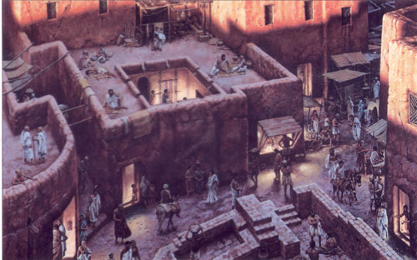
Hospitality: opening their homes to one another
⁴⁶ Day by day continuing with one mind in the temple, and breaking bread from house to house, they were taking their meals together with gladness and sincerity of heart

Slide 82
Hospitality: opening their homes to one another
Dozens of people in this room do that every week!
⁴⁶ Day by day continuing with one mind in the temple, and breaking bread from house to house, they were taking their meals together with gladness and sincerity of heart

Slide 83
Hospitality: opening their homes to one another
Dozens of people in this room do that every week!
And it’s worth it!
⁴⁶ Day by day continuing with one mind in the temple, and breaking bread from house to house, they were taking their meals together with gladness and sincerity of heart

Slide 84
They were “devoted” to doing life together
So like … How much time are they putting into this?
⁴⁶ Day by day continuing with one mind in the temple, and breaking bread from house to house, they were taking their meals together with gladness and sincerity of heart
⁴⁶ Day by day continuing with one mind in the temple, and breaking bread from house to house, they were taking their meals together with gladness and sincerity of heart

Slide 85
They were “devoted” to doing life together
Daily meetings are probably not realistic…
⁴⁶ Day by day continuing with one mind in the temple, and breaking bread from house to house, they were taking their meals together with gladness and sincerity of heart
⁴⁶ Day by day continuing with one mind in the temple, and breaking bread from house to house, they were taking their meals together with gladness and sincerity of heart

Slide 86
They were “devoted” to doing life together
Daily meetings are probably not realistic…
BUT doing life together IS realistic!
⁴⁶ Day by day continuing with one mind in the temple, and breaking bread from house to house, they were taking their meals together with gladness and sincerity of heart
⁴⁶ Day by day continuing with one mind in the temple, and breaking bread from house to house, they were taking their meals together with gladness and sincerity of heart

Slide 87
They were “devoted” to doing life together
Daily meetings are probably not realistic…
BUT doing life together IS realistic!
Not about a certain number of meetings…
⁴⁶ Day by day continuing with one mind in the temple, and breaking bread from house to house, they were taking their meals together with gladness and sincerity of heart
⁴⁶ Day by day continuing with one mind in the temple, and breaking bread from house to house, they were taking their meals together with gladness and sincerity of heart

Slide 88
They were “devoted” to doing life together
Daily meetings are probably not realistic…
BUT doing life together IS realistic!
Not about a certain number of meetings…
It’s about being faithful to make room for koinonia in whatever ways make sense
⁴⁶ Day by day continuing with one mind in the temple, and breaking bread from house to house, they were taking their meals together with gladness and sincerity of heart
⁴⁶ Day by day continuing with one mind in the temple, and breaking bread from house to house, they were taking their meals together with gladness and sincerity of heart

Slide 89
They were “devoted” to doing life together
BUT doing life together IS realistic!
Sounds a little radical…
⁴⁶ Day by day continuing with one mind in the temple, and breaking bread from house to house, they were taking their meals together with gladness and sincerity of heart
⁴⁶ Day by day continuing with one mind in the temple, and breaking bread from house to house, they were taking their meals together with gladness and sincerity of heart

Slide 90
= aphelotes: “simplicity of heart”
⁴⁶ Day by day continuing with one mind in the temple, and breaking bread from house to house, they were taking their meals together with gladness and sincerity of heart
⁴⁶ Day by day continuing with one mind in the temple, and breaking bread from house to house, they were taking their meals together with gladness and sincerity of heart

Slide 91
Pure, Honest, and Real
Not the appearance of intimacy
Not trying to get something from one another
Not FAKEY love
= aphelotes: “simplicity of heart”
⁴⁶ Day by day continuing with one mind in the temple, and breaking bread from house to house, they were taking their meals together with gladness and sincerity of heart
⁴⁶ Day by day continuing with one mind in the temple, and breaking bread from house to house, they were taking their meals together with gladness and sincerity of heart

Slide 92
Pure, Honest, and Real
Real love can’t be faked.
⁴⁶ Day by day continuing with one mind in the temple, and breaking bread from house to house, they were taking their meals together with gladness and sincerity of heart
⁴⁶ Day by day continuing with one mind in the temple, and breaking bread from house to house, they were taking their meals together with gladness and sincerity of heart
⁴⁶ Day by day continuing with one mind in the temple, and breaking bread from house to house, they were taking their meals together with gladness and sincerity of heart
⁴⁶ Day by day continuing with one mind in the temple, and breaking bread from house to house, they were taking their meals together with gladness and sincerity of heart

Slide 93
Pure, Honest, and Real
Real love can’t be faked.
And it’s a MESS
⁴⁶ Day by day continuing with one mind in the temple, and breaking bread from house to house, they were taking their meals together with gladness and sincerity of heart
⁴⁶ Day by day continuing with one mind in the temple, and breaking bread from house to house, they were taking their meals together with gladness and sincerity of heart
⁴⁶ Day by day continuing with one mind in the temple, and breaking bread from house to house, they were taking their meals together with gladness and sincerity of heart
⁴⁶ Day by day continuing with one mind in the temple, and breaking bread from house to house, they were taking their meals together with gladness and sincerity of heart

Slide 94
Pure, Honest, and Real
Real love can’t be faked.
And it’s a MESS
And we love it
⁴⁶ Day by day continuing with one mind in the temple, and breaking bread from house to house, they were taking their meals together with gladness and sincerity of heart
⁴⁶ Day by day continuing with one mind in the temple, and breaking bread from house to house, they were taking their meals together with gladness and sincerity of heart
⁴⁶ Day by day continuing with one mind in the temple, and breaking bread from house to house, they were taking their meals together with gladness and sincerity of heart
⁴⁶ Day by day continuing with one mind in the temple, and breaking bread from house to house, they were taking their meals together with gladness and sincerity of heart

Slide 95
If you want this kind of fellowship, and your life is normal at all, you’re going to have to get creative about time
⁴⁶ Day by day continuing with one mind in the temple, and breaking bread from house to house, they were taking their meals together with gladness and sincerity of heart
⁴⁶ Day by day continuing with one mind in the temple, and breaking bread from house to house, they were taking their meals together with gladness and sincerity of heart

Slide 96
They stood out … in a good way
^{Acts2:47} praising God and having favor with all the people. And the Lord was adding to their number day by day those who were being saved.

Slide 97
Another characteristic of God’s church:
it grows
^{Acts2:47} praising God and having favor with all the people. And the Lord was adding to their number day by day those who were being saved.
^{Acts2:47} praising God and having favor with all the people. And the Lord was adding to their number day by day those who were being saved.

Slide 98
After reading Luke’s description, are you satisfied with the place Christian Community
holds in your life?
Most people feel genuinely conflicted about community

Slide 99
I love the idea of being a part of something
After reading Luke’s description, are you satisfied with the place Christian Community
holds in your life?
But not today
Most people feel genuinely conflicted about community

Slide 100
After reading Luke’s description, are you satisfied with place Christian Community
holds in your life?
I want to spend time with others
But I also want the freedom to do what I want with my time
And I’m busy!
Most people feel genuinely conflicted about community

Slide 101
I want to have people I can depend on
And be totally independent
Most people feel genuinely conflicted about community

Slide 102
I want people to feel like they can depend on me
I want to be needed
In small, convenient blocks of time
Most people feel genuinely conflicted about community

Slide 103
I want to feel connected to people…
But people are messy
And hurtful
And annoying
Most people feel genuinely conflicted about community

Slide 104
I want to be known…
But not too well!
Most people feel genuinely conflicted about community

Slide 105
And so we have become experts at finding ways to have community and keep community at arm’s length at the same time
Most people feel genuinely conflicted about community

Slide 106
And so we have become experts at finding ways to have community and keep community at arm’s length at the same time
“Sunday church” is our culture’s version of koinonia
Most people feel genuinely conflicted about community

Slide 107
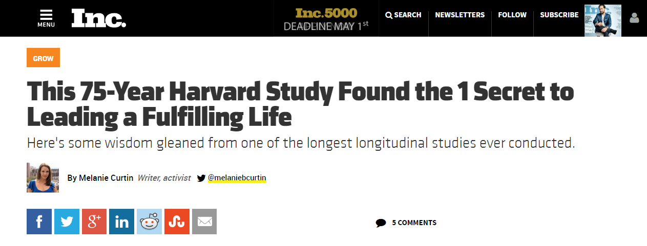
Result: people are more isolated than ever
For over 75 years, Harvard's Grant and Glueck study has tracked the physical and emotional well-being of two populations … Due to the length of the research period, this has required multiple generations of researchers. Since before WWII, they've diligently analyzed blood samples, conducted brain scans (once they became available), and pored over self-reported surveys, as well as actual interactions with these men, to compile the findings.

Slide 108
The conclusion? According to Robert Waldinger, director of the Harvard Study of Adult Development, one thing surpasses all the rest in terms of importance:

Slide 109
The conclusion? According to Robert Waldinger, director of the Harvard Study of Adult Development, one thing surpasses all the rest in terms of importance:
The conclusion? According to Robert Waldinger, director of the Harvard Study of Adult Development, one thing surpasses all the rest in terms of importance:
"The clearest message that we get from this 75-year study is this: Good relationships keep us happier and healthier. Period.”

Slide 110
Not how much is in your 401(k). Not how many conferences you spoke at--or keynoted. Not how many blog posts you wrote or how many followers you had… No, the biggest predictor of your happiness and fulfillment overall in life is, basically, love.
Specifically, the study demonstrates that having someone to rely on helps your nervous system relax, helps your brain stay healthier for longer, and reduces both emotional as well as physical pain. The data is also very clear that those who feel lonely are more likely to see their physical health decline earlier and die younger.

Slide 111
"It's not just the number of friends you have, and it's not whether or not you're in a committed relationship," says Waldinger. "It's the quality of your close relationships that matters.”
What that means is this: It doesn't matter whether you have a huge group of friends and go out every weekend or if you're in a "perfect" romantic relationship (as if those exist). It's the quality of the relationships--how much vulnerability and depth exists within them; how safe you feel sharing with one another; the extent to which you can relax and be seen for who you truly are, and truly see another.

Slide 112
"Relationships are messy and they're complicated," acknowledges Waldinger. But he's adamant in his research-backed assessment:
"The good life is built with good relationships."

Slide 113
But we don’t need a record-breaking study to tell us that

Slide 114
But we don’t need a record-breaking study to tell us that
You are MADE for relationship

Slide 115
After reading Luke’s description, are you satisfied with the place Christian Community
holds in your life?

Slide 116
After reading Luke’s description, are you satisfied with the place Christian Community
holds in your life?
You have a choice

Slide 117
After reading Luke’s description, are you satisfied with the place Christian Community
holds in your life?
You have a choice
Are you going to just accept our culture’s version of “fellowship?”

Slide 118
After reading Luke’s description, are you satisfied with the place Christian Community
holds in your life?
You have a choice
Are you going to just accept our culture’s version of “fellowship?”
Or will you dare to take another step toward the radical and fulfilling way of life laid out for us in the Bible?

Slide 119
Acts
The Church in Jerusalem
Acts 2: Community
teachings available at www.centralteachings.com

