Slide 2
Mark 5
Jesus One on One

Slide 3
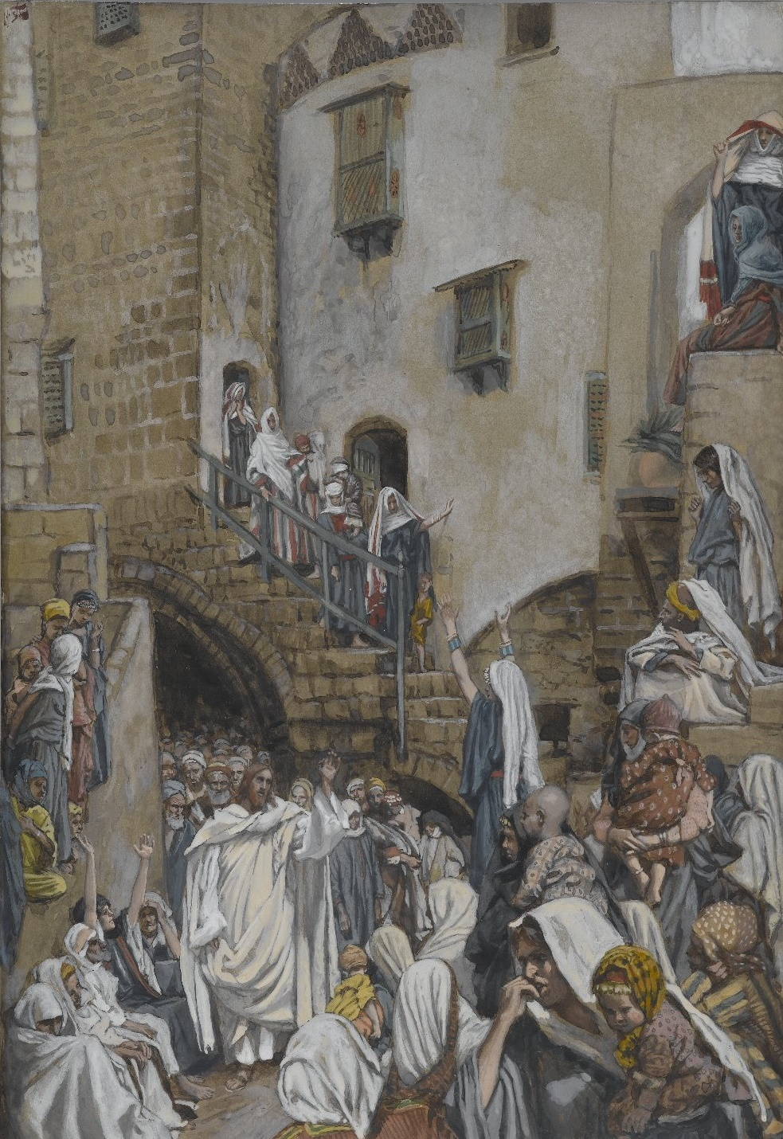
Mark 5
^{Mark 5:21} When Jesus had crossed over again in the boat to the other side, a large crowd gathered around Him; and so He stayed by the seashore.

Slide 4
^{Matt 5:22} One of the synagogue officials named Jairus came up,

Slide 5
^{Matt 5:22} One of the synagogue officials named Jairus came up, and on seeing Him, fell at His feet
²³ and implored Him earnestly, saying, “My little daughter is at the point of death; please come and lay Your hands on her, so that she will get well and live.”

Slide 6
^{Matt 5:24} And He went off with him; and a large crowd was following Him and pressing in on Him.

Slide 7
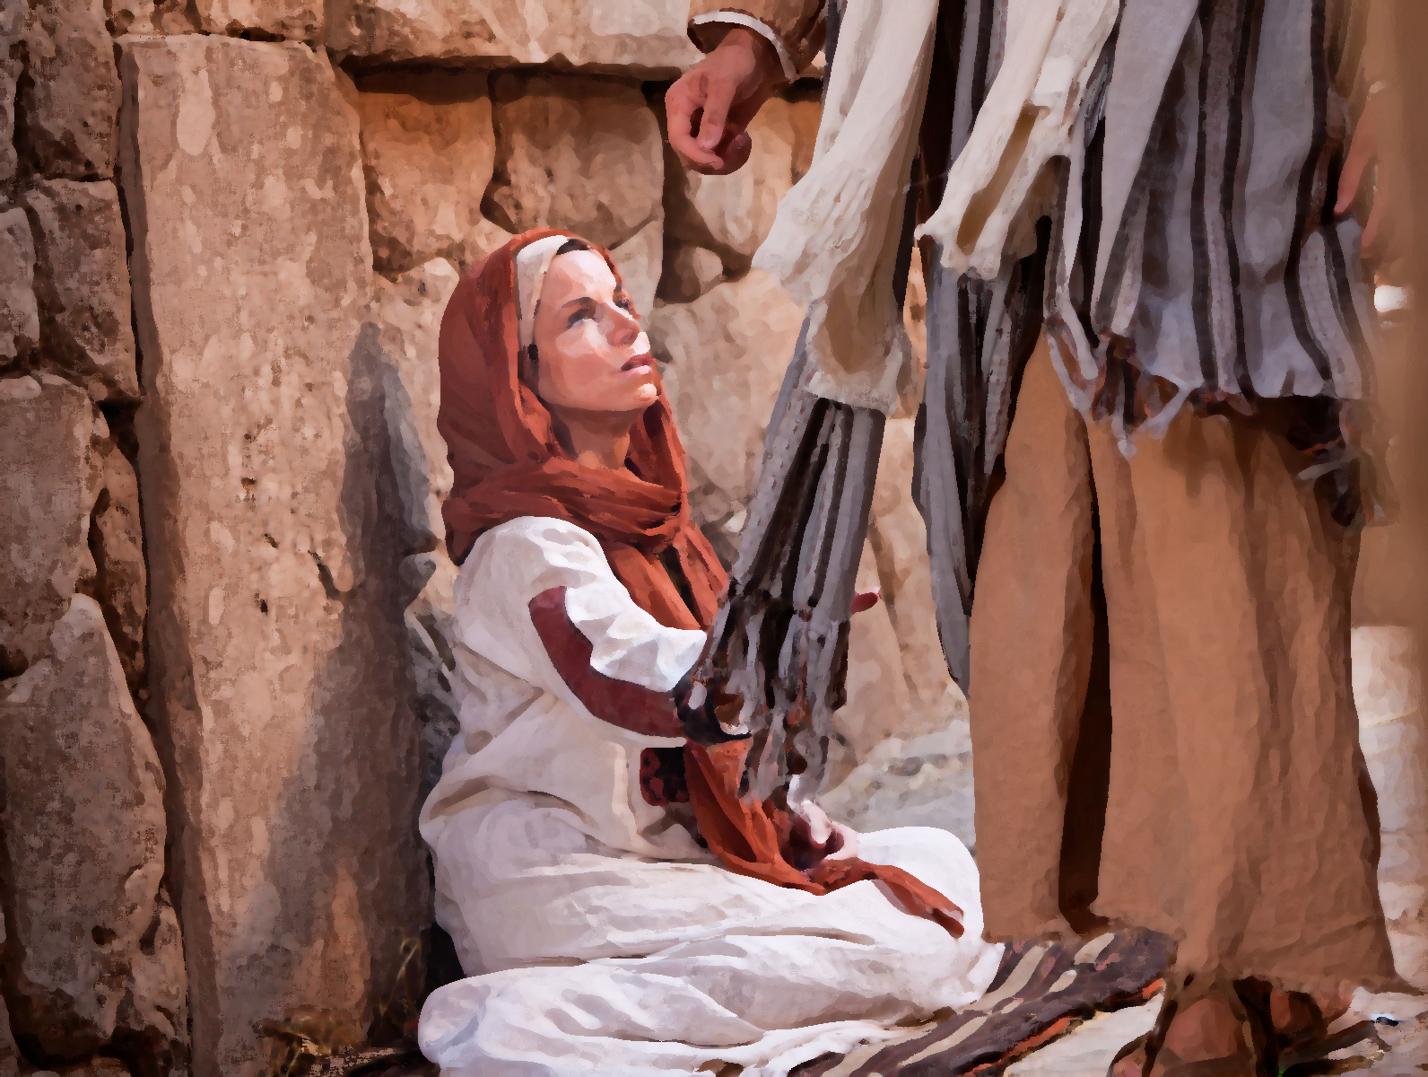
^{Mark 5:25} A woman who had had a hemorrhage for twelve years, ²⁶ and had endured much at the hands of many physicians, and had spent all that she had and was not helped at all, but rather had grown worse— ²⁷ after hearing about Jesus, she came up in the crowd

Slide 8
Physical pain
^{Mark 5:25} A woman who had had a hemorrhage for twelve years, ²⁶ and had endured much at the hands of many physicians, and had spent all that she had and was not helped at all, but rather had grown worse— ²⁷ after hearing about Jesus, she came up in the crowd

Slide 9
Physical pain
^{Mark 5:25} A woman who had had a hemorrhage for twelve years, ²⁶ and had endured much at the hands of many physicians, and had spent all that she had and was not helped at all, but rather had grown worse— ²⁷ after hearing about Jesus, she came up in the crowd

Slide 10
Physical pain
Financial Pain
^{Mark 5:25} A woman who had had a hemorrhage for twelve years, ²⁶ and had endured much at the hands of many physicians, and had spent all that she had and was not helped at all, but rather had grown worse— ²⁷ after hearing about Jesus, she came up in the crowd

Slide 11
Physical pain
Financial Pain
Social Pain
Isolation – humiliation – shame
^{Mark 5:25} A woman who had had a hemorrhage for twelve years, ²⁶ and had endured much at the hands of many physicians, and had spent all that she had and was not helped at all, but rather had grown worse— ²⁷ after hearing about Jesus, she came up in the crowd

Slide 12
Physical pain
Financial Pain
Social Pain
Isolation – humiliation – shame
^{Mark 5:25} A woman who had had a hemorrhage for twelve years, ²⁶ and had endured much at the hands of many physicians, and had spent all that she had and was not helped at all, but rather had grown worse— ²⁷ after hearing about Jesus, she came up in the crowd

Slide 13
She is the opposite of Jairus
But they do have 2 things in common …
^{Mark 5:25} A woman who had had a hemorrhage for twelve years, ²⁶ and had endured much at the hands of many physicians, and had spent all that she had and was not helped at all, but rather had grown worse— ²⁷ after hearing about Jesus, she came up in the crowd

Slide 14
She is the opposite of Jairus
But they do have 2 things in common …
^{Mark 5:27} after hearing about Jesus, she came up in the crowd behind Him and touched His cloak. ²⁸ For she thought, “If I just touch His garments, I will get well.”

Slide 15
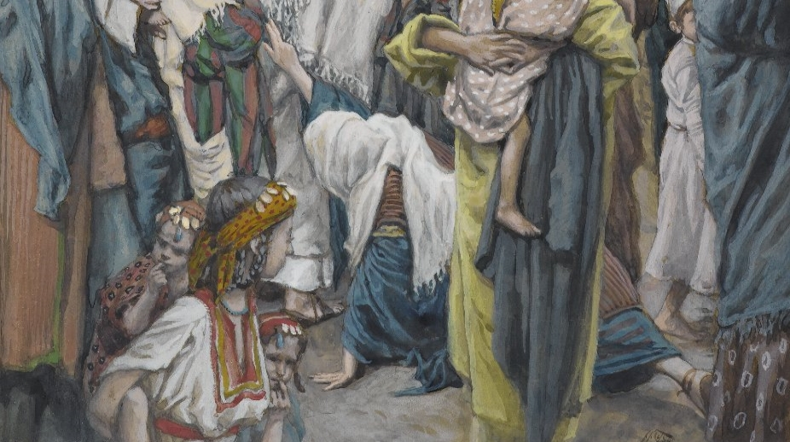
^{Mark 5:27} after hearing about Jesus, she came up in the crowd behind Him and touched His cloak. ²⁸ For she thought, “If I just touch His garments, I will get well.”

Slide 16
^{Mark 5:29} Immediately the flow of her blood was dried up; and she felt in her body that she was healed of her affliction.

Slide 17
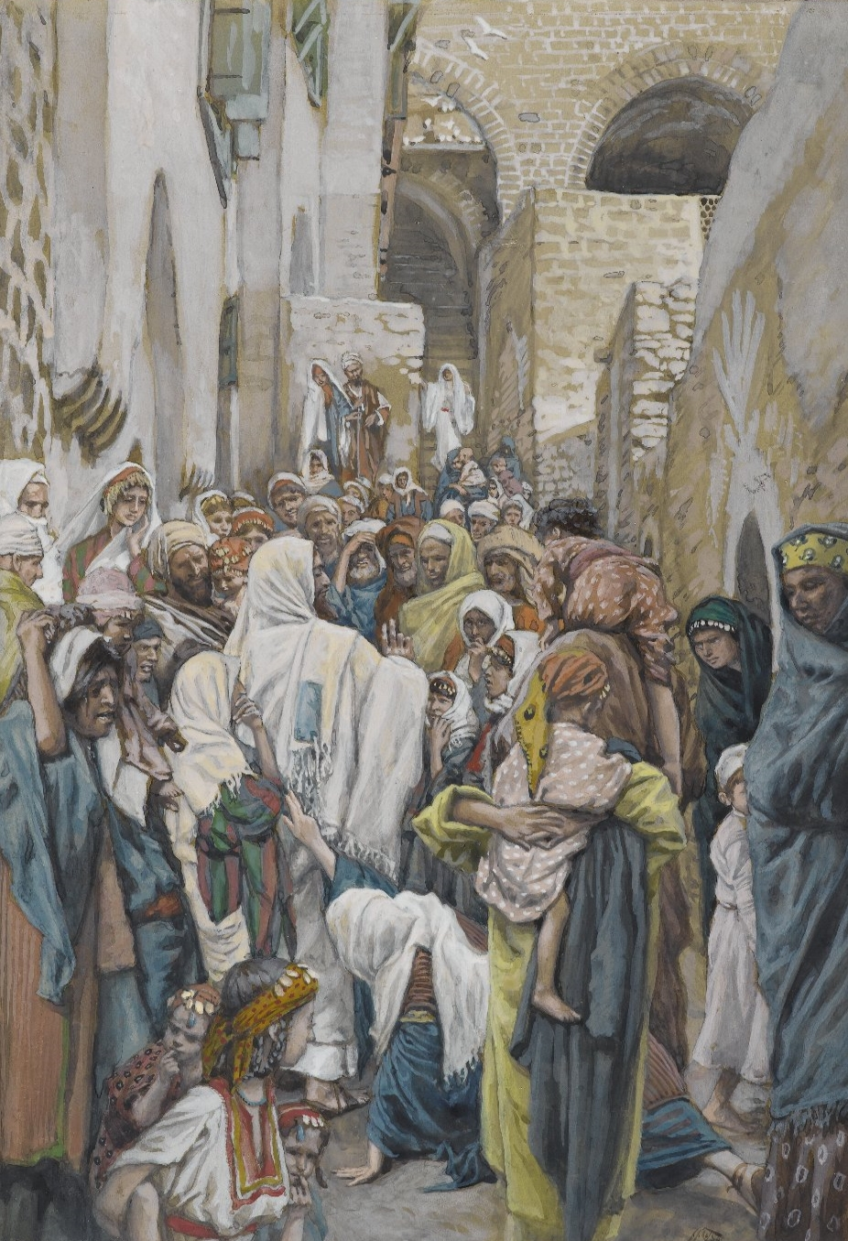
^{Mark 5:30} Immediately Jesus, perceiving in Himself that the power proceeding from Him had gone forth, turned around in the crowd and said, “Who touched My garments?”
³¹ And His disciples said to Him, “You see the crowd pressing in on You, and You say, ‘Who touched Me?’”
Physical pain
Financial Pain
Social Pain
Isolation – humiliation – shame

Slide 18
^{Mark 5:30} Immediately Jesus, perceiving in Himself that the power proceeding from Him had gone forth, turned around in the crowd and said, “Who touched My garments?”
³¹ And His disciples said to Him, “You see the crowd pressing in on You, and You say, ‘Who touched Me?’”
Physical pain
Financial Pain
Social Pain
Isolation – humiliation – shame

Slide 19
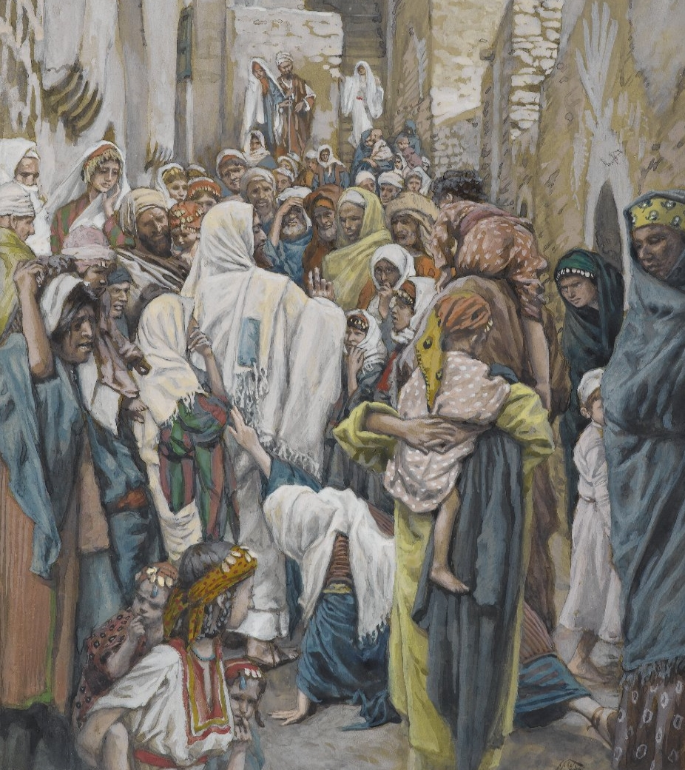
^{Mark 5:32} And He looked around to see the woman who had done this.
³³ But the woman fearing and trembling, aware of what had happened to her, came and fell down before Him and told Him the whole truth.
Physical pain
Financial Pain
Social Pain
Isolation – humiliation – shame

Slide 20
^{Mark 5:34} And He said to her,
“Daughter, your faith has made you well; go in peace and be healed of your affliction.”
Physical pain
Financial Pain
Social Pain
Isolation – humiliation – shame

Slide 21
^{Mark 5:34} And He said to her,
“Daughter, your faith has made you well; go in peace and be healed of your affliction.”
Physical pain
Financial Pain
Social Pain
Isolation – humiliation – shame

Slide 22
^{Mark 5:34} And He said to her,
“Daughter, your faith has made you well; go in peace and be healed of your affliction.”
Physical pain
Financial Pain
Social Pain
Jesus the man of compassion
Isolation – humiliation – shame

Slide 23
^{Mark 5:34} And He said to her,
“Daughter, your faith has made you well; go in peace and be healed of your affliction.”
Physical pain
Financial Pain
Social Pain
Jesus the man of compassion
Isolation – humiliation – shame

Slide 24
^{Mark 5:34} And He said to her,
“Daughter, your faith has made you well; go in peace and be healed of your affliction.”
Physical pain
Financial Pain
Social Pain
Jesus the man of compassion
Isolation – humiliation – shame
Jesus the healer of hopeless situations
Jesus the includer of outcasts

Slide 25
^{Mark 5:34} And He said to her,
“Daughter, your faith has made you well; go in peace and be healed of your affliction.”
Physical pain
Financial Pain
Social Pain
Jesus the man of compassion
Isolation – humiliation – shame
Jesus the healer of hopeless situations
Jesus the includer of outcasts

Slide 26
^{Mark 5:34} And He said to her,
“Daughter, your faith has made you well; go in peace and be healed of your affliction.”
Physical pain
Financial Pain
Social Pain
Jesus the man of compassion
Isolation – humiliation – shame
Jesus the healer of hopeless situations
Jesus the includer of outcasts
Jesus the rewarder of faith

Slide 27
^{Mark 5:34} And He said to her,
“Daughter, your faith has made you well; go in peace and be healed of your affliction.”
What is faith?
Physical pain
Financial Pain
Social Pain
Jesus the man of compassion
Isolation – humiliation – shame
Jesus the healer of hopeless situations
Jesus the includer of outcasts
Jesus the rewarder of faith

Slide 28
^{Mark 5:34} And He said to her,
“Daughter, your faith has made you well; go in peace and be healed of your affliction.”
What is faith?
Placing your trust in someone or something to the extent that you are willing to act based on that trust.
Physical pain
Financial Pain
Social Pain
Jesus the man of compassion
Isolation – humiliation – shame
Jesus the healer of hopeless situations
Jesus the includer of outcasts
Jesus the rewarder of faith

Slide 29
^{Mark 5:34} And He said to her,
“Daughter, your faith has made you well; go in peace and be healed of your affliction.”
What is faith?
Placing your trust in someone or something to the extent that you are willing to act based on that trust.
Physical pain
Financial Pain
Social Pain
Jesus the man of compassion
Isolation – humiliation – shame
Jesus the healer of hopeless situations
Jesus the includer of outcasts
Jesus the rewarder of faith

Slide 30
^{Mark 5:34} And He said to her,
“Daughter, your faith has made you well; go in peace and be healed of your affliction.”
What is faith?
Placing your trust in someone or something to the extent that you are willing to act based on that trust.
- What matters is not the amount or strength of your faith, but the object of your faith
Physical pain
Financial Pain
Social Pain
Jesus the man of compassion
Isolation – humiliation – shame
Jesus the healer of hopeless situations
Jesus the includer of outcasts
Jesus the rewarder of faith

Slide 31
^{Mark 5:34} And He said to her,
“Daughter, your faith has made you well; go in peace and be healed of your affliction.”
What is faith?
Placing your trust in someone or something to the extent that you are willing to act based on that trust.
- What matters is not the amount or strength of your faith, but the object of your faith
- God is delighted when we place our trust in Him
Physical pain
Financial Pain
Social Pain
Jesus the man of compassion
Isolation – humiliation – shame
Jesus the healer of hopeless situations
Jesus the includer of outcasts
Jesus the rewarder of faith

Slide 32
^{Mark 5:34} And He said to her,
“Daughter, your faith has made you well; go in peace and be healed of your affliction.”
Physical pain
Financial Pain
Social Pain
Jesus made the situation into a “teachable moment”
Isolation – humiliation – shame
“Everyone stop and look at this woman’s exemplary faith.”
“I am powerful. I am compassionate. I do care about your suffering and I don’t care about your uncleanness… I have come to begin to set things right and I can … I am the right place to put your faith.”

Slide 33
^{Mark 5:35} While He was still speaking, they came from the house of the synagogue official, saying, “Your daughter has died; why trouble the Teacher anymore?”
Physical pain
Financial Pain
Social Pain
Isolation – humiliation – shame

Slide 34
^{Mark 5:35} While He was still speaking, they came from the house of the synagogue official, saying, “Your daughter has died; why trouble the Teacher anymore?”
³⁶ But Jesus, overhearing what was being spoken, said to the synagogue official, “Do not be afraid any longer, only believe.”
Physical pain
Financial Pain
Social Pain
Isolation – humiliation – shame

Slide 35
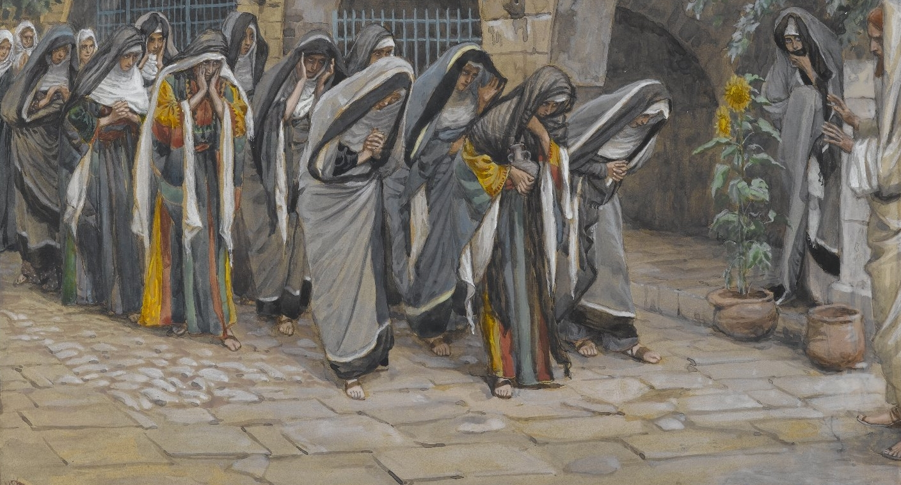
^{Mark 5:37} And He allowed no one to accompany Him, except Peter and James and John the brother of James. ³⁸ They came to the house of the synagogue official; and He saw a commotion, and people loudly weeping and wailing.

Slide 36
^{Mark 5:39} And entering in, He said to them, “Why make a commotion and weep? The child has not died, but is asleep.”
⁴⁰ They began laughing at Him.

Slide 37
^{Mark 5:40} But putting them all out, He took along the child’s father and mother and His own companions, and entered the room where the child was.

Slide 38
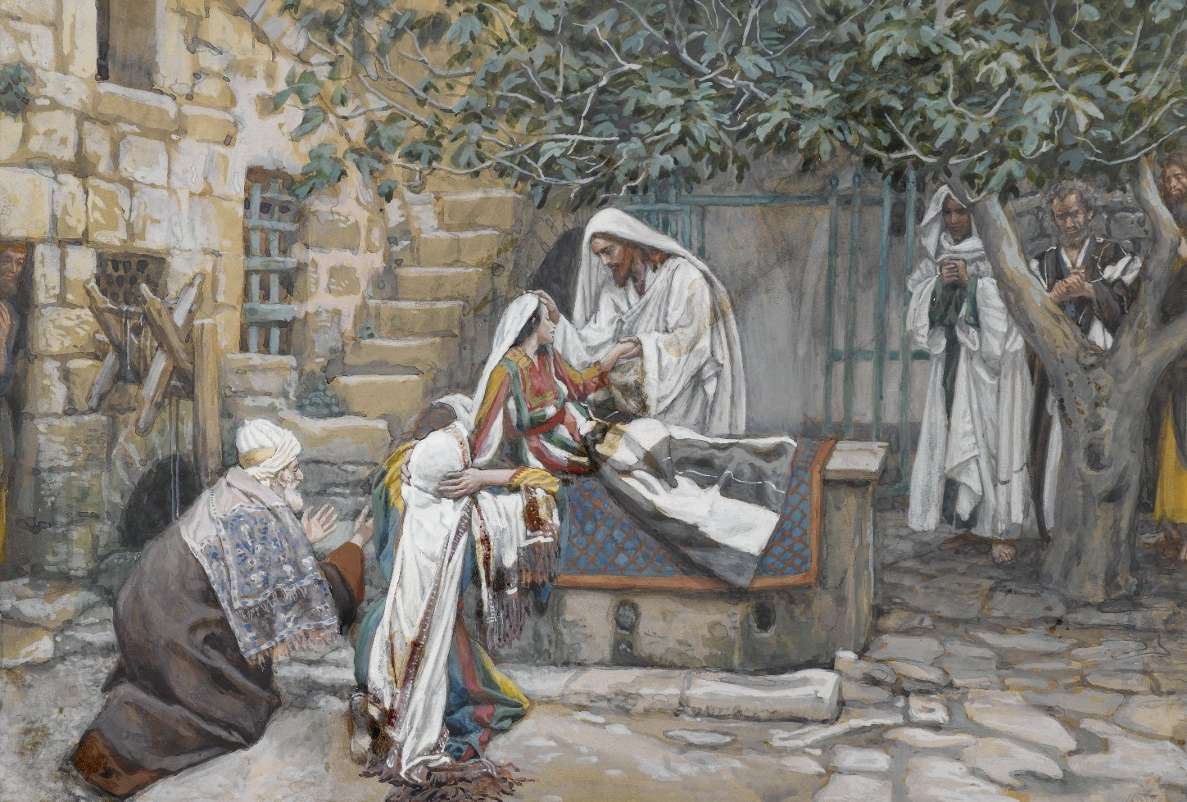
^{Mark 5:41} Taking the child by the hand, He said to her, “Talitha kum!” (which translated means, “Little girl, I say to you, get up!”).

Slide 39
Jesus’s power is absolutely adequate!
^{Mark 5:42} Immediately the girl got up and began to walk, for she was twelve years old. And immediately they were completely astounded.

Slide 40
Jesus’s power is absolutely adequate!
^{Mark 5:43} And He gave them strict orders that no one should know about this, and He said that something should be given her to eat.

Slide 41
What does this teach us about Jesus?
He can and will set hopeless and broken things right
As Christians, we go with hope in the long run, and faith in the mean time

Slide 42
What does this teach us about Salvation?

Slide 43
What does this teach us about Ourselves?

