Slide 2
Matthew 21
The Parable of the Tenants

Slide 6
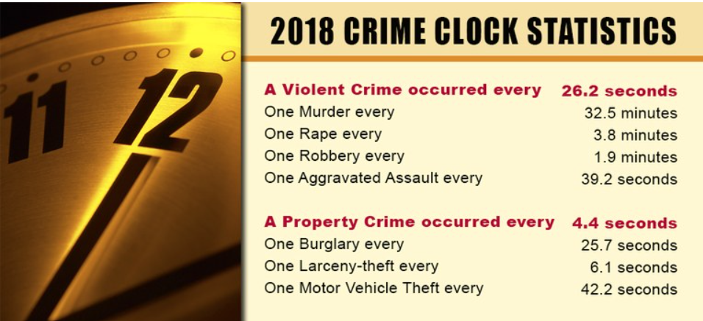

Slide 7
By studying Jesus
We see God’s nature
Character
Perspective

Slide 8
Context
Jesus’ last week before His crucifixion
The Triumphal entry
Clears out the money lenders (Matt 21:12,13)

Slide 9
Context
Making bold claims about being the Messiah!
Up rooting centuries of religious tradition!
Attacking the religious rulers of His day!
Demanding change in the way people approach God?
Jesus’ last week before His crucifixion
The Triumphal entry
Clears out the money lenders (Matt 21:12,13)

Slide 10
Context
Making bold claims about being the Messiah!
Up rooting centuries of religious tradition!
Attacking the religious rulers of His day!
Demanding change in the way people approach God?
What gives Jesus the right to do all these things?!
Jesus’ last week before His crucifixion
The Triumphal entry
Clears out the money lenders (Matt 21:12,13)

Slide 11
Matthew 21:23 (NASB95) —
Jesus answers with several parables
23 When He entered the temple, the chief priests and the elders of the people came to Him while He was teaching, and said, “By what authority are You doing these things, and who gave You this authority?”

Slide 12
Matthew 21:33 (NASB95)
33 “Listen to another parable. There was a landowner who planted a vineyard and put a wall around it and dug a wine press in it, and built a tower, and rented it out to vine-growers and went on a journey.

Slide 13
Stewardship
Share Cropping
Man and God’s relationship
God created the earth (Gen 1)
He put man in charge of its care

Slide 14
Stewardship
Genesis 1:26 (NASB95) — 26 Then God said, “Let Us make man in Our image, according to Our likeness; and let them rule over the fish of the sea and over the birds of the sky and over the cattle and over all the earth, and over every creeping thing that creeps on the earth.”
Share Cropping
Man, and God’s relationship
God created the earth (Gen 1)
He put man in charge of its care

Slide 15
Stewardship
Share Cropping
Man, and God’s relationship
God created the earth (Gen 1)
He put man in charge of its care
But it still belongs to God

Slide 16
Stewardship
Ps.50:7 "Hear, O My people, and I will speak; O Israel, I will testify against you; I am God, … 10 "For every beast of the forest is Mine, The cattle on a thousand hills. 11 "I know every bird of the mountains, And everything that moves in the field is Mine. 12 "If I were hungry, I would not tell you; For the world is Mine, and all it contains.
Share Cropping
Man, and God’s relationship
God created the earth (Gen 1)
He put man in charge of its care
But it still belongs to God

Slide 17
Matthew 21:34–40 (NASB95)
34 “When the harvest time approached, he sent his slaves to the vine-growers to receive his produce. 35 “The vine-growers took his slaves and beat one, and killed another, and stoned a third. 36 “Again he sent another group of slaves larger than the first; and they did the same thing to them.

Slide 18
Seeing this from God’s Perspective
God has something to say about…
How we should live
How we should care for His creation
How we should treat each other
How we should understand Him
How we treat His stuff

Slide 19
Seeing this from God’s Perspective
God has been patient with us
Sending prophets
Writing Scripture
Working through the Jewish people
Establishing the church

Slide 20
Matthew 21:37–40 (NASB95)
37 “But afterward he sent his son to them, saying, ‘They will respect my son.’ 38 “But when the vine-growers saw the son, they said among themselves, ‘This is the heir; come, let us kill him and seize his inheritance.’

Slide 21
Matthew 21:37–40 (NASB95)
39 “They took him and threw him out of the vineyard and killed him. 40 “Therefore when the owner of the vineyard comes, what will he do to those vine-growers?”
Great question!!

Slide 22
We have been evil and disobedient
God as the owner has something to say about how we should live.
He has sent prophets
We continue to live selfishly, harming ourselves and others

Slide 23
We have been evil and disobedient
God as the owner has something to say about how we should live.
He has sent prophets
We continue to live selfishly, harming ourselves and others
Rather than just destroy us, God sent His son

Slide 24
Matthew 21:41 (NASB95)
41 They said to Him, “He will bring those wretches to a wretched end and will rent out the vineyard to other vine-growers who will pay him the proceeds at the proper seasons.”

Slide 25
We deserve God’s Judgment
We are as bad as the renters of the vineyard
We think the picture doesn’t fit us, but it does
We run around like we own the place
Still God doesn’t want to judge us He wants to adopt us!

Slide 26
The Good News and the Bad News
There is a God
He is the owner and creator of all
We are on His planet acting like we are God
We are the reason for injustice, evil, cruelty in the world

Slide 27
The Good News and the Bad News
God isn’t like us
He want’s to be in our lives
He died so that we can be reconciled to him
We can acknowledge this and God will give us the vineyard

Slide 28
Romans 10:9–11 (NASB95)
9 that if you confess with your mouth Jesus as Lord, and believe in your heart that God raised Him from the dead, you will be saved; 10 for with the heart a person believes, resulting in righteousness, and with the mouth he confesses, resulting in salvation. 11 For the Scripture says, “Whoever believes in Him will not be disappointed.”

Slide 29
Romans 8:15–17 (NASB95)
15 For you have not received a spirit of slavery leading to fear again, but you have received a spirit of adoption as sons by which we cry out, “Abba! Father!” 16 The Spirit Himself testifies with our spirit that we are children of God, 17 and if children, heirs also, heirs of God and fellow heirs with Christ, if indeed we suffer with Him so that we may also be glorified with Him.

Slide 30
The Good News and the Bad News
Or we can be like the Pharisees
Matthew 21:45–46 (NASB95) — 45 When the chief priests and the Pharisees heard His parables, they understood that He was speaking about them. 46 When they sought to seize Him, they feared the people, because they considered Him to be a prophet.

Slide 31
The Good News and the Bad News
Or we can be like the Pharisees

Slide 32
Next Time
NO CT
Next CT Jan 2
Starting Jan 9 NEW SERIES
In Feb Matthew will continue online

