Slide 1
Acts
Acts 17 Thessalonica, Berea, and Athens

Slide 2
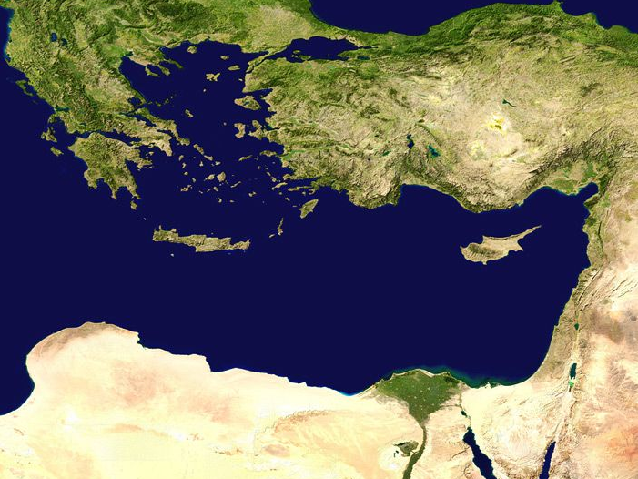
Philippi
Troas
P. Antioch
Iconium
Derbe
Lystra
Tarsus
Antioch
The Second Missionary Journey
Jerusalem

Slide 3
Thessalonica
Philippi
Troas
P. Antioch
Iconium
Derbe
Lystra
Tarsus
Antioch
The Second Missionary Journey
^{Acts 17:1} Paul and Silas then traveled through the towns of Amphipolis and Apollonia and came to Thessalonica, where there was a Jewish synagogue.

Slide 4
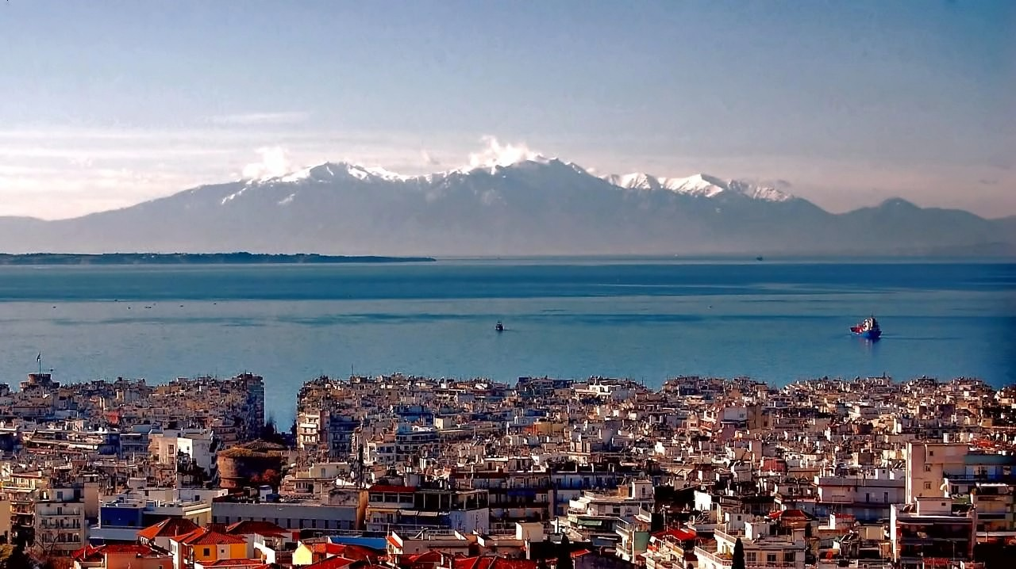
Thessalonica
Philippi
Troas
P. Antioch
Iconium
Derbe
Lystra
Tarsus
Antioch
The Second Missionary Journey
^{Acts 17:1} Paul and Silas then traveled through the towns of Amphipolis and Apollonia and came to Thessalonica, where there was a Jewish synagogue.

Slide 5
Thessalonica
Philippi
Troas
P. Antioch
Iconium
Derbe
Lystra
Tarsus
Antioch
The Second Missionary Journey
^{Acts 17:2} As was Paul’s custom, he went to the synagogue service, and for three Sabbaths in a row he used the Scriptures to reason with the people. ³ He explained the prophecies and proved that the Messiah must suffer and rise from the dead. He said, “This Jesus I’m telling you about is the Messiah.”
^{Acts 17:2} As was Paul’s custom, he went to the synagogue service, and for three Sabbaths in a row he used the Scriptures to reason with the people. ³ He explained the prophecies and proved that the Messiah must suffer and rise from the dead. He said, “This Jesus I’m telling you about is the Messiah.”

Slide 6
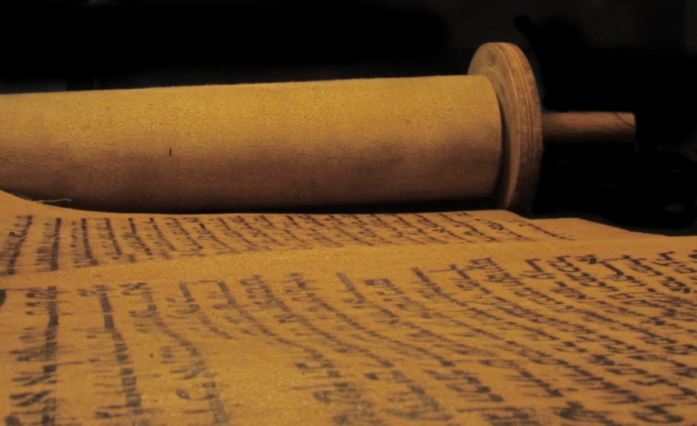
Thessalonica
Philippi
Troas
rational discourse
P. Antioch
A case from the scriptures
Iconium
Derbe
Lystra
Tarsus
Antioch
The Second Missionary Journey
^{Acts 17:2} As was Paul’s custom, he went to the synagogue service, and for three Sabbaths in a row he used the Scriptures to reason with the people. ³ He explained the prophecies and proved that the Messiah must suffer and rise from the dead. He said, “This Jesus I’m telling you about is the Messiah.”
^{Acts 17:2} As was Paul’s custom, he went to the synagogue service, and for three Sabbaths in a row he used the Scriptures to reason with the people. ³ He explained the prophecies and proved that the Messiah must suffer and rise from the dead. He said, “This Jesus I’m telling you about is the Messiah.”
^{Acts 17:2} As was Paul’s custom, he went to the synagogue service, and for three Sabbaths in a row he used the Scriptures to reason with the people. ³ He explained the prophecies and proved that the Messiah must suffer and rise from the dead. He said, “This Jesus I’m telling you about is the Messiah.”

Slide 7
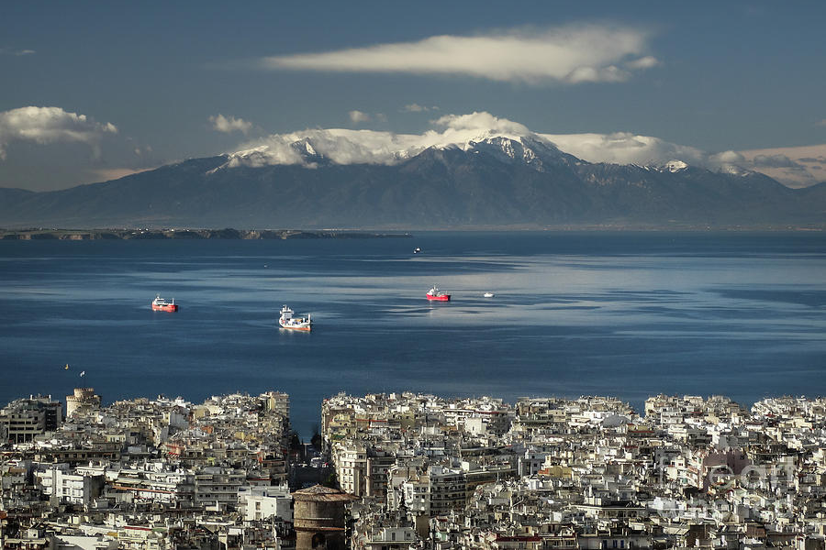
Thessalonica
Philippi
Troas
rational discourse
P. Antioch
A case from the scriptures
Iconium
Derbe
Lystra
Tarsus
Premise: the Messiah is ALSO a suffering servant
Premise: Jesus fits the OT description of Messiah
This argument holds up today!
Antioch
The Second Missionary Journey
^{Acts 17:2} As was Paul’s custom, he went to the synagogue service, and for three Sabbaths in a row he used the Scriptures to reason with the people. ³ He explained the prophecies and proved that the Messiah must suffer and rise from the dead. He said, “This Jesus I’m telling you about is the Messiah.”
^{Acts 17:2} As was Paul’s custom, he went to the synagogue service, and for three Sabbaths in a row he used the Scriptures to reason with the people. ³ He explained the prophecies and proved that the Messiah must suffer and rise from the dead. He said, “This Jesus I’m telling you about is the Messiah.”
^{Acts 17:2} As was Paul’s custom, he went to the synagogue service, and for three Sabbaths in a row he used the Scriptures to reason with the people. ³ He explained the prophecies and proved that the Messiah must suffer and rise from the dead. He said, “This Jesus I’m telling you about is the Messiah.”
^{Acts 17:2} As was Paul’s custom, he went to the synagogue service, and for three Sabbaths in a row he used the Scriptures to reason with the people. ³ He explained the prophecies and proved that the Messiah must suffer and rise from the dead. He said, “This Jesus I’m telling you about is the Messiah.”

Slide 8
^{Acts 17:4} Some of the Jews who listened were persuaded and joined Paul and Silas, along with many God-fearing Greek men and quite a few prominent women.

Slide 9
^{Acts 17:5} But some of the Jews were jealous, so they gathered some troublemakers from the marketplace to form a mob and start a riot. They attacked the home of Jason, searching for Paul and Silas so they could drag them out to the crowd.
^{Acts 17:5} But some of the Jews were jealous, so they gathered some troublemakers from the marketplace to form a mob and start a riot. They attacked the home of Jason, searching for Paul and Silas so they could drag them out to the crowd.
^{Acts 17:5} But some of the Jews were jealous, so they gathered some troublemakers from the marketplace to form a mob and start a riot. They attacked the home of Jason, searching for Paul and Silas so they could drag them out to the crowd.

Slide 10
^{Acts 17:6} Not finding them there, they dragged out Jason and some of the other believers instead and took them before the city council. “Paul and Silas have caused trouble all over the world,” they shouted, “and now they are here disturbing our city, too. ⁷ And Jason has welcomed them into his home. They are all guilty of treason against Caesar, for they profess allegiance to another king, named Jesus.”
^{Acts 17:5} But some of the Jews were jealous, so they gathered some troublemakers from the marketplace to form a mob and start a riot. They attacked the home of Jason, searching for Paul and Silas so they could drag them out to the crowd.
^{Acts 17:5} But some of the Jews were jealous, so they gathered some troublemakers from the marketplace to form a mob and start a riot. They attacked the home of Jason, searching for Paul and Silas so they could drag them out to the crowd.

Slide 11
^{Acts 17:6} Not finding them there, they dragged out Jason and some of the other believers instead and took them before the city council. “Paul and Silas have caused trouble all over the world,” they shouted, “and now they are here disturbing our city, too. ⁷ And Jason has welcomed them into his home. They are all guilty of treason against Caesar, for they profess allegiance to another king, named Jesus.”
^{Acts 17:5} But some of the Jews were jealous, so they gathered some troublemakers from the marketplace to form a mob and start a riot. They attacked the home of Jason, searching for Paul and Silas so they could drag them out to the crowd.

Slide 12
Is this a valid charge?
Is this really the issue?
^{Acts 17:6} Not finding them there, they dragged out Jason and some of the other believers instead and took them before the city council. “Paul and Silas have caused trouble all over the world,” they shouted, “and now they are here disturbing our city, too. ⁷ And Jason has welcomed them into his home. They are all guilty of treason against Caesar, for they profess allegiance to another king, named Jesus.”
^{Acts 17:5} But some of the Jews were jealous, so they gathered some troublemakers from the marketplace to form a mob and start a riot. They attacked the home of Jason, searching for Paul and Silas so they could drag them out to the crowd.
^{Acts 17:5} But some of the Jews were jealous, so they gathered some troublemakers from the marketplace to form a mob and start a riot. They attacked the home of Jason, searching for Paul and Silas so they could drag them out to the crowd.

Slide 13
^{Acts 17:8} The people of the city, as well as the city council, were thrown into turmoil by these reports. ⁹ So the officials forced Jason and the other believers to post bond, and then they released them.
^{Acts 17:8} The people of the city, as well as the city council, were thrown into turmoil by these reports. ⁹ So the officials forced Jason and the other believers to post bond, and then they released them.

Slide 14
Thessalonica
Philippi
Troas
P. Antioch
Iconium
Derbe
Lystra
Tarsus
Antioch
^{Acts 17:10} That very night the believers sent Paul and Silas to Berea. When they arrived there, they went to the Jewish synagogue.
^{Acts 17:10} That very night the believers sent Paul and Silas to Berea. When they arrived there, they went to the Jewish synagogue.

Slide 15
Thessalonica
Philippi
Troas
Berea
P. Antioch
Iconium
Derbe
Lystra
Tarsus
Antioch
^{Acts 17:10} That very night the believers sent Paul and Silas to Berea. When they arrived there, they went to the Jewish synagogue.
^{Acts 17:10} That very night the believers sent Paul and Silas to Berea. When they arrived there, they went to the Jewish synagogue.

Slide 16
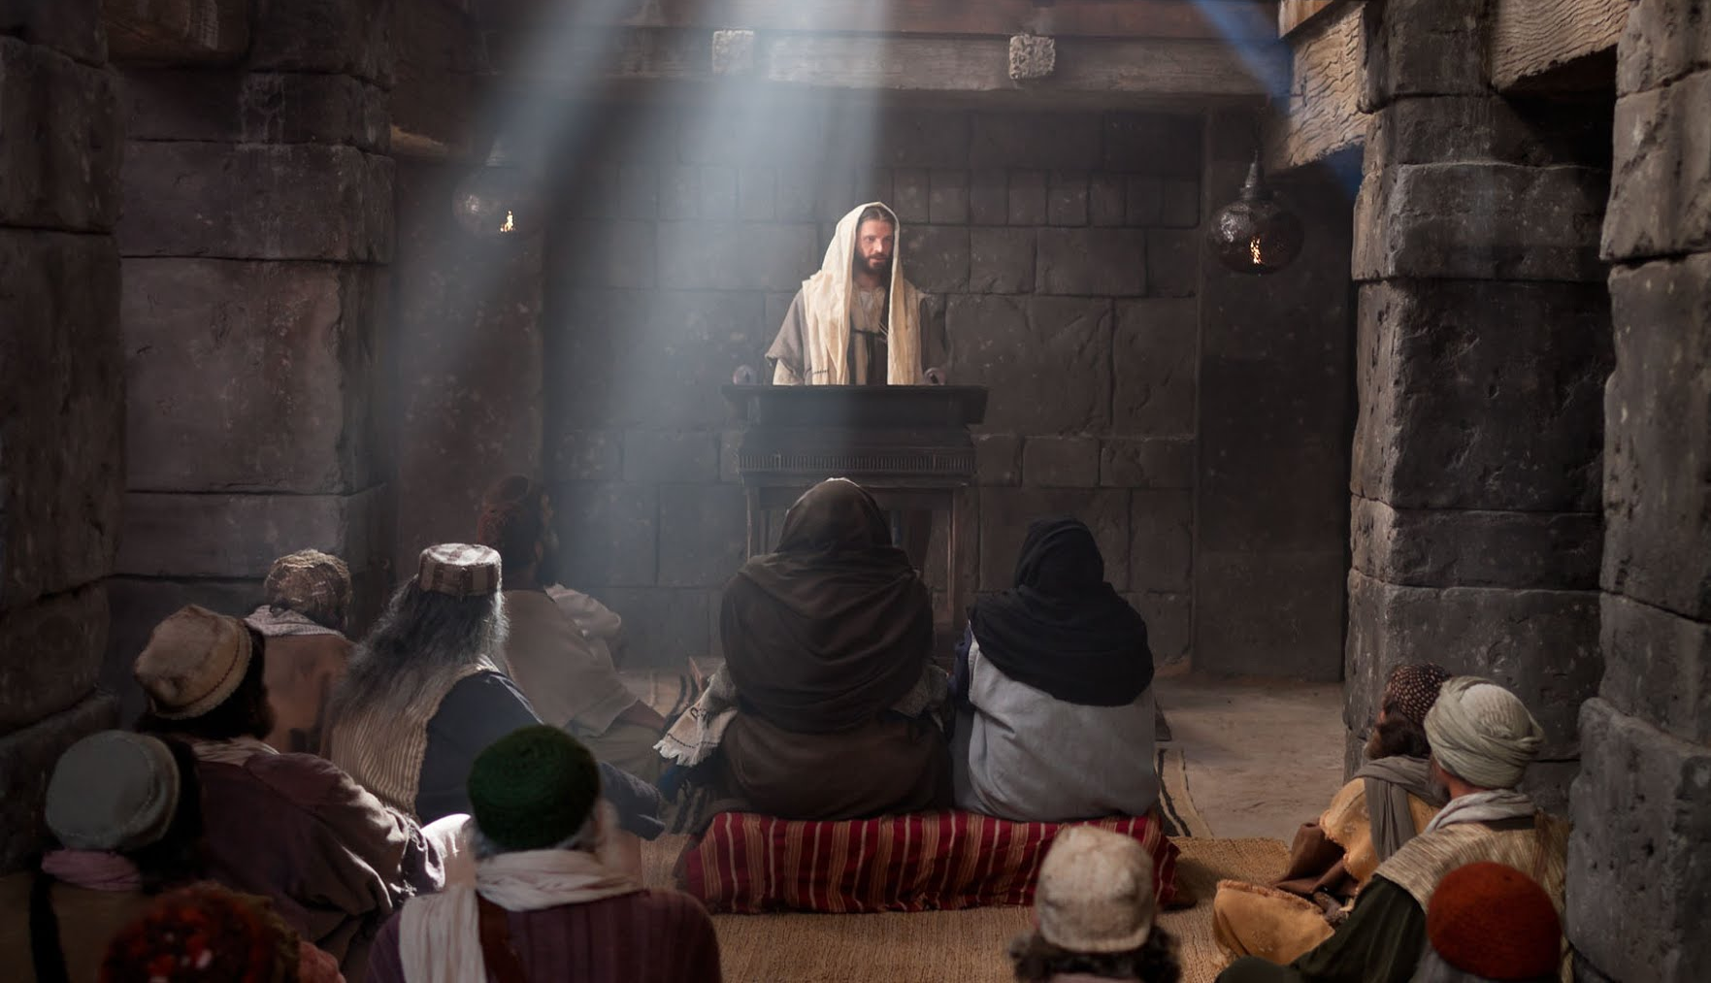
Thessalonica
Philippi
Troas
Berea
P. Antioch
Iconium
Derbe
Lystra
Tarsus
Antioch
^{Acts 17:10} That very night the believers sent Paul and Silas to Berea. When they arrived there, they went to the Jewish synagogue.
^{Acts 17:10} That very night the believers sent Paul and Silas to Berea. When they arrived there, they went to the Jewish synagogue.
^{Acts 17:10} That very night the believers sent Paul and Silas to Berea. When they arrived there, they went to the Jewish synagogue.

Slide 17
Thessalonica
Philippi
Troas
Attitude!
Berea
P. Antioch
Iconium
Derbe
Lystra
Tarsus
Antioch
^{Acts 17:11} And the people of Berea were more open-minded than those in Thessalonica, and they listened eagerly to Paul’s message. They searched the Scriptures day after day to see if Paul and Silas were teaching the truth.

Slide 18
Thessalonica
Philippi
Troas
Attitude!
Why should I believe anything?
Berea
P. Antioch
Iconium
Derbe
Lystra
Tarsus
1) Willing to listen and try to understand the message
2) Willing to do the work to evaluate the claim
Antioch
^{Acts 17:11} And the people of Berea were more open-minded than those in Thessalonica, and they listened eagerly to Paul’s message. They searched the Scriptures day after day to see if Paul and Silas were teaching the truth.
^{Acts 17:11} And the people of Berea were more open-minded than those in Thessalonica, and they listened eagerly to Paul’s message. They searched the Scriptures day after day to see if Paul and Silas were teaching the truth.
^{Acts 17:11} And the people of Berea were more open-minded than those in Thessalonica, and they listened eagerly to Paul’s message. They searched the Scriptures day after day to see if Paul and Silas were teaching the truth.

Slide 19
Thessalonica
Philippi
Troas
Berea
P. Antioch
Iconium
Derbe
Lystra
Tarsus
Antioch
^{Acts 17:12} As a result, many Jews believed, as did many of the prominent Greek women and men. ¹³ But when some Jews in Thessalonica learned that Paul was preaching the word of God in Berea, they went there and stirred up trouble.
^{Acts 17:12} As a result, many Jews believed, as did many of the prominent Greek women and men.
^{Acts 17:12} As a result, many Jews believed, as did many of the prominent Greek women and men. ¹³ But when some Jews in Thessalonica learned that Paul was preaching the word of God in Berea, they went there and stirred up trouble.

Slide 20
Thessalonica
Philippi
Troas
Berea
P. Antioch
Iconium
Derbe
Lystra
Tarsus
Antioch
^{Acts 17:14} The believers acted at once, sending Paul on to the coast, while Silas and Timothy remained behind. ¹⁵ Those escorting Paul went with him all the way to Athens; then they returned to Berea with instructions for Silas and Timothy to hurry and join him.

Slide 21
Thessalonica
Philippi
Troas
Berea
P. Antioch
Iconium
Derbe
Lystra
Tarsus
Antioch
^{Acts 17:14} The believers acted at once, sending Paul on to the coast, while Silas and Timothy remained behind. ¹⁵ Those escorting Paul went with him all the way to Athens; then they returned to Berea with instructions for Silas and Timothy to hurry and join him.

Slide 22
Thessalonica
Philippi
Troas
Berea
P. Antioch
Iconium
Derbe
Lystra
Athens
Tarsus
Antioch
^{Acts 17:14} The believers acted at once, sending Paul on to the coast, while Silas and Timothy remained behind. ¹⁵ Those escorting Paul went with him all the way to Athens; then they returned to Berea with instructions for Silas and Timothy to hurry and join him.

Slide 23
Thessalonica
Philippi
Troas
Berea
P. Antioch
Iconium
Derbe
Lystra
Athens
Tarsus
Antioch
^{Acts 17:14} The believers acted at once, sending Paul on to the coast, while Silas and Timothy remained behind. ¹⁵ Those escorting Paul went with him all the way to Athens; then they returned to Berea with instructions for Silas and Timothy to hurry and join him.

Slide 24
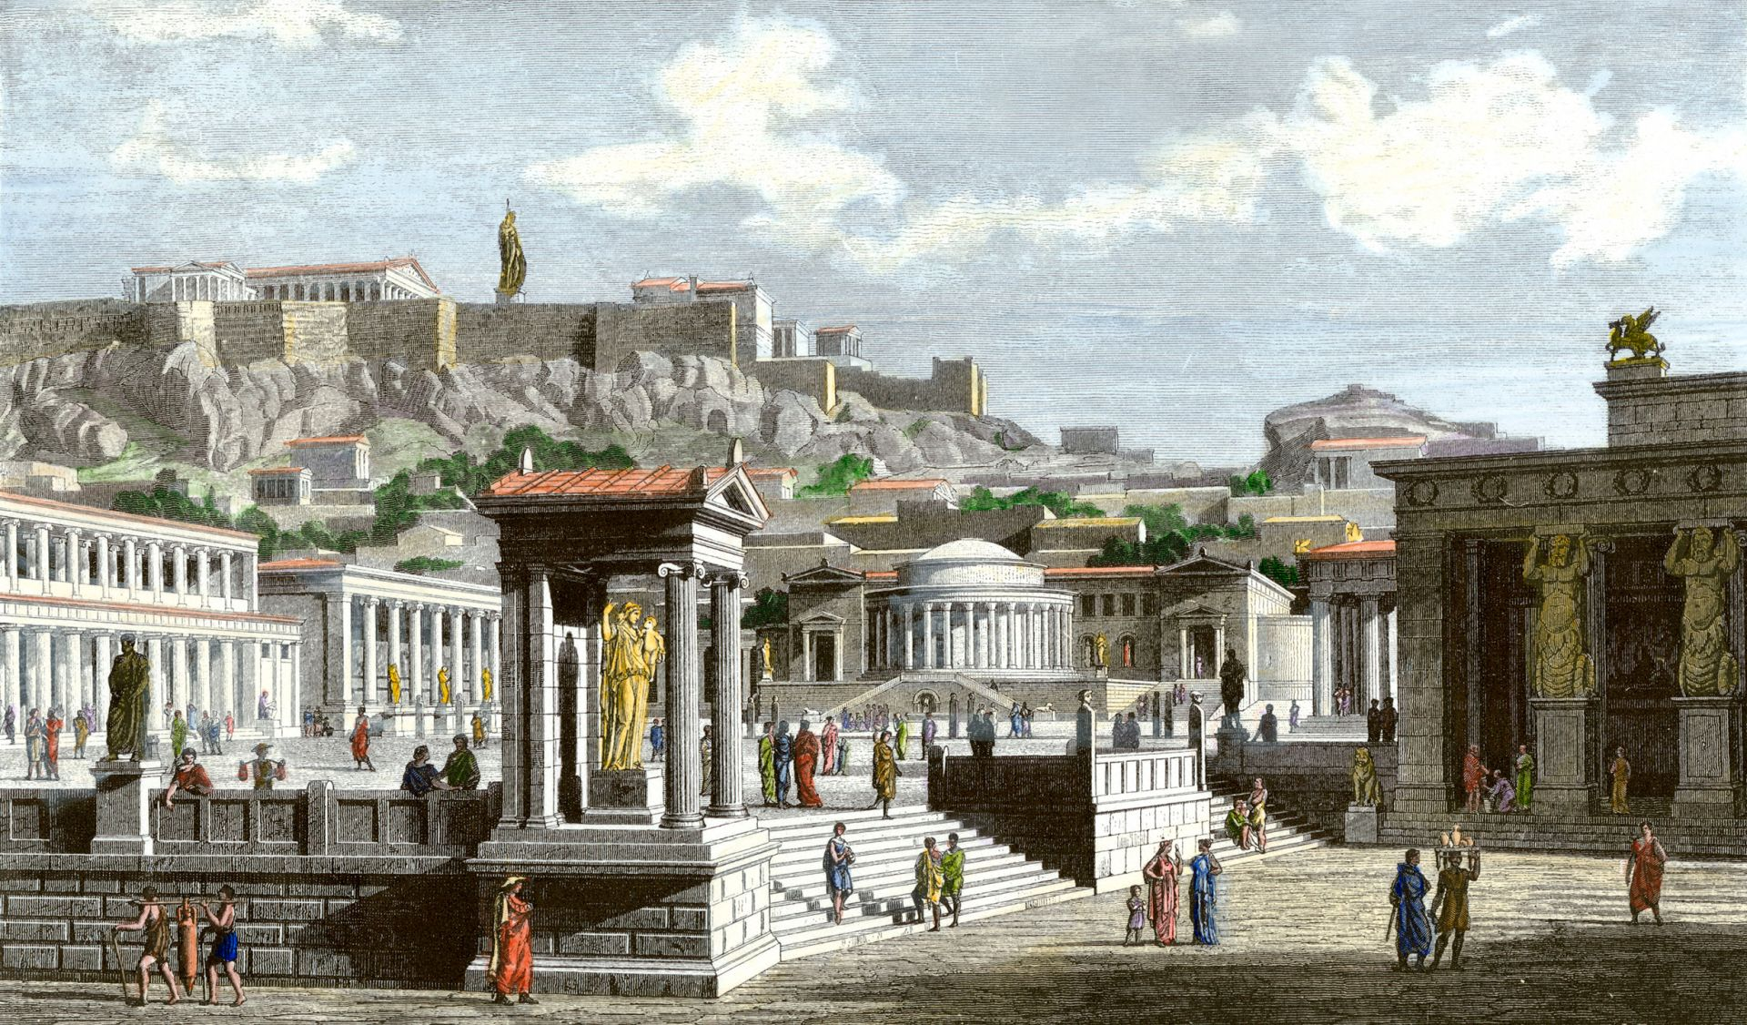
Thessalonica
Philippi
Troas
Berea
P. Antioch
Iconium
Derbe
Lystra
Athens
Tarsus
Antioch
^{Acts 17:16} While Paul was waiting for them in Athens, he was deeply troubled by all the idols he saw everywhere in the city.

Slide 25
Thessalonica
Philippi
Troas
Berea
P. Antioch
Iconium
Derbe
Lystra
Athens
Tarsus
Antioch
^{Acts 17:16} While Paul was waiting for them in Athens, he was deeply troubled by all the idols he saw everywhere in the city.
^{Acts 17:16} While Paul was waiting for them in Athens, he was deeply troubled by all the idols he saw everywhere in the city.

Slide 26
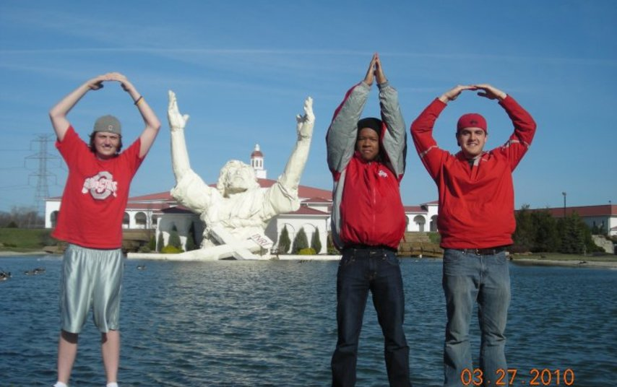
Thessalonica
Philippi
Troas
Berea
P. Antioch
Iconium
Derbe
Lystra
Athens
Tarsus
Antioch
^{Acts 17:16} While Paul was waiting for them in Athens, he was deeply troubled by all the idols he saw everywhere in the city.
^{Acts 17:16} While Paul was waiting for them in Athens, he was deeply troubled by all the idols he saw everywhere in the city.

Slide 27
It’s sad to believe in something that is not true
Thessalonica
Philippi
Troas
Berea
P. Antioch
Iconium
Derbe
Lystra
Athens
Tarsus
Antioch
^{Acts 17:16} While Paul was waiting for them in Athens, he was deeply troubled by all the idols he saw everywhere in the city.
^{Acts 17:16} While Paul was waiting for them in Athens, he was deeply troubled by all the idols he saw everywhere in the city.

Slide 28
It’s sad to believe in something that is not true
Thessalonica
Philippi
Troas
Berea
P. Antioch
Because it can’t actually help you
Iconium
Derbe
Lystra
Athens
Tarsus
Antioch
^{Acts 17:16} While Paul was waiting for them in Athens, he was deeply troubled by all the idols he saw everywhere in the city.
^{Acts 17:16} While Paul was waiting for them in Athens, he was deeply troubled by all the idols he saw everywhere in the city.

Slide 29
It’s sad to believe in something that is not true
Thessalonica
Philippi
Troas
Berea
P. Antioch
Because it can’t actually help you
Iconium
Derbe
It may actually be harming you!
Lystra
Athens
Tarsus
Antioch
^{Acts 17:16} While Paul was waiting for them in Athens, he was deeply troubled by all the idols he saw everywhere in the city.
^{Acts 17:16} While Paul was waiting for them in Athens, he was deeply troubled by all the idols he saw everywhere in the city.

Slide 30
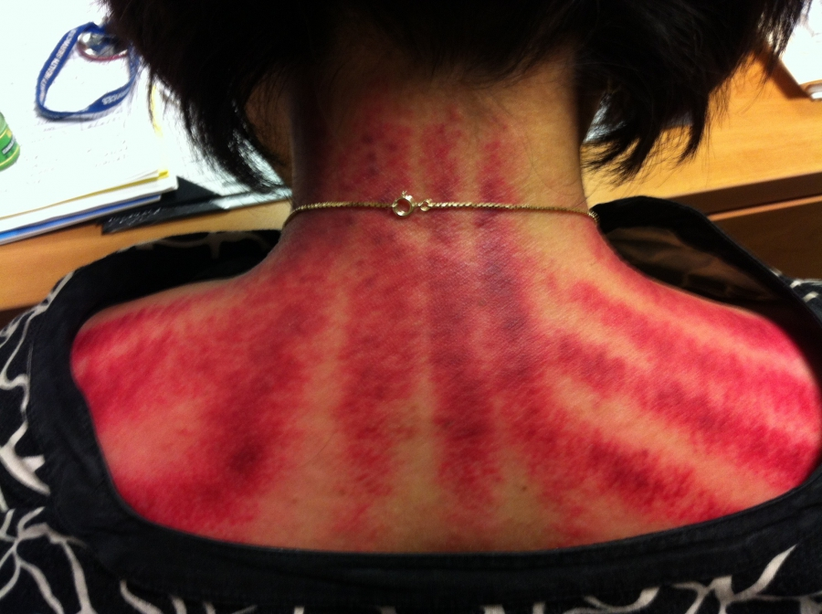
It’s sad to believe in something that is not true
Thessalonica
Philippi
Troas
Berea
P. Antioch
Because it can’t actually help you
Iconium
Derbe
It may actually be harming you!
Lystra
Athens
Tarsus
Antioch
^{Acts 17:16} While Paul was waiting for them in Athens, he was deeply troubled by all the idols he saw everywhere in the city.
^{Acts 17:16} While Paul was waiting for them in Athens, he was deeply troubled by all the idols he saw everywhere in the city.

Slide 31
It’s sad to believe in something that is not true
Thessalonica
Philippi
Troas
Berea
P. Antioch
Because it can’t actually help you
Iconium
Derbe
It may actually be harming you!
Lystra
Athens
Tarsus
A poor substitute for TRUTH
Antioch
^{Acts 17:16} While Paul was waiting for them in Athens, he was deeply troubled by all the idols he saw everywhere in the city.
^{Acts 17:16} While Paul was waiting for them in Athens, he was deeply troubled by all the idols he saw everywhere in the city.

Slide 32
Thessalonica
Philippi
Troas
Berea
P. Antioch
Iconium
Derbe
Lystra
Athens
Tarsus
Antioch
^{Acts 17:16} While Paul was waiting for them in Athens, he was deeply troubled by all the idols he saw everywhere in the city.
^{Acts 17:17} He went to the synagogue to reason with the Jews and the God-fearing Gentiles, and he spoke daily in the public square to all who happened to be there.

Slide 33
Thessalonica
Philippi
Troas
Berea
P. Antioch
Iconium
Derbe
Lystra
Athens
Tarsus
Antioch
^{Acts 17:18} He also had a debate with some of the Epicurean and Stoic philosophers.
^{Acts 17:16} While Paul was waiting for them in Athens, he was deeply troubled by all the idols he saw everywhere in the city.
^{Acts 17:18} He also had a debate with some of the Epicurean and Stoic philosophers.
^{Acts 17:18} He also had a debate with some of the Epicurean and Stoic philosophers.

Slide 34
Thessalonica
Philippi
Troas
Berea
P. Antioch
Iconium
Derbe
Lystra
Athens
Tarsus
Antioch
^{Acts 17:18} When he told them about Jesus and his resurrection, they said, “What’s this babbler trying to say with these strange ideas he’s picked up?” Others said, “He seems to be preaching about some foreign gods.”
^{Acts 17:18} When he told them about Jesus and his resurrection, they said, “What’s this babbler trying to say with these strange ideas he’s picked up?” Others said, “He seems to be preaching about some foreign gods.”
^{Acts 17:16} While Paul was waiting for them in Athens, he was deeply troubled by all the idols he saw everywhere in the city.
^{Acts 17:18} He also had a debate with some of the Epicurean and Stoic philosophers.

Slide 35
Thessalonica
Philippi
Troas
Berea
P. Antioch
Iconium
Derbe
Lystra
Athens
Tarsus
Antioch
“spermologos”
^{Acts 17:18} When he told them about Jesus and his resurrection, they said, “What’s this babbler trying to say with these strange ideas he’s picked up?” Others said, “He seems to be preaching about some foreign gods.”
^{Acts 17:18} When he told them about Jesus and his resurrection, they said, “What’s this babbler trying to say with these strange ideas he’s picked up?” Others said, “He seems to be preaching about some foreign gods.”
^{Acts 17:16} While Paul was waiting for them in Athens, he was deeply troubled by all the idols he saw everywhere in the city.
^{Acts 17:18} He also had a debate with some of the Epicurean and Stoic philosophers.

Slide 36
Thessalonica
Philippi
Troas
Berea
P. Antioch
Iconium
Derbe
Lystra
Athens
Tarsus
Antioch
^{Acts 17:18} When he told them about Jesus and his resurrection, they said, “What’s this babbler trying to say with these strange ideas he’s picked up?” Others said, “He seems to be preaching about some foreign gods.”
^{Acts 17:18} When he told them about Jesus and his resurrection, they said, “What’s this babbler trying to say with these strange ideas he’s picked up?” Others said, “He seems to be preaching about some foreign gods.”
^{Acts 17:16} While Paul was waiting for them in Athens, he was deeply troubled by all the idols he saw everywhere in the city.
^{Acts 17:18} He also had a debate with some of the Epicurean and Stoic philosophers.

Slide 37
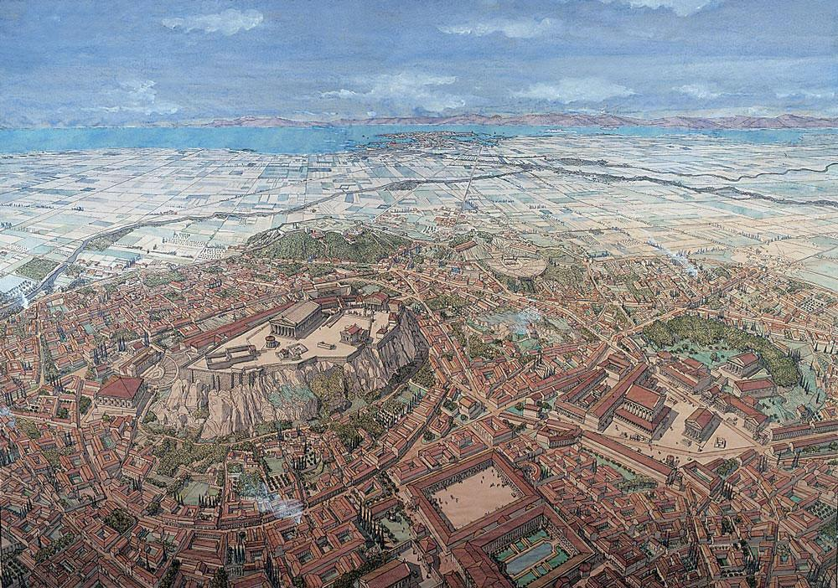
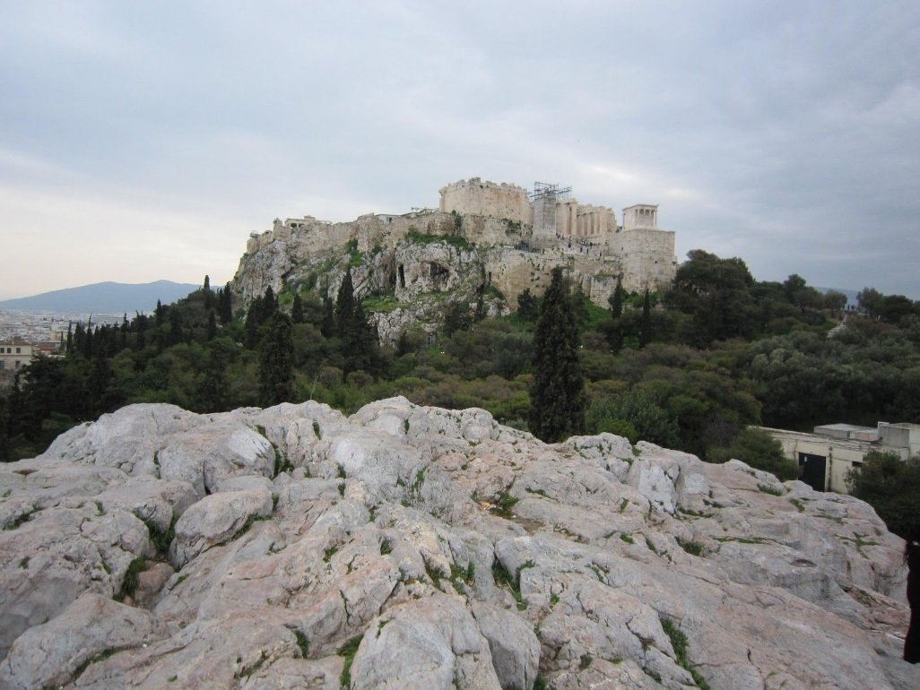
Thessalonica
Philippi
Troas
Berea
P. Antioch
Iconium
Derbe
Lystra
Athens
Tarsus
Antioch
“Areios Pagos” Areopagus
^{Acts 17:18} When he told them about Jesus and his resurrection, they said, “What’s this babbler trying to say with these strange ideas he’s picked up?” Others said, “He seems to be preaching about some foreign gods.”
^{Acts 17:19} Then they took him to the high council of the city. “Come and tell us about this new teaching,” they said. ²⁰ “You are saying some rather strange things, and we want to know what it’s all about.”
^{Acts 17:16} While Paul was waiting for them in Athens, he was deeply troubled by all the idols he saw everywhere in the city.
^{Acts 17:18} He also had a debate with some of the Epicurean and Stoic philosophers.

Slide 38
Thessalonica
Philippi
Troas
Berea
P. Antioch
Iconium
Derbe
Lystra
Athens
Tarsus
Antioch
^{Acts 17:18} When he told them about Jesus and his resurrection, they said, “What’s this babbler trying to say with these strange ideas he’s picked up?” Others said, “He seems to be preaching about some foreign gods.”
^{Acts 17:19} Then they took him to the high council of the city. “Come and tell us about this new teaching,” they said. ²⁰ “You are saying some rather strange things, and we want to know what it’s all about.”
^{Acts 17:16} While Paul was waiting for them in Athens, he was deeply troubled by all the idols he saw everywhere in the city.
^{Acts 17:18} He also had a debate with some of the Epicurean and Stoic philosophers.

Slide 39
Thessalonica
Philippi
Troas
Berea
P. Antioch
Iconium
Derbe
Lystra
Athens
Tarsus
Antioch
“Areios Pagos” Areopagus
^{Acts 17:18} When he told them about Jesus and his resurrection, they said, “What’s this babbler trying to say with these strange ideas he’s picked up?” Others said, “He seems to be preaching about some foreign gods.”
^{Acts 17:19} Then they took him to the high council of the city. “Come and tell us about this new teaching,” they said. ²⁰ “You are saying some rather strange things, and we want to know what it’s all about.”
^{Acts 17:16} While Paul was waiting for them in Athens, he was deeply troubled by all the idols he saw everywhere in the city.
^{Acts 17:18} He also had a debate with some of the Epicurean and Stoic philosophers.

Slide 40
Thessalonica
Philippi
Troas
Berea
P. Antioch
Iconium
Derbe
Lystra
Athens
Tarsus
Antioch
“Areios Pagos” Areopagus
^{Acts 17:18} When he told them about Jesus and his resurrection, they said, “What’s this babbler trying to say with these strange ideas he’s picked up?” Others said, “He seems to be preaching about some foreign gods.”
^{Acts 17:19} Then they took him to the high council of the city. “Come and tell us about this new teaching,” they said. ²⁰ “You are saying some rather strange things, and we want to know what it’s all about.”
^{Acts 17:16} While Paul was waiting for them in Athens, he was deeply troubled by all the idols he saw everywhere in the city.
^{Acts 17:18} He also had a debate with some of the Epicurean and Stoic philosophers.

Slide 41
Thessalonica
Philippi
Troas
Berea
P. Antioch
Iconium
Derbe
Lystra
Athens
Tarsus
Antioch
“Areios Pagos” Areopagus
^{Acts 17:18} When he told them about Jesus and his resurrection, they said, “What’s this babbler trying to say with these strange ideas he’s picked up?” Others said, “He seems to be preaching about some foreign gods.”
^{Acts 17:19} Then they took him to the high council of the city. “Come and tell us about this new teaching,” they said. ²⁰ “You are saying some rather strange things, and we want to know what it’s all about.”
^{Acts 17:16} While Paul was waiting for them in Athens, he was deeply troubled by all the idols he saw everywhere in the city.
^{Acts 17:18} He also had a debate with some of the Epicurean and Stoic philosophers.

Slide 42
Thessalonica
Philippi
Troas
Berea
P. Antioch
Iconium
Derbe
Lystra
Athens
Tarsus
Antioch
^{Acts 17:18} When he told them about Jesus and his resurrection, they said, “What’s this babbler trying to say with these strange ideas he’s picked up?” Others said, “He seems to be preaching about some foreign gods.”
^{Acts 17:19} Then they took him to the high council of the city. “Come and tell us about this new teaching,” they said. ²⁰ “You are saying some rather strange things, and we want to know what it’s all about.”
^{Acts 17:16} While Paul was waiting for them in Athens, he was deeply troubled by all the idols he saw everywhere in the city.
^{Acts 17:18} He also had a debate with some of the Epicurean and Stoic philosophers.

Slide 43
Thessalonica
Philippi
Troas
Berea
P. Antioch
Iconium
Derbe
Lystra
Athens
Tarsus
Antioch
^{Acts 17:18} When he told them about Jesus and his resurrection, they said, “What’s this babbler trying to say with these strange ideas he’s picked up?” Others said, “He seems to be preaching about some foreign gods.”
^{Acts 17:21} (It should be explained that all the Athenians as well as the foreigners in Athens seemed to spend all their time discussing the latest ideas.)
^{Acts 17:16} While Paul was waiting for them in Athens, he was deeply troubled by all the idols he saw everywhere in the city.
^{Acts 17:18} He also had a debate with some of the Epicurean and Stoic philosophers.

Slide 44
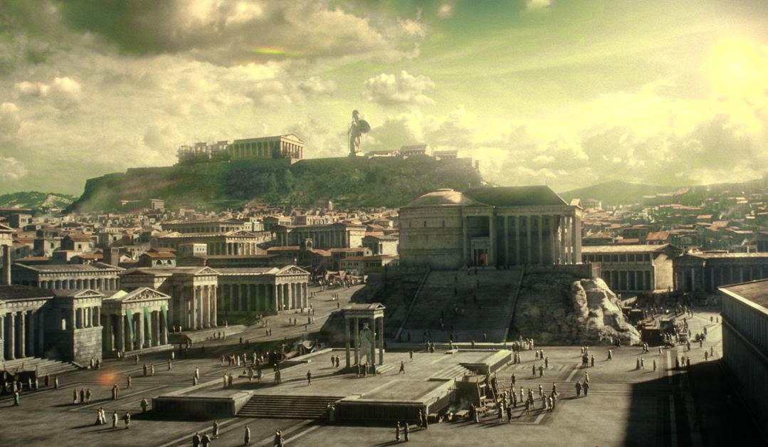
^{Acts 17:22} So Paul, standing before the council, addressed them as follows:
^{Acts 17:18} When he told them about Jesus and his resurrection, they said, “What’s this babbler trying to say with these strange ideas he’s picked up?” Others said, “He seems to be preaching about some foreign gods.”
^{Acts 17:16} While Paul was waiting for them in Athens, he was deeply troubled by all the idols he saw everywhere in the city.
^{Acts 17:18} He also had a debate with some of the Epicurean and Stoic philosophers.

Slide 45
^{Acts 17:22} “Men of Athens, I notice that you are very religious in every way, ²³ for as I was walking along I saw your many shrines. And one of your altars had this inscription on it: ‘To an Unknown God.’ This God, whom you worship without knowing, is the one I’m telling you about.
^{Acts 17:18} When he told them about Jesus and his resurrection, they said, “What’s this babbler trying to say with these strange ideas he’s picked up?” Others said, “He seems to be preaching about some foreign gods.”
^{Acts 17:16} While Paul was waiting for them in Athens, he was deeply troubled by all the idols he saw everywhere in the city.
^{Acts 17:18} He also had a debate with some of the Epicurean and Stoic philosophers.

Slide 46
^{Acts 17:22} “Men of Athens, I notice that you are very religious in every way, ²³ for as I was walking along I saw your many shrines. And one of your altars had this inscription on it: ‘To an Unknown God.’ This God, whom you worship without knowing, is the one I’m telling you about.
^{Acts 17:18} When he told them about Jesus and his resurrection, they said, “What’s this babbler trying to say with these strange ideas he’s picked up?” Others said, “He seems to be preaching about some foreign gods.”
^{Acts 17:16} While Paul was waiting for them in Athens, he was deeply troubled by all the idols he saw everywhere in the city.
^{Acts 17:18} He also had a debate with some of the Epicurean and Stoic philosophers.

Slide 47
“YHWH 101”
…a contrast
^{Acts 17:22} “Men of Athens, I notice that you are very religious in every way, ²³ for as I was walking along I saw your many shrines. And one of your altars had this inscription on it: ‘To an Unknown God.’ This God, whom you worship without knowing, is the one I’m telling you about.
^{Acts 17:18} When he told them about Jesus and his resurrection, they said, “What’s this babbler trying to say with these strange ideas he’s picked up?” Others said, “He seems to be preaching about some foreign gods.”
^{Acts 17:16} While Paul was waiting for them in Athens, he was deeply troubled by all the idols he saw everywhere in the city.
^{Acts 17:18} He also had a debate with some of the Epicurean and Stoic philosophers.

Slide 48
A creator
“YHWH 101”
…a contrast
^{Acts 17:24} “He is the God who made the world and everything in it. Since he is Lord of heaven and earth, he doesn’t live in man-made temples
^{Acts 17:18} When he told them about Jesus and his resurrection, they said, “What’s this babbler trying to say with these strange ideas he’s picked up?” Others said, “He seems to be preaching about some foreign gods.”
^{Acts 17:16} While Paul was waiting for them in Athens, he was deeply troubled by all the idols he saw everywhere in the city.
^{Acts 17:18} He also had a debate with some of the Epicurean and Stoic philosophers.

Slide 49
A creator
“YHWH 101”
Transcendent
…a contrast
^{Acts 17:24} “He is the God who made the world and everything in it. Since he is Lord of heaven and earth, he doesn’t live in man-made temples
^{Acts 17:18} When he told them about Jesus and his resurrection, they said, “What’s this babbler trying to say with these strange ideas he’s picked up?” Others said, “He seems to be preaching about some foreign gods.”
^{Acts 17:16} While Paul was waiting for them in Athens, he was deeply troubled by all the idols he saw everywhere in the city.
^{Acts 17:18} He also had a debate with some of the Epicurean and Stoic philosophers.

Slide 50
Transcendent
“YHWH 101”
Self Sufficient
…a contrast
^{Acts 17:25} and human hands can’t serve his needs—for he has no needs. He himself gives life and breath to everything, and he satisfies every need.
^{Acts 17:18} When he told them about Jesus and his resurrection, they said, “What’s this babbler trying to say with these strange ideas he’s picked up?” Others said, “He seems to be preaching about some foreign gods.”
^{Acts 17:16} While Paul was waiting for them in Athens, he was deeply troubled by all the idols he saw everywhere in the city.
^{Acts 17:18} He also had a debate with some of the Epicurean and Stoic philosophers.

Slide 51
Self Sufficient
“YHWH 101”
A Life-Giver
…a contrast
^{Acts 17:25} and human hands can’t serve his needs—for he has no needs. He himself gives life and breath to everything, and he satisfies every need.
^{Acts 17:18} When he told them about Jesus and his resurrection, they said, “What’s this babbler trying to say with these strange ideas he’s picked up?” Others said, “He seems to be preaching about some foreign gods.”
^{Acts 17:16} While Paul was waiting for them in Athens, he was deeply troubled by all the idols he saw everywhere in the city.
^{Acts 17:18} He also had a debate with some of the Epicurean and Stoic philosophers.

Slide 52
Originator of all things
“YHWH 101”
A Life-Giver
…a contrast
^{Acts 17:26} From one man he created all the nations throughout the whole earth. He decided beforehand when they should rise and fall, and he determined their boundaries.
^{Acts 17:18} When he told them about Jesus and his resurrection, they said, “What’s this babbler trying to say with these strange ideas he’s picked up?” Others said, “He seems to be preaching about some foreign gods.”
^{Acts 17:16} While Paul was waiting for them in Athens, he was deeply troubled by all the idols he saw everywhere in the city.
^{Acts 17:18} He also had a debate with some of the Epicurean and Stoic philosophers.

Slide 53
Originator of all things
“YHWH 101”
Sovereign God of history, outside of time
…a contrast
^{Acts 17:26} From one man he created all the nations throughout the whole earth. He decided beforehand when they should rise and fall, and he determined their boundaries.
^{Acts 17:18} When he told them about Jesus and his resurrection, they said, “What’s this babbler trying to say with these strange ideas he’s picked up?” Others said, “He seems to be preaching about some foreign gods.”
^{Acts 17:16} While Paul was waiting for them in Athens, he was deeply troubled by all the idols he saw everywhere in the city.
^{Acts 17:18} He also had a debate with some of the Epicurean and Stoic philosophers.

Slide 54
Sovereign God of history, outside of time
“YHWH 101”
Has a will, a personal God
…a contrast
^{Acts 17:26} From one man he created all the nations throughout the whole earth. He decided beforehand when they should rise and fall, and he determined their boundaries.
^{Acts 17:18} When he told them about Jesus and his resurrection, they said, “What’s this babbler trying to say with these strange ideas he’s picked up?” Others said, “He seems to be preaching about some foreign gods.”
^{Acts 17:16} While Paul was waiting for them in Athens, he was deeply troubled by all the idols he saw everywhere in the city.
^{Acts 17:18} He also had a debate with some of the Epicurean and Stoic philosophers.

Slide 55
Not “Unknown” - findable
“YHWH 101”
Has a will, a personal God
…a contrast
Good News: There is a supreme God, both transcendent and eminent
… Better than Epicurean impersonal chance
… Better than Stoic inexorable fate
… Better than fearsome idols that need placated
^{Acts 17:27} “His purpose was for the nations to seek after God and perhaps feel their way toward him and find him—though he is not far from any one of us.
^{Acts 17:18} When he told them about Jesus and his resurrection, they said, “What’s this babbler trying to say with these strange ideas he’s picked up?” Others said, “He seems to be preaching about some foreign gods.”
^{Acts 17:16} While Paul was waiting for them in Athens, he was deeply troubled by all the idols he saw everywhere in the city.
^{Acts 17:18} He also had a debate with some of the Epicurean and Stoic philosophers.

Slide 56
Not “Unknown” - findable
“YHWH 101”
Accessible to every person
…a contrast
Good News: There is a supreme God, both transcendent and eminent
And He graciously wants to be found by you, if you will but reach out for Him
^{Acts 17:27} “His purpose was for the nations to seek after God and perhaps feel their way toward him and find him—though he is not far from any one of us.
^{Acts 17:27} “His purpose was for the nations to seek after God and perhaps feel their way toward him and find him—though he is not far from any one of us.
^{Acts 17:18} When he told them about Jesus and his resurrection, they said, “What’s this babbler trying to say with these strange ideas he’s picked up?” Others said, “He seems to be preaching about some foreign gods.”
^{Acts 17:16} While Paul was waiting for them in Athens, he was deeply troubled by all the idols he saw everywhere in the city.
^{Acts 17:18} He also had a debate with some of the Epicurean and Stoic philosophers.

Slide 57
Not “Unknown” - findable
“YHWH 101”
Accessible to every person
…a contrast
Good News: There is a supreme God, both transcendent and eminent
And He graciously wants to be found by you, if you will but reach out for Him
^{Matt 7:7} “Ask, and it will be given to you; seek, and you will find; knock, and it will be opened to you. For everyone who asks receives, and he who seeks finds, and to him who knocks it will be opened.
^{Acts 17:27} “His purpose was for the nations to seek after God and perhaps feel their way toward him and find him—though he is not far from any one of us.
^{Acts 17:27} “His purpose was for the nations to seek after God and perhaps feel their way toward him and find him—though he is not far from any one of us.
^{Acts 17:18} When he told them about Jesus and his resurrection, they said, “What’s this babbler trying to say with these strange ideas he’s picked up?” Others said, “He seems to be preaching about some foreign gods.”
^{Acts 17:16} While Paul was waiting for them in Athens, he was deeply troubled by all the idols he saw everywhere in the city.
^{Acts 17:18} He also had a debate with some of the Epicurean and Stoic philosophers.

Slide 58
“YHWH 101”
…a contrast
^{Acts 17:28} For in him we live and move and exist. As some of your own poets have said, ‘We are his offspring.’ ²⁹ And since this is true, we shouldn’t think of God as an idol designed by craftsmen from gold or silver or stone.
^{Acts 17:27} “His purpose was for the nations to seek after God and perhaps feel their way toward him and find him—though he is not far from any one of us.
^{Acts 17:18} When he told them about Jesus and his resurrection, they said, “What’s this babbler trying to say with these strange ideas he’s picked up?” Others said, “He seems to be preaching about some foreign gods.”
^{Acts 17:16} While Paul was waiting for them in Athens, he was deeply troubled by all the idols he saw everywhere in the city.
^{Acts 17:18} He also had a debate with some of the Epicurean and Stoic philosophers.

Slide 59
“YHWH 101”
Pointing out a contradiction:
…a contrast
If you believe we come from a common divine source, why do you worship these idols?
Surely the divine must be more than something made by humans!
^{Acts 17:28} For in him we live and move and exist. As some of your own poets have said, ‘We are his offspring.’ ²⁹ And since this is true, we shouldn’t think of God as an idol designed by craftsmen from gold or silver or stone.
^{Acts 17:27} “His purpose was for the nations to seek after God and perhaps feel their way toward him and find him—though he is not far from any one of us.
^{Acts 17:18} When he told them about Jesus and his resurrection, they said, “What’s this babbler trying to say with these strange ideas he’s picked up?” Others said, “He seems to be preaching about some foreign gods.”
^{Acts 17:16} While Paul was waiting for them in Athens, he was deeply troubled by all the idols he saw everywhere in the city.
^{Acts 17:18} He also had a debate with some of the Epicurean and Stoic philosophers.

Slide 60
An invitation to change your mind
“YHWH 101”
Pointing out a contradiction:
…a contrast
^{Acts 17:30} “God overlooked people’s ignorance about these things in earlier times, but now he commands everyone everywhere to repent of their sins and turn to him.
^{Acts 17:27} “His purpose was for the nations to seek after God and perhaps feel their way toward him and find him—though he is not far from any one of us.
^{Acts 17:18} When he told them about Jesus and his resurrection, they said, “What’s this babbler trying to say with these strange ideas he’s picked up?” Others said, “He seems to be preaching about some foreign gods.”
^{Acts 17:16} While Paul was waiting for them in Athens, he was deeply troubled by all the idols he saw everywhere in the city.
^{Acts 17:18} He also had a debate with some of the Epicurean and Stoic philosophers.

Slide 61
An invitation to change your mind
“YHWH 101”
…a contrast
Warning: denying the true God means the problem between you and Him is unresolved
^{Acts 17:31} For he has set a day for judging the world with justice by the man he has appointed, and he proved to everyone who this is by raising him from the dead.”
^{Acts 17:27} “His purpose was for the nations to seek after God and perhaps feel their way toward him and find him—though he is not far from any one of us.
^{Acts 17:18} When he told them about Jesus and his resurrection, they said, “What’s this babbler trying to say with these strange ideas he’s picked up?” Others said, “He seems to be preaching about some foreign gods.”
^{Acts 17:16} While Paul was waiting for them in Athens, he was deeply troubled by all the idols he saw everywhere in the city.
^{Acts 17:18} He also had a debate with some of the Epicurean and Stoic philosophers.

Slide 62
An invitation to change your mind
“YHWH 101”
…a contrast
Warning: denying the true God means the problem between you and Him is unresolved
And Jesus will return as a righteous judge
So turn to Him today and be completely forgiven!
^{Acts 17:31} For he has set a day for judging the world with justice by the man he has appointed, and he proved to everyone who this is by raising him from the dead.”
^{Acts 17:27} “His purpose was for the nations to seek after God and perhaps feel their way toward him and find him—though he is not far from any one of us.
^{Acts 17:18} When he told them about Jesus and his resurrection, they said, “What’s this babbler trying to say with these strange ideas he’s picked up?” Others said, “He seems to be preaching about some foreign gods.”
^{Acts 17:16} While Paul was waiting for them in Athens, he was deeply troubled by all the idols he saw everywhere in the city.
^{Acts 17:18} He also had a debate with some of the Epicurean and Stoic philosophers.

Slide 63
^{Acts 17:32} When they heard Paul speak about the resurrection of the dead, some laughed in contempt, but others said, “We want to hear more about this later.” ³³ That ended Paul’s discussion with them,
^{Acts 17:18} When he told them about Jesus and his resurrection, they said, “What’s this babbler trying to say with these strange ideas he’s picked up?” Others said, “He seems to be preaching about some foreign gods.”
^{Acts 17:16} While Paul was waiting for them in Athens, he was deeply troubled by all the idols he saw everywhere in the city.
^{Acts 17:18} He also had a debate with some of the Epicurean and Stoic philosophers.

Slide 64
^{Acts 17:34} but some joined him and became believers. Among them were Dionysius, a member of the council, a woman named Damaris, and others with them.
^{Acts 17:18} When he told them about Jesus and his resurrection, they said, “What’s this babbler trying to say with these strange ideas he’s picked up?” Others said, “He seems to be preaching about some foreign gods.”
^{Acts 17:16} While Paul was waiting for them in Athens, he was deeply troubled by all the idols he saw everywhere in the city.
^{Acts 17:18} He also had a debate with some of the Epicurean and Stoic philosophers.

Slide 65
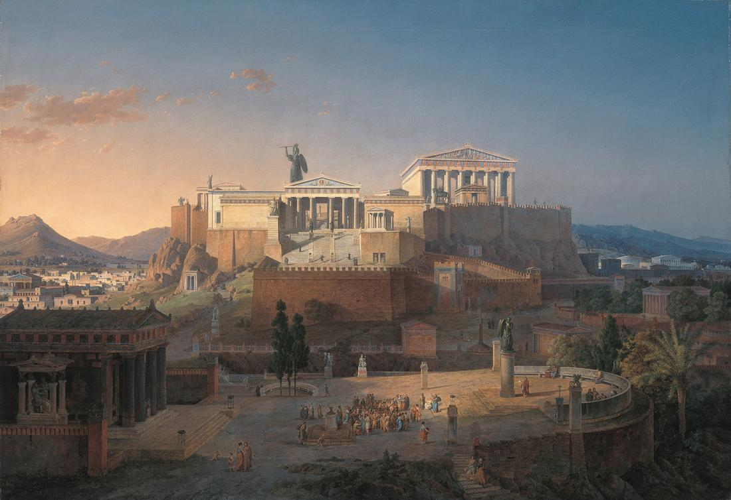
Let’s evaluate Paul’s approach:
“Contextualization”
NOT changing the message
to appeal to the audience
But bridging the cultural gap: making the message accessible to them
This is important because our culture is pluralistic too: a lot of us are standing on different foundations

Slide 66
Let’s evaluate Paul’s approach:
“Contextualization”
He was a student of their culture; he understood their foundation
The first step is always asking good questions

Slide 67
Let’s evaluate Paul’s approach:
“Contextualization”
He discovered common ground

Slide 68
Let’s evaluate Paul’s approach:
“Contextualization”
He introduced them to the God of the bible in a way they could understand

Slide 69
Let’s evaluate Paul’s approach:
“Contextualization”
He corrected their misconceptions

Slide 70
Let’s evaluate Paul’s approach:
“Contextualization”
He approached them with respect …
But he also critiqued their worldview
*gasp*

Slide 71
Let’s evaluate Paul’s approach:
“Contextualization”
He approached them with respect …
But he also critiqued their worldview
It is not inherently evil to suggest someone’s sincerely-held belief might be wrong
In fact, it is often the most loving thing!

Slide 72
Let’s evaluate Paul’s approach:
“Contextualization”
He approached them with respect …
But he also critiqued their worldview
Paul exposed the inadequacy of their worldview

Slide 73
Let’s evaluate Paul’s approach:
“Contextualization”
He approached them with respect …
But he also critiqued their worldview
He pointed them toward a superior alternative
And how to turn to the god they were searching for
He did it with boldness and confidence

Slide 74
Acts

