Slide 1
1 Peter 1
Revealing God’s Rescue

Slide 2
1 Peter 1
1 Peter, an apostle of Jesus Christ,

Slide 3
1 Peter 1
1 Peter, an apostle of Jesus Christ,
Peter
Knew Jesus better than almost anyone
Chosen by Jesus
A surprising choice!
Writing from Rome, early 60’s AD
To suffering Christians in present-day Turkey

Slide 4
1 Peter 1
1 Peter, an apostle of Jesus Christ,
to those who reside as aliens, scattered throughout Pontus, Galatia, Cappadocia, Asia, and Bithynia,

Slide 5
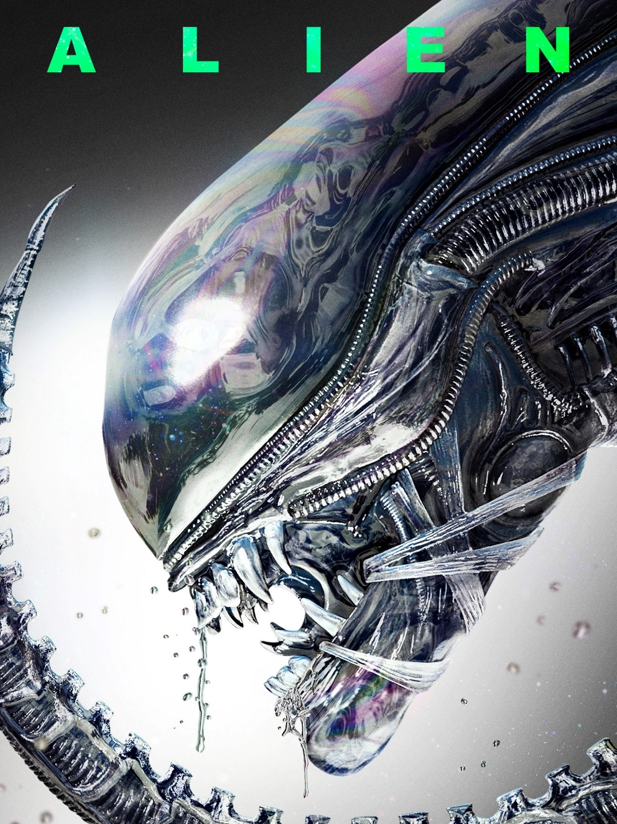
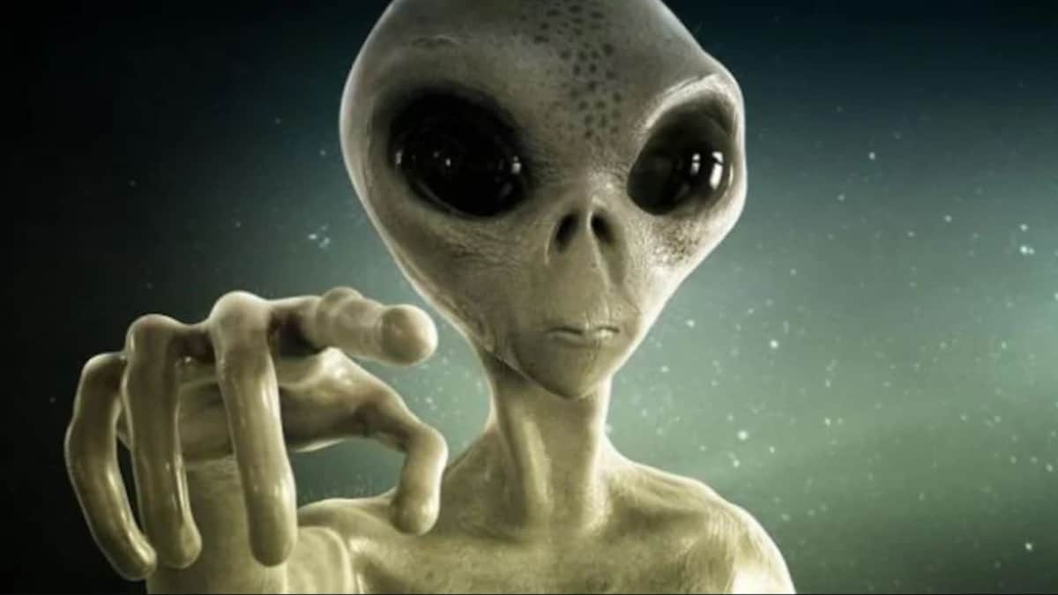
1 Peter 1
1 Peter, an apostle of Jesus Christ,
to those who reside as aliens, scattered throughout Pontus, Galatia, Cappadocia, Asia, and Bithynia,

Slide 6
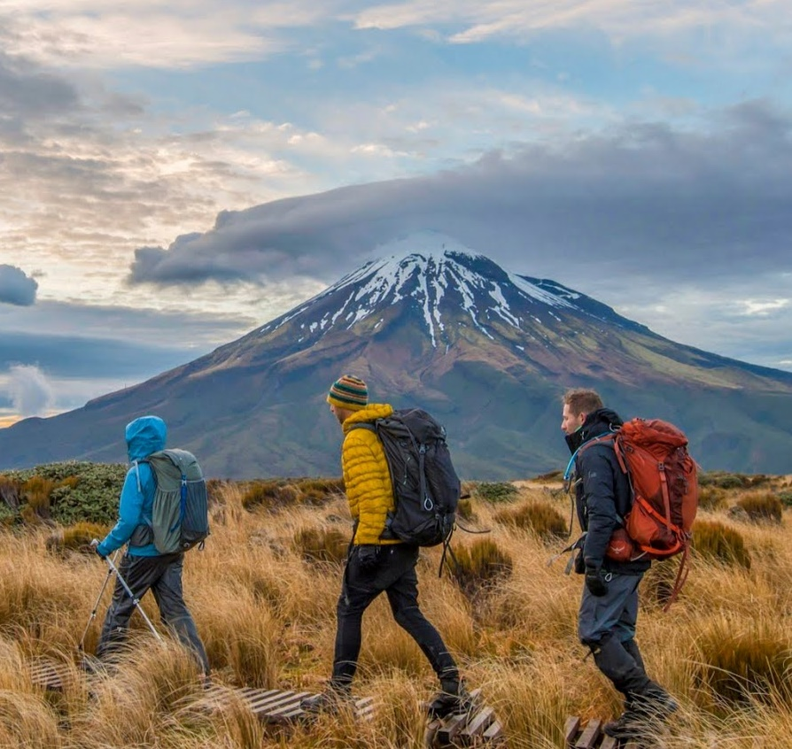
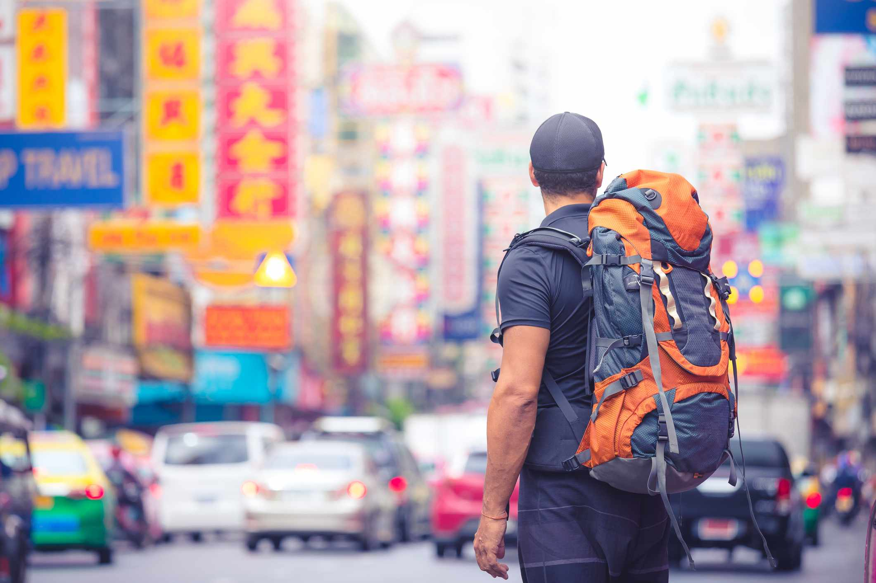
1 Peter 1
Pilgrims, backpackers
1 Peter, an apostle of Jesus Christ,
to those who reside as aliens, scattered throughout Pontus, Galatia, Cappadocia, Asia, and Bithynia,

Slide 7
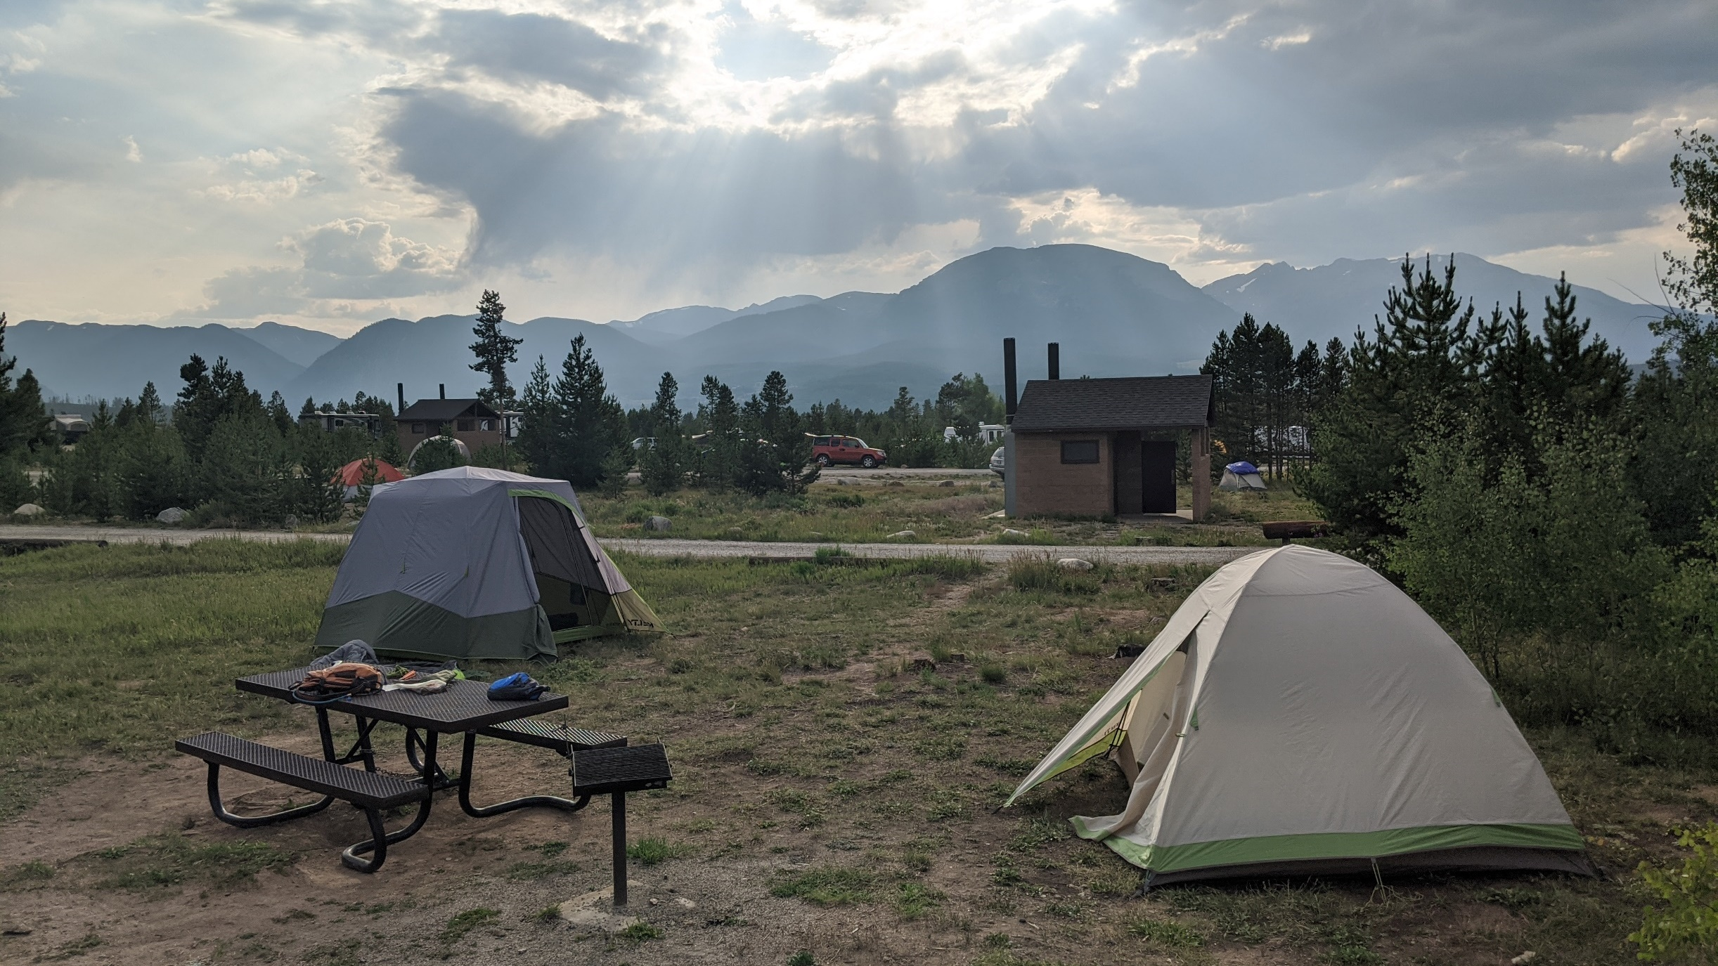

Slide 8
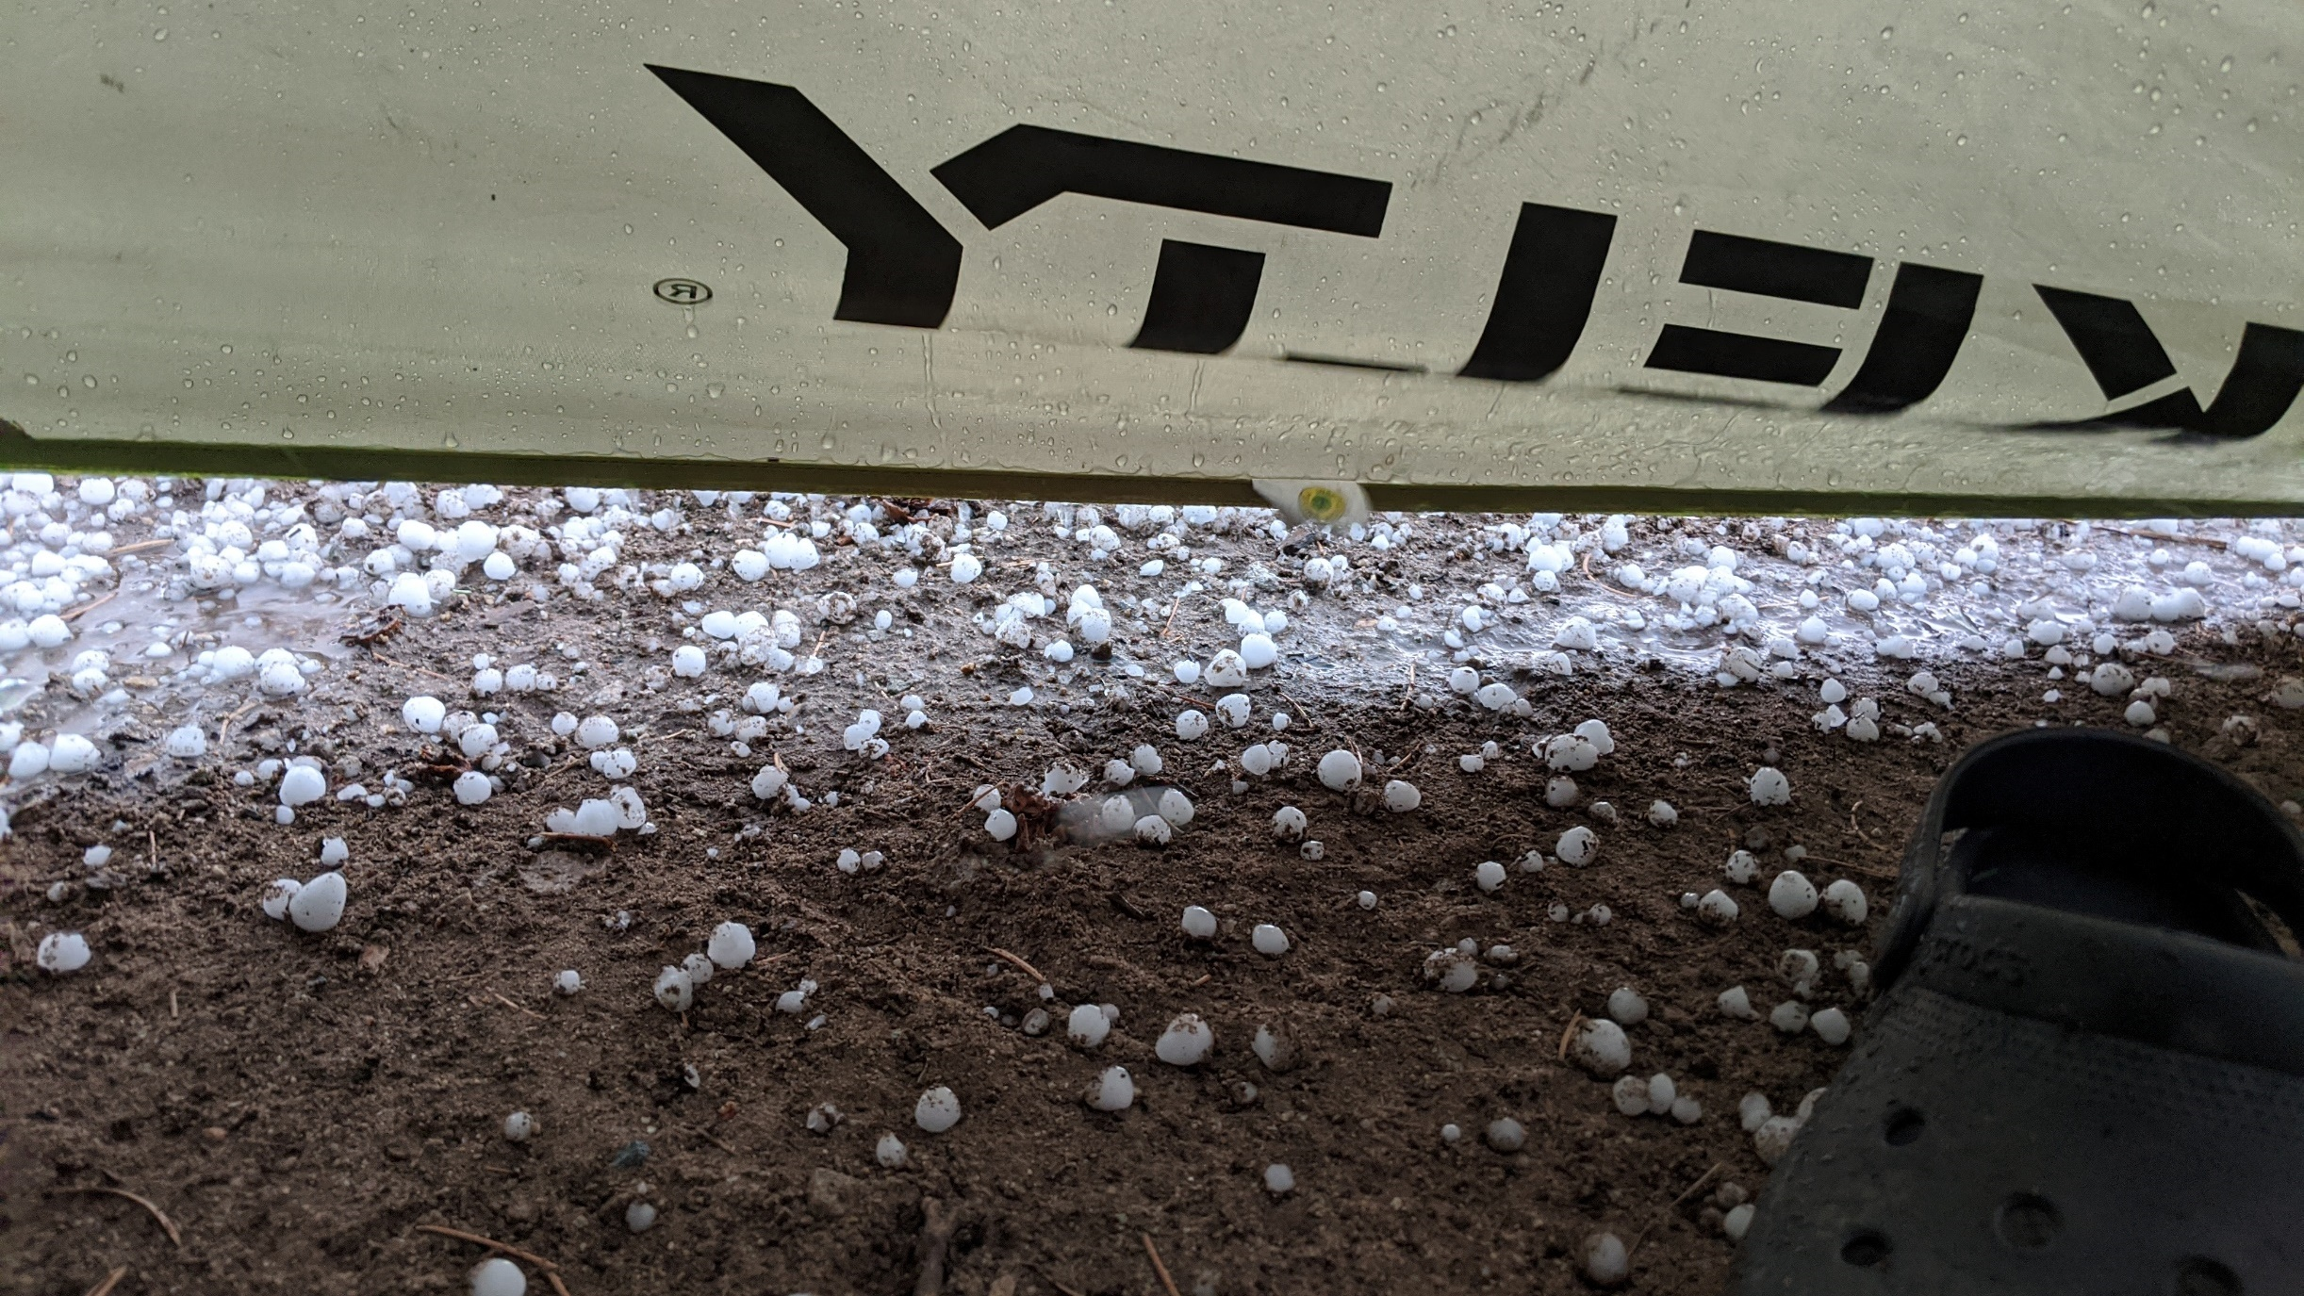

Slide 9
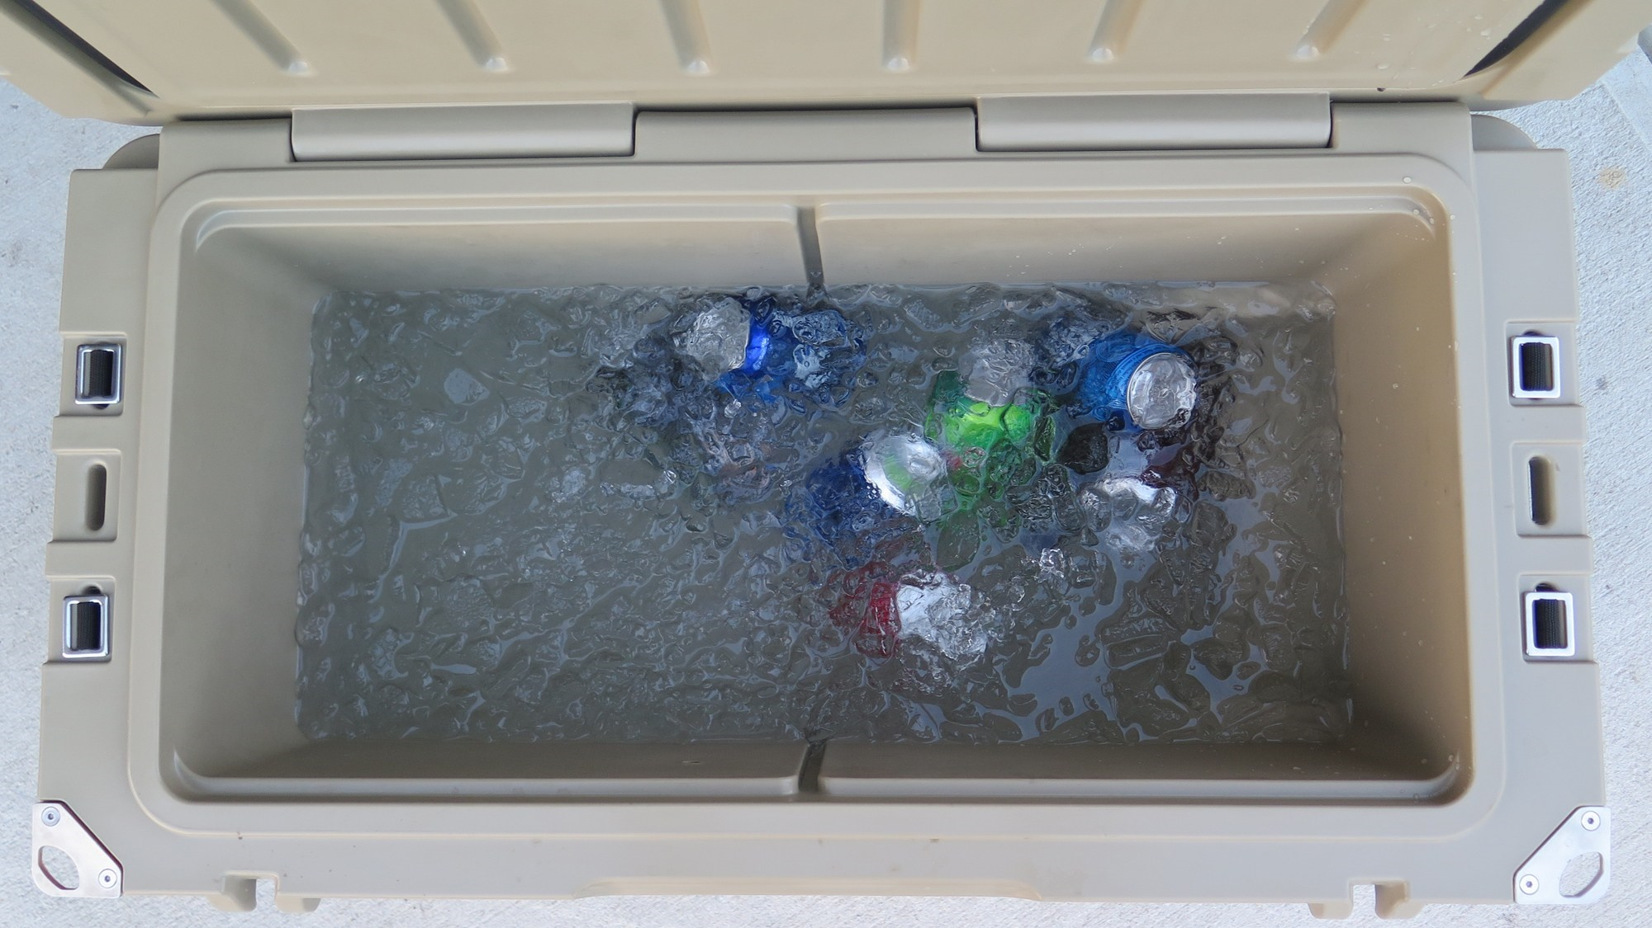

Slide 11
1 Peter 1
1 Peter, an apostle of Jesus Christ,
to those who reside as aliens, scattered throughout Pontus, Galatia, Cappadocia, Asia, and Bithynia,
who are chosen

Slide 12
1 Peter 1
1 who are chosen
2 according to the foreknowledge of God the Father,
Those God foreknew he also predestined to be conformed to the image of his Son (Romans 8:29)

Slide 13
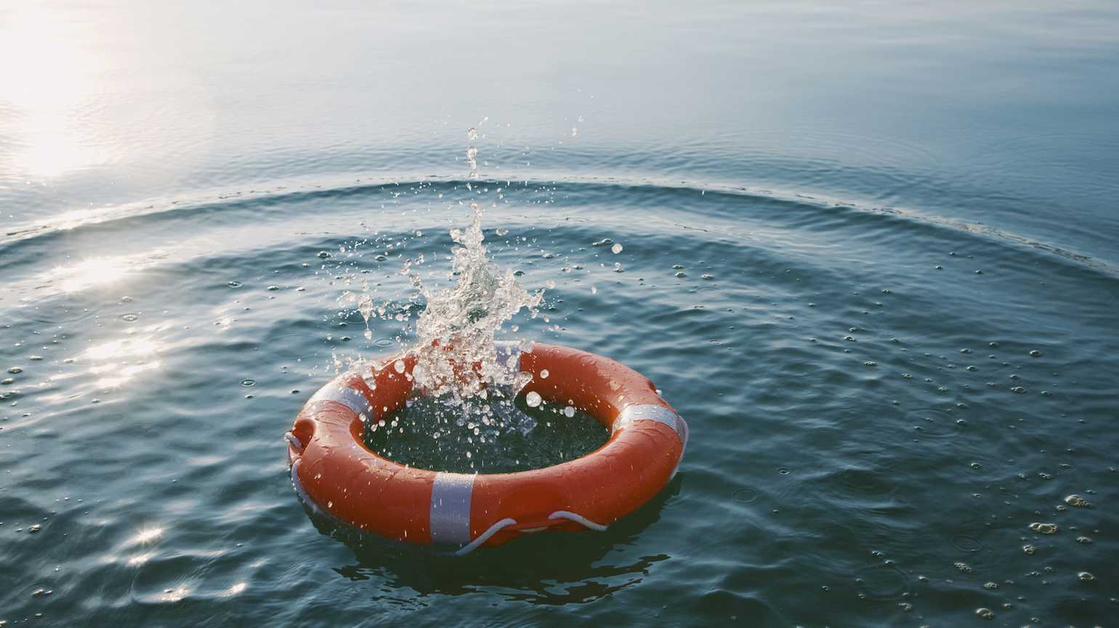

Slide 14
1 Peter 1
1 who are chosen
2 according to the foreknowledge of God the Father,
by the sanctifying work of the Spirit,
= to set apart as different

Slide 15
1 Peter 1
1 who are chosen
2 according to the foreknowledge of God the Father,
by the sanctifying work of the Spirit,
to obey Jesus Christ and be sprinkled with His blood:
Jesus: “This is the only work God wants from you: Believe in the one he has sent.” (John 6:29)

Slide 16
1 Peter 1
1 who are chosen
2 according to the foreknowledge of God the Father,
by the sanctifying work of the Spirit,
to obey Jesus Christ and be sprinkled with His blood:
May grace and peace be yours in the fullest measure.

Slide 17
1 Peter 1
3 Blessed be the God and Father of our Lord Jesus Christ,
who according to His great mercy has caused us to be born again

Slide 18
1 Peter 1
3 Blessed be the God and Father of our Lord Jesus Christ,
who according to His great mercy has caused us to be born again
Therefore, if anyone is in Christ, he is a new creation; the old has gone, the new has come! (2 Cor. 5:17)
“Born again” (John 3:3)
Begins a new life
Requires outside intervention

Slide 19
1 Peter 1
3 Blessed be the God and Father of our Lord Jesus Christ,
who according to His great mercy has caused us to be born again
to a living hope through the resurrection of Jesus Christ from the dead,

Slide 20
1 Peter 1
Contrast with dead hope
“It is best not to be born at all and the second best is to die at birth.” (Sophocles)
3 Blessed be the God and Father of our Lord Jesus Christ,
who according to His great mercy has caused us to be born again
to a living hope through the resurrection of Jesus Christ from the dead,

Slide 21
1 Peter 1
Contrast with dead hope
“Though the sun can set and rise again, once our brief light sets, there is but one unending night to be slept through.” (Catullus)
3 Blessed be the God and Father of our Lord Jesus Christ,
who according to His great mercy has caused us to be born again
to a living hope through the resurrection of Jesus Christ from the dead,

Slide 22
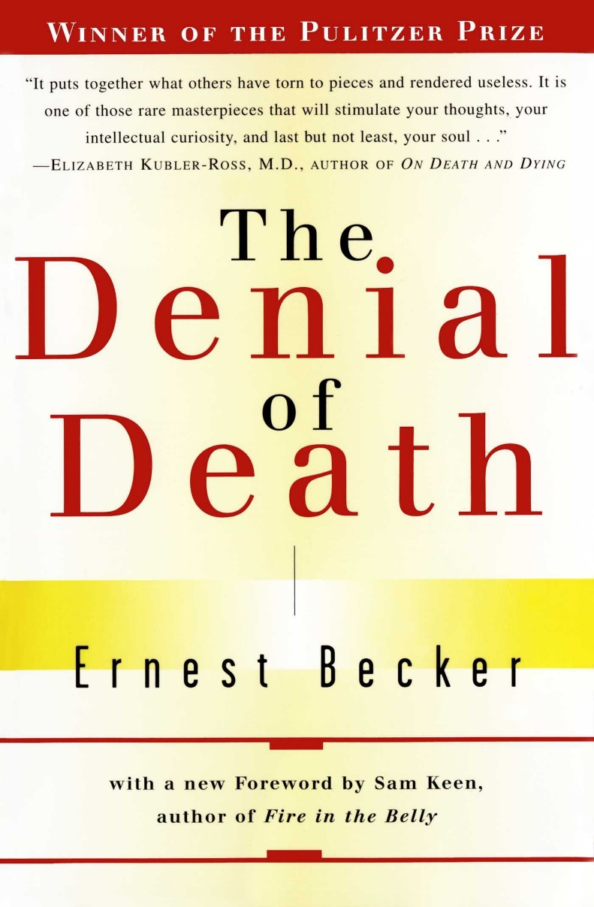
Ernest Becker, The Denial of Death (New York: Free Press, 1973), xvii
The idea of death, the fear of it, haunts the human animal like nothing else:
it is the mainspring of human activity—activity designed largely to avoid the fatality of death,
to overcome it by denying in some way that it is the final destiny of man…

Slide 23
Ernest Becker, The Denial of Death (New York: Free Press, 1973), 32-33
All culture, all man’s creative life-ways, are in some basic part of them a fabricated protest against natural reality,
a denial of the truth of the human condition,
and an attempt to forget the pathetic creature that man is.

Slide 24
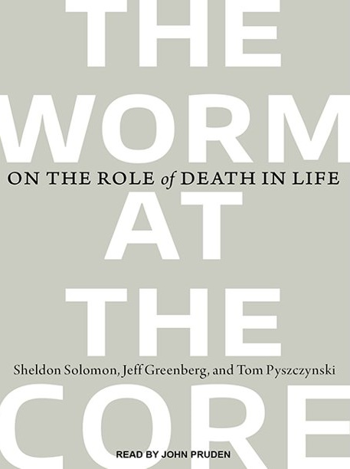
Solomon, Greenberg, and Pyszczynski, The Worm at the Core: On the Role of Death in Life(New York: Random House, 2015), x.
The awareness that we humans will die has a profound and pervasive effect on our thoughts, feelings, and behaviors in almost every domain of life—
whether we are conscious of it or not…

Slide 25
Solomon, Greenberg, and Pyszczynski, The Worm at the Core: On the Role of Death in Life(New York: Random House, 2015), 14.
[The authors report that] “more than five hundred studies and counting” reveal how people are affected by the “terror” of “the knowledge of the inevitability of death.”
But we can have “a living hope through the resurrection of Jesus Christ from the dead”

Slide 26
1 Peter 1
4 to obtain an inheritance

Slide 27
1 Peter 1
4 to obtain an inheritance
which is imperishable
and undefiled
and will not fade away,
reserved in heaven for you,

Slide 28
1 Peter 1
5 who are protected by the power of God through faith for a salvation ready to be revealed in the last time.

Slide 29
1 Peter 1
5 who are protected by the power of God through faith for a salvation ready to be revealed in the last time.
It’s crucial to understand the security of your salvation

Slide 30
1 Peter 1
5 who are protected by the power of God through faith for a salvation ready to be revealed in the last time.
If you knew Christ were coming back tomorrow…
What would you do today?

Slide 31
1 Peter 1
5 who are protected by the power of God through faith for a salvation ready to be revealed in the last time.
“But I don’t want to wait for this salvation.
I want to experience it now!”

Slide 32
1 Peter 1
6 In this you greatly rejoice, even though now for a little while, if necessary, you have been distressed by various trials,

Slide 33
1 Peter 1
6 In this you greatly rejoice, even though now for a little while, if necessary, you have been distressed by various trials,

Slide 34
1 Peter 1
6 In this you greatly rejoice, even though now for a little while, if necessary, you have been distressed by various trials,
We experience various trials too
Physical ailments
Financial struggles
Painful situations with family or friends
Weariness and busyness
Waiting on God

Slide 35
1 Peter 1
6 In this you greatly rejoice, even though now for a little while, if necessary, you have been distressed by various trials,
We experience various trials too
Physical ailments
Financial struggles
Painful situations with family or friends
Weariness and busyness
Waiting on God

Slide 36
1 Peter 1
6 In this you greatly rejoice, even though now for a little while, if necessary, you have been distressed by various trials,
We experience various trials too
Physical ailments
Financial struggles
Painful situations with family or friends
Weariness and busyness
Waiting on God

Slide 37
1 Peter 1
7 so that the proof [or “genuineness”] of your faith, being more precious than gold which is perishable, even though tested by fire,
may be found to result in praise and glory and honor at the revelation of Jesus Christ;

Slide 38
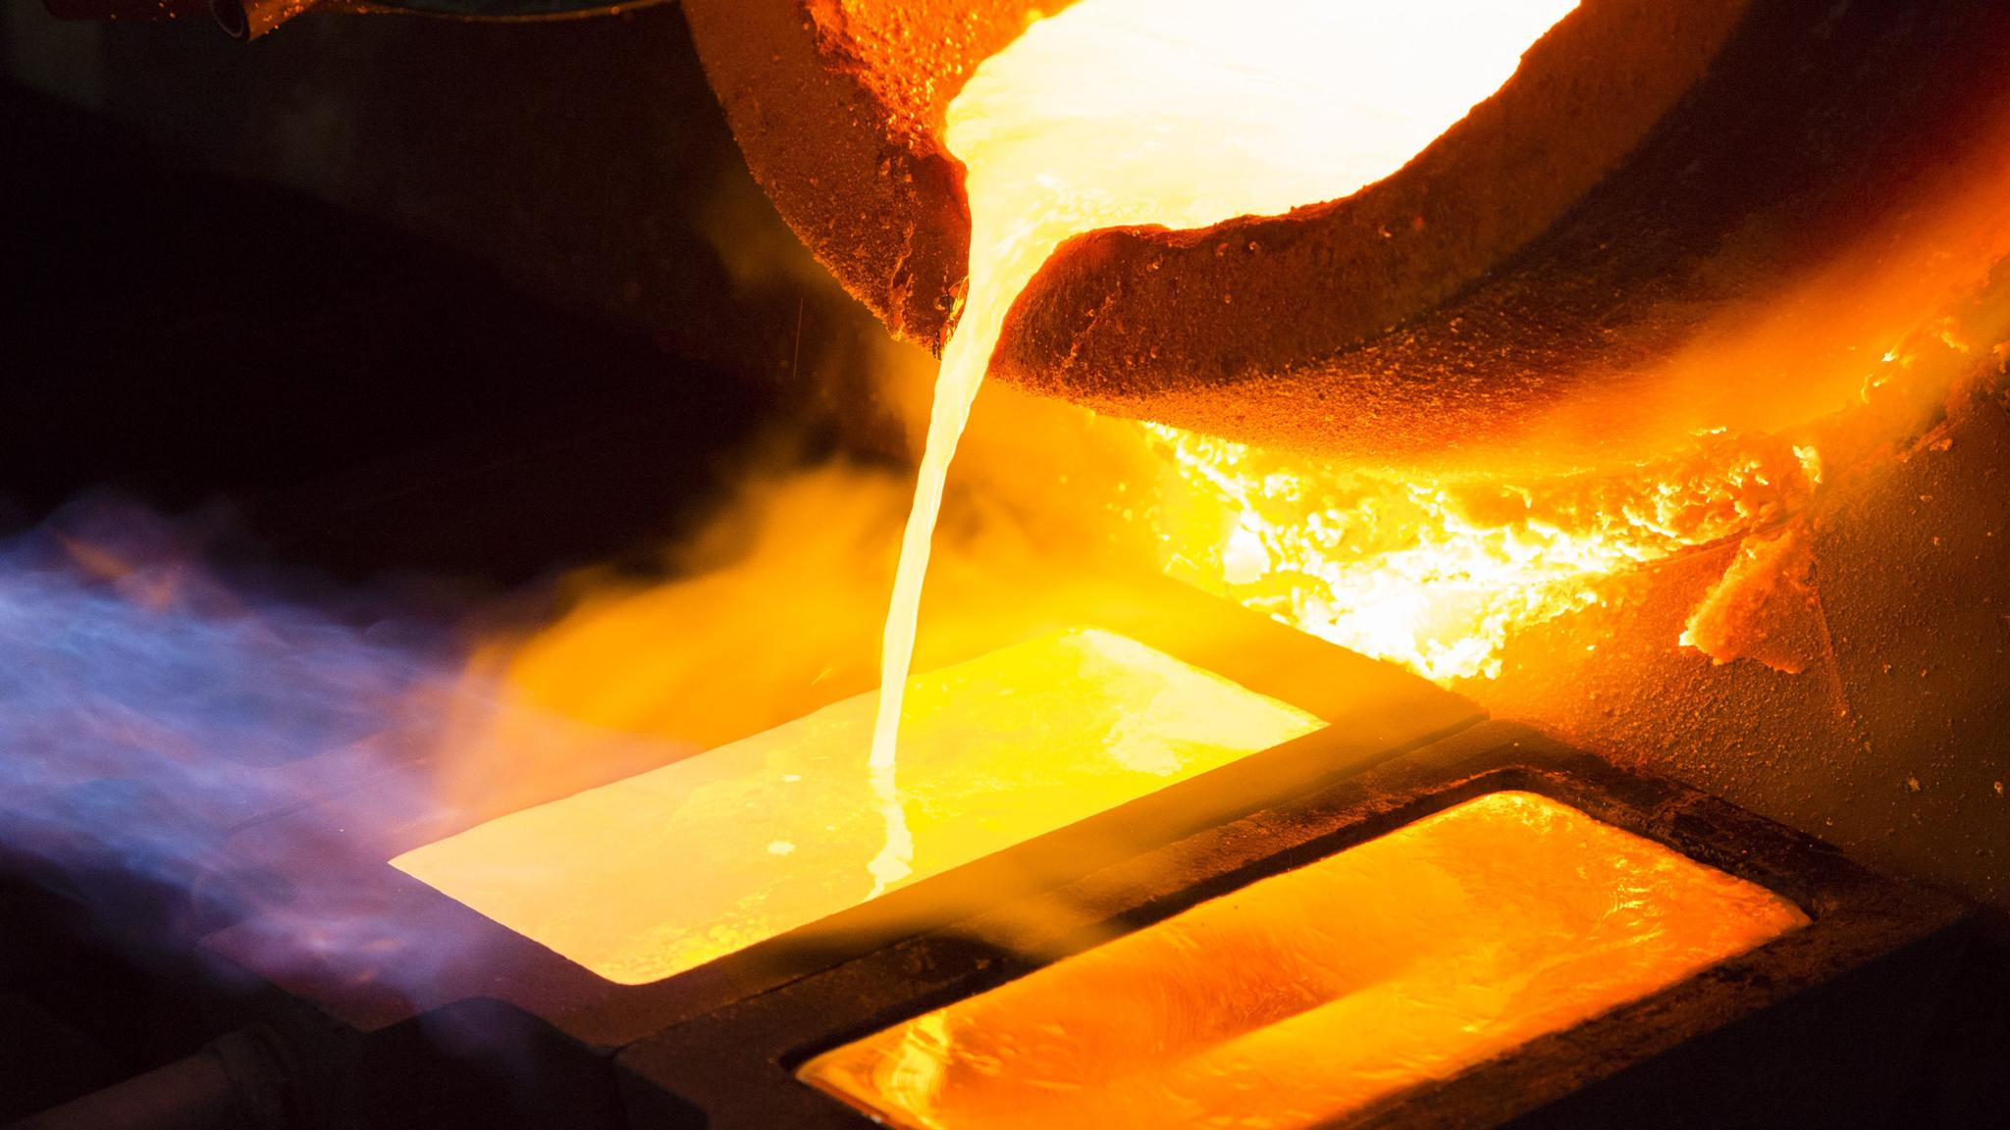

Slide 39
Refining gold:
1 metric ton (2200 lbs) of ore yields…
1.5 grams of gold

Slide 40
Refining gold:
Ground to powder, then heated to ~2000 F
The fire reveals impurities and purifies

Slide 41
Christians who don’t suffer:
May be “at peace” with the kosmos
Cannot really learn to depend on God

Slide 42
Christians who don’t suffer:
Tend to be shallow, with easy answers
Have low empathy & weak ministry skills

Slide 43
Christians who don’t suffer:
Can’t handle suffering when it does come their way

Slide 44
1 Peter 1
8 and though you have not seen Him, you love Him,
and though you do not see Him now, but believe in Him, you greatly rejoice with joy inexpressible and full of glory,
9 obtaining as the outcome of your faith the salvation of your souls.
“You don’t know that Jesus is all you need until Jesus is all you have” (Corrie Ten Boom)

Slide 45
Conclusions
This world is passing away
The return of Christ could come at any minute
God promises to work through suffering in your life to reveal himself to you and through you
It feels good to finally be chosen

Slide 46
1 Peter 1:1-9
Questions?
Comments?
Experiences?
risleys@dwellcc.org
See the Dwell App OR xenos.org/teachings
Next time: 1 Peter 1:10-22 – A Different Way to Live

