Slide 2
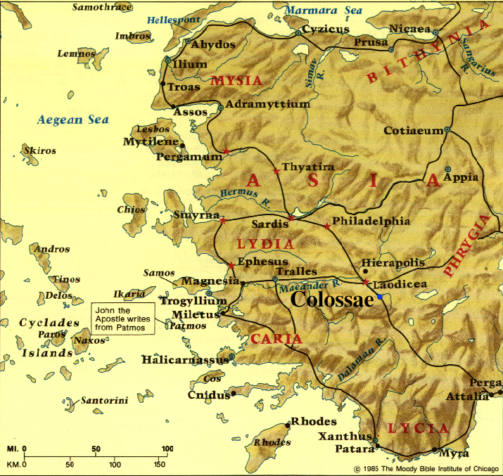

Slide 3
Colossians 1:24 – 2:1
^{1:24} Now I rejoice in my sufferings for your sake, and in my flesh I do my share on behalf of His body, which is the church, in filling up what is lacking in Christ’s afflictions . . . ²⁹ For this purpose also I labor, striving . . . ^{2:1} For I want you to know how great a struggle I have on your behalf and for those who are at Laodicea, and for all those who have not personally seen my face . . .

Slide 4
Colossians 1:24 – 2:1
^{1:24} Now I rejoice in my sufferings for your sake, and in my flesh I do my share on behalf of His body, which is the church, in filling up what is lacking in Christ’s afflictions . . . ²⁹ For this purpose also I labor, striving . . . ^{2:1} For I want you to know how great a struggle I have on your behalf and for those who are at Laodicea, and for all those who have not personally seen my face . . .
Not to solicit their pity, but to alleviate their distress (Eph. 3:13)

Slide 5
Colossians 1:24 – 2:1 Keys to Victorious Suffering
UNDERSTANDING WHERE HISTORY IS HEADED
“(The Communists believed that) there is a great battle going on all over the world which, in the final analysis is a struggle for men’s hearts and minds and souls . . . (and that) although we may not see the end of the battle, its outcome will most probably be decided in this period in which we are living.”
Douglas Hyde, Dedication and Leadership (University of Notre Dame Press, 1966), p. 10.

Slide 6
Colossians 1:24 – 2:1 Keys to Victorious Suffering
UNDERSTANDING WHERE HISTORY IS HEADED
^{1:26} . . . that is, the mystery which has been hidden from the past ages and generations, but has now been manifested to His saints, ²⁷ to whom God willed to make known what is the riches of the glory of this mystery among the Gentiles, which is Christ in you, the hope of glory.

Slide 7
Colossians 1:24 – 2:1 Keys to Victorious Suffering
UNDERSTANDING WHERE HISTORY IS HEADED
^{1:26} . . . that is, the mystery which has been hidden from the past ages and generations, but has now been manifested to His saints, ²⁷ to whom God willed to make known what is the riches of the glory of this mystery among the Gentiles, which is Christ in you, the hope of glory.
THIS PRESENT EVIL AGE
GOD’S KINGDOM

Slide 8
Colossians 1:24 – 2:1 Keys to Victorious Suffering
UNDERSTANDING WHERE HISTORY IS HEADED
^{1:26} . . . that is, the mystery which has been hidden from the past ages and generations, but has now been manifested to His saints, ²⁷ to whom God willed to make known what is the riches of the glory of this mystery among the Gentiles, which is Christ in you, the hope of glory.
THE “MYSTERY” PERIOD
THIS PRESENT EVIL AGE
GOD’S KINGDOM

Slide 9
Colossians 1:24 – 2:1 Keys to Victorious Suffering
UNDERSTANDING WHERE HISTORY IS HEADED
We live between the two comings of Jesus the Messiah . . .
^{1:26} . . . that is, the mystery which has been hidden from the past ages and generations, but has now been manifested to His saints, ²⁷ to whom God willed to make known what is the riches of the glory of this mystery among the Gentiles, which is Christ in you, the hope of glory.
THE “MYSTERY” PERIOD
THIS PRESENT EVIL AGE
GOD’S KINGDOM

Slide 10
Colossians 1:24 – 2:1 Keys to Victorious Suffering
UNDERSTANDING WHERE HISTORY IS HEADED
. . . when He makes believing Gentiles His people & indwells them with His Spirit
^{1:26} . . . that is, the mystery which has been hidden from the past ages and generations, but has now been manifested to His saints, ²⁷ to whom God willed to make known what is the riches of the glory of this mystery among the Gentiles, which is Christ in you, the hope of glory.
THE “MYSTERY” PERIOD
THIS PRESENT EVIL AGE
GOD’S KINGDOM

Slide 11
Colossians 1:24 – 2:1 Keys to Victorious Suffering
UNDERSTANDING WHERE HISTORY IS HEADED
. . . to spread His gospel to all people-groups (Matt. 24:14; 28:19)
^{1:26} . . . that is, the mystery which has been hidden from the past ages and generations, but has now been manifested to His saints, ²⁷ to whom God willed to make known what is the riches of the glory of this mystery among the Gentiles, which is Christ in you, the hope of glory.
THE “MYSTERY” PERIOD
THIS PRESENT EVIL AGE
GOD’S KINGDOM

Slide 12
Colossians 1:24 – 2:1 Keys to Victorious Suffering
UNDERSTANDING WHERE HISTORY IS HEADED
Familiarize yourself with the Bible’s redemptive plan - & embrace it as the truth

Slide 13
Colossians 1:24 – 2:1 Keys to Victorious Suffering
BEING GIVEN A UNIQUE ROLE IN GOD’S PLAN
“People have enough to live by but nothing to live for; they have the means but no meaning . . . One of the central tenets of logotherapy (is) that man’s main concern is not to gain pleasure or avoid pain but rather to see a meaning in his life. That is why man is even ready to suffer, on the condition . . . that his suffering has a meaning . . . Once an individual’s search for . . . meaning is successful, it not only renders him happy but also gives him the capability to cope with suffering.”
Viktor E. Frankl, Man’s Search for Meaning (Washington Square Press, 1985), pp. 135,136,163,165.

Slide 14
Colossians 1:24 – 2:1 Keys to Victorious Suffering
BEING GIVEN A UNIQUE ROLE IN GOD’S PLAN
^{1:24} Now I rejoice in my sufferings for your sake, and in my flesh I do my share on behalf of His body, which is the church, in filling up what is lacking in Christ’s afflictions. ²⁵ Of this church I was made a servant according to the stewardship from God bestowed on me for your benefit, so that I might fully carry out the preaching of the word of God . . . ²⁸ We proclaim Him, admonishing every person and teaching every person with all wisdom, so that we may present every person complete in Christ. ²⁹ For this purpose also I labor, striving . . .

Slide 15
Colossians 1:24 – 2:1 Keys to Victorious Suffering
BEING GIVEN A UNIQUE ROLE IN GOD’S PLAN
^{1:24} Now I rejoice in my sufferings for your sake, and in my flesh I do my share on behalf of His body, which is the church, in filling up what is lacking in Christ’s afflictions. ²⁵ Of this church I was made a servant according to the stewardship from God bestowed on me for your benefit, so that I might fully carry out the preaching of the word of God . . . ²⁸ We proclaim Him, admonishing every person and teaching every person with all wisdom, so that we may present every person complete in Christ. ²⁹ For this purpose also I labor, striving . . .

Slide 16
Colossians 1:24 – 2:1 Keys to Victorious Suffering
BEING GIVEN A UNIQUE ROLE IN GOD’S PLAN
^{Ephesians 2:10} For we are His workmanship (poiema), created in Christ Jesus for good works, which God prepared beforehand so that we would walk in them.

Slide 17
Colossians 1:24 – 2:1 Keys to Victorious Suffering
BEING GIVEN A UNIQUE ROLE IN GOD’S PLAN
Sharing Christ with those who don’t know Him
^{Ephesians 2:10} For we are His workmanship (poiema), created in Christ Jesus for good works, which God prepared beforehand so that we would walk in them.
“There are hands out there that only you can hold. There are people out there that only you can reach. There are hearts breaking that only you can heal. Your . . . gender, your sorrows, your experiences, your age, your everything . . . God made you like a fingerprint, and there are certain people out there that God wants to touch through you, and they’re not going to be touched without you. So go . . .” (Tim Keller)

Slide 18
Colossians 1:24 – 2:1 Keys to Victorious Suffering
BEING GIVEN A UNIQUE ROLE IN GOD’S PLAN
Sharing Christ with those who don’t know Him
Discovering & using your spiritual gift(s) to serve others
^{Ephesians 2:10} For we are His workmanship (poiema), created in Christ Jesus for good works, which God prepared beforehand so that we would walk in them.

Slide 19
Colossians 1:24 – 2:1 Keys to Victorious Suffering
BEING GIVEN A UNIQUE ROLE IN GOD’S PLAN
Sharing Christ with those who don’t know Him
Discovering & using your spiritual gift(s) to serve others
Helping other Christians toward spiritual maturity
^{Ephesians 2:10} For we are His workmanship (poiema), created in Christ Jesus for good works, which God prepared beforehand so that we would walk in them.

Slide 20
Colossians 1:24 – 2:1 Keys to Victorious Suffering
HAVING ACCESS TO GOD’S POWER
^{1:29} For this purpose also I labor, striving according to His power, which mightily works within me.
^{1:11} . . . strengthened with all power, according to His glorious might, for the attaining of all steadfastness and patience . . .

Slide 21
Colossians 1:24 – 2:1 Keys to Victorious Suffering
HAVING ACCESS TO GOD’S POWER
^{1:29} For this purpose also I labor, striving according to His power, which mightily works within me.
^{1:11} . . . strengthened with all power, according to His glorious might, for the attaining of all steadfastness and patience . . .

Slide 22
Colossians 1:24 – 2:1 Keys to Victorious Suffering
HAVING ACCESS TO GOD’S POWER
Receive God’s Spirit by entrusting yourself to Jesus as your Savior-Messiah (Acts 2:38)

Slide 23
Colossians 1:24 – 2:1 Keys to Victorious Suffering
HAVING ACCESS TO GOD’S POWER
Receive God’s Spirit by entrusting yourself to Jesus as your Savior-Messiah (Acts 2:38)
Align yourself with God’s purpose for your life (Rom. 6:13)

Slide 24
Colossians 1:24 – 2:1 Keys to Victorious Suffering
HAVING ACCESS TO GOD’S POWER
Receive God’s Spirit by entrusting yourself to Jesus as your Savior-Messiah (Acts 2:38)
Align yourself with God’s purpose for your life (Rom. 6:13)
Ask God to fill you with His Spirit in each situation (Eph. 5:18)

Slide 25
Colossians 1:24 – 2:1 Keys to Victorious Suffering
UNDERSTANDING WHERE HISTORY IS HEADED
BEING GIVEN A UNIQUE ROLE IN GOD’S PLAN
HAVING ACCESS TO GOD’S POWER

Slide 26
Colossians 1:24 – 2:1 Keys to Victorious Suffering
UNDERSTANDING WHERE HISTORY IS HEADED
BEING GIVEN A UNIQUE ROLE IN GOD’S PLAN
HAVING ACCESS TO GOD’S POWER
This is a big part of the “abundant life” that Jesus came to give us (Jn. 10:10)

