Slide 1
2024
SERVANT TEAM RETREAT

Slide 2
“I came that they may have life, and have it abundantly.”

Slide 3
Ephesians 2:11-13
Remember that formerly you who are Gentiles by birth and called “uncircumcised”…were separate from Christ, excluded from citizenship in Israel and foreigners to the covenants of the promise, without hope and without God in the world. But now in Christ Jesus you who once were far away have been brought near by the blood of Christ.

Slide 4
Colossians 1:21-22
Once you were alienated from God and were enemies in your minds because of your evil behavior. But now he has reconciled you by Christ’s physical body through death to present you holy in his sight, without blemish and free from accusation

Slide 5
The promise of eternity and a full life
1. Gives us joy, independent of our ministry success.
Luke 10:17-20: ‘The seventy-two returned with joy and said, “Lord, even the demons submit to us in your name.”

Slide 6
The promise of eternity and a full life
1. Gives us joy, independent of our ministry success.
Luke 10:17-20: ‘The seventy-two returned with joy and said, “Lord, even the demons submit to us in your name.”
He replied, “I saw Satan fall like lightning from heaven. I have given you authority to trample on snakes and scorpions and to overcome all the power of the enemy; nothing will harm you. However, do not rejoice that the spirits submit to you, but rejoice that your names are recorded in heaven.”

Slide 7
The promise of eternity and a full life
1. Gives us joy, independent of our ministry success.
Luke 15:5-7: ‘“When the shepherd finds his lost sheep, he joyfully puts it on his shoulders and goes home. Then he calls his friends and neighbors together and says, ‘Rejoice with me; I have found my lost sheep.’ I tell you that in the same way there will be more rejoicing in heaven over one sinner who repents than over ninety-nine righteous persons who do not need to repent.”

Slide 8
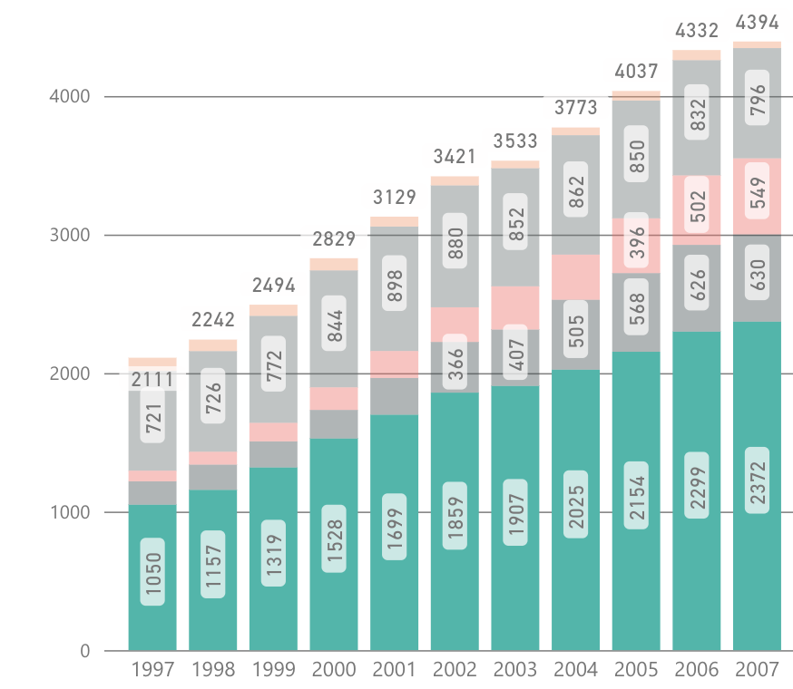
Adult
Ministry
14%

Slide 9
Adult
Ministry
15.85%

Slide 10
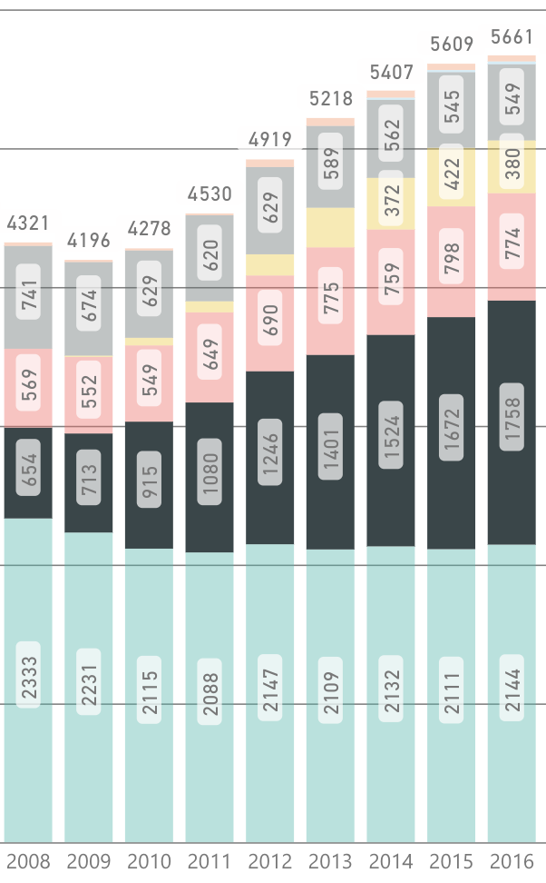
Adult
Ministry
College
Ministry
9.2%

Slide 11
Adult
Ministry
College
Ministry
28.3%
9.2%

Slide 12
Adult
Ministry
College
Ministry
13.9%
9.2%

Slide 13
Adult
Ministry
College
Ministry
Interesting year for me.
9.2%

Slide 14
The promise of eternity and a full life
1. Gives us joy, independent of our ministry success.
2. Gives us a heart for the lost.
Romans 5-8
Romans 5

Slide 15
The promise of eternity and a full life
1. Gives us joy, independent of our ministry success.
2. Gives us a heart for the lost.
Romans 5-8
Romans 5: “But God demonstrates his own love for us in this: While we were still sinners, Christ died for us” (v9).

Slide 16
The promise of eternity and a full life
1. Gives us joy, independent of our ministry success.
2. Gives us a heart for the lost.
Romans 5-8
Romans 5: “But God demonstrates his own love for us in this: While we were still sinners, Christ died for us” (v9).
Romans 6

Slide 17
The promise of eternity and a full life
1. Gives us joy, independent of our ministry success.
2. Gives us a heart for the lost.
Romans 5-8
Romans 5: “But God demonstrates his own love for us in this: While we were still sinners, Christ died for us” (v9).
Romans 6: “Knowing this, that our old self was crucified with Him, in order that our body of sin might be done away with, so that we would no longer be slaves to sin” (v6).

Slide 18
The promise of eternity and a full life
1. Gives us joy, independent of our ministry success.
2. Gives us a heart for the lost.
Romans 5-8
Romans 7

Slide 19
The promise of eternity and a full life
1. Gives us joy, independent of our ministry success.
2. Gives us a heart for the lost.
Romans 5-8
Romans 7: “Thanks be to God who delivers me through Jesus Christ our Lord” (v25).

Slide 20
The promise of eternity and a full life
1. Gives us joy, independent of our ministry success.
2. Gives us a heart for the lost.
Romans 5-8
Romans 7: “Thanks be to God who delivers me through Jesus Christ our Lord” (v25).
Romans 8

Slide 21
The promise of eternity and a full life
1. Gives us joy, independent of our ministry success.
2. Gives us a heart for the lost.
Romans 5-8
Romans 7: “Thanks be to God who delivers me through Jesus Christ our Lord” (v25).
Romans 8: “There is now no condemnation for those who are in Christ Jesus” (v1).

Slide 22
The promise of eternity and a full life
1. Gives us joy, independent of our ministry success.
2. Gives us a heart for the lost.
Romans 5-8
Romans 7: “Thanks be to God who delivers me through Jesus Christ our Lord” (v25).
Romans 8: “Neither death nor life, neither angels nor principalities, neither things present nor the future…nor anything else in all creation can separate him from the love of God that is in Christ Jesus our Lord” (v38-39)

Slide 23
The promise of eternity and a full life
1. Gives us joy, independent of our ministry success.
2. Gives us a heart for the lost.
What effect did Jesus’ promise of eternity and an abundant life produce in Paul?
Romans 9:3-4: “I have great sorrow and unceasing anguish in my heart… for the sake of my people, those of my own race, the people of Israel.”

Slide 24
The promise of eternity and a full life
3. Enables us to enjoy unparalleled unity with other believers.
Ephesians 1:13,14,18: “Once you were far away from God, but now you have been brought near to him through the blood of Christ…He united us into one people when, in his own body on the cross…Now all of us can come to the Father through the same Holy Spirit because of what Christ has done for us.”
And yet what once felt like a privilege, can at times feels like an obligation.

Slide 25
The promise of eternity and a full life
3. Enables us to enjoy unparalleled unity with other believers.
Psalm 133:1, “How good and pleasant it is when God’s people live together in unity!”

Slide 26
The promise of eternity and a full life
3. Enables us to enjoy unparalleled unity with other believers.
4. Ensures our suffering will prepare us for our future glory.
► The experience of suffering puts Scripture’s claims to the test.
► And it puts our faith to the test.
Matthew 11:2-3: ‘John the Baptist, who was in prison, heard about all the things the Messiah was doing. So he sent his disciples to ask Jesus, “Are you the Messiah we’ve been expecting, or should we keep looking for someone else?”’

Slide 27
The promise of eternity and a full life
3. Enables us to enjoy unparalleled unity with other believers.
4. Ensures our suffering will prepare us for our future glory.
► We simultaneously experienced God’s comfort in profound ways.
► Those who persevered in suffering have been changed by it.
2 Corinthians 4:11, 17: “We who are alive are always being given over to death for Jesus’ sake, so that his life may also be revealed in our mortal body…

Slide 28
The promise of eternity and a full life
3. Enables us to enjoy unparalleled unity with other believers.
4. Ensures our suffering will prepare us for our future glory.
► We simultaneously experienced God’s comfort in profound ways.
► Those who persevered in suffering have been changed by it.
2 Corinthians 4:11, 17: For our light and momentary troubles are achieving for us an eternal glory that far outweighs them all.”

Slide 29
The promise of eternity and a full life
5. God speaks and reveals himself to me.
1 Corinthians 2:12-13: “What we have received is…the Spirit who is from God, so that we may understand what God has freely given us…not in words taught us by human wisdom but in words taught by the Spirit, explaining spiritual realities with Spirit-taught words.”

Slide 30
The promise of eternity and a full life
5. God speaks and reveals himself to me.
6. We get to see God’s Spirit work in powerful ways.
The book of Acts talks about when the Spirit was at work in the early church, the believers were “filled with awe” (Acts 2:43)

Slide 31
The promise of eternity and a full life
5. God speaks and reveals himself to me.
6. We get to see God’s Spirit work in powerful ways.
“Friday night the teaching was about the what and why in discipleship. Our students were locked in during the teaching eager to participate. I don't think any of our leaders even had a chance to contribute. After the teaching…I overheard leaders and students talking about their experience with discipleship.
John 3:8 “The wind blows wherever it pleases. You hear its sound, but you cannot tell where it comes from or where it is going.”

Slide 32
The promise of eternity and a full life
5. God speaks and reveals himself to me.
6. We get to see God’s Spirit work in powerful ways.
“It was almost like the idea of discipleship was a new secret that students couldn't stop talking about and asking about. It became contagious…
Saturday morning started rough and we had to send three girls home for smoking that good-good in their bedroom. But it didn't cause any distractions and went as smoothly as possible…
John 3:8 “The wind blows wherever it pleases. You hear its sound, but you cannot tell where it comes from or where it is going.”

Slide 33
The promise of eternity and a full life
5. God speaks and reveals himself to me.
6. We get to see God’s Spirit work in powerful ways.
“I tried to take a nap later that afternoon but couldn't because there were students outside my door asking each other questions about the Bible and reading the Bible together unprompted…They would pull us aside and ask us questions about heaven and problem passages in scripture…
John 3:8 “The wind blows wherever it pleases. You hear its sound, but you cannot tell where it comes from or where it is going.”

Slide 34
The promise of eternity and a full life
5. God speaks and reveals himself to me.
6. We get to see God’s Spirit work in powerful ways.
“Multiple times I had to sit down to observe what was happening. I've never seen anything like this weekend. There's so many more stories about this weekend that I can't include. I believe God is working in our group to develop fully convinced workers to serve for his kingdom...
John 3:8 “The wind blows wherever it pleases. You hear its sound, but you cannot tell where it comes from or where it is going.”

Slide 35
The promise of eternity and a full life
5. God speaks and reveals himself to me.
6. We get to see God’s Spirit work in powerful ways.
“I write this not just to thank people for the prayers or possibly to motivate others, really I'm writing this so I don't forget what I saw…
“I get emotional when I reflect on this awesome weekend. I'm thankful for God's faithfulness. This year for me marks 9 years in HS min and I've been waiting to see God work like this…
John 3:8 “The wind blows wherever it pleases. You hear its sound, but you cannot tell where it comes from or where it is going.”

Slide 36
The promise of eternity and a full life
5. God speaks and reveals himself to me.
6. We get to see God’s Spirit work in powerful ways.
“Psalms 40:1-3: I waited patiently for the Lord; he turned to me and heard my cry…He put a new song in my mouth, a hymn of praise to our God. Many will see and fear the Lord and put their trust in him.”
John 3:8 “The wind blows wherever it pleases. You hear its sound, but you cannot tell where it comes from or where it is going.”

Slide 37
Getting in touch with the awe and wonder we once felt
► Preach the Gospel
► Bringing to remembrance the significance of the Cross through communion.
► Remember: Joy is not circumstantial, it’s something we cultivate.
Grumbling is a form of rebellion against God.
Focusing on the minute problems in the church is a subtle form of legalism.

Slide 38
Getting in touch with the awe and wonder we once felt
► Preach the Gospel
► Bringing to remembrance the significance of the Cross through communion.
► Remember: Joy is not circumstantial, it’s something we cultivate.
► Remember times of God’s faithfulness, without falling prey to nostalgia.

