Slide 1
The Book of James
4:1-11 The Backward Wisdom of God (part 2)

Slide 2
Context
The Mature Christian
Lives out their faith in action
Tames the tongue
Understands God’s wisdom

Slide 3
Tonight
The Mature Christian
Lives in tension with our culture

Slide 4
James 4:1–11 (NLT)
1 What is causing the quarrels and fights among you? Don’t they come from the evil desires at war within you? 2 You want what you don’t have, so you scheme and kill to get it. You are jealous of what others have, but you can’t get it, so you fight and wage war to take it away from them. Yet you don’t have what you want because you don’t ask God for it.

Slide 5
James 4:1–11 (NLT)
3 And even when you ask, you don’t get it because your motives are all wrong—you want only what will give you pleasure.

Slide 6
Quarreling in the church
They were at odds with one another
-The source of their fighting
-Greed
-Jealousy
-Taking
The source of most human conflict

Slide 7
Quarreling in the church
They were at odds with one another
-The source of their fighting
-Greed
-Jealousy
-Taking
This is not God’s way

Slide 8
Quarreling in the church
They were at odds with one another
-The source of their fighting
-Greed
-Jealousy
-Taking
-Generosity
-Rejoicing in other’s successes
-Providing

Slide 9
Quarreling in the church
Our fight is not with one another
Expending energy on petty differences
People are suffering
People are alienated from God
More focused on our own needs to be respected than others needs to be reconciled to God

Slide 10
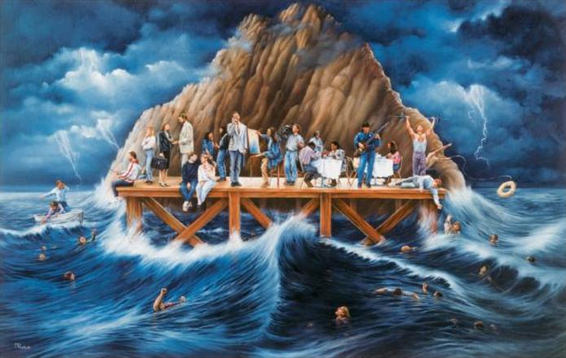
Quarreling in the church
Our fight is not with one another
Expending energy on petty differences
People are suffering
People are alienated from God
More focused on our own needs to be respected than others needs to be reconciled to God

Slide 11
James 4:1–11 (NLT)
4 You adulterers! Don’t you realize that friendship with the world makes you an enemy of God? I say it again: If you want to be a friend of the world, you make yourself an enemy of God.

Slide 12
Jeremiah 3:2–5 (NLT)
2 “Look at the shrines on every hilltop. Is there any place you have not been defiled by your adultery with other gods? You sit like a prostitute beside the road waiting for a customer. You sit alone like a nomad in the desert. You have polluted the land with your prostitution and your wickedness.

Slide 13
Jeremiah 3:2–5 (NLT)
3 That’s why even the spring rains have failed. For you are a brazen prostitute and completely shameless. 4 Yet you say to me, ‘Father, you have been my guide since my youth. 5 Surely you won’t be angry forever! Surely you can forget about it!’ So you talk, but you keep on doing all the evil you can.”

Slide 14
The Cosmos
The world apart from God
1 John 5:19–20 (NASB95) — 19 We know that we are of God, and that the whole world lies in the power of the evil one.

Slide 15
The Cosmos
The world apart from God
1 John 2:16–17 (NASB95) — 16 For all that is in the world, the lust of the flesh and the lust of the eyes and the boastful pride of life, is not from the Father, but is from the world. 17 The world is passing away, and also its lusts; but the one who does the will of God lives forever.

Slide 16
The Cosmos
The world apart from God
The natural man
The system designed to distract us from what is most important
Material goods
How people treat us
Being respected
Getting “what we deserve”

Slide 17
James 4:1–11 (NLT)
5 Do you think the Scriptures have no meaning? They say that God is passionate that the spirit he has placed within us should be faithful to him. 6 And he gives grace generously. As the Scriptures say, “God opposes the proud but gives grace to the humble

Slide 18
We want
To be appreciated
To be respected
To be honored
To be significant
We seek these things by whatever means necessary

Slide 19
God wants
Us to know how much He values us
To save us from destruction
To give us true glory
To give us meaningful work to do

Slide 20
How do I break up with the world?

Slide 21
James 4:1–11 (NLT)
7 So humble yourselves before God. Resist the devil, and he will flee from you. 8 Come close to God, and God will come close to you. Wash your hands, you sinners; purify your hearts, for your loyalty is divided between God and the world. 9 Let there be tears for what you have done. Let there be sorrow and deep grief. Let there be sadness instead of laughter, and gloom instead of joy.

Slide 22
How do I break up with the world?
-Humble yourself before God
-Fight the temptation to be selfish
-Draw near to God
-Recognize your divided loyalties
-Be bothered by your wrong behavior

Slide 23
James 4:1–11 (NLT)
10 Humble yourselves before the Lord, and he will lift you up in honor.
Let God worry about your honor

Slide 24
James 4:1–11 (NLT)
11 Don’t speak evil against each other, dear brothers and sisters. If you criticize and judge each other, then you are criticizing and judging God’s law. But your job is to obey the law, not to judge whether it applies to you.

