Slide 2
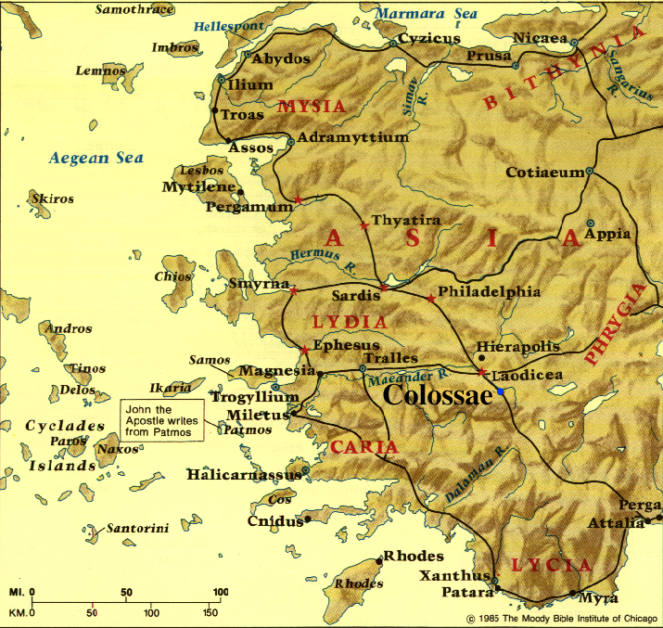

Slide 3
Colossians 4:7-17
^{4:7} As to all my affairs, Tychicus, our beloved brother and faithful servant and fellow bond-servant in the Lord, will bring you information. ⁸ For I have sent him to you for this very purpose, that you may know about our circumstances and that he may encourage your hearts; ⁹ and with him Onesimus, our faithful and beloved brother, who is one of your number. They will inform you about the whole situation here. ¹⁰ Aristarchus, my fellow prisoner, sends you his greetings; and also Barnabas’s cousin Mark (about whom you received instructions; if he comes to you, welcome him); ¹¹ and also Jesus who is called Justus; these are the only fellow workers for the kingdom of God who are from the circumcision, and they have proved to be an encouragement to me.

Slide 4
Colossians 4:7-17
¹² Epaphras, who is one of your number, a bondslave of Jesus Christ, sends you his greetings, always laboring earnestly for you in his prayers, that you may stand perfect and fully assured in all the will of God. ¹³ For I testify for him that he has a deep concern for you and for those who are in Laodicea and Hierapolis. ¹⁴ Luke, the beloved physician, sends you his greetings, and also Demas. ¹⁵ Greet the brethren who are in Laodicea and also Nympha and the church that is in her house. ¹⁶ When this letter is read among you, have it also read in the church of the Laodiceans; and you, for your part read my letter that is coming from Laodicea. ¹⁷ Say to Archippus, “Take heed to the ministry which you have received in the Lord, that you may fulfill it.”

Slide 5
Colossians 4:7-17 Spiritual Lessons from Paul’s Associates
TYCHICUS & LUKE
^{4:7} As to all my affairs, Tychicus, our beloved brother and faithful servant and fellow bond-servant in the Lord, will bring you information. ⁸ For I have sent him to you for this very purpose, that you may know about our circumstances and that he may encourage your hearts . . .

Slide 6
Colossians 4:7-17 Spiritual Lessons from Paul’s Associates
TYCHICUS & LUKE
Tychicus is Paul’s courier & messenger
^{4:7} As to all my affairs, Tychicus, our beloved brother and faithful servant and fellow bond-servant in the Lord, will bring you information. ⁸ For I have sent him to you for this very purpose, that you may know about our circumstances and that he may encourage your hearts . . .

Slide 7
Colossians 4:7-17 Spiritual Lessons from Paul’s Associates
TYCHICUS & LUKE
Luke is Paul’s physician & legal defense researcher
^{4:14} Luke, the beloved physician, sends you his greetings . . .

Slide 8
Colossians 4:7-17 Spiritual Lessons from Paul’s Associates
TYCHICUS & LUKE: Behind-the-scenes ministry roles are essential

Slide 9
Colossians 4:7-17 Spiritual Lessons from Paul’s Associates
MARK & ONESIMUS
^{4:10} . . . and also Barnabas’s cousin Mark (about whom you received instructions; if he comes to you, welcome him);

Slide 10
Colossians 4:7-17 Spiritual Lessons from Paul’s Associates
MARK & ONESIMUS
Mark had been kicked off of Paul’s church-planting team because he deserted them . . .
^{4:10} . . . and also Barnabas’s cousin Mark (about whom you received instructions; if he comes to you, welcome him);

Slide 11
Colossians 4:7-17 Spiritual Lessons from Paul’s Associates
MARK & ONESIMUS
Mark had been kicked off of Paul’s church-planting team because he deserted them . . .
. . . but now he is reconciled with Paul & restored to ministry
^{4:10} . . . and also Barnabas’s cousin Mark (about whom you received instructions; if he comes to you, welcome him);

Slide 12
Colossians 4:7-17 Spiritual Lessons from Paul’s Associates
MARK & ONESIMUS
Onesimus had run away from Colossae after a serious conflict with his master, Philemon . . .
⁹ . . . and with him Onesimus, our faithful and beloved brother, who is one of your number.

Slide 13
Colossians 4:7-17 Spiritual Lessons from Paul’s Associates
MARK & ONESIMUS
Onesimus had run away from Colossae after a serious conflict with his master, Philemon . . .
. . . but now he is converted to Christ & returning to be reconciled to Philemon & serve in the Colossian church
⁹ . . . and with him Onesimus, our faithful and beloved brother, who is one of your number.

Slide 14
Colossians 4:7-17 Spiritual Lessons from Paul’s Associates
MARK & ONESIMUS: Our God is the God of second chances

Slide 15
Colossians 4:7-17 Spiritual Lessons from Paul’s Associates
EPAPHRAS
¹² Epaphras, who is one of your number, a bondslave of Jesus Christ, sends you his greetings, always laboring earnestly for you in his prayers, that you may stand perfect and fully assured in all the will of God. ¹³ For I testify for him that he has a deep concern for you and for those who are in Laodicea and Hierapolis.

Slide 16
Colossians 4:7-17 Spiritual Lessons from Paul’s Associates
EPAPHRAS
Epaphras planted the Colossian church, but is now geographically distant from them
¹² Epaphras, who is one of your number, a bondslave of Jesus Christ, sends you his greetings, always laboring earnestly for you in his prayers, that you may stand perfect and fully assured in all the will of God. ¹³ For I testify for him that he has a deep concern for you and for those who are in Laodicea and Hierapolis.

Slide 17
Colossians 4:7-17 Spiritual Lessons from Paul’s Associates
EPAPHRAS
¹² Epaphras, who is one of your number, a bondslave of Jesus Christ, sends you his greetings, always laboring earnestly for you in his prayers, that you may stand perfect and fully assured in all the will of God. ¹³ For I testify for him that he has a deep concern for you and for those who are in Laodicea and Hierapolis.

Slide 18
Colossians 4:7-17 Spiritual Lessons from Paul’s Associates
EPAPHRAS: Intercessory prayer is a powerful ministry

Slide 19
Colossians 4:7-17 Spiritual Lessons from Paul’s Associates
“Praying is the most powerful thing we do on earth. Let us be faithful at it . . . Prayer is something you can do when you are physically too (weak) for other forms of ministry. When their physical strength is diminished, they simply get a promotion, so that most of their service is done on the higher plane of battling in prayer. Don’t wait until retirement age to become a prayer warrior. If you are out of touch with prayer, it is unlikely that you will get back in touch after retirement, unless you . . . repent of your prayerlessness. But if you are a prayer warrior, retirement will hold no terrors for you. You will be delighted at the prospect of giving more time than before to the most powerful thing you can do. Isn’t that beautiful? When you are too weak to do physically exerting service, you are freed to be a powerful warrior!”
Ajith Fernando, Spiritual Living in a Secular World (Zondervan, 1993), pp. 152,153.
EPAPHRAS: Intercessory prayer is a powerful ministry

Slide 20
Colossians 4:7-17 Spiritual Lessons from Paul’s Associates
TYCHICUS & LUKE: Behind-the-scenes ministry roles are essential
MARK & ONESIMUS: Our God is the God of second chances
EPAPHRAS: Intercessory prayer is a powerful ministry

