Slide 1
Acts
Acts 20 Paul’s Farewell

Slide 2
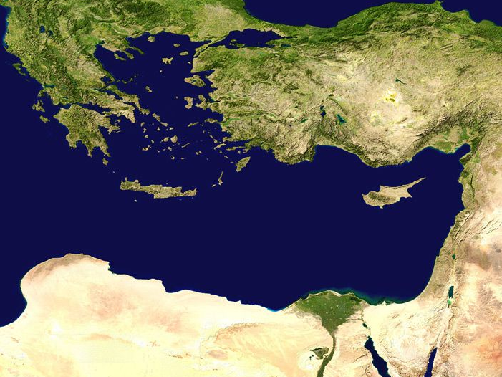
Antioch
The Missionary Journeys
#1
Jerusalem

Slide 3
Antioch
The Missionary Journeys
#2
Jerusalem

Slide 4
13 years!
Antioch
The Missionary Journeys
#3
Jerusalem

Slide 5
Acts 20: Paul is beginning to say some goodbyes
Antioch
The Missionary Journeys
#3
Jerusalem

Slide 6
Troas
Acts 20: Paul is beginning to say some goodbyes
Antioch
The Missionary Journeys
#3
Jerusalem

Slide 7
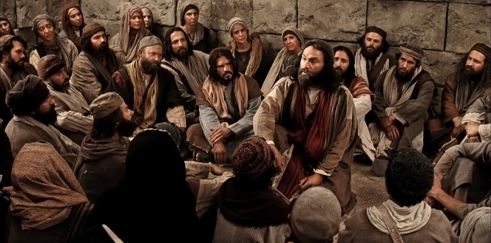
Troas
Acts 20: Paul is beginning to say some goodbyes
Antioch
The Missionary Journeys
#3
^{Acts 20:7} On the first day of the week, when we were gathered together to break bread, Paul began talking to them, intending to leave the next day, and he prolonged his message until midnight.
^{Acts 20:7} On the first day of the week, when we were gathered together to break bread, Paul began talking to them, intending to leave the next day, and he prolonged his message until midnight.
Jerusalem

Slide 8
Troas
Acts 20: Paul is beginning to say some goodbyes
^{Acts 20:7} On the first day of the week, when we were gathered together to break bread, Paul began talking to them, intending to leave the next day, and he prolonged his message until midnight.

Slide 9
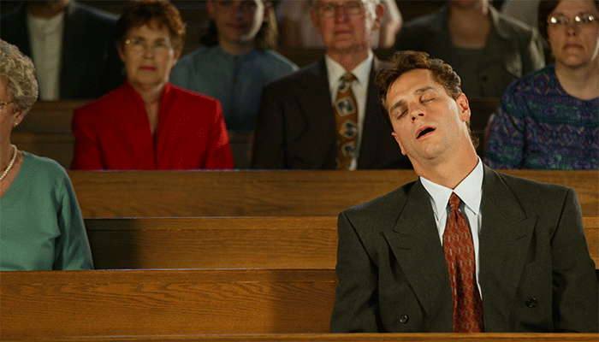
^{Acts 20:8} There were many lamps in the upper room where we were gathered together. ⁹ And there was a young man named Eutychus sitting on the window sill, sinking into a deep sleep;

Slide 10
^{Acts 20:8} There were many lamps in the upper room where we were gathered together. ⁹ And there was a young man named Eutychus sitting on the window sill, sinking into a deep sleep;
^{Acts 20:8} There were many lamps in the upper room where we were gathered together. ⁹ And there was a young man named Eutychus sitting on the window sill, sinking into a deep sleep;
^{Acts 20:8} There were many lamps in the upper room where we were gathered together. ⁹ And there was a young man named Eutychus sitting on the window sill, sinking into a deep sleep;

Slide 11
^{Acts 20:9} and as Paul kept on talking, he was overcome by sleep and fell down from the third floor and was picked up dead.
^{Acts 20:9} and as Paul kept on talking, he was overcome by sleep and fell down from the third floor and was picked up dead.

Slide 12
^{Acts 20:10} But Paul went down and fell upon him, and after embracing him, he said, “Do not be troubled, for his life is in him.”
^{Acts 20:10} But Paul went down and fell upon him, and after embracing him, he said, “Do not be troubled, for his life is in him.”

Slide 13
^{Acts 20:11} When he had gone back up and had broken the bread and eaten, he talked with them a long while until daybreak, and then left. ¹² They took away the boy alive, and were greatly comforted.

Slide 14
^{Acts 20:11} When he had gone back up and had broken the bread and eaten, he talked with them a long while until daybreak, and then left. ¹² They took away the boy alive, and were greatly comforted.

Slide 15
Troas
^{Acts 20:13} But we, going ahead to the ship, set sail for Assos, intending from there to take Paul on board; for so he had arranged it, intending himself to go by land.
^{Acts 20:13} But we, going ahead to the ship, set sail for Assos, intending from there to take Paul on board; for so he had arranged it, intending himself to go by land.
^{Acts 20:13} But we, going ahead to the ship, set sail for Assos, intending from there to take Paul on board; for so he had arranged it, intending himself to go by land.

Slide 16
Troas
Miletus
^{Acts 20:14} And when he met us at Assos, we took him on board and came to Mitylene. ¹⁵ Sailing from there, we arrived the following day opposite Chios; and the next day we crossed over to Samos; and the day following we came to Miletus.

Slide 17
Troas
Miletus
^{Acts 20:16} For Paul had decided to sail past Ephesus so that he would not have to spend time in Asia; for he was hurrying to be in Jerusalem, if possible, on the day of Pentecost.

Slide 18
Troas
Ephesus
Miletus
^{Acts 20:16} For Paul had decided to sail past Ephesus so that he would not have to spend time in Asia; for he was hurrying to be in Jerusalem, if possible, on the day of Pentecost.

Slide 19
Troas
Ephesus
Miletus
^{Acts 20:17} From Miletus he sent to Ephesus and called to him the elders of the church. ¹⁸ And when they had come to him, he said to them,

Slide 20
Troas
Ephesus
Miletus
^{Acts 20:17} From Miletus he sent to Ephesus and called to him the elders of the church. ¹⁸ And when they had come to him, he said to them,

Slide 21
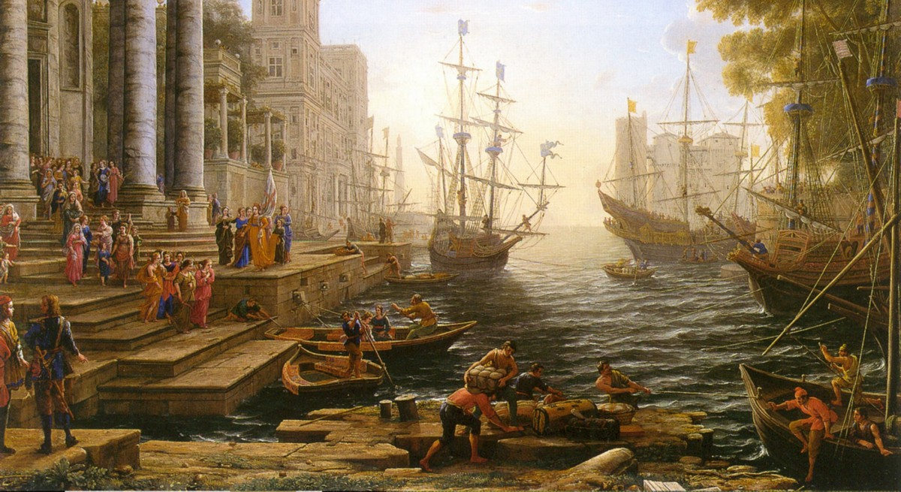
Troas
Ephesus
Miletus
^{Acts 20:17} From Miletus he sent to Ephesus and called to him the elders of the church. ¹⁸ And when they had come to him, he said to them,

Slide 22
Part 1: Paul recounts his ministry with them
^{Acts 20:17} “You yourselves know, from the first day that I set foot in Asia, how I was with you the whole time, ¹⁹ serving the Lord with all humility and with tears and with trials which came upon me through the plots of the Jews;

Slide 23
Part 1: Paul recounts his ministry with them
^{Acts 20:20} how I did not shrink from declaring to you anything that was profitable, and teaching you publicly and from house to house, ²¹ solemnly testifying to both Jews and Greeks of repentance toward God and faith in our Lord Jesus Christ.

Slide 24
Part 1: Paul recounts his ministry with them
^{Acts 20:22} And now, behold, bound by the Spirit, I am on my way to Jerusalem, not knowing what will happen to me there, ²³ except that the Holy Spirit solemnly testifies to me in every city, saying that bonds and afflictions await me.

Slide 25
Part 2: A foreboding look ahead for Paul
^{Acts 20:22} And now, behold, bound by the Spirit, I am on my way to Jerusalem, not knowing what will happen to me there, ²³ except that the Holy Spirit solemnly testifies to me in every city, saying that bonds and afflictions await me.

Slide 26
Part 2: A foreboding look ahead for Paul
^{Acts 20:22} And now, behold, bound by the Spirit, I am on my way to Jerusalem, not knowing what will happen to me there, ²³ except that the Holy Spirit solemnly testifies to me in every city, saying that bonds and afflictions await me.

Slide 27
Part 2: A foreboding look ahead for Paul
^{Acts 20:22} And now, behold, bound by the Spirit, I am on my way to Jerusalem, not knowing what will happen to me there, ²³ except that the Holy Spirit solemnly testifies to me in every city, saying that bonds and afflictions await me.

Slide 28
Part 2: A foreboding look ahead for Paul
^{Acts 20:22} And now, behold, bound by the Spirit, I am on my way to Jerusalem, not knowing what will happen to me there, ²³ except that the Holy Spirit solemnly testifies to me in every city, saying that bonds and afflictions await me.
^{Acts 20:22} And now, behold, bound by the Spirit, I am on my way to Jerusalem, not knowing what will happen to me there, ²³ except that the Holy Spirit solemnly testifies to me in every city, saying that bonds and afflictions await me.

Slide 29
Part 2: A foreboding look ahead for Paul
^{Acts 20:22} And now, behold, bound by the Spirit, I am on my way to Jerusalem, not knowing what will happen to me there, ²³ except that the Holy Spirit solemnly testifies to me in every city, saying that bonds and afflictions await me.

Slide 30
Part 2: A foreboding look ahead for Paul
^{Acts 20:24} But I do not consider my life of any account as dear to myself, so that I may finish my course and the ministry which I received from the Lord Jesus, to testify solemnly of the gospel of the grace of God.

Slide 31
Part 2: A foreboding look ahead for Paul
^{Acts 20:25} “And now, behold, I know that all of you, among whom I went about preaching the kingdom, will no longer see my face.

Slide 32
Part 2: A foreboding look ahead for Paul
^{Acts 20:26} Therefore, I testify to you this day that I am innocent of the blood of all men.²⁷ For I did not shrink from declaring to you the whole purpose of God.

Slide 33
Part 2: A foreboding look ahead for Paul
^{Acts 20:28} Be on guard for yourselves and for all the flock, among which the Holy Spirit has made you overseers, to shepherd the church of God which He purchased with His own blood.

Slide 34
Part 3: Commissioning the elders to carry on
^{Acts 20:28} Be on guard for yourselves and for all the flock, among which the Holy Spirit has made you overseers, to shepherd the church of God which He purchased with His own blood.

Slide 35
Part 3: Commissioning the elders to carry on
^{Acts 20:29} I know that after my departure savage wolves will come in among you, not sparing the flock; ³⁰ and from among your own selves men will arise, speaking perverse things, to draw away the disciples after them.

Slide 36
Part 3: Commissioning the elders to carry on
^{Acts 20:31} Therefore be on the alert, remembering that night and day for a period of three years I did not cease to admonish each one with tears.

Slide 37
Part 3: Commissioning the elders to carry on
^{Acts 20:32} And now I commend you to God and to the word of His grace, which is able to build you up and to give you the inheritance among all those who are sanctified.

Slide 38
Part 3: Commissioning the elders to carry on
^{Acts 20:33} I have coveted no one’s silver or gold or clothes. ³⁴ You yourselves know that these hands ministered to my own needs and to the men who were with me. ³⁵ In everything I showed you that by working hard in this manner you must help the weak and remember the words of the Lord Jesus, that He Himself said, ‘It is more blessed to give than to receive.’”

Slide 39
What kind of leader is Paul?
^{Acts 20:36} When he had said these things, he knelt down and prayed with them all. ³⁷ And they began to weep aloud and embraced Paul, and repeatedly kissed him, ³⁸ grieving especially over the word which he had spoken, that they would not see his face again. And they were accompanying him to the ship.

Slide 40
“Transformational Leadership”
^{1 Cor 11:1} Be imitators of me, just as I also am of Christ.
^{Acts 20:36} When he had said these things, he knelt down and prayed with them all. ³⁷ And they began to weep aloud and embraced Paul, and repeatedly kissed him, ³⁸ grieving especially over the word which he had spoken, that they would not see his face again. And they were accompanying him to the ship.

Slide 41
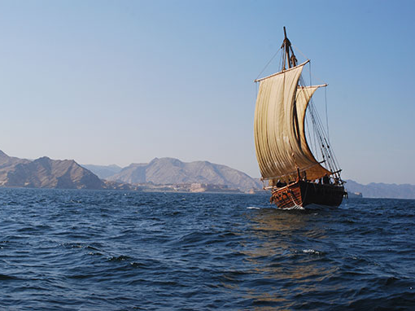
Humility
¹⁸ “You yourselves know, from the first day that I set foot in Asia, how I was with you the whole time, ¹⁹ serving the Lord with all humility
²⁰ how I did not shrink from declaring to you anything that was profitable, and teaching you publicly and from house to house
The heart of a servant leader

Slide 42
Integrity
³³ I have coveted no one’s silver or gold or clothes. ³⁴ You yourselves know that these hands ministered to my own needs and to the men who were with me. ³⁵ In everything I showed you that by working hard in this manner you must help the weak and remember the words of the Lord Jesus, that He Himself said, ‘It is more blessed to give than to receive.’”
³³ I have coveted no one’s silver or gold or clothes. ³⁴ You yourselves know that these hands ministered to my own needs and to the men who were with me. ³⁵ In everything I showed you that by working hard in this manner you must help the weak and remember the words of the Lord Jesus, that He Himself said, ‘It is more blessed to give than to receive.’”
³³ I have coveted no one’s silver or gold or clothes. ³⁴ You yourselves know that these hands ministered to my own needs and to the men who were with me. ³⁵ In everything I showed you that by working hard in this manner you must help the weak and remember the words of the Lord Jesus, that He Himself said, ‘It is more blessed to give than to receive.’”
The heart of a servant leader

Slide 43
Others-centered
³³ I have coveted no one’s silver or gold or clothes. ³⁴ You yourselves know that these hands ministered to my own needs and to the men who were with me. ³⁵ In everything I showed you that by working hard in this manner you must help the weak and remember the words of the Lord Jesus, that He Himself said, ‘It is more blessed to give than to receive.’”
³³ I have coveted no one’s silver or gold or clothes. ³⁴ You yourselves know that these hands ministered to my own needs and to the men who were with me. ³⁵ In everything I showed you that by working hard in this manner you must help the weak and remember the words of the Lord Jesus, that He Himself said, ‘It is more blessed to give than to receive.’”
The heart of a servant leader

Slide 44
Others-centered
¹⁸ from the first day that I set foot in Asia, how I was with you the whole time, ¹⁹ serving the Lord with all humility and with tears and with trials which came upon me through the plots of the Jews;
The heart of a servant leader

Slide 45
Others-centered
Sacrificial
¹⁸ from the first day that I set foot in Asia, how I was with you the whole time, ¹⁹ serving the Lord with all humility and with tears and with trials which came upon me through the plots of the Jews;
The heart of a servant leader

Slide 46
Others-centered
Sacrificial
A thick skin and a tender heart
The heart of a servant leader

Slide 47
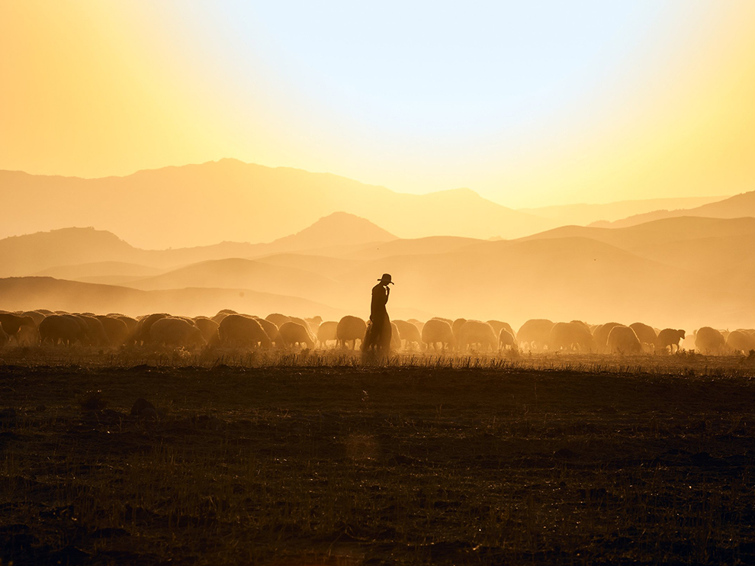
Pastoral
The heart of a servant leader

Slide 48
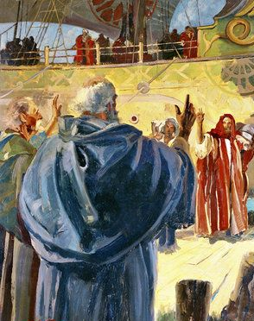
Pastoral
“I have been a shepherd to you, now you must be a shepherd to them”
²⁸ Be on guard for yourselves and for all the flock, among which the Holy Spirit has made you overseers, to shepherd the church of God which He purchased with His own blood.

Slide 49
Pastoral
“I have been a shepherd to you, now you must be a shepherd to them”
²⁸ Be on guard for yourselves and for all the flock, among which the Holy Spirit has made you overseers, to shepherd the church of God which He purchased with His own blood.

Slide 50
Pastoral
You must be stewards of the flock
“These people belong to God. He has entrusted them to me, and now He has entrusted them to you.”
²⁸ Be on guard for yourselves and for all the flock, among which the Holy Spirit has made you overseers, to shepherd the church of God which He purchased with His own blood.

Slide 51
Pastoral
You must be stewards of the flock
“These people belong to God. He has entrusted them to me, and now He has entrusted them to you.”
²⁸ Be on guard for yourselves and for all the flock, among which the Holy Spirit has made you overseers, to shepherd the church of God which He purchased with His own blood.

Slide 52
Pastoral
You must value the flock
²⁸ Be on guard for yourselves and for all the flock, among which the Holy Spirit has made you overseers, to shepherd the church of God which He purchased with His own blood.

Slide 53
Pastoral
You must value the flock
^{John 21} “Do you love me?” … “Tend my lambs”
²⁸ Be on guard for yourselves and for all the flock, among which the Holy Spirit has made you overseers, to shepherd the church of God which He purchased with His own blood.

Slide 54
Pastoral
You must protect the flock
²⁸ Be on guard for yourselves and for all the flock, among which the Holy Spirit has made you overseers, to shepherd the church of God which He purchased with His own blood.

Slide 55
Pastoral
You must protect the flock
²⁹ I know that after my departure savage wolves will come in among you, not sparing the flock; ³⁰ and from among your own selves men will arise, speaking perverse things, to draw away the disciples after them.
.

Slide 56
Pastoral
You must protect the flock
²⁹ I know that after my departure savage wolves will come in among you, not sparing the flock; ³⁰ and from among your own selves men will arise, speaking perverse things, to draw away the disciples after them.
.

Slide 57
Pastoral
You must protect the flock
³¹ Therefore be on the alert, remembering that night and day for a period of three years I did not cease to admonish each one with tears.
.

Slide 58
Pastoral
You must feed the flock
²⁰ how I did not shrink from declaring to you anything that was profitable, and teaching you publicly and from house to house,²¹ solemnly testifying to both Jews and Greeks of repentance toward God and faith in our Lord Jesus Christ.
³¹ Therefore be on the alert, remembering that night and day for a period of three years I did not cease to admonish each one with tears.
.

Slide 59
Pastoral
A shepherd cares for the flock, but ultimately entrusts them to God
^{Acts 20:32} And now I commend you to God and to the word of His grace, which is able to build you up and to give you the inheritance among all those who are sanctified.

Slide 60
Pastoral
A shepherd cares for the flock, but ultimately entrusts them to God
^{Acts 20:32} And now I commend you to God and to the word of His grace, which is able to build you up and to give you the inheritance among all those who are sanctified.

Slide 61
Pastoral
The goal has always been that they could stand on their own
^{2 Tim2:2} The things which you have heard from me … entrust these to faithful men who will be able to teach others also.
And become shepherds in their own right!
Passing of the torch
^{Acts 20:32} And now I commend you to God and to the word of His grace, which is able to build you up and to give you the inheritance among all those who are sanctified.

Slide 62
Pastoral
We’re not just caring for people -
we are equipping people who can care for and equip others … and so on
^{2 Tim2:2} The things which you have heard from me … entrust these to faithful men who will be able to teach others also.
Passing of the torch
^{Acts 20:32} And now I commend you to God and to the word of His grace, which is able to build you up and to give you the inheritance among all those who are sanctified.

Slide 63
Missional
²⁴ But I do not consider my life of any account as dear to myself, so that I may finish my course and the ministry which I received from the Lord Jesus, to testify solemnly of the gospel of the grace of God.
.

Slide 64
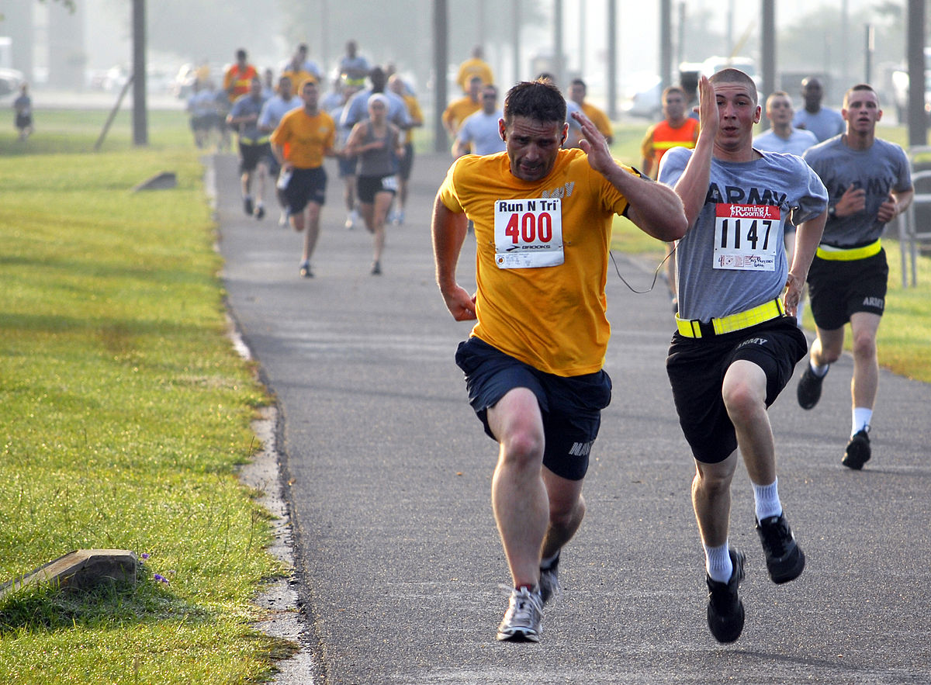
Missional
Paul’s life was about a mission
²⁴ But I do not consider my life of any account as dear to myself, so that I may finish my course and the ministry which I received from the Lord Jesus, to testify solemnly of the gospel of the grace of God.
.

Slide 65
Missional
Paul’s life was about a mission
^{1Cor 9:26} Therefore I run in such a way, as not without aim; I box in such a way, as not beating the air
²⁴ But I do not consider my life of any account as dear to myself, so that I may finish my course and the ministry which I received from the Lord Jesus, to testify solemnly of the gospel of the grace of God.
.

Slide 66
Missional
Paul’s life was about a mission
^{1Cor 9:26} Therefore I run in such a way, as not without aim; I box in such a way, as not beating the air
²⁴ But I do not consider my life of any account as dear to myself, so that I may finish my course and the ministry which I received from the Lord Jesus, to testify solemnly of the gospel of the grace of God.
.

Slide 67
Missional
A mission given by Jesus himself
²⁴ But I do not consider my life of any account as dear to myself, so that I may finish my course and the ministry which I received from the Lord Jesus, to testify solemnly of the gospel of the grace of God.
.

Slide 68
Missional
A mission given by Jesus himself
²⁴ But I do not consider my life of any account as dear to myself, so that I may finish my course and the ministry which I received from the Lord Jesus, to testify solemnly of the gospel of the grace of God.
.

Slide 69
Missional
Paul worked for God, not the other way around
²⁴ But I do not consider my life of any account as dear to myself, so that I may finish my course and the ministry which I received from the Lord Jesus, to testify solemnly of the gospel of the grace of God.
.

Slide 70
Missional
Paul worked for God, not the other way around
²⁴ But I do not consider my life of any account as dear to myself, so that I may finish my course and the ministry which I received from the Lord Jesus, to testify solemnly of the gospel of the grace of God.
.

Slide 71
Missional
The finish line was at the end of his life
How’s your marathon mentality holding up?
²⁴ But I do not consider my life of any account as dear to myself, so that I may finish my course and the ministry which I received from the Lord Jesus, to testify solemnly of the gospel of the grace of God.
.

Slide 72
Missional
^{2 Tim 4:7} I have fought the good fight, I have finished the course, I have kept the faith; ⁸ in the future there is laid up for me the crown of righteousness, which the Lord, the righteous Judge, will award to me on that day;
The finish line was at the end of his life
Challenge: Finish your course!
²⁴ But I do not consider my life of any account as dear to myself, so that I may finish my course and the ministry which I received from the Lord Jesus, to testify solemnly of the gospel of the grace of God.
.

Slide 73
Acts

