Slide 1
The power of a heaven-focused life
Philippians 3:7-14, 1 John 3:1-3

Slide 2
“I am a pilgrim. The king has sent for me, and I am going to the celestial city.”
“How long can I linger in vanity fair?”

Slide 3
“I am a pilgrim. The king has sent for me, and I am going to the celestial city.”
“What does it mean when my friend dies?”

Slide 4
“I am a pilgrim. The king has sent for me, and I am going to the celestial city.”
“Who do I choose as my close companions?”

Slide 5
(Colossians 3:1) Since, then, you have been raised with Christ, set your hearts on things above, where Christ is, seated at the right hand of God.
“I am a pilgrim. The king has sent for me, and I am going to the celestial city.”
We elevate other things as the functional goals of life
There is great power and peace that comes from clear focus on your destination

Slide 6
Philippians 3:7-8
But whatever were gains to me I now consider loss for the sake of Christ. What is more, I consider everything a loss because of the surpassing worth of knowing Christ Jesus my Lord, for whose sake I have lost all things.

Slide 7
Philippians 3:7-8
But whatever were gains to me I now consider loss for the sake of Christ. What is more, I consider everything a loss because of the surpassing worth of knowing Christ Jesus my Lord, for whose sake I have lost all things.
(2. Cor. 4:17) For our light and momentary troubles are achieving for us an eternal glory that far outweighs them all.

Slide 8
Philippians 3:8-9
I consider them garbage, that I may gain Christ and be found in him, not having a righteousness of my own that comes from the law, but that which is through faith in Christ—the righteousness that comes from God on the basis of faith.

Slide 9
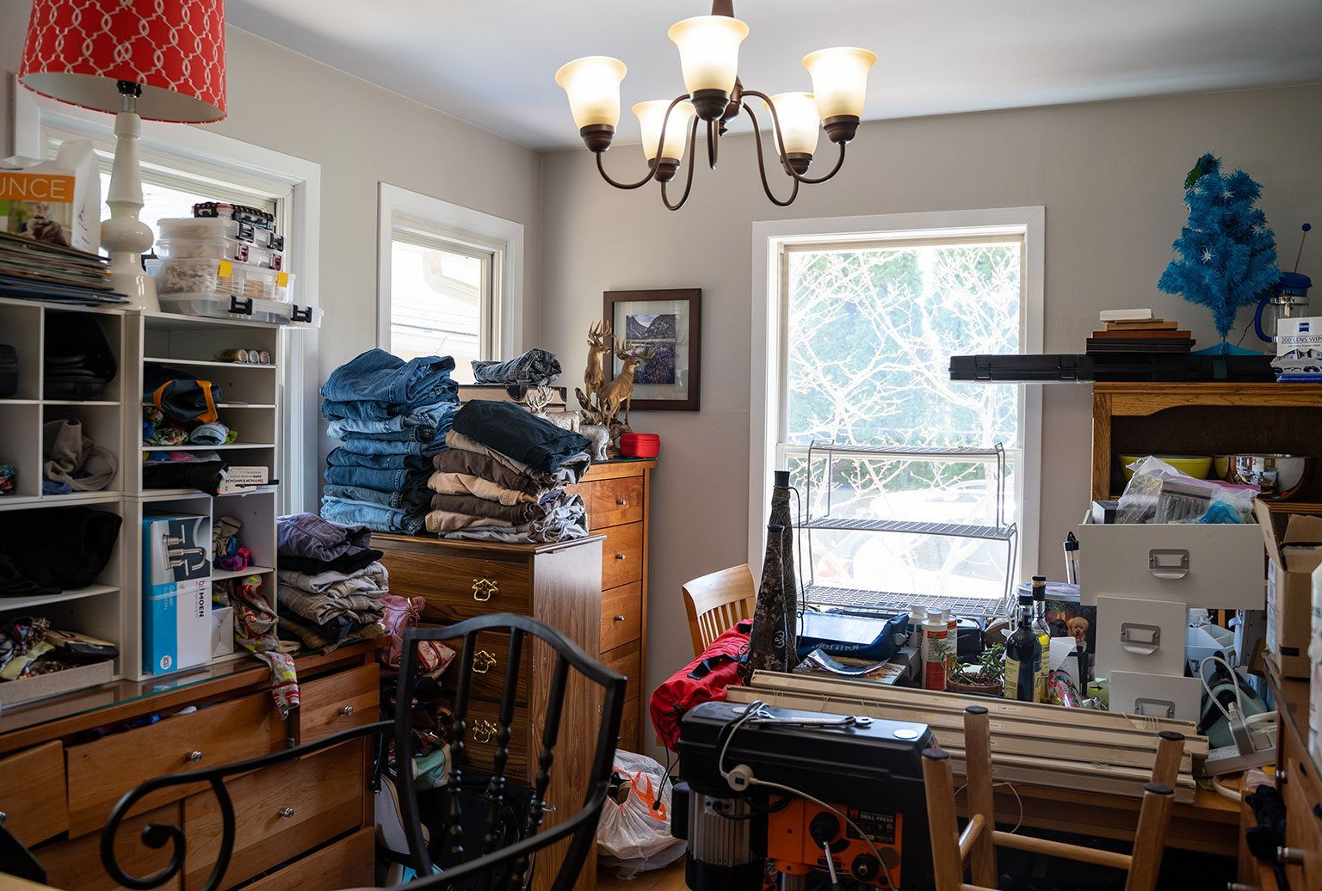
Philippians 3:8-9
This is not extremism, it’s realism
I consider them garbage, that I may gain Christ and be found in him, not having a righteousness of my own that comes from the law, but that which is through faith in Christ—the righteousness that comes from God on the basis of faith.
Christ’s everlasting presence confers everlasting value
What’s truly worth my time, attention, worry?
What in life can I afford to lose?
Evaluation

Slide 10
Philippians 3:10-11
I want to know Christ—yes, to know the power of his resurrection and participation in his sufferings, becoming like him in his death, and so, somehow, attaining to the resurrection from the dead.

Slide 11
Philippians 3:10-11
I want to know Christ—yes, to know the power of his resurrection and participation in his sufferings, becoming like him in his death, and so, somehow, attaining to the resurrection from the dead.
Resurrection power still isn’t resurrection

Slide 12
Philippians 3:12
Not that I have already obtained all this, or have already arrived at my goal, but I press on to take hold of that for which Christ Jesus took hold of me.

Slide 13
Philippians 3:12
Not that I have already obtained all this, or have already arrived at my goal, but I press on to take hold of that for which Christ Jesus took hold of me.
Drive forward, pound, harass, persecute (BDAG)

Slide 14
Philippians 3:12
Not that I have already obtained all this, or have already arrived at my goal, but I press on to take hold of that for which Christ Jesus took hold of me.
Jesus took hold of me, firstly, to be with me
Orientation

Slide 15
Philippians 3:13-14
Brothers and sisters, I do not consider myself yet to have taken hold of it. But one thing I do: Forgetting what is behind and straining toward what is ahead, I press on toward the goal to win the prize for which God has called me heavenward in Christ Jesus.
Orientation

Slide 16
Philippians 3:13-14
Brothers and sisters, I do not consider myself yet to have taken hold of it. But one thing I do: Forgetting what is behind and straining toward what is ahead, I press on toward the goal to win the prize for which God has called me heavenward in Christ Jesus.
Orientation

Slide 17
Philippians 3:13-14
Brothers and sisters, I do not consider myself yet to have taken hold of it. But one thing I do: Forgetting what is behind and straining toward what is ahead, I press on toward the goal to win the prize for which God has called me heavenward in Christ Jesus.
We tend to scatter our energies
Side-quests
Looting
Gear
Other characters
Orientation

Slide 18
C.S. Lewis Mere Christianity
“I must keep alive in myself the desire for my true country, which I shall not find until after death; I must never let it get snowed under or turned aside; I must make it the main object of life to press on to that other country and to help others do the same.”

Slide 19
1 John 3:1-2
See what great love the Father has lavished on us, that we should be called children of God! And that is what we are! The reason the world does not know us is that it did not know him. Dear friends, now we are children of God, and what we will be has not yet been made known.

Slide 20
1 John 3:1-2
See what great love the Father has lavished on us, that we should be called children of God! And that is what we are! The reason the world does not know us is that it did not know him. Dear friends, now we are children of God, and what we will be has not yet been made known.

Slide 21
1 John 3:1-2
See what great love the Father has lavished on us, that we should be called children of God! And that is what we are! The reason the world does not know us is that it did not know him. Dear friends, now we are children of God, and what we will be has not yet been made known.

Slide 22
1 John 3:2-3
But we know that when Christ appears, we shall be like him, for we shall see him as he is. All who have this hope in him purify themselves, just as he is pure.
Transformation

Slide 23
1 John 3:2-3
(1 Cor. 13:12) “For now we see in a mirror dimly, but then face to face”
(Psalm 17:5) “As for me, I will be vindicated and will see your face; when I awake, I will be satisfied with seeing your likeness.”
(John 17:24) “I want those you have given me to be with me where I am, and to see my glory.”
But we know that when Christ appears, we shall be like him, for we shall see him as he is. All who have this hope in him purify themselves, just as he is pure.
Transformation

Slide 24
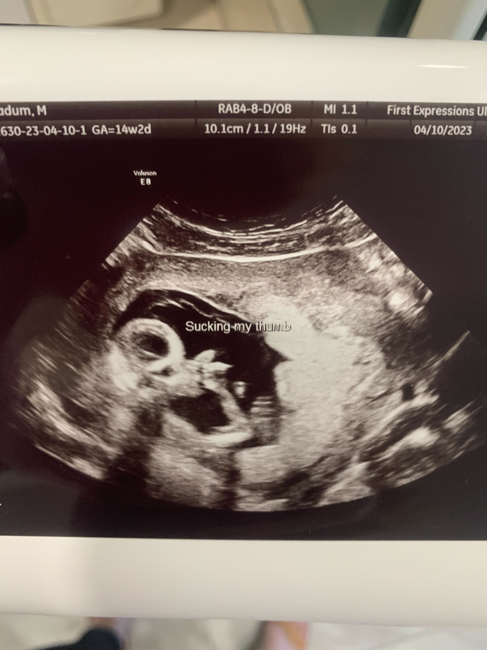
1 John 3:2-3
But we know that when Christ appears, we shall be like him, for we shall see him as he is. All who have this hope in him purify themselves, just as he is pure.
Anticipating an awesome future moment can change you
Transformation

Slide 25
Randy Alcorn Author of Heaven
“What's the hope we should live for? It's more than freedom from suffering. It's deliverance from sin, freeing us to be fully human…May God preserve us from embracing lesser hopes. May we rejoice as we anticipate the height, depth, length, and breadth of our redemption.”

Slide 26
1 John 3:2-3
(Rom. 8:29-30) For those God foreknew he also predestined to be conformed to the image of his Son, that he might be the firstborn among many brothers and sisters. And those he predestined, he also called; those he called, he also justified; those he justified, he also glorified.
But we know that when Christ appears, we shall be like him, for we shall see him as he is. All who have this hope in him purify themselves, just as he is pure.
Appreciation of destiny changes you too
Transformation

Slide 27
Tim Keller Author and Pastor
“The grace of our youth, the strength of our middle years, and the wisdom of our age will all be wrapped together. The pages of the New Testament are rustling with the rumor that we are going to get in to the things we are after.”

Slide 28
Randy Alcorn Author of Heaven
“We can anticipate an eternity of growing in Christlikeness…"transformed into his likeness with ever-increasing glory" (2 Corinthians 3:18). We can [participate in] this joyful process here and now…it will continue forever.”

Slide 29
Final thoughts
We should be people of one thing
Engage moments that provide clearer vision
Don’t mistake even the best parts of the journey for the destination

Slide 30
Little Pilgrim’s Progress By Helen L. Taylor
Standfast had hoped that he might be allowed to spend a long life in working for the King, but this was not his Master’s will. Soon, the King summoned His faithful young servant to cross the river to the Celestial City.

Slide 31
Little Pilgrim’s Progress By Helen L. Taylor
At first Standfast could scarcely believe that the King really wished to receive him…but the Shining One assured him that it was true. “You have served my Master faithfully,” said he, “and He is not willing that you should be living at a distance from Him any longer.”

Slide 32
Little Pilgrim’s Progress By Helen L. Taylor
When Standfast reached the middle of the river, he turned and spoke once more to his friends. “This river makes so many creatures afraid!” he said. “Indeed, I was frightened myself before I entered it. But my fear is gone. I can feel the firm ground under my feet and soon I will be with my Good Prince.”

Slide 33
Little Pilgrim’s Progress By Helen L. Taylor
“It has been pleasant to hear of Him and think on Him, but now I shall see Him with my own eyes. He has helped me and strengthened me all though my pilgrimage, and He is with me now.”

