Slide 2
Matthew 21
The Triumphal Entry

Slide 3
Context
Matt 18 & 19
-Who are God’s people?
Matt 20- Begins a new section
-8 Chapters or ¼ of the entire book focused on the last week of Jesus’ days on earth

Slide 4
Matthew 20:17–19 (NASB95)
17 As Jesus was about to go up to Jerusalem, He took the twelve disciples aside by themselves, and on the way He said to them, 18 “Behold, we are going up to Jerusalem; and the Son of Man will be delivered to the chief priests and scribes, and they will condemn Him to death,

Slide 5
Matthew 20:17–19 (NASB95)
19 and will hand Him over to the Gentiles to mock and scourge and crucify Him, and on the third day He will be raised up.”
Jesus knows what’s coming
His disciples were just confused

Slide 6
Matthew 21:1–5 (NASB95)
1 When they had approached Jerusalem and had come to Bethphage, at the Mount of Olives, then Jesus sent two disciples, 2 saying to them, “Go into the village opposite you, and immediately you will find a donkey tied there and a colt with her; untie them and bring them to Me.

Slide 7
Matthew 21:1–5 (NASB95)
3 “If anyone says anything to you, you shall say, ‘The Lord has need of them,’ and immediately he will send them.” 4 This took place to fulfill what was spoken through the prophet:

Slide 8
Matthew 21:1–5 (NASB95)
5 “Say to the daughter of Zion, ‘Behold your King is coming to you, Gentle, and mounted on a donkey, Even on a colt, the foal of a beast of burden.’ ”
Zech 9:9

Slide 9
Jesus Fulfills Prophecy
Messiah would
Be born of a virgin (Isa 7:14)
In Bethlehem (Micah 5:2)
A descendent of David (2 Sam 7:8-16)
Would be “cut of and return” in 33 A.D. (Daniel 9)
Raised from the dead (Matt 20:19 and many others)

Slide 10
Jesus Fulfills Prophecy
Jesus is making the deliberate statement “I am the Messiah” by coming to Jerusalem this way
Messiah would
Be born of a virgin (Isa 7:14)
In Bethlehem (Micah 5:2)
A descendent of David (2 Sam 7:8-16)
Would be “cut of and return” in 33 A.D. (Daniel 9)
Raised from the dead (Matt 20:19 and many others)

Slide 11
Jesus Fulfills Prophecy
The imagery of a king arriving on a donkey

Slide 12
A Powerful Response
The Roman procession
Recognition of Jesus’ role as king
Recognizing the fulfillment of OT prophecy
The Joy of the people as they welcome him!

Slide 13
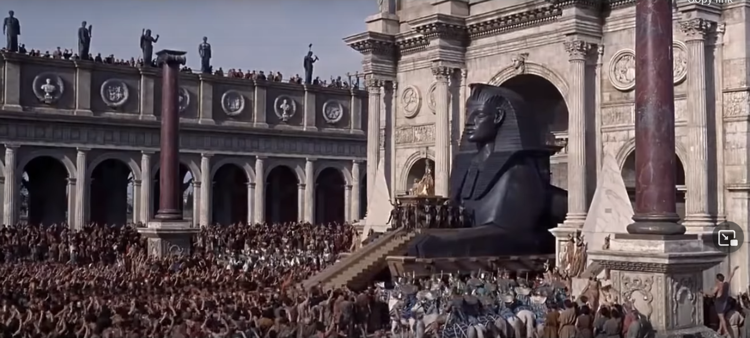
A Powerful Response
The Roman procession

Slide 14
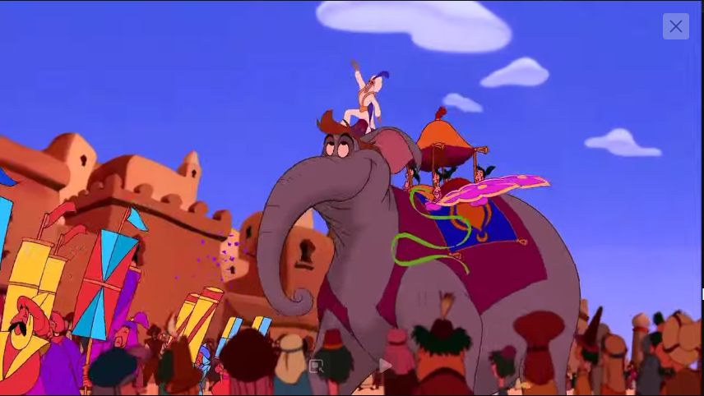
A Powerful Response
The Roman procession

Slide 15
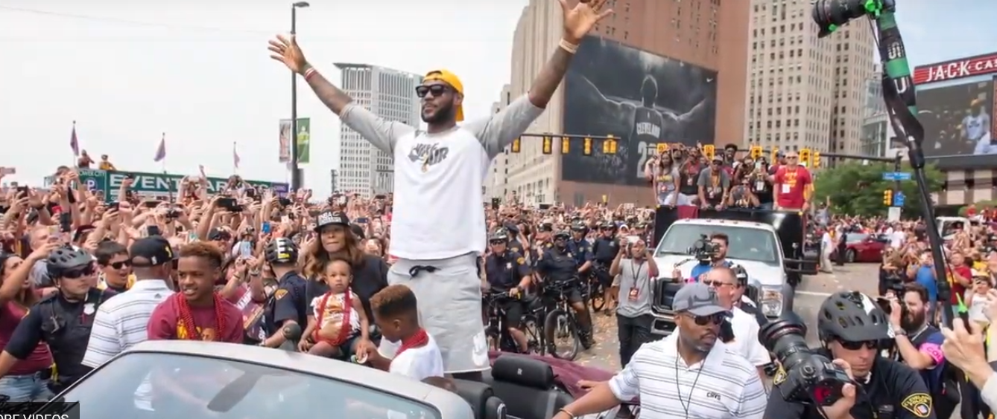
A Powerful Response
The Roman procession

Slide 16
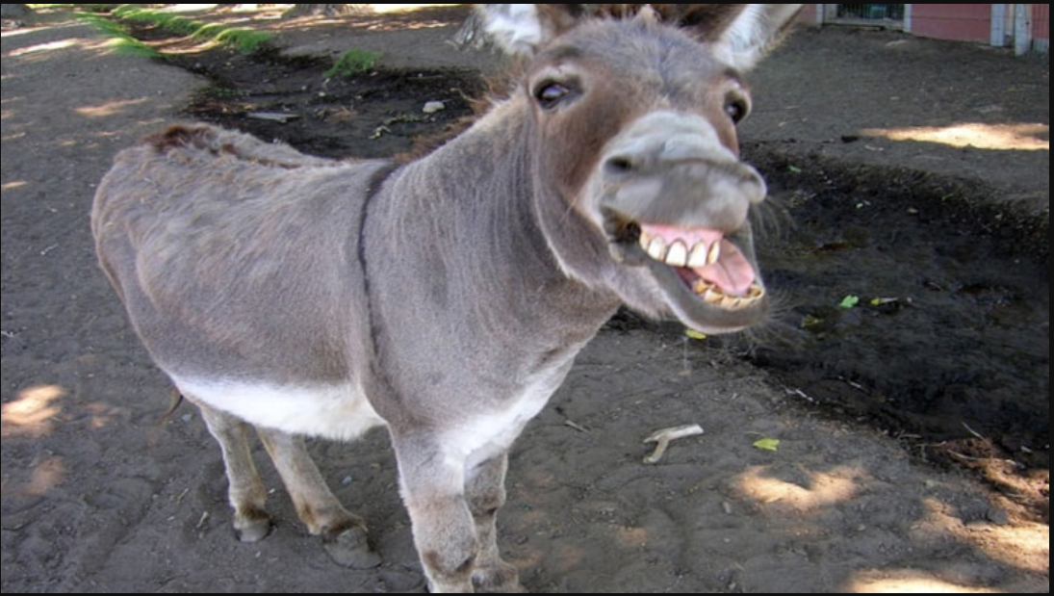
A Powerful Response
The Roman procession

Slide 17
A Powerful Response
Isaiah 55:8–9 (NASB95) — 8 “For My thoughts are not your thoughts, Nor are your ways My ways,” declares the Lord. 9 “For as the heavens are higher than the earth, So are My ways higher than your ways And My thoughts than your thoughts.
The Roman procession

Slide 18
Matthew 21:6–9 (NASB95) —
6 The disciples went and did just as Jesus had instructed them, 7 and brought the donkey and the colt, and laid their coats on them; and He sat on the coats. 8 Most of the crowd spread their coats in the road, and others were cutting branches from the trees and spreading them in the road.

Slide 19
Matthew 21:6-9 (NASB95)
9 The crowds going ahead of Him, and those who followed, were shouting, “Hosanna to the Son of David; Blessed is He who comes in the name of the Lord; Hosanna in the highest!”

Slide 20
Hosanna
“Hosanna”=
יָשַׁע (yāšaʿ) be saved, be delivered
נָא (nāʾ) I (we) pray; now.
Please save us!
Term for worship of God
Quoting Ps 118

Slide 21
Luke 19:36–37 (NASB95)
36 As He was going, they were spreading their coats on the road. 37 As soon as He was approaching, near the descent of the Mount of Olives, the whole crowd of the disciples began to praise God joyfully with a loud voice for all the miracles which they had seen,

Slide 22
Luke 19:38–40 (NASB95)
38 shouting: “Blessed is the King who comes in the name of the Lord; Peace in heaven and glory in the highest!” 39 Some of the Pharisees in the crowd said to Him, “Teacher, rebuke Your disciples.” 40 But Jesus answered, “I tell you, if these become silent, the stones will cry out!”

Slide 23
Jesus is God
He clearly affirms His role
He doesn’t come to conquer Rome
He comes to show us our need for God
He confronts us with a problem in our hearts

Slide 24
Jesus is God
He clearly affirms His role
He doesn’t come to conquer Rome
He comes to show us our need for God
He confronts us with a problem in our hearts
Romans 3:23 (NASB95) — 23 for all have sinned and fall short of the glory of God,

Slide 25
What kind of God do you want?
A God who protects you
A God who punishes evil
Who give you freedom
Who solves your problems

Slide 26
Luke 19:41–44 (NASB95)
41 When He approached Jerusalem, He saw the city and wept over it, 42 saying, “If you had known in this day, even you, the things which make for peace! But now they have been hidden from your eyes.

Slide 27
Jesus’ Lament Over Jerusalem
Even in a moment of triumph He grieves for those who don’t know Him
His thoughts are always about others
God wants to bring us peace

Slide 28
Jesus’ Lament Over Jerusalem
Even in a moment of triumph He grieves for those who don’t know Him
His thoughts are always about others
God wants to bring us peace
Psalm 85:8 (NASB95) — 8 I will hear what God the Lord will say; For He will speak peace to His people, to His godly ones; But let them not turn back to folly.

Slide 29
Conclusion
Jesus is the Messiah and the fulfillment of God’s promises
God is NOT like us
He deserves triumph
He deserves worship
He grieves for those who don’t know Him

Slide 30
Conclusion
God doesn’t do focus groups
He wants to know you
He loves you
He will not make excuses for who He is
He will not change
He wants to change your heart

Slide 31
Conclusion
We have fickle hearts
Hosanna one minute
Crucify the next
Matthew 11:28–29 (NASB95) — 28 “Come to Me, all who are weary and heavy-laden, and I will give you rest. 29 “Take My yoke upon you and learn from Me, for I am gentle and humble in heart, and you will find rest for your souls.

Slide 32
Next Time
Matthew 21 The Parable of the Tenants
God’s perspective on how man responds to Him

