Slide 1
1:27-30
Taking a Stand

Slide 2
(Phil. 1:27) Conduct yourselves in a manner worthy of the gospel of Christ so that—whether I come and see you or whether I remain absent—I should hear that you are standing firm in one spirit,
with one mind,
by contending side by side for the faith of the gospel.

Slide 3
(Phil. 1:28) Do not be intimidated in any way by your opponents.
This is a sign of their destruction, but of your salvation—a sign which is from God.

Slide 4
(Phil. 1:29) For it has been granted to you not only to believe in Christ
but also to suffer for him,
³⁰ since you are encountering the same conflict that you saw me face and now hear that I am facing.

Slide 5
(Phil. 1:27) Conduct yourselves in a manner worthy of the gospel of Christ so that—whether I come and see you or whether I remain absent—I should hear that you are standing firm in one spirit,
with one mind,
by contending side by side for the faith of the gospel.
The Philippians were quite proud of their Roman citizenship…
“Conduct yourselves” (politeuesthe)
“To be a citizen” (BDAG).
“Conduct yourselves as citizens.”
Richard R. Melick, Philippians: The New American Commentary (Nashville: Broadman & Holman Publishers, 1991), 89.
“Live as citizens of heaven” (NLT).

Slide 6
(Jn. 11:26) Jesus said,
“Everyone who lives and believes in me will never ever die.
Do you believe this?”
YES
NO

Slide 7
(Phil. 1:27) Conduct yourselves in a manner worthy of the gospel of Christ so that—whether I come and see you or whether I remain absent—I should hear that you are standing firm in one spirit,
with one mind,
by contending side by side for the faith of the gospel.

Slide 8
(Phil. 1:27) Conduct yourselves in a manner worthy of the gospel of Christ so that—whether I come and see you or whether I remain absent—I should hear that you are standing firm in one spirit,
with one mind,
by contending side by side for the faith of the gospel.
Not co-dependent on others

Slide 9
(Phil. 1:27) Conduct yourselves in a manner worthy of the gospel of Christ so that—whether I come and see you or whether I remain absent—I should hear that you are standing firm in one spirit,
with one mind,
by contending side by side for the faith of the gospel.
Not co-dependent on others
Depending on one another

Slide 10
(Phil. 1:27) Conduct yourselves in a manner worthy of the gospel of Christ so that—whether I come and see you or whether I remain absent—I should hear that you are standing firm in one spirit,
with one mind,
by contending side by side for the faith of the gospel.
“With one mind”
NOT unanimity or uniformity.
Focus on essential convictions.
Bickering and nitpicking signal that you are likely off-mission!
Notes:
“I get my say, but not my way.”

Slide 11
(Phil. 1:27) Conduct yourselves in a manner worthy of the gospel of Christ so that—whether I come and see you or whether I remain absent—I should hear that you are standing firm in one spirit,
with one mind,
by contending side by side for the faith of the gospel.
“Contending side by side” (synathlountes)
“This imagery would remind the Philippian readers of the phalanx, consisting of a body of trained spearmen who fought in closed ranks.”
Ralph P. Martin, Philippians: Tyndale New Testament Commentaries (Downers Grove, IL: InterVarsity Press, 1987), 93.

Slide 12
(Phil. 1:27) Conduct yourselves in a manner worthy of the gospel of Christ so that—whether I come and see you or whether I remain absent—I should hear that you are standing firm in one spirit,
with one mind,
by contending side by side for the faith of the gospel.
Cause of Christ

Slide 13
(Phil. 1:27) Conduct yourselves in a manner worthy of the gospel of Christ so that—whether I come and see you or whether I remain absent—I should hear that you are standing firm in one spirit,
with one mind,
by contending side by side for the faith of the gospel.
Dependent—not co-dependent
Standing together
Focused with one mind
Contending side by side
For the cause of Christ

Slide 14
(Phil. 1:28) Do not be intimidated in any way by your opponents.
“Intimidated” (ptyromenoi)
This “vivid term” was used to refer to “the uncontrollable stampede of startled horses.”
Ralph P. Martin, Philippians: Tyndale New Testament Commentaries (Downers Grove, IL: InterVarsity Press, 1987), 94.
“It was used of horses which ‘spook’ because of something that scares them.”
See footnote. Richard R. Melick, Philippians: The New American Commentary (Nashville: Broadman & Holman Publishers, 1991), 90.

Slide 15
(Phil. 1:28) Do not be intimidated in any way by your opponents.
This is a sign of their destruction,
but of your salvation
—a sign which is from God.
When I’m intimidated or falsely accused,
what does panic signify to others?

Slide 16
(Phil. 1:28) Do not be intimidated in any way by your opponents.
This is a sign of their destruction,
but of your salvation
—a sign which is from God.
GUILT!

Slide 17
(Phil. 1:28) Do not be intimidated in any way by your opponents.
This is a sign of their destruction,
but of your salvation
—a sign which is from God.
Why am I the one who is feeling morbidly guilty by these accusations?

Slide 18
(Phil. 1:28) Do not be intimidated in any way by your opponents.
This is a sign of their destruction,
but of your salvation
—a sign which is from God.

Slide 19
(Phil. 1:29) For it has been granted to you not only to believe in Christ
but also to suffer for him,
³⁰ since you are encountering the same conflict that you saw me face and now hear that I am facing.
Are you willing to take a stand—even if it includes personal pain?

Slide 20
This isn’t our mission.

Slide 21
This isn’t our mission.
Is there any cause for which you’d be willing to sacrifice?
I’m a “citizen of heaven” (Phil. 1:27; 3:20).
I’ll be there relatively soon.
I’ll be there forever.
It’s worth “standing firm” (v.27) “contending side by side” (v.27), and “suffering” (v.29).

Slide 22
This isn’t our mission.
Is there any cause for which you’d be willing to sacrifice?
What might happen if we didn’t have a common cause of sacrificial servant love?

Slide 23
Maybe you need some “exposure therapy.”
Albert Ellis, How To Control Your Anxiety Before It Controls You (Citadel Press, 2000).
Do you appease people in other areas of your life?
Or just the most important one?
Are your convictions for sale?
Tension creates change.
Nobody thinks about you as much as you do!

Slide 24
“Do not be intimidated in any way by your opponents” (v.28).
“Enemies” and “opponents”
Matthew 5:43-44; Acts 13:10; Romans 11:28; 12:20; Philippians 3:18; Luke 21:15; Titus 2:8.
“Persecution”
Matthew 5:11, 44; Jn. 5:16; 15:18-20; Acts 7:52; Romans 8:35; 12:14; 1 Corinthians 4:12; 2 Corinthians 4:9; 2 Thessalonians 1:4; 2 Timothy 3:11-12; 1 Peter 4:12-13.
Opposition can come from people hearing information.

Slide 25
Persecution: easy to avoid!
Distort Jesus’ teaching…
(Gal. 6:12) Those who want to make a good impression are trying to compel you to be circumcised.
The only reason they do this is to avoid being persecuted for the cross of Christ.
Opposition can come from people hearing information.

Slide 26
Barna Study (2019)
“Almost Half of Practicing Christian Millennials Say Evangelism Is Wrong” (2019)
“The best thing that could ever happen to someone is for them to know Jesus (94% to 97%).”
“47% agree that it is wrong to share one’s personal beliefs with someone of a different faith.”
Opposition can come from people hearing information.

Slide 27
1. Falsehood travels faster than truth
2. Repetition can circumvent reason
3. Gossip often seems genuine
Opposition can come from people hearing information.
Opposition can come from people hearing misinformation.

Slide 28
1. Falsehood travels faster than truth
2. Repetition can circumvent reason
3. Gossip often seems genuine
Opposition can come from people hearing information.
Opposition can come from people hearing misinformation.

Slide 29
Zilong Zhao
(School of Reliability and Systems Engineering, Beihang University)
Zilong Zhao (et al.), “Fake news propagates differently from real news even at early stages of spreading.” EPJ Data Science, 9:7 (2020), p.2.
Falsehood propagates significantly farther, faster, deeper, and broader than truth news in many categories of information.

Slide 30
Soroush Vosoughi
(Data Scientist at MIT)
Soroush Vosoughi (et al.), “The spread of true and false news online.” Science 359, (9 March 2018), 1146-1151.
Studied Twitter throughout its existence (2006-2017).
126,000 news stories.
Retweeted over 4.5 million times.
Checked with “six independent fact-checking organizations that exhibited 95 to 98% agreement.”

Slide 31
Soroush Vosoughi
(Data Scientist at MIT)
Soroush Vosoughi (et al.), “The spread of true and false news online.” Science 359, (9 March 2018), 1149.
“Falsehoods were 70% more likely to be retweeted than the truth,
even when controlling for the account age, activity level, and number of followers and followees of the original tweeter.”

Slide 32
Soroush Vosoughi
(Data Scientist at MIT)
Soroush Vosoughi (et al.), “The spread of true and false news online.” Science 359, (9 March 2018), 1150.
“False rumors inspired replies expressing greater surprise, corroborating the novelty hypothesis.”

Slide 34
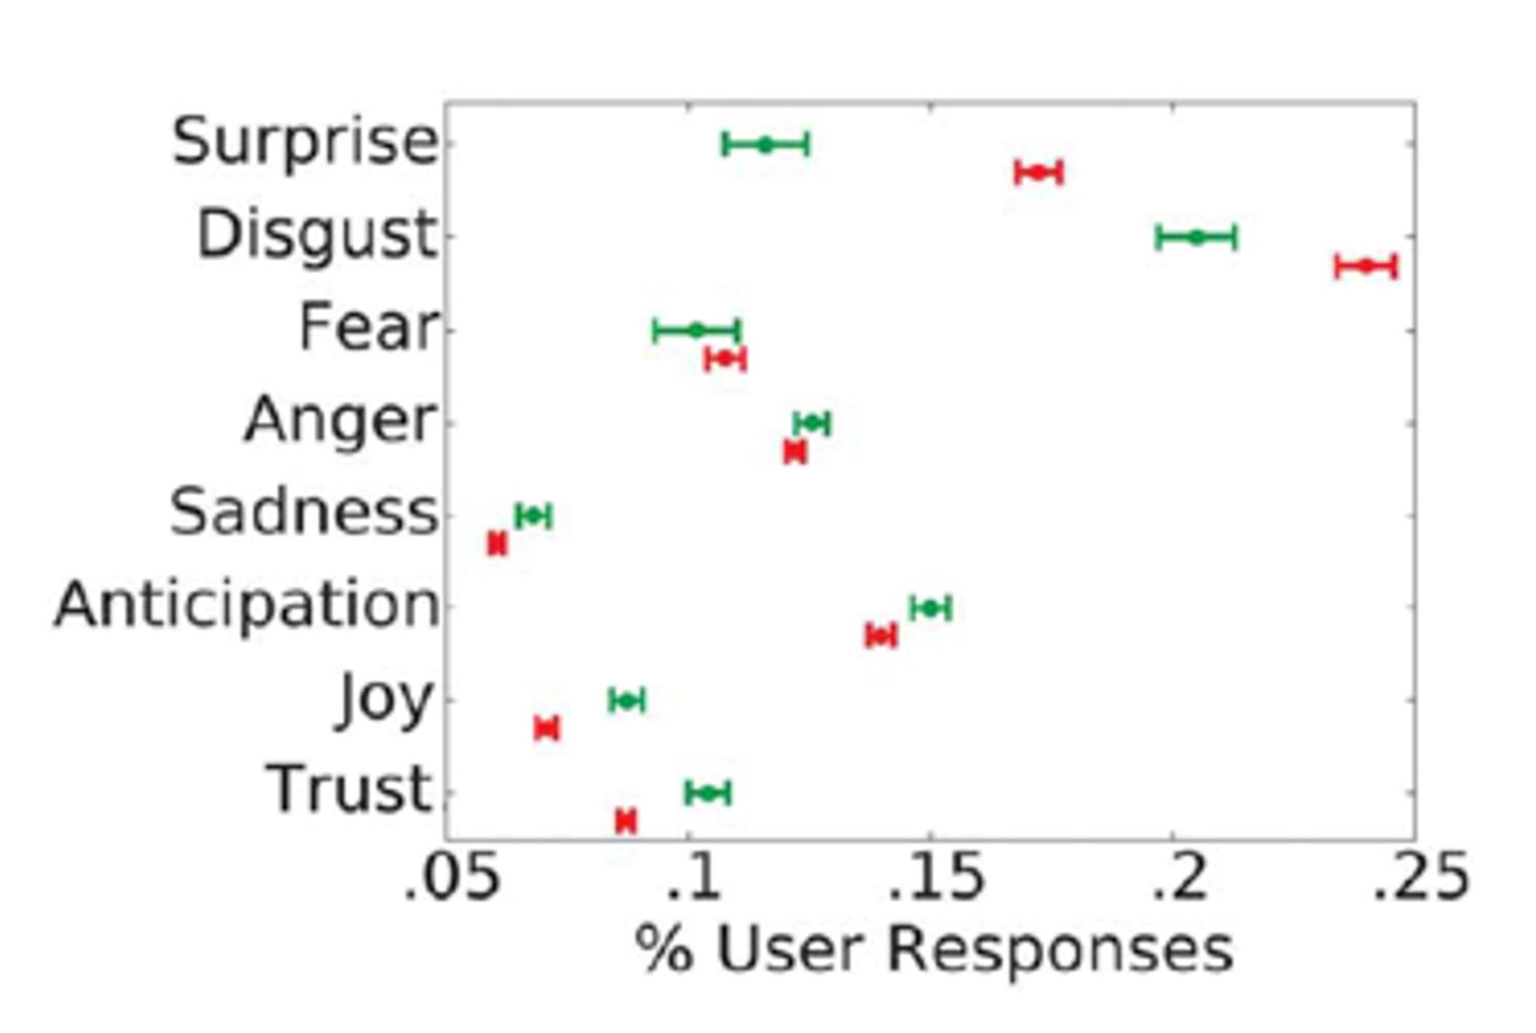

Slide 35
1. Falsehood travels faster than truth
2. Repetition can circumvent reason
3. Gossip often seems genuine
Opposition can come from people hearing information.
Opposition can come from people hearing misinformation.

Slide 36
1. Falsehood travels faster than truth
2. Repetition can circumvent reason
3. Gossip often seems genuine
Opposition can come from people hearing information.
Opposition can come from people hearing misinformation.
“Illusory Truth Effect”
Participants viewed 60 statements (3x).
20 statements were the same (3x).
Confidence level in the 20 statements?
Moved from 4.2 to 4.6 to 4.7 (out of 7).
Lynn Hasher, David Goldstein, Thomas Toppino, (1977). “Frequency and the conference of referential validity” Journal of Verbal Learning and Verbal Behavior. 16 (1): 107-112.

Slide 37
1. Falsehood travels faster than truth
2. Repetition can circumvent reason
3. Gossip often seems genuine
Opposition can come from people hearing information.
Opposition can come from people hearing misinformation.

Slide 38
1. Falsehood travels faster than truth
2. Repetition can circumvent reason
3. Gossip often seems genuine
Opposition can come from people hearing information.
Opposition can come from people hearing misinformation.

Slide 39
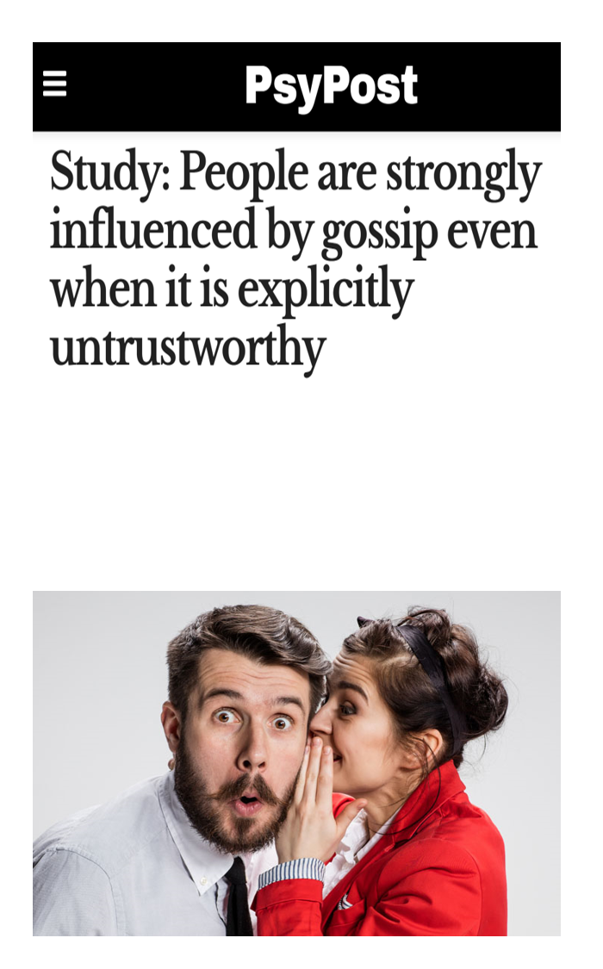
Eric W. Dolan
(Founder of PsyPost)
Eric W. Dolan, “Study: People are strongly influenced by gossip even when it is explicitly untrustworthy.” PsyPost (January 24, 2019).
New research in the journal Emotion suggests that people are highly influenced by gossip,
even when it is explicitly identified as untrustworthy.

Slide 40
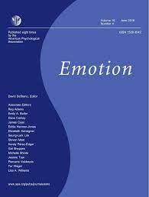
Julia Baum
(Humboldt-Universität Berlin Mind and Brain)
Julia Baum (et al.), “Clear judgments based on unclear evidence: Person evaluation is strongly influenced by untrustworthy gossip.” Emotion. 2020 March 2020 (2): 248.
Spontaneous likability, deliberate person judgments, and …emotional person evaluation were strongly influenced by negative information
yet remarkably unaffected by the trustworthiness of the information.

Slide 41
Julia Baum
(Humboldt-Universität Berlin Mind and Brain)
Julia Baum (et al.), “Clear judgments based on unclear evidence: Person evaluation is strongly influenced by untrustworthy gossip.” Emotion. 2020 March 2020 (2): 248.
Our findings demonstrate a tendency for strong emotional evaluations and person judgments
even when they are knowingly based on unclear evidence.

Slide 42
1. Falsehood travels faster than truth
2. Repetition can circumvent reason
3. Gossip often seems genuine
Opposition can come from people hearing information.
Opposition can come from people hearing misinformation.
Think for yourself!

Slide 43
(Phil. 3:18) I have told you often before, and I say it again with tears in my eyes,
that there are many whose conduct shows
they are really enemies of the cross of Christ.
Opposition can come from people hearing information.
Opposition can come from people hearing misinformation.
Opposition can come from a lack of loving transformation.

Slide 44
The same people who hate God’s mission…
Are the mission!
Opposition can come from people hearing information.
Opposition can come from people hearing misinformation.
Opposition can come from a lack of loving transformation.

Slide 45
Is taking a stand difficult?
Yes.
Is it worth it?
Absolutely!

Slide 48
Is there any cause for which you’d be willing to sacrifice?
What might happen if we didn’t have a common cause of sacrificial love toward those in our world?
Are you going to try to appease people in other areas of your life?
Opposition can come from people hearing information, misinformation, or a lack of transformation.

