Slide 1
FIRST PETER
THE BOOK OF

Slide 2
1 Peter 1
¹⁵ Like the Holy One who called you, be holy…in all your behavior;
¹⁶ because it is written, “YOU SHALL BE HOLY, FOR I AM HOLY.”

Slide 3
1 Peter 1
¹⁵ Like the Holy One who called you, be holy…in all your behavior;
¹⁶ because it is written, “YOU SHALL BE HOLY, FOR I AM HOLY.”

Slide 4
1 Peter 1
¹⁵ Like the Holy One who called you, be holy…in all your behavior;
¹⁶ because it is written, “YOU SHALL BE HOLY, FOR I AM HOLY.”
= “distinct” or “set apart” or “different.”
In what ways should we be different?
» Should we dress differently?

Slide 5
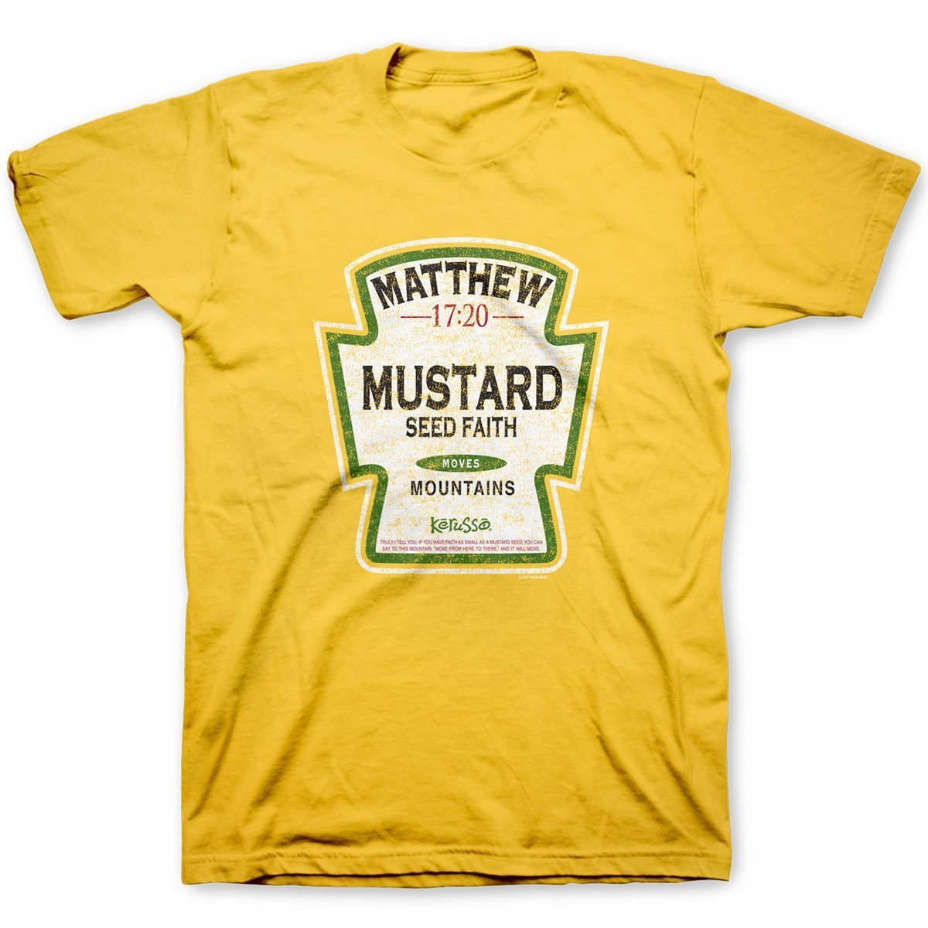

Slide 7
1 Peter 1
¹⁵ Like the Holy One who called you, be holy…in all your behavior;
¹⁶ because it is written, “YOU SHALL BE HOLY, FOR I AM HOLY.”
= “distinct” or “set apart” or “different.”
In what ways should we be different?
» Should we dress differently?
» Should we talk differently?
» Should we do things that signal we are Christians?

Slide 8
1 Peter 1
¹³ Therefore, prepare your minds for action, keep sober in spirit, fix your hope completely on the grace to be brought to you at the revelation of Jesus Christ.

Slide 9
1 Peter 1
¹³ Therefore, prepare your minds for action, keep sober in spirit, fix your hope completely on the grace to be brought to you at the revelation of Jesus Christ.
Peter covered a broad number of theological topics
» “chosen according to God’s foreknowledge” (1:1-2).
» “born again to a living hope” (1:3).
» “an imperishable, undefiled, and unfading inheritance” (1:4).
» “a faith that will be found to result in praise glory and honor at Christ’s coming” (1:7).

Slide 10
1 Peter 1
¹³ Therefore, prepare your minds for action, keep sober in spirit, fix your hope completely on the grace to be brought to you at the revelation of Jesus Christ.
The Christian life does not begin with a big DO, but a big DONE.”
–Watchman Nee

Slide 11
1 Peter 1
¹³ Therefore, prepare your minds for action, keep sober in spirit, fix your hope completely on the grace to be brought to you at the revelation of Jesus Christ.

Slide 12
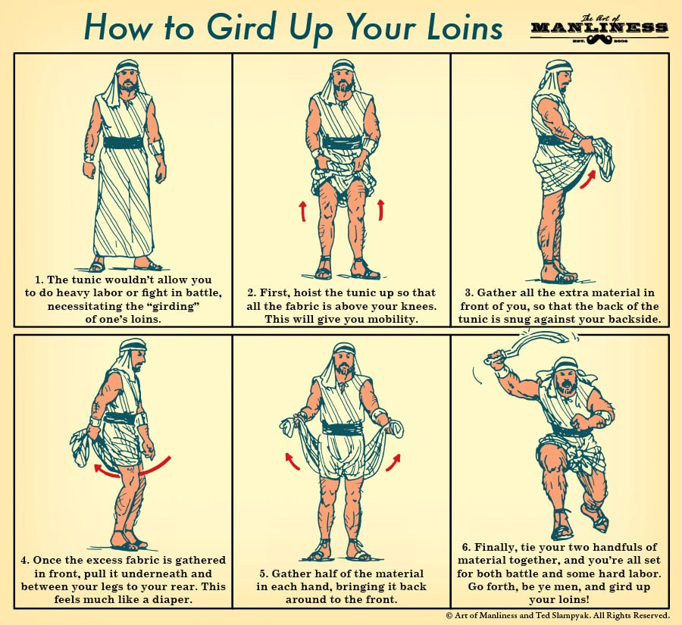

Slide 13
1 Peter 1
¹³ Therefore, prepare your minds for action, keep sober in spirit, fix your hope completely on the grace to be brought to you at the revelation of Jesus Christ.
Gerhart Kittel: “What is in view is the unequivocal and immediately self-evident antithesis to all kinds of mental fuzziness.”

Slide 14
TV AND MOBILE DEVICES: AVERAGE TIME SPENT IN THE US 2014-2021 TIME

Slide 15
TV AND MOBILE DEVICES: AVERAGE TIME SPENT IN THE US 2014-2021 TIME
TV
Source: eMarketer (Market Research Company)

Slide 16
TV AND MOBILE DEVICES: AVERAGE TIME SPENT IN THE US 2014-2021 (Ages 18+)
TV
MOBILE DEVICES
7 HOURS AND 16 MINUTES
PER DAY!
Source: eMarketer (Market Research Company)

Slide 17
TV AND MOBILE DEVICES: AVERAGE TIME SPENT IN THE US 2014-2021 (Ages 18+)
OVER 60 YEARS…?
9.5 MILLION MINUTES
159,000 HOURS
6,630 DAYS
18.1 YEARS
TV
MOBILE DEVICES
FIFTY HOURS
PER WEEK!
Source: eMarketer (Market Research Company)

Slide 18
1 Peter 1
¹³ Therefore, prepare your minds for action, keep sober in spirit, fix your hope completely on the grace to be brought to you at the revelation of Jesus Christ.

Slide 19
1 Peter 1
¹⁴ As obedient children, do not be conformed to the former lusts which were yours in your ignorance.

Slide 20
1 Peter 1
¹⁴ As obedient children, do not be conformed to the former lusts which were yours in your ignorance.

Slide 21
1 Peter 1
¹⁴ As obedient children, do not be conformed to the former lusts which were yours in your ignorance.
Tim Keller: “According to the Bible, the primary way to define sin is not just the doing of bad things, but the making of good things into ultimate things. It is seeking to establish a sense of self by making something else more central to your significance, purpose, and happiness than your relationship to God.”

Slide 22
1 Peter 1
¹⁵ But like the Holy One who called you, be holy…in all your behavior;
¹⁶ because it is written, “YOU SHALL BE HOLY, FOR I AM HOLY.”
George Barna, The Second Coming of the Church
» Have been divorced (Christians: 27%; Non-Christians: 23%
» Took drugs or medication prescribed for depression, in past year (Christians: 7%; Non-Christians: 8%)
» Donated any money to a nonprofit organization, in past month (Christians: 47%; Non-Christians: 48%)
» Satisfied with your life these days (Christians 69%; Non-Christians: 68%)

Slide 23
1 Peter 1
¹⁵ But like the Holy One who called you, be holy…in all your behavior;
¹⁶ because it is written, “YOU SHALL BE HOLY, FOR I AM HOLY.”

Slide 24
1 Peter 1
¹⁵ But like the Holy One who called you, be holy…in all your behavior;
¹⁶ because it is written, “YOU SHALL BE HOLY, FOR I AM HOLY.”
¹⁷ If you address as Father the One who impartially judges according to each one’s work, conduct yourselves in fear during the time of your stay on earth.

Slide 25
1 Peter 1
¹⁵ But like the Holy One who called you, be holy…in all your behavior;
¹⁶ because it is written, “YOU SHALL BE HOLY, FOR I AM HOLY.”
¹⁷ If you address as Father the One who impartially judges according to each one’s work, conduct yourselves in fear during the time of your stay on earth.

Slide 26
1 Peter 1
¹⁸ Knowing that you were not redeemed with perishable things like silver or gold from your futile way of life inherited from your forefathers,
¹⁹ but with precious blood, as of a lamb unblemished and spotless, the blood of Christ.

Slide 27
1 Peter 1
¹⁸ Knowing that you were not redeemed with perishable things like silver or gold from your futile way of life inherited from your forefathers,
¹⁹ but with precious blood, as of a lamb unblemished and spotless, the blood of Christ.
lutroō = used to describe paying the debt and redeeming an indentured servant

Slide 28
1 Peter 1
¹⁸ Knowing that you were not redeemed with perishable things like silver or gold from your futile way of life inherited from your forefathers,
¹⁹ but with precious blood, as of a lamb unblemished and spotless, the blood of Christ.

Slide 29
1 Peter 1
¹⁸ Knowing that you were not redeemed with perishable things like silver or gold from your futile way of life inherited from your forefathers,
¹⁹ but with precious blood, as of a lamb unblemished and spotless, the blood of Christ.
“way of life” = the basis for a stable society in Greek and Jewish culture
Karen Jobes: “First Peter is probably the first Christian writing to use the word in a negative sense for one’s way of life before coming to Christ.”

Slide 30
1 Peter 1
¹⁸ Knowing that you were not redeemed with perishable things like silver or gold from your futile way of life inherited from your forefathers,
¹⁹ but with precious blood, as of a lamb unblemished and spotless, the blood of Christ.
“way of life” = the basis for a stable society in Greek and Jewish culture
MODERN EQUIVALENT: ‘God has redeemed you from the “American Dream” inherited from your parents.’

Slide 31
1 Peter 1
¹⁸ Knowing that you were not redeemed with perishable things like silver or gold from your futile way of life inherited from your forefathers,
¹⁹ but with precious blood, as of a lamb unblemished and spotless, the blood of Christ.
Luke 12:16-20: The ground of a certain rich man produced a good crop. He thought to himself, “What shall I do? I have no place to store my crops.” Then he said, “This is what I’ll do…

Slide 32
1 Peter 1
¹⁸ Knowing that you were not redeemed with perishable things like silver or gold from your futile way of life inherited from your forefathers,
¹⁹ but with precious blood, as of a lamb unblemished and spotless, the blood of Christ.
Luke 12:16-20: I will tear down my barns and build bigger ones, and there I will store all my grain and my goods. And I’ll say to myself, “You have plenty of good things laid up for many years. Take life easy; eat, drink and be merry…

Slide 33
1 Peter 1
¹⁸ Knowing that you were not redeemed with perishable things like silver or gold from your futile way of life inherited from your forefathers,
¹⁹ but with precious blood, as of a lamb unblemished and spotless, the blood of Christ.
Luke 12:16-20: But God said to him, “You fool! This very night your life will be demanded from you. Then who will get what you have prepared for yourself?”

Slide 34
1 Peter 1
²⁰ For He was [known] before the foundation of the world, but has appeared in these last times for [your] sake
²¹ who through Him are believers in God, who raised Him from the dead and gave Him glory, so that your faith and hope are in God.

Slide 35
1 Peter 1
²² Since you have in obedience to the truth purified your souls for a sincere love [for each other], fervently love one another from the heart.

Slide 36
1 Peter 1
²² Since you have in obedience to the truth purified your souls for a sincere love [for each other], fervently love one another from the heart.

Slide 37
1 Peter 1
²² Since you have in obedience to the truth purified your souls for a sincere love [for each other], fervently love one another from the heart.

Slide 38
1 Peter 1
²² Since you have in obedience to the truth purified your souls for a sincere love [for each other], fervently love one another from the heart.
= “to strain” or “to stretch out.”
What does it look like to fervently love one another from the heart?
» Sharing God’s love
» Gently correct in love
» Forgiving one another
» Dropping our expectations

Slide 39
1 Peter 1
²² Since you have in obedience to the truth purified your souls for a sincere love [for each other], fervently love one another from the heart.

Slide 40
Be Different
» Don’t be merely different in superficial ways.
» Your values and your love for people should make you stand out as different.
» Let God transform your values and grow you in your ability to love.

