Slide 1
Daniel 11
21 And the rest were killed with the sword which came from the mouth of Him who sat on the horse…
21 And the rest were killed with the sword which came from the mouth of Him who sat on the horse…
The Last World War

Slide 2
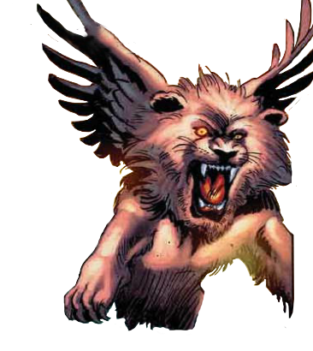
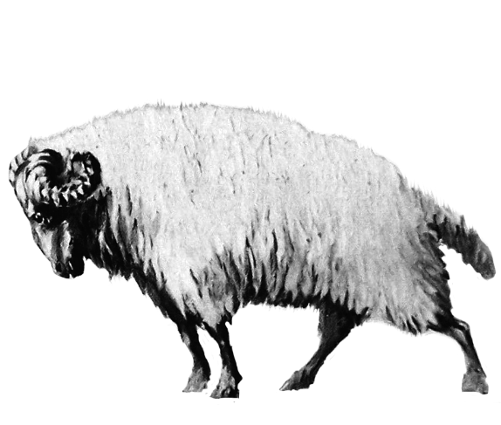
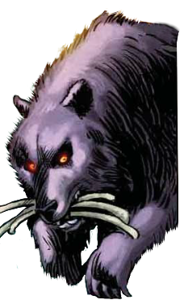
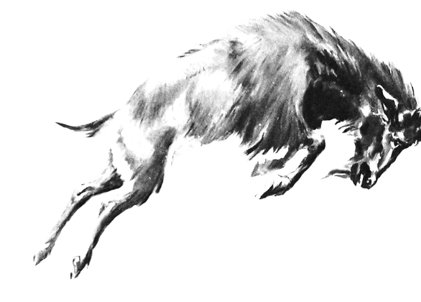
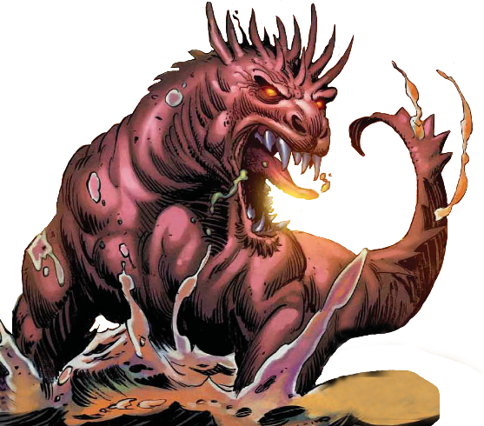
Daniel 2
Daniel 8
Daniel 7
Babylon
Medo-Persian
Greece
Rome
Rome 2

Slide 3
Daniel 11
Daniel 11:1-35
The level of detail explodes here
About 135 fulfilled prophecies
Over 40% about Antiochus Epiphanes
All the intrigue/scandal you could want!
Notes:
Twitter battles!

Slide 4
Daniel 11
Picking up in the Middle
29 “At the appointed time he will invade the South again, but this time the outcome will be different from what it was before.
Antiochus IV

Slide 5
Daniel 11
Picking up in the Middle
30 Ships of the western coastlands will oppose him, and he will lose heart. Then he will turn back and vent his fury against the holy covenant. He will return and show favor to those who forsake the holy covenant.
Roman “Line in the Sand”

Slide 6
Daniel 11
Picking up in the Middle
30 Ships of the western coastlands will oppose him, and he will lose heart. Then he will turn back and vent his fury against the holy covenant. He will return and show favor to those who forsake the holy covenant.

Slide 7
Daniel 11
Picking up in the Middle
31 “His armed forces will rise up to desecrate the temple fortress and will abolish the daily sacrifice. Then they will set up the abomination that causes desolation.

Slide 8
Daniel 11
Picking up in the Middle
32 With flattery he will corrupt those who have violated the covenant, but the people who know their God will firmly resist him.
33 “Those who are wise will instruct many, though for a time they will fall by the sword or be burned or captured or plundered.

Slide 9
Daniel 11
Picking up in the Middle
34 When they fall, they will receive a little help, and many who are not sincere will join them.
35 Some of the wise will stumble, so that they may be refined, purified and made spotless until the time of the end, for it will still come at the appointed time.

Slide 10
Daniel 11
Picking up in the Middle
34 When they fall, they will receive a little help, and many who are not sincere will join them.
35 Some of the wise will stumble, so that they may be refined, purified and made spotless until the time of the end, for it will still come at the appointed time.

Slide 11
Daniel 11
At 11:36, the narrative changes…
A new figure arises, a new king:
Similar to Antiochus Epiphanes, but different
Dan 11:35, 40 both tie it to the end of time
Daniel 11:35
until the time of the end, for it will still come at the appointed time.

Slide 12
Daniel 11
At 11:36, the narrative changes…
A new figure arises, a new king:
Similar to Antiochus Epiphanes, but different
Dan 11:35, 40 both tie it to the end of time
Daniel 11:40
“At the end time the king of the South will collide with him, and the king of the North will storm against him…

Slide 13
Daniel 11
At 11:36, the narrative changes…
A new figure arises, a new king:
Similar to Antiochus Epiphanes, but different
Dan 11:35, 40 both tie it to the end of time
Antiochus was the king of the North
Daniel 11:40
“At the end time the king of the South will collide with him, and the king of the North will storm against him…

Slide 14
Daniel 11
At 11:36, the narrative changes…
A new figure arises, a new king:
Similar to Antiochus Epiphanes, but different
Dan 11:35, 40 both tie it to the end of time
Antiochus was the king of the North
Dan 11:1-35 = fulfilled; Dan 11:36-12:4 = unfulfilled

Slide 15
Daniel 11
At 11:36, the narrative changes…
A new figure arises, a new king:
Similar to Antiochus Epiphanes, but different
Dan 11:37 doesn’t fit Antiochus
Daniel 11:37
He will show no regard for the gods of his fathers…

Slide 16
Daniel 11
At 11:36, the narrative changes…
A new figure arises, a new king:
Similar to Antiochus Epiphanes, but different
Dan 11:37 doesn’t fit Antiochus
Or Dan 11:45
Daniel 11:45
He will come to his end [in Israel]

Slide 17
Daniel 11
The Last World War
36 “Then the king will do as he pleases, and he will exalt and magnify himself above every god and will speak monstrous things against the God of gods;
and he will prosper until the indignation is finished, for that which is decreed will be done.

Slide 18
Daniel 11
The Last World War
37 He will show no regard for the gods of his fathers or for the desire of women, nor will he regard any god, but will exalt himself above them all.
2 Thess 2:4 – displaying himself as being God.

Slide 19
Daniel 11
The Last World War
37 He will show no regard for the gods of his fathers or for the desire of women, nor will he regard any god, but will exalt himself above them all.
38 Instead of them, he will honor a god of fortresses; a god unknown to his fathers he will honor with gold and silver, with precious stones and costly gifts.

Slide 20
Daniel 11
The Last World War
39 He will attack the mightiest fortresses with the help of a foreign god and will greatly honor those who acknowledge him. He will make them rulers over many people and will distribute the land at a price.

Slide 21
Daniel 11
The Last World War
40 “At the time of the end the king of the South will engage him in battle, and the king of the North will storm out against him with chariots and cavalry and a great fleet of ships. He will invade many countries and sweep through them like a flood.

Slide 22
Daniel 11
The Last World War
40 “At the time of the end the king of the South will engage him in battle, and the king of the North will storm out against him with chariots and cavalry and a great fleet of ships. He will invade many countries and sweep through them like a flood.
-Post-Oil Society?
-Phenomenological Language?

Slide 23
Daniel 11
The Last World War
41 He will also invade the Beautiful Land. Many countries will fall, but Edom, Moab and the leaders of Ammon will be delivered from his hand.
42 He will extend his power over many countries; Egypt will not escape.

Slide 24
Daniel 11
The Last World War
43 He will gain control of the treasures of gold and silver and all the riches of Egypt, with the Libyans and Nubians in submission.
44 But reports from the east and the north will alarm him, and he will set out in a great rage to destroy and annihilate many.

Slide 25
Daniel 11
The Last World War
45 He will pitch his royal tents between the seas at the beautiful holy mountain. Yet he will come to his end, and no one will help him.

Slide 26
Daniel 11
The Last World War
12:1 “Now at that time Michael, the great prince who stands guard over the sons of your people, will arise. And there will be a time of distress such as never occurred since there was a nation until that time; and at that time your people, everyone who is found written in the book, will be rescued.”

Slide 27
Ezekiel 37
1 The hand of the Lord was upon me, and He brought me out by the Spirit of the Lord and set me down in the middle of the valley; and it was full of bones.
2 He caused me to pass among them round about, and behold, there were very many on the surface of the valley;
and lo, they were very dry.

Slide 28
Ezekiel 37
3 He said to me, "Son of man, can these bones live?"
And I answered,
“O Lord God, You know."
4 Again He said to me, "Prophesy over these bones and say to them, 'O dry bones, hear the word of the Lord.'

Slide 29
Ezekiel 37
5 "Thus says the Lord God to these bones, 'Behold, I will cause breath to enter you that you may come to life.
6 'I will put sinews on you, make flesh grow back on you, cover you with skin and put breath in you that you may come alive; and you will know that I am the Lord.'"

Slide 30
Ezekiel 37
7 So I prophesied as I was commanded;
and as I prophesied, there was a noise, and behold, a rattling; and the bones came together, bone to its bone.

Slide 31
Ezekiel 37
8 And I looked, and behold, sinews were on them, and flesh grew and skin covered them; but there was no breath in them.
9 Then He said to me, "Prophesy to the breath, prophesy, son of man, and say to the breath, 'Thus says the Lord God, "Come from the four winds, O breath, and breathe on these slain, that they come to life."'

Slide 32
Ezekiel 37
10 So I prophesied as He commanded me, and the breath came into them, and they came to life and stood on their feet, an exceedingly great army.
So this clearly predicts the regathering of Israel…

Slide 33
Ezekiel 37
10 So I prophesied as He commanded me, and the breath came into them, and they came to life and stood on their feet, an exceedingly great army.
11 Then He said to me, "Son of man, these bones are the whole house of Israel; behold, they say, 'Our bones are dried up and our hope has perished. We are completely cut off.'

Slide 34
Ezekiel 37
12 "Therefore prophesy and say to them, 'Thus says the Lord God, "Behold, I will open your graves and cause you to come up out of your graves, My people; and I will bring you into the land of Israel.
13 "Then you will know that I am the Lord, when I have opened your graves and caused you to come up out of your graves, My people.

Slide 35
Ezekiel 37
14 "I will put My Spirit within you and you will come to life, and I will place you on your own land. Then you will know that I, the Lord, have spoken and done it," declares the Lord.'"

Slide 36
Ezekiel 37
21 "Say to them, 'Thus says the Lord God, "Behold, I will take the sons of Israel from among the nations where they have gone, and I will gather them from every side and bring them into their own land;

Slide 37
Ezekiel 37
24 “My servant David will be king over them, and they will all have one shepherd; and they will walk in My ordinances and keep My statutes and observe them.. . . and David My servant will be their prince forever.”
Context = the reign of king Messiah

Slide 38
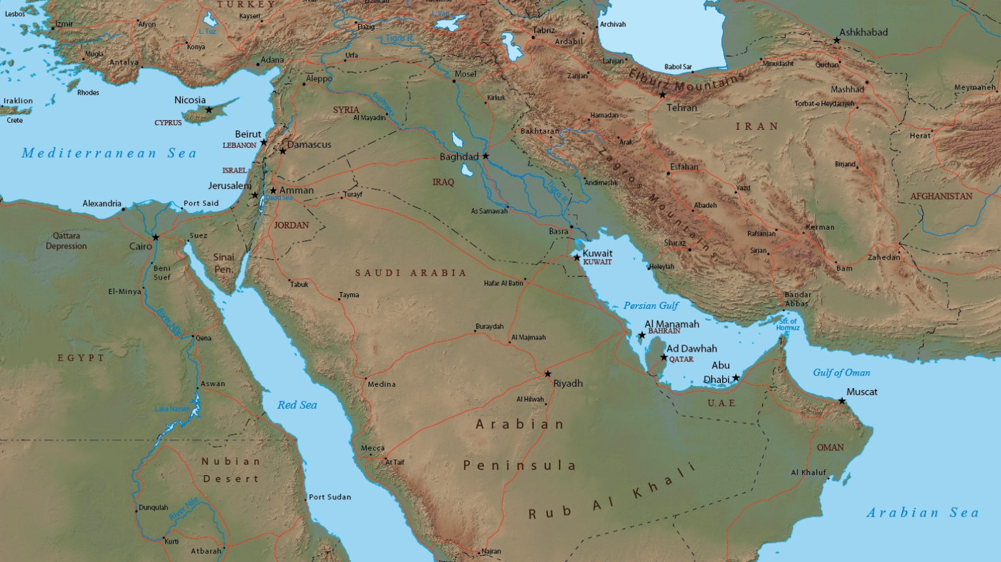
The Regathering Of Israel
Moses: Deut. 4:27-30; 28:64-5; 30:1-6.
Isaiah: 11:11–16; 27:12-13; 43:5-7; 66:19-20.
Jeremiah: 16:14-15; 23:3-8; 30:3-11; 32:37-44.
Ezekiel: 11:16-20; 20:41-42; 28:25; 34:12-14; 37:11-12, 14, 21-22, 25; 38:8; 39:25-29.
Hosea: 1:11; 3:4-5; 11:10-11.
Micah: 2:12-13; 4:6; 5:2-4; 7:9-13.
Zephaniah: 3:18-20.
Zechariah: 8:3, 7, 20-22; 10:9-12.

Slide 39
Ezekiel 38-39
The Last World War
38:1 The word of the Lord came to me:
2 “Son of man, set your face against Gog, of the land of Magog, Rosh, Meshech and Tubal; prophesy against him
3 and say: ‘This is what the Sovereign Lord says: I am against you, O Gog, chief prince of Meshech and Tubal.
Josephus and others say these are the Scythians
“King of the north”?

Slide 40
Ezekiel 38-39
The Last World War
4 I will turn you around, put hooks in your jaws and bring you out with your whole army—your horses, your horsemen fully armed, and a great horde with large and small shields, all of them brandishing their swords.
5 Persia, Cush and Put will be with them, all with shields and helmets,
“King of the south”?

Slide 41
Ezekiel 38-39
The Last World War
6 also Gomer with all its troops, and Beth Togarmah from the far north with all its troops—the many nations with you. . .

Slide 42
The Last World War
6 also Gomer with all its troops, and Beth Togarmah from the far north with all its troops—the many nations with you. . .

Slide 43
Ezekiel 38-39
The Last World War
8 After many days you will be summoned; in the latter years you will come into the land that is restored from the sword, whose inhabitants have been gathered from many nations to the mountains of Israel which had been a continual waste; but its people were brought out from the nations, and they are living securely, all of them.

Slide 44
Ezekiel 38-39
The Last World War
8 After many days you will be summoned; in the latter years you will come into the land that is restored from the sword, whose inhabitants have been gathered from many nations to the mountains of Israel which had been a continual waste; but its people were brought out from the nations, and they are living securely, all of them.

Slide 45
Ezekiel 38-39
The Last World War
10,11 On that day… You will say, “I will invade a land of unwalled villages; I will attack a peaceful and unsuspecting people—all of them living without walls and without gates and bars…”

Slide 46
Ezekiel 38-39
The Last World War
14 “Therefore, son of man, prophesy and say to Gog: ‘This is what the Sovereign Lord says: In that day, when my people Israel are living in safety, will you not take notice of it?
15 You will come from your place in the far north, you and many nations with you, all of them riding on horses, a great horde, a mighty army.

Slide 47
Ezekiel 38-39
The Last World War
16 You will advance against my people Israel like a cloud that covers the land. In days to come, O Gog, I will bring you against my land, so that the nations may know me when I show myself holy through you before their eyes.

Slide 48
Ezekiel 38-39
The Last World War
17 “‘This is what the Sovereign Lord says: Are you not the one I spoke of in former days by my servants the prophets of Israel? At that time they prophesied for years that I would bring you against them.

Slide 49
Ezekiel 38-39
The Last World War
18 This is what will happen in that day: When Gog attacks the land of Israel, my hot anger will be aroused, declares the Sovereign Lord.
19 In my zeal and fiery wrath I declare that at that time there shall be a great earthquake in the land of Israel.

Slide 50
Ezekiel 38-39
The Last World War
20 The fish of the sea, the birds of the air, the beasts of the field, every creature that moves along the ground, and all the people on the face of the earth will tremble at my presence. The mountains will be overturned, the cliffs will crumble and every wall will fall to the ground.

Slide 51
Ezekiel 38-39
The Last World War
21 I will summon a sword against Gog on all my mountains, declares the Sovereign Lord. Every man’s sword will be against his brother.
22 I will execute judgment upon him with plague and bloodshed; I will pour down torrents of rain, hailstones and fire and brimstone on him and on his troops and on the many nations with him.

Slide 52
Ezekiel 38-39
The Last World War
39:2 I will bring you from the far north and send you against the mountains of Israel.
3 Then I will strike your bow from your left hand and make your arrows drop from your right hand.

Slide 53
Ezekiel 38-39
The Last World War
4 On the mountains of Israel you will fall, you and all your troops and the nations with you. I will give you as food to all kinds of carrion birds and to the wild animals.

Slide 54
Ezekiel 38-39
The Last World War
5 You will fall in the open field, for I have spoken, declares the Sovereign Lord.
6 And I shall send fire upon Magog and those who inhabit the coastlands in safety; and they will know that I am the Lord.

Slide 55
Ezekiel 38-39
The Last World War
7 “‘I will make known my holy name among my people Israel. I will no longer let my holy name be profaned, and the nations will know that I the Lord am the Holy One in Israel.
8 It is coming! It will surely take place, declares the Sovereign Lord. This is the day I have spoken of…

Slide 56
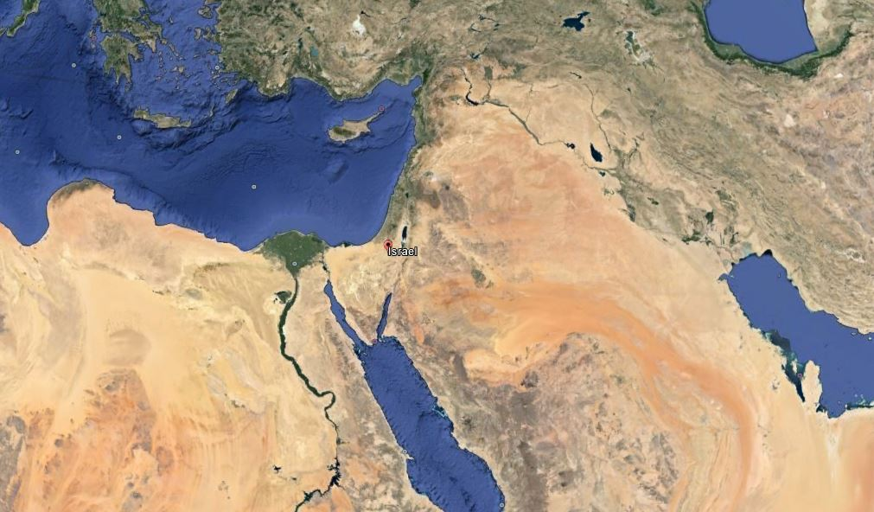
King of North Gog & Magog
Persia, Cush, & Put
Persia, Cush, & Put
Persia, Cush, & Put

Slide 57
Beast
Beast
Beast
Daniel 11:40: “He will invade many countries and sweep through them like a flood.”
Beast

Slide 58
Beast
Beast
Beast
Daniel 11:41: “He will also invade the Beautiful Land.”
Beast

Slide 59
Beast
Beast
Beast
Ezekiel 38:21: "And I shall call for a sword against [Gog and Magog] on all My mountains,” declares the Lord GOD. ” Every man's sword will be against his brother.
Beast

Slide 60
Beast
Beast
Mark 13:20 – “Unless the Lord had shortened those days, no life would have been saved…”
Beast
Ezekiel 38:22: "And with pestilence and with blood I shall enter into judgment with him; and I shall rain on him, and on his troops, and on the many peoples who are with him, a torrential rain, with hailstones, fire, and brimstone.”
Beast

Slide 61
Daniel 11:42: “He will extend his power over many countries; Egypt will not escape.”

Slide 62
Kings of the East
Daniel 11:44: “But rumors from the East and from the North will disturb him…”

Slide 63
Kings of the East
Revelation 9:14: "Release the four angels who are bound at the great river Euphrates."

Slide 64
Kings of the East
Revelation 9:14: "Release the four angels who are bound at the great river Euphrates.“ ¹⁵ And the four angels who had been kept ready for this very hour and day and month and year were released to kill a third of mankind.

Slide 65
Kings of the East
Revelation 9:14: "Release the four angels who are bound at the great river Euphrates.“ ¹⁵ And the four angels who had been kept ready for this very hour and day and month and year were released to kill a third of mankind. ¹⁶ The number of the mounted troops was two hundred million. I heard their number.

Slide 66
Kings of the East
Revelation 16:12, 14, 16: “The sixth angel poured out his bowl on the great river Euphrates, and its water was dried up to prepare the way for the kings from the East…

Slide 67
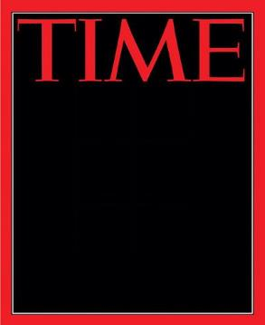
The Euphrates is drying up. Strangled by the water policies of Iraq’s neighbors, Turkey and Syria…
Time Magazine
Campbell Robertson, “Iraq Suffers as the Euphrates River Dwindles.” Time. July 13, 2009.

Slide 68
The river is significantly smaller than it was just a few years ago. Some officials worry that it could soon be half of what it is now.
Time Magazine
Campbell Robertson, “Iraq Suffers as the Euphrates River Dwindles.” Time. July 13, 2009.

Slide 69
The shrinking of the Euphrates, a river so crucial to the birth of civilization that the Book of Revelation prophesied its drying up as a sign of the end times,
Time Magazine
Campbell Robertson, “Iraq Suffers as the Euphrates River Dwindles.” Time. July 13, 2009.

Slide 70
The shrinking of the Euphrates, a river so crucial to the birth of civilization that the Book of Revelation prophesied its drying up as a sign of the end times,
Time Magazine
Campbell Robertson, “Iraq Suffers as the Euphrates River Dwindles.” Time. July 13, 2009.

Slide 71
has decimated farms along its banks, has left fishermen impoverished and has depleted riverside towns as farmers flee to the cities looking for work.
Time Magazine
Campbell Robertson, “Iraq Suffers as the Euphrates River Dwindles.” Time. July 13, 2009.

Slide 72
Israel
Daniel 11:44: “But rumors from the East and from the North will disturb him…”

Slide 73
Israel
Daniel 11:44: “But rumors from the East and from the North will disturb him…”

Slide 74
Kings of the East
Revelation 16:12, 14, 16: “The sixth angel poured out his bowl on the great river Euphrates, and its water was dried up to prepare the way for the kings from the East…and [demons] go out to the kings of the whole world, to gather them for the battle on the great day of God Almighty…”

Slide 75
Kings of the East
Revelation 16:12, 14, 16: “And they gathered them together to the place which in Hebrew is called Har-Magedon.

Slide 76
It is not a single battle but rather a whole series of conflicts that culminate with the Second Coming of Christ.
Paul Benware
(NT Scholar)
Benware, Paul. Understanding End Times Prophecy (Moody:Chicago, 2006) p. 315

Slide 77
The Greek word polemos, translated ‘battle’ in Revelation 16:14, signifies a war of campaign…
Paul Benware
(NT Scholar)
Benware, Paul. Understanding End Times Prophecy (Moody:Chicago, 2006) p. 315

Slide 78
[This] indicates that Armageddon is really a campaign made up of numerous conflicts among a number of nations over a period of time at the end of the tribulation.
Paul Benware
(NT Scholar)
Benware, Paul. Understanding End Times Prophecy (Moody:Chicago, 2006) p. 315
“Har” = Mountain
“Magedon” = Megiddo

Slide 79
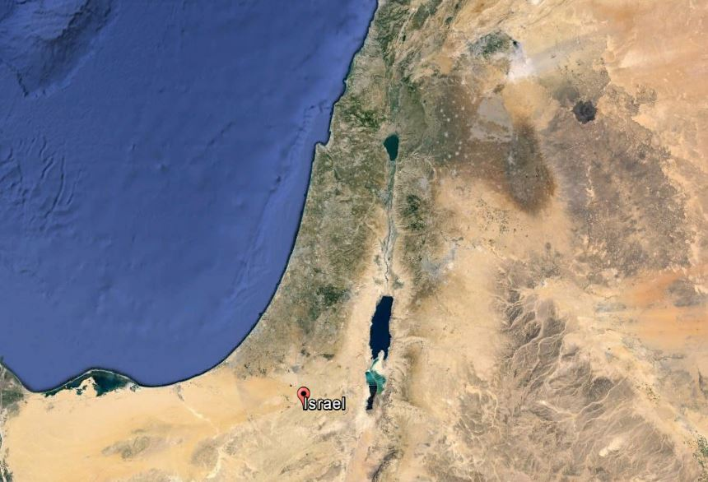
Armageddon

Slide 80
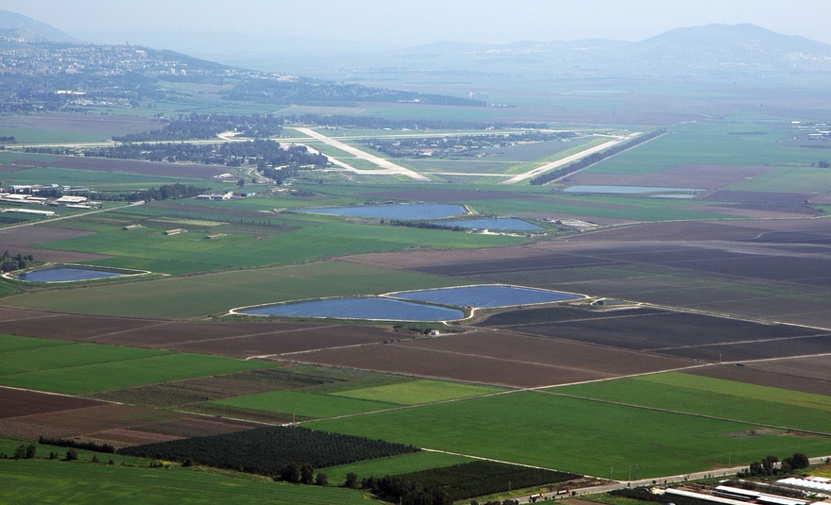
Dan 11:45 Yet he will come to his end, and no one will help him.

Slide 81
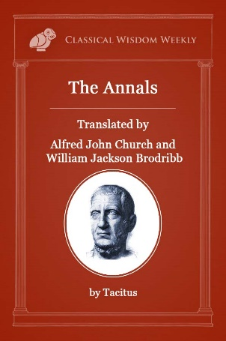
Eric Cline
Professor of Archeology
The Battles of Armageddon: Megiddo and the Jezreel Valley from the Bronze Age to the Nuclear Age, (2002: University of Michigan Press), p. 42
Napoleon supposedly looked over the Jezreel Valley and said,
"All the armies of the world could maneuver their forces on this vast plain...There is no place in the world more suited for war than this...

Slide 82
Eric Cline
Professor of Archeology
The Battles of Armageddon: Megiddo and the Jezreel Valley from the Bronze Age to the Nuclear Age, (2002: University of Michigan Press), p. 42
Napoleon supposedly looked over the Jezreel Valley and said,
[It is] the most natural battleground of the whole earth."

Slide 83
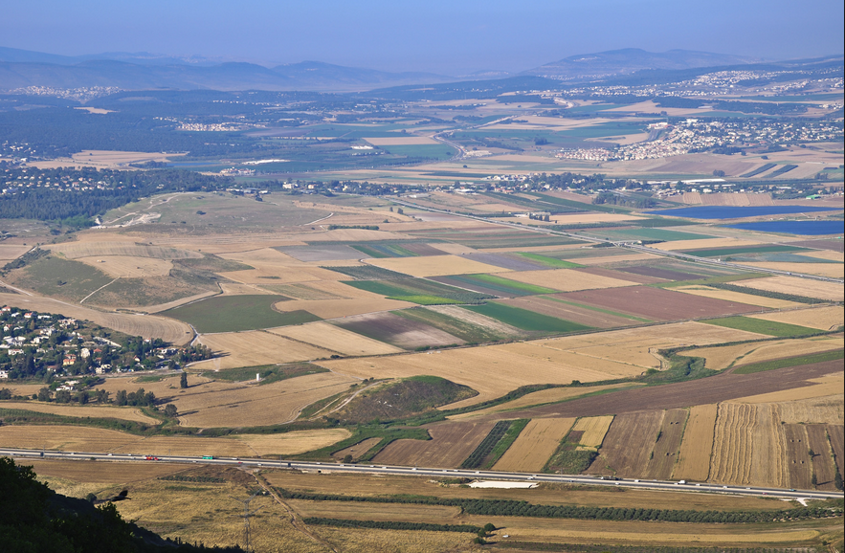
Dan 11:45 Yet he will come to his end, and no one will help him.

Slide 84
Daniel 11:44: “But rumors from the East and from the North will disturb him, and he will go forth with great wrath to destroy and annihilate many.”

Slide 85
Daniel 11:45: “He will pitch his royal tents between the seas at the beautiful holy mountain.

Slide 86
Daniel 11:45: “Yet he will come to his end, and no one will help him.”

Slide 87
Rev 19
11 And I saw heaven opened, and behold, a white horse, and He who sat on it is called Faithful and True, and in righteousness He judges and wages war.
12 His eyes are a flame of fire, and on His head are many crowns; and He has a name written on Him which no one knows except Himself.

Slide 88
Rev 19
13 He is clothed with a robe dipped in blood, and His name is called The Word of God.
14 And the armies which are in heaven, clothed in fine linen, white and clean, were following Him on white horses.

Slide 89
Rev 19
15 From His mouth comes a sharp sword, so that with it He may strike down the nations, and He will rule them with a rod of iron; and He treads the wine press of the fierce wrath of God, the Almighty.
16 And on His robe and on His thigh He has a name written, “KING OF KINGS, AND LORD OF LORDS.”

Slide 90
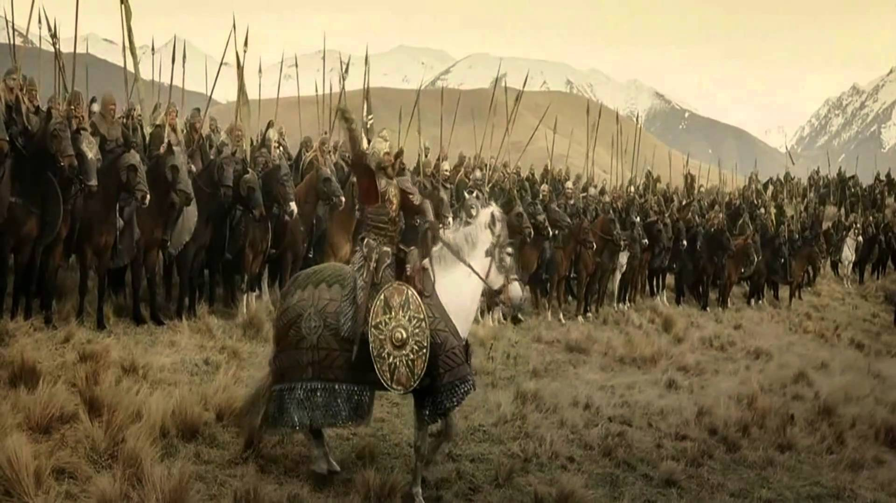

Slide 91
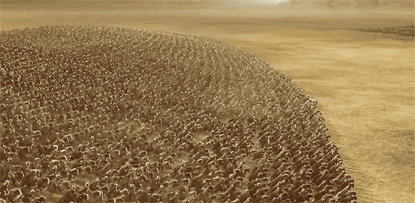

Slide 92
Rev 19
19 And I saw the beast and the kings of the earth and their armies assembled to make war against Him who sat on the horse and against His army.
20 And the beast was seized, and [he was] thrown alive into the lake of fire which burns with brimstone.
21 And the rest were killed with the sword which came from the mouth of Him who sat on the horse…

Slide 93
Summary
- There will be a final world ruler who will be the catalyst for a final world war
Israel needs to be regathered as nation [completed]
The final world war should destroy humanity, but Jesus himself puts a stop to it

Slide 94
Why is This Important?
The human race needs another solution
Jesus’ Second Coming will rescue us from ourselves; Jesus’ First Coming was to save us from our sins
We have no need to fear anything about the future

