Slide 2
(1 Pet. 1:1) Peter, an apostle of Jesus Christ.
Did the Peter really write this?
Claims to be written by Peter.
1 Peter 1:1; 5:1; 2 Peter 1:1; 3:1, 15-16
The letter criticizes deceit (1 Pet. 2:1, 22; 3:10)
Writing from Rome (AD 62-68).
1 Peter 5:13.
Similarities with his speeches in Acts.
Craig Blomberg, From Pentecost to Patmos: an Introduction to Acts through Revelation (Nashville, TN: B & H Academic, 2006), p.441.
Attested very early (AD 95-132)
Didache 1:4; 1 Pet. 2:11; Papias in Church History, 3.39.17; 1 Clem. 23.3; cf. 2 Pet. 3:4; 2 Clement refers to it as “the prophetic word” (2 Clem. 11.2); Barnabas, 15.4; cf. 2 Pet. 3:8; Apocalypse of Peter 1-2 cites 2 Peter 2:1.

Slide 3
Bart Ehrman
(Agnostic NT Critic)
Bart D. Ehrman, Forged: Why the Bible’s Authors Are Not Who We Think They Are (New York: HarperOne, 2011), pp.138-139.
[1 Peter was written by a] highly educated Greek-speaking Christian who understood how to use Greek rhetorical devices and could cite the Greek Old Testament with flair and nuance.

Slide 4
Bart Ehrman
(Agnostic NT Critic)
Bart D. Ehrman, Forged: Why the Bible’s Authors Are Not Who We Think They Are (New York: HarperOne, 2011), pp.138-139.
That does not apply to the uneducated, illiterate, Aramaic-speaking fisherman from rural Galilee, and it does not appear to have been produced by a secretary acting on his behalf.

Slide 5
Bart Ehrman
(Agnostic NT Critic)
Bart D. Ehrman, Forged: Why the Bible’s Authors Are Not Who We Think They Are (New York: HarperOne, 2011), pp.138-139.
The religious leaders called Peter “uneducated and untrained” (Acts 4:13).
Agrammatos doesn’t mean “illiterate.”
By the standards of the Sanhedrin.
“How has [Jesus] become learned,
having never been educated?” (Jn. 7:15)
Even slaves learned Greek (Antiquities, 20.263).
Written 30 years later! (e.g. Rabbi Akiba)
That does not apply to the uneducated, illiterate, Aramaic-speaking fisherman from rural Galilee, and it does not appear to have been produced by a secretary acting on his behalf.

Slide 6
Bart Ehrman
(Agnostic NT Critic)
Bart D. Ehrman, Forged: Why the Bible’s Authors Are Not Who We Think They Are (New York: HarperOne, 2011), pp.138-139.
(1 Pet. 5:12) Through Silvanus, our faithful brother (for so I regard him), I have written to you briefly.
(cf. Mark’s Gospel; Church History 3.39.15; Jerome, Letter to Hebidia [Ep.] 120.11
That does not apply to the uneducated, illiterate, Aramaic-speaking fisherman from rural Galilee, and it does not appear to have been produced by a secretary acting on his behalf.

Slide 7
(1 Pet. 1:1) Peter, an apostle of Jesus Christ.
Did the Peter really write this?
Claims to be written by Peter.
1 Peter 1:1; 5:1; 2 Peter 1:1; 3:1, 15-16
The letter criticizes deceit (1 Pet. 2:1, 22; 3:10)
Writing from Rome (AD 62-68).
1 Peter 5:13.
Similarities with his speeches in Acts.
Craig Blomberg, From Pentecost to Patmos: an Introduction to Acts through Revelation (Nashville, TN: B & H Academic, 2006), p.441.
Attested very early (AD 95-132)
Didache 1:4; 1 Pet. 2:11; Papias in Church History, 3.39.17; 1 Clem. 23.3; cf. 2 Pet. 3:4; 2 Clement refers to it as “the prophetic word” (2 Clem. 11.2); Barnabas, 15.4; cf. 2 Pet. 3:8; Apocalypse of Peter 1-2 cites 2 Peter 2:1.

Slide 8
(1 Pet. 1:1) Peter, an apostle of Jesus Christ.
Did the Peter really write this?
Claims to be written by Peter.
1 Peter 1:1; 5:1; 2 Peter 1:1; 3:1, 15-16
The letter criticizes deceit (1 Pet. 2:1, 22; 3:10)
Writing from Rome (AD 62-68).
1 Peter 5:13.
Similarities with his speeches in Acts.
Craig Blomberg, From Pentecost to Patmos: an Introduction to Acts through Revelation (Nashville, TN: B & H Academic, 2006), p.441.
Attested very early (AD 95-132)
Didache 1:4; 1 Pet. 2:11; Papias in Church History, 3.39.17; 1 Clem. 23.3; cf. 2 Pet. 3:4; 2 Clement refers to it as “the prophetic word” (2 Clem. 11.2); Barnabas, 15.4; cf. 2 Pet. 3:8; Apocalypse of Peter 1-2 cites 2 Peter 2:1.
The best evidence that Peter didn’t write this?
Peter’s track record!

Slide 9
(1 Pet. 1:1) Peter, an apostle of Jesus Christ.
To those who reside as aliens,
scattered throughout Pontus, Galatia, Cappadocia, Asia, and Bithynia.
Modern-day Turkey
“Aliens” (parepidēmos)
“Foreigners” or “illegal aliens.”
(cf. 1 Pet. 2:11; Heb. 11:13; cf. Phil. 3:20).

Slide 10
(1 Pet. 1:2) [Christians] are chosen
according to the foreknowledge of God the Father
“Foreknowledge” (proginōskō)
(2 Pet. 3:17) Knowing this beforehand (proginōskō), be on your guard.
(Rom. 8:29) Those whom He foreknew,
He also predestined.”

Slide 11
(1 Pet. 1:2) [Christians] are chosen
according to the foreknowledge of God the Father
by the sanctifying work of the Spirit,
“Set apart”

Slide 12
(1 Pet. 1:2) [Christians] are chosen
according to the foreknowledge of God the Father
by the sanctifying work of the Spirit,
to obey Jesus Christ and be sprinkled with His blood:
May grace and peace be yours in the fullest measure.
(Rom. 1:5) We have received apostleship to bring about the obedience of faith among all the Gentiles.

Slide 13
(1 Pet. 1:3) Blessed be the God and Father of our Lord Jesus Christ, who according to His great mercy
has caused us to be born again to a living hope
through the resurrection of Jesus Christ from the dead.

Slide 14
(1 Pet. 1:4) To obtain an inheritance
which is imperishable
and undefiled
and will not fade away,
reserved in heaven for you.
Everything in this life is perishable, defiled, and fading away.

Slide 19
(1 Pet. 1:4) To obtain an inheritance
which is imperishable
and undefiled
and will not fade away,
reserved in heaven for you.
Everything in this life is perishable, defiled, and fading away.

Slide 20
(1 Pet. 1:4) To obtain an inheritance
which is imperishable
and undefiled
and will not fade away,
reserved in heaven for you.

Slide 21
(1 Pet. 1:5) You are protected
by the power of God
through faith for a salvation ready to be revealed in the last time.
How likely is it that I’ll lose eternal life?
We know how the story ends…

Slide 23
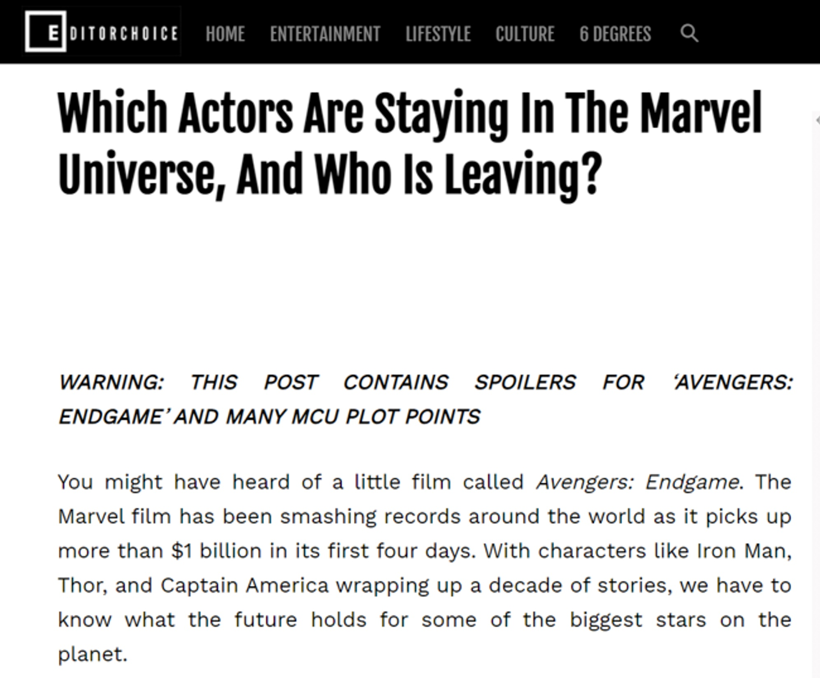
(1 Pet. 1:5) You are protected
by the power of God
through faith for a salvation ready to be revealed in the last time.
How likely is it that I’ll lose eternal life?
We know how the story ends…

Slide 24
(1 Pet. 1:5) You are protected
by the power of God
through faith for a salvation ready to be revealed in the last time.
How likely is it that I’ll lose eternal life?
We know how the story ends…

Slide 25
(1 Pet. 1:6) In this you greatly rejoice,

Slide 26
(1 Pet. 1:6) In this you greatly rejoice,
even though now for a little while,
if necessary, you have been
distressed by various trials.
A paradox?
How could I get to the point where I had this sort of capability?

Slide 27
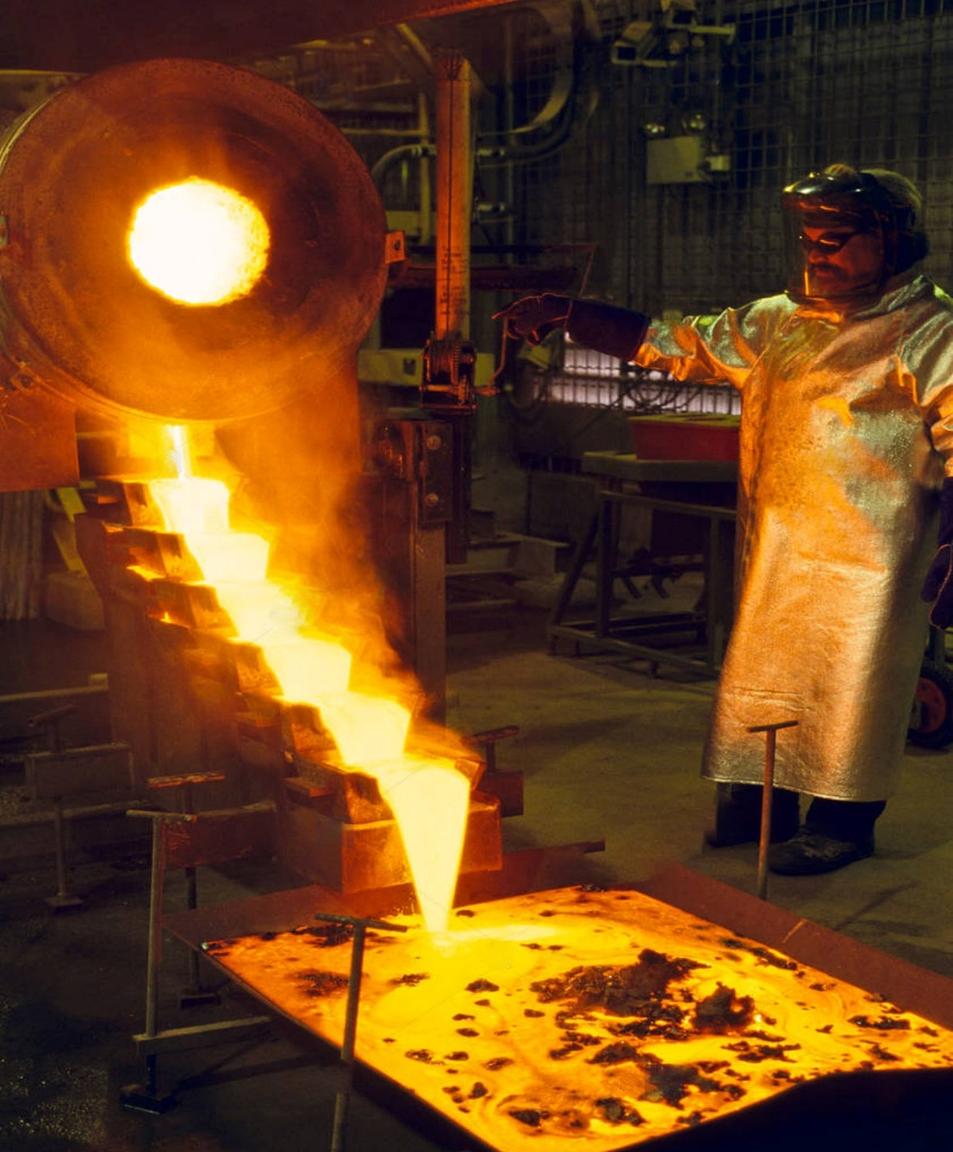
(1 Pet. 1:7) The proof of your faith, being more precious than gold which is perishable,
even though tested by fire,
How does God use suffering?
Reveals what we’ve been trusting in.
Refines our faith, taking it to new depths.
Results in unspeakable reward!

Slide 28
(1 Pet. 1:7) The proof of your faith, being more precious than gold which is perishable,
even though tested by fire,
may be found to result in praise and glory and honor at the revelation of Jesus Christ.

Slide 29
(1 Pet. 1:8) And though you have not seen Him, you love Him, and though you do not see Him now, but believe in Him, you greatly rejoice with joy inexpressible and full of glory,
⁹ obtaining as the outcome of your faith the salvation of your souls.

Slide 30
(1 Pet. 1:10) As to this salvation, the prophets who prophesied of the grace that would come to you made careful searches and inquiries,
¹¹ seeking to know what person or time the Spirit of Christ within them was indicating as He predicted the sufferings of Christ and the glories to follow.

Slide 31
(1 Pet. 1:12) It was revealed to them that they were not serving themselves, but you, in these things which now have been announced to you through those who preached the gospel to you by the Holy Spirit sent from heaven—things into which angels long to look.
Why bring up God’s plan?
No one fully understood the fulfillment of God’s plan in its first installment…

Slide 32
(1 Pet. 1:12) It was revealed to them that they were not serving themselves, but you, in these things which now have been announced to you through those who preached the gospel to you by the Holy Spirit sent from heaven—things into which angels long to look.
Why bring up God’s plan?
If Jesus’ First Coming blew our minds,
what about his Second Coming??

Slide 33
We never have to doubt God’s love (v.2).
We have a permanent clean slate (v.3).
Our place in eternity is secure (vv.4-5).
God will heap rewards on us (v.7).
We can’t fathom the magnitude of what we’re going to experience (vv.8-12).

Slide 34
We never have to doubt God’s love (v.2).
We have a permanent clean slate (v.3).
Our place in eternity is secure (vv.4-5).
God will heap rewards on us (v.7).
We can’t fathom the magnitude of what we’re going to experience (vv.8-12).
With this in mind, how big are the problems in your life?

Slide 35
“I’ve heard all this before, and it hasn’t changed anything in my life.”
Is this an argument?
Or an indictment?
Have you made these truths the greatest treasure of your life?

Slide 36
What’s so Great about Christianity?
We never again need to doubt God’s love (v.2).
Permanently clean slate (v.3).
Eternity is secure (vv.4-5).
God will heap rewards on us (v.7).
We can’t fathom the magnitude of what we’re going to experience (vv.8-12).

Slide 37
Sovereignty = Fatalism
Not biblical.
(Psalm 115:3, 6)
Foreknowledge and freedom are not contradictory.
Knowing is not causing.
Commits a modal fallacy.
Because X is true, then X is necessarily true.
Human limitations do not make foreknowledge impossible.
(Isaiah 46:5)

