Slide 1
1 Peter 2:13-25
Problems With Authority

Slide 2
1 Peter 2
13 Submit yourselves for the Lord’s sake to every human institution, whether to a king as the one in authority,
14 or to governors as sent by him for the punishment of evildoers and the praise of those who do right.
= to subject oneself, to submit voluntarily
King
G
G
G
Submit
You

Slide 3
1 Peter 2
13 Submit yourselves for the Lord’s sake to every human institution, whether to a king as the one in authority,
14 or to governors as sent by him for the punishment of evildoers and the praise of those who do right.
Human governments:
Supposed to keep order (Rom 13:4)
Far from perfect (Emperor Nero)
Better than anarchy
Below God’s authority (Acts 5:29)
God
King
G
G
G
You

Slide 4
1 Peter 2
13 Submit yourselves for the Lord’s sake to every human institution, whether to a king as the one in authority,
14 or to governors as sent by him for the punishment of evildoers and the praise of those who do right.
Human governments:
Christians are to submit to government when possible
“For the Lord’s sake” and for pragmatic reasons (e.g. Jewish revolt)
God
King
G
G
G
You

Slide 5
1 Peter 2
15 For such is the will of God that by doing right you may silence the ignorance of foolish men.
16 Act as free men,
and do not use your freedom as a covering for evil, but use it as bondslaves of God.
God
King
G
G
G
You

Slide 6
1 Peter 2
15 For such is the will of God that by doing right you may silence the ignorance of foolish men.
16 Act as free men,
and do not use your freedom as a covering for evil, but use it as bondslaves of God.
God
King
G
G
G
You
“Do good, not evil”

Slide 7
1 Peter 2
17 Honor all people,
love the brotherhood,
fear God,
honor the king.
God
fear/reverence
King
G
G
G
honor
love
honor
Remember your org. chart!
Family of God
You
All People

Slide 8
Christians and Government
We live in a different type of government
Part of “submission” could include working for reform
Just keep a few things in mind…

Slide 9
Christians and Government
Appeal to “natural law,” not “The Bible says…”
Separation of church and state (Matt 22:21)
Bad things happen when these are not kept separate

Slide 10
Charles Colson, Kingdoms in Conflict: An Insider’s Challenging View of Politics, Power, and the Pulpit (Zondervan, 1989), p.291.
In a pluralistic society it is not only wrong but unwise for Christians to shake their Bibles and arrogantly assert that ‘God says...’
That is the quickest way for Christians, a distinct minority in civil affairs, to lose their case altogether.

Slide 11
Charles Colson, Kingdoms in Conflict: An Insider’s Challenging View of Politics, Power, and the Pulpit (Zondervan, 1989), p.291.
Instead, positions should be argued on their merits.
If the case is sound, a majority can be persuaded;
that's the way democracies and free nations are supposed to work

Slide 12
Christians and Government
Public policy is complicated
Dialogue and discuss without contempt

Slide 13
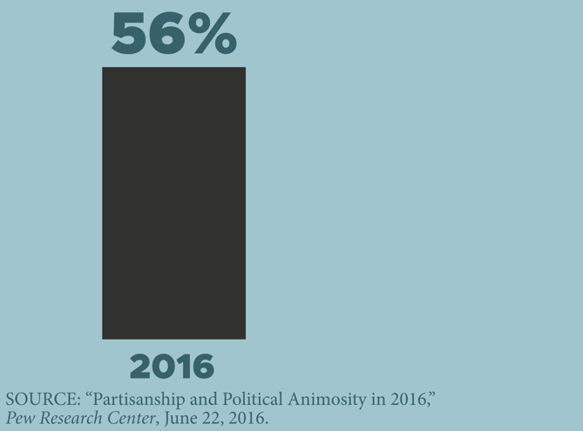
Political Polarization in America
People who have a “very unfavorable” view of members of the opposite party

Slide 14
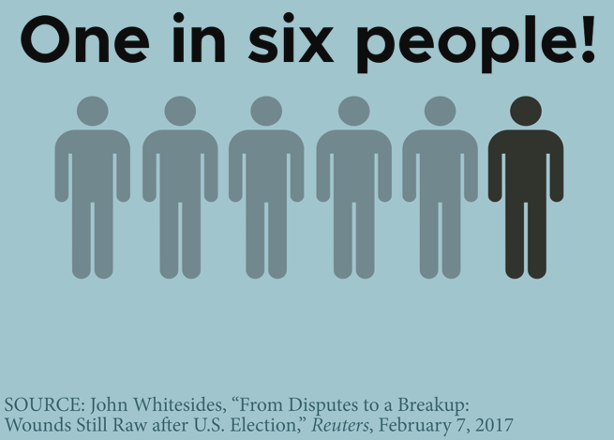
Political Polarization in America
People who stopped talking to a family member or close friend because of the 2016 election

Slide 15
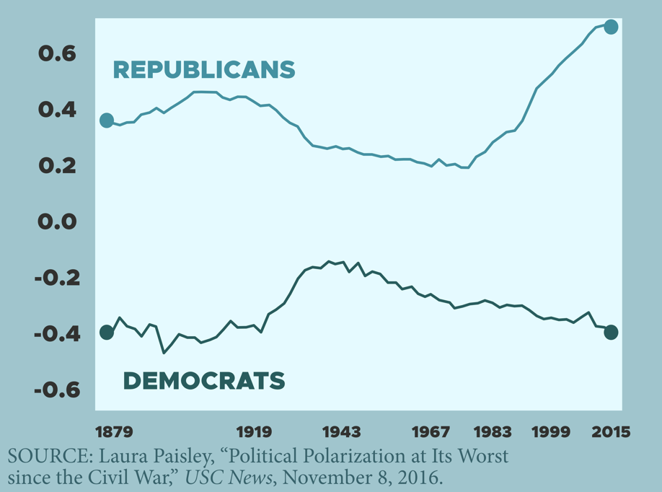
Political Polarization in America
Polarization in the House of Representatives based on voting patterns
Can I listen to, dialogue with, and understand people with whom I disagree?

Slide 16
Christians and Government
Don’t put your hope in government!
Paul talked with a lot of politicians (Felix, Festus, Agrippa II, Nero)
He never brought up politics!

Slide 17
Charles Colson, Kingdoms in Conflict: An Insider’s Challenging View of Politics, Power, and the Pulpit (Zondervan, 1989), p.304.
Today’s misspent enthusiasm for political solutions to the moral problems of our culture arises from a distorted view of both politics and Christianity…

Slide 18
Charles Colson, Kingdoms in Conflict: An Insider’s Challenging View of Politics, Power, and the Pulpit (Zondervan, 1989), p.304.
It also ignores the consistent lesson of history that shows that laws are most often reformed as a result of powerful spiritual movements (not vice versa).
I know of no case where a spiritual movement was achieved by passing laws.

Slide 19
Christians and Government
Don’t put your hope in government!
The fact that we can work for reform might cause us to forget where true change comes from
Remember your org. chart!
Do I share my political views more than I share about the love of Christ?

Slide 20
1 Peter 2
18 Servants, be submissive to your masters with all respect,
not only to those who are good and gentle, but also to those who are unreasonable.
19 For this finds favor, if for the sake of conscience toward God a person bears up under sorrows when suffering unjustly.
God
Master
Submit
Servant

Slide 21
1 Peter 2
20 For what credit is there if, when you sin and are harshly treated, you endure it with patience?
But if when you do what is right and suffer for it you patiently endure it, this finds favor with God.
God
Master
Submit
Servant

Slide 22
1 Peter 2
20 For what credit is there if, when you sin and are harshly treated, you endure it with patience?
But if when you do what is right and suffer for it you patiently endure it, this finds favor with God.
“Do good, not evil… and endure the suffering”
God
Master
Submit
Remember your org. chart!
Servant

Slide 23
Scripture and Slavery
Some have accused the Bible of supporting slavery
Nothing could be further from the truth!
Slaves were in a tough spot

Slide 24
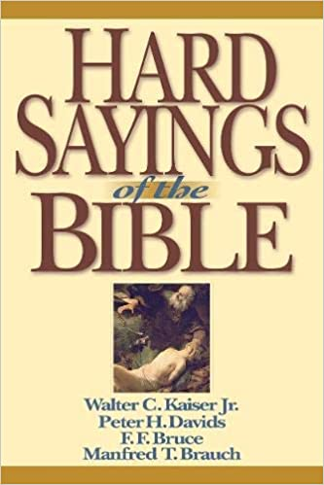
Manfred Brauch in Kaiser et. al, Hard Sayings of The Bible (InterVarsity Press, 1996), p. 643-644
In the social world of Paul’s day slavery was an accepted institution.
There was also a genuine fear of slaves.

Slide 25
Manfred Brauch in Kaiser et. al, Hard Sayings of The Bible (InterVarsity Press, 1996), p. 643-644
In Rome slaves were prohibited from wearing distinctive clothing
for fear that they would discover how numerous they were and start a revolt…

Slide 26
Manfred Brauch in Kaiser et. al, Hard Sayings of The Bible (InterVarsity Press, 1996), p. 643-644
If a master wished, he could have a slave executed (or kill the slave himself).
While this was frowned on if there was no reason for it, it was not outside the master’s rights…

Slide 27
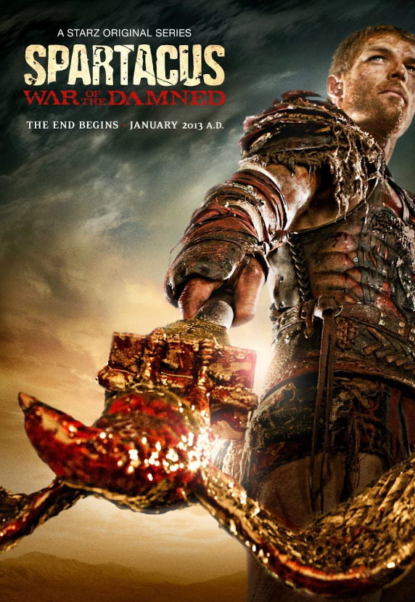
Third Servile War:
30,000 slaves killed in battle
6,000 survivors crucified

Slide 28
Scripture and Slavery
The Bible is anti-slavery, and always ahead of its time

Slide 29
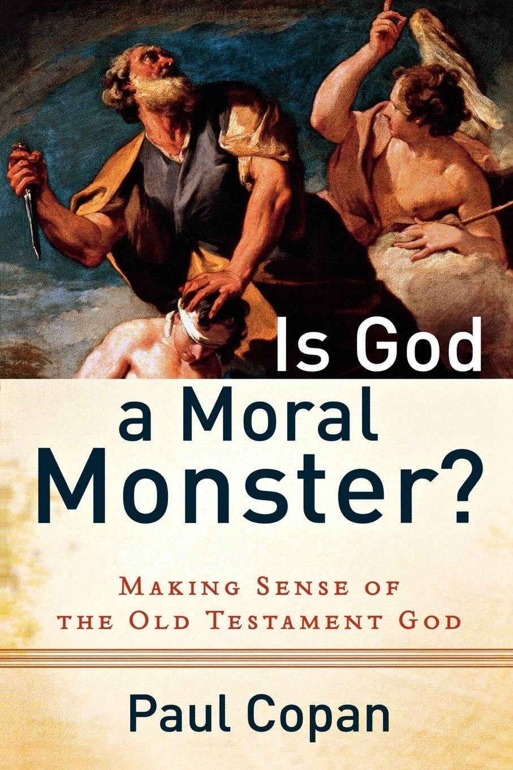
Paul Copan, Is God a Moral Monster (Baker Books, 2011), p. 129-131
[Commenting on Exodus 21]
“For the first time in the ancient near east, legislation required treating servants as persons, not property.”
No bodily abuse allowed (Ex 21:26-27)
Death penalty for masters who kill their servants (Ex 21:20)
Anti-kidnapping laws (Ex 21:16; Deut 24:7)

Slide 30
Scripture and Slavery
The NT is even more radical against slavery:
In a time when even Aristotle held that some humans were slaves by nature (Politics I.13)…
“If you get a chance to be free, take it.” (1 Cor 7:21)
“there is neither slave nor free… for you are all one in Christ Jesus” (Gal 3:28)
“their master and yours is in heaven” (Eph 6:9)
Philemon 1; Rev 18:10-13

Slide 31
Scripture and Slavery
The Bible took an inside-out approach to ending slavery

Slide 32
Manfred Brauch in Kaiser et. al, Hard Sayings of The Bible (InterVarsity Press, 1996), p. 643-644
The church never adopted a rule that converts had to give up their slaves…
Yet we read… of many masters who upon their conversion freed their slaves.

Slide 33
Manfred Brauch in Kaiser et. al, Hard Sayings of The Bible (InterVarsity Press, 1996), p. 643-644
The reality stands that it is difficult to call a person a slave during the week and treat them like a brother or sister in the church…

Slide 34
Manfred Brauch in Kaiser et. al, Hard Sayings of The Bible (InterVarsity Press, 1996), p. 643-644
Paul did in the end create a revolution,
not one from without, but one from within,
in which a changed heart produced changed behavior and through that in the end brought about social change.

Slide 35
Eric Metaxas, Amazing Grace (HarperCollins, 2007), p. 272
Christians in England raised 20 million pounds as part of their push for abolition – enough to buy back every slave in the British Empire

Slide 36
Scripture and Slavery
Scripture is pro-slavery in exactly one area:
“Use your freedom… as bondslaves of God” (1 Pet 2:16)
God
Master
Remember your org. chart!
Servant

Slide 37
1 Peter 2
21 For you have been called for this purpose,
Do what is right and suffer for it and patiently endure it (1 Pet 2:20)

Slide 38
1 Peter 2
21 For you have been called for this purpose,
since Christ also suffered for you,
He Himself bore our sins in His body on the cross, so that we might die to sin and live to righteousness; for by His wounds you were healed (1 Peter 2:24)

Slide 39
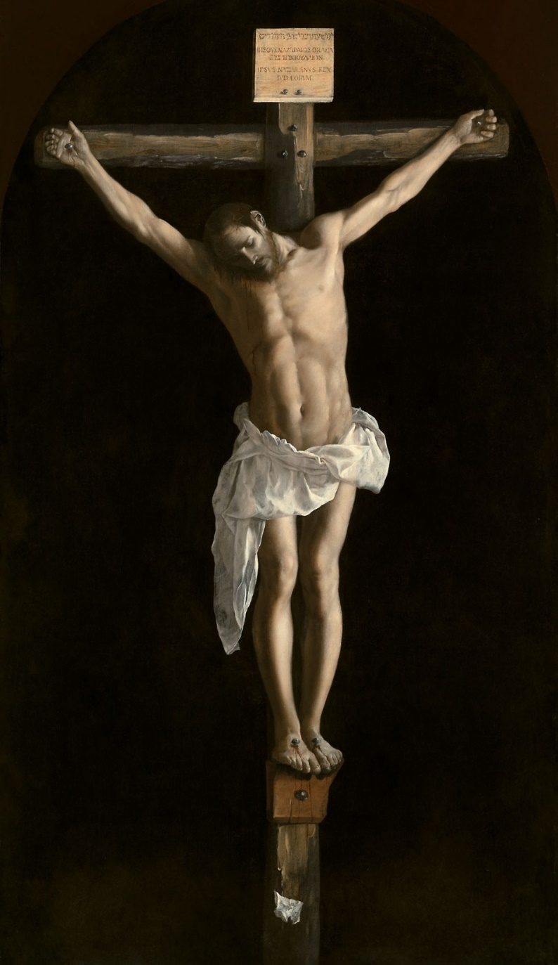
1 Peter 2
21 For you have been called for this purpose,
since Christ also suffered for you,
leaving you an example for you to follow in His steps,
22 who committed no sin,
nor was any deceit found in his mouth; (Isa 53:9)

Slide 40
1 Peter 2
23 and while being reviled, He did not revile in return; (Mark 15:16-18; 29-32; Lk 22:60-61)
while suffering, He uttered no threats, (Isa 53:7)
but kept entrusting Himself to Him who judges righteously

Slide 41
1 Peter 2
23 and while being reviled, He did not revile in return; (Mark 15:16-18; 29-32; Lk 22:60-61)
while suffering, He uttered no threats, (Isa 53:7)
but kept entrusting ______ to Him who judges righteously

Slide 42
1 Peter 2
23 and while being reviled, He did not revile in return; (Mark 15:16-18; 29-32; Lk 22:60-61)
while suffering, He uttered no threats, (Isa 53:7)
but kept entrusting ______ to Him who judges righteously
The Father
Trusted
Everyone
Submitted
Christ

Slide 43
1 Peter 2
23 and while being reviled, He did not revile in return; (Mark 15:16-18; 29-32; Lk 22:60-61)
while suffering, He uttered no threats, (Isa 53:7)
but kept entrusting ______ to Him who judges righteously
The Father
Trusted
Everyone
Submitted
His enemies (Lk 23:34)
His control (John 19:11)
His dignity (Mark 15:24)
His mother (John 19:26)
His will (Matt 26:38-39)
His soul (Luke 23:46)
Christ

Slide 44
1 Peter 2
23 and while being reviled, He did not revile in return; (Mark 15:16-18; 29-32; Lk 22:60-61)
while suffering, He uttered no threats, (Isa 53:7)
but kept entrusting ______ to Him who judges righteously
The Father
Trusted
Everyone
Submitted
Jesus remembered his org. chart!
Christ

Slide 45
1 Peter 2
23 and while being reviled, He did not revile in return; (Mark 15:16-18; 29-32; Lk 22:60-61)
while suffering, He uttered no threats, (Isa 53:7)
but kept entrusting ______ to Him who judges righteously
The Father
Trusted
Everyone
Submitted
We need to remember ours too!
Christ

Slide 46
1 Peter 2
25 For you were continually straying like sheep,
but now you have returned to the Shepherd and Guardian of your souls.
The Father
Trusted
Everyone
Submitted
We need to remember ours too!
Christ

Slide 47
Conclusions
Our authority system is temporarily out of order
But one day God will set up the government we’ve always longed for
The Father
Fallen Authorities
You

Slide 48
Conclusions
Our authority system is temporarily out of order
But one day God will set up the government we’ve always longed for
For now, we have follow Jesus’s example and keep on trusting the Father
The Father
Jesus Christ
You

Slide 49
1 Peter 2:13-25
Questions?
Comments?
Experiences?
risleys@dwellcc.org
See the Dwell App OR teachings.dwellcc.org
Next time: 1 Peter 3:1-7 – Authority and Marriage

