Slide 2
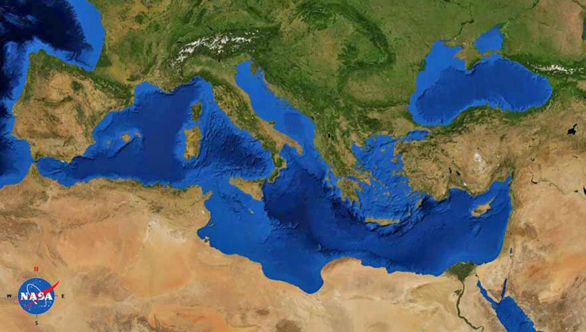
2 Timothy
Paul (Rome)
Timothy (Ephesus)

Slide 3
2 Timothy
Paul (Rome)
Timothy (Ephesus)
^{2 Tim 3:14} You, however, continue in the things you have learned and become convinced of, knowing from whom you have learned them, ¹⁵ and that from childhood you have known the sacred writings which are able to give you the wisdom that leads to salvation through faith which is in Christ Jesus.

Slide 4
2 Timothy
Paul (Rome)
Timothy (Ephesus)
^{2 Tim 3:14} You, however, continue in the things you have learned and become convinced of, knowing from whom you have learned them, ¹⁵ and that from childhood you have known the sacred writings which are able to give you the wisdom that leads to salvation through faith which is in Christ Jesus.

Slide 5
2 Timothy
Paul (Rome)
Timothy (Ephesus)
Timothy’s foundation
^{2 Tim 3:14} You, however, continue in the things you have learned and become convinced of, knowing from whom you have learned them, ¹⁵ and that from childhood you have known the sacred writings which are able to give you the wisdom that leads to salvation through faith which is in Christ Jesus.

Slide 6
2 Timothy
Paul (Rome)
Timothy (Ephesus)
Timothy’s foundation
^{2 Tim 3:14} You, however, continue in the things you have learned and become convinced of, knowing from whom you have learned them, ¹⁵ and that from childhood you have known the sacred writings which are able to give you the wisdom that leads to salvation through faith which is in Christ Jesus.

Slide 7
2 Timothy
Paul (Rome)
Timothy (Ephesus)
Timothy’s foundation
^{2 Tim 3:14} You, however, continue in the things you have learned and become convinced of, knowing from whom you have learned them, ¹⁵ and that from childhood you have known the sacred writings which are able to give you the wisdom that leads to salvation through faith which is in Christ Jesus.

Slide 8
Stay with the Word
^{2 Tim 3:14} You, however, continue in the things you have learned and become convinced of, knowing from whom you have learned them, ¹⁵ and that from childhood you have known the sacred writings which are able to give you the wisdom that leads to salvation through faith which is in Christ Jesus.

Slide 9
Stay with the Word
“the Word of God”
^{2 Tim 3:14} You, however, continue in the things you have learned and become convinced of, knowing from whom you have learned them, ¹⁵ and that from childhood you have known the sacred writings which are able to give you the wisdom that leads to salvation through faith which is in Christ Jesus.

Slide 10
Stay with the Word
^{2 Tim 3:14} You, however, continue in the things you have learned and become convinced of, knowing from whom you have learned them, ¹⁵ and that from childhood you have known the sacred writings which are able to give you the wisdom that leads to salvation through faith which is in Christ Jesus.

Slide 11
Stay with the Word
^{2 Tim 3:14} You, however, continue in the things you have learned and become convinced of, knowing from whom you have learned them, ¹⁵ and that from childhood you have known the sacred writings which are able to give you the wisdom that leads to salvation through faith which is in Christ Jesus.

Slide 12
Stay with the Word: leads to salvation
^{2 Tim 3:14} You, however, continue in the things you have learned and become convinced of, knowing from whom you have learned them, ¹⁵ and that from childhood you have known the sacred writings which are able to give you the wisdom that leads to salvation through faith which is in Christ Jesus.

Slide 13
Stay with the Word: leads to salvation
And in the scriptures, He’s given His word to you
^{2 Tim 3:14} You, however, continue in the things you have learned and become convinced of, knowing from whom you have learned them, ¹⁵ and that from childhood you have known the sacred writings which are able to give you the wisdom that leads to salvation through faith which is in Christ Jesus.

Slide 14
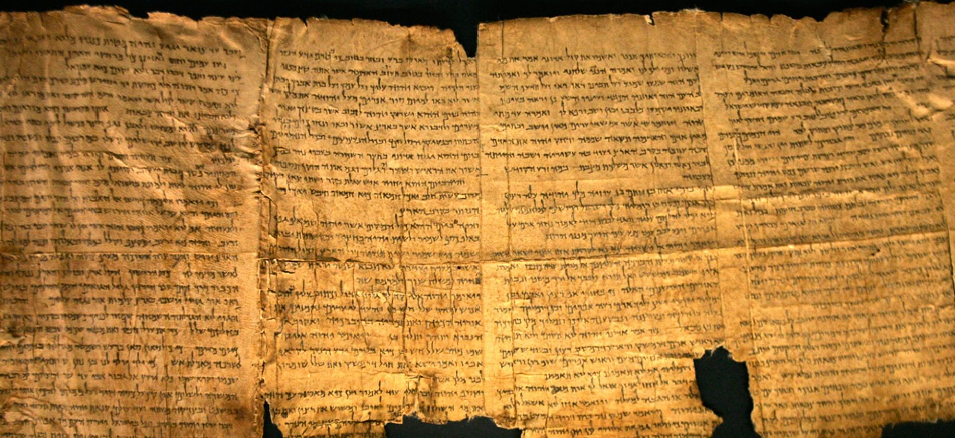
Stay with the Word: leads to salvation
^{2 Tim 3:16} All Scripture is inspired by God and beneficial for teaching, for rebuke, for correction, for training in righteousness; ¹⁷ so that the man or woman of God may be fully capable, equipped for every good work.

Slide 15
Stay with the Word: leads to salvation
Theopneustos: God Breathed
^{2 Tim 3:16} All Scripture is inspired by God and beneficial for teaching, for rebuke, for correction, for training in righteousness; ¹⁷ so that the man or woman of God may be fully capable, equipped for every good work.

Slide 16
Stay with the Word: leads to salvation
Claim: When you read the scriptures, you are reading the Word of God
Theopneustos: God Breathed
^{2 Tim 3:16} All Scripture is inspired by God and beneficial for teaching, for rebuke, for correction, for training in righteousness; ¹⁷ so that the man or woman of God may be fully capable, equipped for every good work.

Slide 17
Stay with the Word:
Truth from God
Claim: When you read the scriptures, you are reading the Word of God
Theopneustos: God Breathed
^{2 Tim 3:16} All Scripture is inspired by God and beneficial for teaching, for rebuke, for correction, for training in righteousness; ¹⁷ so that the man or woman of God may be fully capable, equipped for every good work.

Slide 18
Stay with the Word:
Truth from God
Speculation
vs.
Revelation
^{2 Tim 3:16} All Scripture is inspired by God and beneficial for teaching, for rebuke, for correction, for training in righteousness; ¹⁷ so that the man or woman of God may be fully capable, equipped for every good work.

Slide 19
Stay with the Word:
Truth from God
Verbal Plenary Inspiration
^{2 Tim 3:16} All Scripture is inspired by God and beneficial for teaching, for rebuke, for correction, for training in righteousness; ¹⁷ so that the man or woman of God may be fully capable, equipped for every good work.

Slide 20
Stay with the Word:
Truth from God
Verbal Plenary Inspiration
Moses “wrote down all the words of the Lord” (Ex 24:4)
Isaiah “inscribed” God’s instructions “on a scroll” (Is 30:8)
Ezekiel “when I speak to you, I will open your mouth and you will say to them…” (Ezk 3:27)
^{2 Tim 3:16} All Scripture is inspired by God and beneficial for teaching, for rebuke, for correction, for training in righteousness; ¹⁷ so that the man or woman of God may be fully capable, equipped for every good work.

Slide 21
Stay with the Word:
Truth from God
Verbal Plenary Inspiration
David “The Spirit of the Lord spoke by me, and His word was on my tongue” (2 Sam 23:2)
Jeremiah “Speak … all the words that I have commanded you … Do not omit a word!” (Jer 26:2)
^{2 Tim 3:16} All Scripture is inspired by God and beneficial for teaching, for rebuke, for correction, for training in righteousness; ¹⁷ so that the man or woman of God may be fully capable, equipped for every good work.

Slide 22
Stay with the Word:
Truth from God
Verbal Plenary Inspiration
Paul spoke “not in words taught by human wisdom, but in those taught by the Spirit” (1 Cor 2:13)
Hebrews 1:1 “God, after He spoke long ago to the fathers in the prophets in many portions and in many ways, in these last days has spoken to us in His Son.”
^{2 Tim 3:16} All Scripture is inspired by God and beneficial for teaching, for rebuke, for correction, for training in righteousness; ¹⁷ so that the man or woman of God may be fully capable, equipped for every good work.

Slide 23
Stay with the Word:
Truth from God
Verbal Plenary Inspiration
^{2 Tim 3:16} All Scripture is inspired by God and beneficial for teaching, for rebuke, for correction, for training in righteousness; ¹⁷ so that the man or woman of God may be fully capable, equipped for every good work.

Slide 24
Stay with the Word:
Truth from God
Verbal Plenary Inspiration
^{2 Tim 3:16} All Scripture is inspired by God and beneficial for teaching, for rebuke, for correction, for training in righteousness; ¹⁷ so that the man or woman of God may be fully capable, equipped for every good work.

Slide 25
Stay with the Word:
Truth from God
There are several good reasons to believe this
^{2 Tim 3:16} All Scripture is inspired by God and beneficial for teaching, for rebuke, for correction, for training in righteousness; ¹⁷ so that the man or woman of God may be fully capable, equipped for every good work.

Slide 26
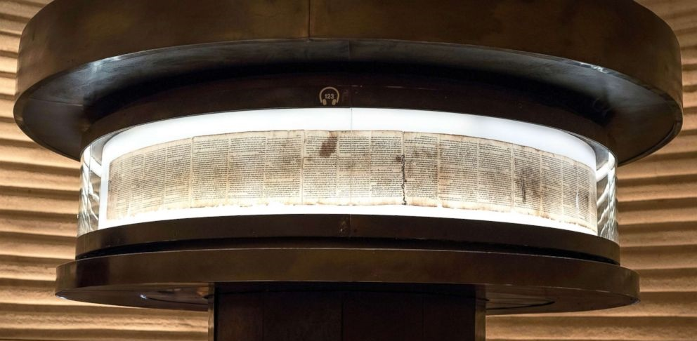
Stay with the Word:
Truth from God
There are several good reasons to believe this
^{2 Tim 3:16} All Scripture is inspired by God and beneficial for teaching, for rebuke, for correction, for training in righteousness; ¹⁷ so that the man or woman of God may be fully capable, equipped for every good work.

Slide 27
Stay with the Word:
Truth from God
This is what Jesus taught about the scriptures
^{2 Tim 3:16} All Scripture is inspired by God and beneficial for teaching, for rebuke, for correction, for training in righteousness; ¹⁷ so that the man or woman of God may be fully capable, equipped for every good work.

Slide 28
Stay with the Word:
Truth from God
Jesus affirmed and taught the OT as God’s Word
^{John 5:46} For if you believed Moses, you would believe Me, for he wrote about Me. ⁴⁷ But if you do not believe his writings, how will you believe My words?”
^{2 Tim 3:16} All Scripture is inspired by God and beneficial for teaching, for rebuke, for correction, for training in righteousness; ¹⁷ so that the man or woman of God may be fully capable, equipped for every good work.

Slide 29
Stay with the Word:
Truth from God
Jesus affirmed and taught the OT as God’s Word
^{Matt 5:18} Until heaven and earth pass away, not the smallest letter or stroke shall pass from the Law until all is accomplished.
^{2 Tim 3:16} All Scripture is inspired by God and beneficial for teaching, for rebuke, for correction, for training in righteousness; ¹⁷ so that the man or woman of God may be fully capable, equipped for every good work.

Slide 30
Stay with the Word:
Truth from God
Jesus affirmed and taught the OT as God’s Word
^{Luke24:44} “all things which are written about Me in the law of Moses and the Prophets and the Psalms must be fulfilled.”
^{2 Tim 3:16} All Scripture is inspired by God and beneficial for teaching, for rebuke, for correction, for training in righteousness; ¹⁷ so that the man or woman of God may be fully capable, equipped for every good work.

Slide 31
Stay with the Word:
Truth from God
Jesus claimed his words were God’s Word
^{2 Tim 3:16} All Scripture is inspired by God and beneficial for teaching, for rebuke, for correction, for training in righteousness; ¹⁷ so that the man or woman of God may be fully capable, equipped for every good work.

Slide 32
Stay with the Word:
Truth from God
Jesus claimed his words were God’s Word
^{Matt 24:34} Heaven and earth will pass away, but My words will not pass away
^{Matt 5:18} Until heaven and earth pass away, not the smallest letter or stroke shall pass from the Law until all is accomplished.
^{2 Tim 3:16} All Scripture is inspired by God and beneficial for teaching, for rebuke, for correction, for training in righteousness; ¹⁷ so that the man or woman of God may be fully capable, equipped for every good work.

Slide 33
Stay with the Word: Truth from God
Jesus preauthorized the apostles to write scripture
^{John 15:26 “}the Spirit of truth … He will testify about Me, ²⁷ and you will testify also, because you have been with Me from the beginning”
^{2 Tim 3:16} All Scripture is inspired by God and beneficial for teaching, for rebuke, for correction, for training in righteousness; ¹⁷ so that the man or woman of God may be fully capable, equipped for every good work.

Slide 34
Stay with the Word: Truth from God
Jesus preauthorized the apostles to write scripture
^{John 14:26 “}the Helper, the Holy Spirit… He will teach you all things, and bring to remembrance all that I said to you”
^{2 Tim 3:16} All Scripture is inspired by God and beneficial for teaching, for rebuke, for correction, for training in righteousness; ¹⁷ so that the man or woman of God may be fully capable, equipped for every good work.

Slide 35
Stay with the Word: Truth from God
Jesus preauthorized the apostles to write scripture
^{John 16:10 “}When He, the Spirit of Truth comes, He will guide you in all the truth … He will disclose to you what is to come.”
^{2 Tim 3:16} All Scripture is inspired by God and beneficial for teaching, for rebuke, for correction, for training in righteousness; ¹⁷ so that the man or woman of God may be fully capable, equipped for every good work.

Slide 36
Stay with the Word:
Truth from God
The church and the apostles recognized the NT as scripture from day one
^{1Thess 2:13} we also constantly thank God that when you received the word of God which you heard from us, you accepted it not as the word of men, but for what it really is, the word of God, which also performs its work in you who believe.
^{2 Tim 3:16} All Scripture is inspired by God and beneficial for teaching, for rebuke, for correction, for training in righteousness; ¹⁷ so that the man or woman of God may be fully capable, equipped for every good work.

Slide 37
Stay with the Word:
Truth from God
The church and the apostles recognized the NT as scripture from day one
^{1Cor 14:37} recognize that the things which I write to you are the Lord’s commandment.
^{2 Tim 3:16} All Scripture is inspired by God and beneficial for teaching, for rebuke, for correction, for training in righteousness; ¹⁷ so that the man or woman of God may be fully capable, equipped for every good work.

Slide 38
Stay with the Word:
Truth from God
The church and the apostles recognized the NT as scripture from day one
^{2 Pet 3:15} …just as our beloved brother Paul, according to the wisdom given him, wrote to you, as also in all his letters, speaking in them of these things, in which are some things hard to understand, which the untaught and unstable distort, as they do also the rest of the Scriptures.
^{2 Tim 3:16} All Scripture is inspired by God and beneficial for teaching, for rebuke, for correction, for training in righteousness; ¹⁷ so that the man or woman of God may be fully capable, equipped for every good work.

Slide 39
Stay with the Word:
Truth from God
This was Jesus’s take on the scriptures
You don’t need to agree on this to come to Christ
There is a strong extra-biblical case for Jesus’s deity and the resurrection
^{2 Tim 3:16} All Scripture is inspired by God and beneficial for teaching, for rebuke, for correction, for training in righteousness; ¹⁷ so that the man or woman of God may be fully capable, equipped for every good work.

Slide 40
Stay with the Word:
Truth from God
This was Jesus’s take on the scriptures
You don’t need to agree on this to come to Christ
But when we embrace Christ, we are confronted with his claim about scripture
^{2 Tim 3:16} All Scripture is inspired by God and beneficial for teaching, for rebuke, for correction, for training in righteousness; ¹⁷ so that the man or woman of God may be fully capable, equipped for every good work.

Slide 41
Stay with the Word:
Truth from God
This was Jesus’s take on the scriptures
Isn’t that circular reasoning?
^{2 Tim 3:16} All Scripture is inspired by God and beneficial for teaching, for rebuke, for correction, for training in righteousness; ¹⁷ so that the man or woman of God may be fully capable, equipped for every good work.

Slide 42
Stay with the Word:
Truth from God
This was Jesus’s take on the scriptures
Even laying the Bible aside, there is historical consensus that Jesus’s lived, taught, and was crucified
There is a very strong case for the historicity of the NT documents
^{2 Tim 3:16} All Scripture is inspired by God and beneficial for teaching, for rebuke, for correction, for training in righteousness; ¹⁷ so that the man or woman of God may be fully capable, equipped for every good work.

Slide 43
Stay with the Word:
Truth from God
What if this is true?
^{2 Tim 3:16} All Scripture is inspired by God and beneficial for teaching, for rebuke, for correction, for training in righteousness; ¹⁷ so that the man or woman of God may be fully capable, equipped for every good work.

Slide 44
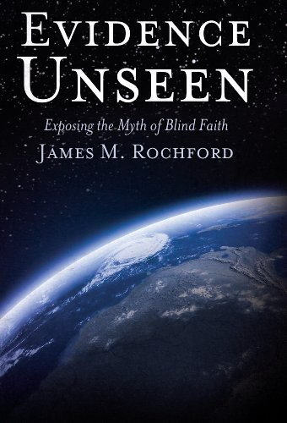
Stay with the Word:
Truth from God
^{2 Tim 3:16} All Scripture is inspired by God and beneficial for teaching, for rebuke, for correction, for training in righteousness; ¹⁷ so that the man or woman of God may be fully capable, equipped for every good work.

Slide 45
Stay with the Word:
Truth from God
^{2 Tim 3:16} All Scripture is inspired by God and beneficial for teaching, for rebuke, for correction, for training in righteousness; ¹⁷ so that the man or woman of God may be fully capable, equipped for every good work.

Slide 46
Stay with the Word:
Truth from God
Subjective evidence
^{2 Tim 3:16} All Scripture is inspired by God and beneficial for teaching, for rebuke, for correction, for training in righteousness; ¹⁷ so that the man or woman of God may be fully capable, equipped for every good work.

Slide 47
Stay with the Word:
which is useful
^{2 Tim 3:16} All Scripture is inspired by God and beneficial for teaching, for rebuke, for correction, for training in righteousness; ¹⁷ so that the man or woman of God may be fully capable, equipped for every good work.

Slide 48
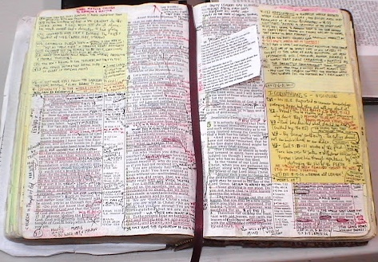
Stay with the Word:
which is useful
^{2 Tim 3:16} All Scripture is inspired by God and beneficial for teaching, for rebuke, for correction, for training in righteousness; ¹⁷ so that the man or woman of God may be fully capable, equipped for every good work.

Slide 49
Stay with the Word:
which is useful
To learn and teach the truth
^{2 Tim 3:16} All Scripture is inspired by God and beneficial for teaching, for rebuke, for correction, for training in righteousness; ¹⁷ so that the man or woman of God may be fully capable, equipped for every good work.

Slide 50
Stay with the Word:
which is useful
To correct our thinking
^{2 Tim 3:16} All Scripture is inspired by God and beneficial for teaching, for rebuke, for correction, for training in righteousness; ¹⁷ so that the man or woman of God may be fully capable, equipped for every good work.

Slide 51
Stay with the Word:
which is useful
Your only authority to influence others
^{2 Tim 3:16} All Scripture is inspired by God and beneficial for teaching, for rebuke, for correction, for training in righteousness; ¹⁷ so that the man or woman of God may be fully capable, equipped for every good work.

Slide 52
Stay with the Word:
which is useful
For spiritual growth
To make disciples
^{2 Tim 3:16} All Scripture is inspired by God and beneficial for teaching, for rebuke, for correction, for training in righteousness; ¹⁷ so that the man or woman of God may be fully capable, equipped for every good work.

Slide 53
Stay with the Word:
which is useful
To be useful to God!
^{2 Tim 3:16} All Scripture is inspired by God and beneficial for teaching, for rebuke, for correction, for training in righteousness; ¹⁷ so that the man or woman of God may be fully capable, equipped for every good work.

Slide 54
Stay with the Word:
which is useful
To be useful to God!
^{2 Tim 3:16} All Scripture is inspired by God and beneficial for teaching, for rebuke, for correction, for training in righteousness; ¹⁷ so that the man or woman of God may be fully capable, equipped for every good work.

Slide 55
Stay with the Word:
your equipment
So get equipped!
^{2 Tim 3:16} All Scripture is inspired by God and beneficial for teaching, for rebuke, for correction, for training in righteousness; ¹⁷ so that the man or woman of God may be fully capable, equipped for every good work.

Slide 56
Stay with the Word:
your equipment
^{2 Tim 4:1} I solemnly exhort you in the presence of God and of Christ Jesus, who is to judge the living and the dead, and by His appearing and His kingdom: ² preach the word; be ready in season and out of season; correct, rebuke, and exhort, with great patience and instruction.

Slide 57
Stay with the Word:
your equipment
^{2 Tim 4:1} I solemnly exhort you in the presence of God and of Christ Jesus, who is to judge the living and the dead, and by His appearing and His kingdom: ² preach the word; be ready in season and out of season; correct, rebuke, and exhort, with great patience and instruction.

Slide 58
Stay with the Word:
your equipment
^{2 Tim 4:1} I solemnly exhort you in the presence of God and of Christ Jesus, who is to judge the living and the dead, and by His appearing and His kingdom: ² preach the word; be ready in season and out of season; correct, rebuke, and exhort, with great patience and instruction.

Slide 59
Stay with the Word:
your charge
^{2 Tim 4:1} I solemnly exhort you in the presence of God and of Christ Jesus, who is to judge the living and the dead, and by His appearing and His kingdom: ² preach the word; be ready in season and out of season; correct, rebuke, and exhort, with great patience and instruction.

Slide 60
Stay with the Word:
your charge
Preach the Word
^{2 Tim 4:1} I solemnly exhort you in the presence of God and of Christ Jesus, who is to judge the living and the dead, and by His appearing and His kingdom: ² preach the word; be ready in season and out of season; correct, rebuke, and exhort, with great patience and instruction.

Slide 61
Stay with the Word:
your charge
Preach the Word
^{2 Tim 4:1} I solemnly exhort you in the presence of God and of Christ Jesus, who is to judge the living and the dead, and by His appearing and His kingdom: ² preach the word; be ready in season and out of season; correct, rebuke, and exhort, with great patience and instruction.

Slide 62
^{Isaiah 55:8} “For My thoughts are not your thoughts, Nor are your ways My ways,” declares the Lord. ⁹ “For as the heavens are higher than the earth, So are My ways higher than your ways And My thoughts than your thoughts. ¹⁰ For as the rain and the snow come down from heaven, And do not return there without watering the earth And making it produce and sprout, And providing seed to the sower and bread to the eater; ¹¹ So will My word be which goes out of My mouth; It will not return to Me empty, Without accomplishing what I desire, And without succeeding in the purpose for which I sent it.
Stay with the Word:
your charge
Preach the Word
^{2 Tim 4:1} I solemnly exhort you in the presence of God and of Christ Jesus, who is to judge the living and the dead, and by His appearing and His kingdom: ² preach the word; be ready in season and out of season; correct, rebuke, and exhort, with great patience and instruction.

Slide 63
Stay with the Word:
your charge
Preach the Word
^{2 Tim 4:1} I solemnly exhort you in the presence of God and of Christ Jesus, who is to judge the living and the dead, and by His appearing and His kingdom: ² preach the word; be ready in season and out of season; correct, rebuke, and exhort, with great patience and instruction.

Slide 64
Stay with the Word:
your charge
Preach the Word
^{2Tim 4:3} For the time will come when they will not tolerate sound doctrine; doctrine; but wanting to have their ears tickled, they will accumulate for themselves teachers in accordance with their own desires, ⁴ and they will turn their ears away from the truth and will turn aside to myths.

Slide 65
Stay with the Word:
your charge
Preach the Word
^{2Tim 4:5} But as for you, use self-restraint in all things, endure hardship, do the work of an evangelist, fulfill your ministry.

Slide 66
Stay with the Word:
your charge
Preach the Word
^{2Tim 4:5} But as for you, use self-restraint in all things, endure hardship, do the work of an evangelist, fulfill your ministry.

Slide 67
Stay with the Word:
your charge
Preach the Word
^{2Tim 4:5} But as for you, use self-restraint in all things, endure hardship, do the work of an evangelist, fulfill your ministry.

Slide 68
Stay with the Word:
your charge
Preach the Word
^{2Tim 4:5} But as for you, use self-restraint in all things, endure hardship, do the work of an evangelist, fulfill your ministry.

Slide 69
Stay with the Word:
your good news
to tell
Preach the Word
^{2Tim 4:5} But as for you, use self-restraint in all things, endure hardship, do the work of an evangelist, fulfill your ministry.

Slide 70
Stay with the Word:
your good news
to tell
Preach the Word
^{2Tim 4:5} But as for you, use self-restraint in all things, endure hardship, do the work of an evangelist, fulfill your ministry.

Slide 71
Stay with the Word:
Do you realize what you have?

Slide 72
Stay with the Word:
Are you getting equipped?

Slide 73
Stay with the Word:
Who needs to hear the Word of God from you today?

Slide 74
Discussion Questions to-go:
What lingering questions do you have about the Bible? Who can you ask?
Have you ever seen an example of how coming under the Word changes lives?
What do you think it looks like practically to “preach the word” aside from teaching in a church?

