Slide 2
(1 Pet. 2:18) Servants, be submissive to your masters with all respect,
“Servants” (oiketēs) is not the ordinary word for slave, but “nearly synonymous.”
Wayne A. Grudem, 1 Peter (Downers Grove, IL: InterVarsity Press, 1988), 131.

Slide 3
(1 Pet. 2:18) Servants, be submissive to your masters with all respect,
“Servants” (oiketēs) is not the ordinary word for slave, but “nearly synonymous.”
Wayne A. Grudem, 1 Peter (Downers Grove, IL: InterVarsity Press, 1988), 131.
Roman Slavery = American Slavery
(1) Many slaves were skilled and educated.
e.g. Managers, doctors, nurses, teachers, musicians, artisans. Grudem, 1 Peter (1988), 132.
(2) Roman law regulated the treatment of slaves.
e.g. Slaves were paid. Grudem, 1 Peter (1988), 132.
(3) Slaves could purchase their freedom.
“Manumission.” Schreiner, 1 Peter (2003), 135.
(4) Slavery was based on class—not race.
25-35% of the Roman Empire.

Slide 4
(1 Pet. 2:18) Servants, be submissive to your masters with all respect,
“Servants” (oiketēs) is not the ordinary word for slave, but “nearly synonymous.”
Wayne A. Grudem, 1 Peter (Downers Grove, IL: InterVarsity Press, 1988), 131.
So, slavery wasn’t that bad??

Slide 5
(1 Pet. 2:18) Servants, be submissive to your masters with all respect,
not only to those who are good and gentle,
but also to those who are unreasonable.
“Unreasonable” (skolios)
This refers to “being morally bent or twisted, crooked, unscrupulous, dishonest” (BDAG, p.930).

Slide 6
(1 Pet. 2:19) For this finds favor,
if for the sake of conscience toward God
a person bears up under sorrows
when suffering unjustly.

Slide 7
(1 Pet. 2:20) For what credit is there if,
when you sin and are harshly treated,
you endure it with patience?

Slide 8
(1 Pet. 2:20) But if when you
do what is right and suffer for it you patiently endure it,
this finds favor with God.
??????

Slide 9
R. Joseph Hoffman
(Atheistic Historian)
Morton Smith and R. Joseph Hoffman, editors. What the Bible Really Says (Buffalo, NY: Prometheus, 1989), pp.145-146.
There is no reasonable doubt that the New Testament, like the Old, not only tolerated chattel slavery…
but helped to perpetuate it by making the slaves’ obedience to their masters a religious duty.

Slide 10
R. Joseph Hoffman
(Atheistic Historian)
Morton Smith and R. Joseph Hoffman, editors. What the Bible Really Says (Buffalo, NY: Prometheus, 1989), pp.145-146.
This biblical morality was one of the greatest handicaps that the emancipation movement in the United States had to overcome.

Slide 11
The Bible’s defense of slavery is very plain.
St. Paul was inspired, and knew the will of the Lord Jesus Christ, and was only intent on [teaching] it.

Slide 12
Who are we, that in our modern wisdom presume to set aside the Word of God, and scorn the example of the Divine Redeemer,
and spurn the preaching and the conduct of the apostles,
and invent for ourselves a ‘higher law’ than [the] holy Scriptures?

Slide 13
…Who are we to virtually blot out the language of the sacred record, and dictate to the majesty of heaven what HE shall regard as sin and reward as duty?

Slide 14
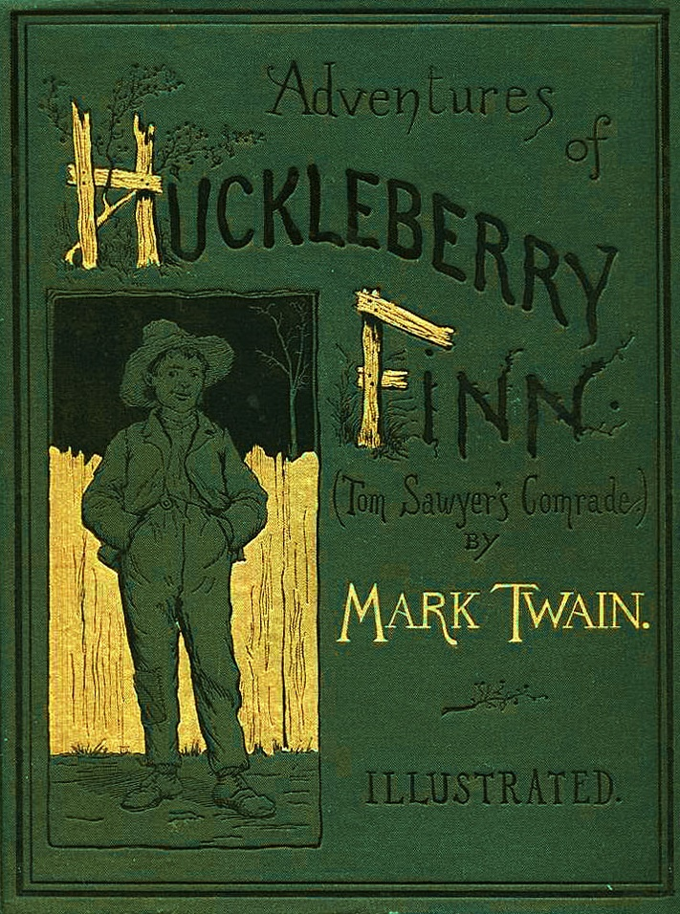
(1) Countercultural context

Slide 15
(1) Countercultural context
W.L. Westermann: “The institution of slavery was a fact of Mediterranean economic life so completely accepted as a part of the labour structure of the time that one cannot correctly speak of the slave ‘problem’ in antiquity.”
W.L. Westermann, The Slave Systems of Greek and Roman Antiquity (The American Philosophical Society, 1955), p.215.

Slide 16
(1) Countercultural context
Aristotle: “The manager of a household must have his tools,
some [tools] are lifeless and others living…
A slave is a live article of property.”
Aristotle Politics, 1253b.

Slide 17
(1) Countercultural context
Aristotle: “[Slaves] are as different as the soul from the body or man from beast…
[They] are slaves by nature.”
Aristotle Politics, 1254b
Aristotle and Seneca both described slaves as human property.
Aristotle Oeconomica, 1.5.1-2; Seneca, Moral Epistles, 47

Slide 18
(1) Countercultural context
What about revolt or resistance?
Jewish War (AD 66-70)
1.1 million killed. 200,000 enslaved.
Josephus, Jewish War, 6.3.201-213; 6.5.271-73; 6.9.420; 7.5.118, 138, 154
Spartacus’ Revolt (73 BC)
6,000 survivors were crucified.
Appian, Civil Wars, 1.120

Slide 19
Peter called these slave masters “unreasonable” (skolios), and slaves were “suffering unjustly.”
(1) Countercultural context
(2) The NT decries slave-trading
Paul states that “kidnappers” are “lawless and rebellious” (1 Tim. 1:9-10).

Slide 20
(1) Countercultural context
(2) The NT decries slave-trading
“Kidnappers” (andrapodistai)
“One who acquires persons for use by others, slave-dealer, kidnapper” (BDAG, p.76).
Paul states that “kidnappers” are “lawless and rebellious” (1 Tim. 1:9-10).

Slide 21
(1) Countercultural context
(2) The NT decries slave-trading
(3) The NT urges slaves to get their freedom
(1 Cor. 7:21) Were you a slave when you were called? Don’t let it trouble you—although if you can gain your freedom, do so.
²³ Do not become slaves of men.

Slide 22
R. Joseph Hoffman
(Atheistic Historian)
Morton Smith and R. Joseph Hoffman, editors. What the Bible Really Says (Buffalo, NY: Prometheus, 1989), pp.145-146.
(Lk. 4:18) The LORD… has sent me
to proclaim that captives will be released…
that the oppressed will be set free.
Jesus never attacked the practice…
If Jesus had denounced slavery, we should almost certainly have heard of his doing so.

Slide 23
R. Joseph Hoffman
(Atheistic Historian)
Morton Smith and R. Joseph Hoffman, editors. What the Bible Really Says (Buffalo, NY: Prometheus, 1989), pp.145-146.
(Lk. 6:27) Love your enemies!
Do good to those who hate you.
²⁸ Bless those who curse you.
Pray for those who hurt you.
Jesus never attacked the practice…
If Jesus had denounced slavery, we should almost certainly have heard of his doing so.

Slide 24
R. Joseph Hoffman
(Atheistic Historian)
Morton Smith and R. Joseph Hoffman, editors. What the Bible Really Says (Buffalo, NY: Prometheus, 1989), pp.145-146.
(Lk. 6:29) If someone slaps you on one cheek, offer the other cheek also.
³¹ Do to others as you would like them to do to you.
Jesus never attacked the practice…
If Jesus had denounced slavery, we should almost certainly have heard of his doing so.

Slide 25
(Gal. 3:28) There is neither Jew nor Greek,
there is neither slave nor free,
there is neither male nor female;
for you are all one in Christ Jesus.
cf. 1 Corinthians 12:13; Colossians 3:11
(1) Countercultural context
(2) The NT decries slave-trading
(3) The NT urges slaves to get their freedom
(4) The NT affirms the value and equality of all people

Slide 26
(1) Countercultural context
(2) The NT decries slave-trading
(3) The NT urges slaves to get their freedom
(4) The NT affirms the value and equality of all people
(5) The NT ethic led to abolition

Slide 27
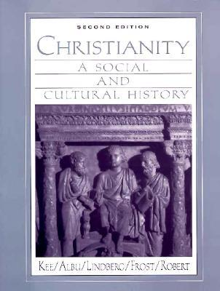
Mark A. Noll
(Leading Church Historian)
Howard Clark Kee, Christianity: A Social and Cultural History (New York, NY: Macmillan Publishing Company, 1991), p.625.
The first known American protest appeared in 1688
from Quakers and Mennonites at Germantown, Pennsylvania…

Slide 28
Mark A. Noll
(Leading Church Historian)
Howard Clark Kee, Christianity: A Social and Cultural History (New York, NY: Macmillan Publishing Company, 1991), p.625.
To the extent that a protest existed at this time,
it was mounted by religious leaders.

Slide 29
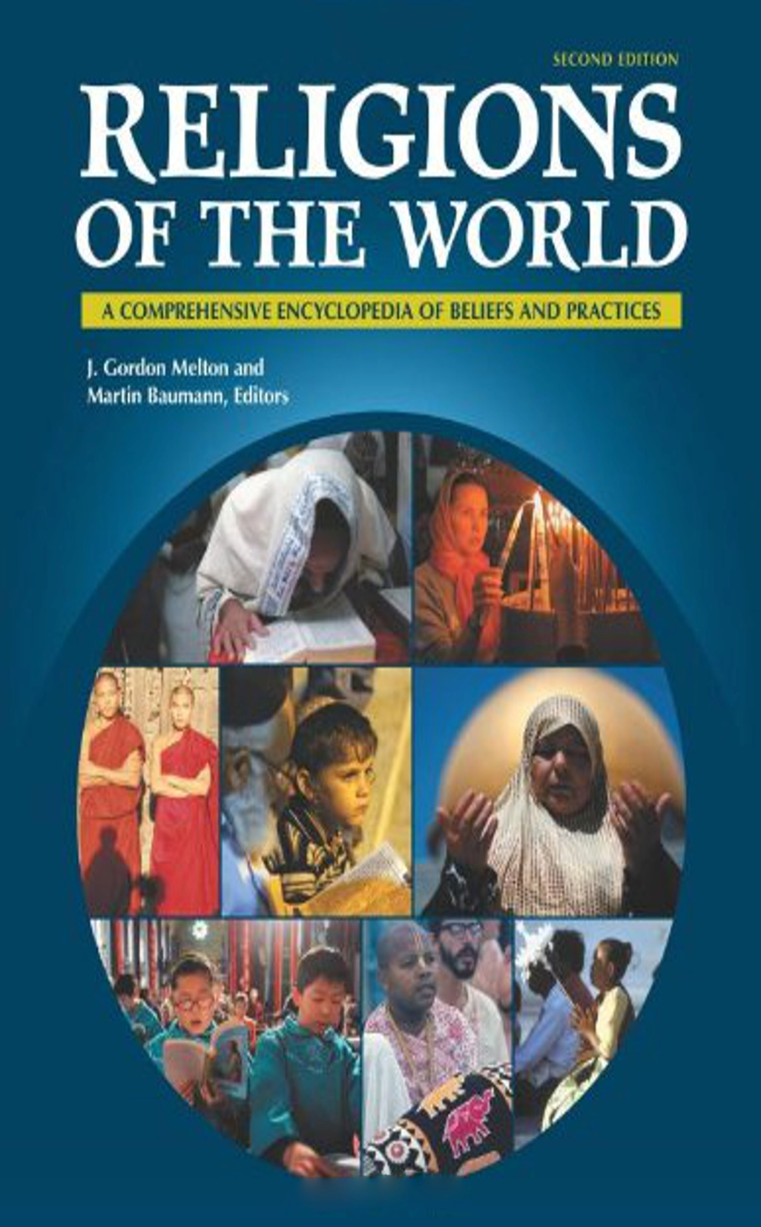
J. Gordon Melton
(Professor of Religious History)
J. Gordon Melton and Martin Baumann, Religions of the World (2nd Edition). Santa Barbara, CA: ABC-CLIO. 2010, 737.
The Clapham Sect was a diverse but influential group
of evangelical Christian social reformers that emerged in England at the end of the 18th century.

Slide 30
J. Gordon Melton
(Professor of Religious History)
J. Gordon Melton and Martin Baumann, Religions of the World (2nd Edition). Santa Barbara, CA: ABC-CLIO. 2010, 737.
The group became best known for its support of William Wilberforce’s activity in Parliament to end British participation in the international slave trade…

Slide 31
J. Gordon Melton
(Professor of Religious History)
J. Gordon Melton and Martin Baumann, Religions of the World (2nd Edition). Santa Barbara, CA: ABC-CLIO. 2010, 737.
After several decades of work, the group was initially rewarded with Parliament’s passage of the Slave Trade Act in 1807, which banned the trade throughout the British Empire.

Slide 32
J. Gordon Melton
(Professor of Religious History)
J. Gordon Melton and Martin Baumann, Religions of the World (2nd Edition). Santa Barbara, CA: ABC-CLIO. 2010, 737.
Their efforts culminated in the passing of the Slavery Abolition Act in 1833,
which eliminated slavery throughout the British Empire.

Slide 33
J. Gordon Melton
(Professor of Religious History)
J. Gordon Melton and Martin Baumann, Religions of the World (2nd Edition). Santa Barbara, CA: ABC-CLIO. 2010, 737.
Many contemporaries looked upon the Clapham Sect as a bunch of do-gooders whom they called pejoratively ‘the saints.’

Slide 34
J. Gordon Melton
(Professor of Religious History)
J. Gordon Melton and Martin Baumann, Religions of the World (2nd Edition). Santa Barbara, CA: ABC-CLIO. 2010, 737.
In the light of history, however, the group has been looked upon as moral pioneers.

Slide 35
(1) Countercultural context
(2) The NT decries slave-trading
(3) The NT urges slaves to get their freedom
(4) The NT affirms the value and equality of all people
(5) The NT ethic led to abolition
The New Testament doesn’t just give us ethics to follow.
It gives us an example.

Slide 36
(1 Pet. 2:21) For you have been called for this purpose,
since Christ also suffered for you,
leaving you an example for you to follow in His steps.

Slide 37
(1 Pet. 2:22) Jesus committed no sin,
nor was any deceit found in His mouth.

Slide 38
(1 Pet. 2:23) While being reviled, Jesus did not revile in return.
While suffering, He uttered no threats, but kept entrusting Himself to Him who judges righteously.
Why did Jesus do this??

Slide 39
(1 Pet. 2:24) Jesus bore our sins in His body on the cross, so that we might die to sin and live to righteousness.
By His wounds you were healed.

Slide 40
(1 Pet. 2:25) For you were continually straying like sheep,
but now you have returned to the Shepherd and Guardian of your souls.

Slide 41
If you’re outraged by slaves submitting to masters,
then you’ve missed the point!
The real outrage is that the Master would submit to slaves!

Slide 42
The Bible & Slavery
(1) Countercultural context
(2) NT decries slave-trading
(3) NT urges slaves to get their freedom
(4) NT affirms the value and equality of all people
(5) The NT ethic led to abolition
(6) The NT gives us an example—not just ethics

