Slide 1
September 29-30, 2017
The Church at Mill Run
Columbus, OH

Slide 2
GOD’S LIVING WORD: IS THE NEW TESTAMENT TRUE?
Understanding the New Testament’s Credibility

Slide 3
Tools for Reaching Muslims
After this session you will be able to
Answer the most common question Muslims have about Christianity
Share about the authenticity of the Injeel (New Testament) in a sensitive way
Present theological, logical, and historical reasoning for the Injeel’s integrity

Slide 4
Authenticity of the Injeel
Muslims say...
“Hasn’t the Injeel been corrupted?”
“Isn’t the Qur’an the replacement for the Injeel?”

Slide 5
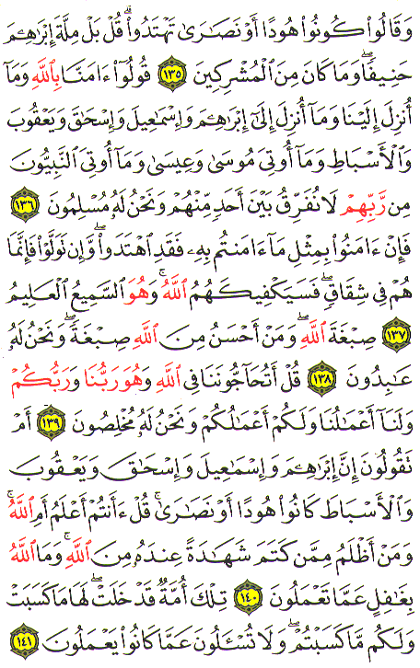
What the Qur’an says about the Injeel
Qur’an 2:146
The people of the Book know this as they know their own sons; but some of them conceal truth, which they themselves know.

Slide 6
What the Qur’an says about the Injeel
Qur’an 2:136
Say ye: "We believe in Allah and the revelation given to us and to Abraham Isma`il Isaac Jacob and the Tribes and that given to Moses and Jesus and that given to (all) Prophets from their Lord we make no difference between one and another of them and we bow to Allah (in Islam)."

Slide 7
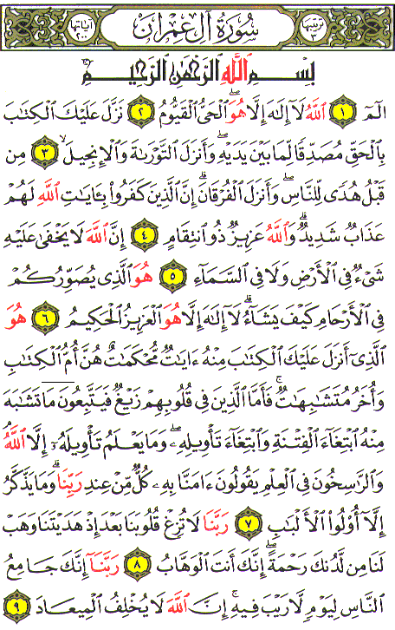
What the Qur’an says about the Injeel
Qur’an 3:2-3
Allah! there is no god but He the Living the Self-Subsisting Eternal. It is He Who sent down to thee (step by step), in truth, the Book, confirming what went before it; and He sent down Law (Of Moses) and the Gospel (of Jesus).

Slide 8
Authenticity of the Injeel
God sent the Tawrat
It was changed
God sent the Zabur
It was changed
God sent the Injeel
It was changed
God sent the Qur’an
God keeps his word

Slide 9
Authenticity of the Injeel
Islamic leaders (Imams) teach:
The Injeel has gone through many versions and the real meaning has been lost.
Christians have changed many stories and deleted any references to Islam and Muhammad.

Slide 10
Authenticity of the Injeel
2 Timothy 2:2
And these things you have heard me say in the presence of many witnesses entrust to reliable men who will also be qualified to teach others.
2 Timothy 3:16-17
All Scripture is God-breathed and is useful for teaching, rebuking, correcting and training in righteousness, so that the man of God may be thoroughly equipped for every good work.

Slide 11
Authenticity of the Injeel
CHRISTIAN PERSPECTIVE:
God inspired the writing of the Injeel.
God will keep His Word to enlighten and judge the human race.
The many versions are merely translations with the same message.
Interested individuals may learn Koine Greek and study the Injeel in the original language.

Slide 12
Authenticity of the Injeel
Respond on three levels
Theological
Logical
Historical
Mark 13:31
Heaven and earth will pass away, but my words will never pass away.

Slide 13
Authenticity of the Injeel
Theological
When Muslims say that the Bible has been corrupted, respond with “AstaghfurAllah!” (God forbid!).
Ask “who is stronger, God or humans?”
If a person believes that the Injeel is corrupted, then he or she believes that humans are stronger than God.

Slide 14
What does the Qur’an say about the Injeel?
Qur’an 3:2-3
Allah! there is no god but He the Living the Self-Subsisting Eternal. It is He Who sent down to thee (step by step), in truth, the Book, confirming what went before it; and He sent down Law (Of Moses) and the Gospel (of Jesus).

Slide 15
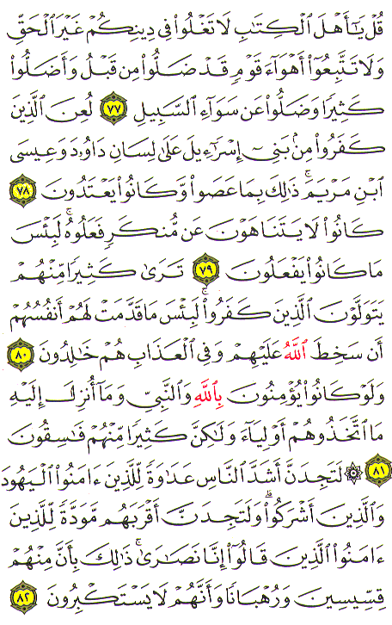
What does the Qur’an say about the Injeel?
Qur’an 2:136
Say ye: "We believe in Allah and the revelation given to us and to Abraham Isma`il Isaac Jacob and the Tribes and that given to Moses and Jesus and that given to (all) Prophets from their Lord we make no difference between one and another of them and we bow to Allah (in Islam)."

Slide 16
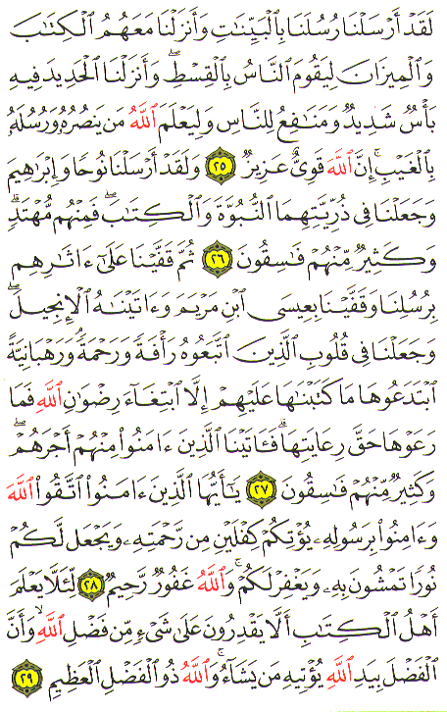
What does the Qur’an say about the Injeel?
Qur’an 57:27
Then in their wake We followed them up with (others of) Our apostles: We sent after them Jesus the son of Mary and bestowed on him the Gospel; and We ordained in the hearts of those who followed him Compassion and Mercy.

Slide 17
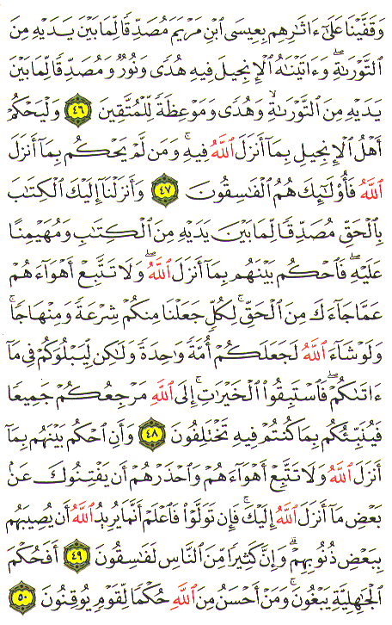
What does the Qur’an say about the Injeel?
Qur’an 5:47
Let the people of the Gospel Judge by what Allah hath revealed therein. If any do fail to judge by (the light of) what Allah hath revealed they are (no better than) those who rebel.

Slide 18
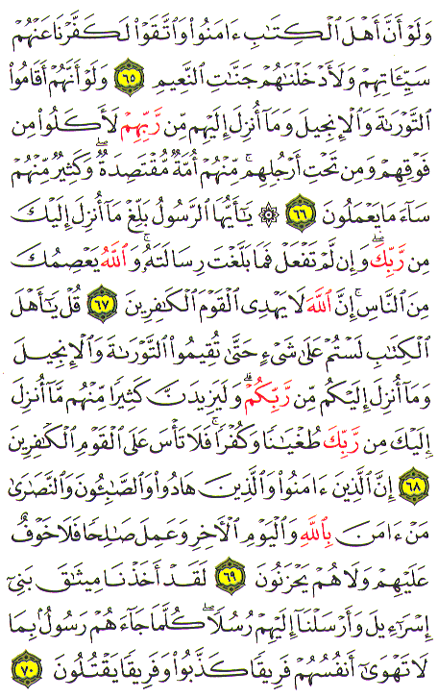
What does the Qur’an say about the Injeel?
Qur’an 5:68
Say: “O People of the Book! ye have no ground to stand upon unless ye stand fast by the Law the Gospel and all the revelation that has come to you from your Lord.”

Slide 19
Authenticity of the Injeel
Logical
These questions must be answered:
Who corrupted the Injeel?
Why was the Injeel corrupted?
Where was the Injeel corrupted?
When was the Injeel corrupted?
Where is the original Injeel?
What parts of the Injeel were corrupted?
Was the Injeel corrupted before or after the life of Muhammad?

Slide 20
Authenticity of the Injeel
Historical Overview
Eyewitness Stage (AD 1-100)
The Persecution Stage (AD 100-325)
The Translation Stage (AD 325-present)
a. EyewitnessStage
b. Persecution Stage
c. Translation Stage

Slide 21
Authenticity of the Injeel
The Eyewitness Stage (AD 1-100)
AD 33 Jesus Christ of Nazareth was crucified and raised from the dead.
AD 100 There are no living eyewitnesses of the life, crucifixion, and resurrection of Jesus.
During this stage, the Injeel was written on papyri in the language of Koine Greek.
These are the days of the Injeel, the disciples, and of Matthew 28:11-15 and Acts 2:1-4

Slide 22
Authenticity of the Injeel
The Persecution Stage (AD 100-325)
The Romans decreed to martyr Christians and burn their books
Partial Manuscripts are found
Writings/letters of church fathers
Lectionaries
Early Translations

Slide 23
Authenticity of the Injeel
The Translation Stage (AD 325-pressent)
AD 325 Codex Sinaiticus
AD 350 Codex Vaticanus
AD 400 Codex Alexandrines

Slide 24
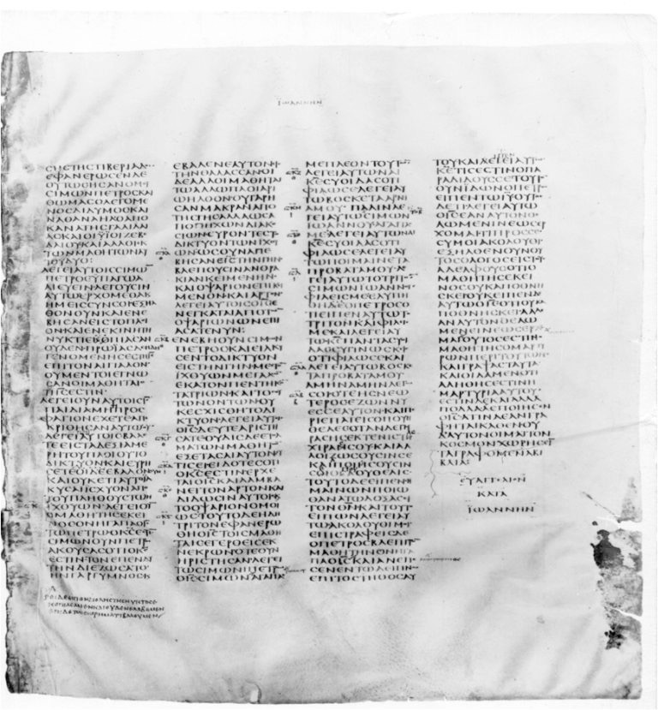
Codex Sinaiticus

Slide 25
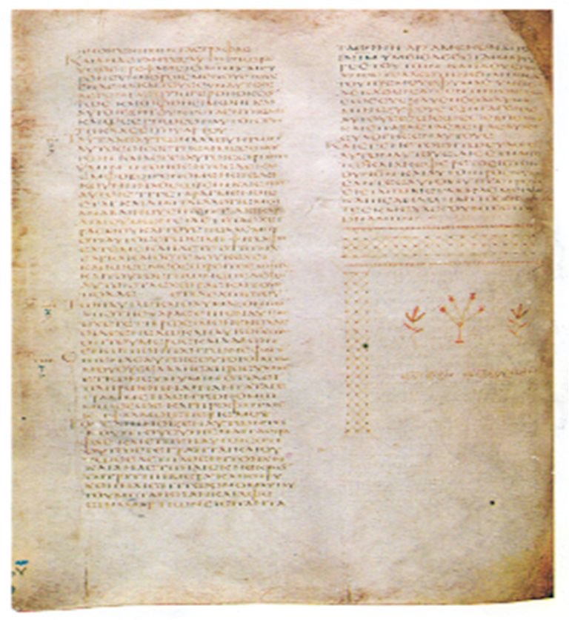

Slide 26
Authenticity of the Injeel
All present day translations go to the Greek manuscripts. The message is one and the meaning is the same.
There are manuscripts available prior to Muhammad’s birth in 570 AD. Muhammad instructed Muslims to believe, and therefore read, the Injeel as part of following Islam.

Slide 28
Authenticity of the Injeel
The Persecution Stage (AD 100-325)
The Romans decreed to martyr Christians and burn their books
Partial Manuscripts are found
Writings/letters of church fathers
Lectionaries
Early Translations

Slide 29
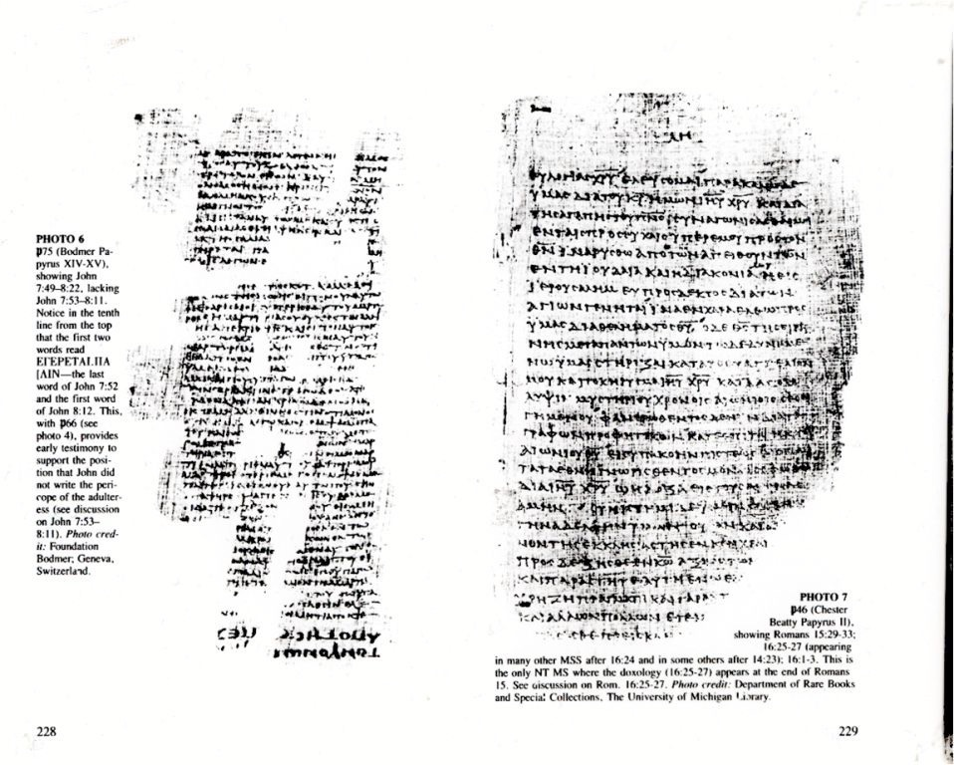

Slide 30
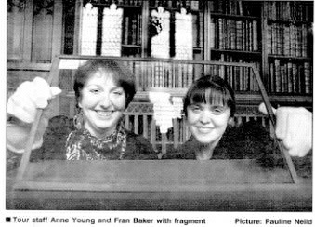

Slide 31
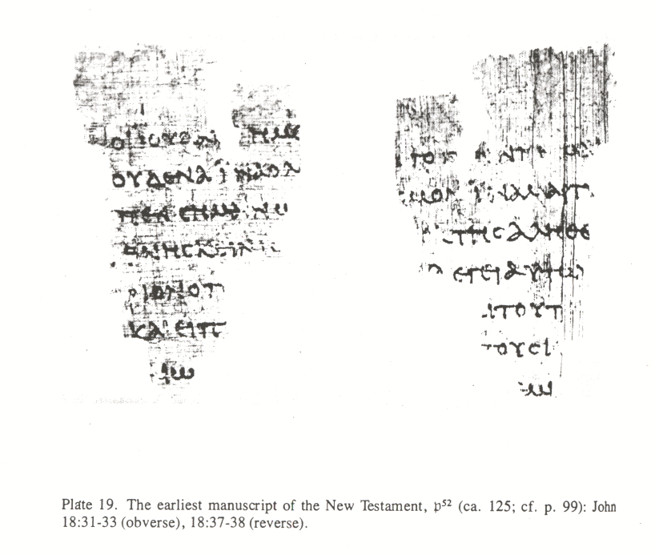

Slide 32
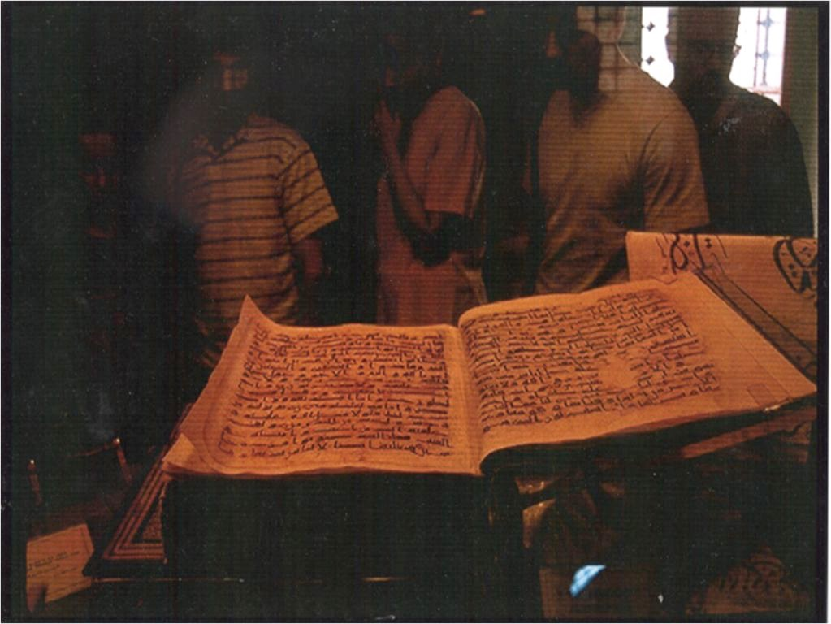

Slide 33
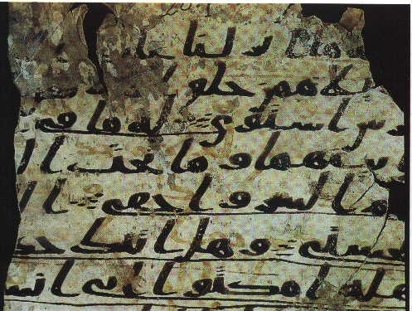

Slide 34
