Slide 2
2 Timothy 4:9-22
Joys and Pains in Paul’s Relationships

Slide 3
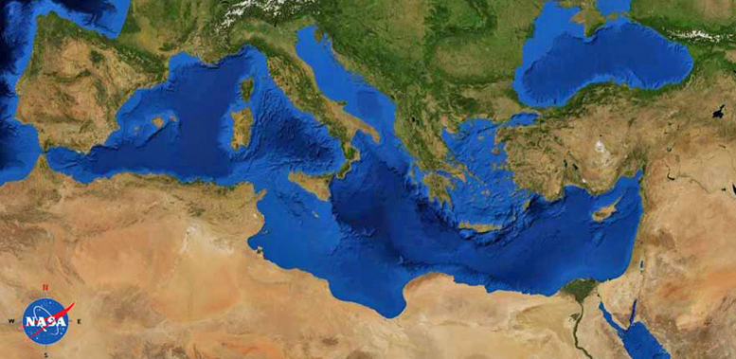
2 Timothy
Paul (Rome)
Timothy (Ephesus)
Paul’s final NT letter (approx. 67 AD) during house arrest.
Written to his best friend and mentee. A letter to strengthen and encourage Timothy in leadership.

Slide 4
CONTEXT
Paul is close to death
^{2 Tim 4:6} For I am already being poured out as a drink offering, and the time of my departure has come. ⁷ I have fought the good fight, I have finished the course, I have kept the faith; ⁸ in the future there is reserved for me the crown of righteousness, which the Lord, the righteous Judge, will award to me on that day; and not only to me, but also to all who have loved His appearing.

Slide 5
Our Passage: final regards
Why is this even in the bible??
God’s word is written though human agency in real-time settings.
People are often surprised by the historical authenticity and veracity in scripture.
Details of relationships can give us insight into spiritual realities, and provides an example.

Slide 6
^{2 Tim 4:9} Make every effort to come to me soon; ¹⁰ for Demas, having loved this present world, has deserted me and gone to Thessalonica; Crescens has gone to Galatia, Titus to Dalmatia. ¹¹ Only Luke is with me. Take along Mark and bring him with you, for he is useful to me for service. ¹² But I have sent Tychicus to Ephesus.

Slide 7
^{2 Tim 4:9} Make every effort to come to me soon; ¹⁰ for Demas, having loved this present world, has deserted me and gone to Thessalonica; Crescens has gone to Galatia, Titus to Dalmatia. ¹¹ Only Luke is with me. Take along Mark and bring him with you, for he is useful to me for service. ¹² But I have sent Tychicus to Ephesus. ¹³ When you come, bring the overcoat which I left at Troas with Carpus, and the books, especially the parchments. ¹⁴ Alexander the coppersmith did me great harm; the Lord will repay him according to his deeds. ¹⁵ Be on guard against him yourself too, for he vigorously opposed our teaching.

Slide 8
^{2 Tim 4:16} At my first defense no one supported me, but all deserted me; may it not be counted against them. ¹⁷ But the Lord stood with me and strengthened me, so that through me the proclamation might be fully accomplished, and that all the Gentiles might hear; and I was rescued out of the lion’s mouth.

Slide 9
^{2 Tim 4:16} At my first defense no one supported me, but all deserted me; may it not be counted against them. ¹⁷ But the Lord stood with me and strengthened me, so that through me the proclamation might be fully accomplished, and that all the Gentiles might hear; and I was rescued out of the lion’s mouth. ¹⁸ The Lord will rescue me from every evil deed, and will bring me safely to His heavenly kingdom; to Him be the glory forever and ever. Amen.
¹⁹ Greet Prisca and Aquila, and the household of Onesiphorus. ²⁰ Erastus remained at Corinth, but I left Trophimus sick at Miletus. ²¹ Make every effort to come before winter. Eubulus greets you, also Pudens, Linus, Claudia, and all the brothers and sisters.
²² The Lord be with your spirit. Grace be with you.

Slide 10
Paul’s Relationship Joys and Pains
Negatives
“make every effort to come see me soon”
“Demas, having loved this present world”
“Alexander the coppersmith did me great harm”
“no one supported me”
“I left Trophimus sick in Miletus”

Slide 11
Paul’s Relationship Joys and Pains
Have you ever been...
Separated by distance from a loved one?
Deserted while on mission? Had trust broken by someone close?
Betrayed or hated when doing no wrong? Or had a wolf in sheep's clothing hurting your loved ones?
Friend/s who don’t stand by you when times get tough?
Separated by sickness or death?
Negatives
“make every effort to come see me soon”
“Demas, having loved this present world”
“Alexander the coppersmith did me great harm”
“no one supported me”
“I left Trophimus sick in Miletus”

Slide 12
Paul’s Relationship Joys and Pains
Positives
Negatives
“bring along Mark, he is useful to me”
“Luke, Titus…Prisca, Aquilla, Claudia”
“All the brothers and sisters”
“Make every effort to come see me soon” (Timothy)
Have you experienced...
Redemption and second chances
Long time compadres who know what you’ve gone through
Unity and Love in God’s family
A mentor or mentee who becomes a best friend and compadre.
“make every effort to come see me soon”
“Demas, having loved this present world”
“Alexander the coppersmith did me great harm”
“no one supported me”
“I left Trophimus sick in Miletus”

Slide 13
What formed and sustained Paul’s drive to be a so invested in people?
Jesus loves Paul
Jesus forgave Paul the persecutor
Jesus called Paul to proclaim the gospel to the Gentiles
Jesus is always with Paul
Jesus gave Paul sufficient grace
PAUL was close to Jesus
^{2 Tim 4:17} But the Lord stood with me and strengthened me, so that through me the proclamation might be fully accomplished, and that all the Gentiles might hear; and I was rescued out of the lion’s mouth. ¹⁸ The Lord will rescue me from every evil deed, and will bring me safely to His heavenly kingdom; to Him be the glory forever and ever. Amen.

Slide 14
Paul was close to Jesus
Galatians 2:20
I have been crucified with Christ and I no longer live, but Christ lives in me. The life I now live in the body, I live by faith in the Son of God, who loved me and gave himself for me.

Slide 15
Paul was close to Jesus
Philippians 1:22-23
If I am to go on living in the body, this will mean fruitful labor for me. Yet what shall I choose? I do not know! I am torn between the two: I desire to depart and be with Christ, which is better by far;

Slide 16
Paul was close to Jesus
Philippians 3:7-8
But whatever were gains to me I now consider loss for the sake of Christ. What is more, I consider everything a loss because of the surpassing worth of knowing Christ Jesus my Lord, for whose sake I have lost all things.

Slide 17
Paul was close to Jesus
1 Corinthians 9
(19) Though I am free and belong to no one, I have made myself a slave to everyone, to win as many as possible…. (22)I have become all things to all people so that by all possible means I might save some. I do all this for the sake of the gospel, that I may share in its blessings.

Slide 18
Attitudes in Ministry and Long-term Relationships
Self
Selfless
“I just want to play it safe with a few close friends, I am tired of the difficulty”
“You have been faithful to me, and I am willing to move towards others outside my tribe, counting on you to bring me joy and peace”

Slide 19
Attitudes in Ministry and Long-term Relationships
Self
Selfless
“I am KEEPING my spiritual comrades as close as possible for as long as possible”
“I am willing to cooperate in SENDING good people to bless others, even if it’s loss or risk to me”

Slide 20
Attitudes in Ministry and Long-term Relationships
Self
Selfless
“Some brothers and sisters just annoy me… I don’t HAVE to be friends with everyone”
“I can be REAL, GENUINE, and CARING towards all God’s church, and some I don’t naturally click may become dear”

Slide 21
Attitudes in Ministry and Long-term Relationships
Self
Selfless
“I am the mature one, I teach and counsel others…I don’t need anyone's help”
“People don’t have to be spiritual ‘superstars’ to be a blessing”

Slide 22
Attitudes in Ministry and Long-term Relationships
(for spiritual leaders)
Self
Selfless
“I don’t get the benefit of the doubt, and people expect too much”
“You need to be graceful and give others the benefit of the doubt, especially good people who are trying and make mistakes”

Slide 23
Key’s to Longevity
“Alexander the coppersmith did me great harm; the Lord will repay him according to his deeds. Be on guard against him yourself too, for he vigorously opposed our teaching.”
1) Living without bitterness:
Some offenses may require discipline, boundaries, and protection.
Without God, revenge could be reasonable.
We don’t have to see eye to eye on everything. Perfectionism kills love.
Value good players and seek to their praise and reward!
“Mark is useful to me”
“May it not be counted against them”

Slide 24
Key’s to Longevity
“Alexander did me great harm”
“Demas loved this world”
“No one stood by me”
Living without bitterness
Understanding human nature
Essentially Good?
Fallen?
HUMAN NATURE
Fundamentally broken, Utterly sinful, Yet of incredible value to God…
To believe human nature is “essentially good” is to set ourselves up for disappointment.

Slide 25
Key’s to Longevity
Living without bitterness
Understanding Human Nature
Staying close to Jesus
Results
A joyful last days of life.
The continuing flow of gospel life for generations.

