Slide 1
Acts
The Church in Jerusalem
Acts 3 & 4: Spiritual Confidence
teachings available at www.centralteachings.com

Slide 2
Acts
The Church in Jerusalem
Last week: we met “the church”

Slide 3
^{Acts 3:1} Now Peter and John were going up to the temple at the ninth hour, the hour of prayer.
^{Acts 3:1} Now Peter and John were going up to the temple at the ninth hour, the hour of prayer.
Last week: we met “the church”

Slide 4
^{Acts 3:2} And a man who had been lame from his mother’s womb was being carried along, whom they used to set down every day at the gate of the temple which is called Beautiful, in order to beg alms of those who were entering the temple.
^{Acts 3:2} And a man who had been lame from his mother’s womb was being carried along, whom they used to set down every day at the gate of the temple which is called Beautiful, in order to beg alms of those who were entering the temple.
^{Acts 3:2} And a man who had been lame from his mother’s womb was being carried along, whom they used to set down every day at the gate of the temple which is called Beautiful, in order to beg alms of those who were entering the temple.
Last week: we met “the church”

Slide 5
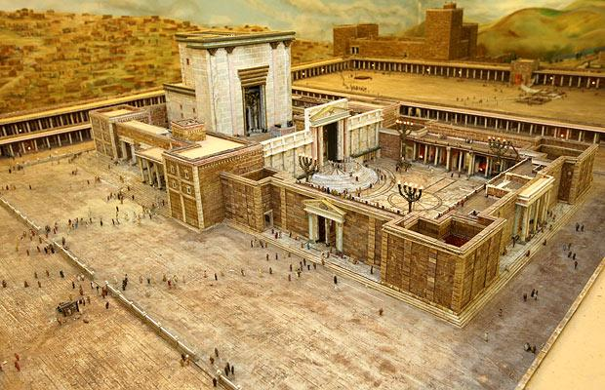
^{Acts 3:2} And a man who had been lame from his mother’s womb was being carried along, whom they used to set down every day at the gate of the temple which is called Beautiful, in order to beg alms of those who were entering the temple.
^{Acts 3:2} And a man who had been lame from his mother’s womb was being carried along, whom they used to set down every day at the gate of the temple which is called Beautiful, in order to beg alms of those who were entering the temple.
^{Acts 3:2} And a man who had been lame from his mother’s womb was being carried along, whom they used to set down every day at the gate of the temple which is called Beautiful, in order to beg alms of those who were entering the temple.
^{Acts 3:2} And a man who had been lame from his mother’s womb was being carried along, whom they used to set down every day at the gate of the temple which is called Beautiful, in order to beg alms of those who were entering the temple.
^{Acts 3:2} And a man who had been lame from his mother’s womb was being carried along, whom they used to set down every day at the gate of the temple which is called Beautiful, in order to beg alms of those who were entering the temple.
Last week: we met “the church”

Slide 6
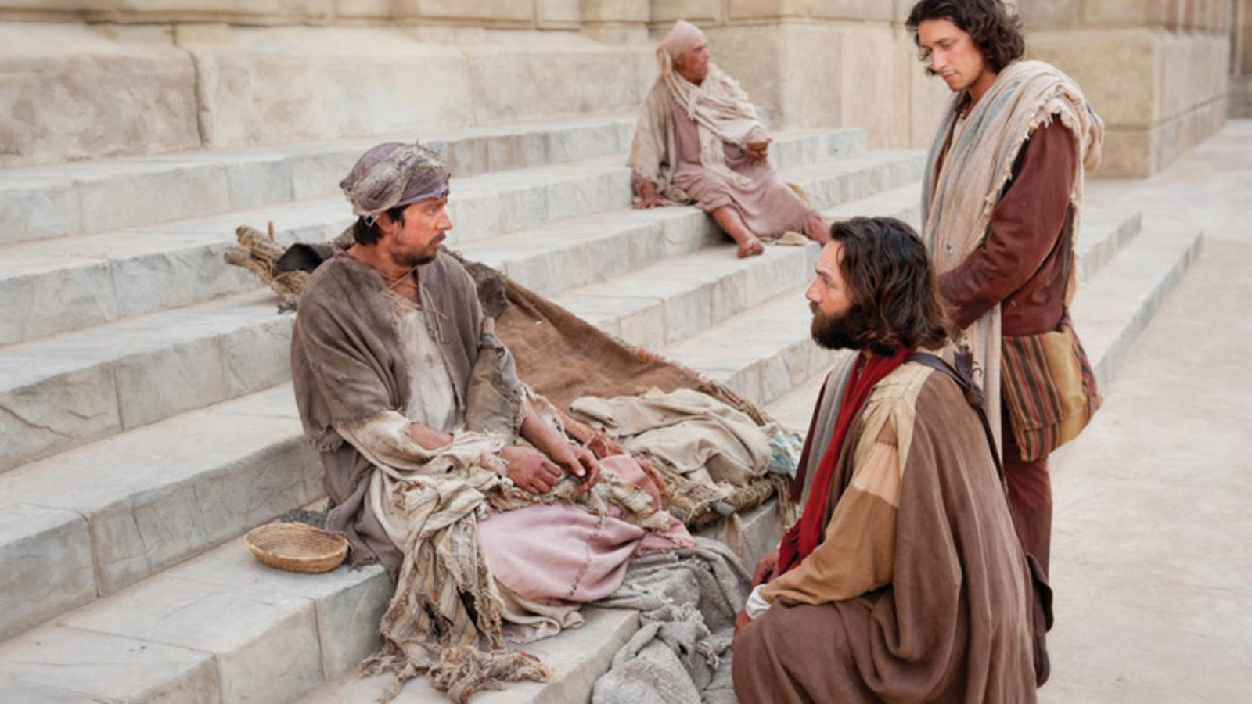
^{Acts 3:3} When he saw Peter and John about to go into the temple, he began asking to receive alms. ⁴ But Peter, along with John, fixed his gaze on him and said, “Look at us!” ⁵ And he began to give them his attention, expecting to receive something from them.
Last week: we met “the church”

Slide 7
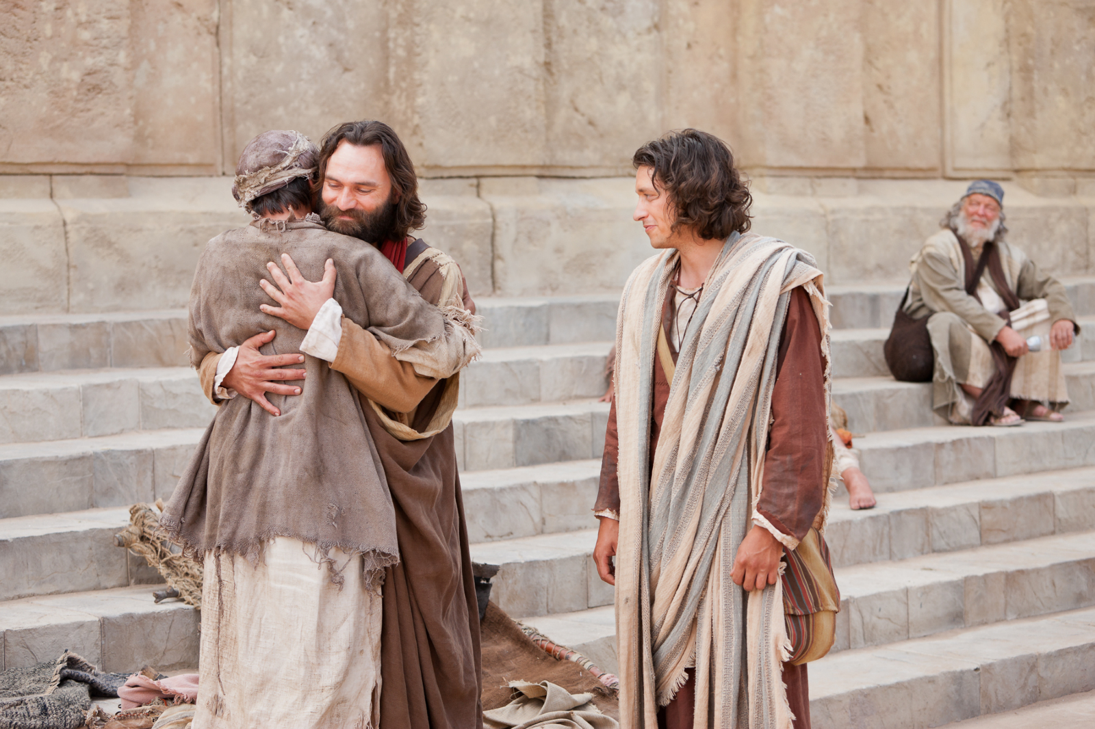
^{Acts 3:6} But Peter said, “I do not possess silver and gold, but what I do have I give to you: In the name of Jesus Christ the Nazarene—walk!” ⁷ And seizing him by the right hand, he raised him up; and immediately his feet and his ankles were strengthened.
Last week: we met “the church”

Slide 8
^{Acts 3:8} With a leap he stood upright and began to walk; and he entered the temple with them, walking and leaping and praising God.
Last week: we met “the church”

Slide 9
^{Acts 3:9} And all the people saw him walking and praising God; ¹⁰ and they were taking note of him as being the one who used to sit at the Beautiful Gate of the temple to beg alms, and they were filled with wonder and amazement at what had happened to him.
^{Acts 3:9} And all the people saw him walking and praising God; ¹⁰ and they were taking note of him as being the one who used to sit at the Beautiful Gate of the temple to beg alms, and they were filled with wonder and amazement at what had happened to him.
Last week: we met “the church”

Slide 10
God is demonstrating His power
^{Acts 3:9} And all the people saw him walking and praising God; ¹⁰ and they were taking note of him as being the one who used to sit at the Beautiful Gate of the temple to beg alms, and they were filled with wonder and amazement at what had happened to him.
^{Acts 3:9} And all the people saw him walking and praising God; ¹⁰ and they were taking note of him as being the one who used to sit at the Beautiful Gate of the temple to beg alms, and they were filled with wonder and amazement at what had happened to him.
Last week: we met “the church”

Slide 11
God is verifying the authority of the Apostles
^{Acts 3:9} And all the people saw him walking and praising God; ¹⁰ and they were taking note of him as being the one who used to sit at the Beautiful Gate of the temple to beg alms, and they were filled with wonder and amazement at what had happened to him.
^{Acts 3:9} And all the people saw him walking and praising God; ¹⁰ and they were taking note of him as being the one who used to sit at the Beautiful Gate of the temple to beg alms, and they were filled with wonder and amazement at what had happened to him.
Last week: we met “the church”

Slide 12
God is authenticating the Apostles’ message
^{Acts 3:9} And all the people saw him walking and praising God; ¹⁰ and they were taking note of him as being the one who used to sit at the Beautiful Gate of the temple to beg alms, and they were filled with wonder and amazement at what had happened to him.
^{Acts 3:9} And all the people saw him walking and praising God; ¹⁰ and they were taking note of him as being the one who used to sit at the Beautiful Gate of the temple to beg alms, and they were filled with wonder and amazement at what had happened to him.
Last week: we met “the church”

Slide 13
God is authenticating the Apostles’ message
their message is news
^{Acts 3:9} And all the people saw him walking and praising God; ¹⁰ and they were taking note of him as being the one who used to sit at the Beautiful Gate of the temple to beg alms, and they were filled with wonder and amazement at what had happened to him.
^{Acts 3:9} And all the people saw him walking and praising God; ¹⁰ and they were taking note of him as being the one who used to sit at the Beautiful Gate of the temple to beg alms, and they were filled with wonder and amazement at what had happened to him.
Last week: we met “the church”

Slide 14
God is authenticating the Apostles’ message
their message is news
God can work miracles anytime
^{Acts 3:9} And all the people saw him walking and praising God; ¹⁰ and they were taking note of him as being the one who used to sit at the Beautiful Gate of the temple to beg alms, and they were filled with wonder and amazement at what had happened to him.
^{Acts 3:9} And all the people saw him walking and praising God; ¹⁰ and they were taking note of him as being the one who used to sit at the Beautiful Gate of the temple to beg alms, and they were filled with wonder and amazement at what had happened to him.
Last week: we met “the church”

Slide 15
God is authenticating the Apostles’ message
their message is news
God can work miracles anytime
But in the bible, what we see are clusters of miraculous signs, usually concentrated around the introduction of new phases in God’s plan.
^{Acts 3:9} And all the people saw him walking and praising God; ¹⁰ and they were taking note of him as being the one who used to sit at the Beautiful Gate of the temple to beg alms, and they were filled with wonder and amazement at what had happened to him.
^{Acts 3:9} And all the people saw him walking and praising God; ¹⁰ and they were taking note of him as being the one who used to sit at the Beautiful Gate of the temple to beg alms, and they were filled with wonder and amazement at what had happened to him.
Last week: we met “the church”

Slide 16
God is authenticating the Apostles’ message
their message is news
God can work miracles anytime
^{Acts 5:14} At the hands of the apostles many signs and wonders were taking place among the people... ¹⁵ to such an extent that they even carried the sick out into the streets and laid them on cots and pallets, so that when Peter came by at least his shadow might fall on any one of them. ¹⁶ Also the people from the cities in the vicinity of Jerusalem were coming together, bringing people who were sick or afflicted with unclean spirits, and they were all being healed.
But in the bible, what we see are clusters of miraculous signs, usually concentrated around the introduction of new phases in God’s plan.

Slide 17
God is authenticating the Apostles’ message
their message is news
God can work miracles anytime
^{Acts 5:14} At the hands of the apostles many signs and wonders were taking place among the people... ¹⁵ to such an extent that they even carried the sick out into the streets and laid them on cots and pallets, so that when Peter came by at least his shadow might fall on any one of them. ¹⁶ Also the people from the cities in the vicinity of Jerusalem were coming together, bringing people who were sick or afflicted with unclean spirits, and they were all being healed.
But in the bible, what we see are clusters of miraculous signs, usually concentrated around the introduction of new phases in God’s plan.
So on the one hand we shouldn’t be cynical about miracles

Slide 18
God is authenticating the Apostles’ message
their message is news
God can work miracles anytime
^{Acts 5:14} At the hands of the apostles many signs and wonders were taking place among the people... ¹⁵ to such an extent that they even carried the sick out into the streets and laid them on cots and pallets, so that when Peter came by at least his shadow might fall on any one of them. ¹⁶ Also the people from the cities in the vicinity of Jerusalem were coming together, bringing people who were sick or afflicted with unclean spirits, and they were all being healed.
But in the bible, what we see are clusters of miraculous signs, usually concentrated around the introduction of new phases in God’s plan.
So on the one hand we shouldn’t be cynical about miracles
But on the other hand we shouldn’t have an expectation on God that miracles are a normative part of the Christian life

Slide 19
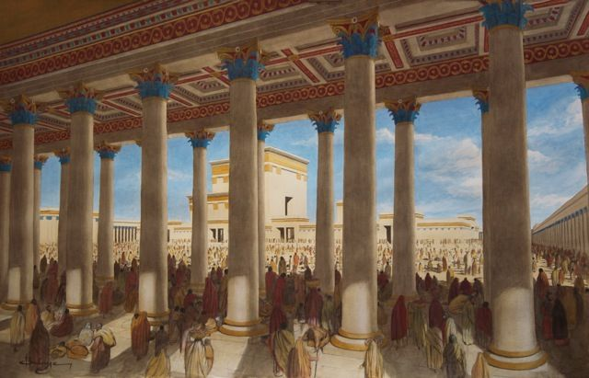
^{Acts 3:11} While he was clinging to Peter and John, all the people ran together to them at the so-called portico of Solomon, full of amazement. ¹² But when Peter saw this, he replied to the people,
^{Acts 3:11} While he was clinging to Peter and John, all the people ran together to them at the so-called portico of Solomon, full of amazement. ¹² But when Peter saw this, he replied to the people,
Last week: we met “the church”

Slide 20
^{Acts 3:12} “Men of Israel, why are you amazed at this, or why do you gaze at us, as if by our own power or piety we had made him walk? ¹³ The God of Abraham, Isaac and Jacob, the God of our fathers, has glorified His servant Jesus, the one whom you delivered and
^{Acts 3:12} “Men of Israel, why are you amazed at this, or why do you gaze at us, as if by our own power or piety we had made him walk? ¹³ The God of Abraham, Isaac and Jacob, the God of our fathers, has glorified His servant Jesus, the one whom you delivered and
^{Acts 3:11} While he was clinging to Peter and John, all the people ran together to them at the so-called portico of Solomon, full of amazement. ¹² But when Peter saw this, he replied to the people,
Last week: we met “the church”

Slide 21
disowned in the presence of Pilate, when he had decided to release Him. ¹⁴ But you disowned the Holy and Righteous One and asked for a murderer to be granted to you, ¹⁵ but put to death the Prince of life, the one whom God raised from the dead, a fact to which we are witnesses.
^{Acts 3:11} While he was clinging to Peter and John, all the people ran together to them at the so-called portico of Solomon, full of amazement. ¹² But when Peter saw this, he replied to the people,
Last week: we met “the church”

Slide 22
1) The Bad News
disowned in the presence of Pilate, when he had decided to release Him. ¹⁴ But you disowned the Holy and Righteous One and asked for a murderer to be granted to you, ¹⁵ but put to death the Prince of life, the one whom God raised from the dead, a fact to which we are witnesses.
^{Acts 3:11} While he was clinging to Peter and John, all the people ran together to them at the so-called portico of Solomon, full of amazement. ¹² But when Peter saw this, he replied to the people,
Last week: we met “the church”

Slide 23
1) The Bad News
^{Acts 3:16} And on the basis of faith in His name, it is the name of Jesus which has strengthened this man whom you see and know; and the faith which comes through Him has given him this perfect health in the presence of you all.
Last week: we met “the church”

Slide 24
1) The Bad News
^{Acts 3:17} “And now, brethren, I know that you acted in ignorance, just as your rulers did also. ¹⁸ But the things which God announced beforehand by the mouth of all the prophets, that His Christ would suffer, He has thus fulfilled.
Last week: we met “the church”

Slide 25
1) The Bad News
2) Evidence
^{Acts 3:17} “And now, brethren, I know that you acted in ignorance, just as your rulers did also. ¹⁸ But the things which God announced beforehand by the mouth of all the prophets, that His Christ would suffer, He has thus fulfilled.
Last week: we met “the church”

Slide 26
2) Evidence
^{Acts 3:19} Therefore repent and return, so that your sins may be wiped away, in order that times of refreshing may come from the presence of the Lord; ²⁰ and that He may send Jesus, the Christ appointed for you, ²¹ whom heaven must receive until the period of restoration of all things about which God spoke by the mouth of His holy prophets from ancient time.
^{Acts 3:19} Therefore repent and return, so that your sins may be wiped away, in order that times of refreshing may come from the presence of the Lord; ²⁰ and that He may send Jesus, the Christ appointed for you, ²¹ whom heaven must receive until the period of restoration of all things about which God spoke by the mouth of His holy prophets from ancient time.
^{Acts 3:19} Therefore repent and return, so that your sins may be wiped away, in order that times of refreshing may come from the presence of the Lord; ²⁰ and that He may send Jesus, the Christ appointed for you, ²¹ whom heaven must receive until the period of restoration of all things about which God spoke by the mouth of His holy prophets from ancient time.
^{Acts 3:19} Therefore repent and return, so that your sins may be wiped away, in order that times of refreshing may come from the presence of the Lord; ²⁰ and that He may send Jesus, the Christ appointed for you, ²¹ whom heaven must receive until the period of restoration of all things about which God spoke by the mouth of His holy prophets from ancient time.
Last week: we met “the church”

Slide 27
3) Good News
2) Evidence
^{Acts 3:19} Therefore repent and return, so that your sins may be wiped away, in order that times of refreshing may come from the presence of the Lord; ²⁰ and that He may send Jesus, the Christ appointed for you, ²¹ whom heaven must receive until the period of restoration of all things about which God spoke by the mouth of His holy prophets from ancient time.
^{Acts 3:19} Therefore repent and return, so that your sins may be wiped away, in order that times of refreshing may come from the presence of the Lord; ²⁰ and that He may send Jesus, the Christ appointed for you, ²¹ whom heaven must receive until the period of restoration of all things about which God spoke by the mouth of His holy prophets from ancient time.
^{Acts 3:19} Therefore repent and return, so that your sins may be wiped away, in order that times of refreshing may come from the presence of the Lord; ²⁰ and that He may send Jesus, the Christ appointed for you, ²¹ whom heaven must receive until the period of restoration of all things about which God spoke by the mouth of His holy prophets from ancient time.
^{Acts 3:19} Therefore repent and return, so that your sins may be wiped away, in order that times of refreshing may come from the presence of the Lord; ²⁰ and that He may send Jesus, the Christ appointed for you, ²¹ whom heaven must receive until the period of restoration of all things about which God spoke by the mouth of His holy prophets from ancient time.
Last week: we met “the church”

Slide 28
3) Good News
2) Evidence
An invitation
^{Acts 3:19} Therefore repent and return, so that your sins may be wiped away, in order that times of refreshing may come from the presence of the Lord; ²⁰ and that He may send Jesus, the Christ appointed for you, ²¹ whom heaven must receive until the period of restoration of all things about which God spoke by the mouth of His holy prophets from ancient time.
^{Acts 3:19} Therefore repent and return, so that your sins may be wiped away, in order that times of refreshing may come from the presence of the Lord; ²⁰ and that He may send Jesus, the Christ appointed for you, ²¹ whom heaven must receive until the period of restoration of all things about which God spoke by the mouth of His holy prophets from ancient time.
^{Acts 3:19} Therefore repent and return, so that your sins may be wiped away, in order that times of refreshing may come from the presence of the Lord; ²⁰ and that He may send Jesus, the Christ appointed for you, ²¹ whom heaven must receive until the period of restoration of all things about which God spoke by the mouth of His holy prophets from ancient time.
^{Acts 3:19} Therefore repent and return, so that your sins may be wiped away, in order that times of refreshing may come from the presence of the Lord; ²⁰ and that He may send Jesus, the Christ appointed for you, ²¹ whom heaven must receive until the period of restoration of all things about which God spoke by the mouth of His holy prophets from ancient time.
Last week: we met “the church”

Slide 29
3) Good News
2) Evidence
An invitation
With promised blessings
^{Acts 3:19} Therefore repent and return, so that your sins may be wiped away, in order that times of refreshing may come from the presence of the Lord; ²⁰ and that He may send Jesus, the Christ appointed for you, ²¹ whom heaven must receive until the period of restoration of all things about which God spoke by the mouth of His holy prophets from ancient time.
^{Acts 3:19} Therefore repent and return, so that your sins may be wiped away, in order that times of refreshing may come from the presence of the Lord; ²⁰ and that He may send Jesus, the Christ appointed for you, ²¹ whom heaven must receive until the period of restoration of all things about which God spoke by the mouth of His holy prophets from ancient time.
^{Acts 3:19} Therefore repent and return, so that your sins may be wiped away, in order that times of refreshing may come from the presence of the Lord; ²⁰ and that He may send Jesus, the Christ appointed for you, ²¹ whom heaven must receive until the period of restoration of all things about which God spoke by the mouth of His holy prophets from ancient time.
^{Acts 3:19} Therefore repent and return, so that your sins may be wiped away, in order that times of refreshing may come from the presence of the Lord; ²⁰ and that He may send Jesus, the Christ appointed for you, ²¹ whom heaven must receive until the period of restoration of all things about which God spoke by the mouth of His holy prophets from ancient time.
Last week: we met “the church”

Slide 30
3) Good News
2) Evidence
An invitation
With promised blessings
Exaleiph: “to obliterate, erase, or blot out.”
^{Acts 3:19} Therefore repent and return, so that your sins may be wiped away, in order that times of refreshing may come from the presence of the Lord; ²⁰ and that He may send Jesus, the Christ appointed for you, ²¹ whom heaven must receive until the period of restoration of all things about which God spoke by the mouth of His holy prophets from ancient time.
^{Acts 3:19} Therefore repent and return, so that your sins may be wiped away, in order that times of refreshing may come from the presence of the Lord; ²⁰ and that He may send Jesus, the Christ appointed for you, ²¹ whom heaven must receive until the period of restoration of all things about which God spoke by the mouth of His holy prophets from ancient time.
^{Acts 3:19} Therefore repent and return, so that your sins may be wiped away, in order that times of refreshing may come from the presence of the Lord; ²⁰ and that He may send Jesus, the Christ appointed for you, ²¹ whom heaven must receive until the period of restoration of all things about which God spoke by the mouth of His holy prophets from ancient time.
^{Acts 3:19} Therefore repent and return, so that your sins may be wiped away, in order that times of refreshing may come from the presence of the Lord; ²⁰ and that He may send Jesus, the Christ appointed for you, ²¹ whom heaven must receive until the period of restoration of all things about which God spoke by the mouth of His holy prophets from ancient time.
Last week: we met “the church”

Slide 31
3) Good News
2) Evidence
An invitation
With promised blessings
Anapsuxis: “reviving of the soul.”
^{Acts 3:19} Therefore repent and return, so that your sins may be wiped away, in order that times of refreshing may come from the presence of the Lord; ²⁰ and that He may send Jesus, the Christ appointed for you, ²¹ whom heaven must receive until the period of restoration of all things about which God spoke by the mouth of His holy prophets from ancient time.
^{Acts 3:19} Therefore repent and return, so that your sins may be wiped away, in order that times of refreshing may come from the presence of the Lord; ²⁰ and that He may send Jesus, the Christ appointed for you, ²¹ whom heaven must receive until the period of restoration of all things about which God spoke by the mouth of His holy prophets from ancient time.
^{Acts 3:19} Therefore repent and return, so that your sins may be wiped away, in order that times of refreshing may come from the presence of the Lord; ²⁰ and that He may send Jesus, the Christ appointed for you, ²¹ whom heaven must receive until the period of restoration of all things about which God spoke by the mouth of His holy prophets from ancient time.
^{Acts 3:19} Therefore repent and return, so that your sins may be wiped away, in order that times of refreshing may come from the presence of the Lord; ²⁰ and that He may send Jesus, the Christ appointed for you, ²¹ whom heaven must receive until the period of restoration of all things about which God spoke by the mouth of His holy prophets from ancient time.
^{Acts 3:19} Therefore repent and return, so that your sins may be wiped away, in order that times of refreshing may come from the presence of the Lord; ²⁰ and that He may send Jesus, the Christ appointed for you, ²¹ whom heaven must receive until the period of restoration of all things about which God spoke by the mouth of His holy prophets from ancient time.
Last week: we met “the church”

Slide 32
3) Good News
2) Evidence
An invitation
With promised blessings
^{Acts 3:19} Therefore repent and return, so that your sins may be wiped away, in order that times of refreshing may come from the presence of the Lord; ²⁰ and that He may send Jesus, the Christ appointed for you, ²¹ whom heaven must receive until the period of restoration of all things about which God spoke by the mouth of His holy prophets from ancient time.
^{Acts 3:19} Therefore repent and return, so that your sins may be wiped away, in order that times of refreshing may come from the presence of the Lord; ²⁰ and that He may send Jesus, the Christ appointed for you, ²¹ whom heaven must receive until the period of restoration of all things about which God spoke by the mouth of His holy prophets from ancient time.
^{Acts 3:19} Therefore repent and return, so that your sins may be wiped away, in order that times of refreshing may come from the presence of the Lord; ²⁰ and that He may send Jesus, the Christ appointed for you, ²¹ whom heaven must receive until the period of restoration of all things about which God spoke by the mouth of His holy prophets from ancient time.
^{Acts 3:19} Therefore repent and return, so that your sins may be wiped away, in order that times of refreshing may come from the presence of the Lord; ²⁰ and that He may send Jesus, the Christ appointed for you, ²¹ whom heaven must receive until the period of restoration of all things about which God spoke by the mouth of His holy prophets from ancient time.
^{Acts 3:19} Therefore repent and return, so that your sins may be wiped away, in order that times of refreshing may come from the presence of the Lord; ²⁰ and that He may send Jesus, the Christ appointed for you, ²¹ whom heaven must receive until the period of restoration of all things about which God spoke by the mouth of His holy prophets from ancient time.
^{Acts 3:19} Therefore repent and return, so that your sins may be wiped away, in order that times of refreshing may come from the presence of the Lord; ²⁰ and that He may send Jesus, the Christ appointed for you, ²¹ whom heaven must receive until the period of restoration of all things about which God spoke by the mouth of His holy prophets from ancient time.
Last week: we met “the church”

Slide 33
3) Good News
2) Evidence
An invitation
With promised blessings
The invitation stands today!
^{Acts 3:19} Therefore repent and return, so that your sins may be wiped away, in order that times of refreshing may come from the presence of the Lord; ²⁰ and that He may send Jesus, the Christ appointed for you, ²¹ whom heaven must receive until the period of restoration of all things about which God spoke by the mouth of His holy prophets from ancient time.
^{Acts 3:19} Therefore repent and return, so that your sins may be wiped away, in order that times of refreshing may come from the presence of the Lord; ²⁰ and that He may send Jesus, the Christ appointed for you, ²¹ whom heaven must receive until the period of restoration of all things about which God spoke by the mouth of His holy prophets from ancient time.
^{Acts 3:19} Therefore repent and return, so that your sins may be wiped away, in order that times of refreshing may come from the presence of the Lord; ²⁰ and that He may send Jesus, the Christ appointed for you, ²¹ whom heaven must receive until the period of restoration of all things about which God spoke by the mouth of His holy prophets from ancient time.
^{Acts 3:19} Therefore repent and return, so that your sins may be wiped away, in order that times of refreshing may come from the presence of the Lord; ²⁰ and that He may send Jesus, the Christ appointed for you, ²¹ whom heaven must receive until the period of restoration of all things about which God spoke by the mouth of His holy prophets from ancient time.
^{Acts 3:19} Therefore repent and return, so that your sins may be wiped away, in order that times of refreshing may come from the presence of the Lord; ²⁰ and that He may send Jesus, the Christ appointed for you, ²¹ whom heaven must receive until the period of restoration of all things about which God spoke by the mouth of His holy prophets from ancient time.
^{Acts 3:19} Therefore repent and return, so that your sins may be wiped away, in order that times of refreshing may come from the presence of the Lord; ²⁰ and that He may send Jesus, the Christ appointed for you, ²¹ whom heaven must receive until the period of restoration of all things about which God spoke by the mouth of His holy prophets from ancient time.
Last week: we met “the church”

Slide 34
^{Acts 4:1} As they were speaking to the people, the priests and the captain of the temple guard and the Sadducees came up to them, ² being greatly disturbed because they were teaching the people and proclaiming in Jesus the resurrection from the dead.

Slide 35
Uh Oh…
^{Acts 4:1} As they were speaking to the people, the priests and the captain of the temple guard and the Sadducees came up to them, ² being greatly disturbed because they were teaching the people and proclaiming in Jesus the resurrection from the dead.

Slide 36
Uh Oh…
^{Acts 4:1} As they were speaking to the people, the priests and the captain of the temple guard and the Sadducees came up to them, ² being greatly disturbed because they were teaching the people and proclaiming in Jesus the resurrection from the dead.
^{Acts 4:1} As they were speaking to the people, the priests and the captain of the temple guard and the Sadducees came up to them, ² being greatly disturbed because they were teaching the people and proclaiming in Jesus the resurrection from the dead.
^{Acts 4:1} As they were speaking to the people, the priests and the captain of the temple guard and the Sadducees came up to them, ² being greatly disturbed because they were teaching the people and proclaiming in Jesus the resurrection from the dead.
^{Acts 4:1} As they were speaking to the people, the priests and the captain of the temple guard and the Sadducees came up to them, ² being greatly disturbed because they were teaching the people and proclaiming in Jesus the resurrection from the dead.
^{Acts 4:1} As they were speaking to the people, the priests and the captain of the temple guard and the Sadducees came up to them, ² being greatly disturbed because they were teaching the people and proclaiming in Jesus the resurrection from the dead.

Slide 37
^{Acts 4:3} And they laid hands on them and put them in jail until the next day, for it was already evening. ⁴ But many of those who had heard the message believed; and the number of the men came to be about five thousand.
^{Acts 4:3} And they laid hands on them and put them in jail until the next day, for it was already evening. ⁴ But many of those who had heard the message believed; and the number of the men came to be about five thousand.

Slide 38
The first setback for the church …
^{Acts 4:3} And they laid hands on them and put them in jail until the next day, for it was already evening. ⁴ But many of those who had heard the message believed; and the number of the men came to be about five thousand.
^{Acts 4:3} And they laid hands on them and put them in jail until the next day, for it was already evening. ⁴ But many of those who had heard the message believed; and the number of the men came to be about five thousand.
^{Acts 4:3} And they laid hands on them and put them in jail until the next day, for it was already evening. ⁴ But many of those who had heard the message believed; and the number of the men came to be about five thousand.

Slide 39
The first setback for the church …
^{Acts 4:3} And they laid hands on them and put them in jail until the next day, for it was already evening. ⁴ But many of those who had heard the message believed; and the number of the men came to be about five thousand.
^{Acts 4:3} And they laid hands on them and put them in jail until the next day, for it was already evening. ⁴ But many of those who had heard the message believed; and the number of the men came to be about five thousand.
^{Acts 4:3} And they laid hands on them and put them in jail until the next day, for it was already evening. ⁴ But many of those who had heard the message believed; and the number of the men came to be about five thousand.

Slide 40
The first setback for the church …
Theme in Acts:
“you’re only making it stronger”
^{Acts 4:3} And they laid hands on them and put them in jail until the next day, for it was already evening. ⁴ But many of those who had heard the message believed; and the number of the men came to be about five thousand.
^{Acts 4:3} And they laid hands on them and put them in jail until the next day, for it was already evening. ⁴ But many of those who had heard the message believed; and the number of the men came to be about five thousand.
^{Acts 4:3} And they laid hands on them and put them in jail until the next day, for it was already evening. ⁴ But many of those who had heard the message believed; and the number of the men came to be about five thousand.

Slide 41
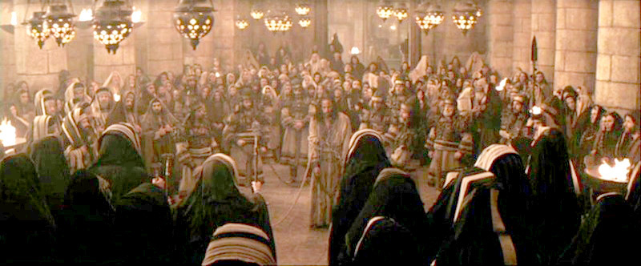
^{Acts 4:5} On the next day, their rulers and elders and scribes were gathered together in Jerusalem; ⁶ and Annas the high priest was there, and Caiaphas and John and Alexander, and all who were of high-priestly descent. ⁷ When they had placed them in the center, they began to inquire, “By what power, or in what name, have you done this?”
^{Acts 4:5} On the next day, their rulers and elders and scribes were gathered together in Jerusalem; ⁶ and Annas the high priest was there, and Caiaphas and John and Alexander, and all who were of high-priestly descent. ⁷ When they had placed them in the center, they began to inquire, “By what power, or in what name, have you done this?”
^{Acts 4:5} On the next day, their rulers and elders and scribes were gathered together in Jerusalem; ⁶ and Annas the high priest was there, and Caiaphas and John and Alexander, and all who were of high-priestly descent. ⁷ When they had placed them in the center, they began to inquire, “By what power, or in what name, have you done this?”
^{Acts 4:5} On the next day, their rulers and elders and scribes were gathered together in Jerusalem; ⁶ and Annas the high priest was there, and Caiaphas and John and Alexander, and all who were of high-priestly descent. ⁷ When they had placed them in the center, they began to inquire, “By what power, or in what name, have you done this?”
^{Acts 4:5} On the next day, their rulers and elders and scribes were gathered together in Jerusalem; ⁶ and Annas the high priest was there, and Caiaphas and John and Alexander, and all who were of high-priestly descent. ⁷ When they had placed them in the center, they began to inquire, “By what power, or in what name, have you done this?”
^{Acts 4:5} On the next day, their rulers and elders and scribes were gathered together in Jerusalem; ⁶ and Annas the high priest was there, and Caiaphas and John and Alexander, and all who were of high-priestly descent. ⁷ When they had placed them in the center, they began to inquire, “By what power, or in what name, have you done this?”

Slide 42
Challenge to the church:
Intimidation from another authority
^{Acts 4:5} On the next day, their rulers and elders and scribes were gathered together in Jerusalem; ⁶ and Annas the high priest was there, and Caiaphas and John and Alexander, and all who were of high-priestly descent. ⁷ When they had placed them in the center, they began to inquire, “By what power, or in what name, have you done this?”
^{Acts 4:5} On the next day, their rulers and elders and scribes were gathered together in Jerusalem; ⁶ and Annas the high priest was there, and Caiaphas and John and Alexander, and all who were of high-priestly descent. ⁷ When they had placed them in the center, they began to inquire, “By what power, or in what name, have you done this?”
^{Acts 4:5} On the next day, their rulers and elders and scribes were gathered together in Jerusalem; ⁶ and Annas the high priest was there, and Caiaphas and John and Alexander, and all who were of high-priestly descent. ⁷ When they had placed them in the center, they began to inquire, “By what power, or in what name, have you done this?”
^{Acts 4:5} On the next day, their rulers and elders and scribes were gathered together in Jerusalem; ⁶ and Annas the high priest was there, and Caiaphas and John and Alexander, and all who were of high-priestly descent. ⁷ When they had placed them in the center, they began to inquire, “By what power, or in what name, have you done this?”
^{Acts 4:5} On the next day, their rulers and elders and scribes were gathered together in Jerusalem; ⁶ and Annas the high priest was there, and Caiaphas and John and Alexander, and all who were of high-priestly descent. ⁷ When they had placed them in the center, they began to inquire, “By what power, or in what name, have you done this?”
^{Acts 4:5} On the next day, their rulers and elders and scribes were gathered together in Jerusalem; ⁶ and Annas the high priest was there, and Caiaphas and John and Alexander, and all who were of high-priestly descent. ⁷ When they had placed them in the center, they began to inquire, “By what power, or in what name, have you done this?”

Slide 43
Challenge to the church:
Intimidation from another authority
Who’s in the room?
^{Acts 4:5} On the next day, their rulers and elders and scribes were gathered together in Jerusalem; ⁶ and Annas the high priest was there, and Caiaphas and John and Alexander, and all who were of high-priestly descent. ⁷ When they had placed them in the center, they began to inquire, “By what power, or in what name, have you done this?”
^{Acts 4:5} On the next day, their rulers and elders and scribes were gathered together in Jerusalem; ⁶ and Annas the high priest was there, and Caiaphas and John and Alexander, and all who were of high-priestly descent. ⁷ When they had placed them in the center, they began to inquire, “By what power, or in what name, have you done this?”
^{Acts 4:5} On the next day, their rulers and elders and scribes were gathered together in Jerusalem; ⁶ and Annas the high priest was there, and Caiaphas and John and Alexander, and all who were of high-priestly descent. ⁷ When they had placed them in the center, they began to inquire, “By what power, or in what name, have you done this?”
^{Acts 4:5} On the next day, their rulers and elders and scribes were gathered together in Jerusalem; ⁶ and Annas the high priest was there, and Caiaphas and John and Alexander, and all who were of high-priestly descent. ⁷ When they had placed them in the center, they began to inquire, “By what power, or in what name, have you done this?”
^{Acts 4:5} On the next day, their rulers and elders and scribes were gathered together in Jerusalem; ⁶ and Annas the high priest was there, and Caiaphas and John and Alexander, and all who were of high-priestly descent. ⁷ When they had placed them in the center, they began to inquire, “By what power, or in what name, have you done this?”
^{Acts 4:5} On the next day, their rulers and elders and scribes were gathered together in Jerusalem; ⁶ and Annas the high priest was there, and Caiaphas and John and Alexander, and all who were of high-priestly descent. ⁷ When they had placed them in the center, they began to inquire, “By what power, or in what name, have you done this?”

Slide 44
Challenge to the church:
Intimidation from another authority
What is their question?
^{Acts 4:5} On the next day, their rulers and elders and scribes were gathered together in Jerusalem; ⁶ and Annas the high priest was there, and Caiaphas and John and Alexander, and all who were of high-priestly descent. ⁷ When they had placed them in the center, they began to inquire, “By what power, or in what name, have you done this?”
^{Acts 4:5} On the next day, their rulers and elders and scribes were gathered together in Jerusalem; ⁶ and Annas the high priest was there, and Caiaphas and John and Alexander, and all who were of high-priestly descent. ⁷ When they had placed them in the center, they began to inquire, “By what power, or in what name, have you done this?”
^{Acts 4:5} On the next day, their rulers and elders and scribes were gathered together in Jerusalem; ⁶ and Annas the high priest was there, and Caiaphas and John and Alexander, and all who were of high-priestly descent. ⁷ When they had placed them in the center, they began to inquire, “By what power, or in what name, have you done this?”
^{Acts 4:5} On the next day, their rulers and elders and scribes were gathered together in Jerusalem; ⁶ and Annas the high priest was there, and Caiaphas and John and Alexander, and all who were of high-priestly descent. ⁷ When they had placed them in the center, they began to inquire, “By what power, or in what name, have you done this?”
^{Acts 4:5} On the next day, their rulers and elders and scribes were gathered together in Jerusalem; ⁶ and Annas the high priest was there, and Caiaphas and John and Alexander, and all who were of high-priestly descent. ⁷ When they had placed them in the center, they began to inquire, “By what power, or in what name, have you done this?”
^{Acts 4:5} On the next day, their rulers and elders and scribes were gathered together in Jerusalem; ⁶ and Annas the high priest was there, and Caiaphas and John and Alexander, and all who were of high-priestly descent. ⁷ When they had placed them in the center, they began to inquire, “By what power, or in what name, have you done this?”
^{Acts 4:5} On the next day, their rulers and elders and scribes were gathered together in Jerusalem; ⁶ and Annas the high priest was there, and Caiaphas and John and Alexander, and all who were of high-priestly descent. ⁷ When they had placed them in the center, they began to inquire, “By what power, or in what name, have you done this?”

Slide 45
Challenge to the church:
Intimidation from another authority
What is their question?
In ancient Rome, NAME = AUTHORITY
^{Acts 4:5} On the next day, their rulers and elders and scribes were gathered together in Jerusalem; ⁶ and Annas the high priest was there, and Caiaphas and John and Alexander, and all who were of high-priestly descent. ⁷ When they had placed them in the center, they began to inquire, “By what power, or in what name, have you done this?”
^{Acts 4:5} On the next day, their rulers and elders and scribes were gathered together in Jerusalem; ⁶ and Annas the high priest was there, and Caiaphas and John and Alexander, and all who were of high-priestly descent. ⁷ When they had placed them in the center, they began to inquire, “By what power, or in what name, have you done this?”
^{Acts 4:5} On the next day, their rulers and elders and scribes were gathered together in Jerusalem; ⁶ and Annas the high priest was there, and Caiaphas and John and Alexander, and all who were of high-priestly descent. ⁷ When they had placed them in the center, they began to inquire, “By what power, or in what name, have you done this?”
^{Acts 4:5} On the next day, their rulers and elders and scribes were gathered together in Jerusalem; ⁶ and Annas the high priest was there, and Caiaphas and John and Alexander, and all who were of high-priestly descent. ⁷ When they had placed them in the center, they began to inquire, “By what power, or in what name, have you done this?”
^{Acts 4:5} On the next day, their rulers and elders and scribes were gathered together in Jerusalem; ⁶ and Annas the high priest was there, and Caiaphas and John and Alexander, and all who were of high-priestly descent. ⁷ When they had placed them in the center, they began to inquire, “By what power, or in what name, have you done this?”
^{Acts 4:5} On the next day, their rulers and elders and scribes were gathered together in Jerusalem; ⁶ and Annas the high priest was there, and Caiaphas and John and Alexander, and all who were of high-priestly descent. ⁷ When they had placed them in the center, they began to inquire, “By what power, or in what name, have you done this?”
^{Acts 4:5} On the next day, their rulers and elders and scribes were gathered together in Jerusalem; ⁶ and Annas the high priest was there, and Caiaphas and John and Alexander, and all who were of high-priestly descent. ⁷ When they had placed them in the center, they began to inquire, “By what power, or in what name, have you done this?”

Slide 46
Challenge to the church:
Intimidation from another authority
This is an “authority” SHOWDOWN
^{Acts 4:5} On the next day, their rulers and elders and scribes were gathered together in Jerusalem; ⁶ and Annas the high priest was there, and Caiaphas and John and Alexander, and all who were of high-priestly descent. ⁷ When they had placed them in the center, they began to inquire, “By what power, or in what name, have you done this?”
^{Acts 4:5} On the next day, their rulers and elders and scribes were gathered together in Jerusalem; ⁶ and Annas the high priest was there, and Caiaphas and John and Alexander, and all who were of high-priestly descent. ⁷ When they had placed them in the center, they began to inquire, “By what power, or in what name, have you done this?”

Slide 47
Challenge to the church:
Intimidation from another authority
This is an “authority” SHOWDOWN
“Who do you think you are?”
^{Acts 4:5} On the next day, their rulers and elders and scribes were gathered together in Jerusalem; ⁶ and Annas the high priest was there, and Caiaphas and John and Alexander, and all who were of high-priestly descent. ⁷ When they had placed them in the center, they began to inquire, “By what power, or in what name, have you done this?”
^{Acts 4:5} On the next day, their rulers and elders and scribes were gathered together in Jerusalem; ⁶ and Annas the high priest was there, and Caiaphas and John and Alexander, and all who were of high-priestly descent. ⁷ When they had placed them in the center, they began to inquire, “By what power, or in what name, have you done this?”

Slide 48
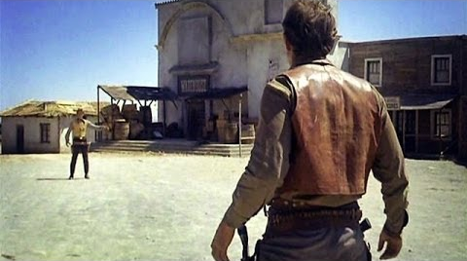
Challenge to the church:
Intimidation from another authority
This is an “authority” SHOWDOWN
^{Acts 4:5} On the next day, their rulers and elders and scribes were gathered together in Jerusalem; ⁶ and Annas the high priest was there, and Caiaphas and John and Alexander, and all who were of high-priestly descent. ⁷ When they had placed them in the center, they began to inquire, “By what power, or in what name, have you done this?”
^{Acts 4:5} On the next day, their rulers and elders and scribes were gathered together in Jerusalem; ⁶ and Annas the high priest was there, and Caiaphas and John and Alexander, and all who were of high-priestly descent. ⁷ When they had placed them in the center, they began to inquire, “By what power, or in what name, have you done this?”

Slide 49
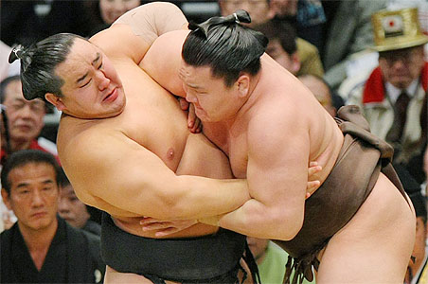
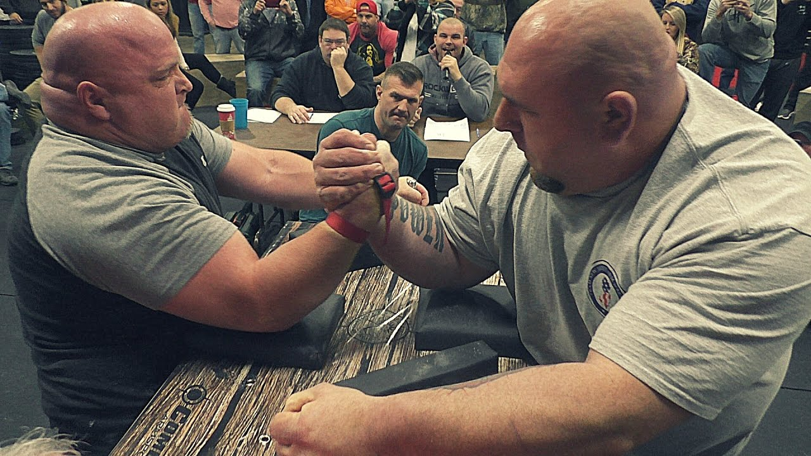
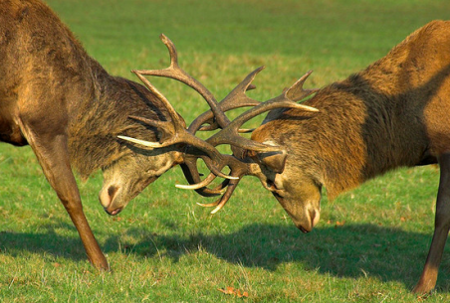
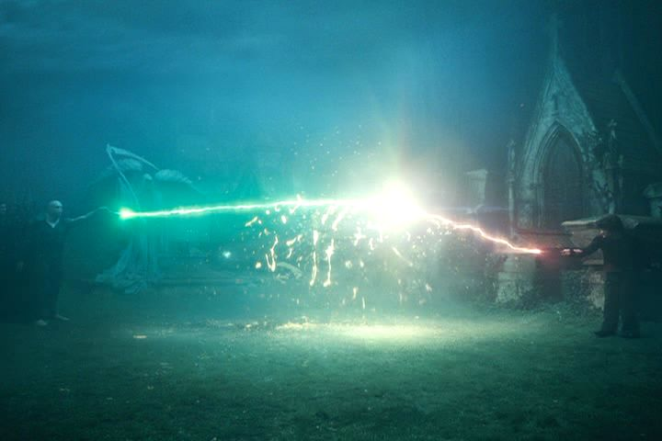
Challenge to the church:
Intimidation from another authority
This is an “authority” SHOWDOWN
^{Acts 4:5} On the next day, their rulers and elders and scribes were gathered together in Jerusalem; ⁶ and Annas the high priest was there, and Caiaphas and John and Alexander, and all who were of high-priestly descent. ⁷ When they had placed them in the center, they began to inquire, “By what power, or in what name, have you done this?”
^{Acts 4:5} On the next day, their rulers and elders and scribes were gathered together in Jerusalem; ⁶ and Annas the high priest was there, and Caiaphas and John and Alexander, and all who were of high-priestly descent. ⁷ When they had placed them in the center, they began to inquire, “By what power, or in what name, have you done this?”

Slide 50
This is an intimidating question!
^{Acts 4:5} On the next day, their rulers and elders and scribes were gathered together in Jerusalem; ⁶ and Annas the high priest was there, and Caiaphas and John and Alexander, and all who were of high-priestly descent. ⁷ When they had placed them in the center, they began to inquire, “By what power, or in what name, have you done this?”
^{Acts 4:5} On the next day, their rulers and elders and scribes were gathered together in Jerusalem; ⁶ and Annas the high priest was there, and Caiaphas and John and Alexander, and all who were of high-priestly descent. ⁷ When they had placed them in the center, they began to inquire, “By what power, or in what name, have you done this?”

Slide 51
This is an intimidating question!
^{Acts 4:5} On the next day, their rulers and elders and scribes were gathered together in Jerusalem; ⁶ and Annas the high priest was there, and Caiaphas and John and Alexander, and all who were of high-priestly descent. ⁷ When they had placed them in the center, they began to inquire, “By what power, or in what name, have you done this?”
^{Acts 4:5} On the next day, their rulers and elders and scribes were gathered together in Jerusalem; ⁶ and Annas the high priest was there, and Caiaphas and John and Alexander, and all who were of high-priestly descent. ⁷ When they had placed them in the center, they began to inquire, “By what power, or in what name, have you done this?”
How would you answer this?

Slide 52
This is an intimidating question!
^{Acts 4:5} On the next day, their rulers and elders and scribes were gathered together in Jerusalem; ⁶ and Annas the high priest was there, and Caiaphas and John and Alexander, and all who were of high-priestly descent. ⁷ When they had placed them in the center, they began to inquire, “By what power, or in what name, have you done this?”
^{Acts 4:5} On the next day, their rulers and elders and scribes were gathered together in Jerusalem; ⁶ and Annas the high priest was there, and Caiaphas and John and Alexander, and all who were of high-priestly descent. ⁷ When they had placed them in the center, they began to inquire, “By what power, or in what name, have you done this?”
How would you answer this?
^{Luke 12:11} When they bring you before the synagogues and the rulers and the authorities, do not worry about how or what you are to speak in your defense, or what you are to say; ¹² for the Holy Spirit will teach you in that very hour what you ought to say.”

Slide 53
^{Acts 4:5} On the next day, their rulers and elders and scribes were gathered together in Jerusalem; ⁶ and Annas the high priest was there, and Caiaphas and John and Alexander, and all who were of high-priestly descent. ⁷ When they had placed them in the center, they began to inquire, “By what power, or in what name, have you done this?”
^{Acts 4:8} Then Peter, filled with the Holy Spirit, said to them, “Rulers and elders of the people, ⁹ if we are on trial today for a benefit done to a sick man, as to how this man has been made well, ¹⁰ let it be known to all of you and to all the people of Israel, that by the name of Jesus Christ the Nazarene, whom you crucified, whom God raised from the dead –

Slide 54
^{Acts 4:5} On the next day, their rulers and elders and scribes were gathered together in Jerusalem; ⁶ and Annas the high priest was there, and Caiaphas and John and Alexander, and all who were of high-priestly descent. ⁷ When they had placed them in the center, they began to inquire, “By what power, or in what name, have you done this?”
^{Acts 4:8} Then Peter, filled with the Holy Spirit, said to them, “Rulers and elders of the people, ⁹ if we are on trial today for a benefit done to a sick man, as to how this man has been made well, ¹⁰ let it be known to all of you and to all the people of Israel, that by the name of Jesus Christ the Nazarene, whom you crucified, whom God raised from the dead –

Slide 55
^{Acts 4:5} On the next day, their rulers and elders and scribes were gathered together in Jerusalem; ⁶ and Annas the high priest was there, and Caiaphas and John and Alexander, and all who were of high-priestly descent. ⁷ When they had placed them in the center, they began to inquire, “By what power, or in what name, have you done this?”
^{Acts 4:8} Then Peter, filled with the Holy Spirit, said to them, “Rulers and elders of the people, ⁹ if we are on trial today for a benefit done to a sick man, as to how this man has been made well, ¹⁰ let it be known to all of you and to all the people of Israel, that by the name of Jesus Christ the Nazarene, whom you crucified, whom God raised from the dead –

Slide 56
^{Acts 4:5} On the next day, their rulers and elders and scribes were gathered together in Jerusalem; ⁶ and Annas the high priest was there, and Caiaphas and John and Alexander, and all who were of high-priestly descent. ⁷ When they had placed them in the center, they began to inquire, “By what power, or in what name, have you done this?”
^{Acts 4:8} Then Peter, filled with the Holy Spirit, said to them, “Rulers and elders of the people, ⁹ if we are on trial today for a benefit done to a sick man, as to how this man has been made well, ¹⁰ let it be known to all of you and to all the people of Israel, that by the name of Jesus Christ the Nazarene, whom you crucified, whom God raised from the dead –

Slide 57
^{Acts 4:5} On the next day, their rulers and elders and scribes were gathered together in Jerusalem; ⁶ and Annas the high priest was there, and Caiaphas and John and Alexander, and all who were of high-priestly descent. ⁷ When they had placed them in the center, they began to inquire, “By what power, or in what name, have you done this?”
^{Acts 4:8} Then Peter, filled with the Holy Spirit, said to them, “Rulers and elders of the people, ⁹ if we are on trial today for a benefit done to a sick man, as to how this man has been made well, ¹⁰ let it be known to all of you and to all the people of Israel, that by the name of Jesus Christ the Nazarene, whom you crucified, whom God raised from the dead –

Slide 58
^{Acts 4:10} by this name this man stands here before you in good health. ¹¹ He is the stone which was rejected by you, the builders, but which became the chief corner stone. ¹² And there is salvation in no one else; for there is no other name under heaven that has been given among men by which we must be saved.”

Slide 59
Jesus Christ – the highest name under Heaven, that’s who.
^{Acts 4:10} by this name this man stands here before you in good health. ¹¹ He is the stone which was rejected by you, the builders, but which became the chief corner stone. ¹² And there is salvation in no one else; for there is no other name under heaven that has been given among men by which we must be saved.”

Slide 60
Jesus Christ – the highest name under Heaven, that’s who.
Higher than yours BTW
^{Acts 4:10} by this name this man stands here before you in good health. ¹¹ He is the stone which was rejected by you, the builders, but which became the chief corner stone. ¹² And there is salvation in no one else; for there is no other name under heaven that has been given among men by which we must be saved.”

Slide 61
Jesus Christ – the highest name under Heaven, that’s who.
Higher than yours BTW
^{Acts 4:10} by this name this man stands here before you in good health. ¹¹ He is the stone which was rejected by you, the builders, but which became the chief corner stone. ¹² And there is salvation in no one else; for there is no other name under heaven that has been given among men by which we must be saved.”

Slide 62
^{Acts 4:13} Now as they observed the confidence of Peter and John and understood that they were uneducated and untrained men, they were amazed, and began to recognize them as having been with Jesus.¹⁴ And seeing the man who had been healed standing with them, they had nothing to say in reply.

Slide 63
= parresia: “boldness, openness, freedom of speech”
^{Acts 4:13} Now as they observed the confidence of Peter and John and understood that they were uneducated and untrained men, they were amazed, and began to recognize them as having been with Jesus.¹⁴ And seeing the man who had been healed standing with them, they had nothing to say in reply.

Slide 64
= agrammatos: “without learning, unlettered”
= idiotes “ungifted, unskilled, untrained”
^{Acts 4:13} Now as they observed the confidence of Peter and John and understood that they were uneducated and untrained men, they were amazed, and began to recognize them as having been with Jesus.¹⁴ And seeing the man who had been healed standing with them, they had nothing to say in reply.

Slide 65
^{Acts 4:13} Now as they observed the confidence of Peter and John and understood that they were uneducated and untrained men, they were amazed, and began to recognize them as having been with Jesus.¹⁴ And seeing the man who had been healed standing with them, they had nothing to say in reply.

Slide 66
^{Acts 4:13} Now as they observed the confidence of Peter and John and understood that they were uneducated and untrained men, they were amazed, and began to recognize them as having been with Jesus.¹⁴ And seeing the man who had been healed standing with them, they had nothing to say in reply.

Slide 67
^{Acts 4:13} Now as they observed the confidence of Peter and John and understood that they were uneducated and untrained men, they were amazed, and began to recognize them as having been with Jesus.¹⁴ And seeing the man who had been healed standing with them, they had nothing to say in reply.

Slide 68
^{Acts 4:15} But when they had ordered them to leave the Council, they began to confer with one another, ¹⁶ saying, “What shall we do with these men? For the fact that a noteworthy miracle has taken place through them is apparent to all who live in Jerusalem, and we cannot deny it.
^{Acts 4:15} But when they had ordered them to leave the Council, they began to confer with one another, ¹⁶ saying, “What shall we do with these men? For the fact that a noteworthy miracle has taken place through them is apparent to all who live in Jerusalem, and we cannot deny it.

Slide 69
^{Acts 4:17} But so that it will not spread any further among the people, let us warn them to speak no longer to any man in this name.” ¹⁸ And when they had summoned them, they commanded them not to speak or teach at all in the name of Jesus.
^{Acts 4:17} But so that it will not spread any further among the people, let us warn them to speak no longer to any man in this name.” ¹⁸ And when they had summoned them, they commanded them not to speak or teach at all in the name of Jesus.
^{Acts 4:17} But so that it will not spread any further among the people, let us warn them to speak no longer to any man in this name.” ¹⁸ And when they had summoned them, they commanded them not to speak or teach at all in the name of Jesus.

Slide 70
Total lack of curiously!
^{Acts 4:17} But so that it will not spread any further among the people, let us warn them to speak no longer to any man in this name.” ¹⁸ And when they had summoned them, they commanded them not to speak or teach at all in the name of Jesus.
^{Acts 4:17} But so that it will not spread any further among the people, let us warn them to speak no longer to any man in this name.” ¹⁸ And when they had summoned them, they commanded them not to speak or teach at all in the name of Jesus.
^{Acts 4:17} But so that it will not spread any further among the people, let us warn them to speak no longer to any man in this name.” ¹⁸ And when they had summoned them, they commanded them not to speak or teach at all in the name of Jesus.

Slide 71
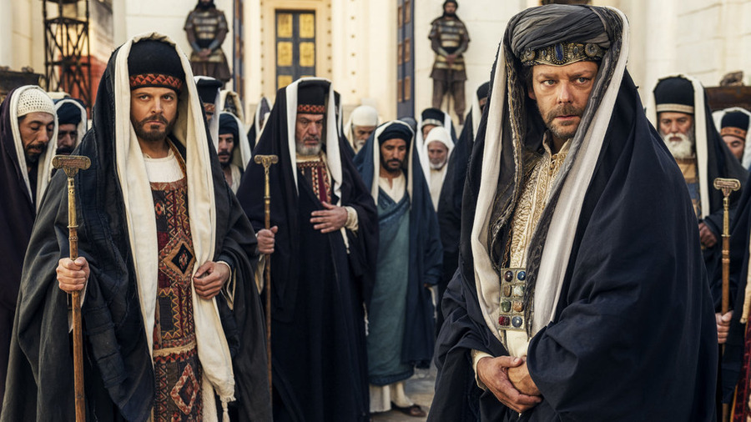
^{Acts 4:17} But so that it will not spread any further among the people, let us warn them to speak no longer to any man in this name.” ¹⁸ And when they had summoned them, they commanded them not to speak or teach at all in the name of Jesus.
^{Acts 4:17} But so that it will not spread any further among the people, let us warn them to speak no longer to any man in this name.” ¹⁸ And when they had summoned them, they commanded them not to speak or teach at all in the name of Jesus.
^{Acts 4:17} But so that it will not spread any further among the people, let us warn them to speak no longer to any man in this name.” ¹⁸ And when they had summoned them, they commanded them not to speak or teach at all in the name of Jesus.

Slide 72
^{Acts 4:19} But Peter and John answered and said to them, “Whether it is right in the sight of God to give heed to you rather than to God, you be the judge; ²⁰ for we cannot stop speaking about what we have seen and heard.”
^{Acts 4:19} But Peter and John answered and said to them, “Whether it is right in the sight of God to give heed to you rather than to God, you be the judge; ²⁰ for we cannot stop speaking about what we have seen and heard.”
^{Acts 4:19} But Peter and John answered and said to them, “Whether it is right in the sight of God to give heed to you rather than to God, you be the judge; ²⁰ for we cannot stop speaking about what we have seen and heard.”
^{Acts 4:19} But Peter and John answered and said to them,

Slide 73
^{Acts 4:19} But Peter and John answered and said to them, “Whether it is right in the sight of God to give heed to you rather than to God, you be the judge; ²⁰ for we cannot stop speaking about what we have seen and heard.”
^{Acts 4:19} But Peter and John answered and said to them, “Whether it is right in the sight of God to give heed to you rather than to God, you be the judge; ²⁰ for we cannot stop speaking about what we have seen and heard.”
^{Acts 4:19} But Peter and John answered and said to them, “Whether it is right in the sight of God to give heed to you rather than to God, you be the judge; ²⁰ for we cannot stop speaking about what we have seen and heard.”
^{Acts 4:19} But Peter and John answered and said to them, “Whether it is right in the sight of God to give heed to you rather than to God, you be the judge; ²⁰ for we cannot stop speaking about what we have seen and heard.”

Slide 74
“You have put us in a position where we have to choose between obeying your authority or God’s authority…”
^{Acts 4:19} But Peter and John answered and said to them, “Whether it is right in the sight of God to give heed to you rather than to God, you be the judge; ²⁰ for we cannot stop speaking about what we have seen and heard.”
^{Acts 4:19} But Peter and John answered and said to them, “Whether it is right in the sight of God to give heed to you rather than to God, you be the judge; ²⁰ for we cannot stop speaking about what we have seen and heard.”
^{Acts 4:19} But Peter and John answered and said to them, “Whether it is right in the sight of God to give heed to you rather than to God, you be the judge; ²⁰ for we cannot stop speaking about what we have seen and heard.”
^{Acts 4:19} But Peter and John answered and said to them, “Whether it is right in the sight of God to give heed to you rather than to God, you be the judge; ²⁰ for we cannot stop speaking about what we have seen and heard.”

Slide 75
“I’m goin’ to”
^{Acts 4:19} But Peter and John answered and said to them, “Whether it is right in the sight of God to give heed to you rather than to God, you be the judge; ²⁰ for we cannot stop speaking about what we have seen and heard.”
^{Acts 4:19} But Peter and John answered and said to them, “Whether it is right in the sight of God to give heed to you rather than to God, you be the judge; ²⁰ for we cannot stop speaking about what we have seen and heard.”
^{Acts 4:19} But Peter and John answered and said to them, “Whether it is right in the sight of God to give heed to you rather than to God, you be the judge; ²⁰ for we cannot stop speaking about what we have seen and heard.”

Slide 76
^{Acts 4:21} When they had threatened them further, they let them go (finding no basis on which to punish them) on account of the people, because they were all glorifying God for what had happened; ²² for the man was more than forty years old on whom this miracle of healing had been performed.
^{Acts 4:21} When they had threatened them further, they let them go (finding no basis on which to punish them) on account of the people, because they were all glorifying God for what had happened; ²² for the man was more than forty years old on whom this miracle of healing had been performed.
^{Acts 4:21} When they had threatened them further, they let them go (finding no basis on which to punish them) on account of the people, because they were all glorifying God for what had happened; ²² for the man was more than forty years old on whom this miracle of healing had been performed.
^{Acts 4:21} When they had threatened them further, they let them go (finding no basis on which to punish them) on account of the people, because they were all glorifying God for what had happened; ²² for the man was more than forty years old on whom this miracle of healing had been performed.
^{Acts 4:19} But Peter and John answered and said to them, “Whether it is right in the sight of God to give heed to you rather than to God, you be the judge; ²⁰ for we cannot stop speaking about what we have seen and heard.”
^{Acts 4:19} But Peter and John answered and said to them, “Whether it is right in the sight of God to give heed to you rather than to God, you be the judge; ²⁰ for we cannot stop speaking about what we have seen and heard.”

Slide 77
This isn’t over…
^{Acts 4:21} When they had threatened them further, they let them go (finding no basis on which to punish them) on account of the people, because they were all glorifying God for what had happened; ²² for the man was more than forty years old on whom this miracle of healing had been performed.
^{Acts 4:21} When they had threatened them further, they let them go (finding no basis on which to punish them) on account of the people, because they were all glorifying God for what had happened; ²² for the man was more than forty years old on whom this miracle of healing had been performed.
^{Acts 4:21} When they had threatened them further, they let them go (finding no basis on which to punish them) on account of the people, because they were all glorifying God for what had happened; ²² for the man was more than forty years old on whom this miracle of healing had been performed.
^{Acts 4:21} When they had threatened them further, they let them go (finding no basis on which to punish them) on account of the people, because they were all glorifying God for what had happened; ²² for the man was more than forty years old on whom this miracle of healing had been performed.
^{Acts 4:19} But Peter and John answered and said to them, “Whether it is right in the sight of God to give heed to you rather than to God, you be the judge; ²⁰ for we cannot stop speaking about what we have seen and heard.”
^{Acts 4:19} But Peter and John answered and said to them, “Whether it is right in the sight of God to give heed to you rather than to God, you be the judge; ²⁰ for we cannot stop speaking about what we have seen and heard.”

Slide 78
Where did their confidence come from?

Slide 79
Where did their confidence come from?
Not from themselves!

Slide 80
Where did their confidence come from?
Not from themselves!
^{Acts 3:12} “Men of Israel, why are you amazed at this, or why do you gaze at us, as if by our own power or piety we had made him walk? ¹³ The God of Abraham, Isaac and Jacob, the God of our fathers, has glorified His servant Jesus

Slide 81
Where did their confidence come from?
Not from themselves!
^{Acts 3:12} “Men of Israel, why are you amazed at this, or why do you gaze at us, as if by our own power or piety we had made him walk? ¹³ The God of Abraham, Isaac and Jacob, the God of our fathers, has glorified His servant Jesus
^{Acts 3:12} “Men of Israel, why are you amazed at this, or why do you gaze at us, as if by our own power or piety we had made him walk? ¹³ The God of Abraham, Isaac and Jacob, the God of our fathers, has glorified His servant Jesus

Slide 82
Where did their confidence come from?
Not from themselves!
^{Acts 3:12} “Men of Israel, why are you amazed at this, or why do you gaze at us, as if by our own power or piety we had made him walk? ¹³ The God of Abraham, Isaac and Jacob, the God of our fathers, has glorified His servant Jesus
^{Acts 3:12} “Men of Israel, why are you amazed at this, or why do you gaze at us, as if by our own power or piety we had made him walk? ¹³ The God of Abraham, Isaac and Jacob, the God of our fathers, has glorified His servant Jesus
^{Acts 3:6} … “In the name of Jesus Christ the Nazarene—walk!”

Slide 83
Where did their confidence come from?
Not from themselves!
^{Acts 3:12} “Men of Israel, why are you amazed at this, or why do you gaze at us, as if by our own power or piety we had made him walk? ¹³ The God of Abraham, Isaac and Jacob, the God of our fathers, has glorified His servant Jesus
^{Acts 3:12} “Men of Israel, why are you amazed at this, or why do you gaze at us, as if by our own power or piety we had made him walk? ¹³ The God of Abraham, Isaac and Jacob, the God of our fathers, has glorified His servant Jesus
^{Acts 3:6} … “In the name of Jesus Christ the Nazarene—walk!”
^{Acts 3:16} And on the basis of faith in His name, it is the name of Jesus which has strengthened this man whom you see and know…

Slide 84
Where did their confidence come from?
Their confidence was in the Name of Jesus Christ
Not from themselves!
^{Acts 3:12} “Men of Israel, why are you amazed at this, or why do you gaze at us, as if by our own power or piety we had made him walk? ¹³ The God of Abraham, Isaac and Jacob, the God of our fathers, has glorified His servant Jesus
^{Acts 3:12} “Men of Israel, why are you amazed at this, or why do you gaze at us, as if by our own power or piety we had made him walk? ¹³ The God of Abraham, Isaac and Jacob, the God of our fathers, has glorified His servant Jesus
^{Acts 3:6} … “In the name of Jesus Christ the Nazarene—walk!”
^{Acts 3:16} And on the basis of faith in His name, it is the name of Jesus which has strengthened this man whom you see and know…

Slide 85
Their confidence was in the Name of Jesus Christ
The Name of their King

Slide 86
Their confidence was in the Name of Jesus Christ
The Name of their King
They are acting on HIS authority

Slide 87
Their confidence was in the Name of Jesus Christ
The Name of their King
They are acting on HIS authority
“… all I can do is be a small finger pointing to a large Christ.” Jack Miller, The Heart of a Servant Leader, p.244.

Slide 88
Their confidence was in the Name of Jesus Christ
The Name of their King
The Name that has power

Slide 89
Their confidence was in the Name of Jesus Christ
The Name of their King
The Name that has power
It gives us confidence to know that the Name that backs us up is a powerful one

Slide 90
Their confidence was in the Name of Jesus Christ
The Name of their King
The Name that has power
Not a magical incantation…

Slide 91
Their confidence was in the Name of Jesus Christ
The Name of their King
The Name that has power
The Name in which they were sent

Slide 92
Their confidence was in the Name of Jesus Christ
The Name of their King
The Name that has power
The Name in which they were sent
^{Matt 28:19 “}Go therefore and make disciples of all the nations, baptizing them in the name of the Father and the Son and the Holy Spirit ²⁰ teaching them to observe all that I commanded you; and lo, I am with you always, even to the end of the age.”
^{Matt 28:19 “}Go therefore and make disciples of all the nations, baptizing them in the name of the Father and the Son and the Holy Spirit ²⁰ teaching them to observe all that I commanded you; and lo, I am with you always, even to the end of the age.”

Slide 93
Their confidence was in the Name of Jesus Christ
The Name of their King
The Name that has power
The Name in which they were sent
^{Luke 24:47} that repentance for forgiveness of sins would be proclaimed in His name to all the nations, beginning from Jerusalem.

Slide 94
Their confidence was in the Name of Jesus Christ
The Name of their King
The Name that has power
The Name in which they were sent
This is My message – and when you speak it you speak for Me
^{Luke 24:47} that repentance for forgiveness of sins would be proclaimed in His name to all the nations, beginning from Jerusalem.

Slide 95
Their confidence was in the Name of Jesus Christ
The Name of their King
The Name that has power
The Name in which they were sent
The Name that saves
^{Acts 4:12} And there is salvation in no one else; for there is no other name under heaven that has been given among men by which we must be saved.”

Slide 96
Their confidence was in the Name of Jesus Christ
The Name of their King
The Name that has power
The Name in which they were sent
The Name that saves
The Name that is above every name

Slide 97
Their confidence was in the Name of Jesus Christ
^{Eph 1:9} He raised Him from the dead and seated Him at His right hand in the heavenly places, ²¹ far above all rule and authority and power and dominion, and every name that is named, not only in this age but also in the one to come. ²² And He put all things in subjection under His feet …
The Name of their King
The Name that has power
The Name in which they were sent
The Name that saves
The Name that is above every name

Slide 98
Their confidence was in the Name of Jesus Christ
^{Eph 1:9} He raised Him from the dead and seated Him at His right hand in the heavenly places, ²¹ far above all rule and authority and power and dominion, and every name that is named, not only in this age but also in the one to come. ²² And He put all things in subjection under His feet …
The Name of their King
The Name that has power
The Name in which they were sent
The Name that saves
The Name that is above every name
They knew Who they were dealing with

Slide 99
Their confidence was in the Name of Jesus Christ
^{Acts4:23} When they had been released, they went to their own companions and reported all that the chief priests and the elders had said to them. ²⁴ And when they heard this, they lifted their voices to God with one accord and said, “O Lord, it is You who made the heaven and the earth and the sea, and all that is in them
They knew Who they were dealing with

Slide 100
Their confidence was in the Name of Jesus Christ
^{Acts4:23} When they had been released, they went to their own companions and reported all that the chief priests and the elders had said to them. ²⁴ And when they heard this, they lifted their voices to God with one accord and said, “O Lord, it is You who made the heaven and the earth and the sea, and all that is in them
^{Acts4:23} When they had been released, they went to their own companions and reported all that the chief priests and the elders had said to them. ²⁴ And when they heard this, they lifted their voices to God with one accord and said, “O Lord, it is You who made the heaven and the earth and the sea, and all that is in them,
^{Acts4:23} When they had been released, they went to their own companions and reported all that the chief priests and the elders had said to them. ²⁴ And when they heard this, they lifted their voices to God with one accord and said, “O Lord, it is You who made the heaven and the earth and the sea, and all that is in them,
Exodus 20:11
They knew Who they were dealing with

Slide 101
Their confidence was in the Name of Jesus Christ
^{Acts 4:25} who by the Holy Spirit, through the mouth of our father David Your servant, said,
‘Why did the Gentiles rage, And the peoples devise futile things? ²⁶ ‘The kings of the earth took their stand, And the rulers were gathered together Against the Lord and against His Christ.’
^{Acts 4:25} who by the Holy Spirit, through the mouth of our father David Your servant, said,
‘Why did the Gentiles rage, And the peoples devise futile things? ²⁶ ‘The kings of the earth took their stand, And the rulers were gathered together Against the Lord and against His Christ.’
Psalm 2:2
They knew Who they were dealing with

Slide 102
Their confidence was in the Name of Jesus Christ
^{Acts 4:25} who by the Holy Spirit, through the mouth of our father David Your servant, said,
‘Why did the Gentiles rage, And the peoples devise futile things? ²⁶ ‘The kings of the earth took their stand, And the rulers were gathered together Against the Lord and against His Christ.’
^{Acts 4:25} who by the Holy Spirit, through the mouth of our father David Your servant, said,
‘Why did the Gentiles rage, And the peoples devise futile things? ²⁶ ‘The kings of the earth took their stand, And the rulers were gathered together Against the Lord and against His Christ.’
Psalm 2:2
^{Psalm 2:4} He who sits in the heavens laughs, The Lord scoffs at them.
They knew Who they were dealing with

Slide 103
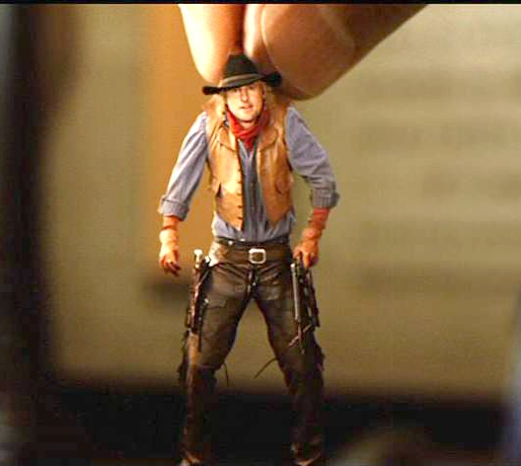
Their confidence was in the Name of Jesus Christ
^{Acts 4:25} who by the Holy Spirit, through the mouth of our father David Your servant, said,
‘Why did the Gentiles rage, And the peoples devise futile things? ²⁶ ‘The kings of the earth took their stand, And the rulers were gathered together Against the Lord and against His Christ.’
^{Acts 4:25} who by the Holy Spirit, through the mouth of our father David Your servant, said,
‘Why did the Gentiles rage, And the peoples devise futile things? ²⁶ ‘The kings of the earth took their stand, And the rulers were gathered together Against the Lord and against His Christ.’
Psalm 2:2
^{Psalm 2:4} He who sits in the heavens laughs, The Lord scoffs at them.
They knew Who they were dealing with

Slide 104
Their confidence was in the Name of Jesus Christ
^{Acts 4:27} For truly in this city there were gathered together against Your holy servant Jesus, whom You anointed, both Herod and Pontius Pilate, along with the Gentiles and the peoples of Israel, ²⁸ to do whatever Your hand and Your purpose predestined to occur.
They knew Who they were dealing with

Slide 105
Their confidence was in the Name of Jesus Christ
^{Acts 4:29} And now, Lord, take note of their threats, and grant that Your bond-servants may speak Your word with all confidence, ³⁰ while You extend Your hand to heal, and signs and wonders take place through the name of Your holy servant Jesus.” ³¹ And when they had prayed, the place where they had gathered together was shaken, and they were all filled with the Holy Spirit and began to speak the word of God with boldness.
^{Acts 4:29} And now, Lord, take note of their threats, and grant that Your bond-servants may speak Your word with all confidence, ³⁰ while You extend Your hand to heal, and signs and wonders take place through the name of Your holy servant Jesus.” ³¹ And when they had prayed, the place where they had gathered together was shaken, and they were all filled with the Holy Spirit and began to speak the word of God with boldness.
They knew Who they were dealing with

Slide 106
Their confidence was in the Name of Jesus Christ
^{Acts 4:29} And now, Lord, take note of their threats, and grant that Your bond-servants may speak Your word with all confidence, ³⁰ while You extend Your hand to heal, and signs and wonders take place through the name of Your holy servant Jesus.” ³¹ And when they had prayed, the place where they had gathered together was shaken, and they were all filled with the Holy Spirit and began to speak the word of God with boldness.
^{Acts 4:29} And now, Lord, take note of their threats, and grant that Your bond-servants may speak Your word with all confidence, ³⁰ while You extend Your hand to heal, and signs and wonders take place through the name of Your holy servant Jesus.” ³¹ And when they had prayed, the place where they had gathered together was shaken, and they were all filled with the Holy Spirit and began to speak the word of God with boldness.
They knew Who they were dealing with
And it emboldened them!

Slide 107
Their confidence was in the Name of Jesus Christ
^{Acts 4:29} And now, Lord, take note of their threats, and grant that Your bond-servants may speak Your word with all confidence, ³⁰ while You extend Your hand to heal, and signs and wonders take place through the name of Your holy servant Jesus.” ³¹ And when they had prayed, the place where they had gathered together was shaken, and they were all filled with the Holy Spirit and began to speak the word of God with boldness.
^{Acts 4:29} And now, Lord, take note of their threats, and grant that Your bond-servants may speak Your word with all confidence, ³⁰ while You extend Your hand to heal, and signs and wonders take place through the name of Your holy servant Jesus.” ³¹ And when they had prayed, the place where they had gathered together was shaken, and they were all filled with the Holy Spirit and began to speak the word of God with boldness.
They knew Who they were dealing with
And it emboldened them!

Slide 108
Acts
The Church in Jerusalem
Next Time:
Another challenge to the church
teachings available at www.centralteachings.com

