Slide 1
10:32-45
Servant Leadership

Slide 2
(Mark 10:32) Jesus took the Twelve aside and told them what was going to happen to him.

Slide 3
(Mark 10:33) “We are going up to Jerusalem,” he said, “and the Son of Man will be betrayed to the chief priests and teachers of the law. They will condemn him to death and will hand him over to the Gentiles.”

Slide 4
(Mark 10:34) “They will mock him and spit on him, flog him and kill him. Three days later he will rise.”
This is the third time Jesus predicted his selfless death (cf. Mk. 8:31; 9:31).
How will the disciples respond?

Slide 5
(Mark 10:35) Then James and John, the sons of Zebedee, came to him.
“Teacher,” they said, “we want you to do for us whatever we ask.”
³⁶ “What do you want me to do for you?” he asked.
³⁷ They replied, “Let one of us sit at your right and the other at your left in your glory.”
With their mom! (Mt. 20:20-21)
Positions of power and honor
1 Kings 2:19; Ps. 110:1; Josephus, Antiquities VI. xi. 9

Slide 6
(Mark 10:38) “You don’t know what you are asking,” Jesus said.
“Can you drink the cup I drink or be baptized with the baptism I am baptized with?”
The cup = God’s wrath
Ps. 75:8; Isa. 51:17-23; Jer. 25:15-28; 49:12; 51:7; Lam. 4:21 f.; Ezek. 23:31-34; Hab. 2:16; Zech. 12:2
“Baptism” (baptizō) = suffering
“I have a baptism to undergo, and how distressed I am until it is accomplished!” (Lk. 12:50)

Slide 7
(Mark 10:39) “We can,” they answered.
Jesus said to them, “You will drink the cup I drink and be baptized with the baptism I am baptized with.”
James died by public execution
~AD 44 (Acts 12:2)
John died as an exile in Patmos
Tertullian (AD 200): “The Apostle John was first plunged, unhurt, into boiling oil, and thence remitted to his island-exile!” (On the Prescription of Heretics, 36)
(Rev. 1:9; Jn. 21:21-23)

Slide 8
(Mark 10:40) “To sit at my right or left is not for me to grant. These places belong to those for whom they have been prepared.”

Slide 9
(Mark 10:41) When the ten heard about this,
they became indignant with James and John.
Jesus uses this as a teaching moment…

Slide 10
(Mark 10:42) Jesus called them together and said, “You know that those who are regarded as rulers of the Gentiles lord it over them, and their high officials exercise authority over them.”

Slide 11
(Mark 10:43-44) “Not so with you.
Instead, whoever wants to become great among you must be your servant, and whoever wants to be first must be slave of all.”

Slide 12
(Mark 10:45) “For even the Son of Man did not come to be served,
but to serve,
and to give his life as a ransom for many.”

Slide 13
Growing distrust of leadership & authority

Slide 16
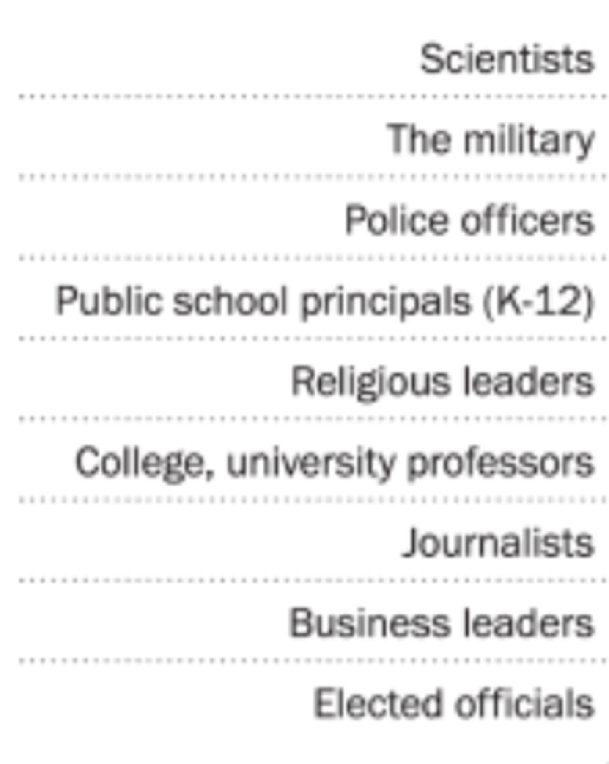

Slide 17
“I had a bad experience…”
So, what’s your plan?
Punish people in the present,
because someone hurt you in the past?
If you refuse to confront and forgive,
then that person is still controlling you.
Jesus redefined leadership!
Growing distrust of leadership & authority
Scandals expose and humiliate leaders
Human nature desires power and position
Experience of inept or absentee leaders

Slide 20
Desires to lead because it “makes me somebody”
Takes their value from influencing others
Leads because they are somebody “in Christ”
Knows influencing others is valuable—but not a stable identity

Slide 21
Competitive
When others succeed, they grow jealous and even depressed!
View talented people as a threat, and work harder to outperform them
Collaborative
When others succeed, they are happy, because that’s their main goal.
View talented people as a God-given asset, working harder to equip them

Slide 22
Can never find time for prayer for some reason…
Defensive when receiving feedback
Desperate for recognition from peers
Desires the title leadership
Follow Jesus’ example of dependent prayer
Looks for the “diamond amidst the dirt.”
Enjoys regular recognition from God
Enjoys the role of leading

Slide 24
The scope of the authority is limited to the space of the authority given by God.
Yes, but Christian leaders are…
(1) Subservient to Scripture
(Gal. 2:11ff; Mk. 7:9-13; Acts 17:11)
(2) On a team of peers—not solo
(1 Pet. 5:2; Acts 14:23; Titus 1:5)
(3) Publicly accountable
(1 Tim. 5:20; 2 Cor. 8:19-21; 1 Cor. 14:29; 1 Thess. 5:21)

Slide 25
Prohistemi
“The functions of leadership in an army, a state, or a party.” (NIDNTT, 1:193; 1 Macc. 5:19)
“To put oneself at the head,” “to go first,” “to preside” (TDNT, 6:700).
(1 Thess. 5:12) [You should] appreciate those who diligently labor among you, and have charge over you in the Lord and give you instruction.

Slide 26
(Heb. 13:17) Obey your leaders and submit to them, for they keep watch over your souls as those who will give an account. Let them do this with joy and not with grief, for this would be unprofitable for you.
Peithesthe (Peitho)
“Convince… persuade, appeal to… win over” (BDAG).
Middle: “To be persuaded.”
William Lane, Hebrews (Dallas, Word, Inc. 1991), p.554.

Slide 27
(Heb. 13:17) Obey your leaders and submit to them, for they keep watch over your souls as those who will give an account. Let them do this with joy and not with grief, for this would be unprofitable for you.
Hypeikete (eiko)
Eiko means “to yield… weak.”
“To yield to someone’s authority, yield, give way, submit” (BDAG).

Slide 28
(Heb. 13:17) Obey your leaders and submit to them, for they keep watch over your souls as those who will give an account. Let them do this with joy and not with grief, for this would be unprofitable for you.

Slide 29
Demonstrate that you are able to…
Civilly discuss disagreements
Defer to others’ ideas
Support subjective judgment calls
“Everyone gets their say, but not their way.”
(Heb. 13:17) Obey your leaders and submit to them, for they keep watch over your souls as those who will give an account. Let them do this with joy and not with grief, for this would be unprofitable for you.

Slide 31
Leadership is biblical

Slide 32
Leadership is biblical
Leadership is unavoidable
Leadership = influence

Slide 33
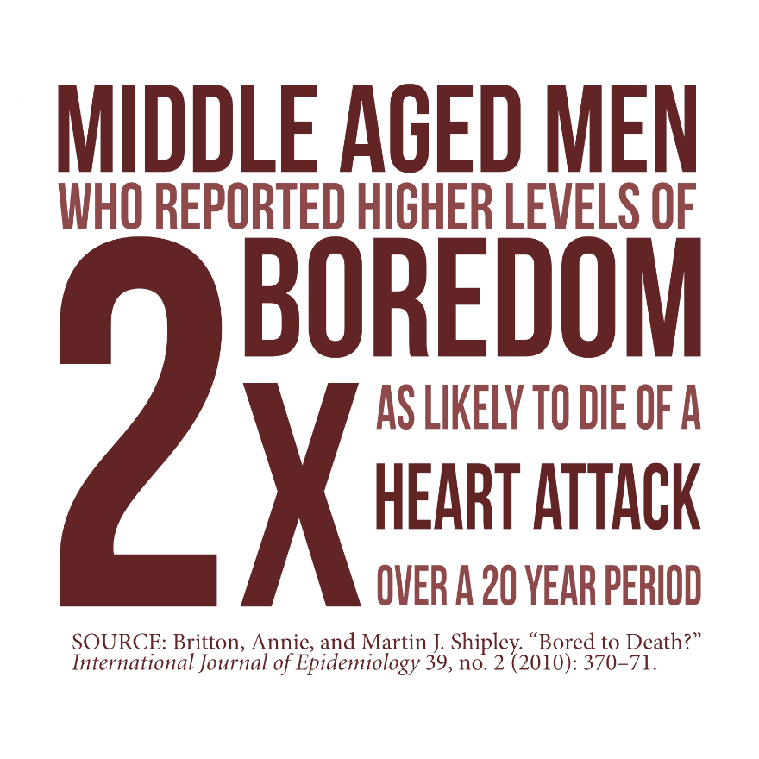
Boss: “Move these boxes to the garage… Then tomorrow, move them back.”
Leadership is biblical
Leadership is unavoidable
Leadership is meaningful

Slide 34
Leadership is biblical
Leadership is unavoidable
Leadership is meaningful
Leadership is rewarding and brings happiness

Slide 35
Leadership is biblical
Leadership is unavoidable
Leadership is meaningful
Leadership is rewarding and brings happiness
Leadership is necessary for healthy groups

Slide 37
Look for needs

Slide 38
Look for needs
One-on-one influence
(Mt. 28:18-20; 2 Tim. 2:2; Col. 1:28-29; Rom. 15:14)

Slide 39
(Jn. 15:4) Remain in me, and I will remain in you.
For a branch cannot produce fruit if it is severed from the vine,
and you cannot be fruitful unless you remain in me.
Look for needs
One-on-one influence
(Mt. 28:18-20; 2 Tim. 2:2; Col. 1:28-29; Rom. 15:14)
Personal study and prayer
(Jn. 15:5; 17:17; 2 Tim. 3:16-17; Acts 6:2-4)

Slide 40
(Jn. 15:4) Remain in me, and I will remain in you.
For a branch cannot produce fruit if it is severed from the vine,
and you cannot be fruitful unless you remain in me.
Look for needs
One-on-one influence
(Mt. 28:18-20; 2 Tim. 2:2; Col. 1:28-29; Rom. 15:14)
Personal study and prayer
(Jn. 15:5; 17:17; 2 Tim. 3:16-17; Acts 6:2-4)

Slide 41
(Jn. 15:5) Yes, I am the vine; you are the branches.
Those who remain in me, and I in them, will produce much fruit.
For apart from me you can do nothing.
Look for needs
One-on-one influence
(Mt. 28:18-20; 2 Tim. 2:2; Col. 1:28-29; Rom. 15:14)
Personal study and prayer
(Jn. 15:5; 17:17; 2 Tim. 3:16-17; Acts 6:2-4)

Slide 42
(1 Thess. 5:11) Encourage each other and build each other up.
¹⁴ Warn those who are lazy.
Encourage those who are timid.
Take tender care of those who are weak. Be patient with everyone.
Look for needs
One-on-one influence
(Mt. 28:18-20; 2 Tim. 2:2; Col. 1:28-29; Rom. 15:14)
Personal study and prayer
(Jn. 15:5; 17:17; 2 Tim. 3:16-17; Acts 6:2-4)
Contemplate how to motivate and inspire others
(Heb. 10:24; 1 Thess. 5:11, 14)

Slide 44
“When I left the dining room after sitting next to Mr. Gladstone,
I thought he was the cleverest man in England.
But after sitting next to Mr. Disraeli, I thought I was the cleverest woman in England.”
John C. Maxwell, The 21 Indispensable Qualities of a Leader (Nashville, TN: Thomas Nelson Publishers, 1999), p.10.

Slide 45
Tom Rath
Tom Rath, Strengths Finder 2.0 (New York: Gallup, 2007), p.4.
If your Boss IGNORES you…
you have a 40% chance of being disengaged.
If your Boss CRITICIZES you…
you have a 22% chance of being disengaged.

Slide 46
Tom Rath
Tom Rath, Strengths Finder 2.0 (New York: Gallup, 2007), p.4.
If your Boss focuses on your STRENGTHS…
you have a 1% chance of being disengaged.

Slide 47
(1 Thess. 5:11) Encourage each other and build each other up.
¹⁴ Warn those who are lazy.
Encourage those who are timid.
Take tender care of those who are weak. Be patient with everyone.
Look for needs
One-on-one influence
(Mt. 28:18-20; 2 Tim. 2:2; Col. 1:28-29; Rom. 15:14)
Personal study and prayer
(Jn. 15:5; 17:17; 2 Tim. 3:16-17; Acts 6:2-4)
Contemplate how to motivate and inspire others
(Heb. 10:24; 1 Thess. 5:11, 14)

Slide 48
Look for needs
One-on-one influence
(Mt. 28:18-20; 2 Tim. 2:2; Col. 1:28-29; Rom. 15:14)
Personal study and prayer
(Jn. 15:5; 17:17; 2 Tim. 3:16-17; Acts 6:2-4)
Contemplate how to motivate and inspire others
(Heb. 10:24; 1 Thess. 5:11)
Grow into an example of Christ-like love
(1 Thess. 2:8; 1 Tim. 4:12)
(1 Thess. 2:8) Having so fond an affection for you,
we were well-pleased to impart to you not only the gospel of God but also our own lives,
because you had become very dear to us.

Slide 50
(Mt. 9:37-38) Jesus said to his disciples,
“The harvest is great, but the workers are few. So pray to the Lord who is in charge of the harvest; ask him to send more workers into his fields.”

