Slide 1
MATTHEW
THE BOOK OF

Slide 2
Matthew 20
²⁰ Then the mother of Zebedee’s sons came to Jesus with her sons and, kneeling down, asked a favor of him.
²¹ “What is it you want?” he asked.
She said, “Grant that one of these two sons of mine may sit at your right and the other at your left in your kingdom.”

Slide 3
Matthew 20
²⁰ Then the mother of Zebedee’s sons came to Jesus with her sons and, kneeling down, asked a favor of him.
²¹ “What is it you want?” he asked.
She said, “Grant that one of these two sons of mine may sit at your right and the other at your left in your kingdom.”

Slide 4
Matthew 20
²² “You don’t know what you are asking,” Jesus said to them. “Can you drink the cup I am going to drink?”
“We can,” they answered.

Slide 5
Matthew 20
²² “You don’t know what you are asking,” Jesus said to them. “Can you drink the cup I am going to drink?”
“We can,” they answered.
The Old Testament symbol for God’s wrath.
» Jeremiah 25:13-16: “Take from my hand this cup filled with the wine of my wrath and make all the nations to whom I send you drink it.”
» Isaiah 51:17, “You who have drunk from the hand of the LORD the cup of his wrath…the goblet that makes people stagger.”

Slide 6
Matthew 20
²² “You don’t know what you are asking,” Jesus said to them. “Can you drink the cup I am going to drink?”
“We can,” they answered.
God’s love and wrath are not incompatible; they’re inseparable.
» One way to define sin is that it’s the destruction of God’s creation.
» We often get angry at someone because we love them.

Slide 7
Matthew 20
²² “You don’t know what you are asking,” Jesus said to them. “Can you drink the cup I am going to drink?”
“We can,” they answered.
²³ Jesus said to them, “You will indeed drink from my cup, but to sit at my right or left is not for me to grant. These places belong to those for whom they have been prepared by my Father.”

Slide 8
Matthew 20
²² “You don’t know what you are asking,” Jesus said to them. “Can you drink the cup I am going to drink?”
“We can,” they answered.
²³ Jesus said to them, “You will indeed drink from my cup, but to sit at my right or left is not for me to grant. These places belong to those for whom they have been prepared by my Father.”

Slide 9
Matthew 20
²² “You don’t know what you are asking,” Jesus said to them. “Can you drink the cup I am going to drink?”
“We can,” they answered.
²³ Jesus said to them, “You will indeed drink from my cup, but to sit at my right or left is not for me to grant. These places belong to those for whom they have been prepared by my Father.”

Slide 10
Matthew 20
²² “You don’t know what you are asking,” Jesus said to them. “Can you drink the cup I am going to drink?”
“We can,” they answered.
²³ Jesus said to them, “You will indeed drink from my cup, but to sit at my right or left is not for me to grant. These places belong to those for whom they have been prepared by my Father.”
²⁴ When the ten heard about this, they were indignant with the two brothers.
Mark 9:33-34: They came to Capernaum; and when He was in the house, He began to question them, “What were you discussing on the way?” But they kept silent, for on the way they had discussed with one another which of them was the greatest.

Slide 11
Matthew 20
²⁵ Jesus called them together and said, “You know that those who are regarded as rulers of the [nations] lord it over them, and their high officials exercise authority over them.
²⁶ Not so with you.
Instead, whoever wants to become great among you must be your servant,
²⁷ and whoever wants to be first must be slave of all.
²⁸ just as the Son of Man did not come to be served, but to serve, and to give his life as a ransom for many.”

Slide 12
Matthew 20
²⁵ Jesus called them together and said, “You know that those who are regarded as rulers of the [nations] lord it over them, and their high officials exercise authority over them.
²⁶ Not so with you.
Instead, whoever wants to become great among you must be your servant,
²⁷ and whoever wants to be first must be slave of all.
²⁸ just as the Son of Man did not come to be served, but to serve, and to give his life as a ransom for many.”

Slide 13
Matthew 20
²⁵ Jesus called them together and said, “You know that those who are regarded as rulers of the [nations] lord it over them, and their high officials exercise authority over them.
²⁶ Not so with you.
Instead, whoever wants to become great among you must be your servant,
²⁷ and whoever wants to be first must be slave of all.
²⁸ just as the Son of Man did not come to be served, but to serve, and to give his life as a ransom for many.”
Jesus, however, measured greatness in terms of service, not status.

Slide 14
Matthew 20
²⁵ Jesus called them together and said, “You know that those who are regarded as rulers of the [nations] lord it over them, and their high officials exercise authority over them.
²⁶ Not so with you.
Instead, whoever wants to become great among you must be your servant,
²⁷ and whoever wants to be first must be slave of all.
²⁸ just as the Son of Man did not come to be served, but to serve, and to give his life as a ransom for many.”
God determines your greatness by how many people you serve, not how many people serve you.

Slide 15
Matthew 20
Consumer
²⁵ Jesus called them together and said, “You know that those who are regarded as rulers of the Gentiles lord it over them, and their high officials exercise authority over them.
²⁶ Not so with you.
Instead, whoever wants to become great among you must be your servant,
²⁷ and whoever wants to be first must be slave of all.
²⁸ just as the Son of Man did not come to be served, but to serve, and to give his life as a ransom for many.”

Slide 16
Matthew 20
Consumer
Contributor
» “Our product promises to make you healthier, happier, and more productive.”
» Following Jesus isn’t another product in the crowded self-care market.
John 13:15-17: You should do as I have done for you…Now that you know these things, you will be blessed if you do them.
²⁵ Jesus called them together and said, “You know that those who are regarded as rulers of the Gentiles lord it over them, and their high officials exercise authority over them.
²⁶ Not so with you.
Instead, whoever wants to become great among you must be your servant,
²⁷ and whoever wants to be first must be slave of all.
²⁸ just as the Son of Man did not come to be served, but to serve, and to give his life as a ransom for many.”

Slide 17
Matthew 20
Consumer
Contributor
» “Does this brand fit with the image I want to project?”
» Prepared to risk loss of reputation and shame for the cause of Christ
Luke 9:23-24: If anyone wishes to come after Me, he must deny himself, and take up his cross daily and follow Me.
²⁵ Jesus called them together and said, “You know that those who are regarded as rulers of the Gentiles lord it over them, and their high officials exercise authority over them.
²⁶ Not so with you.
Instead, whoever wants to become great among you must be your servant,
²⁷ and whoever wants to be first must be slave of all.
²⁸ just as the Son of Man did not come to be served, but to serve, and to give his life as a ransom for many.”

Slide 18
Matthew 20
Consumer
Contributor
» “Is this brand delivering high quality goods or the services I paid for?”
» If we appeal to people’s felt needs and never address people’s core needs
» The Christian life isn’t about you; it’s about others.
²⁵ Jesus called them together and said, “You know that those who are regarded as rulers of the Gentiles lord it over them, and their high officials exercise authority over them.
²⁶ Not so with you.
Instead, whoever wants to become great among you must be your servant,
²⁷ and whoever wants to be first must be slave of all.
²⁸ just as the Son of Man did not come to be served, but to serve, and to give his life as a ransom for many.”

Slide 19
Matthew 20
Consumer
Contributor
» “Is this brand delivering high quality goods or the services I paid for?”
» We’re just peddling another product that cures modern ailments.
» The Christian life isn’t about you; it’s about others.
» It’s possible to devote yourself to serving others, only to realize you are secretly serving yourself.
²⁵ Jesus called them together and said, “You know that those who are regarded as rulers of the Gentiles lord it over them, and their high officials exercise authority over them.
²⁶ Not so with you.
Instead, whoever wants to become great among you must be your servant,
²⁷ and whoever wants to be first must be slave of all.
²⁸ just as the Son of Man did not come to be served, but to serve, and to give his life as a ransom for many.”

Slide 20
Matthew 20
²⁵ Jesus called them together and said, “You know that those who are regarded as rulers of the [nations] lord it over them, and their high officials exercise authority over them.
²⁶ Not so with you.
Instead, whoever wants to become great among you must be your servant,
²⁷ and whoever wants to be first must be slave of all.
²⁸ just as the Son of Man did not come to be served, but to serve, and to give his life as a ransom for many.”
There’s a temptation to build a false identity from ministry
» The success of your ministry or the size of your following becomes an indication of your self-worth.
» You won’t be able to take criticism.
» You cannot stand comparisons.

Slide 21
Matthew 20
²⁵ Jesus called them together and said, “You know that those who are regarded as rulers of the [nations] lord it over them, and their high officials exercise authority over them.
²⁶ Not so with you.
Instead, whoever wants to become great among you must be your servant,
²⁷ and whoever wants to be first must be slave of all.
²⁸ just as the Son of Man did not come to be served, but to serve, and to give his life as a ransom for many.”
There’s a temptation to build a false identity from ministry
» You will focus on your outward life rather than your inward life

Slide 22
Matthew 20
²⁵ Jesus called them together and said, “You know that those who are regarded as rulers of the [nations] lord it over them, and their high officials exercise authority over them.
²⁶ Not so with you.
Instead, whoever wants to become great among you must be your servant,
²⁷ and whoever wants to be first must be slave of all.
²⁸ just as the Son of Man did not come to be served, but to serve, and to give his life as a ransom for many.”
There’s a temptation to build a false identity from ministry
» You will focus on your outward life rather than your inward life (see Judas).

Slide 23
Matthew 20
²⁵ Jesus called them together and said, “You know that those who are regarded as rulers of the [nations] lord it over them, and their high officials exercise authority over them.
²⁶ Not so with you.
Instead, whoever wants to become great among you must be your servant,
²⁷ and whoever wants to be first must be slave of all.
²⁸ just as the Son of Man did not come to be served, but to serve, and to give his life as a ransom for many.”
There’s a temptation to build a false identity from ministry
» You will focus on your outward life rather than your inward life (see Judas).
“We mistake the operation of gifts in our lives for the operation of grace in our lives.”

Slide 24
Matthew 20
²⁵ Jesus called them together and said, “You know that those who are regarded as rulers of the Gentiles lord it over them, and their high officials exercise authority over them.
²⁶ Not so with you.
Instead, whoever wants to become great among you must be your servant,
²⁷ and whoever wants to be first must be slave of all.
²⁸ just as the Son of Man did not come to be served, but to serve, and to give his life as a ransom for many.”
Jesus paid our ransom to release us from bondage.

Slide 25
Matthew 20
²⁵ Jesus called them together and said, “You know that those who are regarded as rulers of the Gentiles lord it over them, and their high officials exercise authority over them.
²⁶ Not so with you.
Instead, whoever wants to become great among you must be your servant,
²⁷ and whoever wants to be first must be slave of all.
²⁸ just as the Son of Man did not come to be served, but to serve, and to give his life as a ransom for many.”

Slide 26
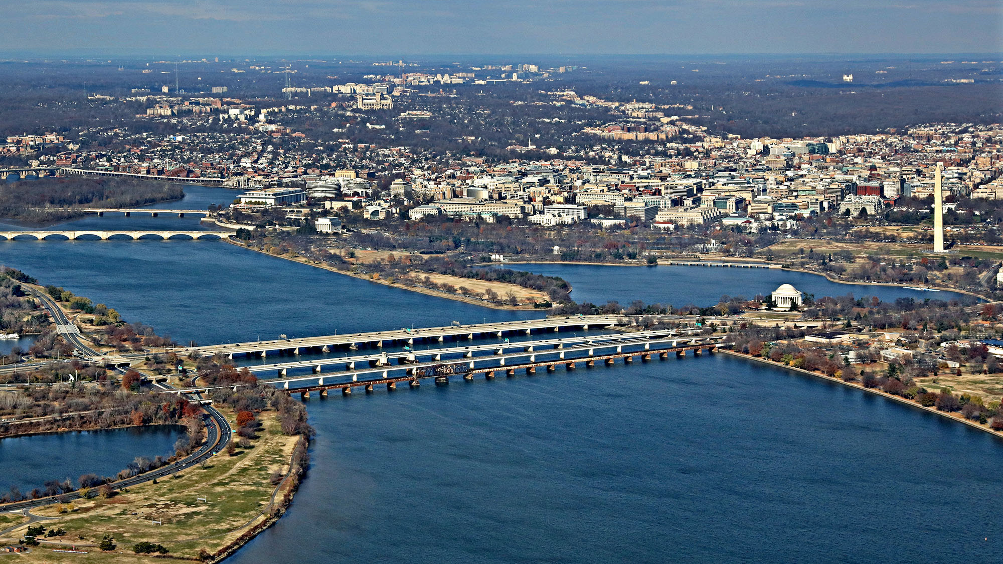
Arland D. Williams Bridge
Washington DC

Slide 27
Air Florida, Flight 90
January 1982

Slide 30
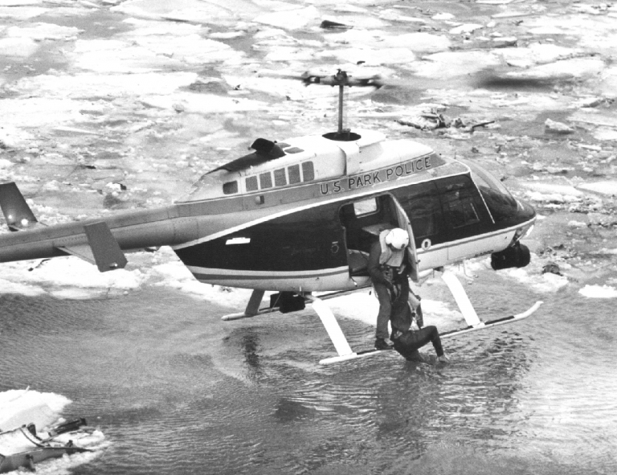

Slide 31
Conclusions
» If you want to be first, you must be last.
» Serving others is at heart of the Christian life.
» God designed you to serve.
» Discover your unique contribution by serving in a variety of ways.
» Make sure Jesus’ love is the motive that drives you to serve and follow him.

Slide 32
MATTHEW
THE BOOK OF

