Slide 2
Matthew 4
The Calling

Slide 3
Context
Jesus
Baptized
Tempted
Ready to begin his ministry

Slide 4
Matthew 4:12–13 (NASB95)
12 Now when Jesus heard that John had been taken into custody, He withdrew into Galilee; 13 and leaving Nazareth, He came and settled in Capernaum, which is by the sea, in the region of Zebulun and Naphtali.

Slide 5
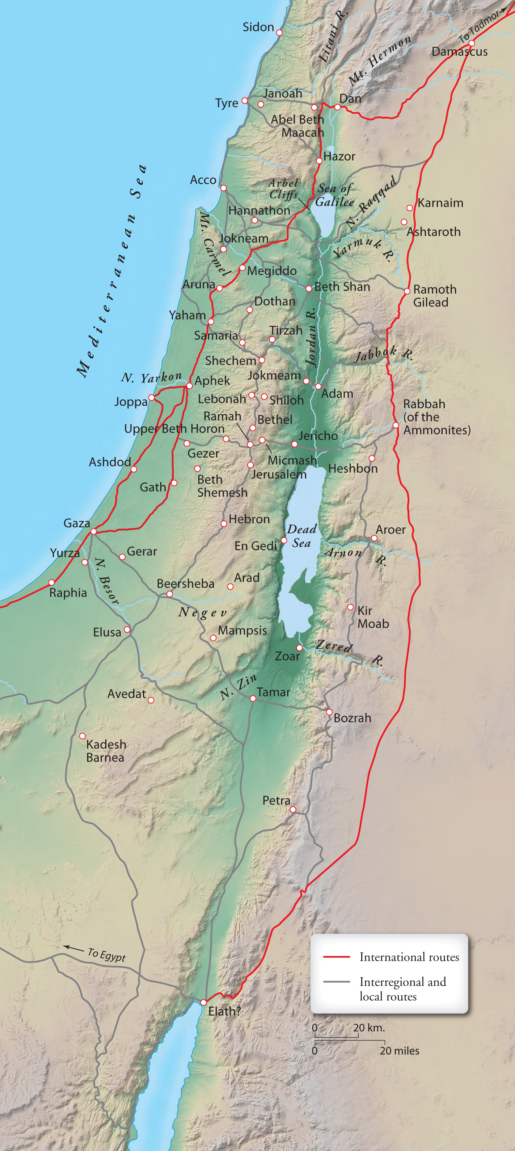
Less than 150 miles

Slide 6
Less than 50 miles

Slide 7
Galilee
Samaria
Judah

Slide 8
Capernaum
Nazareth
Desert Temptation?

Slide 9
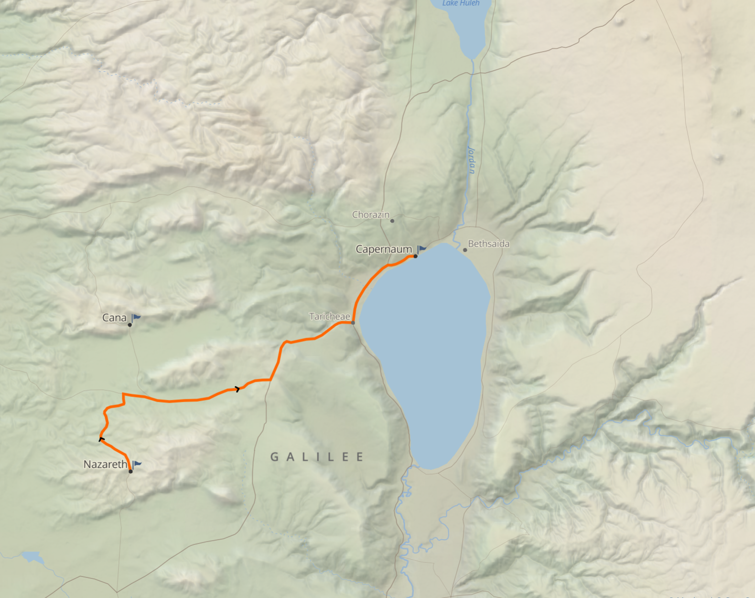
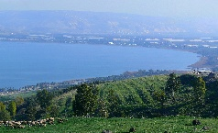
Capernaum
20 miles
Nazareth

Slide 10
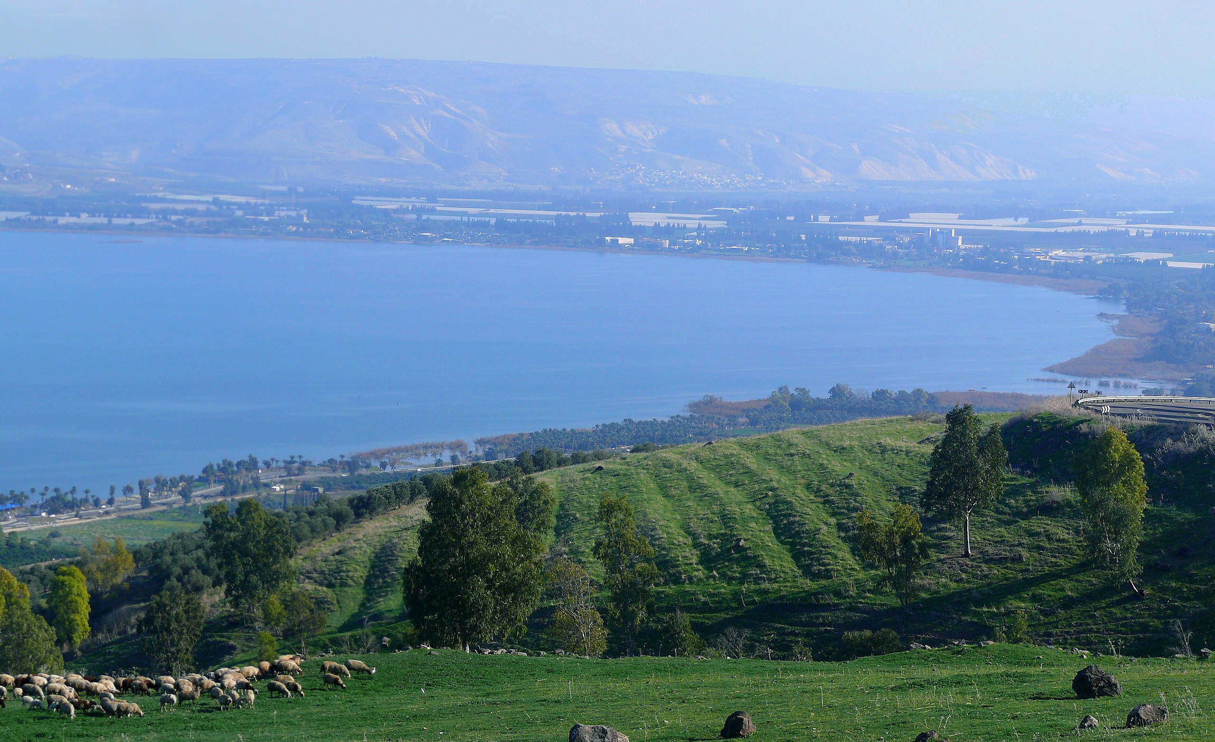
Capernaum
Nazareth

Slide 11
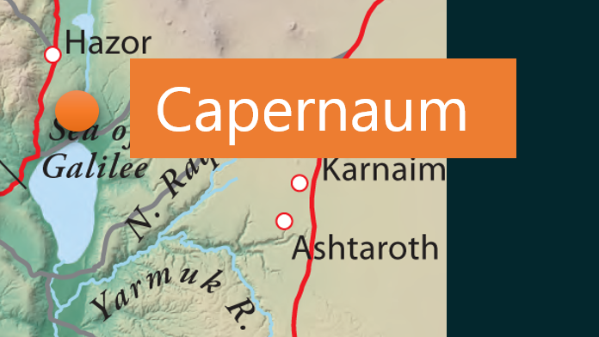
Capernaum
Prosperous fishing village on Sea of Galilee (Lake of Gennesaret)
Jesus’ northern base of operations
Peter, Andrew, James, John birthplace

Slide 12
Matthew 4:17 (NASB95)
17 From that time Jesus began to preach and say, “Repent, for the kingdom of heaven is at hand.”

Slide 13
Matthew 4:18–25 (NASB95)
18 Now as Jesus was walking by the Sea of Galilee, He saw two brothers, Simon who was called Peter, and Andrew his brother, casting a net into the sea; for they were fishermen. 19 And He said to them, “Follow Me, and I will make you fishers of men.” 20 Immediately they left their nets and followed Him.

Slide 14
Matthew 4:18–25 (NASB95)
18 Now as Jesus was walking by the Sea of Galilee, He saw two brothers, Simon who was called Peter, and Andrew his brother, casting a net into the sea; for they were fishermen. 19 And He said to them, “Follow Me, and I will make you fishers of men.” 20 Immediately they left their nets and followed Him.
See Luke Chapter 5

Slide 15
Luke 5:1–2 (NASB95)
1 Now it happened that while the crowd was pressing around Him and listening to the word of God, He was standing by the lake of Gennesaret; 2 and He saw two boats lying at the edge of the lake; but the fishermen had gotten out of them and were washing their nets.

Slide 16
Luke 5:3–4 (NASB95)
3 And He got into one of the boats, which was Simon’s, and asked him to put out a little way from the land. And He sat down and began teaching the people from the boat. 4 When He had finished speaking, He said to Simon, “Put out into the deep water and let down your nets for a catch.”

Slide 17
Luke 5:5–7 (NASB95)
5 Simon answered and said, “Master, we worked hard all night and caught nothing, but I will do as You say and let down the nets.” 6 When they had done this, they enclosed a great quantity of fish, and their nets began to break;

Slide 18
Luke 5:5–7 (NASB95)
7 so they signaled to their partners in the other boat for them to come and help them. And they came and filled both of the boats, so that they began to sink.

Slide 19
Luke 5:8–11 (NASB95)
8 But when Simon Peter saw that, he fell down at Jesus’ feet, saying, “Go away from me Lord, for I am a sinful man!” 9 For amazement had seized him and all his companions because of the catch of fish which they had taken;

Slide 20
Luke 5:8–11 (NASB95)
10 and so also were James and John, sons of Zebedee, who were partners with Simon. And Jesus said to Simon, “Do not fear, from now on you will be catching men.” 11 When they had brought their boats to land, they left everything and followed Him.

Slide 21
Discipleship
μαθητής [mathetes /math·ay·tes/]
Learner or pupil
Jesus’ primary way of spreading His message
Public teaching ministry (Matt. 4:17)
Healing/miracles and acts of service (Matt. 4:23)
In depth personal training of a group of teachable men and women. (Matt. 4:19)

Slide 22
The Disciples
What was Jesus looking for?
Well educated?
Wealthy?
Highly esteemed?
Moral?

Slide 23
The Disciples
1 Samuel 16:7 (NASB95) — 7 But the Lord said to Samuel, “Do not look at his appearance or at the height of his stature, because I have rejected him; for God sees not as man sees, for man looks at the outward appearance, but the Lord looks at the heart.”
What was Jesus looking for?
Well educated?
Wealthy?
Highly esteemed?
Moral?

Slide 24
Simon/Peter
A bold/brash man
A Fisherman
Not afraid to speak his mind/dissent
“Master, we worked hard all night and caught nothing,

Slide 25
Simon/Peter
A bold/brash man
A Fisherman
Not afraid to speak his mind/dissent
Blind faith vs. informed faith

Slide 26
The Disciples
Proverbs 3:5–8 (NASB95) — 5 Trust in the Lord with all your heart And do not lean on your own understanding. 6 In all your ways acknowledge Him, And He will make your paths straight. 7 Do not be wise in your own eyes; Fear the Lord and turn away from evil. 8 It will be healing to your body And refreshment to your bones.
What was Jesus looking for?
Well educated?
Wealthy?
Highly esteemed?
Moral?

Slide 27
Simon/Peter
A bold/brash man
A Fisherman
Not afraid to speak his mind/dissent
Teachable and willing to try
but I will do as You say and let down the nets.”

Slide 28
Simon/Peter
A real understanding of his personal flaws
“Go away from me Lord, for I am a sinful man!”

Slide 29
Simon/Peter
A real understanding of his personal flaws
Luke 5:31–32 (NASB95) — 31 And Jesus answered and said to them, “It is not those who are well who need a physician, but those who are sick. 32 “I have not come to call the righteous but sinners to repentance.”

Slide 30
Jesus’ response?
You’re not that bad!
Don’t be so hard on yourself!
Don’t be afraid
We have work to do

Slide 31
Simon/Peter
Willing to answer the call
When they had brought their boats to land, they left everything and followed Him.

Slide 32
Simon/Peter
John 10:27–28 (NASB95) — 27 “My sheep hear My voice, and I know them, and they follow Me; 28 and I give eternal life to them, and they will never perish; and no one will snatch them out of My hand.
Willing to answer the call
When they had brought their boats to land, they left everything and followed Him.

Slide 33
Matthew 4:18–25 (NASB95)
23 Jesus was going throughout all Galilee, teaching in their synagogues and proclaiming the gospel of the kingdom, and healing every kind of disease and every kind of sickness among the people.

Slide 34
Matthew 4:18–25 (NASB95)
24 The news about Him spread throughout all Syria; and they brought to Him all who were ill, those suffering with various diseases and pains, demoniacs, epileptics, paralytics; and He healed them.

Slide 35
Matthew 4:18–25 (NASB95)
25 Large crowds followed Him from Galilee and the Decapolis and Jerusalem and Judea and from beyond the Jordan.

Slide 36
What is your response?
Are you willing to take a small step?
Throw out your net
Investigate the evidence
Have you tried praying?
Keep coming and listening to Bible teachings
Start getting to know people in a real way

Slide 37
What is your response?
Are you telling God to depart?
Think you are already too far gone?
Offended by Christ’s teaching?
Turned off by the Bible?
Turned off by Christians?
Angry about the church and politics?

Slide 38
What is your response?
Are you asking Him to draw near?
Why not?
Try taking some small steps

Slide 39
What is your response?
Are you willing to take a big step?
Get discipled
Disciple someone else
Take classes
Share your faith
Serve in the community
Lead a home group

Slide 40
Matthew 4:18–25 (NASB95)
25 Large crowds followed Him from Galilee and the Decapolis and Jerusalem and Judea and from beyond the Jordan.
2 Timothy 2:2 (NASB95) — 2 The things which you have heard from me in the presence of many witnesses, entrust these to faithful men who will be able to teach others also.

