Slide 1
1 Peter 5
Shepherd the Flock

Slide 2
1 Peter 5
1 Therefore, I exhort the elders among you,
as your fellow elder
and witness of the sufferings of Christ,
and a partaker also of the glory that is to be revealed,
2 shepherd the flock of God among you

Slide 3
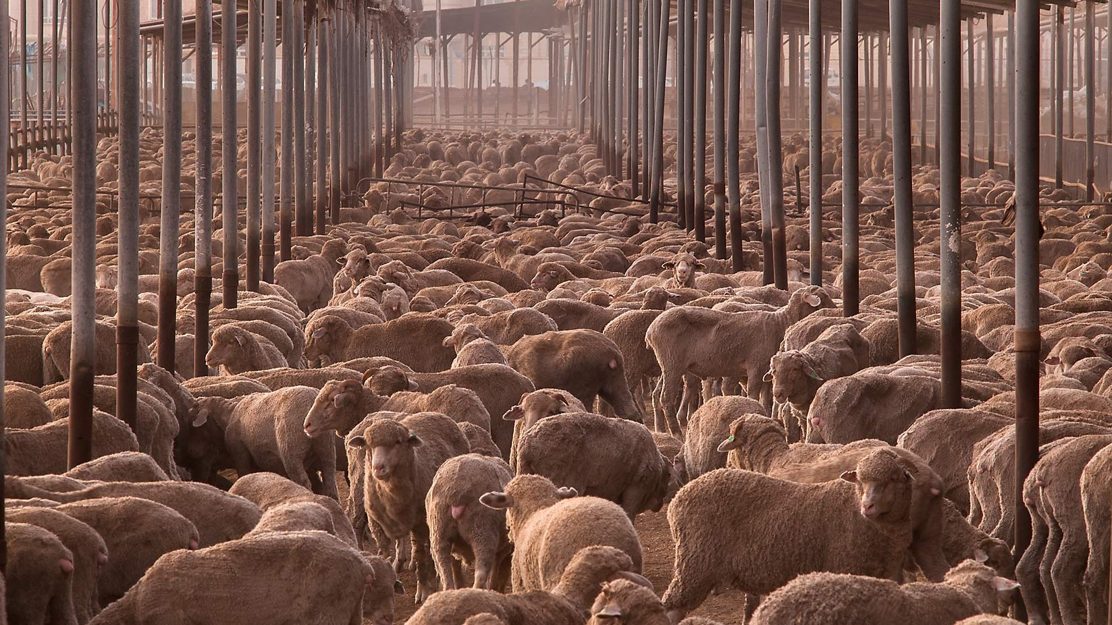

Slide 4
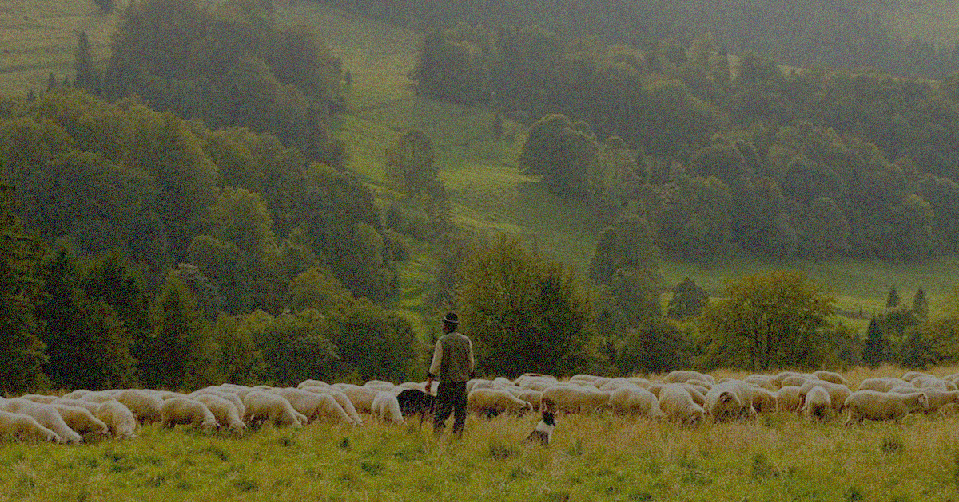

Slide 5
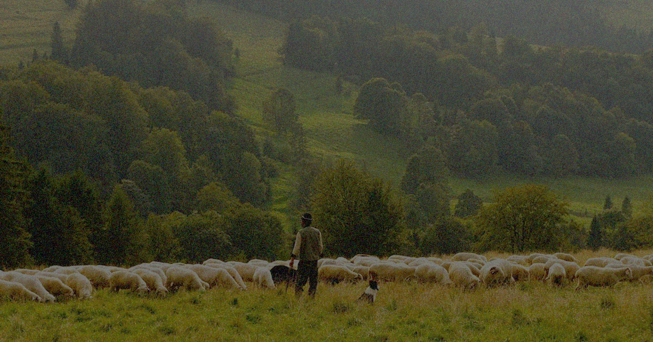
Shepherd the Flock of God
The earliest Jews were shepherds (Genesis 13:5; 26:14; 47:3)
God is depicted as our shepherd (Psalm 23)
God criticizes the leaders for being bad shepherds
What sorrow awaits you shepherds who feed yourselves instead of your flocks (Ezekiel 34:2)
I will set over them one shepherd (Ezekiel 34:23)

Slide 6
Shepherd the Flock of God
Jesus claimed to be that Shepherd!
Biblical leadership is sacrificial servant leadership
Peter calls his readers (and us) to take up the staff
“I am the good shepherd. The good shepherd sacrifices his life for the sheep.” (John 10:11)
I will set over them one shepherd (Ezekiel 34:23)

Slide 7
1 Peter 5
1 Therefore, I exhort the elders among you,
as your fellow elder

Slide 8
1 Peter 5
1 Therefore, I exhort the elders among you,
as your fellow elder
Not a “Pope”
Only two leadership offices in the early church:
Elder/Overseer/Bishop
Deacon
Elders
Deacons
Other Believers

Slide 9
1 Peter 5
1 Therefore, I exhort the elders among you,
as your fellow elder
Application:
We lead in teams and not alone (“among you”)

Slide 10
1 Peter 5
1 Therefore, I exhort the elders among you,
as your fellow elder
and witness of the sufferings of Christ,
and a partaker also of the glory that is to be revealed,
This is what kept Peter going in leadership

Slide 11
1 Peter 5
2 Shepherd the flock of God among you,
exercising oversight
not under compulsion, but voluntarily, according to the will of God;
1. “I get to” vs. “I have to”

Slide 12
1 Peter 5
2 Shepherd the flock of God among you,
exercising oversight
not under compulsion, but voluntarily, according to the will of God;
“I have to” leadership:
Getting “roped into” something
Some serve God this way
Ineffective, bare minimum, resentful
Something needs to change
1. “I get to” vs. “I have to”

Slide 13
1 Peter 5
2 Shepherd the flock of God among you,
exercising oversight
not under compulsion, but voluntarily, according to the will of God;
I need to thank God:
For his grace and mercy
For the ways leading has led to growth in my character
And has grown me closer to Jesus
1. “I get to” vs. “I have to”

Slide 14
1 Peter 5
2 Shepherd the flock of God among you,
exercising oversight
not under compulsion, but voluntarily, according to the will of God;
I need to thank God:
For the friends I’ve made through leading for him
For how it has helped my family
For the future rewards I have gained
1. “I get to” vs. “I have to”

Slide 15
1 Peter 5
2 Shepherd the flock of God among you,
exercising oversight
not under compulsion, but voluntarily, according to the will of God;
and not for sordid gain, but with eagerness
“The hired hand runs away because he’s working only for the money and doesn’t really care about the sheep.” (John 10:13)
2. Eager to take vs. Eager to give

Slide 16
1 Peter 5
Christian leaders often get busted for taking
We can give because we are receiving from the Shepherd and focused on his return
Otherwise we might have other expectations (recognition, appreciation, romance)
2 Shepherd the flock of God among you,
exercising oversight
not under compulsion, but voluntarily, according to the will of God;
and not for sordid gain, but with eagerness
2. Eager to take vs. Eager to give

Slide 17
1 Peter 5
2 Shepherd the flock of God among you,
exercising oversight
not under compulsion, but voluntarily, according to the will of God;
and not for sordid gain, but with eagerness
3 nor yet as lording it over those allotted to your charge, but proving to be examples to the flock.
Jesus turned this world’s leadership model upside-down
3. Lording over vs. Serving under

Slide 18
1 Peter 5
“You know that the rulers in this world lord it over their people,
and officials flaunt their authority over those under them.
But among you it will be different.
2 Shepherd the flock of God among you,
exercising oversight
not under compulsion, but voluntarily, according to the will of God;
and not for sordid gain, but with eagerness
3 nor yet as lording it over those allotted to your charge, but proving to be examples to the flock.
3. Lording over vs. Serving under

Slide 19
1 Peter 5
Whoever wants to be a leader among you must be your servant…
For even the Son of Man came not to be served but to serve others and to give his life as a ransom for many.” (Mark 10:42-45)
2 Shepherd the flock of God among you,
exercising oversight
not under compulsion, but voluntarily, according to the will of God;
and not for sordid gain, but with eagerness
3 nor yet as lording it over those allotted to your charge, but proving to be examples to the flock.
This is why the sheep follow the shepherd
3. Lording over vs. Serving under

Slide 20
1 Peter 5
5 You younger men, likewise, be subject to your elders;
and all of you, clothe yourselves with humility toward one another,
for God is opposed to the proud, but gives grace to the humble.
Bad followers make bad leaders
4. Humbling yourself vs Exalting yourself

Slide 21
1 Peter 5
5 You younger men, likewise, be subject to your elders;
and all of you, clothe yourselves with humility toward one another,
for God is opposed to the proud, but gives grace to the humble.
Bad followers make bad leaders
Pride can be subtle…
4. Humbling yourself vs Exalting yourself

Slide 22
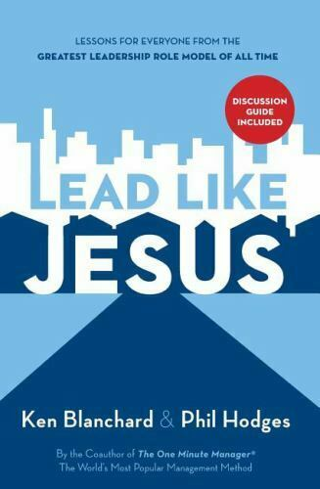
Blanchard and Hodges, Lead Like Jesus (Thomas Nelson, 2005), 51-52
When you are engaged in a discussion, you resist acknowledging that the other person’s idea is actually better than your own.

Slide 23
Blanchard and Hodges, Lead Like Jesus (Thomas Nelson, 2005), 51-52
You start to do all the talking, taking too much credit, demanding all the attention, boasting, showing off, or demanding service on the basis of your position.
You judge the value of an idea by who said it rather than by the quality of the thought.

Slide 24
Blanchard and Hodges, Lead Like Jesus (Thomas Nelson, 2005), 51-52
You treat people as too far below you in position or credentials to seek out their input on issues that affect them.
Your image becomes more important than substance and truth.

Slide 25
Blanchard and Hodges, Lead Like Jesus (Thomas Nelson, 2005), 51-52
You act as if the rules, judgments, and standards you impose on others should not apply to you…
Winning and losing become the only criteria you value and character becomes an option.

Slide 26
Blanchard and Hodges, Lead Like Jesus (Thomas Nelson, 2005), 51-52
You look in the mirror to find the source of all success and out the window for the cause of failure.
Do you want to be opposed or exalted by God?

Slide 27
1 Peter 5
6 Therefore humble yourselves under the mighty hand of God,
that He may exalt you at the proper time, (cf. Lk 14:8-11)
7 casting all your anxiety on Him, because He cares for you.
Do you want to be opposed or exalted by God?
4. Humbling yourself vs Exalting yourself

Slide 28
1 Peter 5
6 Therefore humble yourselves under the mighty hand of God,
that He may exalt you at the proper time, (cf. Lk 14:8-11)
7 casting all your anxiety on Him, because He cares for you.
If you strive to gain, you will strive to maintain
4. Humbling yourself vs Exalting yourself

Slide 29
Shepherd the Flock of God
Why did Peter devote his life to this?
Because he knew the Shepherd’s grace and love (John 13, 18, 21)
Because he couldn’t wait for his homecoming
When the Chief Shepherd appears, you will receive the unfading crown of glory (1 Peter 5:4)

Slide 30
Shepherd the Flock of God
The Chief Shepherd has two questions for you:
“Will you join my flock?”
“Will you shepherd my sheep?”

Slide 31
1 Peter 5:1-7
Questions?
Comments?
Experiences?
risleys@dwellcc.org
See the Dwell App OR teachings.dwellcc.org
Next time: 1 Peter 5 – The Roaring Lion

