Slide 1
Psalm 31
Our Safe Place

Slide 2
Corrie Ten Boom
Boom, Corrie ten (2015-04-28). The Hiding Place (Kindle Locations 201-203). Baker Publishing Group. Kindle Edition.
“You are my hiding place and my shield: I hope in your word.”
What kind of hiding place? I wondered idly. What was there to hide from?

Slide 3
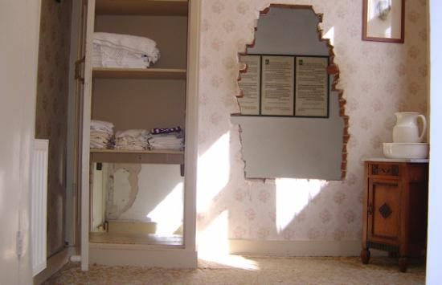
She discovers the only true hiding place is the presence of her heavenly Father

Slide 4
Psalm 31
Surrounded by enemies on every side, David turns to God as his rock and his fortress
Many have turned to Psalm 31 in their hour of greatest need
Jeremiah (Jer. 6:25; 20:10; 46:5; 49:29; Lam 2:22)
Jonah (Jonah 2:8)
Jesus (Luke 23:46)
Stephen (Acts 7:59)
1 Peter (1 Peter 4:19)

Slide 5
Psalm 31
1 Yahweh, I have come to you for protection; don’t let me be disgraced.
Save me, for you do what is right.
2 Turn your ear to listen to me; rescue me quickly.
Be my rock of protection, a fortress where I will be safe.
3 For you are my rock and my fortress.
For the honor of your name, lead me out of this danger.

Slide 6
Psalm 31
4 Pull me from the trap my enemies set for me, for I find protection in you alone.
What Enemies?

Slide 7
Psalm 31
4 Pull me from the trap my enemies set for me, for I find protection in you alone.
David had a lot of enemies
Scripture says a lot about “enemies”
The basic meaning of the verb is “to be hostile towards”
God was our enemy
What Enemies?

Slide 8
Psalm 31
4 Pull me from the trap my enemies set for me, for I find protection in you alone.
David had a lot of enemies
Scripture says a lot about “enemies”
The basic meaning of the verb is “to be hostile towards”
God was our enemy
Romans 5
10 Our friendship with God was restored by the death of his Son while we were still his enemies…
11 So now we can rejoice in our wonderful new relationship with God because our Lord Jesus Christ has made us friends of God.
What Enemies?

Slide 9
Psalm 31
4 Pull me from the trap my enemies set for me, for I find protection in you alone.
David had a lot of enemies
Scripture says a lot about “enemies”
The basic meaning of the verb is “to be hostile towards”
God was our enemy
Satan is God’s enemy, and therefore the enemy of God’s people
1 Peter 5:8 – Be of sober spirit, be on the alert. Your adversary, the devil, prowls around like a roaring lion, seeking someone to devour.
What Enemies?

Slide 10
Psalm 31
4 Pull me from the trap my enemies set for me, for I find protection in you alone.
David had a lot of enemies
Scripture says a lot about “enemies”
The basic meaning of the verb is “to be hostile towards”
God was our enemy
Satan is God’s enemy, and therefore the enemy of God’s people
He is the real source of much hostility against Christians and will take every opportunity to vent his anger
What Enemies?

Slide 11
Psalm 31
4 Pull me from the trap my enemies set for me, for I find protection in you alone.
People can be our enemies as well
John 15:18-19 – If the world hates you, keep in mind that it hated me first. If you belonged to the world, it would love you as its own. As it is, you do not belong to the world, but I have chosen you
What Enemies?

Slide 12
Psalm 31
4 Pull me from the trap my enemies set for me, for I find protection in you alone.
People can be our enemies as well
Coworkers, classmates or neighbors
Legal opponents
Christians who used to be friends with you
Fellow Christian workers
Galatians 4:16 – “Have I become your enemy by telling you the truth?”
What Enemies?

Slide 13
Psalm 31
4 Pull me from the trap my enemies set for me, for I find protection in you alone.
People can be our enemies as well
Coworkers, classmates or neighbors
Legal opponents
Christians who used to be friends with you
Fellow Christian workers
Family members
Matthew 10:36 – A man’s enemies will be the members of his own household.
What Enemies?

Slide 14
Psalm 31
1 Yahweh
I have come to you for protection;
don’t let me be disgraced.
Save me, for you do what is right.
2 Turn your ear to listen to me;
rescue me quickly.
Be my rock of protection,
a fortress where I will be safe.
1
2
3
4
5
6
7
What is the basis for his plea?

Slide 15
Psalm 31
3 For you are my rock and my fortress.
What is the basis for his plea?

Slide 16
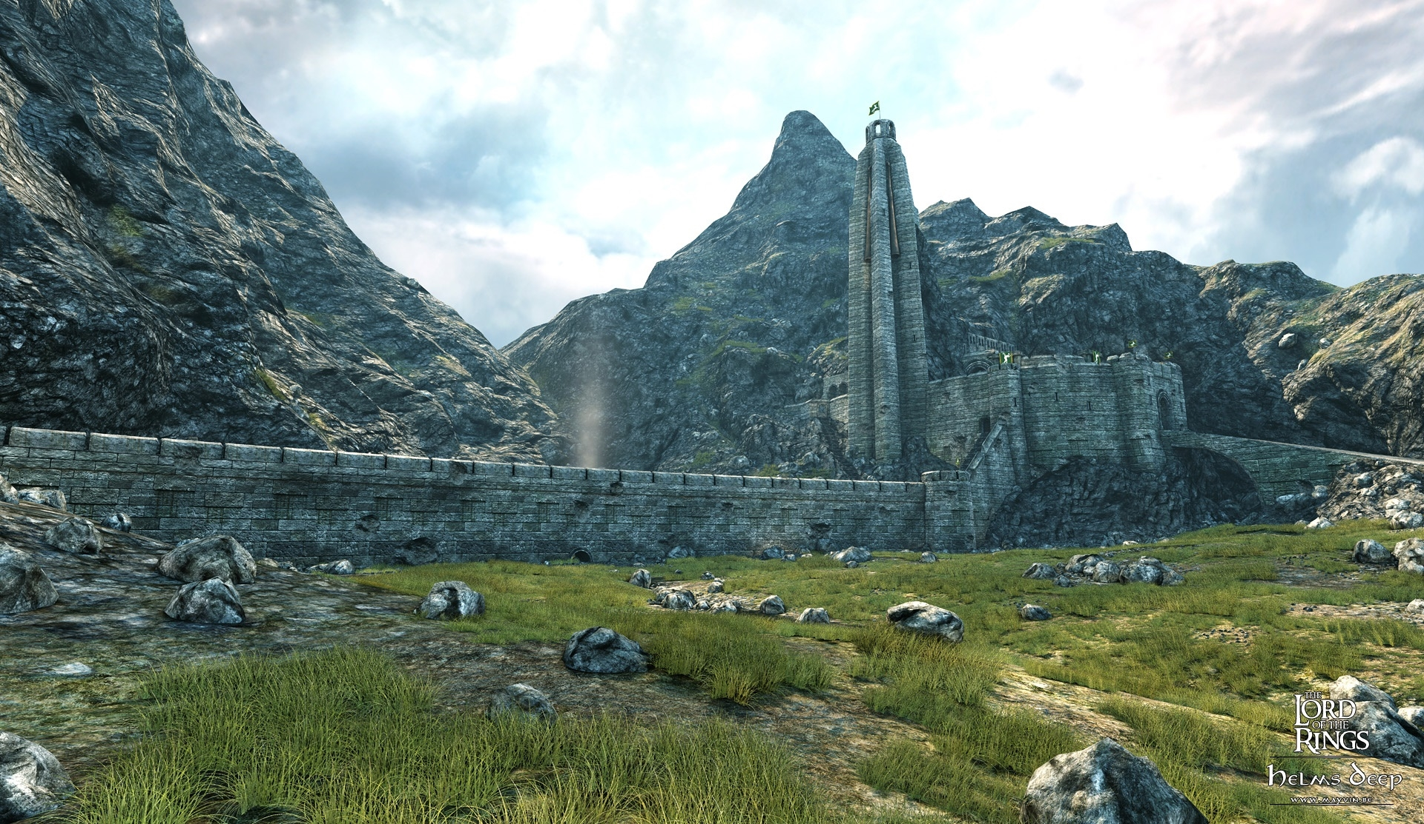
Psalm 31
3 For you are my rock and my fortress.

Slide 17
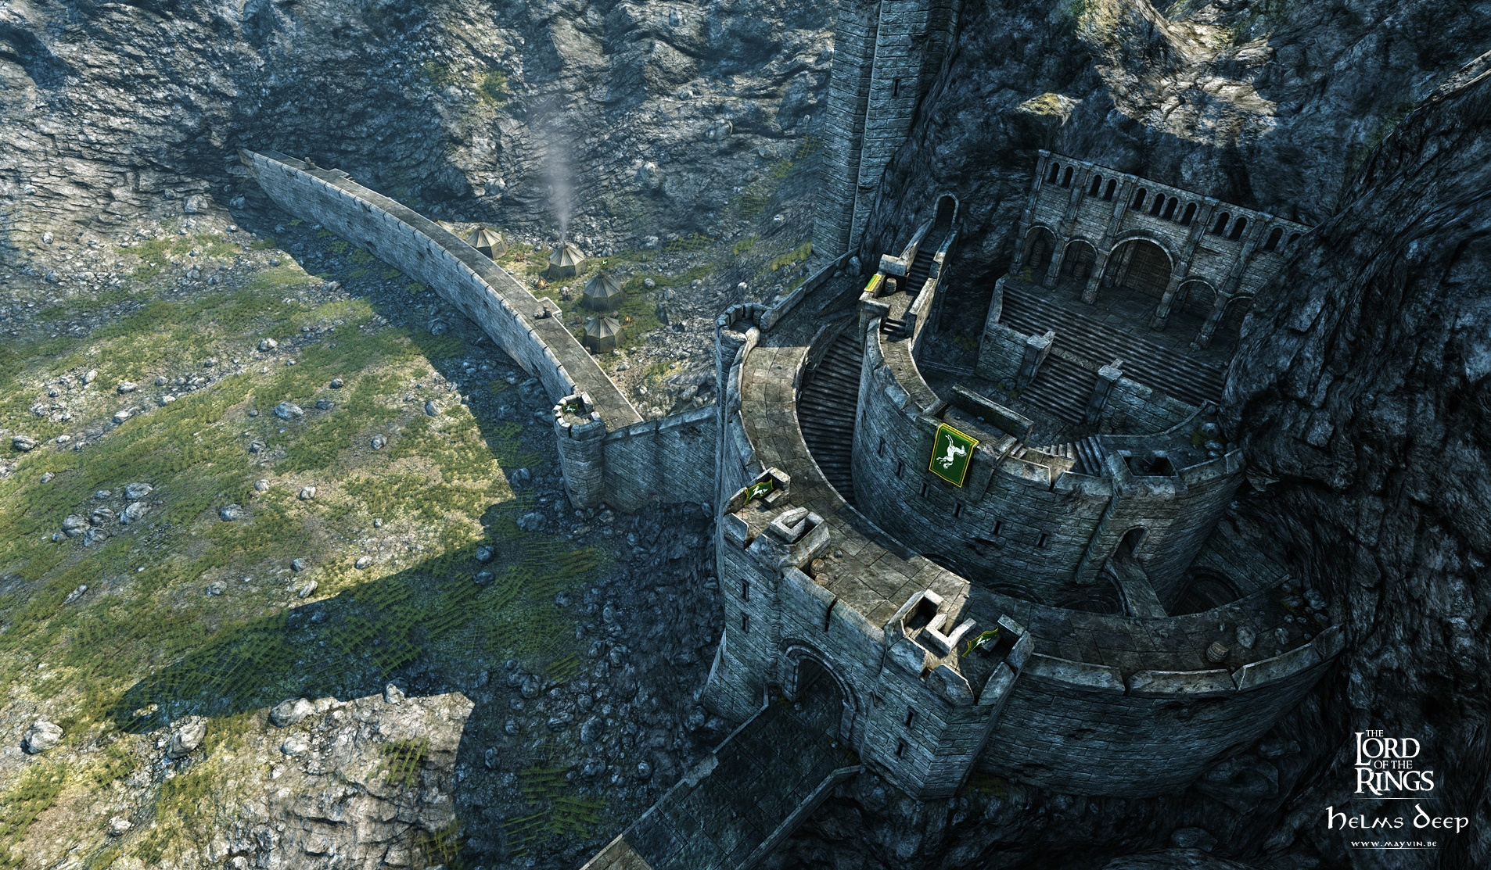
Psalm 31
3 For you are my rock and my fortress.
Desperate prayers sound different

Slide 18
Psalm 31
3 For you are my rock and my fortress.
For the honor of your name, lead me out of this danger.
There are more important factors in play here beyond David’s suffering
Anytime I can recognize that my suffering isn’t just about me, that’s a good thing!
What is the basis for his plea?

Slide 19
Psalm 31
3 For you are my rock and my fortress.
For the honor of your name, lead me out of this danger.
4 Pull me from the trap my enemies set for me,
for I find protection in you alone.
What is the basis for his plea?

Slide 20
Psalm 31
5 I entrust my spirit into your hand.
Rescue me, Yahweh, for you are a faithful God.
6 I hate those who worship worthless idols. I trust in Yahweh.

Slide 21
Psalm 31
7 I will be glad and rejoice in your unfailing love,
Instead of fretting about his troubles he choses to rejoice in God’s unfailing love

Slide 22
Psalm 31
7 I will be glad and rejoice in your unfailing love,
for you have seen my troubles,
and you care about the anguish of my soul.
Have you ever wondered if God sees or cares?

Slide 23
Psalm 31
8 You have not given me over to the hand of my enemies but have set me in a safe place.
Seems like David is starting to have a breakthrough…

Slide 24
Psalm 31
9 Have mercy on me, Yahweh, for I am in distress.
Tears blur my eyes.
My body and soul are withering away.

Slide 25
Psalm 31
10 I am dying from grief;
my years are shortened by sadness.
My strength fails me because of my sin.
I am wasting away from within.

Slide 26
Psalm 31
10 I am dying from grief;
my years are shortened by sadness.
My strength fails me because of my sin.
I am wasting away from within.
This can be one of the most painful parts
If only I had been stronger
If only I had been more thoughtful
If only I hadn’t lost my temper
If only I had prayed more
If only I had been more articulate
If only I was a better leader

Slide 27
Psalm 31
10 I am dying from grief;
my years are shortened by sadness.
My strength fails me because of my sin.
I am wasting away from within.
But how does David’s sin affect his boldness?
Do God’s promises suddenly not apply?
Has God ceased to be his rock and fortress?
Does David’s sin make God any less concerned for the sake of his name?
Does it reduce God’s hesed?
Does it mean that God neither sees nor cares?

Slide 28
Psalm 31
10 I am dying from grief;
my years are shortened by sadness.
My strength fails me because of my sin.
I am wasting away from within.
It’s not just perfect people who need a place of safety
Hebrews 4:16 – Therefore let us draw near with confidence to the throne of grace, so that we may receive mercy and find grace to help in time of need.

Slide 29
Psalm 31
11 I am scorned by all my enemies
and despised by my neighbors—
even my friends are afraid to come near me.
When they see me on the street,
they run the other way.

Slide 30
Psalm 31
12 I am ignored as if I were dead,
as if I were a broken pot.
13 I have heard the many rumors about me,
and I am surrounded by terror.
My enemies conspire against me,
plotting to take my life.

Slide 31
Psalm 31
14 But I am trusting you, Yahweh,
saying, “You are my God!”
15 My future is in your hand.
Rescue me from the hand of those who hunt me down relentlessly.

Slide 32
Psalm 31
16 Let your favor shine on your servant. [Num. 6:24-26]
In your unfailing love, rescue me.
17 Don’t let me be disgraced, Yahweh,
for I call out to you for help.
Let the wicked be disgraced;
let them lie silent in the grave.

Slide 33
Psalm 31
18 Silence their lying lips—
those proud and arrogant lips that accuse the godly.
19 How great is the goodness
you have stored up for those who fear you.
You lavish it on those who come to you for protection,
blessing them before the watching world.

Slide 34
Psalm 31
20 You hide them in the hiding place of your presence,
safe from those who conspire against them.
You shelter them in your presence,
far from accusing tongues.

Slide 35
Psalm 31
21 Praise Yahweh,
for he has shown me the wonders of his unfailing love.
He kept me safe when my city was under attack.

Slide 36
Psalm 31
22 In panic I cried out,
“I am cut off from Yahweh!”
But you heard my cry for mercy
and answered my call for help.

Slide 37
Psalm 31
23 Love Yahweh, all you, godly ones!
For Yahweh protects those who are loyal to him,
but he harshly punishes the arrogant.

Slide 38
Psalm 31
24 So be strong
and let your heart be strengthened
all you who put your hope in Yahweh!

Slide 39
Psalm 31
24 So be strong
and let your heart be strengthened
all you who put your hope in Yahweh!
Two forces at work: We need to be strong and we need to let our hearts be strengthened – by God
We learn from Psalm 31 that trusting Yahweh as your safe place takes courage

Slide 40
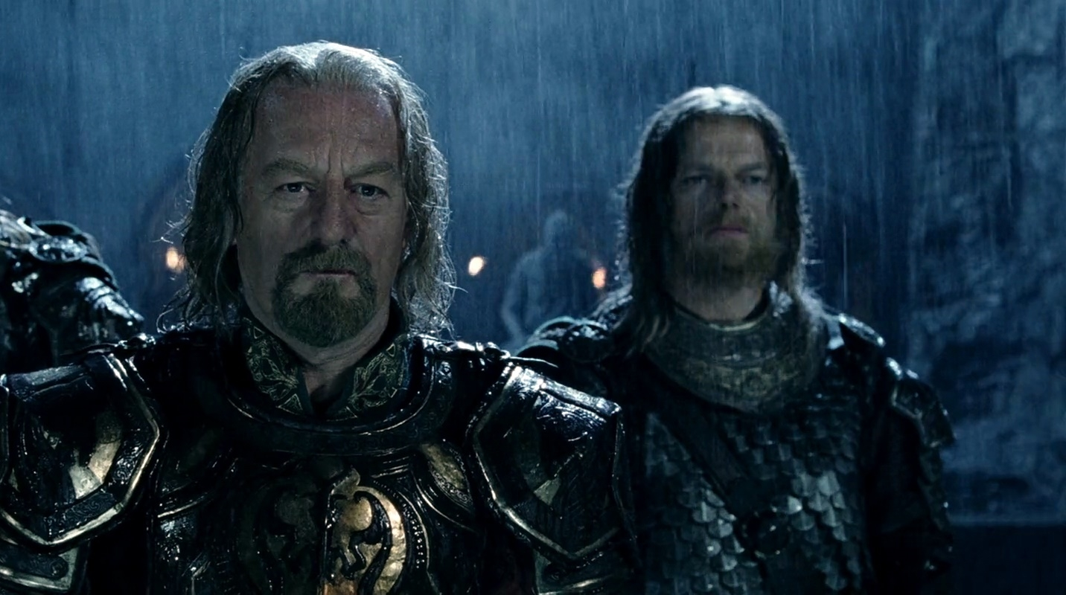

Slide 41
Háma: ‘True enough, but for myself, I will wait until I see Gandalf again.’

Slide 42
It is said that this fortress has never fallen to assault, but now my heart is doubtful.
The world changes, and all that once was strong now proves unsure.

Slide 43
How shall any tower withstand such numbers and such reckless hate?
Gandalf’s counsel seems not now so good as it did under the morning sun.

Slide 44
‘Do not judge the counsel of Gandalf, until all is over, lord.’
[And, of course, Gandalf does show up]
The point of the story?

Slide 45
The reason why it takes courage to wait on the Lord is because He often doesn’t just take the hostility away
What glorifies God more: Not having any opposition or loving your enemies and having joy and peace in the midst of the storm
Would you rather have hostility from others and closeness with God? Or neither one?
Some of you are here tonight because you came looking for a safe place in the face of hostility
What would have been better for David?
What would have been better for Corrie Ten Boom?

Slide 46
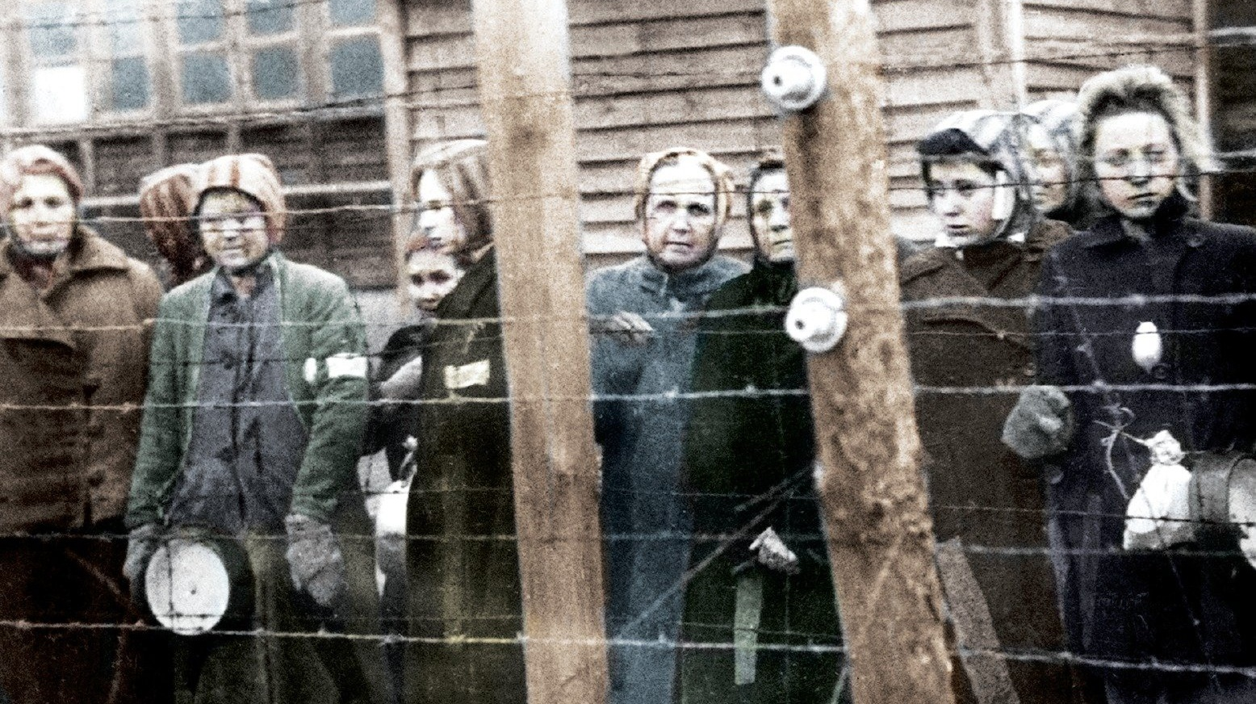
“We must tell people that there is no pit so deep that He is not deeper still.
They will listen to us, Corrie, because we have been here.”
Boom, Corrie ten (2015-04-28). The Hiding Place (Kindle Locations 1928-1929). Baker Publishing Group. Kindle Edition.

Slide 47
What would be better for you?
For God to clear all opposition and hostility out of your life?
Or to leave some there for the short time you have left in this life.
So you can learn to pray Psalm 31 like you really mean it
So you can find out what it means for God to be your place of safety

