Slide 1
James
James
From Trials to Triumph
Chapter 1

Slide 2
1. From James, a slave of God and the Lord Jesus Christ, to the twelve tribes dispersed abroad. Greetings!
James

Slide 3
1. From James, a slave of God and the Lord Jesus Christ, to the twelve tribes dispersed abroad. Greetings!
(Matt. 13:55-56) Then they scoffed at Jesus, “He’s just the carpenter’s son, and we know Mary, his mother, and his brothers: James, Joseph, Simon, and Judas. All his sisters live right here among us.
James

Slide 4
1. From James, a slave of God and the Lord Jesus Christ, to the twelve tribes dispersed abroad. Greetings!
(Jn. 7:3-5) Jesus’ brothers said to him, “Leave here and go to Judea, where your followers can see your miracles! You can’t become famous if you hide like this! If you can do such wonderful things, show yourself to the world!” For even his brothers didn’t believe in him.
James

Slide 5
1. From James, a slave of God and the Lord Jesus Christ, to the twelve tribes dispersed abroad. Greetings!
(1 Cor. 15:3-7) Christ died for our sins, just as the Scriptures said. He was buried, and he was raised from the dead on the third day, just as the Scriptures said. He was seen by Peter and then by the Twelve. After that, he was seen by more than 500 of his followers at one time, most of whom are still alive, though some have died. Then he was seen by James and later by all the apostles.
James

Slide 6
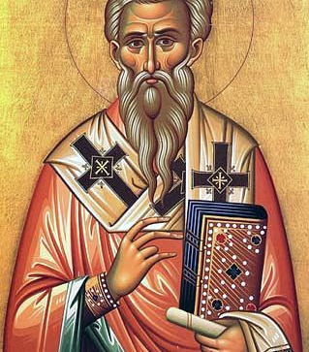
(Hegesippus) “They came, therefore, in a body to James, and said: "We entreat you, restrain the people: for they have gone astray in their opinions about Jesus, as if he were the Christ. We entreat you to persuade all who have come for the day of the passover, concerning Jesus…

Slide 7
…Take a stand, then, upon the summit of the temple, that from that elevated spot you may be clearly seen, and your words may be plainly audible to all the people”…

Slide 8
…The scribes and Pharisees accordingly set James on the summit of the temple, and cried aloud to him, and said: "O just one, whom we are all bound to obey, forasmuch as the people are in error, and follow Jesus the crucified, do tell us what is the door of Jesus, the crucified.”…

Slide 9
… And James answered with a loud voice: "Why ask me concerning Jesus the Son of man? He Himself sits in heaven, at the right hand of the Great Power, and shall come on the clouds of heaven.”…

Slide 10
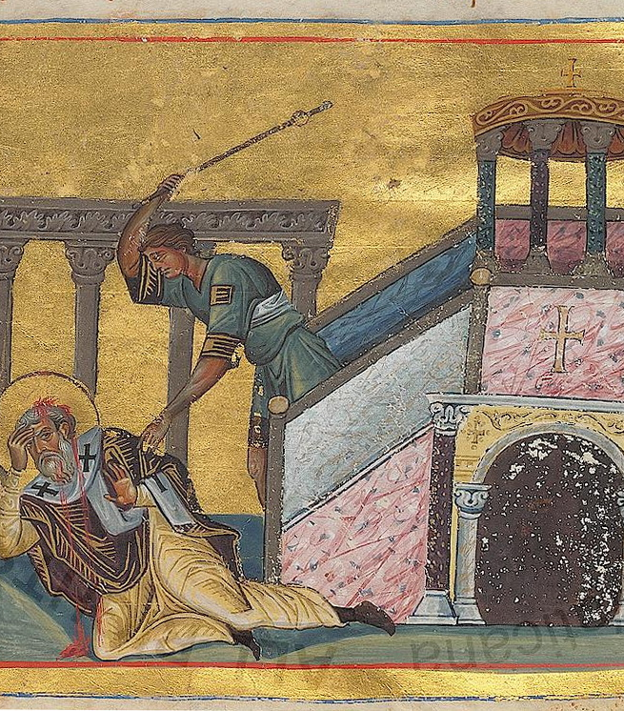
… And, when many were fully convinced by these words, and offered praise for the testimony of James…the Pharisees and scribes said to one another… “let us go up and throw him down, that they may be afraid, and not believe him." And they cried aloud, and said: "Oh! oh! the just man himself is in error.”…

Slide 11
…So they went up and threw down the just man, and said to one another: "Let us stone James the Just." And they began to stone him: for he was not killed by the fall; but he turned, and kneeled down, and said: "I ask You, Lord God our Father, forgive them; for they know not what they do.”…

Slide 12
…and, while they were thus stoning him to death…one among them, one of the fullers, took the staff with which he was accustomed to wring out the garments he dyed, and hurled it at the head of the just man. And so James the Just suffered martyrdom.

Slide 13
1. From James, a slave of God and the Lord Jesus Christ, to the twelve tribes dispersed abroad. Greetings!
These early, Jewish Christians had two strikes against them from the start!
James

Slide 14
1. From James, a slave of God and the Lord Jesus Christ, to the twelve tribes dispersed abroad. Greetings!
diaspora (διασπορά): carries the idea of scattering seed
James

Slide 15
2. My brothers and sisters, consider it nothing but joy when you fall into all sorts of trials,
James

Slide 16
2. My brothers and sisters, consider it nothing but joy when you fall into all sorts of trials,
How should we respond in times of trial?
James

Slide 17
Reality

Slide 18
2. My brothers and sisters, consider it nothing but joy when you fall into all sorts of trials,
Suffering in life is inevitable.
James

Slide 19
2. My brothers and sisters, consider it nothing but joy when you fall into all sorts of trials,
Suffering in life is inevitable.
(Job 14:1) “How frail is humanity!
How short is life, how full of trouble!”
James

Slide 20
2. My brothers and sisters, consider it nothing but joy when you fall into all sorts of trials,
Suffering in life is inevitable.
(Job 5:7) People are born for trouble as readily as sparks fly up from a fire.
James

Slide 21
2. My brothers and sisters, consider it nothing but joy when you fall into all sorts of trials,
Suffering in life is inevitable.
(Ps. 34:19) The righteous person faces many troubles, but the Lord comes to the rescue each time.
James

Slide 22
2. My brothers and sisters, consider it nothing but joy when you fall into all sorts of trials,
Suffering in life is inevitable.
(1 Pt. 4:12) Dear friends, do not be astonished that a trial by fire is occurring among you, as though something strange were happening to you.
James

Slide 23
2. My brothers and sisters, consider it nothing but joy when you fall into all sorts of trials,
peripiptō (περιπίπτω): to hit against; to be struck by; fall into or in with.
James

Slide 24
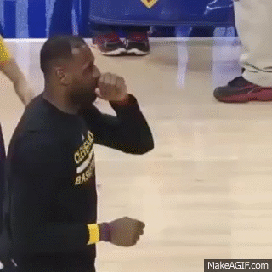
2. My brothers and sisters, consider it nothing but joy when you fall into all sorts of trials,
peripiptō (περιπίπτω): to hit against; to be struck by; fall into or in with.
James

Slide 25
2. My brothers and sisters, consider it nothing but joy when you fall into all sorts of trials,
Many times, suffering in life is unpredictable.
(Lk. 10:30) A man was going down from Jerusalem to Jericho, and fell into the hands of robbers, who stripped him, beat him up, and went off, leaving him half dead.
James

Slide 26
2. My brothers and sisters, consider it nothing but joy when you fall into all sorts of trials,
(Winston Churchill) “We must always be ready to meet at our average moment, the thing that any possible enemy could hurl against us at his selected moment.”
Many times, suffering in life is unpredictable.
(Lk. 10:30) A man was going down from Jerusalem to Jericho, and fell into the hands of robbers, who stripped him, beat him up, and went off, leaving him half dead.
James

Slide 27
2. My brothers and sisters, consider it nothing but joy when you fall into all sorts of trials,
Suffering in life is variable.
James

Slide 28
Response

Slide 29
2. My brothers and sisters, consider it nothing but joy when you fall into all sorts of trials,
He is describing a deliberate attitude of joy.
How do we do this?
James

Slide 30
2. My brothers and sisters, consider it nothing but joy when you fall into all sorts of trials,
James is not saying…
“Enjoy your suffering”
“Suffering is a joy”
“Feel happy about your suffering”
James

Slide 31
2. My brothers and sisters, consider it nothing but joy when you fall into all sorts of trials,
James is talking about a perspective.
James is not saying…
“Enjoy your suffering”
“Suffering is a joy”
“Feel happy about your suffering”
James

Slide 32
2. My brothers and sisters, consider it nothing but joy when you fall into all sorts of trials,
James is talking about a perspective.
Paul is not saying…
“Enjoy your suffering”
“Suffering is a joy”
“Feel happy about your suffering”
(Heb. 12:2) keeping our eyes fixed on Jesus, the pioneer and perfecter of our faith. For the joy set out for him he endured the cross, disregarding its shame, and has taken his seat at the right hand of the throne of God.
James

Slide 33
(Warren Wiersbe) Our values determine our evaluations. If we value comfort more than character, then trials will upset us. If we value the material and physical more than the spiritual, we will not be able to “count it all joy.” If we live only for the present and forget the future, then trials will make us bitter, not better…

Slide 34
… So, when trials come, immediately give thanks to the Lord and adopt a joyful attitude. Do not pretend; do not try self-hypnosis; simply look at trials through the eyes of faith. Outlook determines outcome; to end with joy, begin with joy.

Slide 35
… So, when trials come, immediately give thanks to the Lord and adopt a joyful attitude. Do not pretend; do not try self-hypnosis; simply look at trials through the eyes of faith. Outlook determines outcome; to end with joy, begin with joy.
(Job 23:10) But God knows where I am going. And when he tests me, I will come out as pure as gold.

Slide 36
2. My brothers and sisters, consider it nothing but joy when you fall into all sorts of trials,
(Col. 3:1,3) Therefore if you have been raised up with Christ, keep seeking the things above, where Christ is…For you have died and your life is hidden with Christ in God.
James

Slide 37
2. My brothers and sisters, consider it nothing but joy when you fall into all sorts of trials,
We can respond this way because we can know the results of our trials…
(Col. 3:1,3) Therefore if you have been raised up with Christ, keep seeking the things above, where Christ is…For you have died and your life is hidden with Christ in God.
James

Slide 38
Results

Slide 39
3. because you know that the testing of your faith produces endurance.
James

Slide 40
3. because you know that the testing of your faith produces endurance.
James

Slide 41
3. because you know that the testing of your faith produces endurance.
(1 Pt. 1:6-7) This brings you great joy, although you may have to suffer for a short time in various trials…
James

Slide 42
3. because you know that the testing of your faith produces endurance.
… Such trials show the proven character of your faith, which is much more valuable than gold—gold that is tested by fire, even though it is passing away—and will bring praise and glory and honor when Jesus Christ is revealed.
James

Slide 43
3. because you know that the testing of your faith produces endurance.
God doesn’t test our faith to see if we have any, rather he tests it to strengthen it!
… Such trials show the proven character of your faith, which is much more valuable than gold—gold that is tested by fire, even though it is passing away—and will bring praise and glory and honor when Jesus Christ is revealed.
James

Slide 44
3. because you know that the testing of your faith produces endurance.
Testing of our Faith:
Repeated theme in Scripture.
God tests, Satan tempts. (Jas 1:13)
Testing works for us, not against us.
Trials correctly used help us mature.
James

Slide 45
3. because you know that the testing of your faith produces endurance.
hypomonē (ὑπομονή): the capacity to hold out or bear up in the face of difficulty, patience, endurance, fortitude, steadfastness, perseverance
In the Bible, patience is not a passive acceptance of circumstances. It is a courageous perseverance in the face of suffering and difficulty.
James

Slide 46
4. And let endurance have its perfect effect, so that you will be perfect and complete, not deficient in anything.
James

Slide 47
4. And let endurance have its perfect effect, so that you will be perfect and complete, not deficient in anything.
teleios (τέλειος): mature; grown up; an adult; developed
James

Slide 48
4. And let endurance have its perfect effect, so that you will be perfect and complete, not deficient in anything.
teleios (τέλειος): mature; grown up; an adult; developed
Without the testing of our faith spiritual maturity is impossible.
James

Slide 49
As followers of Jesus, we have a choice in how we respond in the midst of suffering.
Final Thoughts

Slide 50
We should be careful to not equate trials with judgment.
Final Thoughts

Slide 51
We should be careful to not equate these trials with personal sin.
Final Thoughts

Slide 52
Do you look at trials in your life as opportunities for spiritual growth?
Final Thoughts

Slide 53
Would you like to experience the peace that Jesus offers, even in the midst of suffering?
Final Thoughts

Slide 54
(Jn. 16:33) Jesus said, “I have told you these things so that in me you may have peace. In the world you have trouble and suffering, but take courage—I have conquered the world.”
Would you like to experience the peace that Jesus offers, even in the midst of suffering?
Final Thoughts

Slide 55
James
James
Thoughts?
Questions?
Comments?
Chapter 1

