Slide 1
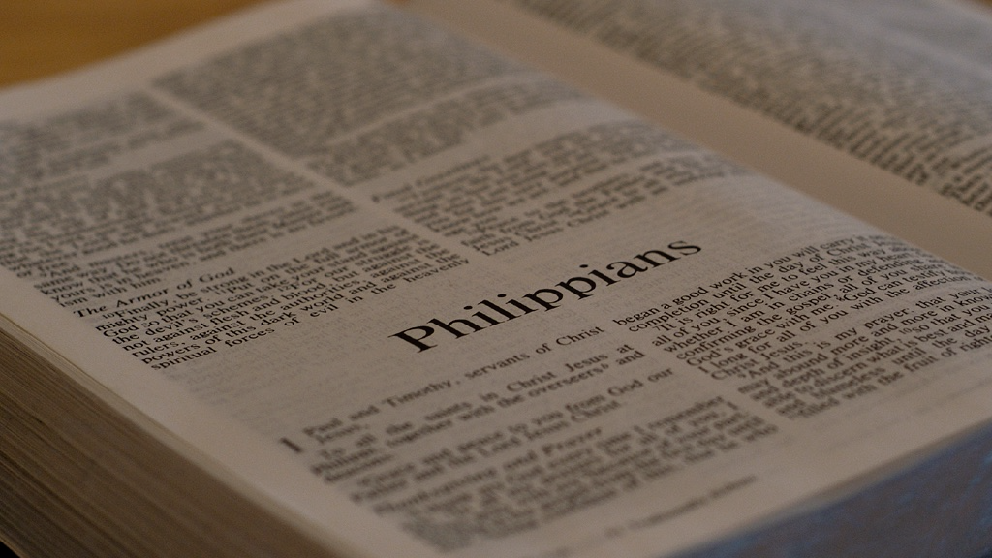
Philippians
Living with Dying

Slide 2
Paul is writing this letter under house arrest in Rome.
Chained 24 hours a day to a Roman guard.
By this point he’s been in prison for around 4 years.
Every day he’s living in the shadow of his own execution.

Slide 3
Paul is writing this letter under house arrest in Rome.
Chained 24 hours a day to a Roman guard.
By this point he’s been in prison for around 4 years.
Every day he’s living in the shadow of his own execution.
Our purpose in living will shape our perspective on dying.

Slide 4
I. Our Purpose in Life

Slide 5
19. Yes, and I will continue to rejoice, for I know that this will turn out for my deliverance through your prayers and the help of the Spirit of Jesus Christ.
Philippians

Slide 6
19. Yes, and I will continue to rejoice, for I know that this will turn out for my deliverance through your prayers and the help of the Spirit of Jesus Christ.
Paul knows he will be saved either way.
Philippians

Slide 7
19. Yes, and I will continue to rejoice, for I know that this will turn out for my deliverance through your prayers and the help of the Spirit of Jesus Christ.
Paul was not too prideful to remain dependent on the prayers of others.
Philippians

Slide 8
19. Yes, and I will continue to rejoice, for I know that this will turn out for my deliverance through your prayers and the help of the Spirit of Jesus Christ.
Mixture of people & God
Philippians

Slide 9
20. My confident hope is that I will in no way be ashamed but that with complete boldness, even now as always, Christ will be exalted in my body, whether I live or die.
Philippians

Slide 10
20. My confident hope is that I will in no way be ashamed but that with complete boldness, even now as always, Christ will be exalted in my body, whether I live or die.
Not intimidated; embarrassed
Philippians

Slide 11
20. My confident hope is that I will in no way be ashamed but that with complete boldness, even now as always, Christ will be exalted in my body, whether I live or die.
Frankness; plainness; publicly open
Philippians

Slide 12
20. My confident hope is that I will in no way be ashamed but that with complete boldness, even now as always, Christ will be exalted in my body, whether I live or die.
megalynō (μεγαλύνω): to make large; to make great; to magnify
Binoculars & Microscope
Philippians

Slide 13
21. For to me, living is Christ and dying is gain.
Philippians

Slide 14
21. For to me, living is Christ and dying is gain.
All that Paul wants out of life is to live for Christ and all he wants out of death is to
be with Christ.
One Sentence
Philippians

Slide 15
Many will say that they want to live a long life, but the question to ask is, why?
21. For to me, living is Christ and dying is gain.
All that Paul wants out of life is to live for Christ and all he wants out of death is to
be with Christ.
“For me to live is ____ and to die is ____.”
One Sentence
Philippians

Slide 16
Many will say that they want to live a long life, but the question to ask is, why?
21. For to me, living is Christ and dying is gain.
(Heb. 12:1-2)…we must get rid of every weight and the sin that clings so closely, and run with endurance the race set out for us, keeping our eyes fixed on Jesus, the pioneer and perfecter of our faith.
All that Paul wants out of life is to live for Christ and all he wants out of death is to
be with Christ.
“For me to live is ____ and to die is ____.”
One Sentence
Philippians

Slide 17
II. Our Perspective on Death
“Nobody is ready to die until they know what it means to live.”

Slide 18
21. For to me, living is Christ and dying is gain.
For Paul, death was a gain and a departure.
Florist
Philippians

Slide 19
21. For to me, living is Christ and dying is gain.
For Paul, death was gain and a departure.
Christians could actually call this life “pre-life” and after death, “real-life”.
Florist
Philippians

Slide 20
22. Now if I am to go on living in the body, this will mean productive work for me, yet I don’t know which I prefer:
Philippians

Slide 21
22. Now if I am to go on living in the body, this will mean productive work for me, yet I don’t know which I prefer:
Paul had been to Heaven
2 Cor. 12:1-4
Philippians

Slide 22
23-24. I feel torn between the two, because I have a desire to depart and be with Christ, which is better by far, but it is more vital for your sake that I remain in the body.
Philippians

Slide 23
23-24. I feel torn between the two, because I have a desire to depart and be with Christ, which is better by far, but it is more vital for your sake that I remain in the body.
(2 Tim. 4:6-8) For I am already being poured out as an offering, and the time for me to depart is at hand. I have competed well; I have finished the race; I have kept the faith! Finally the crown of righteousness is reserved for me. The Lord, the righteous Judge, will award it to me in that day—and not to me only, but also to all who have set their affection on his appearing.
For Paul, death was not a termination, but a transition.
Philippians

Slide 24
23-24. I feel torn between the two, because I have a desire to depart and be with Christ, which is better by far, but it is more vital for your sake that I remain in the body.
This is available to all people!
(2 Tim. 4:6-8) For I am already being poured out as an offering, and the time for me to depart is at hand. I have competed well; I have finished the race; I have kept the faith! Finally the crown of righteousness is reserved for me. The Lord, the righteous Judge, will award it to me in that day—and not to me only, but also to all who have set their affection on his appearing.
Philippians

Slide 25
23-24. I feel torn between the two, because I have a desire to depart and be with Christ, which is better by far, but it is more vital for your sake that I remain in the body.
No soul sleep, no purgatory, no reincarnation
(2 Cor. 5:8) Thus we are full of courage and would prefer to be away from the body and at home with the Lord.
Philippians

Slide 26
23-24. I feel torn between the two, because I have a desire to depart and be with Christ, which is better by far, but it is more vital for your sake that I remain in the body.
No soul sleep, no purgatory, no reincarnation
Immediate, conscious, personal, fellowship with Jesus
(Lk. 23:43) And Jesus said to him, “I tell you the truth, today you will be with me in paradise.”
Philippians

Slide 27
23-24. I feel torn between the two, because I have a desire to depart and be with Christ, which is better by far, but it is more vital for your sake that I remain in the body.
There is no comparison!
My dogs
Philippians

Slide 28
23-24. I feel torn between the two, because I have a desire to depart and be with Christ, which is better by far, but it is more vital for your sake that I remain in the body.
Gold or Silver?
Remember, Paul was saying this while he was in PRISON!!
Philippians

Slide 29
25. And since I am sure of this, I know that I will remain and continue with all of you for the sake of your progress and joy in the faith,
Philippians

Slide 30
25. And since I am sure of this, I know that I will remain and continue with all of you for the sake of your progress and joy in the faith,
Paul’s purpose in life was to help others draw close to Jesus
Philippians

Slide 31
26. so that what you can be proud of may increase because of me in Christ Jesus, when I come back to you.
Moments before death
Our purpose in life will shape our perspective on death.
Philippians

Slide 32
(Heb. 12:14-15) Because God’s children are human beings—made of flesh and blood—the Son also became flesh and blood. For only as a human being could he die, and only by dying could he break the power of the devil, who had the power of death. Only in this way could he set free all who have lived their lives as slaves to the fear of dying.
26. so that what you can be proud of may increase because of me in Christ Jesus, when I come back to you.
Moments before death
Our purpose in life will shape our perspective on death.
Philippians

