Slide 1
Ecclesiastes 3
Time and Eternity

Slide 2
Imagine…
86,400 pennies each morning
Over $6000 per week
More than $315,000 per year

Slide 3
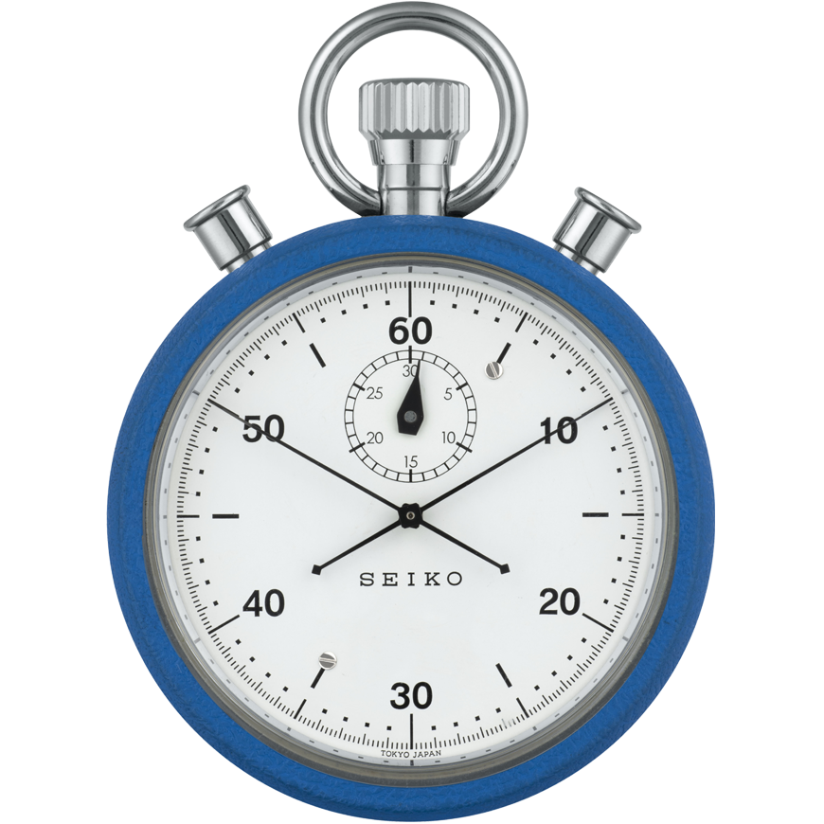
The Reality
86,400 seconds each morning
More than 600,000 seconds per week
Over 31.5 million seconds per year

Slide 4
The Reality

Slide 5
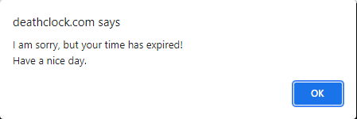
The Reality

Slide 6
The Reality
What is time?
“A duration in which things happen”
Completely irretrievable
Can never repeat it or relive it
Travels alongside us every day
Has eternity wrapped up in it

Slide 7
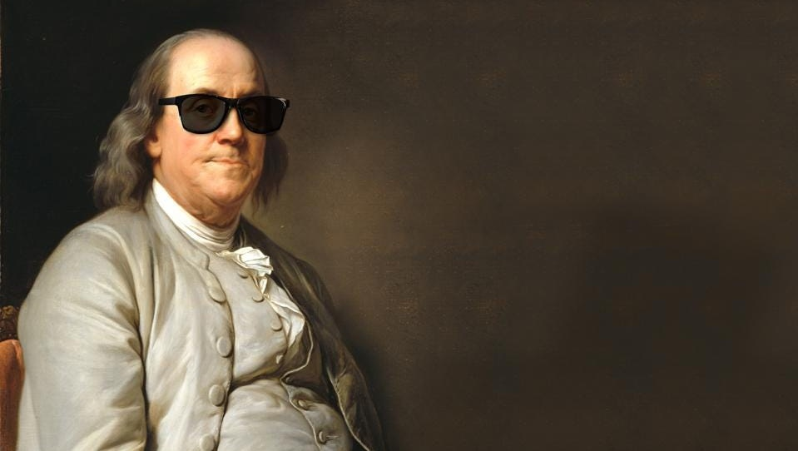
Do you love life?
Then do not squander time for that’s the stuff life is made of.

Slide 8
Ecclesiastes 3
Solomon mentions “time” 31 times in 11 verses.
Then he speaks of “eternity” and “forever”
So… what do time and eternity have to do with the meaninglessness of life under the sun?

Slide 9
Ecclesiastes 3
1 For everything there is a season, a time for every purpose under heaven.
2 A time to be born and a time to die. A time to plant and a time to harvest.
3 A time to kill and a time to heal. A time to tear down and a time to build up.
4 A time to cry and a time to laugh. A time to grieve and a time to dance.

Slide 10
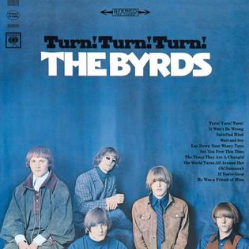
Ecclesiastes 3
5 A time to scatter stones and a time to gather stones. A time to embrace and a time to turn away.
6 A time to search and a time to quit searching. A time to keep and a time to throw away.
7 A time to tear and a time to mend. A time to be quiet and a time to speak.
8 A time to love and a time to hate. A time for war and a time for peace.
1965 #1 Hit
Written ~1000 B.C.

Slide 11
Ecclesiastes 3
1 For everything there is a season, a time for every purpose under heaven.
2 A time to be born and a time to die. A time to plant and a time to harvest.
3 A time to kill and a time to heal. A time to tear down and a time to build up.
4 A time to cry and a time to laugh. A time to grieve and a time to dance.

Slide 12
Ecclesiastes 3
1 For everything there is a season, a time for every purpose under heaven.
2 A time to be born and a time to die. A time to plant and a time to harvest.
3 A time to kill and a time to heal. A time to tear down and a time to build up.
4 A time to cry and a time to laugh. A time to grieve and a time to dance.
Birth and death are the bookends of life under the sun
There are fourteen pairs, and each positive thing is paired with a negative that cancels it out

Slide 13
Ecclesiastes 3
1 For everything there is a season, a time for every purpose under heaven.
2 A time to be born and a time to die. A time to plant and a time to harvest.
3 A time to kill and a time to heal. A time to tear down and a time to build up.
4 A time to cry and a time to laugh. A time to grieve and a time to dance.
Better to spend your time at funerals than at parties.
After all, everyone dies— so the living should take this to heart…
A wise person thinks a lot about death, while a fool thinks only about having a good time. (Eccl 7:2, 4)
Birth and death are the bookends of life under the sun
14 pairs… and each positive thing is paired with a negative that cancels it out

Slide 14
Ecclesiastes 3
1 For everything there is a season, a time for every purpose under heaven.
2 A time to be born and a time to die. A time to plant and a time to harvest.
3 A time to kill and a time to heal. A time to tear down and a time to build up.
4 A time to cry and a time to laugh. A time to grieve and a time to dance.
That happy time at the birth of a child…
That happy time of planting the new tree…
The happiness at the wedding day…

Slide 15
Ecclesiastes 3
1 For everything there is a season, a time for every purpose under heaven.
2 A time to be born and a time to die. A time to plant and a time to harvest.
3 A time to kill and a time to heal. A time to tear down and a time to build up.
4 A time to cry and a time to laugh. A time to grieve and a time to dance.
The day of death often comes unexpectedly

Slide 16
Ecclesiastes 3
1 For everything there is a season, a time for every purpose under heaven.
2 A time to be born and a time to die. A time to plant and a time to harvest.
3 A time to kill and a time to heal. A time to tear down and a time to build up.
4 A time to cry and a time to laugh. A time to grieve and a time to dance.
When you dig a well, you might fall in.
When you demolish an old wall, you could be bitten by a snake.
When you work in a quarry, stones might fall and crush you.
When you chop wood, there is danger with each stroke of your ax. (Eccl 10:8-9)
The day of death often comes unexpectedly

Slide 17
We’d like to eliminate the negatives
A time to be born and … plant and … heal and … build up… and laugh… and dance… and embrace … and search … and keep … and mend… and love … and a time for peace.
A time to die… and to uproot… and to kill … and tear down … and cry … and grieve … and turn away… and quit searching… and throw away… and tear… and to hate… and a time for war
We have to accept both parts, and sometimes all we can do is respond

Slide 18
Ecclesiastes 3
9 What profit is there to the worker from that in which he toils?

Slide 19
Ecclesiastes 3
9 What profit is there to the worker from that in which he toils?
10 I have seen the task which God has given the sons of men with which to occupy themselves.
Under the sun, it all cancels out
What do we gain from a whole lifetime of cancelling events?
Especially when the end cancels the beginning!
You received 86,400 seconds yesterday.

Slide 20
Ecclesiastes 3
11 Yet God has made everything beautiful for its own time.
He has also planted eternity in the human heart,
but even so, people cannot see the whole scope of God’s work from beginning to end.

Slide 21
Ecclesiastes 3
11 Yet God has made everything beautiful for its own time.
He has also planted eternity in the human heart,
but even so, people cannot see the whole scope of God’s work from beginning to end.
Born
Die

Slide 22
Ecclesiastes 3
11 Yet God has made everything beautiful for its own time.
He has also planted eternity in the human heart,
but even so, people cannot see the whole scope of God’s work from beginning to end.
We should be fine with death
But we simply cannot accept the fact of our own death
We feel like we were made for eternity
Born
Die

Slide 23
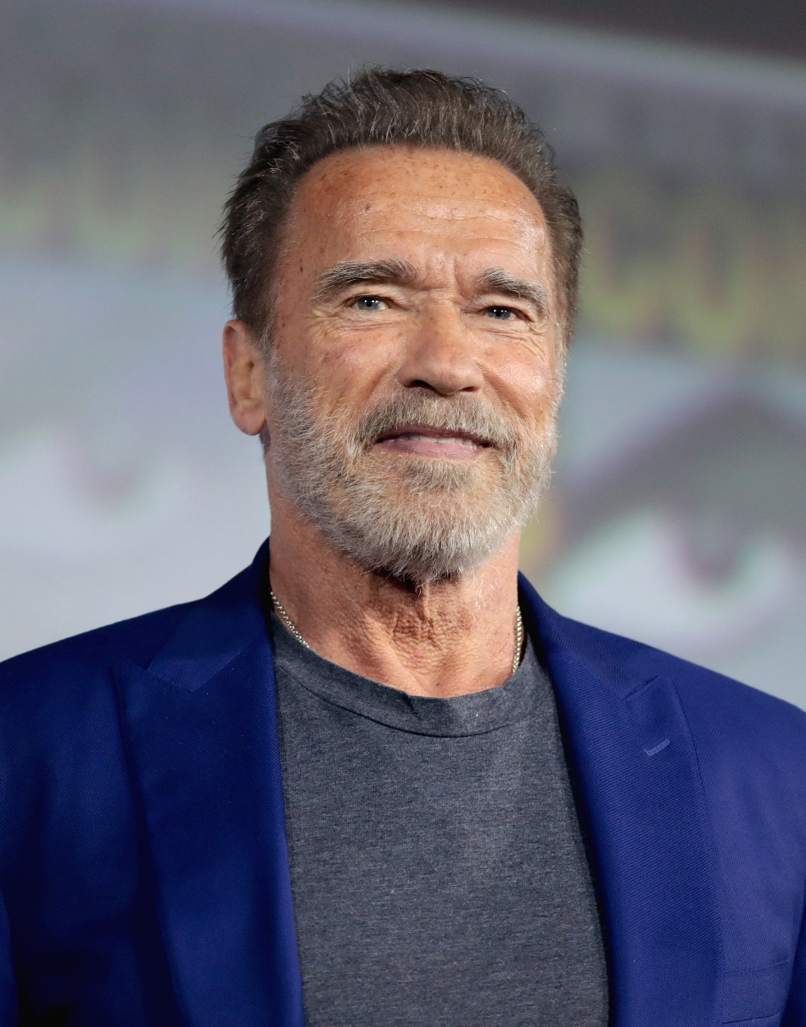
http://www.schwarzenegger.com/newsletter/post/this-is-a-long-one-but-its-worth-it, retrieved 12/9/2021
Q: What do you think about death?
Well, unfortunately, death is the one thing we can’t overcome.
And I have to say, that pisses me off...
I hate the idea of death.
I don’t like to think about it,
I don’t even like to say the word.

Slide 24
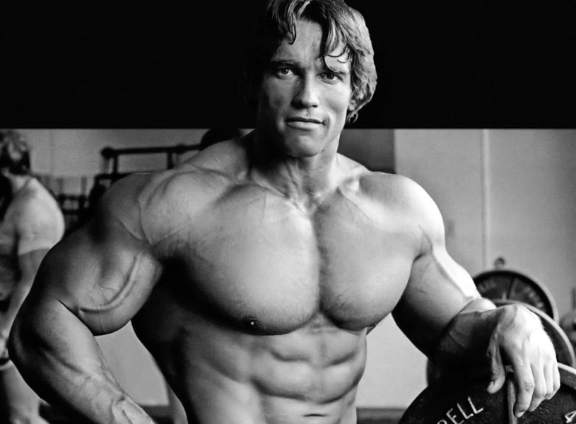
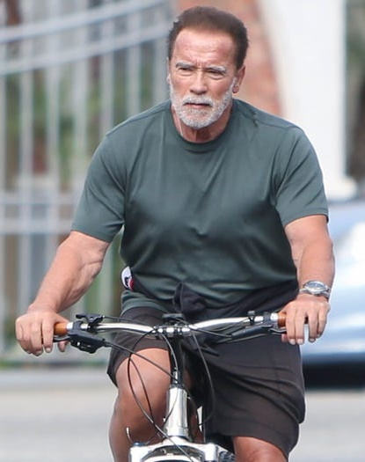
http://www.schwarzenegger.com/newsletter/post/this-is-a-long-one-but-its-worth-it, retrieved 12/9/2021
Q: What do you think about death?
Well, unfortunately, death is the one thing we can’t overcome.
And I have to say, that pisses me off...
I hate the idea of death.
I don’t like to think about it,
I don’t even like to say the word.
There is a time to be born, and a time to die…
Yet he has planted eternity in the human heart

Slide 25
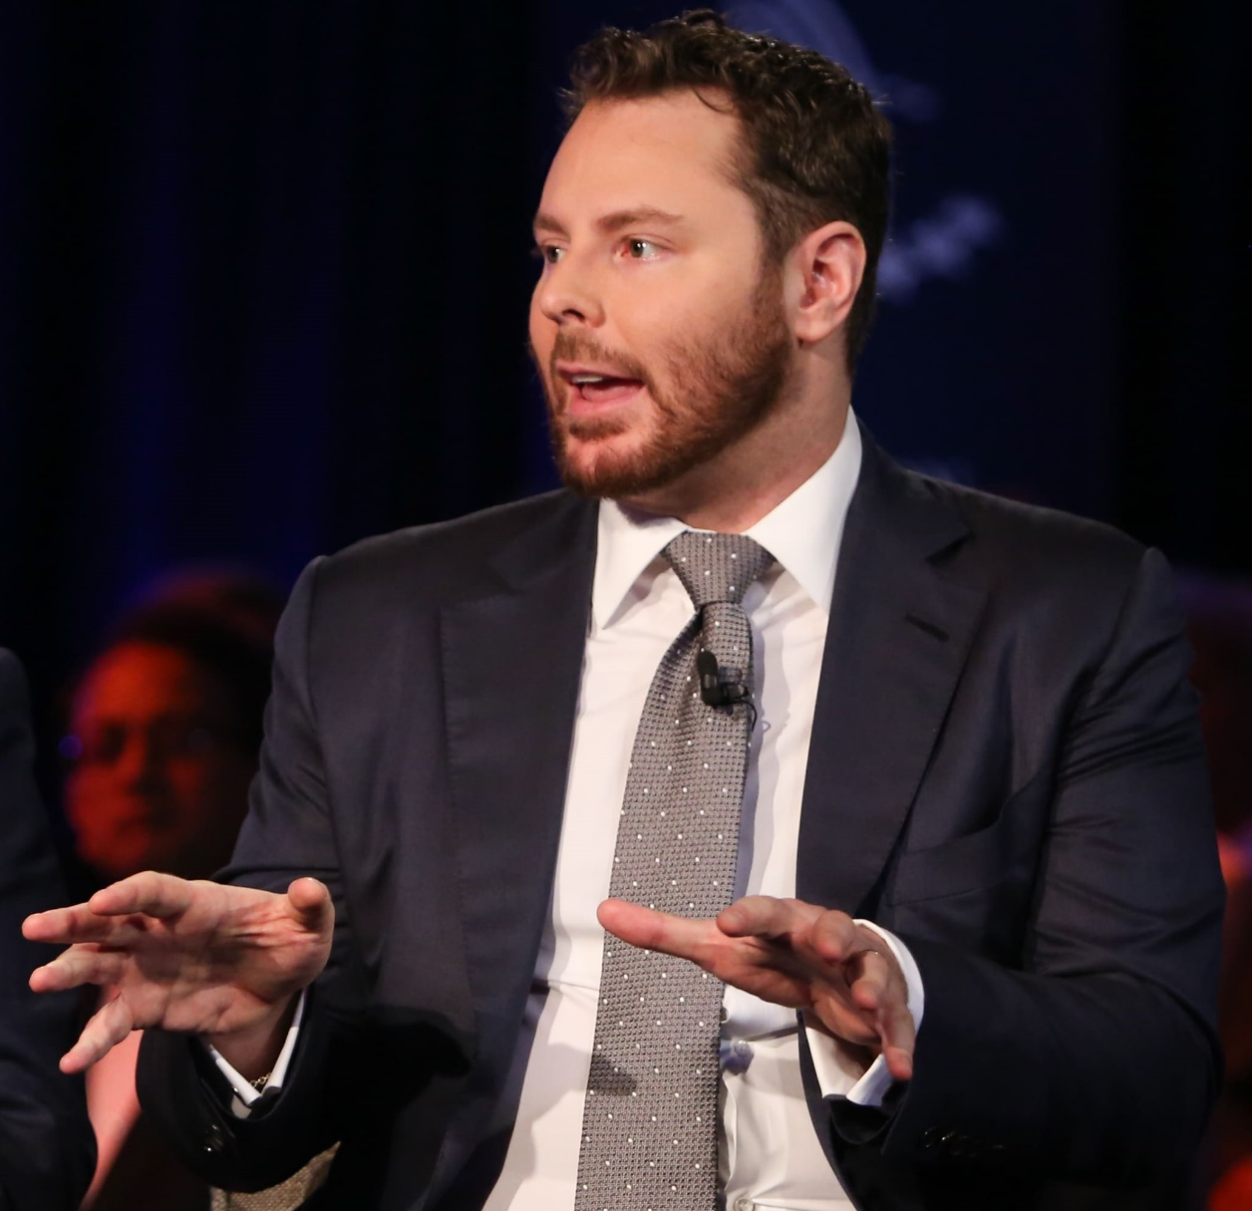
Tanza Loudenback, “Ex-Facebook President and Billionaire Sean Parker Reveals One of the Biggest Advantages Rich People Have over Everyone Else,” Business Insider, November 10, 2017, http://www.businessinsider.com/ex-facebook-president-sean-parker-billionaire-advantage-better-healthcare-2017-11 (accessed May 31, 2018). Cited in Clay Jones, Immortal (Harvest House, 2020), p. 27
Because I’m a billionaire, I’m going to have access to better healthcare…
I’m going to be like 160 and I’m going to be part of this, like, class of immortal overlords
Sean Parker, Founder of Napster, First Facebook President

Slide 26
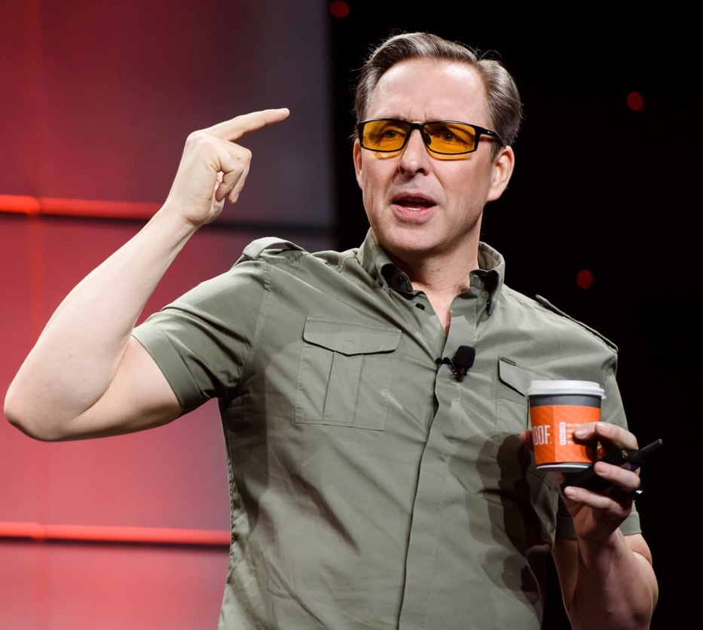
“Asprey’s Quest for 180,” The Week, February 15, 2019, 10., Cited in Clay Jones, Immortal (Harvest House, 2020), p. 27
Claims to have spent $1 million on a quest to live to 180.
He has bone marrow extracted from his hips and then has the stem cells filtered out and injected into every joint in his body, his spinal cord, and his cerebral fluid.
David Asprey, Founder of Bulletproof Coffee

Slide 27
“Asprey’s Quest for 180,” The Week, February 15, 2019, 10., Cited in Clay Jones, Immortal (Harvest House, 2020), p. 27
He intends to do this twice a year.
He also “takes 100 supplements a day, religiously follows a low-carb, high fat diet, bathes in infrared light, chills in a cryotherapy chamber, and relaxes in a hyperbaric oxygen chamber.”
David Asprey, Founder of Bulletproof Coffee

Slide 28
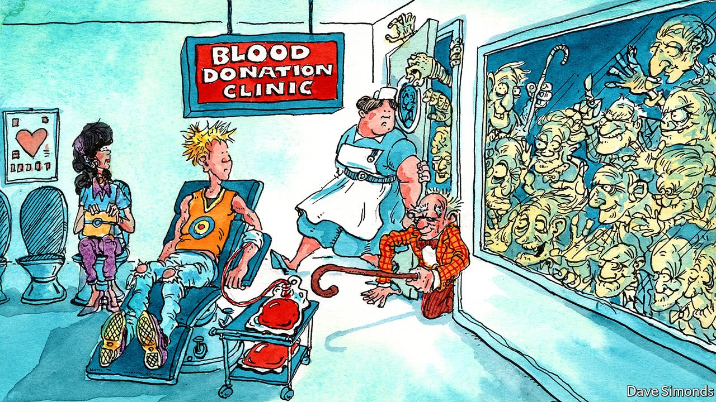
“Young Blood Transfusion”
Or “Vampire Therapy”

Slide 29
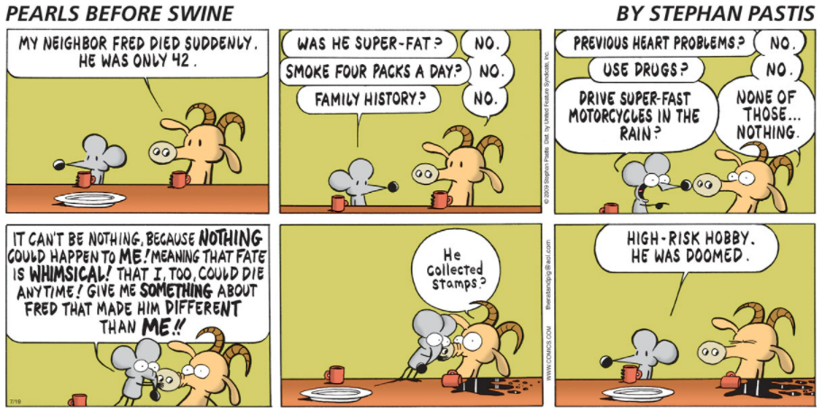
https://www.gocomics.com/pearlsbeforeswine/2009/07/19

Slide 30
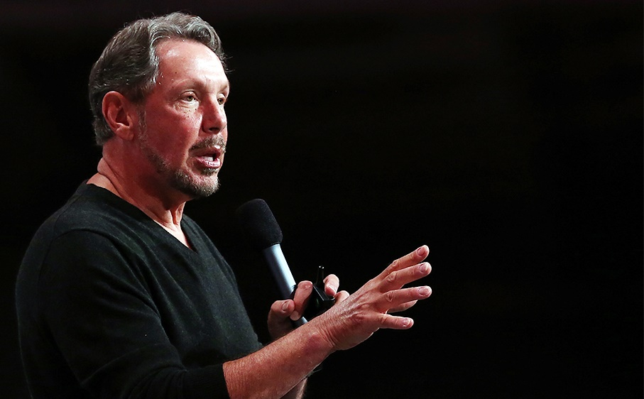
Mike Wilson, The Difference Between God and Larry Ellison: Inside the Oracle Corporation (New York: HarperBusiness, 2002), 266. Cited in Clay Jones, Immortal (Harvest House, 2020), p. 24
Ellison has donated more than $430 million to antiaging research…
“Death has never made any sense to me. How can a person be there and then just vanish, just not be there? …
Death makes me very angry.
Premature death makes me angrier still.”
There is a time to be born, and a time to die…
Yet he has planted eternity in the human heart
Larry Ellison, Founder of Oracle, worth $108B

Slide 31
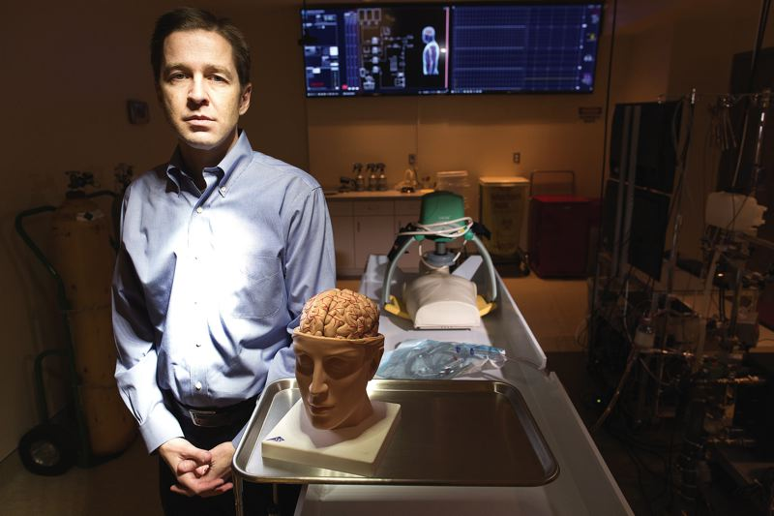
Ben Makuch in “Frozen Faith: Cryonics and the Quest to Cheat Death,” YouTube video uploaded by Motherboard, May 5, 2016, https://www.youtube.com/watch?v=m5KuNAeOtJ0 (accessed December 15, 2018).Cited in Clay Jones, Immortal (Harvest House, 2020), p. 50-51
Yeah, I’m afraid of death in all ways, and I will never give up…
I want to yell at the entire world,
‘Don’t you get it, you’re going to die.
Here’s an option, the only option.’
There is a time to be born, and a time to die…
Yet he has planted eternity in the human heart
Jordan Sparks, director of the Oregon Cryonics Institute

Slide 32
Ecclesiastes 3
What if there was a way to overcome death? To get safely from “now” to “eternity”?
The eternal Son of God entered the “now”
He lived as a human and died for your sins
“Death is swallowed up in victory” (1 Cor 15:54)
The first step to a proper use of time is getting right with God
Now
Eternity
Born
Die

Slide 33
Ecclesiastes 3
A big key to understanding Ecclesiastes (and life!) is finding that balance between eternity and now
Enjoy life… and remember there’s an afterlife and a God who is really there
Enjoy pleasure… but under God’s design, and allow your desires to point you to the Creator of pleasure and eternity with Him
Now
Eternity
Born
Die

Slide 34
Ecclesiastes 3
A big key to understanding Ecclesiastes (and life!) is finding that balance between eternity and now
You need to live wisely now… but do it in light of eternity, because time is final
Now
Eternity
Born
Die

Slide 35
Ecclesiastes 3
A big key to understanding Ecclesiastes (and life!) is finding that balance between eternity and now
You need to live wisely now… but do it in light of eternity, because time is final
¹³ People should eat and drink and enjoy the fruits of their labor, for these are gifts from God.
¹⁴ And I know that whatever God does will endure forever. Nothing can be added to it or taken from it.
Now
Eternity
Born
Die

Slide 36
Application
Once we have a relationship with him, we will need guidance from him to know how to use our time in light of eternity
We need to see things from his perspective
“People cannot see the whole scope of God’s work from beginning to end.” (Eccl 3:11)

Slide 37
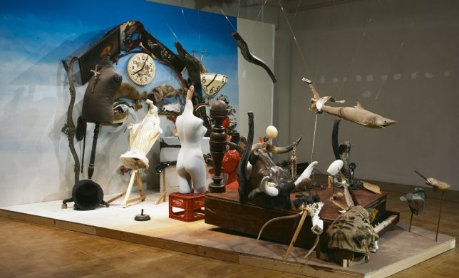

Slide 38
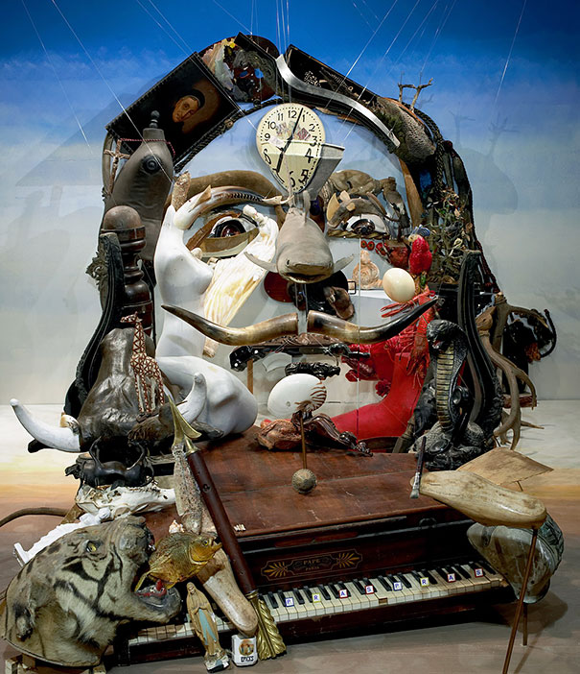

Slide 39
Application
Time is in God’s hands, so learn to enjoy whatever season you are in
Some always long for the next phase of life
Others live in the past, full of regrets
You have to learn to be happy in all the seasons of life.
Don’t long for “the good old days.” This is not wise. (Eccl 7:10)

Slide 40
Application
Learn to accept the negatives in life
With God, we know he causes all things to work together for good (Rom 8:28)
We also can look forward to that day when these negatives will be deleted – when he makes all things new

Slide 41
Application
Make the most of the time God has given you
Do a time study
“How is eternity reflected in my daily use of time?”
Keep a personal calendar
Get the important stuff onto a regular schedule
Be very careful, then, how you live—not as unwise but as wise, making the most of every opportunity (Eph 5:15-16)

Slide 42
Application
Put your trust in Jesus to overcome death
Solomon: “There is a time to be born and a time to die.”
Jesus: I bring a new birth (John 3:7)
Jesus: “He who believes in Me will live even if he dies” (John 11:25)

Slide 43
“God himself will be with them.
He will wipe every tear from their eyes, and there will be no more death or sorrow or crying or pain.
All these things are gone forever.”
And the one sitting on the throne said, “Look, I am making everything new!”
A time to kill – grieve – tear down – turn away – give up the search – to tear – to hate – to war – to die

Slide 44
Ecclesiastes 3
Questions?
Comments?
Experiences?
risleys@dwellcc.org
See the Dwell App OR teachings.dwellcc.org
Next time: Ecclesiastes 4 – The Daily Grind and Our Relationships

