Slide 1
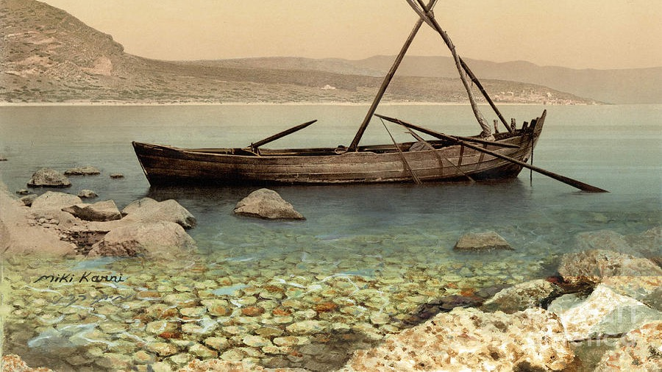
The
Gospel
of Mark
Chapter 13: The Return of Christ

Slide 2
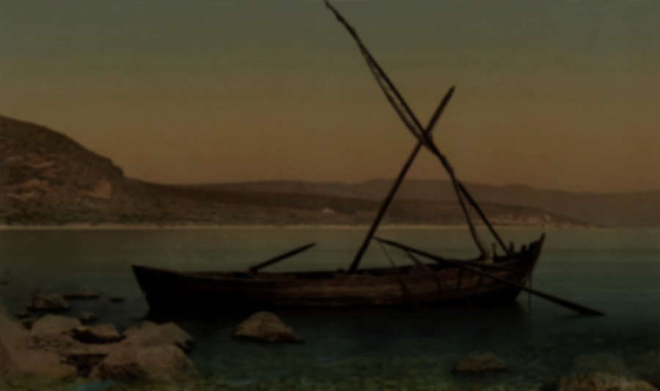
4. “Tell us, when will these things happen? And what will be the sign that all these things are about to take place?”
(Matt. 24: 3) “Tell us, when will these things happen? And what will be the sign of your coming and of the end of the age?”
Mark 13
Notes:
Let’s go on to look at the: preview, picture, place, people & purpose of his return.

Slide 3
The Second Coming…
Every New Testament book mentions the second coming, except for Philemon, 2 John and 3 John.
There are 260 chapters in the New Testament and over 300 references to this event.
Jesus directs his followers to be ready for his return over 50 times.
Christians have been awaiting this event since the time of Jesus’ ascension. (Acts 1:10-11)

Slide 4
The Second Coming…
Every New Testament book mentions the second coming, except for Philemon, 2 John and 3 John.
There are 260 chapters in the New Testament and over 300 references to this event.
Jesus directs his followers to be ready for his return over 50 times.
Christians have been awaiting this event since the time of Jesus’ ascension. (Acts 1:10-11)
(2 Pt. 3:3-4) Above all, understand this: In the last days blatant scoffers will come, being propelled by their own evil urges and saying, “Where is his promised return? For ever since our ancestors died, all things have continued as they were from the beginning of creation.”

Slide 5
The PREVIEW of his return

Slide 6
24. “But in those days, after that tribulation, the sun will be darkened and the moon will not give its light;
Mark 13

Slide 7
25. the stars will be falling from heaven, and the powers in the heavens will be shaken.
Mark 13

Slide 8
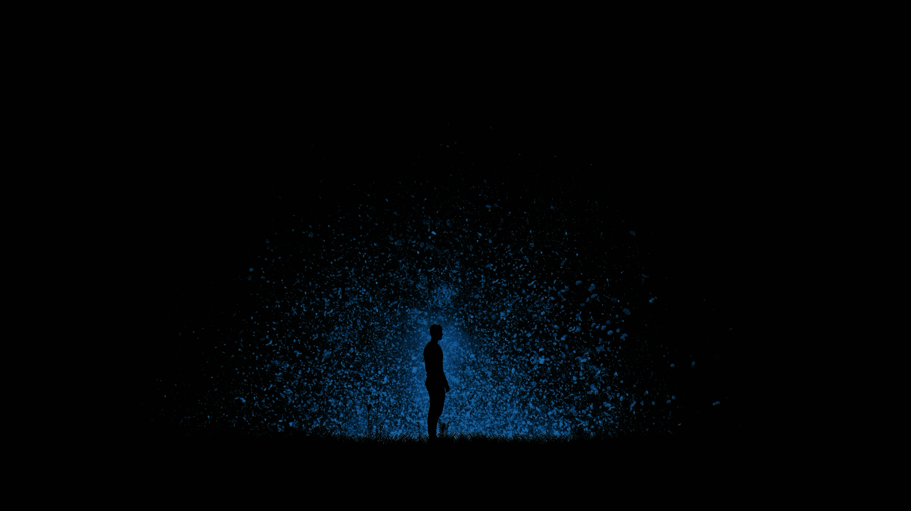
Luke 24: 25-26
And there will be signs in the sun and moon and stars, and on the earth nations will be in distress, anxious over the roaring of the sea and the surging waves. People will be fainting from fear and from the expectation of what is coming on the world, for the powers of the heavens will be shaken.

Slide 9
Isaiah 13:10
Indeed the stars in the sky and their constellations no longer give out their light; the sun is darkened as soon as it rises, and the moon does not shine.

Slide 10
Joel 2:10
The earth quakes before them;
the sky reverberates.
The sun and the moon grow dark;
the stars refuse to shine.
When will this happen?

Slide 11
24. “But in those days, after that tribulation, the sun will be darkened and the moon will not give its light;
Mark 13

Slide 12
Rescue
JESUS RETURNS
CHURCH AGE
TRIBULATION
?
33 A.D.

Slide 13
(David Jeremiah) ﻿Back in 1843, for example, a New Englander named William Miller came to ardently believe in the imminent return of Jesus Christ. Unfortunately, he began to speculate about the date of that return using some dubious mathematical calculations. He collected mounds of data, analyzed it, and was certain he had made no mistakes. He therefore confidently announced to his followers that on March 21, 1843, Jesus Christ would return to the earth…
Notes:
Jeremiah, Dr. David. Jesus' Final Warning . Thomas Nelson. Kindle Edition.

Slide 14
…﻿At midnight on the appointed day, his devoted followers donned their ascension robes, trekked into the mountains, and climbed towering trees to get as high as possible so they would have “less distance to travel through the air” when the Lord returned to take them home. But the day came and went. The Lord did not return. And the trees became awfully uncomfortable.
Notes:
Jeremiah, Dr. David. Jesus' Final Warning . Thomas Nelson. Kindle Edition.

Slide 15
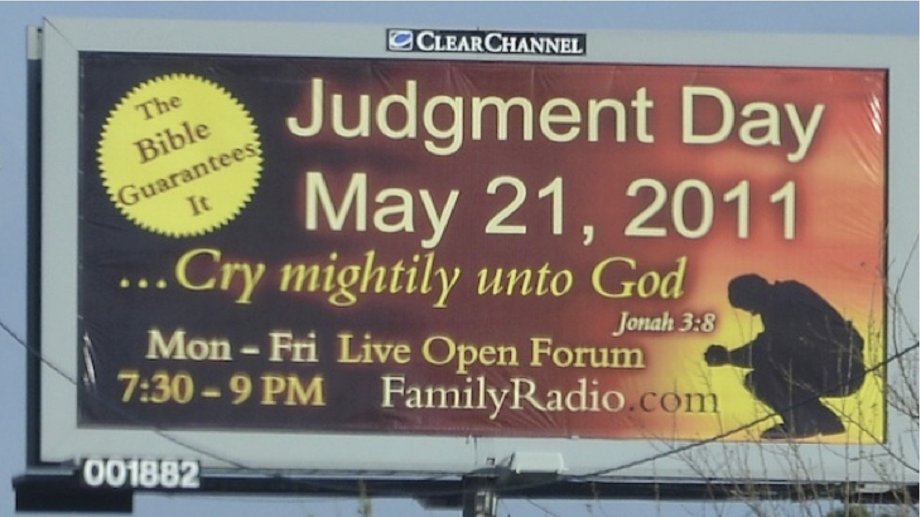

Slide 16
Avoiding the extremes…
We need to view world events in light of Biblical truth, not the other way around.
Reject date setting outright.
Never focus on the future at the expense of the present.
We live our lives in light of our eternal destiny.
Avoid scoffing.
Humbly allow for corrections after further reflection.
Understand the difference between negotiables and non-negotiables.

Slide 17
(Ed Hindson) “God’s clock, the clock of history, is ticking away. It never speeds up and never slows down. It just keeps on ticking, continually and relentlessly, moving us closer and closer to the end of the age. How close we are to the end will only be revealed by time itself.”
Notes:
Ed Hindson, Final Signs: Amazing Prophecies of the End Times (Eugene, OR: Harvest House, 1996), 196.

Slide 18
(Ed Hindson) “God’s clock, the clock of history, is ticking away. It never speeds up and never slows down. It just keeps on ticking, continually and relentlessly, moving us closer and closer to the end of the age. How close we are to the end will only be revealed by time itself.”
(Mk. 13:32) But as for that day or hour no one knows it—neither the angels in heaven, nor the Son—only the Father.

Slide 19
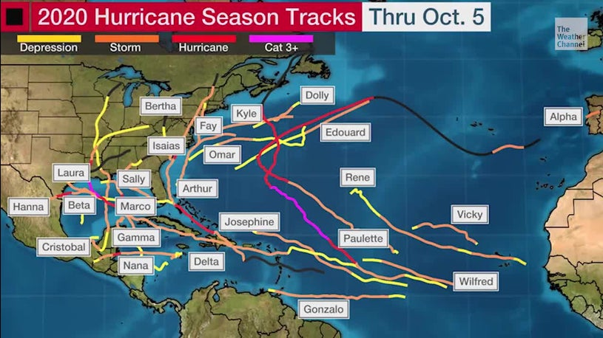
Notes:
Its not uncommon, even in our day to notice signs and and base our predictions upon them.
-We do it with the weather all the time!
-Jesus addressed this specifically…

Slide 20
Matthew 16:1-3
Now when the Pharisees and Sadducees came to test Jesus, they asked him to show them a sign from heaven...

Slide 21
Matthew 16:1-3
…He said, “When evening comes you say, ‘It will be fair weather, because the sky is red,’ and in the morning, ‘It will be stormy today, because the sky is red and darkening.’ You know how to judge correctly the appearance of the sky, but you cannot evaluate the signs of the times.
Notes:
-Scholars point to over 100 Biblical prophecies fulfilled during Christ’s first coming in his life on earth. (Mark Hitchcock, The End, p. 108)
-In other words, Jesus rebuked them because they did not notice or acknowledge the signs that were given in Scripture concerning his first coming!
-They could fairly accurately discern the next days weather based on the signs, but they did not recognize all that the Bible had to say about the coming of the Messiah.
-We can easily extrapolate this principle to Jesus’ second coming as well!

Slide 22
The PICTURE of his return

Slide 23
26. Then everyone will see the Son of Man arriving in the clouds with great power and glory.
Mark 13

Slide 24
26. Then everyone will see the Son of Man arriving in the clouds with great power and glory.
Mark 13
Notes:
There will be no secret return of Christ!
-All the earth will know.

Slide 25
Matthew 24:27
For just like the lightning comes from the east and flashes to the west, so the coming of the Son of Man will be.

Slide 26
Revelation 1:7
Look! He is returning with the clouds,
and every eye will see him,
even those who pierced him,
and all the tribes on the earth will mourn because of him.
This will certainly come to pass!

Slide 27
The PLACE of his return

Slide 28
Acts 1:10-11
As they were still staring into the sky while he was going, suddenly two men in white clothing stood near them and said, “Men of Galilee, why do you stand here looking up into the sky? This same Jesus who has been taken up from you into heaven will come back in the same way you saw him go into heaven.”

Slide 29
Zechariah 14:4
On that day his feet will stand on the Mount of Olives which lies to the east of Jerusalem, and the Mount of Olives will be split in half from east to west, leaving a great valley. Half the mountain will move northward and the other half southward.
His return will be literal, physical, visible and personal.

Slide 30
Zechariah 14:4
On that day his feet will stand on the Mount of Olives which lies to the east of Jerusalem, and the Mount of Olives will be split in half from east to west, leaving a great valley. Half the mountain will move northward and the other half southward.

Slide 31
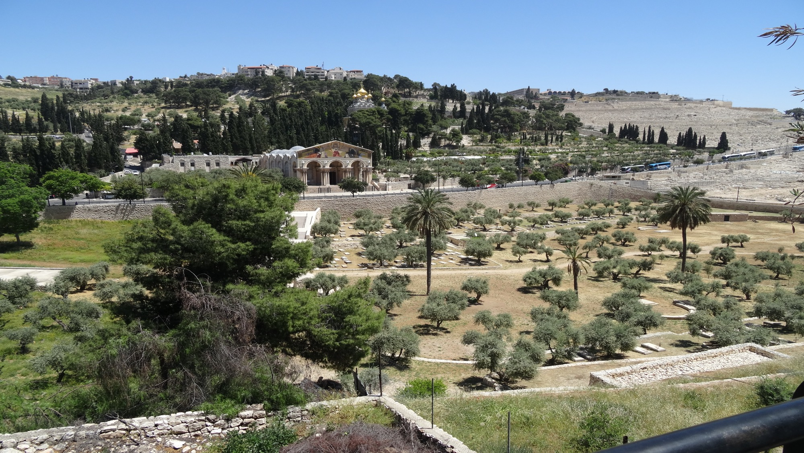
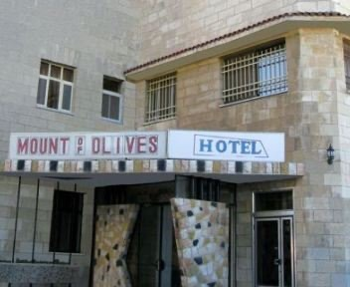

Slide 32
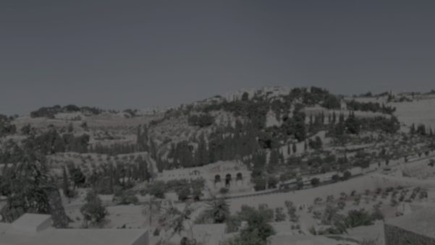
(J. Dwight Pentecost) A large hotel chain in the late 1950’s tried to build here, but after geological studies were done they were told that it was a poor site to build on because a fault line ran under the mountain and that it would be extremely risky to build there. Later in 1960 a hotel was actually built on this site. When I stayed there I asked the front desk manager when I was checking in if they had good earthquake insurance, but the man had no idea what I was talking about.
Notes:
(From: Will Man Survive)

Slide 33
The PEOPLE with his return

Slide 34
Zechariah 14:5
…Then the Lord my God will come with all his holy ones with him.

Slide 35
Matthew 25:31
When the Son of Man comes in his glory and all the angels with him, then he will sit on his glorious throne.

Slide 36
Matthew 25:31
When the Son of Man comes in his glory and all the angels with him, then he will sit on his glorious throne.

Slide 37
1 Thessalonians 3:13
So that your hearts are strengthened in holiness to be blameless before our God and Father at the coming of our Lord Jesus with all his saints.

Slide 38
Revelation 19:14
The armies that are in heaven, dressed in white, clean, fine linen, were following him on white horses.

Slide 39
The PURPOSE of his return

Slide 40
27. Then he will send angels and they will gather his elect from the four winds, from the ends of the earth to the ends of heaven.
Mark 13

Slide 41
Luke 21:28
But when these things begin to happen, stand up and raise your heads, because your redemption is drawing near.

Slide 42
Zechariah 12:8
On that day the Lord himself will defend the inhabitants of Jerusalem, so that the weakest among them will be like mighty David, and the dynasty of David will be like God, like the angel of the Lord before them.

Slide 43
Zechariah 14:3
Then the Lord himself will go to battle and fight against those nations, just as he fought battles in ancient days.

Slide 44
Zechariah 14:9;11
The Lord will then be king over all the earth. In that day the Lord will be seen as one with a single name…And people will settle there, and there will no longer be the threat of divine extermination—Jerusalem will dwell in security.

Slide 45
Revelation 19:11-12
Then I saw heaven opened and here came a white horse! The one riding it was called “Faithful” and “True,” and with justice he judges and goes to war. His eyes are like a fiery flame and there are many diadem crowns on his head.

Slide 46
(J. Dwight Pentecost) A short time ago, I took occasion to go through the New Testament to mark each reference to the coming of the Lord Jesus Christ and to observe the use made of that teaching about His coming. I was struck anew with the fact that almost without exception, when the coming of Christ is mentioned in the New Testament, it is followed by an exhortation to godliness and holy living…
Notes:
Swindoll, Charles R.. The Tale of the Tardy Oxcart (Swindoll Leadership Library) . Thomas Nelson. Kindle Edition.

Slide 47
…﻿While the study of prophecy will give us proof of the authority of the Word of God, it will also reveal the purpose of God and the power of God, and will give us the peace and assurance of God. We have missed the whole purpose of the study of prophecy if it does not conform us to the Lord Jesus Christ in our daily living.
Notes:
Swindoll, Charles R.. The Tale of the Tardy Oxcart (Swindoll Leadership Library) . Thomas Nelson. Kindle Edition.

Slide 48
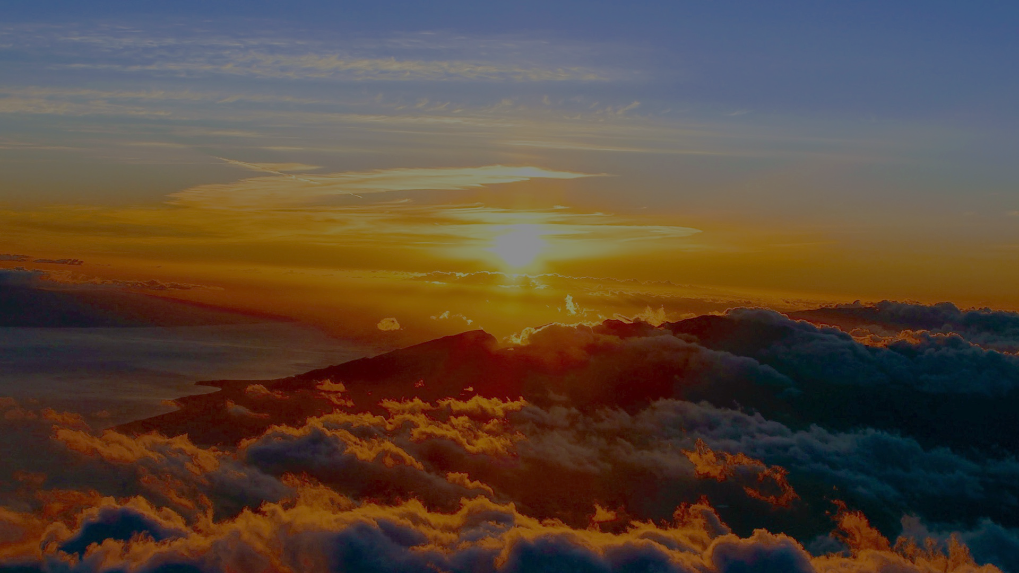
Revelation 22:12
Look! I am coming soon, and my reward is with me to pay each one according to what he has done!
Are you in a place to accept this reward from Jesus?

Slide 50
Questions for Consideration:
Is the return of Jesus exciting for you or scary? Explain your reasoning.
What would be the difference between a healthy anticipation of his return and an unhealthy preoccupation?
Knowing the day will come, are there implications for your daily life? Why or why not?
Have you chosen to be on Jesus’ side? Explain your story.

