Slide 2
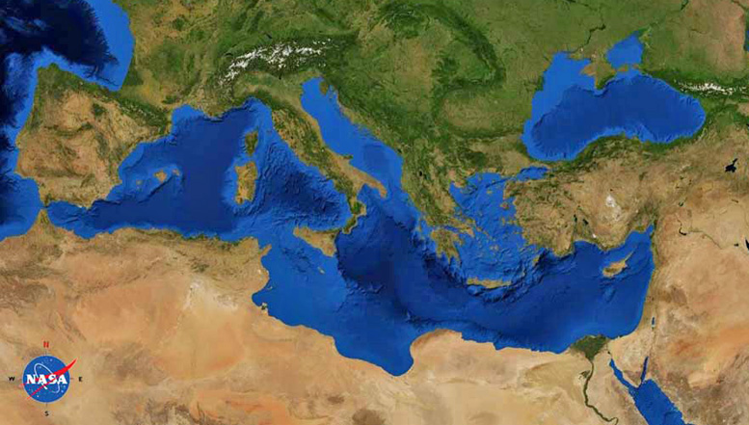
2 Timothy
Paul (Rome)
Timothy (Ephesus)

Slide 3
2 Timothy
Paul (Rome)
Timothy (Ephesus)
^{2 Tim 3:1} But realize this, that in the last days difficult times will come. ² For people will be lovers of self, lovers of money, boastful, arrogant, slanderers, disobedient to parents, ungrateful, unholy, ³ unloving, irreconcilable, malicious gossips, without self-control, brutal, haters of good, ⁴ treacherous, reckless, conceited, lovers of pleasure rather than lovers of God, ⁵ holding to a form of godliness although they have denied its power; avoid such people as these.

Slide 4
2 Timothy
Paul (Rome)
Timothy (Ephesus)
^{2 Tim 3:6} For among them are those who slip into households and captivate weak women weighed down with sins, led on by various impulses, ⁷ always learning and never able to come to the knowledge of the truth. ⁸ Just as Jannes and Jambres opposed Moses, so these men also oppose the truth, men of depraved mind, worthless in regard to the faith. ⁹ But they will not make further progress; for their foolishness will be obvious to all, just as was that also of Jannes and Jambres.

Slide 5
2 Timothy
Paul (Rome)
Timothy (Ephesus)
^{2 Tim 3:6} For among them are those who slip into households and captivate weak women weighed down with sins, led on by various impulses, ⁷ always learning and never able to come to the knowledge of the truth. ⁸ Just as Jannes and Jambres opposed Moses, so these men also oppose the truth, men of depraved mind, worthless in regard to the faith. ⁹ But they will not make further progress; for their foolishness will be obvious to all, just as was that also of Jannes and Jambres.

Slide 6
2 Timothy
Paul (Rome)
Timothy (Ephesus)
^{2 Tim 3:6} For among them are those who slip into households and captivate weak women weighed down with sins, led on by various impulses, ⁷ always learning and never able to come to the knowledge of the truth. ⁸ Just as Jannes and Jambres opposed Moses, so these men also oppose the truth, men of depraved mind, worthless in regard to the faith. ⁹ But they will not make further progress; for their foolishness will be obvious to all, just as was that also of Jannes and Jambres.

Slide 7
2 Timothy
Paul (Rome)
Timothy (Ephesus)
^{2 Tim 3:6} For among them are those who slip into households and captivate weak women weighed down with sins, led on by various impulses, ⁷ always learning and never able to come to the knowledge of the truth. ⁸ Just as Jannes and Jambres opposed Moses, so these men also oppose the truth, men of depraved mind, worthless in regard to the faith. ⁹ But they will not make further progress; for their foolishness will be obvious to all, just as was that also of Jannes and Jambres.

Slide 8
2 Timothy
Paul (Rome)
Timothy (Ephesus)
^{2 Tim 3:6} For among them are those who slip into households and captivate weak women weighed down with sins, led on by various impulses, ⁷ always learning and never able to come to the knowledge of the truth. ⁸ Just as Jannes and Jambres opposed Moses, so these men also oppose the truth, men of depraved mind, worthless in regard to the faith. ⁹ But they will not make further progress; for their foolishness will be obvious to all, just as was that also of Jannes and Jambres.

Slide 9
2 Timothy
Paul (Rome)
Timothy (Ephesus)
^{2 Tim 3:6} For among them are those who slip into households and captivate weak women weighed down with sins, led on by various impulses, ⁷ always learning and never able to come to the knowledge of the truth. ⁸ Just as Jannes and Jambres opposed Moses, so these men also oppose the truth, men of depraved mind, worthless in regard to the faith. ⁹ But they will not make further progress; for their foolishness will be obvious to all, just as was that also of Jannes and Jambres.

Slide 10
2 Timothy
Paul (Rome)
Timothy (Ephesus)
^{2 Tim 3:6} For among them are those who slip into households and captivate weak women weighed down with sins, led on by various impulses, ⁷ always learning and never able to come to the knowledge of the truth. ⁸ Just as Jannes and Jambres opposed Moses, so these men also oppose the truth, men of depraved mind, worthless in regard to the faith. ⁹ But they will not make further progress; for their foolishness will be obvious to all, just as was that also of Jannes and Jambres.

Slide 11
2 Timothy
Paul (Rome)
Timothy (Ephesus)
2 diverging paths
^{2 Tim 3:10} Now you followed my teaching, conduct, purpose, faith, patience, love, perseverance, ¹¹ persecutions, and sufferings, such as happened to me at Antioch, at Iconium, and at Lystra; what persecutions I endured, and out of them all the Lord rescued me! ¹² Indeed, all who want to live in a godly way in Christ Jesus will be persecuted.

Slide 12
2 Timothy
Paul (Rome)
Timothy (Ephesus)
2 diverging paths
^{2 Tim 3:10} Now you followed my teaching, conduct, purpose, faith, patience, love, perseverance, ¹¹ persecutions, and sufferings, such as happened to me at Antioch, at Iconium, and at Lystra; what persecutions I endured, and out of them all the Lord rescued me! ¹² Indeed, all who want to live in a godly way in Christ Jesus will be persecuted.

Slide 13
2 Timothy
Paul (Rome)
Timothy (Ephesus)
2 diverging paths
^{2 Tim 3:10} Now you followed my teaching, conduct, purpose, faith, patience, love, perseverance, ¹¹ persecutions, and sufferings, such as happened to me at Antioch, at Iconium, and at Lystra; what persecutions I endured, and out of them all the Lord rescued me! ¹² Indeed, all who want to live in a godly way in Christ Jesus will be persecuted.

Slide 14
2 Timothy
Paul (Rome)
Timothy (Ephesus)
2 diverging paths
^{2 Tim 3:10} Now you followed my teaching, conduct, purpose, faith, patience, love, perseverance, ¹¹ persecutions, and sufferings, such as happened to me at Antioch, at Iconium, and at Lystra; what persecutions I endured, and out of them all the Lord rescued me! ¹² Indeed, all who want to live in a godly way in Christ Jesus will be persecuted.

Slide 15
2 Timothy
Paul (Rome)
Timothy (Ephesus)
2 diverging paths
^{2 Tim 3:10} Now you followed my teaching, conduct, purpose, faith, patience, love, perseverance, ¹¹ persecutions, and sufferings, such as happened to me at Antioch, at Iconium, and at Lystra; what persecutions I endured, and out of them all the Lord rescued me! ¹² Indeed, all who want to live in a godly way in Christ Jesus will be persecuted.

Slide 16
2 Timothy
Paul (Rome)
Timothy (Ephesus)
2 diverging paths
^{2 Tim 3:10} Now you followed my teaching, conduct, purpose, faith, patience, love, perseverance, ¹¹ persecutions, and sufferings, such as happened to me at Antioch, at Iconium, and at Lystra; what persecutions I endured, and out of them all the Lord rescued me! ¹² Indeed, all who want to live in a godly way in Christ Jesus will be persecuted.

Slide 17
2 Timothy
Paul (Rome)
Timothy (Ephesus)
2 diverging paths
A spiraling contrast
^{2 Tim 3:13} But evil people and impostors will proceed from bad to worse, deceiving and being deceived. ¹⁴ You, however, continue in the things you have learned and become convinced of, knowing from whom you have learned them, ¹⁵ and that from childhood you have known the sacred writings which are able to give you the wisdom that leads to salvation through faith which is in Christ Jesus.

Slide 18
2 Timothy
Paul (Rome)
Timothy (Ephesus)
2 diverging paths
A spiraling contrast
^{2 Tim 3:13} But evil people and impostors will proceed from bad to worse, deceiving and being deceived. ¹⁴ You, however, continue in the things you have learned and become convinced of, knowing from whom you have learned them, ¹⁵ and that from childhood you have known the sacred writings which are able to give you the wisdom that leads to salvation through faith which is in Christ Jesus.

Slide 19
2 Timothy
Paul (Rome)
Timothy (Ephesus)
2 diverging paths
A spiraling contrast
^{2 Tim 3:13} But evil people and impostors will proceed from bad to worse, deceiving and being deceived. ¹⁴ You, however, continue in the things you have learned and become convinced of, knowing from whom you have learned them, ¹⁵ and that from childhood you have known the sacred writings which are able to give you the wisdom that leads to salvation through faith which is in Christ Jesus.

Slide 20
2 Timothy
Paul (Rome)
Timothy (Ephesus)
2 diverging paths
A spiraling contrast
^{2 Tim 3:13} But evil people and impostors will proceed from bad to worse, deceiving and being deceived. ¹⁴ You, however, continue in the things you have learned and become convinced of, knowing from whom you have learned them, ¹⁵ and that from childhood you have known the sacred writings which are able to give you the wisdom that leads to salvation through faith which is in Christ Jesus.

Slide 21
2 Timothy
Paul (Rome)
Timothy (Ephesus)
2 diverging paths
A spiraling contrast
^{2 Tim 3:13} But evil people and impostors will proceed from bad to worse, deceiving and being deceived. ¹⁴ You, however, continue in the things you have learned and become convinced of, knowing from whom you have learned them, ¹⁵ and that from childhood you have known the sacred writings which are able to give you the wisdom that leads to salvation through faith which is in Christ Jesus.

Slide 22
Continue on your course
Continue against the current
1) “Realize”
2) “Avoid”
3) “Continue”
^{2 Tim 3:13} But evil people and impostors will proceed from bad to worse, deceiving and being deceived. ¹⁴ You, however, continue in the things you have learned and become convinced of, knowing from whom you have learned them, ¹⁵ and that from childhood you have known the sacred writings which are able to give you the wisdom that leads to salvation through faith which is in Christ Jesus.

Slide 23
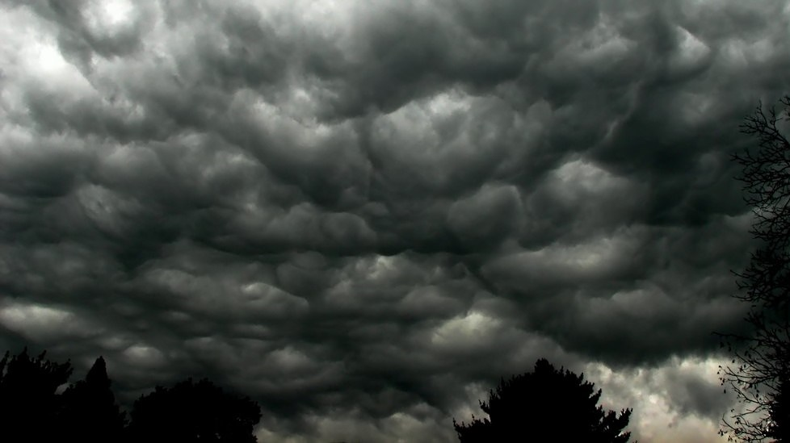
1) “Realize”
^{2 Tim 3:1} But realize this, that in the last days difficult times will come.

Slide 24
1) “Realize”
^{2 Tim 3:1} But realize this, that in the last days difficult times will come.

Slide 25
1) “Realize”
^{2 Tim 3:1} But realize this, that in the last days difficult times will come.

Slide 26
1) “Realize” the trajectory of the world
^{2 Tim 3:1} But realize this, that in the last days difficult times will come.

Slide 27
1) “Realize” the trajectory of the world
What is wrong with the world?
^{2 Tim 3:1} But realize this, that in the last days difficult times will come.

Slide 28
1) “Realize” the trajectory of the world
What is wrong with the world?
^{2 Tim 3:2} For people will be lovers of self, lovers of money, boastful, arrogant, slanderers, disobedient to parents, ungrateful, unholy, ³ unloving, irreconcilable, malicious gossips, without self-control, brutal, haters of good, ⁴ treacherous, reckless, conceited, lovers of pleasure rather than lovers of God,

Slide 29
1) “Realize” the trajectory of the world
What is wrong with the world?
^{2 Tim 3:2} For people will be lovers of self, lovers of money, boastful, arrogant, slanderers, disobedient to parents, ungrateful, unholy, ³ unloving, irreconcilable, malicious gossips, without self-control, brutal, haters of good, ⁴ treacherous, reckless, conceited, lovers of pleasure rather than lovers of God,

Slide 30
1) “Realize” the trajectory of the world
What is wrong with the world?
^{2 Tim 3:2} For people will be lovers of self, lovers of money, boastful, arrogant, slanderers, disobedient to parents, ungrateful, unholy, ³ unloving, irreconcilable, malicious gossips, without self-control, brutal, haters of good, ⁴ treacherous, reckless, conceited, lovers of pleasure rather than lovers of God,

Slide 31
1) “Realize” the trajectory of the world
The world without God
^{2 Tim 3:2} For people will be lovers of self, lovers of money, boastful, arrogant, slanderers, disobedient to parents, ungrateful, unholy, ³ unloving, irreconcilable, malicious gossips, without self-control, brutal, haters of good, ⁴ treacherous, reckless, conceited, lovers of pleasure rather than lovers of God,

Slide 32
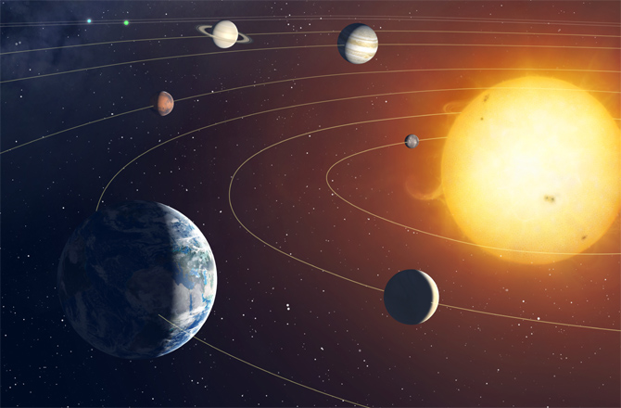
1) “Realize” the way of the world
Self
^{2 Tim 3:2} For people will be lovers of self, lovers of money, boastful, arrogant, slanderers, disobedient to parents, ungrateful, unholy, ³ unloving, irreconcilable, malicious gossips, without self-control, brutal, haters of good, ⁴ treacherous, reckless, conceited, lovers of pleasure rather than lovers of God,

Slide 33
1) “Realize” the way of the world
Self
Goals & priorities
^{2 Tim 3:2} For people will be lovers of self, lovers of money, boastful, arrogant, slanderers, disobedient to parents, ungrateful, unholy, ³ unloving, irreconcilable, malicious gossips, without self-control, brutal, haters of good, ⁴ treacherous, reckless, conceited, lovers of pleasure rather than lovers of God,

Slide 34
1) “Realize” the way of the world
Self
Goals & priorities
^{2 Tim 3:2} For people will be lovers of self, lovers of money, boastful, arrogant, slanderers, disobedient to parents, ungrateful, unholy, ³ unloving, irreconcilable, malicious gossips, without self-control, brutal, haters of good, ⁴ treacherous, reckless, conceited, lovers of pleasure rather than lovers of God,

Slide 35
1) “Realize” the way of the world
$
Self
Goals & priorities
^{2 Tim 3:2} For people will be lovers of self, lovers of money, boastful, arrogant, slanderers, disobedient to parents, ungrateful, unholy, ³ unloving, irreconcilable, malicious gossips, without self-control, brutal, haters of good, ⁴ treacherous, reckless, conceited, lovers of pleasure rather than lovers of God,

Slide 36
1) “Realize” the way of the world
identity
$
Self
Goals & priorities
^{2 Tim 3:2} For people will be lovers of self, lovers of money, boastful, arrogant, slanderers, disobedient to parents, ungrateful, unholy, ³ unloving, irreconcilable, malicious gossips, without self-control, brutal, haters of good, ⁴ treacherous, reckless, conceited, lovers of pleasure rather than lovers of God,

Slide 37
1) “Realize” the way of the world
identity
Speech
$
Self
Goals & priorities
^{2 Tim 3:2} For people will be lovers of self, lovers of money, boastful, arrogant, slanderers, disobedient to parents, ungrateful, unholy, ³ unloving, irreconcilable, malicious gossips, without self-control, brutal, haters of good, ⁴ treacherous, reckless, conceited, lovers of pleasure rather than lovers of God,

Slide 38
1) “Realize” the way of the world
identity
Speech
$
Self
Goals & priorities
Family
^{2 Tim 3:2} For people will be lovers of self, lovers of money, boastful, arrogant, slanderers, disobedient to parents, ungrateful, unholy, ³ unloving, irreconcilable, malicious gossips, without self-control, brutal, haters of good, ⁴ treacherous, reckless, conceited, lovers of pleasure rather than lovers of God,

Slide 39
1) “Realize” the way of the world
identity
Relation-
ships
Speech
$
Self
Goals & priorities
Family
^{2 Tim 3:2} For people will be lovers of self, lovers of money, boastful, arrogant, slanderers, disobedient to parents, ungrateful, unholy, ³ unloving, irreconcilable, malicious gossips, without self-control, brutal, haters of good, ⁴ treacherous, reckless, conceited, lovers of pleasure rather than lovers of God,

Slide 40
1) “Realize” the way of the world
conduct
Body
identity
Relation-
ships
Speech
$
Self
Goals & priorities
Family
^{2 Tim 3:2} For people will be lovers of self, lovers of money, boastful, arrogant, slanderers, disobedient to parents, ungrateful, unholy, ³ unloving, irreconcilable, malicious gossips, without self-control, brutal, haters of good, ⁴ treacherous, reckless, conceited, lovers of pleasure rather than lovers of God,

Slide 41
1) “Realize” the way of the world
conduct
Body
identity
Relation-
ships
Speech
values
$
Self
Goals & priorities
Family
^{2 Tim 3:2} For people will be lovers of self, lovers of money, boastful, arrogant, slanderers, disobedient to parents, ungrateful, unholy, ³ unloving, irreconcilable, malicious gossips, without self-control, brutal, haters of good, ⁴ treacherous, reckless, conceited, lovers of pleasure rather than lovers of God,

Slide 42
1) “Realize” the way of the world
conduct
Body
identity
Relation-
ships
Speech
values
$
Self
religion
Goals & priorities
Family
⁵ holding to a form of godliness although they have denied its power; avoid such people as these.

Slide 43
1) “Realize” the way of the world
conduct
Body
identity
Relation-
ships
Speech
values
$
Self
religion
Goals & priorities
Family
Sound familiar?
⁵ holding to a form of godliness although they have denied its power; avoid such people as these.

Slide 44
1) “Realize” the way of the world
conduct
Body
identity
Relation-
ships
Speech
values
$
Self
religion
Goals & priorities
Family
… and where it’s headed
⁵ holding to a form of godliness although they have denied its power; avoid such people as these.

Slide 45
1) “Realize” the way of the world
conduct
Body
identity
Relation-
ships
Speech
values
$
Self
religion
Goals & priorities
Family
… and where it’s headed
⁵ holding to a form of godliness although they have denied its power; avoid such people as these.

Slide 46
2) “Avoid”
conduct
Body
identity
Relation-
ships
Speech
values
$
Self
religion
Goals & priorities
Family
⁵ holding to a form of godliness although they have denied its power; avoid such people as these.

Slide 47
2) “Avoid” the influence of the way of the world
conduct
Body
identity
Relation-
ships
Speech
values
$
Self
religion
Goals & priorities
Family
Recognize the emptiness of this way of life
⁵ holding to a form of godliness although they have denied its power; avoid such people as these.

Slide 48
2) “Avoid” the influence of the way of the world
conduct
Body
identity
Relation-
ships
Speech
values
$
Self
religion
Goals & priorities
Family
Does living for self lead to fulfillment and happiness?
⁵ holding to a form of godliness although they have denied its power; avoid such people as these.

Slide 49
2) “Avoid” the influence of the way of the world
conduct
Body
identity
Relation-
ships
Speech
values
$
Self
religion
Goals & priorities
Family
Is it compatible with others’ solar systems?
⁵ holding to a form of godliness although they have denied its power; avoid such people as these.

Slide 50
2) “Avoid” the influence of the way of the world
conduct
Body
identity
Relation-
ships
Speech
values
$
Self
religion
Goals & priorities
Family
Is it reality?
⁵ holding to a form of godliness although they have denied its power; avoid such people as these.

Slide 51
2) “Avoid” the influence of the way of the world
conduct
Body
identity
Relation-
ships
Speech
values
$
Self
religion
Goals & priorities
Family
Assumes that everything I desire is good
⁵ holding to a form of godliness although they have denied its power; avoid such people as these.

Slide 52
2) “Avoid” the influence of the way of the world
conduct
Body
identity
Relation-
ships
Speech
values
$
Self
religion
Goals & priorities
Family
Saddles everyone and everything else with the weight of ME
⁵ holding to a form of godliness although they have denied its power; avoid such people as these.

Slide 53
2) “Avoid” the influence of the way of the world
conduct
Body
identity
Relation-
ships
Speech
values
$
Self
religion
Goals & priorities
Family
It is ultimately destructive to others,
and enslaving to you!
⁵ holding to a form of godliness although they have denied its power; avoid such people as these.

Slide 54
2) “Avoid” the influence of the way of the world
conduct
Body
identity
Relation-
ships
Speech
values
$
Self
religion
Goals & priorities
Family
¹³ But evil people and impostors will proceed from bad to worse, deceiving and being deceived.
⁵ holding to a form of godliness although they have denied its power; avoid such people as these.

Slide 55
2) “Avoid” the influence of the way of the world
conduct
Body
identity
Relation-
ships
Speech
values
$
Self
religion
Goals & priorities
Family
Recognize the power of the current
⁵ holding to a form of godliness although they have denied its power; avoid such people as these.

Slide 56
Recognize the power of the current

Slide 57
^{2 Tim 3:14} You, however, continue in the things you have learned and become convinced of, knowing from whom you have learned them, ¹⁵ and that from childhood you have known the sacred writings which are able to give you the wisdom that leads to salvation through faith which is in Christ Jesus.

Slide 58
3) “Continue”
Persevere in the way you have learned: against the current
^{2 Tim 3:14} You, however, continue in the things you have learned and become convinced of, knowing from whom you have learned them, ¹⁵ and that from childhood you have known the sacred writings which are able to give you the wisdom that leads to salvation through faith which is in Christ Jesus.

Slide 59
3) “Continue” in a better way
Persevere in the way you have learned: against the current
^{2 Tim 3:14} You, however, continue in the things you have learned and become convinced of, knowing from whom you have learned them, ¹⁵ and that from childhood you have known the sacred writings which are able to give you the wisdom that leads to salvation through faith which is in Christ Jesus.

Slide 60
3) “Continue” in a better way
Persevere in the way you have learned: against the current
^{2 Tim 3:14} You, however, continue in the things you have learned and become convinced of, knowing from whom you have learned them, ¹⁵ and that from childhood you have known the sacred writings which are able to give you the wisdom that leads to salvation through faith which is in Christ Jesus.

Slide 61
3) “Continue” in a better way
With salvation as its foundation, trajectory, and ultimate terminus
^{2 Tim 3:14} You, however, continue in the things you have learned and become convinced of, knowing from whom you have learned them, ¹⁵ and that from childhood you have known the sacred writings which are able to give you the wisdom that leads to salvation through faith which is in Christ Jesus.
The gospel is the antidote to the life built on self

Slide 62
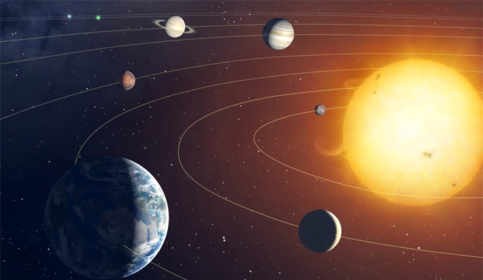
3) “Continue” in a better way
conduct
values
Identity
Speech
Family
Goals & priorities
GOD
$
Relation-
ships
purpose
Body
The gospel is the antidote to the life built on self

Slide 63
3) “Continue” in a better way
conduct
values
Identity
Speech
Family
Goals & priorities
GOD
$
Relation-
ships
purpose
Body
The gospel is the antidote to the life built on self
Pleasure and fulfillment are the result!

Slide 64
3) “Continue” in a better way
conduct
values
Identity
Speech
Family
Goals & priorities
GOD
$
Relation-
ships
purpose
Body
When we submit to God, we are aligning with reality

Slide 65
Set your resolve on this course
Realize
Avoid
Continue
^{2 Tim 3:14} You, however, continue in the things you have learned and become convinced of, knowing from whom you have learned them, ¹⁵ and that from childhood you have known the sacred writings which are able to give you the wisdom that leads to salvation through faith which is in Christ Jesus.

Slide 67
Discussion Questions to-go:
What’s your reaction to Paul’s description of the world that “loves self rather than God?”
What would be a practical step for someone who wants to get their focus off of self and more on to God and others?
How would you respond to someone who said
“it’s hard for me to believe that submitting to God would be more fulfilling than just pursuing my own best interest.”

