Slide 2
Jesus One on One
John 1

Slide 3
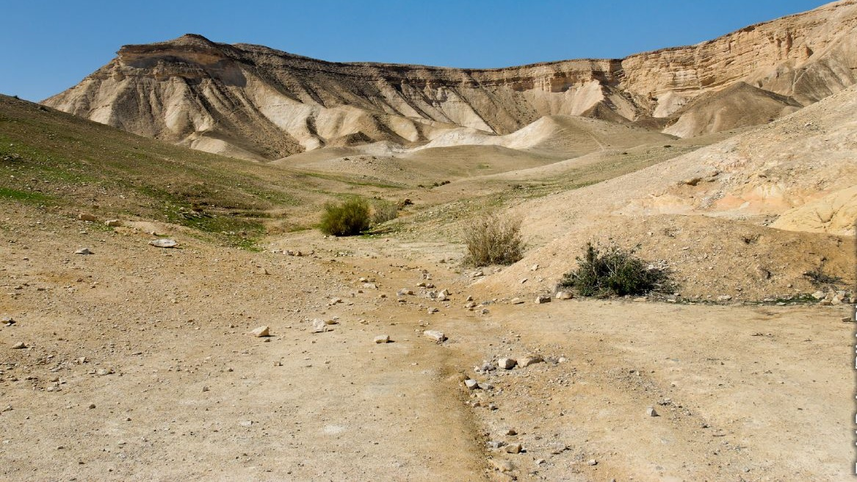
Jesus One on One
^{John 1:35} Again the next day John was standing with two of his disciples, ³⁶ and he looked at Jesus as He walked, and said, “Behold, the Lamb of God!” ³⁷ And the two disciples heard him speak, and they followed Jesus.

Slide 4
Jesus One on One
^{John 1:35} Again the next day John was standing with two of his disciples, ³⁶ and he looked at Jesus as He walked, and said, “Behold, the Lamb of God!” ³⁷ And the two disciples heard him speak, and they followed Jesus.

Slide 5
Jesus One on One
^{John 1:35} Again the next day John was standing with two of his disciples, ³⁶ and he looked at Jesus as He walked, and said, “Behold, the Lamb of God!” ³⁷ And the two disciples heard him speak, and they followed Jesus.

Slide 6
: Andrew
Jesus One on One
^{John 1:35} Again the next day John was standing with two of his disciples, ³⁶ and he looked at Jesus as He walked, and said, “Behold, the Lamb of God!” ³⁷ And the two disciples heard him speak, and they followed Jesus.

Slide 7
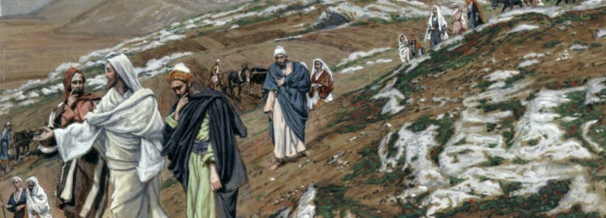
: Andrew
Jesus One on One
^{John 1:38} And Jesus turned and saw them following, and said to them, “What are you seeking?” They said to Him, “Rabbi (which translated means Teacher), where are You staying?” ³⁹ He said to them, “Come, and you will see.” So they came and saw where He was staying, and they stayed with Him that day; it was about the tenth hour.

Slide 8
: Andrew
Jesus One on One
^{John 1:38} And Jesus turned and saw them following, and said to them, “What are you seeking?” They said to Him, “Rabbi (which translated means Teacher), where are You staying?” ³⁹ He said to them, “Come, and you will see.” So they came and saw where He was staying, and they stayed with Him that day; it was about the tenth hour.

Slide 9
: Andrew
Jesus One on One
^{John 1:38} And Jesus turned and saw them following, and said to them, “What are you seeking?” They said to Him, “Rabbi (which translated means Teacher), where are You staying?” ³⁹ He said to them, “Come, and you will see.” So they came and saw where He was staying, and they stayed with Him that day; it was about the tenth hour.

Slide 10
: Andrew
Jesus One on One
^{John 1:38} And Jesus turned and saw them following, and said to them, “What are you seeking?” They said to Him, “Rabbi (which translated means Teacher), where are You staying?” ³⁹ He said to them, “Come, and you will see.” So they came and saw where He was staying, and they stayed with Him that day; it was about the tenth hour.

Slide 11
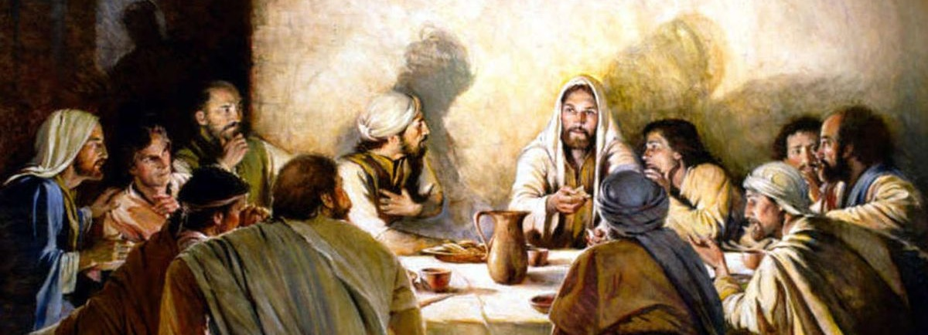
Jesus One on One
^{John 1:38} And Jesus turned and saw them following, and said to them, “What are you seeking?” They said to Him, “Rabbi (which translated means Teacher), where are You staying?” ³⁹ He said to them, “Come, and you will see.” So they came and saw where He was staying, and they stayed with Him that day; it was about the tenth hour.

Slide 12
^{John 1:40} One of the two who heard John speak, and followed Him, was Andrew, Simon Peter’s brother. ⁴¹ He first found his own brother Simon and said to him, “We have found the Messiah” (which translated means Christ).

Slide 13
^{John 1:40} One of the two who heard John speak, and followed Him, was Andrew, Simon Peter’s brother. ⁴¹ He first found his own brother Simon and said to him, “We have found the Messiah” (which translated means Christ).

Slide 14
Something about their interaction with Jesus dramatically changed their perspective about Him!
matches my experience of “come and see”
^{John 1:40} One of the two who heard John speak, and followed Him, was Andrew, Simon Peter’s brother. ⁴¹ He first found his own brother Simon and said to him, “We have found the Messiah” (which translated means Christ).

Slide 15
^{John 1:42} He brought him to Jesus.
Jesus looked at him and said, “You are Simon the son of John; you shall be called Cephas” (which is translated Peter).

Slide 16
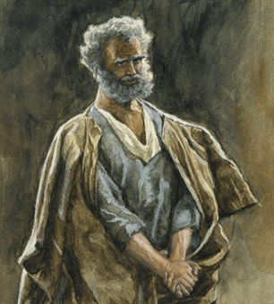
Jesus and Simon
^{John 1:42} He brought him to Jesus.
Jesus looked at him and said, “You are Simon the son of John; you shall be called Cephas” (which is translated Peter).

Slide 17
Jesus and Simon
^{John 1:42} He brought him to Jesus.
Jesus looked at him and said, “You are Simon the son of John; you shall be called Cephas” (which is translated Peter).

Slide 18
Jesus and Simon
^{John 1:42} He brought him to Jesus.
Jesus looked at him and said, “You are Simon the son of John; you shall be called Cephas” (which is translated Peter).

Slide 19
Jesus and Simon
^{Genesis 49:5} Simeon and Levi are brothers; Their swords are implements of violence. ⁶ May my soul not enter into their council; May my glory not be united with their assembly; For in their anger they killed men, And in their self-will they lamed oxen. ⁷ Cursed be their anger, for it is fierce; And their wrath, for it is cruel.
^{John 1:42} He brought him to Jesus.
Jesus looked at him and said, “You are Simon the son of John; you shall be called Cephas” (which is translated Peter).

Slide 20
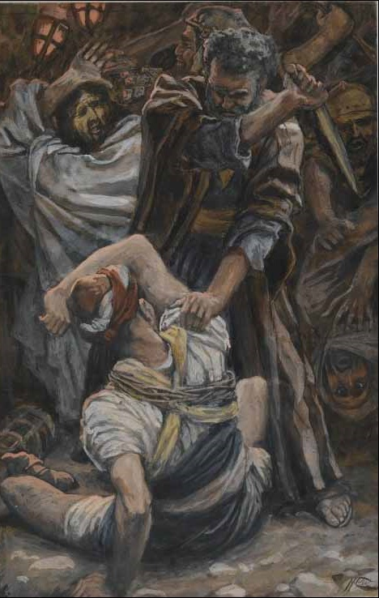
Jesus and Simon
^{John 1:42} He brought him to Jesus.
Jesus looked at him and said, “You are Simon the son of John; you shall be called Cephas” (which is translated Peter).

Slide 21
Jesus and Simon
^{John 1:42} He brought him to Jesus.
Jesus looked at him and said, “You are Simon the son of John; you shall be called Cephas” (which is translated Peter).

Slide 22
Jesus and Simon
Jesus accepts us as we are
And focuses on what we can become
^{John 1:42} He brought him to Jesus.
Jesus looked at him and said, “You are Simon the son of John; you shall be called Cephas” (which is translated Peter).

Slide 23
Jesus and Simon
He has a vision for our lives
^{John 1:42} He brought him to Jesus.
Jesus looked at him and said, “You are Simon the son of John; you shall be called Cephas” (which is translated Peter).

Slide 24
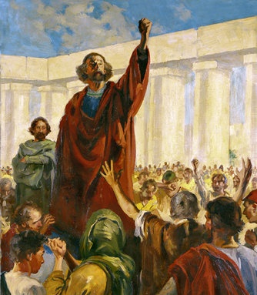
Jesus and Simon
He has a vision for our lives
^{John 1:42} He brought him to Jesus.
Jesus looked at him and said, “You are Simon the son of John; you shall be called Cephas” (which is translated Peter).

Slide 25
Jesus and Simon
He has a vision for our lives
And sometimes it’s the opposite of what we thought defined us
^{John 1:42} He brought him to Jesus.
Jesus looked at him and said, “You are Simon the son of John; you shall be called Cephas” (which is translated Peter).

Slide 26
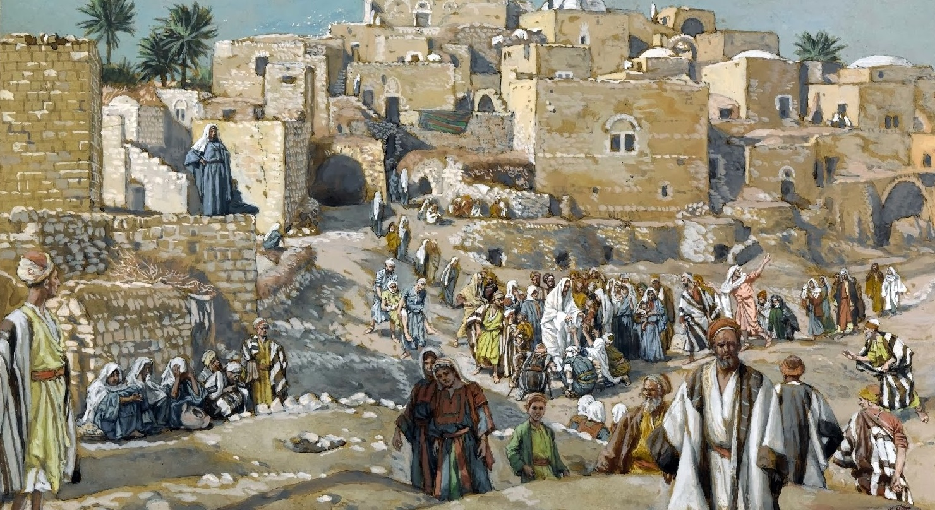
^{John 1:43} The next day He decided to go to Galilee, and He found Philip. And Jesus said to him, “Follow Me.” ⁴⁴ Now Philip was from Bethsaida, the city of Andrew and Peter.

Slide 27
^{John 1:43} The next day He decided to go to Galilee, and He found Philip. And Jesus said to him, “Follow Me.” ⁴⁴ Now Philip was from Bethsaida, the city of Andrew and Peter.

Slide 28
^{John 1:45} Philip found Nathanael and said to him, “We have found Him of whom Moses wrote in the Law, and the prophets also wrote: Jesus the son of Joseph, from Nazareth!”

Slide 29
^{John 1:45} Philip found Nathanael and said to him, “We have found Him of whom Moses wrote in the Law, and the prophets also wrote: Jesus the son of Joseph, from Nazareth!”

Slide 30
^{John 1:45} Philip found Nathanael and said to him, “We have found Him of whom Moses wrote in the Law, and the prophets also wrote: Jesus the son of Joseph, from Nazareth!”

Slide 31
^{John 1:45} Philip found Nathanael and said to him, “We have found Him of whom Moses wrote in the Law, and the prophets also wrote: Jesus the son of Joseph, from Nazareth!”

Slide 32
Something about Jesus makes people want to show him to others
^{John 1:46} Nathanael said to him, “Can anything good be from Nazareth?”
Philip said to him, “Come and see.”

Slide 33
Something about Jesus makes people want to show him to others
^{John 1:46} Nathanael said to him, “Can anything good be from Nazareth?”
Philip said to him, “Come and see.”

Slide 34
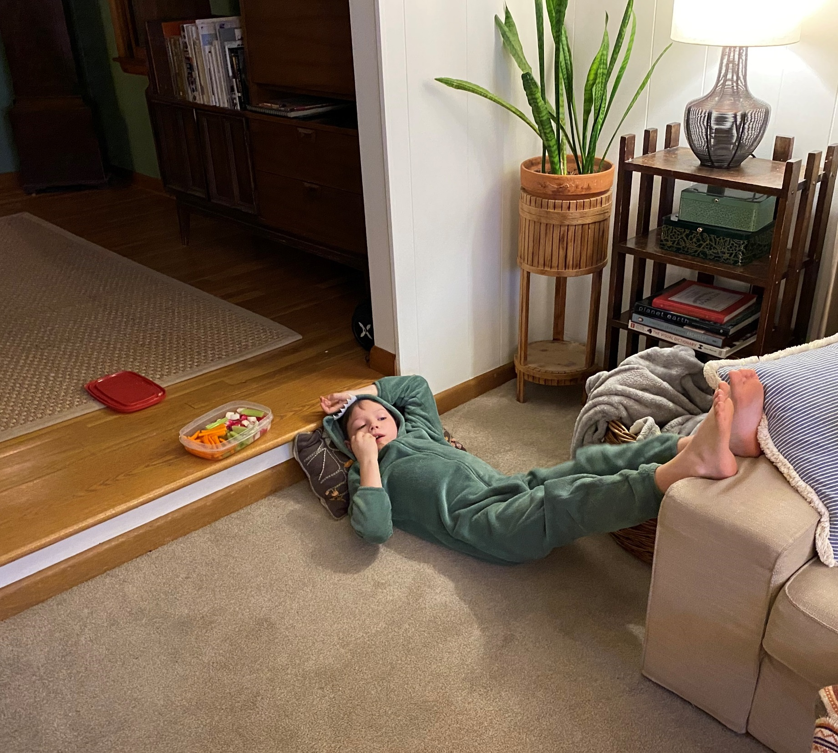

Slide 35
Something about Jesus makes people want to show him to others
^{John 1:46} Nathanael said to him, “Can anything good be from Nazareth?”
Philip said to him, “Come and see.”

Slide 36
Something about Jesus makes people want to show him to others
Share what you know with who you know
^{John 1:46} Nathanael said to him, “Can anything good be from Nazareth?”
Philip said to him, “Come and see.”

Slide 37
Something about Jesus makes people want to show him to others
The most natural thing in the world
^{John 1:46} Nathanael said to him, “Can anything good be from Nazareth?”
Philip said to him, “Come and see.”

Slide 38
Jesus and Nathanael
^{John 1:47} Jesus saw Nathanael coming to Him,
and said of him, “Here is truly an Israelite, in whom there is no deceit!”

Slide 39
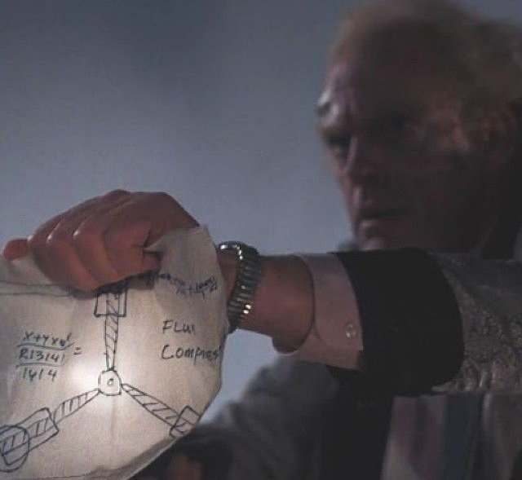
Jesus and Nathanael
^{John 1:48} Nathanael said to Him, “How do You know me?”
Jesus answered and said to him, “Before Philip called you, when you were under the fig tree, I saw you.”

Slide 40
Jesus and Nathanael
^{John 1:48} Nathanael said to Him, “How do You know me?”
Jesus answered and said to him, “Before Philip called you, when you were under the fig tree, I saw you.”

Slide 41
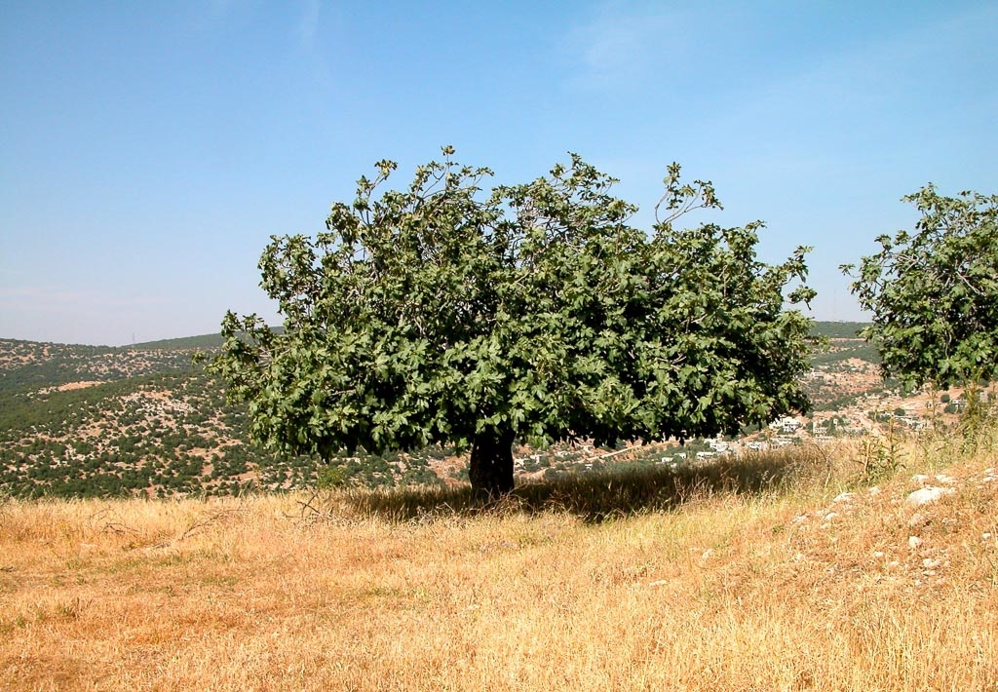
^{John 1:48} Nathanael said to Him, “How do You know me?”
Jesus answered and said to him, “Before Philip called you, when you were under the fig tree, I saw you.”

Slide 42
^{John 1:49} Nathanael answered Him, “Rabbi, You are the Son of God; You are the King of Israel!”

Slide 43
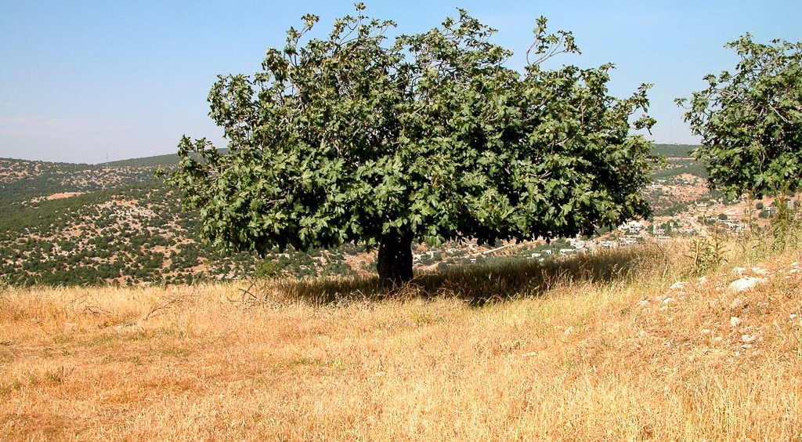
Jesus did not reject him for being a skeptic
^{John 1:49} Nathanael answered Him, “Rabbi, You are the Son of God; You are the King of Israel!”

Slide 44
Nathanael didn’t believe it. But he was willing to “come and see”
^{John 1:49} Nathanael answered Him, “Rabbi, You are the Son of God; You are the King of Israel!”

Slide 45
^{Matt 7:7} Ask, and it will be given to you; seek, and you will find; knock, and it will be opened to you. For everyone who asks receives, and the one who seeks finds, and to the one who knocks it will be opened.
Nathanael didn’t believe it. But he was willing to “come and see”
^{John 1:49} Nathanael answered Him, “Rabbi, You are the Son of God; You are the King of Israel!”

Slide 46
God knows you
One aspect of the human condition is longing to be known
But no one can really know us perfectly
And if they could… would we even want that?
^{John 1:49} Nathanael answered Him, “Rabbi, You are the Son of God; You are the King of Israel!”

Slide 47
God knows you
One aspect of reconciliation with God is being fully known
^{Psalm 139:1} O Lord, you have searched me and known me! ² You know when I sit down and when I rise up; you discern my thoughts from afar. ³ You search out my path and my lying down and are acquainted with all my ways. ⁴ Even before a word is on my tongue, behold, O Lord, you know it altogether. ⁵ You hem me in, behind and before, and lay your hand upon me.
^{John 1:49} Nathanael answered Him, “Rabbi, You are the Son of God; You are the King of Israel!”

Slide 48
God knows you
One aspect of reconciliation with God is being fully known
^{Psalm 139:13} For you created my innermost parts; you wove me in my mother’s womb. ¹⁴ I will give thanks to you, because I am awesomely and wonderfully made… ¹⁶ Your eyes have seen my formless substance; and in your book were written all the days that were ordained for me, when as yet there was not one of them.
^{John 1:49} Nathanael answered Him, “Rabbi, You are the Son of God; You are the King of Israel!”

Slide 49
God knows you
One aspect of reconciliation with God is being fully known
What would be the ramifications of there being a God who knows you?
^{John 1:49} Nathanael answered Him, “Rabbi, You are the Son of God; You are the King of Israel!”

Slide 50
^{John 1:50} Jesus answered and said to him, “Because I said to you that I saw you under the fig tree, do you believe? You will see greater things than these.” ⁵¹ And He said to him, “Truly, truly I say to you, you will see heaven opened and the angels of God ascending and descending on the Son of Man.

