Slide 2
(1 Pet. 3:1) In the same way, you wives, be submissive to your own husbands so that even if any of them are disobedient to the word, they may be won without a word by the behavior of their wives,
² as they observe your chaste and respectful behavior.

Slide 3
(1 Pet. 3:3) Your adornment must not be merely external: braiding the hair, wearing gold jewelry, or putting on dresses.
⁴ Instead, let it be the hidden person of the heart, with the imperishable quality of a gentle and quiet spirit, which is precious in the sight of God.

Slide 4
(1 Pet. 3:5) For in this way in former times the holy women also, who hoped in God, used to adorn themselves, being submissive to their own husbands.
⁶ Sarah obeyed Abraham, calling him lord, and you have become her children if you do what is right without being frightened by any fear.

Slide 5
(1 Pet. 3:7) You husbands, in the same way, live with your wives in an understanding way,
as with someone weaker,
since she is a woman.
Show her honor as a fellow heir of the grace of life,
so that your prayers will not be hindered.

Slide 6
Summary
Wives, be submissive to sinful husbands (v.1).
Be sexually pure (v.2) and talk less (v.4).
Make sure to look good and ugly (vv.3-4).
Just a suggestion: Call your husband, “Lord” (v.6).
BTW… you’re weak! (v.7)

Slide 8
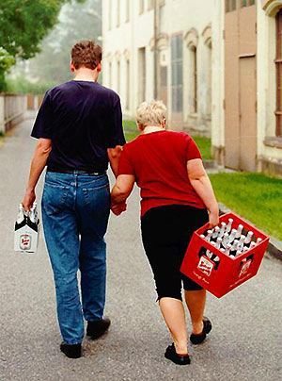

Slide 9
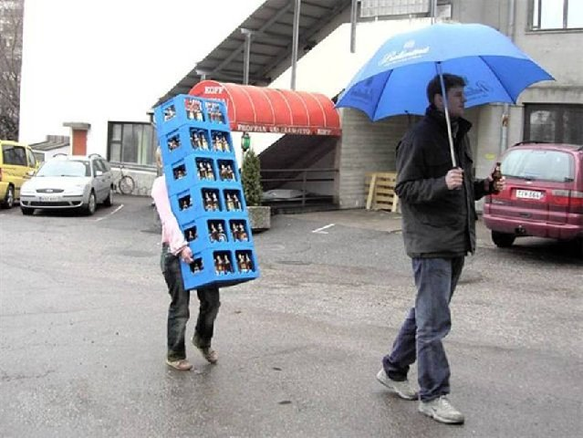

Slide 10
(1 Pet. 3:1) In the same way, you wives, be submissive to your own husbands so that even if any of them are disobedient to the word, they may be won without a word by the behavior of their wives,
² as they observe your chaste and respectful behavior.
Submission is NOT…
(1) Inequality.
(Gal. 3:28; Gen. 1:27)
(Gal. 3:28) There is neither male nor female. You are all one in Christ Jesus.

Slide 11
(1 Pet. 3:1) In the same way, you wives, be submissive to your own husbands so that even if any of them are disobedient to the word, they may be won without a word by the behavior of their wives,
² as they observe your chaste and respectful behavior.
(Mk. 10:42) Jesus said, “You know that the rulers in this world lord it over their people, and officials flaunt their authority over those under them.
⁴³ But among you it will be different. Whoever wants to be a leader among you must be your servant.”
Submission is NOT…
(1) Inequality.
(Gal. 3:28; Gen. 1:27)
(2) Patriarchy or misogyny.
(Mk. 10:42-45; Eph. 5:25, 28; Col. 3:19; 1 Pet. 3:7)

Slide 12
(1 Pet. 3:1) In the same way, you wives, be submissive to your own husbands so that even if any of them are disobedient to the word, they may be won without a word by the behavior of their wives,
² as they observe your chaste and respectful behavior.
(Eph. 5:25) Husbands, love your wives,
just as Christ also loved the church and gave Himself up for her.
(Col. 3:19) Husbands, love your wives
and never treat them harshly.
Submission is NOT…
(1) Inequality.
(Gal. 3:28; Gen. 1:27)
(2) Patriarchy or misogyny.
(Mk. 10:42-45; Eph. 5:25, 28; Col. 3:19; 1 Pet. 3:7)

Slide 13
(1 Pet. 3:1) In the same way, you wives, be submissive to your own husbands so that even if any of them are disobedient to the word, they may be won without a word by the behavior of their wives,
² as they observe your chaste and respectful behavior.
Submission is NOT…
(1) Inequality.
(Gal. 3:28; Gen. 1:27)
(2) Patriarchy or misogyny.
(Mk. 10:42-45; Eph. 5:25, 28; Col. 3:19; 1 Pet. 3:7)
(3) Unqualified authority.
(Acts 4:19; 5:29; 1 Pet. 2:13; Abigail in 1 Sam. 25)

Slide 14
(1 Pet. 3:1) In the same way, you wives, be submissive to your own husbands so that even if any of them are disobedient to the word, they may be won without a word by the behavior of their wives,
² as they observe your chaste and respectful behavior.
Husbands are never told to force their wives to submit!
Submission is NOT…
(1) Inequality.
(Gal. 3:28; Gen. 1:27)
(2) Patriarchy or misogyny.
(Mk. 10:42-45; Eph. 5:25, 28; Col. 3:19; 1 Pet. 3:7)
(3) Unqualified authority.
(Acts 4:19; 5:29; 1 Pet. 2:13; Abigail in 1 Sam. 25)
(4) Forced or involuntary.
(Men and women “read their own mail”)

Slide 15
(1 Pet. 3:1) In the same way, you wives, be submissive to your own husbands so that even if any of them are disobedient to the word, they may be won without a word by the behavior of their wives,
² as they observe your chaste and respectful behavior.
Submission is voluntarily surrendering one’s rights for the true good of:
(1) the husband
(2) the family
(3) the advancement of Jesus’ message of love and forgiveness

Slide 16
(1 Pet. 3:1) In the same way, you wives, be submissive to your own husbands so that even if any of them are disobedient to the word, they may be won without a word by the behavior of their wives,
² as they observe your chaste and respectful behavior.

Slide 17
(1 Pet. 3:1) In the same way, you wives, be submissive to your own husbands so that even if any of them are disobedient to the word, they may be won without a word by the behavior of their wives,
² as they observe your chaste and respectful behavior.
Peter isn’t speaking to ideal marriages
These husbands aren’t Christians.
Jobes (p.204), Schreiner (p.147), Grudem (p.145).
“Disobedient to the word” (1 Pet. 2:8).
Rebellious wives = persecution.
Context: persecution from government (v.13) and slave masters (2:18).
Any deviation was seen as a threat!
Karen H. Jobes, 1 Peter, Baker Exegetical Commentary on the New Testament (Grand Rapids, MI: Baker Academic, 2005), 203.

Slide 18
Plutarch
(Greek Philosopher & Historian (AD 46-119)
Plutarch, Advice to Bride and Groom, 140.19.
“A wife ought not to make friends of her own,
but to enjoy her husband’s friends in common with him.”

Slide 19
Plutarch
(Greek Philosopher & Historian (AD 46-119)
Plutarch, Advice to Bride and Groom, 140.19.
“It is [expected] for a wife to worship and to know only the gods that her husband believes in,
and to shut the front door tight upon all [strange] rituals and outlandish superstitions.”

Slide 20
Karen Jobes
(New Testament Scholar)
Karen H. Jobes, 1 Peter, Baker Exegetical Commentary on the New Testament (Grand Rapids, MI: Baker Academic, 2005), 183.
“The Egyptian Isis cult was viewed as a threat to the Roman way of life
because it permitted a woman authority over her husband.”

Slide 21
(1 Pet. 3:1) In the same way, you wives, be submissive to your own husbands so that even if any of them are disobedient to the word, they may be won without a word by the behavior of their wives,
² as they observe your chaste and respectful behavior.
What was the best way to avoid persecution?
Love!
Peter isn’t speaking to ideal marriages
These husbands aren’t Christians.
Jobes (p.204), Schreiner (p.147), Grudem (p.145).
“Disobedient to the word” (1 Pet. 2:8).
Rebellious wives = persecution.
Context: persecution from government (v.13) and slave masters (2:18).
Any deviation was seen as a threat!
Karen H. Jobes, 1 Peter, Baker Exegetical Commentary on the New Testament (Grand Rapids, MI: Baker Academic, 2005), 203.

Slide 22
(1 Pet. 3:1) In the same way, you wives, be submissive to your own husbands so that even if any of them are disobedient to the word, they may be won without a word by the behavior of their wives,
² as they observe your chaste and respectful behavior.
#1. Follow the example of Jesus
(1 Pet. 2:21) Christ suffered for you, leaving you an example for you to follow in His steps.

Slide 23
(1 Pet. 3:1) In the same way, you wives, be submissive to your own husbands so that even if any of them are disobedient to the word, they may be won without a word by the behavior of their wives,
² as they observe your chaste and respectful behavior.
Respectful words break the toxic cycle of verbal attacks!
#2. Live an attractive and winsome lifestyle
Never underestimate the evidence of love!
“Chaste” (hagnon) means “pure” (BDAG, p.13).
“Respectful” because men are profoundly insecure!

Slide 24
(1 Pet. 3:3) Your adornment must not be merely external: braiding the hair, wearing gold jewelry, or putting on dresses.
#3. Avoid needless suspicion
Men interpreted cosmetics as a sign of seduction or infidelity.
Philo, On the Virtues 7.39
Plutarch, Advice to Bride and Groom 30
Xenophon, Oeconomicus 10.2
Picture how this would appear in a 1st century context…

Slide 25
(1 Pet. 3:4) Instead, let it be the hidden person of the heart, with the imperishable quality of a gentle and quiet spirit, which is precious in the sight of God.
#4. Trust in love—not looks
“Gentle” (praüs) is restraint—not weakness.
Matthew 5:5; 11:29; 21:5
“Quiet” relates to winning their husbands “without a word by [their] behavior” (v.1).

Slide 26
(1 Pet. 3:4) Instead, let it be the hidden person of the heart, with the imperishable quality of a gentle and quiet spirit, which is precious in the sight of God.
(Prov. 31:10, 30) An excellent wife, who can find? Her worth is far above jewels.
Charm is deceitful and beauty is vain,
but a woman who fears the LORD, she shall be praised.

Slide 27
(1 Pet. 3:5) For in this way in former times the holy women also, who hoped in God, used to adorn themselves, being submissive to their own husbands.
⁶ Sarah obeyed Abraham, calling him lord,
and you have become her children if you do what is right without being frightened by any fear.
Genesis 18:12
#5. Trust God for the growth of your marriage
We are not supposed to fear humans (1 Pet. 3:14), only God (1 Pet. 1:17; 2:17).

Slide 28
(1 Pet. 3:7) You husbands, in the same way, live with your wives in an understanding way, as with someone weaker, since she is a woman.
Show her honor as a fellow heir of the grace of life,
so that your prayers will not be hindered.

Slide 29
(1 Pet. 3:7) You husbands, in the same way, live with your wives in an understanding way, as with someone weaker, since she is a woman.
Show her honor as a fellow heir of the grace of life,
so that your prayers will not be hindered.
The same way that Jesus loved us (1 Pet. 2:21-25).

Slide 30
(1 Pet. 3:7) You husbands, in the same way, live with your wives in an understanding way, as with someone weaker, since she is a woman.
Show her honor as a fellow heir of the grace of life,
so that your prayers will not be hindered.
Continual relational investment
(e.g. her needs, desires, longings, fears, goals, etc.)

Slide 31
(1 Pet. 3:7) You husbands, in the same way, live with your wives in an understanding way, as with someone weaker, since she is a woman.
Show her honor as a fellow heir of the grace of life,
so that your prayers will not be hindered.
Generally true for physical strength

Slide 32
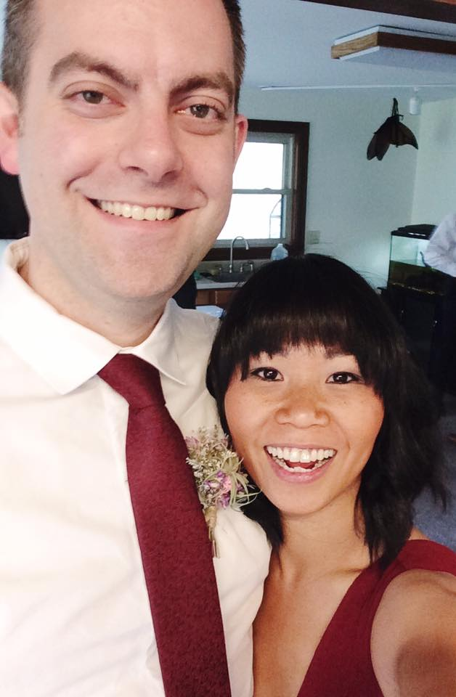
(1 Pet. 3:7) You husbands, in the same way, live with your wives in an understanding way, as with someone weaker, since she is a woman.
Show her honor as a fellow heir of the grace of life,
so that your prayers will not be hindered.
Generally true for physical strength

Slide 33
(1 Pet. 3:7) You husbands, in the same way, live with your wives in an understanding way, as with someone weaker, since she is a woman.
Show her honor as a fellow heir of the grace of life,
so that your prayers will not be hindered.
Use your strength to protect and provide.
Not to intimidate or abuse.

Slide 34
(1 Pet. 3:7) You husbands, in the same way, live with your wives in an understanding way, as with someone weaker, since she is a woman.
Show her honor as a fellow heir of the grace of life,
so that your prayers will not be hindered.
Thomas Schreiner: “The admonition to husbands to honor their wives
is unique in Greco-Roman literature.”
Thomas R. Schreiner, 1, 2 Peter, Jude, vol. 37, The New American Commentary (Nashville: Broadman & Holman Publishers, 2003), 161.

Slide 35
(1 Pet. 3:7) You husbands, in the same way, live with your wives in an understanding way, as with someone weaker, since she is a woman.
Show her honor as a fellow heir of the grace of life,
so that your prayers will not be hindered.
Karen Jobes: “How ironic it is that the words… wives would have read as affirming and empowering are criticized by some today as enslaving and oppressive.”
Karen H. Jobes, 1 Peter, Baker Exegetical Commentary on the New Testament (Grand Rapids, MI: Baker Academic, 2005), 209.

Slide 36
(1 Pet. 3:7) You husbands, in the same way, live with your wives in an understanding way, as with someone weaker, since she is a woman.
Show her honor as a fellow heir of the grace of life,
so that your prayers will not be hindered.
No threats like this are given to the wives…

Slide 37
(1 Pet. 3:8) To sum up,
all of you
be harmonious, sympathetic, brotherly, kindhearted, and humble in spirit.

Slide 38
For Women
Do you want a husband who loves you sacrificially, understands you deeply, provides security, and honors you as ultimately precious?
For Men
Do you want a wife who will love you despite your faults, publicly and privately respect you, and seek God first for her needs and identity?

Slide 39
For Women
Do you want a husband who loves you sacrificially, understands you deeply, provides security, and honors you as ultimately precious?
For Men
Do you want a wife who will love you despite your faults, publicly and privately respect you, and seek God first for her needs and identity?
Are you willing to wait for a spouse like this?
Are you willing to become a spouse like this?

