Slide 1
The Book of James
5:1-6 The Perils of Wealth

Slide 2
Context
The Mature Christian
Understands God’s wisdom
Lives in tension with our culture
Brings God into their decision making

Slide 3
Tonight
The Mature Christian
Understands the perils of wealth

Slide 4
James 5:1–6 (NASB95)
1 Come now, you rich, weep and howl for your miseries which are coming upon you. 2 Your riches have rotted and your garments have become moth-eaten. 3 Your gold and your silver have rusted; and their rust will be a witness against you and will consume your flesh like fire. It is in the last days that you have stored up your treasure!

Slide 5
James 5:1–6 (NASB95)
4 Behold, the pay of the laborers who mowed your fields, and which has been withheld by you, cries out against you; and the outcry of those who did the harvesting has reached the ears of the Lord of Sabaoth. 5 You have lived luxuriously on the earth and led a life of wanton pleasure; you have fattened your hearts in a day of slaughter.

Slide 6
James 5:1–6 (NASB95)
6 You have condemned and put to death the righteous man; he does not resist you.

Slide 7
James on “The Rich”
Don’t show them favoritism (2:1-5)
They often oppress the poor (2:1-5)

Slide 8
James on “The Rich”
Riches can bring you misery (5:1)
Riches don’t last (5:2)
You are accountable for God for how you use your riches (5:4)

Slide 9
What James doesn’t say
It is evil to be wealthy
ALL wealthy people are evil

Slide 10
What James doesn’t say
Instead of giving up when troubles come, the mature believer turns to God in prayer and seeks divine help. The immature person trusts in his own experience and skill, or else turns to others for help. While it is true that God often meets our needs through the hands of other people, this aid must be the result of prayer. James did not say it was a sin to be rich. After all, Abraham was a wealthy man, yet he walked with God and was greatly used of God to bless the whole world. James was concerned about the selfishness of the rich and advised them to “weep and howl.” He gave three reasons for his exhortation.
Wiersbe, Warren W.. Be Mature (James): Growing Up in Christ (The BE Series Commentary) (pp. 149-150). David C Cook. Kindle Edition.
It is evil to be wealthy
ALL wealthy people are evil

Slide 11
The Path to being rich and miserable
Acquiring your wealth through immoral means
Thievery, dishonesty, exploitation

Slide 12
The Path to being rich and miserable
2) Using your wealth selfishly
Refusing to pay others what they deserve hoarding it for selfish use
Spending it on a lavish lifestyle

Slide 13
The Path to being rich and miserable
Allowing your wealth to rule you
When wealth becomes an end rather than a means
Amazon=935,000 employees
Jeff Bezos=$200,000,000,000
$106,500,000,000

Slide 14
The Path to being rich and miserable
Allowing your wealth to rule you
When wealth becomes an end rather than a means
Building a kingdom that will rot

Slide 15
The Path to being rich and miserable
Proverbs 30:7–9 (NASB95) — 7 Two things I asked of You, Do not refuse me before I die: 8 Keep deception and lies far from me, Give me neither poverty nor riches; Feed me with the food that is my portion, 9 That I not be full and deny You and say, “Who is the Lord?” Or that I not be in want and steal, And profane the name of my God.
Allowing your wealth to rule you
When wealth becomes an end rather than a means
Building a kingdom that will rot

Slide 16
The Path to being rich and miserable
“But more recently, a 2018 study from Purdue University used much wider data from the Gallup World Poll and found that the ideal income point for individuals is $95,000 for life satisfaction and $60,000 to $75,000 for emotional well-being. When people earned more than $105,000, their happiness levels decreased.”
Purdue University Study (2018)
https://www.cnbc.com/2020/05/26/how-your-salary-and-the-way-you-spend-money-affect-your-happiness.html
Allowing your wealth to rule you
When wealth becomes an end rather than a means
Building a kingdom that will rot

Slide 17
Being corrupted by wealth
It is socially acceptable even admirable to put your career before…
Your marriage
Your children
Your friendships
Your faith

Slide 18
Being corrupted by wealth
The example of the Pharisees
Wealthy men of influence
Strict religious adherence
Waiting of the messiah to come

Slide 19
Glad I’m not rich!
“If you want to know what water is, don’t ask the fish”
-Chinese proverb

Slide 20
Glad I’m not rich!
The median annual household income worldwide is $9,733
https://news.gallup.com/poll/166211/worldwide-median-household-income-000.aspx
“If you want to know what water is, don’t ask the fish”
-Chinese proverb
The median annual household income U.S. is $43,585
https://news.gallup.com/poll/166211/worldwide-median-household-income-000.aspx

Slide 21
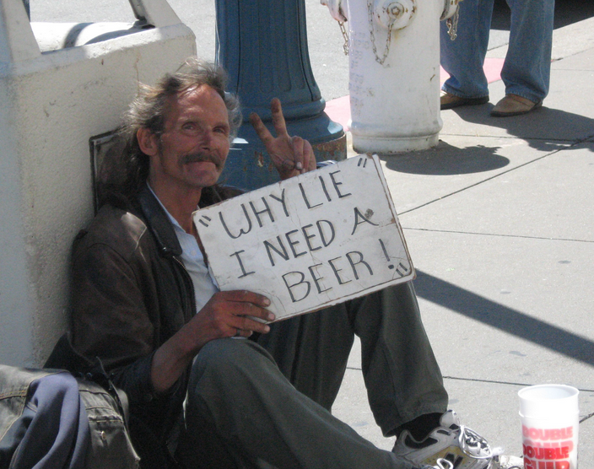
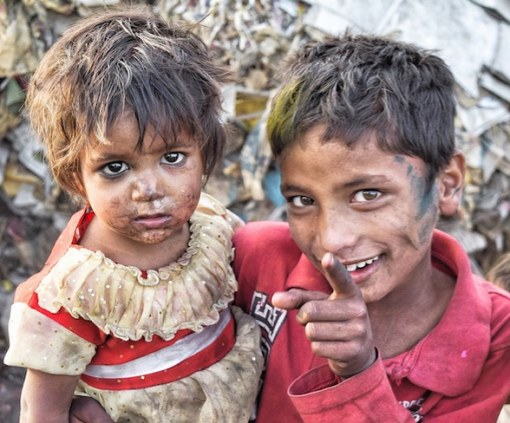

Slide 22
James on “The Rich”
Riches can blind you to the needs of others
Riches can cause you to treat people unjustly
Create a dangerous self focus
Cause you to play for the wrong team

Slide 23
James 5:1–6 (NASB95)
1 Come now, you rich, weep and howl for your miseries which are coming upon you.

Slide 24
What can I do?
Be aware of the danger!
Keep your head straight about what is important!
Be generous
Strive to be just in your dealing with others
Be accountable
Draw near to God

Slide 25
What can I do?
1 Timothy 6:9–11 (NASB95) — 9 But those who want to get rich fall into temptation and a snare and many foolish and harmful desires which plunge men into ruin and destruction. 10 For the love of money is a root of all sorts of evil, and some by longing for it have wandered away from the faith and pierced themselves with many griefs. 11 But flee from these things, you man of God, and pursue righteousness, godliness, faith, love, perseverance and gentleness.
Be aware of the danger!
Keep your head straight about what is important!
Be generous
Strive to be just in your dealing with others
Be accountable
Draw near to God

