Slide 3
How do people change?
Rituals? Mediators? Rules?
Colossians 2:16-23
Ignoring major problems and dysfunctions in our lives?
Colossians 3:1-10
Growing our relationship with God and with others!
Colossians 3:11-17

Slide 4
(Col. 3:11) There is no distinction
between Greek and Jew,
circumcised and uncircumcised,
barbarian, Scythian,
slave and freeman,
but Christ is all, and in all.
Racism
Moralism
Classism

Slide 5
(Col. 3:11) There is no distinction
between Greek and Jew,
circumcised and uncircumcised,
barbarian, Scythian,
slave and freeman,
but Christ is all, and in all.
Spiritual growth is based on our unbreakable bond with Christ and others.

Slide 6
(Col. 3:11) There is no distinction
between Greek and Jew,
circumcised and uncircumcised,
barbarian, Scythian,
slave and freeman,
but Christ is all, and in all.
Long-lost siblings?
“That was one of the best things that ever happened to me in my life.”
“Long lost brothers reunite.” WTHR (July 8, 2023).
“It was amazing. It was unbelievable, really.”
“Finding a long-lost brother a world away.” CityNews (September 1, 2023).
“I can’t really find the words to describe this feeling. It’s just a blessing to say the least.”
“Family Meets long lost brother.” FOX 4 Now (February 22, 2019).
Spiritual growth is based on our unbreakable bond with Christ and others.

Slide 7
(Col. 3:12) So, as those who have been chosen of God, holy and beloved,
put on a heart of compassion, kindness, humility, gentleness and patience.

Slide 8
(Col. 3:12) So, as those who have been chosen of God, holy and beloved,
put on a heart of compassion, kindness, humility, gentleness and patience.
“Heart of compassion” (splanchna oiktrimou) is a “display of concern over another’s misfortune.”
William Arndt et al., A Greek-English Lexicon of the New Testament and Other Early Christian Literature (Chicago: 2000), 700.

Slide 9
(Col. 3:12) So, as those who have been chosen of God, holy and beloved,
put on a heart of compassion, kindness, humility, gentleness and patience.
“Heart of compassion” (splanchna oiktrimou) is a “display of concern over another’s misfortune.”
William Arndt et al., A Greek-English Lexicon of the New Testament and Other Early Christian Literature (Chicago: 2000), 700.
Ask God to help you understand.
“Be harmonious, sympathetic, brotherly, kindhearted, and humble in spirit” (1 Peter 3:8).
Pray that God would help you show the feelings.
“Rejoice with those who rejoice, and weep with those who weep” (Romans 12:15)

Slide 10
(Col. 3:12) So, as those who have been chosen of God, holy and beloved,
put on a heart of compassion, kindness, humility, gentleness and patience.
“Kindness” (chrēstotēs) refers to a “friendly nature” or a “sweetness of disposition.”
Lothar Coenen, et al., New International Dictionary of New Testament Theology (Grand Rapids, MI: Zondervan Publishing House, 1986), 105.
Curtis Vaughan, Colossians (Zondervan, 1981), 215.
The actions might need to precede the feelings of friendliness…

Slide 11
(Col. 3:12) So, as those who have been chosen of God, holy and beloved,
put on a heart of compassion, kindness, humility, gentleness and patience.
“Humility” (tapeinophrosunē) comes from the words “lowly” (tapeinos) and “thought” (phrēn).
Humility is thinking accurately about myself.

Slide 12
Andrew Murray
(Missionary and Pastor in South Africa)
Andrew Murray, Humility and Absolute Surrender (Peabody, Massachusetts: Hendrickson Publishers, 2005), 7.
“Humility is acknowledging the truth of our position as a creature, and yielding to God His place as the Creator.”

Slide 13
Andrew Murray
(Missionary and Pastor in South Africa)
Andrew Murray, Humility and Absolute Surrender (Peabody, Massachusetts: Hendrickson Publishers, 2005), 15.
“Humility is acknowledging that we have nothing good in ourselves.
We are simply an empty vessel
which God can and must fill.
We cannot claim to be or do anything apart from Him.”

Slide 14
Andrew Murray
(Missionary and Pastor in South Africa)
Andrew Murray, Humility and Absolute Surrender (Peabody, Massachusetts: Hendrickson Publishers, 2005), 18.
“Humility is what God offers us.
In it, we shall find rest for our souls. Humility is our salvation.”

Slide 15
If someone stole $500 from you, how much would that bother you?
Andrew Murray
(Missionary and Pastor in South Africa)
Andrew Murray, Humility and Absolute Surrender (Peabody, Massachusetts: Hendrickson Publishers, 2005), 51.
“It is… the deep happiness of heaven to be so free from our focus on ourselves that whatever is said of us or done to us is lost and swallowed up in the thought that Jesus is all.”

Slide 16
Gavin Ortlund
(Pastor, Author, Ph.D. in Historical Theology)
Gavin Ortlund, Humility: The Joy of Self-Forgetfulness (Wheaton, IL: Crossway, 2023).
Being a big deal is a burden.
Humility, in contrast, means you don’t interpret everything in relation to yourself,
and you don’t need to.

Slide 17
(Col. 3:12) So, as those who have been chosen of God, holy and beloved,
put on a heart of compassion, kindness, humility, gentleness and patience.

Slide 18
(Col. 3:12) So, as those who have been chosen of God, holy and beloved,
put on a heart of compassion, kindness, humility, gentleness and patience.
“Gentleness” (prautēs) referred to “[tamed] animals.”
For us, it refers to a person who has their strength under control.
Lothar Coenen, et al., New International Dictionary of New Testament Theology (Zondervan, 1986), 256.

Slide 19
(Col. 3:12) So, as those who have been chosen of God, holy and beloved,
put on a heart of compassion, kindness, humility, gentleness and patience.
“Patience” (makrothymia) comes the root words “long” (makro) and “suffering” (thumia).
The guy who mentored me.

Slide 20
(Col. 3:13) Bearing with one another,
and forgiving each other,
whoever has a complaint against anyone—just as the Lord forgave you, so also should you.

Slide 21
(Col. 3:13) Bearing with one another, and forgiving each other,
whoever has a complaint against anyone—just as the Lord forgave you, so also should you.
“Something must be wrong…
I became a Christian,
but some of my roommates still getting on my nerves!”

Slide 22
(Col. 3:13) Bearing with one another, and forgiving each other,
whoever has a complaint against anyone—just as the Lord forgave you, so also should you.
“But you don’t know what he said and did!”

Slide 23
(Col. 3:13) Bearing with one another, and forgiving each other,
whoever has a complaint against anyone—just as the Lord forgave you, so also should you.
“But you don’t know what he said and did!”

Slide 24
(Col. 3:13) Bearing with one another, and forgiving each other,
whoever has a complaint against anyone—just as the Lord forgave you, so also should you.
“But you don’t know what he said and did!”

Slide 25
(Col. 3:13) Bearing with one another, and forgiving each other,
whoever has a complaint against anyone—just as the Lord forgave you, so also should you.
(Col. 2:13-14) God made you alive together with Christ, having forgiven (charizomai) us all our transgressions, having canceled out the certificate of debt.

Slide 26
(Col. 3:13) Bearing with one another, and forgiving each other,
whoever has a complaint against anyone—just as the Lord forgave you, so also should you.
Why should I forgive?
If you don’t, it will poison your body, soul, and mind!
(Heb. 12:15) Watch out that no poisonous root of bitterness grows up… corrupting many.
You will find yourself in a controversy with God.
Matthew 5:23-24; 18:21-35
You allow the offender to keep controlling you.
“I’ll never go to church because my dad was a hypocrite.”

Slide 27
(Col. 3:13) Bearing with one another, and forgiving each other,
whoever has a complaint against anyone—just as the Lord forgave you, so also should you.
Why should I forgive?
Positive changes in affect.
West, W. (2001). Issues relating to the use of forgiveness in counselling and psychotherapy. British Journal of Guidance and Counselling, 29 (4), 415-423.
Positive changes in both physical and mental health.
Exline, J. J., & Baumeister, R. F. (2000). Expressing forgiveness and repentance: Benefits and barriers. In M. E. McCullough, K. I. Pargament & C. E. Thoresen (Eds.), Forgiveness: Theory, research and practice.
Sense of personal power.
Goboda-Madikizela, P. (2002). Remorse, forgiveness and rehumanization: Stories from South Africa. The Journal of Humanistic Psychology, 42 (1), 7-32.

Slide 28
(Col. 3:13) Bearing with one another, and forgiving each other,
whoever has a complaint against anyone—just as the Lord forgave you, so also should you.
How can I forgive?
Get in touch with your own forgiveness.
Matthew 7:3-5; 18:21-35
Forgiveness is like paying off a debt on a credit card.
Timothy Keller, Forgive: Why Should I and How Can I? (Viking, 2022), p.168.
Forgive 490 sins, and forgive one sin 490 times.
C.S. Lewis, Reflections on the Psalms (New York: Houghton Mifflin, 1958), 25.
Ask for help.
1 Corinthians 6:5-6; Philippians 4:3

Slide 29
(Col. 3:13) Bearing with one another, and forgiving each other,
whoever has a complaint against anyone—just as the Lord forgave you, so also should you.
How can I forgive?
Get in touch with your own forgiveness.
Matthew 7:3-5; 18:21-35
Forgiveness is like paying off a debt on a credit card.
Timothy Keller, Forgive: Why Should I and How Can I? (Viking, 2022), p.168.
Forgive 490 sins, and forgive one sin 490 times.
C.S. Lewis, Reflections on the Psalms (New York: Houghton Mifflin, 1958), 25.
Ask for help.
1 Corinthians 6:5-6; Philippians 4:3
(Lk. 6:28) Jesus said,
“Bless those who curse you,
pray for those who mistreat you.”

Slide 30
(Col. 3:14) Beyond all these things
put on love,
which is the perfect bond of unity.

Slide 31
(Col. 3:15) Let the peace of Christ rule in your hearts, to which indeed you were called in one body.
Be thankful.

Slide 32
(Col. 3:15) Let the peace of Christ rule in your hearts, to which indeed you were called in one body.
Be thankful.
“With thankfulness in your hearts to God” (v.16).
“Giving thanks” (v.17).

Slide 33
Sara Algoe
(Professor of Psychology at the University of North Carolina, Chapel Hill)
Sara B. Algoe (et al.), “It’s the little things” Personal Relationships, 17 (2010), 228.
[Both partners answered yes or no to these two statements:
(1) “I did something thoughtful for my partner” and (2) “My partner did something thoughtful for me.”]

Slide 34
Sara Algoe
(Professor of Psychology at the University of North Carolina, Chapel Hill)
Sara B. Algoe (et al.), “It’s the little things” Personal Relationships, 17 (2010), 228.
[Then they rated their emotions on a scale of 0-6. Then finally, participants answered the question:
“Today our relationship was _______.” (1-9 scale).]

Slide 35
Sara Algoe
(Professor of Psychology at the University of North Carolina, Chapel Hill)
Sara B. Algoe (et al.), “It’s the little things” Personal Relationships, 17 (2010), 228.
[When one person reported feeling more gratitude from their partner,
their partner independently felt better about the relationship than they did the day before.]

Slide 36
Sara Algoe
(Professor of Psychology at the University of North Carolina, Chapel Hill)
Sara B. Algoe (et al.), “It’s the little things” Personal Relationships, 17 (2010), 228.
John Gottman (Ph.D.) studied 73 couples and quantified their interactions.
e.g. a contemptuous facial expression (-0.4) measured differently than an expression of disgust (-3.0) or whining (-1.0).
He was able to predict with 94% accuracy whether they would stay married!
John Gottman, “Marital processes predictive of later dissolution: Behavior, physiology, and health,” Journal of Personality and Social Psychology, Vol 63 (2), Aug 1992, 221-233.
[When one person reported feeling more gratitude from their partner,
their partner independently felt better about the relationship than they did the day before.]

Slide 37
(Col. 3:14) Beyond all these things
put on love,
which is the perfect bond of unity.
¹⁵ Let the peace of Christ rule in your hearts, to which indeed you were called in one body.
Be thankful.

Slide 38
(Col. 3:16) Let the word of Christ richly dwell within you,
with all wisdom teaching and admonishing one another.
With psalms and hymns and spiritual songs, singing with thankfulness in your hearts to God.

Slide 39
(Col. 3:17) Whatever you do in word or deed, do all in the name of the Lord Jesus, giving thanks through Him to God the Father.

Slide 40
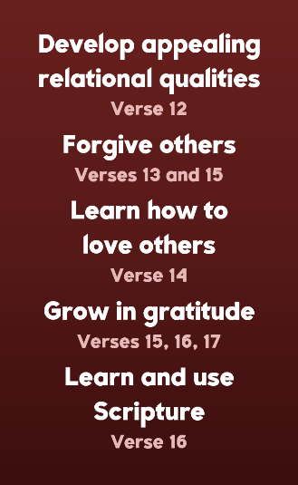
Is this your focus?
Do you think you’re growing or weakening in these areas?
Are you close enough to others to experience this?

Slide 43
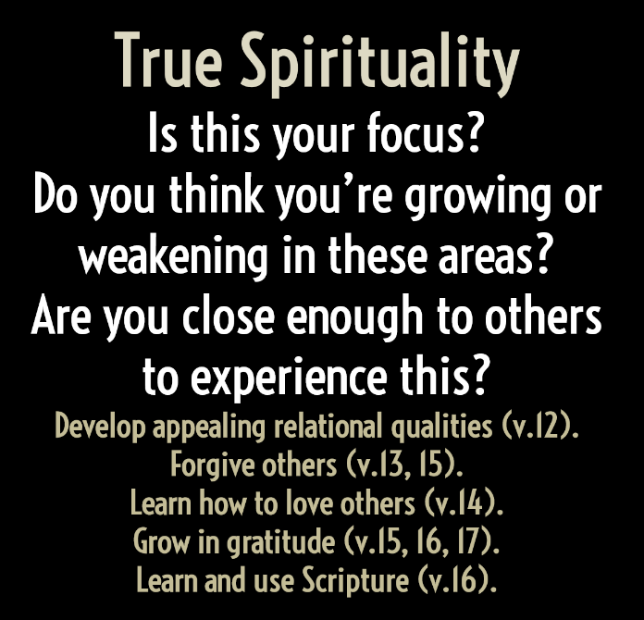

Slide 44
Minimizes and excuses sin.
e.g. “mistake” “stupid” “screwed up”
Based in a feeling.
How well did they weep and beg for mercy?
A sign of weakness.
“You’re letting him off the hook!”
No consequences.
“Forgive and forget.”
“I’m the ultimate Judge!”
No transcendental reality
Punishment for sin.
Rom. 2:1; Col. 2:13-14
Based in a choice.
2 Cor. 7:9-10; “Compassion” (Mt. 18:27)
A display of strength.
Jesus put himself on the hook! Lk. 17:3-4
Trust is earned.
John 2:24-25; 21:1ff; Acts 15:38-40; David
“The Judge forgave me!”
Mt. 18:21-35; Ps. 51:4

