Slide 2
1 Thess. 4
God’s View on Sexuality

Slide 3
Last Time
Mature Christian Love
Close but willing to let go
Serving but willing to be served
Inward and outward facing
Christ centered

Slide 4
What about sex?

Slide 5
1 Thessalonians 4:1–12 (NLT)
1 Finally, dear brothers and sisters, we urge you in the name of the Lord Jesus to live in a way that pleases God, as we have taught you. You live this way already, and we encourage you to do so even more. 2 For you remember what we taught you by the authority of the Lord Jesus. 3 God’s will is for you to be holy, so stay away from all sexual sin.

Slide 6
1 Thessalonians 4:1–12 (NLT)
4 Then each of you will control his own body and live-in holiness and honor—5 not in lustful passion like the pagans who do not know God and his ways.

Slide 7
1 Thess 4
3 God’s will is for you to be holy, so stay away from all sexual sin.
ἁγιασμός [hagiasmos /hag·ee·as·mos/]
Dedicated to the service of God.
Strong, J. (1995). . Woodside Bible Fellowship. Strong, J. (1995). Enhanced Strong’s Lexicon. Woodside Bible Fellowship.

Slide 8
1 Thess 4
3 God’s will is for you to be holy, so stay away from all sexual sin.
πορνεία [porneia /por·ni·ah/]
Having sex with someone you are not married to

Slide 9
Context
Vs. 1 - Live in a way that pleases God
Vs. 3 - Be distinct in the way that you live
Vs. 3 - By not letting your lust rule your life
Why does God care about our sex lives?

Slide 10
Theory #1

Slide 11
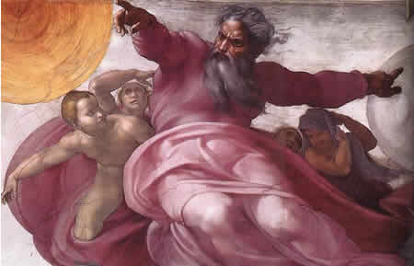
God hates fun

Slide 12
Sex is Fun

Slide 13
Sex is Fun
Therefore, God is very angry about sex

Slide 14
Rebuttal
God created Men, and Women, and all their parts
God commands sex in the Bible
“As for you, be fruitful and multiply; Populate the earth abundantly and multiply in it.” -Genesis 9:7

Slide 15
Theory #2

Slide 16
Sex is only for procreation
God created sex, but not to enjoy only to make babies.
We are to make as many babies as possible enjoying it as little as possible during our time here on earth.

Slide 17
Sex is only for procreation
I hate God
I hate men

Slide 18
Sex is only for procreation
I hate
God and Men

Slide 19
Rebuttal
The Bible clearly states that sex is about MORE than procreation
It’s about unity

Slide 20
Rebuttal
Gen. 2:24 For this reason a man shall leave his father and his mother, and be joined to his wife; and they shall become one flesh. 25 And the man and his wife were both naked and were not ashamed.

Slide 21
Rebuttal
Jesus’ commentary on Genesis 2
Matt 19:6 “So they are no longer two, but one flesh. What therefore God has joined together, let no man separate.”

Slide 22
Rebuttal
The Bible clearly states that sex is about MORE than procreation
It’s about unity
A physical expression of love between a husband and wife

Slide 23
Song of Solomon
So. 7:6 How beautiful you are and how pleasing, O love, with your delights! Your stature is like that of the palm, and your breasts like clusters of fruit. 8 I said, “I will climb the palm tree; I will take hold of its fruit.”

Slide 24
1 Corinthians
1 Cor. 7:5 Stop depriving one another, except by agreement for a time, so that you may devote yourselves to prayer, and come together again so that Satan will not tempt you because of your lack of self-control.

Slide 25
Theory #1- God Hates Sex
Theory #2- Sex is only for Procreation
Are wrong because they are unbiblical and don’t give sexuality it’s proper God given place.

Slide 26
Theory #3

Slide 27
God wants only good things for us
God created sex as an extremely powerful, wonderful and meaningful expression.
It is Physical, Emotional, and Spiritual
It is good!

Slide 28
God wants only good things for us
The Bible sanctions sex as much more than procreation
Like any father our spiritual Father wants only good things for His children
Sex outside of marriage is BAD for us!

Slide 29
1 Corinthians
1 Cor.6:18 Flee immorality. Every other sin that a man commits is outside the body, but the immoral man sins against his own body.19 Or do you not know that your body is a temple of the Holy Spirit who is in you, whom you have from God, and that you are not your own?

Slide 30
1 Corinthians
Sexual immorality is singled out as a particularly damaging sin

Slide 31
Biblical Sexuality
Sex creates such a powerful union between people, once we have it we are not supposed to be torn apart

Slide 32
1 Thess.
4 Then each of you will control his own body and live-in holiness and honor—5 not in lustful passion like the pagans who do not know God and his ways.

Slide 33
Sexual Immorality causes a LOT of our problems
Pedophilia
Abortion
Sex Trafficking
Rape
Prostitution
Adultery
Divorce
Pornography

Slide 34
Biblical Sexuality
Obviously, our culture see’s things differently
Statistics show over 80% of Americans have sex before marriage.
It is estimated Americans spend upwards of 15 billion dollars a year on porn

Slide 35
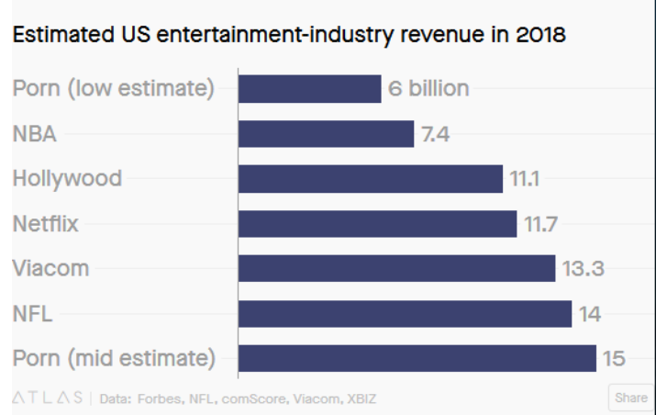
Biblical Sexuality
Obviously our culture see’s things differently
Statistics show over 80% of Americans have sex before marriage.
It is estimated Americans spend upwards of 15 billion dollars a year on porn

Slide 36
Biblical Sexuality
Obviously, our culture see’s things differently
Sex is considered no big deal!
People constantly hook up, break up, and move on.
70% of all couples cohabitate before marriage

Slide 37
Biblical Sexuality
Obviously, our culture see’s things differently
The Bible is old fashioned
The sex stuff only applies to their ancient culture not ours!

Slide 38
Biblical Sexuality
Obviously, our culture see’s things differently
The Bible is old fashioned
The sex stuff only applies to their ancient culture not ours!
1 Thessalonians 4:7–8 (NLT) — 7 God has called us to live holy lives, not impure lives. 8 Therefore, anyone who refuses to live by these rules is not disobeying human teaching but is rejecting God, who gives his Holy Spirit to you.

Slide 39
Cohabitation
70% of all couples cohabitate before marriage
NUMEROUS studies show people who cohabitate are at higher risk for divorce and tend to have lower marital satisfaction.

Slide 40
Divorce
Between 40 and 50% of all marriages in the U.S. end in divorce
Divorce numbers are down because marriage numbers are down.

Slide 41
Summary
More sex outside of marriage than ever
More cohabitation than ever
Rampant divorce
More sexual addiction than ever
More broken families
Disease, abortion, Sex crimes

Slide 42
Abortion
Estimated average of 1 million abortions a year during the last 50 years
Should it be legal?
It shouldn’t be necessary!

Slide 43
Biblical Sexuality
Our increasingly animalistic view of sex demeans the value of the human spirit
God wants better for us
Healthy marriages
Healthy sex lives

Slide 44
God’s view of sex is very different
Isa .55:8 “For My thoughts are not your thoughts, Nor are your ways My ways,” declares the Lord. 9 “For as the heavens are higher than the earth, So are My ways higher than your ways And My thoughts than your thoughts.

Slide 45
Biblical Sexuality
This is all motivated by God’s love for us, nothing more.
Ps 37:4 Delight yourself in the Lord;
And He will give you the desires of your heart.

Slide 46
What should we do?
God doesn’t expect us to get our sex lives straightened out BEFORE we come to God
Rom 5:8 But God demonstrates His own love toward us, in that while we were yet sinners, Christ died for us.

Slide 47
What should we do?
God doesn’t expect us to get our sex lives straightened out BEFORE we come to God
Jn 6:29 Jesus answered and said to them, “This is the work of God, that you believe in Him whom He has sent.”

Slide 48
What should we do?
God doesn’t expect us to get our sex lives straightened out BEFORE we come to God
No matter how far from God we’ve been, or how bad our sex lives have gotten, it’s never too late!

Slide 49
What should we do?
IS. 55:7 Let the wicked forsake his way And the unrighteous man his thoughts; And let him return to the Lord, And He will have compassion on him, And to our God, For He will abundantly pardon.

Slide 50
What should we do?
It is not our job to judge or condemn, but to love and to teach

