Slide 1
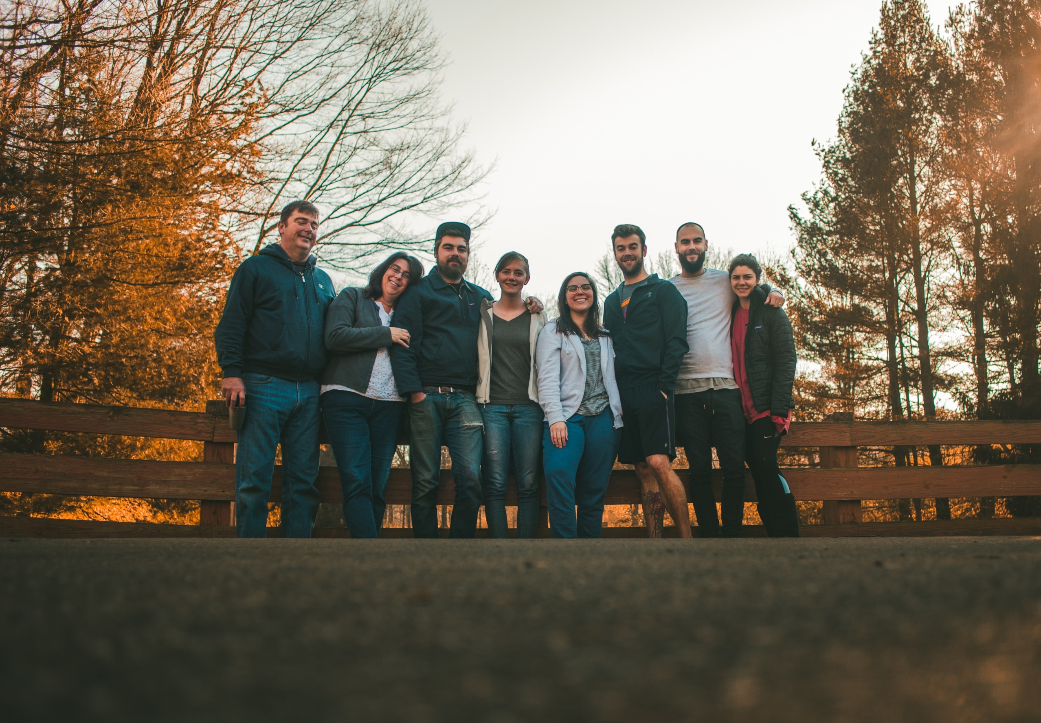

Slide 2
Entrusting our Children to God

Slide 3
Fears for our children from the womb through their adulthood!
Will my child be healthy?
What if I'm not a good parent? Will I “mess up” this child? What if I am not doing the right things?
Do we have enough money to take care of our child?
Is what I am seeing a real character issue? Is this going to become a real problem in my child’s life?
My kid doesn’t make friends well? Will they be lonely and friendless?
Will they have a good future? Marry well? Get a decent job?
Will they follow God with their own convictions?
Etc., etc., etc.

Slide 4
What does fear-based parenting look like?
Controlling – believe if we control things, we can manage outcomes.
Over protective – we think we can minimize the harm that may come to them. Next months parenting meeting.
Over directing – pushy. Remove choices. You should be this, you should do this, you should like this, dislike that…..
Focusing on the minutia – small things become big things.
Over “no-ing.”
Too permissive - if they like me, they will want to please me. If there are no rules, they won’t rebel. They will become the little angels that I want them to be!

Slide 5
Results of Fear-Based Parenting:
Suffocate our kids with our fears by laying on them things they shouldn’t be carrying.
Makes them afraid of failing. And potentially ashamed when they inevitably will.
Breeds distrust between you and your child. Begins to erode your relationship.
It makes God small.

Slide 6
Chip – Our Story of Fear

Slide 7
From Fear to Faith – Entrusting our children to God
Psalm 56:3-4
³ But when I am afraid, I will put my trust in you. ⁴ I praise God for what he has promised. I trust in God, so why should I be afraid? What can mere mortals do to me?
Psalm 91:1-2
¹ Those who live in the shelter of the Most High will find rest in the shadow of the Almighty. ² This I declare about the Lord: He alone is my refuge, my place of safety; he is my God, and I trust him.

Slide 8
1. Jarius – Putting fears in their Proper Place
Luke 8:40-42
⁴⁰ Now when Jesus returned, a crowd welcomed him, for they were all expecting him. ⁴¹ Then a man named Jairus, a synagogue leader, came and fell at Jesus’ feet, pleading with him to come to his house⁴² because his only daughter, a girl of about twelve, was dying……..

Slide 9
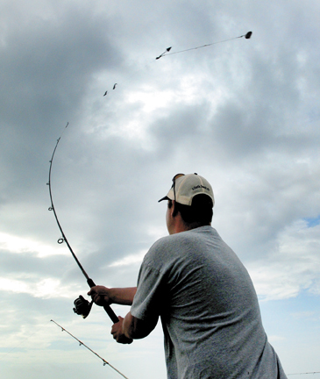
1. Jarius – Putting fears in Proper Place
I Peter 5:7
Cast all your anxiety on him because he cares for you.

Slide 10
2. Hannah – Pray Until Peace
I Samuel 1:10-18
¹⁰ In her deep anguish Hannah prayed to the Lord, weeping bitterly. ¹¹ And she made a vow, saying, “Lord Almighty, if you will only look on your servant’s misery and remember me, and not forget your servant but give her a son, then I will give him to the Lord for all the days of his life, and no razor will ever be used on his head.”
¹² As she kept on praying to the Lord, Eli observed her mouth. ¹³ Hannah was praying in her heart, and her lips were moving but her voice was not heard. Eli thought she was drunk ¹⁴ and said to her, “How long are you going to stay drunk? Put away your wine.” ¹⁵ “Not so, my lord,” Hannah replied, “I am a woman who is deeply troubled. I have not been drinking wine or beer; I was pouring out my soul to the Lord. ¹⁶ Do not take your servant for a wicked woman; I have been praying here out of my great anguish and grief.” ¹⁷ Eli answered, “Go in peace, and may the God of Israel grant you what you have asked of him.” ¹⁸ She said, “May your servant find favor in your eyes.” Then she went her way and ate something, and her face was no longer downcast.

Slide 11
2. Hannah – Pray Until Peace
I Samuel 1:10-18
¹⁰ In her deep anguish Hannah prayed to the Lord, weeping bitterly. ¹¹ And she made a vow, saying, “Lord Almighty, if you will only look on your servant’s misery and remember me, and not forget your servant but give her a son, then I will give him to the Lord for all the days of his life, and no razor will ever be used on his head.”
¹² As she kept on praying to the Lord, Eli observed her mouth. ¹³ Hannah was praying in her heart, and her lips were moving but her voice was not heard. Eli thought she was drunk¹⁴ and said to her, “How long are you going to stay drunk? Put away your wine.” ¹⁵ “Not so, my lord,” Hannah replied, “I am a woman who is deeply troubled. I have not been drinking wine or beer; I was pouring out my soul to the Lord. ¹⁶ Do not take your servant for a wicked woman; I have been praying here out of my great anguish and grief.” ¹⁷ Eli answered, “Go in peace, and may the God of Israel grant you what you have asked of him.” ¹⁸ She said, “May your servant find favor in your eyes.” Then she went her way and ate something, and her face was no longer downcast.

Slide 12
2. Hannah – Pray Until Peace
Philippians 4: 6-7
⁶ Do not be anxious about anything, but in every situation, by prayer and petition, with thanksgiving, present your requests to God. ⁷ And the peace of God, which transcends all understanding, will guard your hearts and your minds in Christ Jesus.

Slide 13
3. Royal Official – Take God at His word
John 4:49, 50
⁴⁹ The royal official said, “Sir, come down before my child dies.”
⁵⁰ “Go,” Jesus replied, “your son will live.”
The man took Jesus at his word and departed.

Slide 14
3. Royal Official – Take God at His word
Hebrews 6:18-19
¹⁸ So God has given both his promise and his oath. These two things are unchangeable because it is impossible for God to lie. Therefore, we who have fled to him for refuge can have great confidence as we hold to the hope that lies before us. ¹⁹ This hope is a strong and trustworthy anchor for our souls. It leads us through the curtain into God’s inner sanctuary.

Slide 15
Chip – Our Story of Faith

Slide 16
From Fear to Faith - Entrusting our children to God
Place fears in proper place
Pray until you experience peace
Promises – take God at His word
Repeat 1-3 regularly!
“I have held many things in my hands, and I have lost them all. But whatever I have placed in God’s hands, that I still possess.” ~Corrie Ten Boom

