Slide 1
Mark 12
Who Owns this Place?

Slide 2
Mark 12
During the last week of Jesus’ life, his conflict with the religious leaders is intensifying

Slide 3
Mark 12
The parable of the evil vintners

Slide 4
Mark 12
1 Then Jesus began teaching them with stories: “A man planted a vineyard. He built a wall around it, dug a pit for pressing out the grape juice, and built a lookout tower. Then he leased the vineyard to tenant farmers and moved to another country.

Slide 5
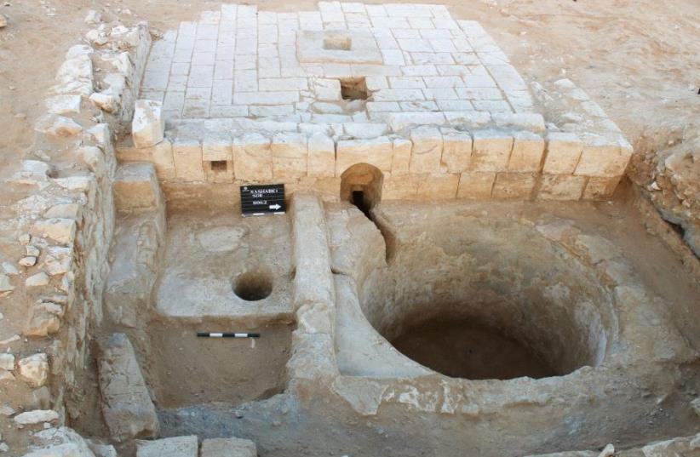
Mark 12
1 Then Jesus began teaching them with stories: “A man planted a vineyard. He built a wall around it, dug a pit for pressing out the grape juice, and built a lookout tower. Then he leased the vineyard to tenant farmers and moved to another country.

Slide 6
Mark 12
2 At the time of the grape harvest, he sent one of his servants to collect his share of the crop.

Slide 7
Mark 12
2 At the time of the grape harvest, he sent one of his servants to collect his share of the crop.
3 But the farmers grabbed the servant, beat him up, and sent him back empty-handed.

Slide 8
Mark 12
4 The owner then sent another servant, but they insulted him and beat him over the head.

Slide 9
Mark 12
4 The owner then sent another servant, but they insulted him and beat him over the head.
5 The next servant he sent was killed. Others he sent were either beaten or killed,

Slide 10
Mark 12
Mat. 23:37 “Jerusalem, Jerusalem, who kills the prophets and stones those who are sent to her! How often I wanted to gather your children together, the way a hen gathers her chicks under her wings, and you were unwilling.”
4 The owner then sent another servant, but they insulted him and beat him over the head.
5 The next servant he sent was killed. Others he sent were either beaten or killed,

Slide 11
Mark 12
4 The owner then sent another servant, but they insulted him and beat him over the head.
5 The next servant he sent was killed. Others he sent were either beaten or killed,

Slide 12
Mark 12
6 until there was only one left—his son whom he loved dearly. The owner finally sent him, thinking, ‘Surely they will respect my son.’

Slide 13
Mark 12
7 “But the tenant farmers said to one another, ‘Here comes the heir to this estate. Let’s kill him and get the estate for ourselves!’

Slide 14
Mark 12
8 So they grabbed him and murdered him and threw his body out of the vineyard.

Slide 15
Mark 12
What’s wrong with this picture?
This would never happen!
What’s wrong with these vintners?
What’s wrong with this owner?
8 So they grabbed him and murdered him and threw his body out of the vineyard.

Slide 16
Mark 12
9 “What will the owner of the vineyard do?

Slide 17
Mark 12
9 “What will the owner of the vineyard do? He will come and destroy the vine-growers, and will give the vineyard to others.”

Slide 18
Mark 12
10 Didn’t you ever read this in the Scriptures?
‘The stone that the builders rejected has now become the cornerstone.’
11 This is the Lord’s doing, and it is wonderful to see.’” Ps118:22

Slide 19
Mark 12
12 The religious leaders wanted to arrest Jesus because they realized he was telling the story against them. But they were afraid of the crowd, so they left him and went away.

Slide 20
Mark 12
12 The religious leaders wanted to arrest Jesus because they realized he was telling the story against them. But they were afraid of the crowd, so they left him and went away.

Slide 21
Mark 12
Tax trap

Slide 22
Mark 12
13 Later the leaders sent some Pharisees and supporters of Herod to trap Jesus into saying something for which he could be arrested.

Slide 23
Mark 12
14 “Teacher,” they said, “we know how honest you are. You are impartial and don’t play favorites. You teach the way of God truthfully.”

Slide 24
Mark 12
Now tell us—is it right to pay taxes to Caesar or not?

Slide 25
Mark 12
Jesus saw through their hypocrisy and said, “Why are you trying to trap me? Show me a Roman coin, and I’ll tell you.”

Slide 26
Mark 12
16 When they handed it to him, he asked, “Whose picture and title are stamped on it?”

Slide 27
Mark 12
16 When they handed it to him, he asked, “Whose picture and title are stamped on it?”
“Caesar’s,” they replied.

Slide 28
Mark 12
17 “Well, then,” Jesus said, “give to Caesar what belongs to Caesar, and give to God what belongs to God.”

Slide 29
Mark 12
17 “Well, then,” Jesus said, “give to Caesar what belongs to Caesar, and give to God what belongs to God.”
His reply completely amazed them.

Slide 30
Mark 12
17 “Well, then,” Jesus said, “give to Caesar what belongs to Caesar, and give to God what belongs to God.”
His reply completely amazed them.
Ownership

Slide 31
Mark 12
Resurrection Trap

Slide 32
Mark 12
18 Then Jesus was approached by some Sadducees—religious leaders who say there is no resurrection from the dead.

Slide 33
Mark 12
18 Then Jesus was approached by some Sadducees—religious leaders who say there is no resurrection from the dead. They posed this question:

Slide 34
Mark 12
19 “Teacher, Moses gave us a law that if a man dies, leaving a wife without children, his brother should marry the widow and have a child who will carry on the brother’s name.

Slide 35
Mark 12
20 Well, suppose there were seven brothers. The oldest one married and then died without children.
21 So the second brother married the widow, but he also died without children. Then the third brother married her.

Slide 36
Mark 12
22 This continued with all seven of them, and still there were no children. Last of all, the woman also died.
23 So tell us, whose wife will she be in the resurrection? For all seven were married to her.”

Slide 37
Mark 12
24 Jesus replied, “You’re mistaken because you don’t know the Scriptures, and you don’t know the power of God.

Slide 38
Mark 12
25 For when the dead rise, they will neither marry nor be given in marriage. In this respect they will be like the angels in heaven.”

Slide 39
Mark 12
26 “But now, as to whether the dead will be raised—haven’t you ever read about this in the writings of Moses, in the story of the burning bush? God said to Moses, ‘I am the God of Abraham, the God of Isaac, and the God of Jacob.’

Slide 40
Mark 12
27 So he is the God of the living, not the dead. You are greatly mistaken.”

Slide 41
Mark 12
The Greatest Commandment

Slide 42
Mark 12
28 One of the teachers of religious law was standing there listening to the debate. He realized that Jesus had answered well, so he asked, “Of all the commandments, which is the most important?”

Slide 43
Mark 12
29 Jesus replied, “The most important commandment is this: ‘Listen, O Israel! The Lord our God is one Lord.
30 And you shall love the Lord your God with all your heart, all your soul, all your mind, and all your strength.’

Slide 44
Mark 12
29 Jesus replied, “The most important commandment is this: ‘Listen, O Israel! The Lord our God is one Lord.
30 And you shall love the Lord your God with all your heart, all your soul, all your mind, and all your strength.’

Slide 45
Mark 12
31 The second is equally important: ‘Love your neighbor as yourself.’ No other commandment is greater than these.”

Slide 46
Mark 12
31 The second is equally important: ‘Love your neighbor as yourself.’ No other commandment is greater than these.”

Slide 47
Mark 12
Biblical Christianity:
Focused on love more than any other
Love so central that it cancels out everything else!
31 The second is equally important: ‘Love your neighbor as yourself.’ No other commandment is greater than these.”

Slide 48
Mark 12
Biblical Christianity:
Focused on love more than any other
Love so central that it cancels out everything else!
31 The second is equally important: ‘Love your neighbor as yourself.’ No other commandment is greater than these.”
Romans 13: 8Let no debt remain outstanding, except the continuing debt to love one another, for whoever loves others has fulfilled the law.

Slide 49
Mark 12
Biblical Christianity:
Focused on love more than any other
Love so central that it cancels out everything else!
31 The second is equally important: ‘Love your neighbor as yourself.’ No other commandment is greater than these.”
Romans 13:9The commandments, “You shall not commit adultery,” “You shall not murder,” “You shall not steal,” “You shall not covet,” and whatever other command there may be,

Slide 50
Mark 12
Biblical Christianity:
Focused on love more than any other
Love so central that it cancels out everything else!
31 The second is equally important: ‘Love your neighbor as yourself.’ No other commandment is greater than these.”
are summed up in this one command: “Love your neighbor as yourself.” 10Love does no harm to its neighbor. Therefore love is the fulfillment of the law.

Slide 51
Mark 12
Biblical Christianity:
Focused on love more than any other
Love so central that it cancels out everything else!
31 The second is equally important: ‘Love your neighbor as yourself.’ No other commandment is greater than these.”
Galatians 5:6For in Christ Jesus neither circumcision nor uncircumcision has any value. The only thing that counts is faith expressing itself through love.

Slide 52
Mark 12
Biblical Christianity:
Focused on love more than any other
Love so central that it cancels out everything else!
31 The second is equally important: ‘Love your neighbor as yourself.’ No other commandment is greater than these.”
Galatians 5:6For in Christ Jesus neither circumcision nor uncircumcision has any value. The only thing that counts is faith expressing itself through love.

Slide 53
Mark 12
Biblical Christianity:
Focused on love more than any other
Love so central that it cancels out everything else!
Begins with the Holy Spirit
31 The second is equally important: ‘Love your neighbor as yourself.’ No other commandment is greater than these.”

Slide 54
Mark 12
Biblical Christianity:
Focused on love more than any other
Love so central that it cancels out everything else!
Begins with the Holy Spirit
31 The second is equally important: ‘Love your neighbor as yourself.’ No other commandment is greater than these.”
Romans 5:5 God’s love has been poured out into our hearts through the Holy Spirit, who has been given to us.

Slide 55
Mark 12
Biblical Christianity:
Focused on love more than any other
Love so central that it cancels out everything else!
Begins with the Holy Spirit
31 The second is equally important: ‘Love your neighbor as yourself.’ No other commandment is greater than these.”
Galatians 5:23 The fruit of the Spirit is love…

Slide 56
Mark 12
Biblical Christianity:
Focused on love more than any other
Love so central that it cancels out everything else!
Begins with the Holy Spirit
31 The second is equally important: ‘Love your neighbor as yourself.’ No other commandment is greater than these.”
1 John 4:10 In this is love, not that we loved God, but that He loved us and sent His Son to be the satisfaction for our sins

Slide 57
Mark 12
Biblical Christianity:
Focused on love more than any other
Love so central that it cancels out everything else!
Begins with the Holy Spirit
31 The second is equally important: ‘Love your neighbor as yourself.’ No other commandment is greater than these.”
1 John 4:19We love because he first loved us.

Slide 58
Mark 12
31 The second is equally important: ‘Love your neighbor as yourself.’ No other commandment is greater than these.”

